Slide 1
Overview of recent economic and social developments in Africa
Adam Elhiraika Director, Macroeconomics and Governance Division (MGD) 11 May 2022

Slide 2
Key messages
Africa’s growth prospects have been severely affected by the pandemic, however growth is projected to rebound in the short- to medium-term.
The pandemic has reversed more than two decades of progress in achieving the SDGs, particularly in relation to poverty, health, education and employment.
Fiscal deficits and debt levels remain high due to increased spending to cushion the effects of the pandemic, amid low revenue levels.
This situation has been further exacerbated by the war in Ukraine, which has pushed up food prices, potentially increasing hunger and food insecurity.
External shocks – such as a protracted war in Ukraine, emergence of coronavirus variants, monetary policy tightening in developed countries and climatic shocks – could adversely affect Africa’s economic growth outlook.

Slide 3
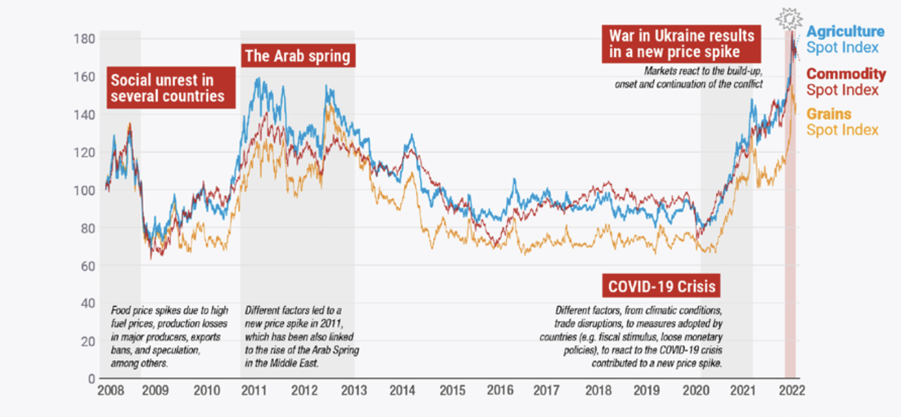
The global economy is recovering despite the headwinds
The global economy is recovering from the pandemic despite the headwinds such as the Ukraine crisis and rising prices.
Africa’s recovery is slower than other regions.
Source: World Economic Situations and Prospects (2022) & World Bank (2021)

Slide 4
Africa’s economy is rebounding with drivers of growth
GDP Growth Rate by subregions, 2019-2023
Africa’s GDP growth is estimated to be 4.7 percent in 2021, and 4 precent in 2022.
However, the Ukraine crisis may lead to a 0.4 percentage point drop in 2022.
Source: UN (2022) World Economic Situations and Prospects 2022.
Note: e= estimates, f=forecast
Notes:
The economic recovery is supported by: Pent up demand following the relaxation of COVID-19 restrictions; improving global economic conditions; and
the rebound in global commodity prices.

Slide 5
Fiscal space remains constrained and debt vulnerabilities elevated
Debt-to-GDP ratio in Africa by subregion, 2019–2023
Fiscal deficits in Africa by subregions, 2019–2023
Source: IMF World Economic Outlook Database, October 2021
Source: IMF World Economic Outlook Database, October 2021
African countries continue to have constrained fiscal space despite narrowing fiscal deficits along with increased economic activities.
As of March 2022, 23 African countries are in debt distress or at high risk of debt distress.

Slide 6
Increased inflation pressures due to COVID-19 and Ukraine crisis
Inflation rate for selected Africa countries, 2020-2022
Energy price, 2021-2022
Source: International Financial Statistics, (IFS, IMF 2022)
Source: Bloomberg & Marketwatch, Accessed April 11th
Previously exacerbated by challenges with the supply chain due to the COVID-19 pandemic, has been further aggravated by the Ukrainian crisis and soaring energy and food prices globally.
10+ African countries have witnessed double digit inflation rate since 2022 due to the Ukraine crisis.

Slide 7
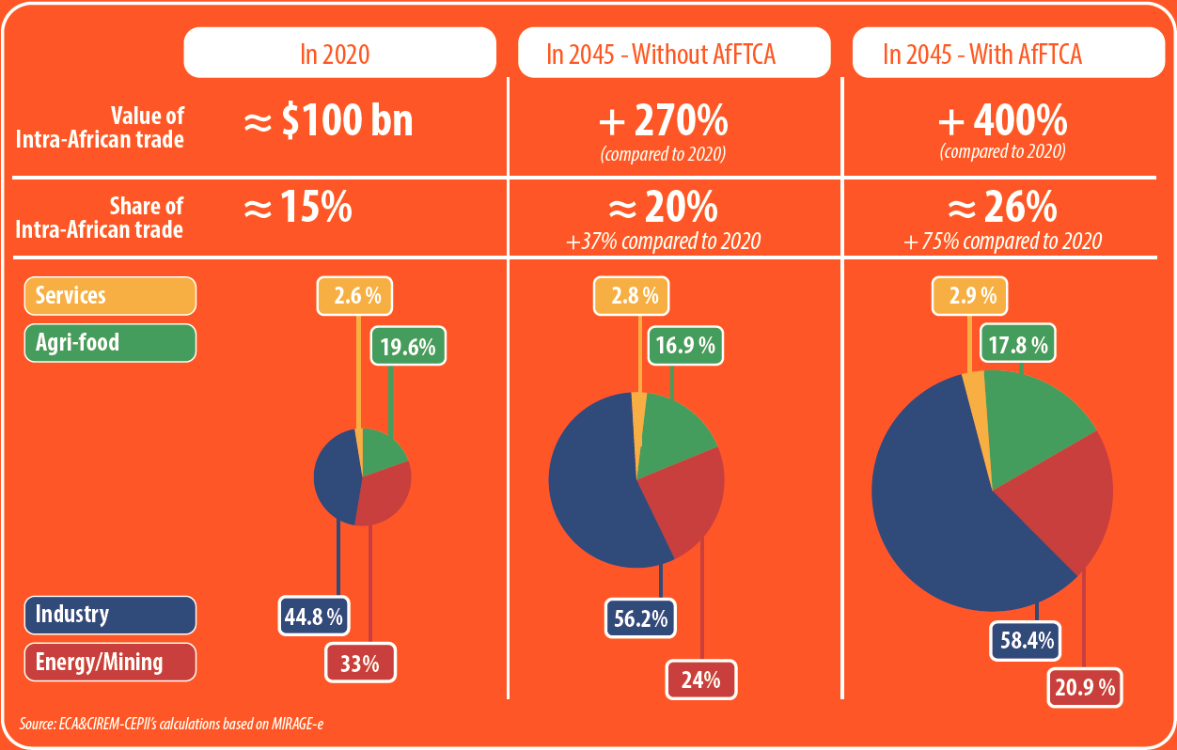
The AfCFTA is envisaged to play a key role in economic recovery
African trade is rebounding due to rebounding economic activities, increased vaccinations and easing of restrictions. The AfCFTA is expected to stimulate Africa’s GDP, output, welfare and trade, with largest gains expected from intra-African trade.
Compared to 2020, ECA estimates intra-African trade to increase by over 400% by 2045.
The largest gains are expected in the industry, agrifood and services sectors.
Greater intra-African trade and development of key value chains will insulate Africa from future external shocks and reduce dependency on external economies.

Slide 8
Service sector has been significantly hit by the pandemic
African Services exports by sector (2010-2020)
Source: UNWTO, 2022
Particularly travel-related services, have been severely affected.
African services’ exports fell from US$124.4 billion in 2019 to US$82.7 billion in 2020.
Source: ECA calculations based on UNCTADstat data, November 17, 2021

Slide 9
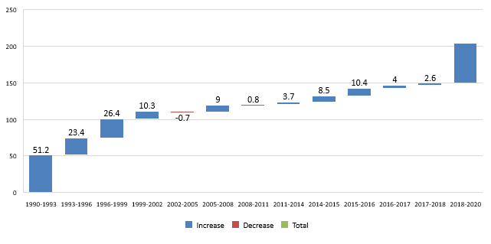
: Increase in absolute number of poor, in Africa** since 1990
54.7*
Social development impacts of COVID-19 and Ukraine crisis
Increase in absolute number of the poor in Africa since 1990
The pandemic has pushed an estimated 55 million people into poverty, with 30-35 million formal jobs at risk.
Gains in health and education were also reversed.
These impacts are exacerbated by the Ukraine war.
Source: ECA calculations from World Bank (2020).
FAO Food Price Index January 2021-March 2022, 2014-2016=100
Source: FAO, 2022
Notes:
The pandemic has pushed an estimated 55 million people into poverty, reversing more than two decades of progress.
The pandemic has placed between 30-35 million formal jobs at risk, due to reduced demand and enforced lockdowns, alongside existing high and vulnerable informal employment.
Gains in health and education were also reversed, as a result of the unprecedented pressure on national health systems and temporary school closures; gender inequalities were also accentuated during the pandemic.
Gains in health and education were also reversed, as a result of the unprecedented pressure on national health systems and temporary school closures; gender inequalities were also accentuated during the pandemic.
These impacts are exacerbated by the Ukraine war, with soaring grain, oil and fertilizer prices resulting in food insecurity and undernutrition

Slide 10
Policy recommendations
African countries need to strengthen their efforts to address the health and economic impact of the coronavirus pandemic through continued investments in the health sector and in achieving the SGDs.
Credible reforms are needed to restore debt and fiscal sustainability and enhance efficiencies in the use of existing resources, coupled with appropriate monetary policies to boost liquidity, while ensuring that inflationary expectations are credibly anchored to maintain stable and low inflation.
There is need to improve tax administration and enforcement in combination with reducing tax exemptions and eliminating corrupt practices, including illicit financial flows, as well broadening of the countries’ tax bases to raise revenues.
Countries should take advantage of the African Continental Free Trade Area and the use of digital technologies to accelerate the industrialization and diversification of the productive sectors of their economies.

Slide 11
THANK YOU!
Follow the conversation: #COM2022
More: www.uneca.org/cfm2022

