Slide 1
Economic and Social Consequences of COVID19 on Africa and ECA Response/Support
Economic Commission for Africa
22 July, 2020
Addis Ababa and Beijing

Slide 2
Current case trends
Africa currently accounts for relatively small (but growing) share of world cases
Daily new cases continuing upward trend across Africa, especially in South Africa
Source: Based on Johns Hopkins University Data
Total population of Africa has fewer total (and daily new) cases than most other regions, but with an upward trajectory indicating that worst is ahead of us
South Africa currently accounts for about 2/3rds of daily new cases in Africa
Source:

Slide 3
Africa: Corona Virus new blow to economic
Growth expected to drop from 3.1% to -2.7%
Source: ECA

Slide 4
GDP contraction expected in 4 of the 5 regions
Source: ECA, DESA

Slide 5
Similarly, 6 out of 8 RECs will experience GDP contractions
Source: ECA

Slide 6
Magnitude of COVID Impact on businesses in Eastern Africa
Source: EABC

Slide 7
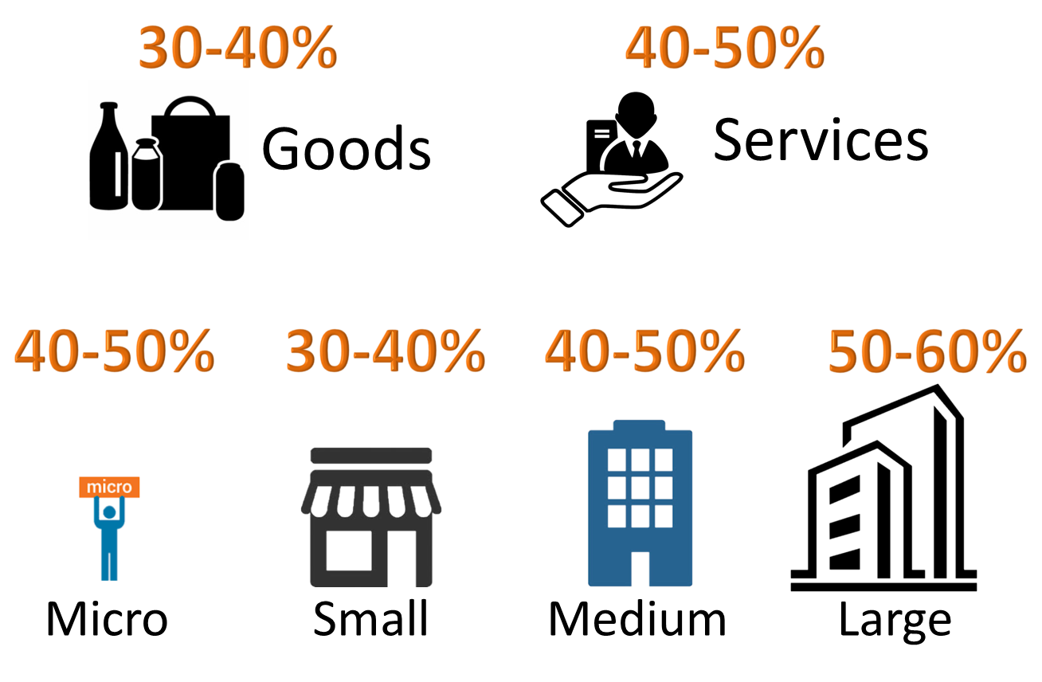
Capacity utilization low, with smaller businesses worse hit
African firms are operating at low capacity utilization rates
Source: ECA & IEC. 2020. Insights on African businesses’ reaction and outlook to COVID-19’s. IEC: Mauritius & ECA: Addis Ababa. 30 April
Notes: Each respondent represents a company that operates in at least one and up to 54 African countries, data was collected on 210 firms from 14 to 20 April
On average, businesses in Africa report to be operating at only 43 percent (in April), though with larger firms reporting to operate at a slightly better capacity
Top challenges: drop in demand, cash flow, labour restrictions, logistics difficulties

Slide 8
5m to 29 million will be impoverished and 19m will be jobless due to growth decline
Source: ECA

Slide 9
Risks of Job losses per activity (A survey from Uganda)
Source: Uganda Business Impact Survey 2020

Slide 10
Limited fiscal space: COVID19 more fiscal pressures
Source: ECA

Slide 11
………..disrupting fiscal consolidation path
Constrained fiscal space in the short to medium term
Source: ECA, DESA, IMF

Slide 12
North Africa most affected by the crisis
(Middle Income economies – no access to DSSI)
Source: ECA, DESA, IMF, EIU

Slide 13
Consequently, Africa’s debt expected to increase in the medium term
Source: ECA

Slide 14
Highlights of ECA’s COVID-19 response support to member states
COVID-19 in Africa: Protecting Lives and Economies
Africa Covid-19 Communications & Information Platform (ACCIP)
AfCFTA Pharma Initiative Pilot & African Medical Supplies Platform
Meetings of African Ministers of Finance
COVID-19: Lockdown exit strategies for Africa
Policy Exchange and Peer Learning Platform
Multi stakeholder coordination meeting on Africa’s response
Global debate on Africa’s COVID-19 lockdown exit strategies
Africa-wide macroeconomic model
UNECA.ORG

Slide 15
Highlights of ECA’s COVID-19 response support to member states (cont)
Guinea: Accountability framework for use of Covid-19 relief funds
Zambia: macro-modelling
Namibia: socio-economic impact assessment of Covid-19
Ethiopia: socio-economic impact assessment; macro-modelling
SG’s Policy brief on the Socio-economic impact of Covid-19
Partnerships – MTN, CIVICUS, Citi-Bank
Towards recovery: the role of stimulus packages and economic governance measures
Estimates of GDP impact of stimulus package
UNECA.ORG

Slide 16
THANK YOU!

