Slide 1
The Road to FfD4 and Opportunity for INFF Implementation
Setting the Development Financing Stage in Africa
Regional Workshop on Integrated National Financing Frameworks 2024: Public Finance for Sustainable Development in Africa
Wednesday, 12 June 2024

Slide 2
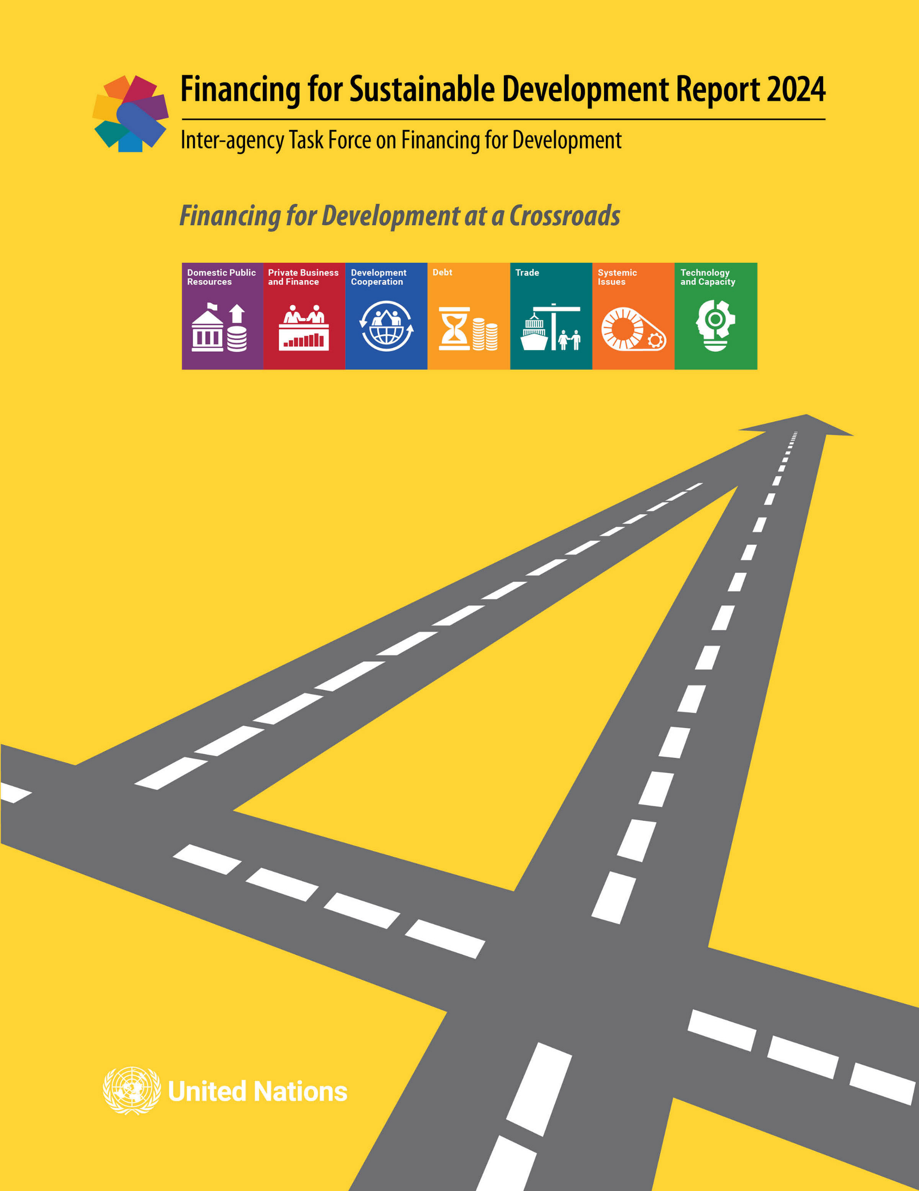
Overview
The financing challenge today
How did we get here?
The opportunity of the Fourth International Conference on Financing for Development (FfD4)
Public finance and INFFs
Financing for Sustainable Development Office

Slide 3
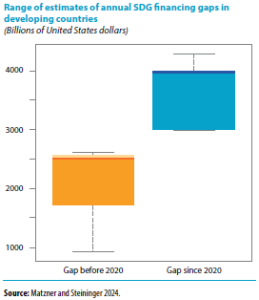
The Financing Challenge
Financing for Sustainable Development Office

Slide 4
How did we get here?
Underlying drivers and trends
Progress of Addis Ababa Action Areas
Rising systemic risks
A challenging global economic environment
Persistent inequalities
Rapid technological change
Rising geopolitical tensions
Public finance and investment
Private investment, trade and technological policies
Financial sector: access, stability, sustainability
Aligning domestic and international policy frameworks and governance
Financing for Sustainable Development Office

Slide 5
The Opportunity of FfD4
United Nations Member States have given FfD4, to be held in Spain from 30 June to 3 July 2025, an ambitious mandate to address financing challenges “in the context of the urgent need to accelerate the implementation of the 2030 Agenda and the achievement of the SDGs and to support reform of the international financial architecture.”
Financing for Sustainable Development Office

Slide 6
The Opportunity of FfD4: Overarching Questions
How can FfD4 help close large financing and investment gaps, at scale and with urgency, and enhance spending effectiveness?
How can FfD4 help address issues in the international financial architecture and support international rules for trade, investment and finance that are fit for today’s challenges?
How can FfD4 close credibility gaps and rebuild trust in global partnership and multilateralism?
How can FfD4 help formulate and finance new development pathways to deliver on the SDGs and ensure no one is left behind?
Financing for Sustainable Development Office

Slide 7
The Opportunity of FfD4: Public Finance and INFFs
How can FfD4 help to turn commitments for domestic tax reforms into actions to make tax systems more fair, transparent, efficient and effective?
How can FfD4 add further momentum to aligning expenditure with the SDGs and support fiscal policies to reduce inequalities?
How can FfD4 help to leverage INFFs in supporting domestic efforts?
Financing for Sustainable Development Office

Slide 8
The Opportunity of FfD4: Public Finance and INFFs
How can FfD4 help with the future direction and governance of international tax cooperation?
How can FfD4 enhance efforts to combat illicit financial flows?
How can FfD4 tackle challenges of high borrowing costs and debt service burdens and address gaps in the debt restructuring architecture?
Financing for Sustainable Development Office

Slide 9
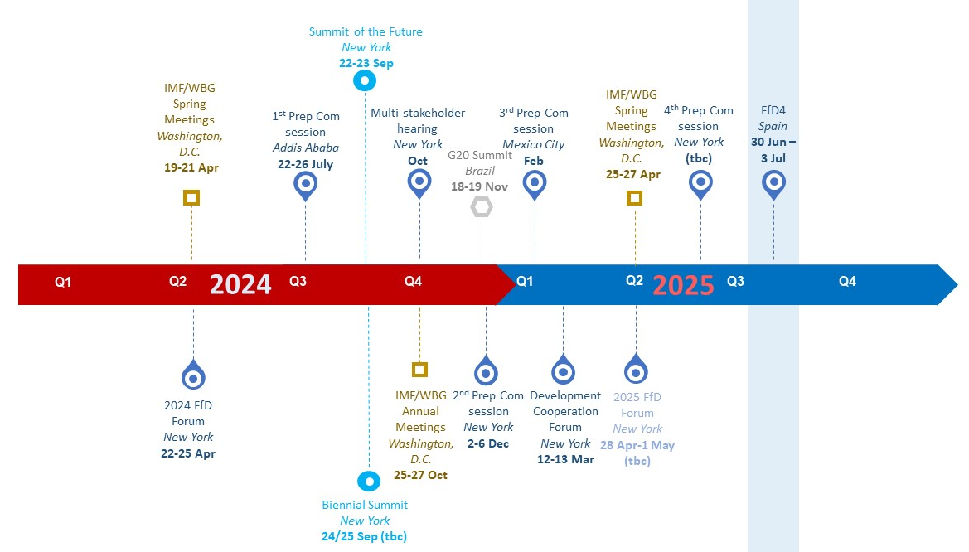
The Road to FFD4
Prep Com co-chairs:
Burundi and Portugal
Prep Com vice chairs:
South Africa, Zambia, Iran, Nepal, Pakistan, Poland, the Russian Federation, Brazil, Colombia, Mexico, Canada, and Norway. China on a rotational basis with other elected Asia-Pacific States
FfD4 website:
https://financing.desa.un.org/ffd4
Financing for Sustainable Development Office

Slide 10
Thank you
Presented by: Resina Katafono
Inter-Regional Adviser on Financing for Sustainable Development
Policy Analysis & Development Branch
Financing for Sustainable Development Office
Contact: resina.katafono@un.org
References: 2024 Financing for Sustainable Development Report
FFD4 Conference

