Slide 1



Making use of the SDGs Taxation Framework Rethinking tax expenditures
Regional Workshop on Integrated National Financing Frameworks 2024 Public Finance for Sustainable Development in Africa
Dr Amna Khalifa
Technical and Outreach Specialist SDG Taxation Framework, UNDP
12-13 June 2024 Addis Ababa, Ethiopia

Slide 2






Introducing - SDG Tax Framework (STF)
Enhance domestic resource mobilization (DRM)
Provide tools for evidence-based tax polices to promote sustainable development
Diagnostic tool
Aligns a country’s tax system with SDGs
Improve state capacity to leverage taxation as a tool for SDGs
Coordination mechanism between government and with development partners

Slide 3
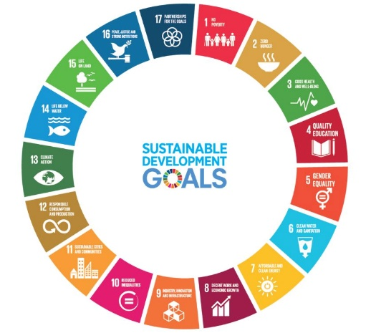
Demand for STF
What is STF responding to?
Niche area – aligning tax policies with SDGs
Relevance
6 years to Agenda 2030; financing gap USD 2.5 to 4 trillion annually (2024 Financing for Sustainable Development Report)
Rationale behind developing this tool
Lack of benchmarking
    Lack of coordination at country level
    Fostering Multi and Bilateral partnerships
SDGs identify what are the targets and their indicators
STF explains how these indicators can be achieved

Slide 4


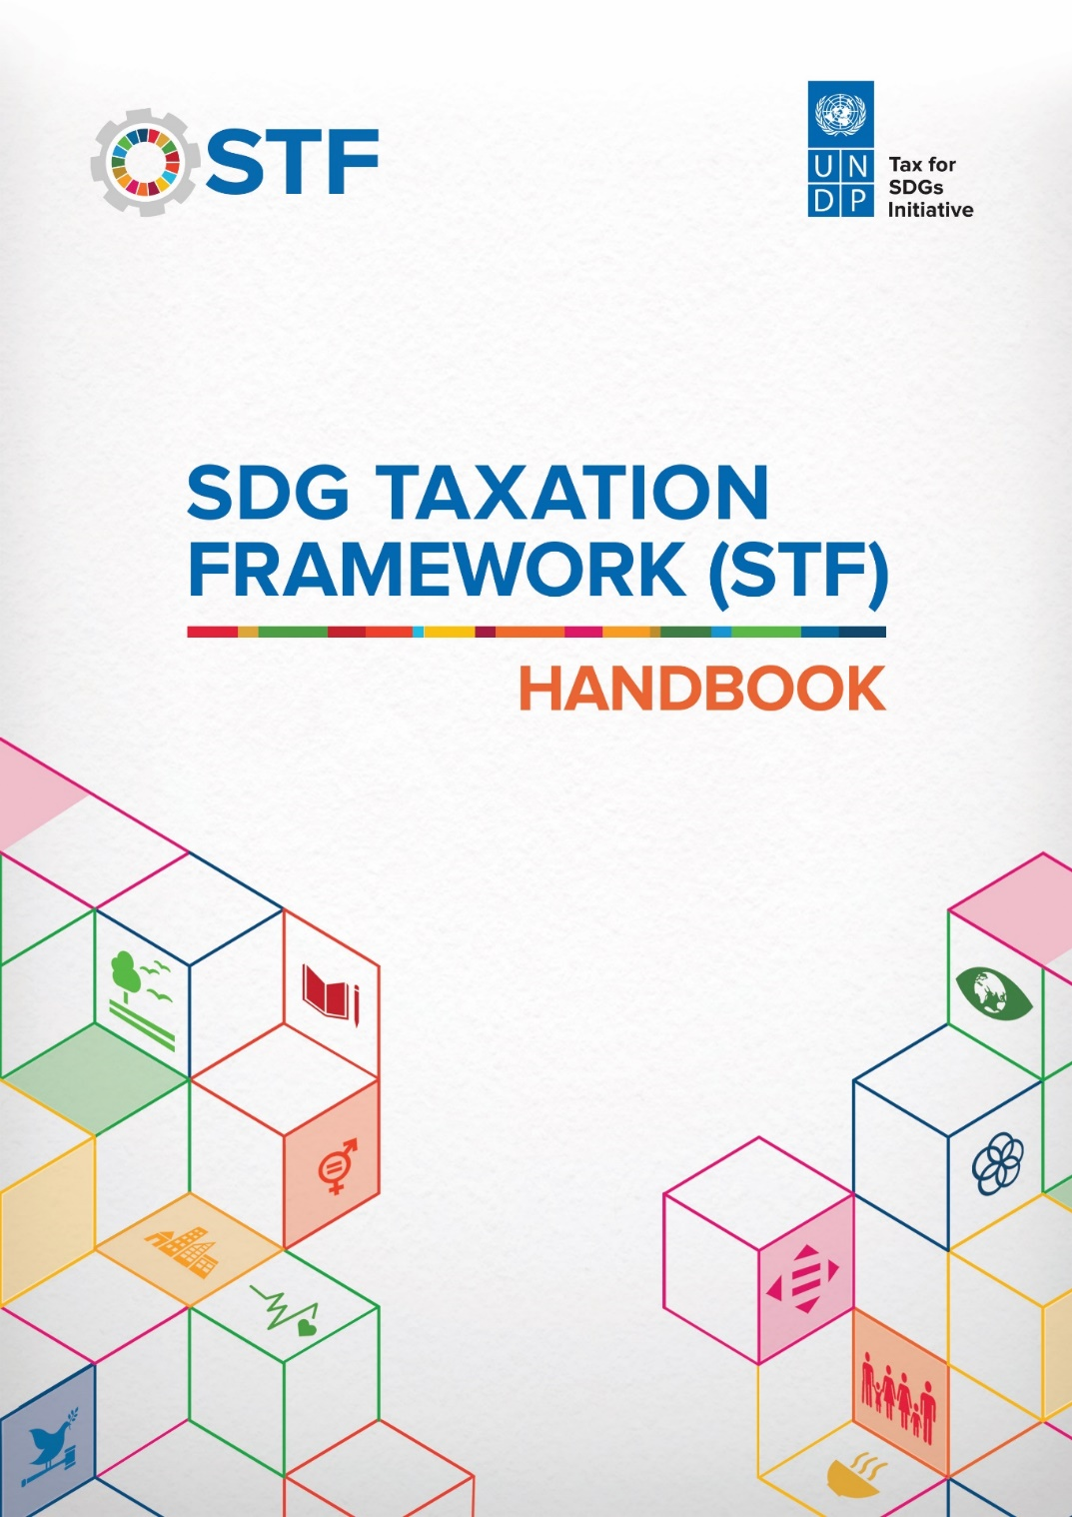
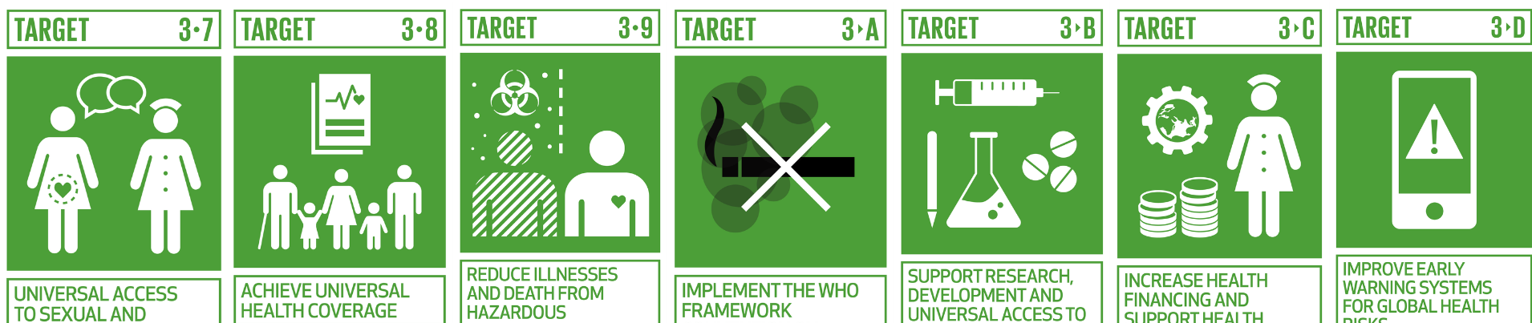
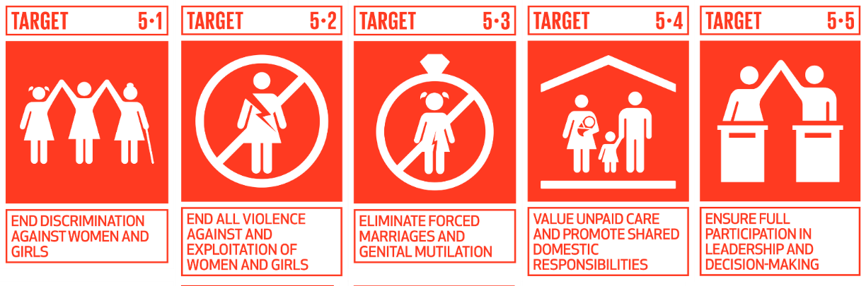
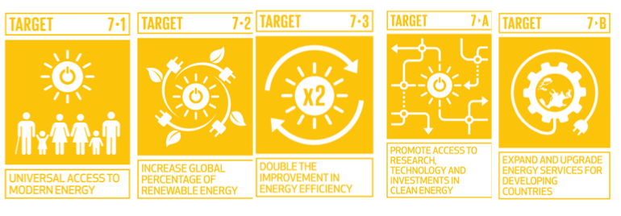
STF Methodology
The STF focuses on targets and indicators that can possibly be achieved through tax interventions.
STF Handbook
17 SDG-wise Modules
49 Selected Targets
and more..

Slide 5
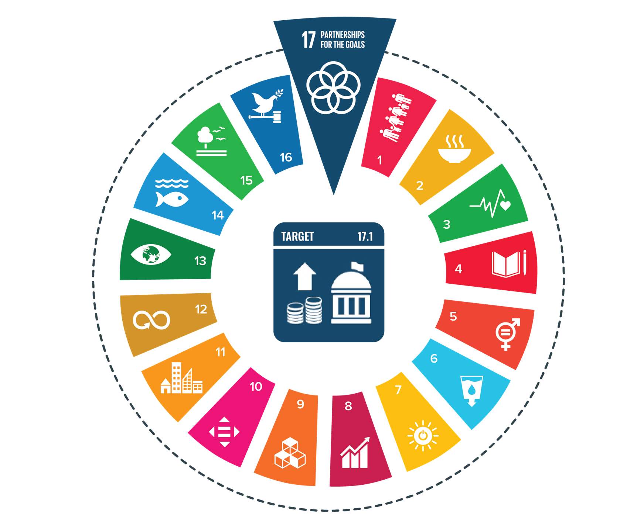
Overarching Theme - SDG 17 Strengthen the means of implementation and revitalize the Global Partnership for Sustainable Development
Target 17.1 – Domestic Resource Mobilization
D1 Building the social contract – Tax Morale
D2 Tax effort
D3 Monitoring tax expenditures
D4 Strengthening the tax administration efficiency by harnessing use of digital technology
D5 Tackling tax avoidance and evasion
D6 Strengthening taxation of extractive industries
Other Targets (17.3, 17.7, 17.9, 17.16)
D7 Level of cooperation with international institutions on domestic resource mobilization
SDG 17 enhances DRM to finance all other SDGs in line with national priorities

Slide 6
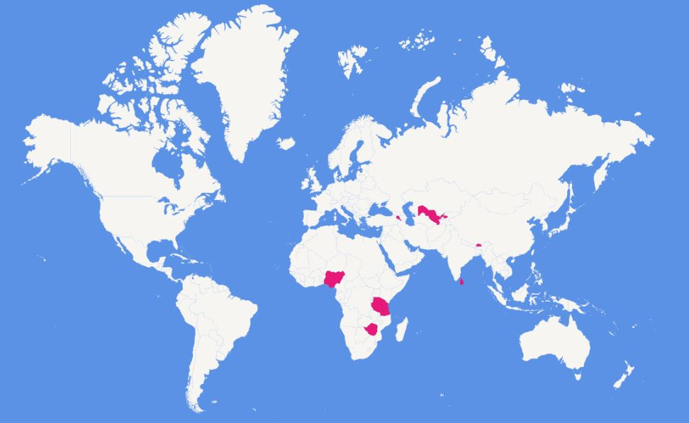




















15 Countries implementing STF
Ghana
Colombia
Honduras
Eswatini

Slide 7
Tax Expenditures - Overview
Tax Expenditures: Knowledge of how much revenue is forgone as a result of tax reliefs such as exemptions, rebates, deductions, accelerated depreciations and other preferential tax regimes
Represent significant sources of revenue loss in addition to hidden activities in the informal economy, base erosion and profit shifting (BEPS) and aggressive international tax planning practices
In lower income countries, tax expenditures equate 2.8 percent of GDP or 27.1 percent of all tax revenues (Global Tax Expenditures Database latest info)
Rationalizing the use of tax expenditures present a real opportunity for DRM
  Jordan and Djibouti TE represent more than 70 and 87% of total tax revenue
Notes:
The Global Tax Expenditures Database (GTED) provides information on tax expenditures from 218 countries worldwide. Whereas there are currently 103 reporting countries, the remaining 116 have never released any tax expenditure data.²⁰⁶ The latest findings from the GTED suggest that in lower income countries, tax expenditures equate 2.8 percent of GDP or 27.1 percent of all tax revenues; compared to 2.6 percent of GDP or 18.2 percent of tax revenue for lower middle-income countries; and 4.0 percent of GDP or 27.5 percent of tax revenue for upper middle-income countries
In some countries, such as Jordan and Djibouti, tax expenditures represent more than 70 and 87 percent of total tax revenue. In summary, tax expenditures represent one of the most significant sources of revenue loss apart from hidden activities in the informal economy, base erosion and profit shifting (BEPS) and aggressive international tax planning practices.
It is important for the government to periodically review if specific tax expenditures are effective in achieving the goals they pursue.

Slide 8
Tax Expenditures - Overview
Structural conditions for TE systems to be effective:
  Governance - custodian institution in charge of estimation, legal requirements for reporting & monitoring TEs
  Reporting - quality, scope & timeliness of TE data to inform policy making processes
  Evaluation - covering both ex-ante assessments and ex-post evaluations - identify poorly designed and targeted tax expenditures
Coordination between the ministry responsible for fiscal policy, other line ministries, the tax administration and the national assembly is a crucial requirement for effective TE systems
Evidence-based tax expenditure policymaking
  Revenue forgone
  Cost-benefit analysis
  Rationale for introduction of TE and consistency with broader economic policy objectives
  Alignment of TEs’ objectives with the different SDGs
Benefits from streamlining ineffective TEs: 1) simplify the tax system; 2) raise more revenue (or the same revenue at lower tax rates); 3) enhance progressivity and efficiency

Slide 9

SDG 17 – Heatmap Trends
Dimension where countries perform low - more support is required
SDG 17: DRM and Partnerships |  |  | Countries SER |  |  |  |  |  | Countries DER
Dimensions | Sub-dimensions |  | 1 | 2 | 3 | 4 | 5 | 6 | 7 | 8 | 9 | 10 | 11 | 12 | 13 | 14 | 15
G17-D3: Monitoring tax expenditures | G17.D3.1 | Governance of tax expenditure | B | D | D | A | B | D | D | D | C | D | B | D | D | D | D
 | G17.D3.2 | Reporting of tax expenditure | B | D | D | B | A | B | D | D | D | D | B | A | B | D | D
 | G17.D3.3 | Evaluation of tax expenditure | C | D | D | D | D | D | D | D | D | D | D | D | D | D | D
A number of countries do not measure Tax Expenditures (TE) and where these are measured, they are rarely published
Weak frameworks for management of TE
Low capacities to conduct TE analysis
The GTED reveals that over 64% of African countries do not provide any information on their TEs, while most of the countries that do report on TEs leave out important information such as the policy objectives and beneficiaries of those provisions.
On average, TEs in African countries account for 2.8% of GDP and 17.8% of total tax revenue
  7.8% (in Senegal) and 58.4% (in Mauritania)

Slide 10


STF complements INFF
Through appropriate tax measures, helps attract private investment
Helps manage tax expenditures as closely as budget expenditures
Enhances domestic component of financing for development
Reduces duplication and streamline coordination, delivery and reporting on financing reforms and outcomes

Slide 11

Questions?

Slide 13
Overview of Best Practices in Tax Expenditures
Importance of Strengthening DRM in Developing Countries
Domestic taxes should help bridge the gap between ambitious SDGs and available development finance.
Increased taxation typically leads to more social spending.
Greater reliance on taxation can result in a more responsive, accountable, and capable state and citizenry.
Interdependence of Tax Policy and Tax Administration
Policy and administration are closely linked and improvements in one can trigger changes in the other.
Opportunities to enhance the tax system through dual targeting of policy and administration.
The extent of DRM improvement depends on the specific economic and fiscal structure of a country.
Rationalizing Tax Expenditures
Reduce the burden of consumption taxes and informal and nuisance taxes on the poor.
Strengthen taxation of income and wealth to enhance equity.
Rationalize the use of tax exemptions, concessions, and rebates to provide a level playing field for private businesses.
Accountability and Transparency
Critical pillars of good tax governance.
Necessary for the political sustainability of tax reform strategies and broader DRM efforts.
Good tax governance is essential for acceptance by the wider population and responsiveness to citizens' demands.

