Slide 1
Improving public finance architecture in Africa: lessons and Policy Options
Regional Workshop on Integrated National Financing Frameworks 2024
Public Finance for Sustainable Development in Africa by
Gamal Ibrahim
Chief
Economic Governance and Public Finance Section
Macroeconomics and Governance Division
UNECA
Addis Ababa, Ethiopia 12-13 June 2024

Slide 2
Africa’s constrained and fragile financing landscape
Africa’s fragile financing landscape has been worsened by recent global shocks( incl.Covid-19 pandemic, the Russia-Ukraine war and climate threats)
The financing gap for SDGs in Africa is estimated at USD 1.3 trillion per year (ECA, 2020)
The financing gap is further heightened by high and unsustainable public debt.
Average public debt relative to GDP in Africa exceeds 60 per cent of GDP;
Africa’s debt has increased by 183% since 2010, a rate roughly four times higher than its growth rate of GDP in dollar terms.

Slide 3
Key drivers of Africa’s financing gap
Low mobilization of domestic resources amid escalating financing needs.
Systemic constraints incl. weak tax administration systems, excessive tax exemptions, substantial illicit financial outflows, large informal sectors, tax avoidance and evasion, and narrow tax.
Shallow capital domestic markets- limiting the extent to which countries can mobilize domestic and international capital
Inadequate Global Financial Architecture that has failed to serve Africa.
CF failing to address debt crises and systemic vulnerabilities in Africa: low uptake, slow and untransparent processes, and limited scope of debt instruments.
Highly biased credit ratings and rising costs of borrowing- Africa’s perceived high risks and premium
Ineffective and unfair international taxation systems- tax from MNEs unfairly distributed, under-representation of Africa in relevant global tax forums etc.

Slide 4
Inadequate GFA -- Africa’s looming debt crisis
Public debt-GDP-ratio (%)
Forecasts indicate that in the short term elevated public debt levels will persist, remaining above the pre-pandemic level (of 61 percent of GDP) over 2024–25.
The heavy debt burdens have caused “development distress” by impeding capacity of African governments to finance health, education, sustainable infrastructure, and the energy transition, among others.
Several countries (Ghana, Zambia, Ethiopia, Malawi), which face solvency and liquidity constraints, have been pursuing or undergoing public debt restructuring.

Slide 5
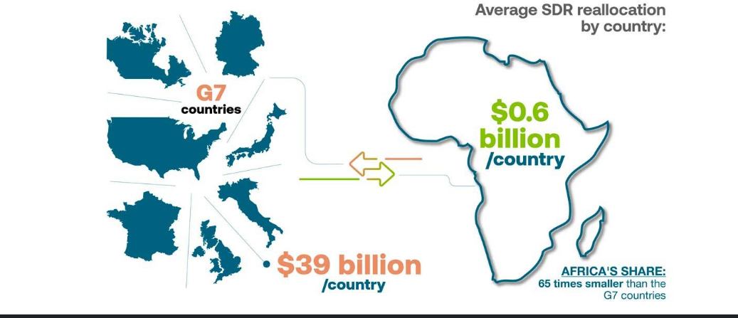
Inadequate GFA-: SDRs allocations/reallocations
Unequal IMF’s SDRs allocations
Need for SDRs reallocations/rechanneling
IMF’s recent approval of the rechanneling of unused SDRs to regional banks is welcomed
But rechanneling mechanisms yet to be operationalized
Those who hold unused SDRS( mainly OECD members) need to adhere to the rechanneling mechanisms

Slide 6
Narrowing Africa’s financing gap- key policy options
REFORMING THE GFA through raising African MSs’ access to concessional funding by reforming MDBs
  Building better, bigger, bolder and more effective multilateral development banks (MDBs).
  Re-channelling Special Drawing Rights to MDBs to boost their lending capacity. operationalizing the innovative proposals developed by the AfDB and IADB
  MDBs should play a much bigger role in attracting private sector resources to transformational projects by both de-risking the project and capacitating key stakeholders to prepare bankable projects
  MDBs should also expand mandates to address global issues such as persistent food insecurity, climate change, persistent digital divide and diverging global demographic trend
  Scale up the use of sovereign and MDB-backed guarantees to lower borrowing costs for African countries
  Consider vulnerabilities beyond a country’s income status to determine eligibility for concessional financing windows

Slide 7
Narrowing Africa’s financing gap- key policy options
REFORMING THE GFA through addressing gaps in the global sovereign debt architecture.
As of end 2023, Africa’s debt burden was 65.8 percent of GDP, approximately the level reached prior to the MDRI in mid 2000s. Debt service has surged to a historic high, surpassing 10% of GDP. There is need to:
i. Overhaul the G20 Common Framework to make it more effective, time-bound, and transparent, by:
a) Suspending debt service for all countries entering Common Framework restructurings
b) Expanding eligibility for the Common Framework to middle-income countries
c) Establishing comparability of treatment formula and adopting an integrated approach among official and private creditors as well as multilateral and bilateral debt restructurings
Promote transparency and accountability in financial transactions and debt management practices in both creditor and debtor countries.
Strengthen the International Debt Legal Framework around:
  Enhanced Collective Action Clauses
  Anti-Vulture Fund Legislation
  State-Contingent Debt Instruments
Explore and implement innovative debt instruments including debt-for climate or debt-for development swaps that fortifies Africa’s efforts towards debt sustainability

Slide 8
Narrowing / closing Africa’s financing gap- key policy options-Cont’ed
C. Reform the international tax Cooperation Framework
Effective engagement of African countries and contribution to reshaping international tax cooperation framework,
Africa should ensure that the international cooperation framework effectively address issues such as resource exploitation, transfer pricing, harmful tax practices are well addressed in the new international tax cooperation and capacity.
Technical support is needed to support member states engage effectively in the reform of the GFA.
FFD4 process should be leveraged to ensure a concerted approach for Africa to accelerate efforts toward UN-international Tax Cooperation Framework.

Slide 9
Narrowing / closing Africa’s financing gap- key policy options-Cont’ed
2. ENHACE DRM AND STREAMILNE PUBLIC EXPENDITURES THROUGH:
Tackling weaknesses and inefficiencies in tax systems and administration and streamline expenditures.
Addressing leakages from tax system, including through illicit financial flows and unproductive tax incentives.
Improve public expenditure allocative and spending efficiency- Inc. expenditure planning and prioritization and enforcement of control systems to reduce leakages.
B. Widening sources of domestic financing, especially developing and diversifying domestic capital markets
Development of Local Currency Bond Markets (LCBM).
Leveraging innovative financial products such as pension funds, diaspora bonds, and many others.

Slide 10
Narrowing / closing Africa’s financing gap- key policy options-Cont’ed
C. Effective public debt governance frameworks, inc. fiscal rules.
Robust public debt governance frameworks are critical for preventing debt crises in Africa,
Improved transparency in debt management will be key for effective debt management, monitoring and accountability,
Introducing fiscal rules - through numerical limits on budgetary aggregates such as public debt, fiscal deficit could enhance fiscal discipline,
Fiscal rules would also enhance fiscal discipline through expenditure planning, tradeoffs and prioritization.

Slide 11
Leveraging INFF for fiscal discipline in Africa.
Linking national development plans to various financing options is an important step toward efficient public spending,
Through INFF, various sources of finance ( including private finance) can be leveraged toward national development plans,
This in turn, improves public expenditure planning, prioritization and tradeoffs as spending plans are made based on better knowledge of available resources,
Experiences from countries will provide us with valuable lessons and experiences on the INFF implementation in respective countries.

Slide 12

Thank You

