Slide 1

Regional Workshop on Integrated National Financing Frameworks 2024
Public Finance for Sustainable Development in Africa
Enhancing revenue mobilization and exploring sustainable debt instruments in Nigeria within INFF by
Alfred Okoh
Addis Ababa, Ethiopia 12-13 June 2024

Slide 2


Contents
01.
Overview –
Background & Context
INFF –
SDG Financing Challenges – Managing Budgetary Pressures and Fiscal Constraints
02.
Plans & Initiatives –
The INFF Fund
03.
Conclusion –
Key PFM Reforms and DRM
04.

Slide 3
Contents
01.
Overview –
Background & Context
INFF –
SDG Financing Challenges – Managing Budgetary Pressures and Fiscal Constraints
02.
Plans & Initiatives –
The INFF Fund
03.
Conclusion –
Key PFM Reforms and DRM
04.

Slide 4
The SDGs in Nigeria - Context
PROBLEM
Nigeria has undertaken several initiatives toward monitoring and achieving the SDGs
Despite this, 13 out of the seventeen SDGs are either worsening or stagnating - with the exception of Goals 5, 6, 12 and 13
Before the pandemic, a business-as- usual approach to financing development appeared insufficient.
Challenges of decreased fiscal space, low investments, inflation, food insecurity, amongst others persist.

Slide 5



$10 billion annual financing need
THE NUMBERS
>210m
Population
40%
Poverty
17%
formal paid
work
33.7%
In ation
_{36.0} 33%
32.0
28.0
^{24.0}17.7%
20.0
16.0
2019
2022
Unemployment

Slide 6
INFF Process in Nigeria: Key Milestones
Dec. 2019
Nigeria commits to be amongst pioneer INFF implementers & setup institutional structure
June 2020
Kicked-off Development Finance Assessment (DFA) process and stakeholder workshop
Oct. 2020
DFA Report Concluded
April 2021
Kicked-off INFF Phase 2 – Financing Strategy / INFS
Nov. 2021
Draft INFS completed & begun preparing the Roadmap
Sept. 2022
INFF Report completed and launched at UNGA
Jan. 2023
Began implementing/ testing a few action plans
July 2015 Addis Ababa Action Agenda adopted
The entire process is with commendable support from the UNDP country office in Nigeria and of course, other Development Partners on the steering Committee.

Slide 7
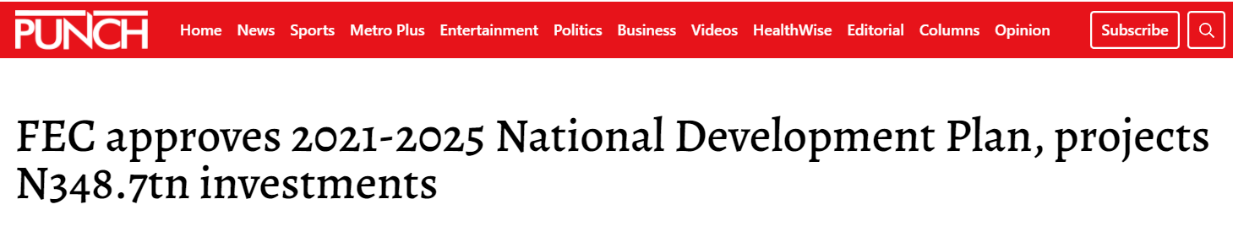
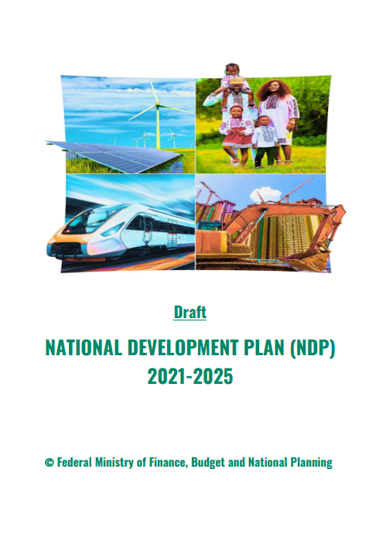

The NDP 2021-25
Thematic Areas
1
Key Policy Action - Infrastructure
Prioritization and implementation of critical and strategic infrastructure projects that will directly boost production and productivity
The plan, with an investment size of N348.7tn, will be funded by the federal, state governments and the private sector.
For the investment size above, the expected financing contribution is shown below -
  Public Sector: N49.7 tn
  Private Sector: N298.3 tn
It is there imperative to understand the importance of the conversation here today.
2
Green Economy
Nigeria will move towards climate adaptation by diversifying its energy sources away from fossil fuels and embracing the green economy to create new and sustainable economic activities
3
Protecting the Environment
Develop a Nigerian circular economy and environmental protection programme to reduce the footprint of mine waste and create new job opportunities

Slide 8
Contents
01.
Overview –
Background & Context
INFF –
SDG Financing Challenges – Managing Budgetary Pressures and Fiscal Constraints
02.
Plans & Initiatives –
The INFF Fund
03.
Conclusion –
Key PFM Reforms and DRM
04.

Slide 9
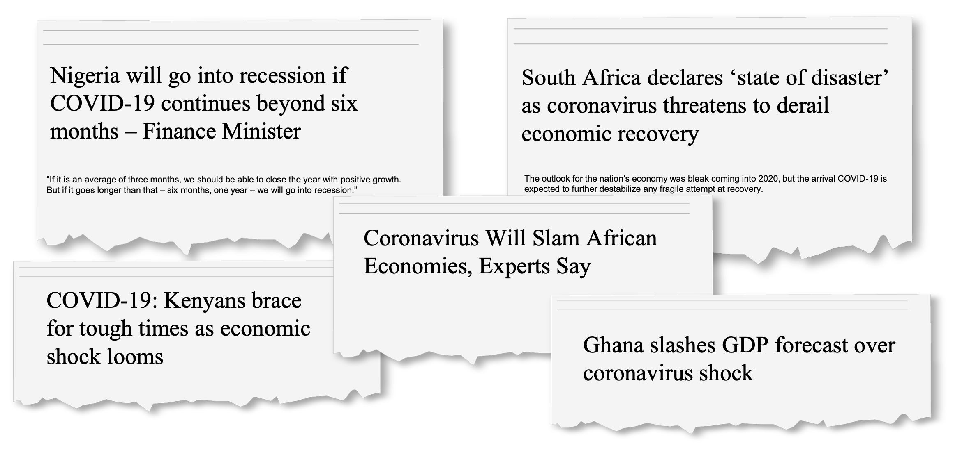
Managing Budgetary Pressures
Fiscal authorities are faced with difficult choices in resource mobilization and allocation. Hence, allocative efficiency then becomes critical in line with government’s priorities for SDG financing.
COVID-19 worsen financing landscape
Depressed external environment (oil price/demand, FDI)
Exerted downward pressure on government revenue and economic growth
Exerted upward pressure on public expenditure
In 2020, the world was hit hard by the twin shocks of the COVID-19 pandemic and the worst economic crisis (oil price shocks) since the Great Depression of 1929.
To achieve this, fiscal and financial policies needed to prioritize investing in people, infrastructure, and coping mechanisms.

Slide 10
Fiscal Balance Challenges
Fiscal Policy, with only four instances of Budget Deficit Below 3% of GDP
Budget Deficit as % of GDP
Given the increased frequency of shocks, building capacity to withstand them becomes essential to protect development gains.
With a resulting 60% decline in FGN oil & gas revenues in 2020, we had to resort to borrowing, including the expensive and inflationary ways & means.
The graph here shows the impact and the trend of FGN’s deficit to GDP ratio since the covid disruptions.
Until recently, regressive Fuel & Power Subsidies have compounded the fiscal challenge, which has been consistently higher than budgeted as well as the 3% threshold

Slide 11
Contents
01.
Overview –
Background & Context
INFF –
SDG Financing Challenges – Managing Budgetary Pressures and Fiscal Constraints
02.
Plans & Initiatives –
The INFF Fund
03.
Conclusion –
Key PFM Reforms and DRM
04.

Slide 12
INFF Implementation – Providing Critical Funding Support
Government’s ability to achieve the 13 SDG Goals by 2030 requires a reframing of the usual approach to funding the support required for a successful implementation of the different initiatives
Nigeria has undertaken several initiatives toward monitoring and providing the supporting framework for achieving the SDGs. However, 13 out of the 17 SDGs are either worsening or stagnating
An aggregate of approximately US$2.6M has been provided by the UNDP and the European Union in counter-part funding to support the initial phase of INFF’s implementation
To enhance the chances of successfully delivering the different initiatives, we are proposing a structured framework for providing funding to support the implementation of the INFF programme
INFF’s Intended Outcomes
Increased revenue/GDP ratio to enable development financing to achieve SDGs by 2030
Increased financial flows including FDI and remittances commensurate with the size of the economy
Strengthened capacities of national and state level institutions to raise revenue flows from various sources
Improved enabling environment for private sector businesses to thrive and raise revenues
Increased incentives for local and international investors and financial institutions

Slide 13

Proposed INFF Fund
The INFF Fund is envisioned as a government and multi-donor financial commitment that will act as catalytic fund to enable the kick-off the implementation of the INFF action plan roadmap, in line with government’s priorities for SDG financing.
Indicative Terms | Description
Proposed Fund Size: | Up to $100M
Programme Term: | Up to 10 years
Funding mechanism: | Multi-year funding commitments
The INFF Fund is proposed as a collaboration with key stakeholders to strengthen the development financing envelope of the government to achieve the SDGs.
The multi-donor financial contribution will enable stakeholders to finance the implementation of the INFF action plan roadmap

Slide 14
Proposed Source of Funds
Funding is to be raised from a combination of the public and private sectors, across domestic and international sources for the implementation of the identified initiatives of the INFF programme
Federal Government
Sub – National Governments
Development Finance Partners
Others
  The Federal Government, through the Federal Ministry of Finance, would seek to provide multi-year counter-part financing commitments to participate in the INFF Fund.
  (Subject to receipt of necessary approvals)
  Given the national coverage of the activities of the INFF, sub-national governments would be encouraged to participate in the INFF Fund.
  Counter-part funding is expected to be provided from all the development partners who are part of the INFF programme through multi-year, rolling commitments.
  Participation from a broad cross-section of donor agencies would be sought to provide one-time and/or term commitments to the Fund.

Slide 15
Proposed Use of Funds
Proceeds of the proposed INFF Fund would be used to finance critical activities of the programme over a seven-year period
Use of Funds
Funding the sourcing and provision of technical assistance to facilitate learning, technical analysis, feasibility studies, etc
Facilitation of policy and regulatory reforms
Funding the procurement of hardware and digital tools
Funding business processes and applications that address barriers to development financing
Funding agencies cost-share in SDG aligned development planning exercises

Slide 16
Contents
01.
Overview –
Background & Context
INFF –
SDG Financing Challenges – Managing Budgetary Pressures and Fiscal Constraints
02.
Plans & Initiatives –
The INFF Fund
03.
Conclusion –
Key PFM Reforms and Domestic Revenue Mobilisation
04.

Slide 17
Enhancing Revenue Mobilization & Public Finance Reforms
PFM Reforms have been summarised across 4 broad PFM thematic areas:
Resource Generation
Public Debt Management
Implementation of Annual Finance Acts.
Tax administration and tax compliance - now resulting in increased revenue collections
Amending aspects of the Fiscal Responsibility Act 2007;
Enhancing fiscal efficiencies by controlling the cost-to-revenue ratios of key State and Government-Owned Enterprises;
Debt Management Strategy is within the threshold of the approved MTDMS (2016-2019) and (2020 – 2023)
Public Debt as a percentage of GDP is to be under 40%;
Borrowings will be from the domestic and foreign sources as well as use of long-term instruments.
External borrowings from concessional and semi concessional multilateral and bilateral sources to be prioritised.
Resource Allocation
Further to FGN’s retained revenue and amount available to fund FGN Budget:
Funds are allocated to MDAs based on the overarching priorities of the FGN;
Priority sectors that will stimulate growth;
Social investments for the most vulnerable segment of our population;
Infrastucture and public investments (including Education & Health)
Security
Expenditure Management
MDAs now integrated to GIFMIS-led payments system, effectiveness of commitment controls improving
Cash balances now consolidated and reported with a few exceptions on a daily basis and paymennts publicly disclosed via the Open Treasury Portal.
Revenue accounts reconciliation, conducted monthly within OAGF and via the Presidential Revenue Monitoring & Reconciliation Committee (PRM&RC)

Slide 18
ANNUAL FINANCE ACTS: a Renewed fiscal tradition…
Keeping Presidential Commitments Vis-à-vis Annual Finance Bills as a renewed Fiscal Tradition
      Mr. President is committed to end subsidies and plough back savings into Development efforts. Furthermore, the Presidential Fiscal Policy & Tax Reform Committee is required to revive the discipline of annual Finance Acts to support improved revenues for budget implementation
      Key Reform Areas amended by previous Finance Acts include:
S/N | LAWS & STATUTES PROPOSED TO BE AMENDED
1. | Capital Gains Tax Act (‘CGTA’);
2. | Companies Income Tax Act (‘CITA’);
3. | Customs, Excise Tariffs Etc. (Consolidation) Act (‘CETECA’);
4. | Federal Inland Revenue Service (Establishment) Act (‘FIRSEA’);
5. | Personal Income Tax Act (‘PITA’);
6. | Stamp Duties Act (‘SDA’);
7. | Tertiary Education Trust Fund (Establishment) Act (‘TETFEA’);
8. | Value Added Tax Act (‘VATA’);
9. | Insurance Act;
10. | Nigeria Police Trust Fund (Establishment) Act;
11. | Nat’l Agency for Science & Engineering Infrastructure Act (‘NASENI’);
12. | Finance (Control & Management) Act; &
13. | Fiscal Responsibility Act.
1. Domestic Revenue Mobilisation
2. Tax Administration & Legislative Drafting
3. International Taxation
4. Financial Sector Reforms & Tax Equity
5. Public Financial Management Reforms

Slide 19

Finance act: critical policy thrusts
Key Points
#1. Domestic Revenue Mobilisation
Sections | Issues | Mechanisms | Rationale & Commentary
§2-FA, amending §30-CGTA | Partial Roll-back of Exemption of Shares from Capital Gains Taxes | 10% Capital Gains Tax imposed on Shares’ Disposal Transactions where the aggregate Disposal Proceeds exceed N100m in any 12 consecutive calendar months; Reinvestment Relief provided to defer Capital Gains Tax where Disposal Proceeds are Wholly or Partially Reinvested; & Taxpayers are required to report Disposals annually for ease of administration & compliance (to FIRS for corporate shareholders & State IRS for individuals) | Partial Roll-back of CGT exemption on Shares intended to raise revenues for States & FGN: Reinvestment Relief retained to encourage long-term investments in equities Pension Funds’ Assets are exempted under §10 Pension Reforms Act, 2014 to protect Pensioners)
§17-FA amending §21-CETECA | Duty on Non-alcoholic, Carbonated & Sweetened Beverages | Excise Duty of N10/liter imposed on all Non-alcoholic, Carbonated & Sweetened Beverages To discourage excessive consumption of sugar in beverages which contributes to diabetes, obesity, etc. | New ‘Sugar Tax’ introduced to raise excise duties & revenues for health-related & other critical expenditures (in line with the 2022 Budget’s Priorities)

Slide 20

Finance act: critical policy thrusts
Key Points
#2. Tax Administration & Legislative Drafting
Sections | Issues | Mechanisms | Rationale & Commentary
§18-FA amending §25-FIRSEA | FIRS Automation & ICT Reforms | FIRS empowered to sanction non-compliant taxpayers refusing access to IT systems FIRS may deploy both Proprietary & Third-Party Tech Applications to collect information from taxpayers | To enhance the ongoing ICT & Tax Admin. reforms by FIRS to increase revenue generation (in line with the 2022 Budget’s Priorities)
§21-FA amending §50-FIRSEA | Taxpayers’ Confidential Data | Enhance confidentiality & non-disclosure by FIRS staff of Taxpayers’ Confidential Data Penalize data breaches by non-compliant FIRS staff | Provide safeguards to protect Taxpayers’ Data & provide sanctions

Slide 21

Finance act: critical policy thrusts
Key Points
#3. International Taxation
Sections | Issues | Mechanisms | Rationale & Commentary
§4-FA amending §13-CITA; & §8-FA amending §30-CITA | Taxation of E-Commerce Biz. by Non-Resident Companies on a Fair & Reasonable Turnover Tax Basis (i.e. 6% of Turnover) | Empower FIRS to assess Non-Resident Firms to tax on Fair & Reasonable Turnover Tax Basis on Turnover earned from providing Digital Services to Nigerian customers Introduce Turnover Tax on Fair & Reasonable Percentage of Profits earned from providing Digital Services to Nigerian customers Note that such Digital Services include Apps, High Frequency Trading, Electronic Data Storage, Online Advertising, etc. | Modernize the taxation of ICT & digital economy in line with current realities (in line with the NDP 2021-25) Enhance administrative modalities for the taxation of Non-Resident Taxpayers deriving revenues from Nigeria (in line with the NDP 2021-25)
§30-FA amending §10-VATA; & §31-FA amending §14-VATA | VAT Obligations of Digital Non-Resident Companies | Restrict VAT obligations mainly to Digital Non-Resident Companies (who supply individuals who cannot self-account for VAT) Reduce compliance burden on other Non-Resident Taxpayers who are not required to register for VAT in Nigeria Clarify that FIRS may appoint persons (including Non-Residents) for the purpose of tax collection Clarify that such appointed persons may collect & remit taxes to FIRS / Relevant Tax Authorities

Slide 22

Finance act: critical policy thrusts
Key Points
#4. Financial Sector Reforms & Tax Equity
Sections | Issues | Mechanisms | Rationale & Commentary
§3-FA amending §9-CITA | Securities Lending Transaction Reforms by Securities & Exchange Commission (‘SEC’) | Securities Lending: permit Lenders to receive compensating ‘manufactured dividends’ from securities lending traders | Tax Equity: to enable Securities Lending Reforms being championed by SEC (in line with the NDP 2021-25)
§14-FA amending §78-CITA; & §16-FA amending §105-CITA | Real Estate Investment Trusts (‘REITs’) Reforms by SEC | Clarify that Withholding Taxes deducted from Unit Trusts’ dividends are final taxes on Unit Trusts’ income Clarify that REITs’ special tax regime provisions apply to REITs set up as Unit Trust Schemes | Tax Equity: in support of SEC’s REITs & Unit Trusts financial sector reforms (in line with the NDP 2021-25)
§33, §34, §35-FA amending §9, §10 & §102-Insurance Act, 2003 | Insurance Companies’ Capitalization Reforms by the National Insurance Commission (‘NAICOM’) | Enhance definition of share capital (capital requirement) in determining minimum capital to enhance NAICOM’s recapitalization reforms | Tax Equity: in support of NAICOM insurance sector capitalization reforms (in line with the NDP 2021-25)

Slide 23




Next Steps
Core Working Group to Revise INFF Roadmap/M&E for monitoring and evaluating the action plan inline with new priorities
Report on INFF progress, at global and national levels, continuously positioning Nigeria as a leading country on the INFF for peer learning.
Finalize INFF Phase II programme implementation (sub-national DFA, market intelligence, strategic initiatives etc)
Mobilize additional resources to support the implementation of INFF Roadmap for Phase III; including setting up an INFF Fund
Roadmap/M&E framework currently has 22 financing sources, and 115 initiatives. Government & stakeholders will agree on Baseline, Targets, and Means of Verification of the initiatives to be tracked within the framework

Slide 24

Thank You

