Slide 1
Tax Policy Reforms to Improve Tax Revenues
Federal Democratic Republic of Ethiopia
Regional Workshop on Integrated National Financing Frameworks 2024
Public Finance for Sustainable Development in Africa
Mr Mulay Weldu Asegehegn
Head of Tax Policy Department, Ministry of Finance asegehegn@gmail.com OR mweldu@mofed.gov.et
Addis Ababa, Ethiopia 12-13 June 2024

Slide 2
Presentation Contents
Current Issues and Opportunities
INNF’s Approach to Mobilize Public Financing
Domestic Revenues Mobilization Efforts
Planned Tax Policy Reforms
Concluding Remarks

Slide 3
Current Issues and Opportunities
Ten Years Perspective Development Plan (2021 – 2030)
The development plan will be achieved through the following key strategic pillars
  Quality Economic Growth and Shared Prosperity,
  Economic Productivity and Competitiveness,
  Technological Capability and Digital Economy,
  Sustainable Development Financing,
  Private Sector-led Economic Growth,
  Resilient Green Economy,
  Institutional Transformation,
  Gender and Social Inclusion,
  Access to Justice and Efficient Civil Services, and
  Regional Peace Building and Economic Integration.
Existing Opportunities are:
  There is political commitment from the government
  A ten year development plan is prepared and under implementation
  Potential for development exist.
  Development partners support for Domestic Revenue Mobilization
  National Medium-term Revenues Mobilization Strategy prepared
The issue is financing gap indicated by low and falling tax-to-GDP ratio.

Slide 4
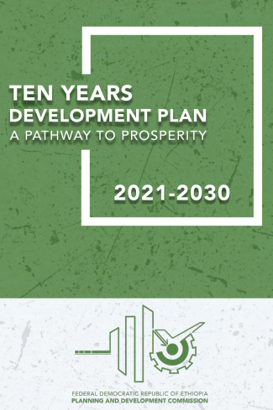
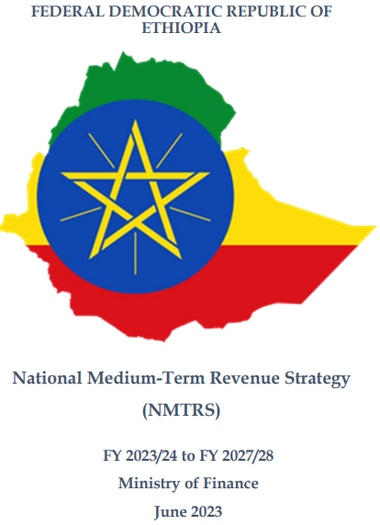
Ethiopia’s Development Plan and Revenues Mobilization Strategy
Where we are from the Minimum 15% tax-to-GDP required to achieve SDGs?

Slide 5
INNF’s Approach to Mobilize Public Financing
INFF is, as we know, serves as the tool to implement the Addis Ababa Action Agenda at country level.
INFF helps to:
    Strengthen planning process
    Overcome existing financing challenges
    Pave ways of financing sources (Domestic and Internationally from private and public sources)
Implementing the National and SDGs through cohesive national sustainable
development strategies

Slide 6
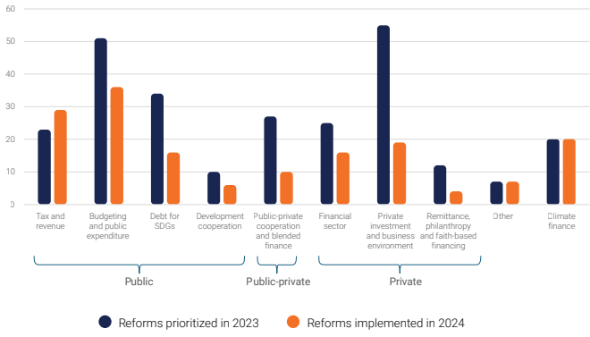
INNF’s Approach … Cont.
Financing reforms shaped by INFFs

Slide 7
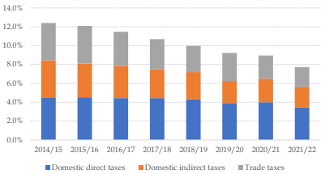
Domestic Revenues Mobilization Efforts
Government gives higher emphasis to Domestic Revenues Mobilization (DRM)
H.E the Prime Minister established national ministerial committee to ensure economy’s tax revenue potential fully mobilized
In so far many reforms with additional revenue potential of over 60 Billion Birr implemented.
National Medium-Term Revenue Strategy (NMTRS) prepared and ready for implementation.
Tax revenue continued to be low and falling as measured by tax-to-GDP Ratio.
The tax to GDP ratio has been falling continuously since 2014/15 from 12.4% to 7.7% in FY 2021/22 despite improved revenue collections in nominal terms implying a slower growth in revenues relative to GDP.

Slide 8
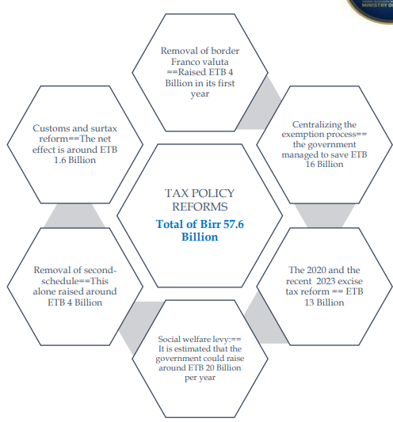
Domestic Revenues … Cont.
The Ministry of Finance has introduced a series of comprehensive tax reforms, especially in the last four years.
  Excise Tax Reform
  Excise Tax Amendment
  Trade Tariff Reform (Including Sur Tax)
  Introduction of Social Welfare Levy
  Centralization of Tax Incentives Granting Process
  Removal of redundant Tax Incentives (Vehicles)
  Removal of Franco Valuta Tax and tariff exemption
  VAT Reform
Despite such tax policy reforms, still tax to GDP ration shows no improvement as falling trend continued.

Slide 9
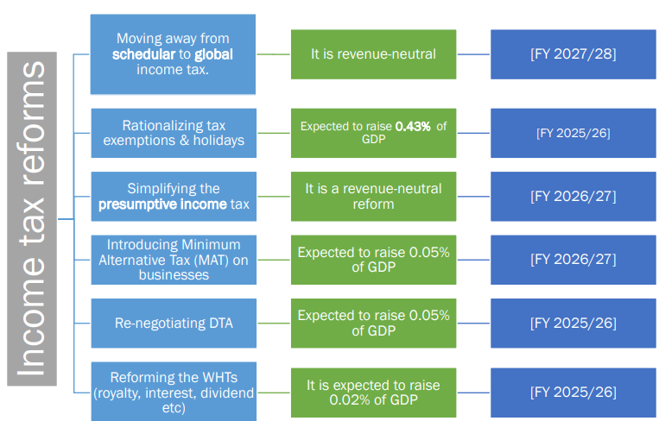
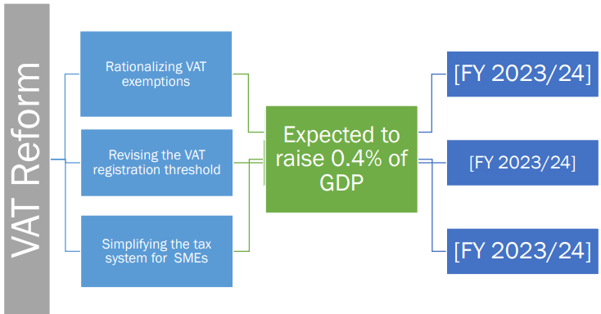
Planned Tax Policy Reforms and Expected Respective Revenues Returns
Efforts are continued to improve tax revenues.
A 5 Year NMTRS is prepared with expected tax revenues of 4% (only from policy reforms) by the end of strategies implementation tax to GDP ratio to increase from 7.5% to 11.5%.

Slide 10
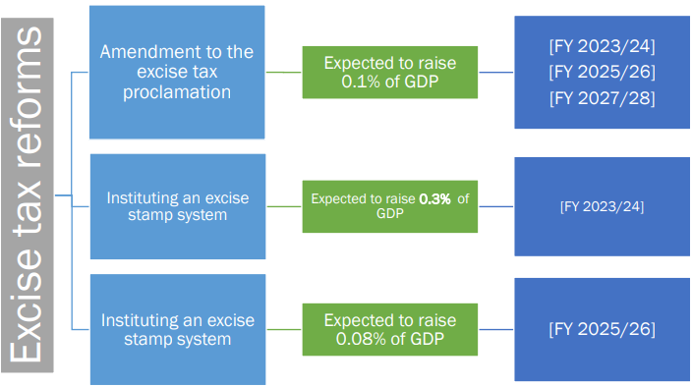
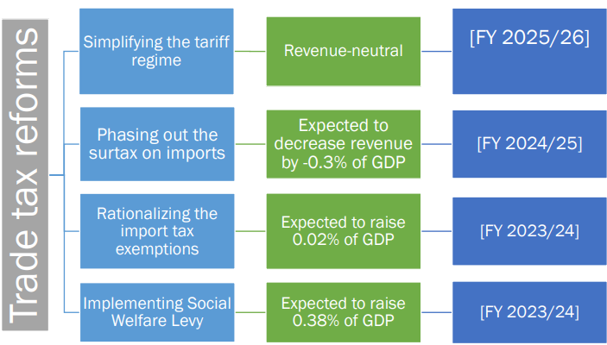
Planned Tax Policy … Cont.

Slide 11
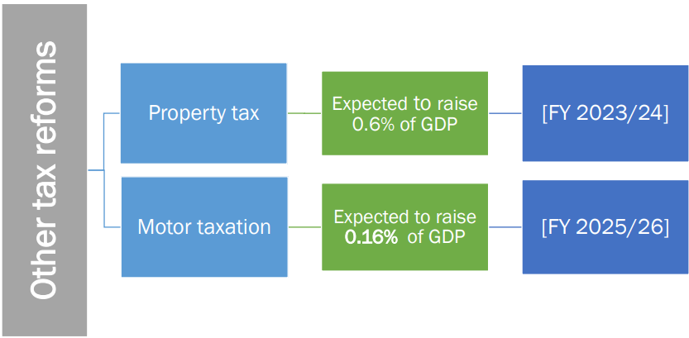
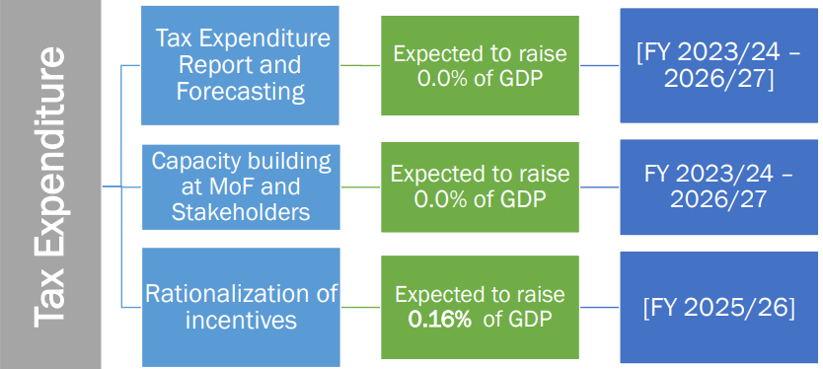
Planned Tax Policy … Cont.

Slide 12
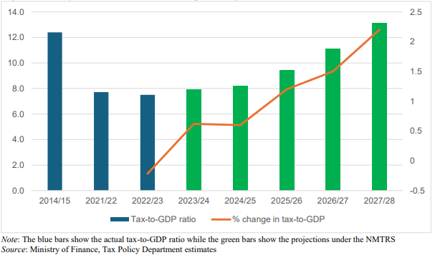
Concluding Remarks
Continued government political commitment to improve DRM through policy and administration reforms is pivotal.
Strict implementation of the NMTRS is critically important.
UN support is important in the implementation of the NMTRS.

Slide 13

Thank You

