Slide 1
Harmonizing public finance with SDGs with a focus on tax and debt policies
Regional Workshop on Integrated National Financing Frameworks 2024
Public Finance for Sustainable Development in Africa by
Farzana Sharmin
Economic Affairs Officer
Macroeconomics and Governance Division
UNECA
Addis Ababa, Ethiopia 13 June 2024

Slide 2
Key Highlights from day 1- Gaps in SDGs attainment
In the aftermath of the unexpected pandemic, progress towards meeting the SDGs has slowed and, in some countries/areas reversed.
The financing gap for SDGs in Africa is estimated at USD 1.3 trillion per year (ECA, 2020)
With multilateral development bank (MDB) disbursements of only $200 billion annually and the grossly inadequate and biased GFA, the funds that are currently accessible, are restricted and inadequate to address the disparity and confront developmental challenges of Africa.
The financing gap is further heightened by high and unsustainable public debt.
Moreover, there is exponential risks from climate change with substantial financing need for climate action.
A rising number of African countries with high debt levels now also face growing climate vulnerabilities, creating a vicious cycle of indebtedness.
Notes:
With multilateral development bank (MDB) disbursements of only $200 billion annually, the funds that are currently accessible, are restricted and inadequate to address the disparity and confront global issues such as food insecurity and debt distress leading to development distress.

Slide 3
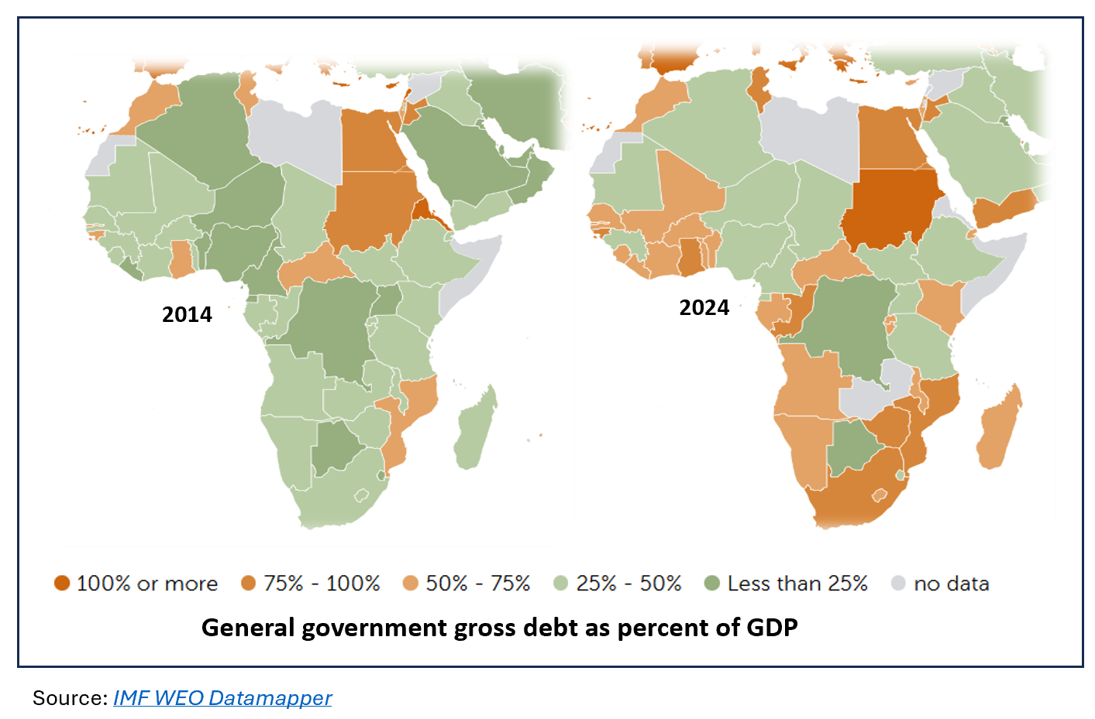
Key Highlights from day 1-Debt crisis
Average public debt relative to GDP in Africa exceeds 60 per cent of GDP;
As of November 2023, 8 African countries were in debt distress, and 13 were at a high risk of debt distress
Africa’s debt has increased by 183% since 2010, a rate roughly four times higher than its growth rate of GDP in dollar terms
Rising debt service diverts resources away from critical sectors like health, education, energy transition, infrastructure and so on, - creating a “development distress”

Slide 4
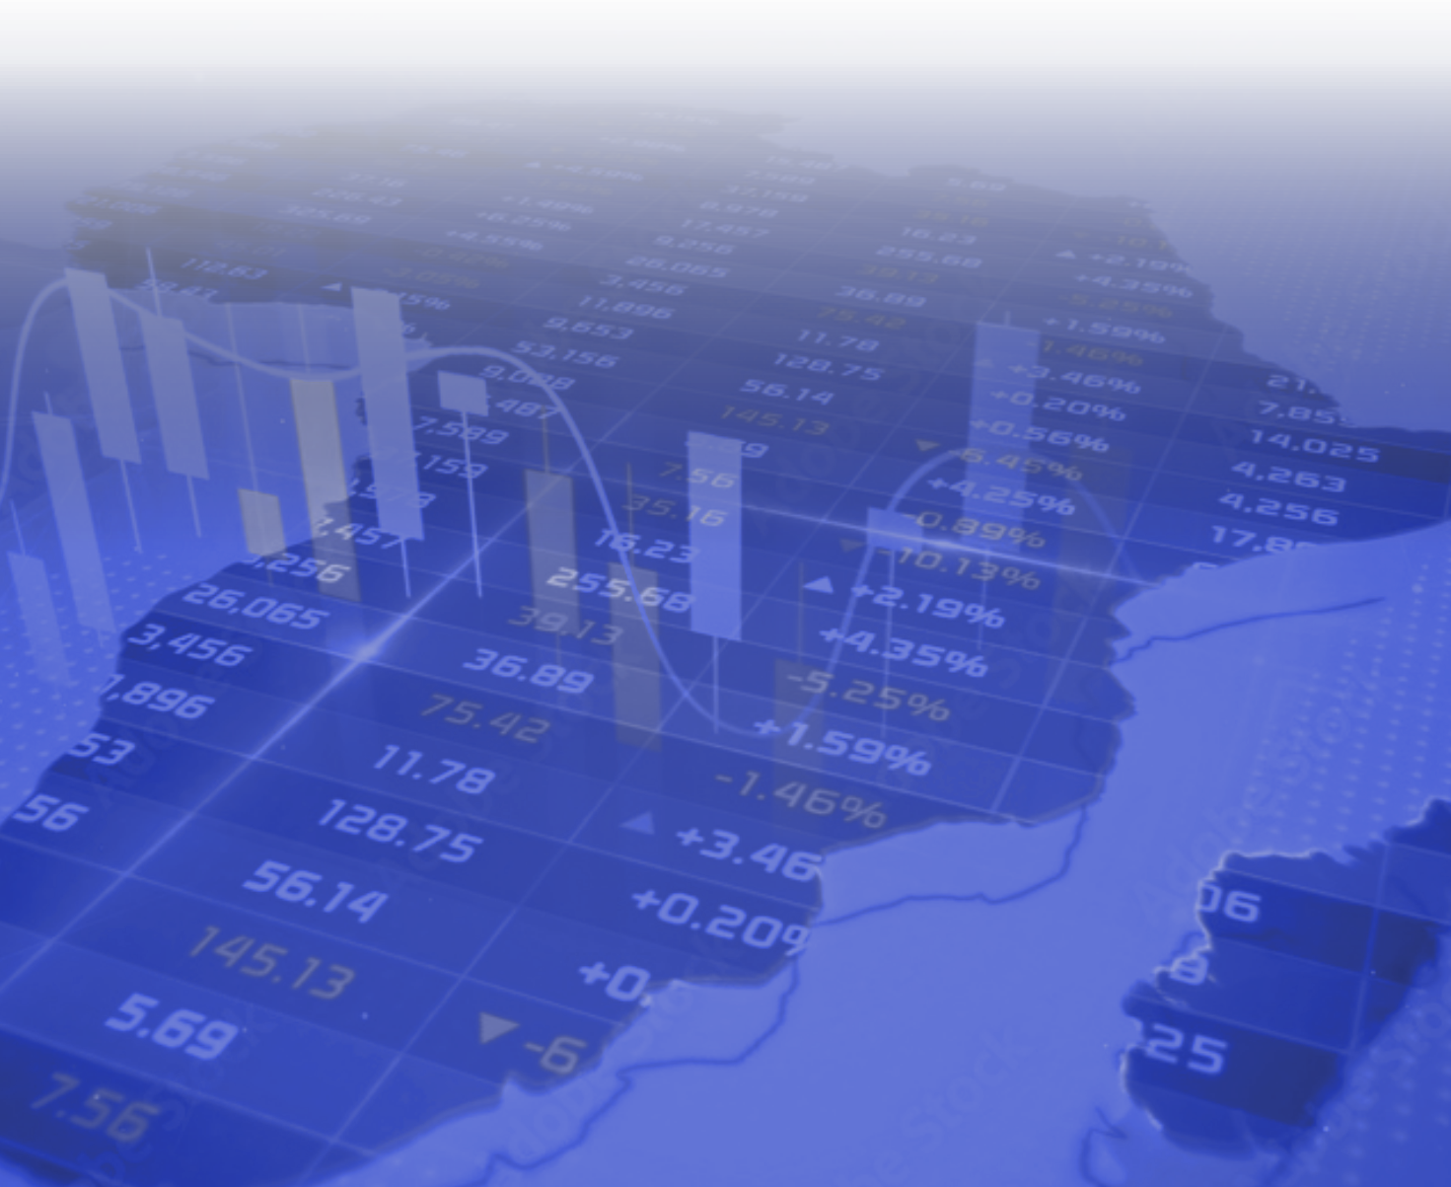
Key Highlights from Day 1- Low contribution of DRM
Low DRM potential in Africa for several systematic constraints, such as weak tax administration systems, excessive tax exemptions, substantial illicit financial outflows, large informal sectors, tax avoidance and evasion, and narrow tax base.
The average tax-to-GDP ratio remaining below its 2019 rate of 15.8% (ECA, 2024)
Untapped and emerging areas of DRM such as environmental taxes and digital economy
Shallow domestic capital markets - limiting the extent to which countries can mobilize domestic and international capital
Ineffective and unfair international taxation systems - tax from MNEs unfairly distributed, under-representation of Africa in relevant global tax forums etc.

Slide 5
Importance of public finance and INFFs as a tool
Domestic sources are more relevant to national priorities and sustainable medium-to long-term transformation given their level of stability compared with external resources
Integrating national plans and priorities with available resources from the public and private sectors is critical for attaining the SDGs
Using the INFF tool, governments are now able to mobilize necessary financing from a range of financing options and manage the complex financing landscape against the background of the country needs.
To tap the fullest potential of public finance, holistic reforms is needed
We need to know
What are the current issues and opportunities of the country?
How has the INFF approach can benefit the country
How has partners supported in this journey
And moving forward, what are your country’s plans on INFF implementation and what support do you anticipate you would need?

Slide 6
Thank You

