Slide 1
CHALLENGES AND OPPORTUNITIES IN MEASURING TAX EXPENDITURE IN BENIN
REGIONAL WORKSHOP ON INTEGRATED NATIONAL FINANCING FRAMEWORKS 2024
PUBLIC FINANCE FOR SUSTAINABLE DEVELOPMENT IN AFRICA
Thibaut TOSSOU
Economic and Statistical Engineer
General Directorate of Taxes of Benin
Addis Ababa, Ethiopia June 12-13, 2024

Slide 2
PRESENTATION PLAN
INTRODUCTION
CONCLUSION
II. INSTITUTIONAL GOVERNANCE OF TAX EXPENDITURE
III. CHALLENGES IN MEASURING TAX EXPENDITURE
I. EXPERIENCE IN EVALUATING TAX EXPENDITURE
IV. OPPORTUNITIES

Slide 3
INTRODUCTION
Experience in evaluating tax expenditures since 2008
Evaluation of state tax measures - annual frequency
Several socio-economic impact studies of tax expenditure measures
Transparency in the evaluation of tax expenditures :
  report appended each year to the finance bill (French National Assembly)
  report published each year on the website of the Budget Directorate General

Slide 4
I. EXPERIENCE IN EVALUATING TAX EXPENDITURE (1/6)
Guide to evaluating tax expenditures ;
Definition of a reference tax system updated each year, together with an inventory matrix of exemption measures;
Inventory of tax expenditures by legislative and regulatory acts ;
Codification of indirect tax expenditures (regulatory act) ;
Evaluation of tax expenditures by :
  Type of tax ;
  Tax expenditure measure ;
  Objective;
  Beneficiaries ;
  business sector.
  The method used is the loss of revenue method.

Slide 5
I. EXPERIENCE IN TAX EXPENDITURE EVALUATION (SFR) (2/6)
Corporate income tax (IS)
REFERENCE RATE | TAXABLE BASIS | THRESHOLD | CONTRIBUTABLE
30% CGI, Art. 46 The tax resulting from the above rate is increased by 4,000 CFA francs. Minimum tax : -10% of cashable income for property companies -3% in cashable income for companies in the building and civil engineering sector -1% of cashable income in all other cases (Minimum tax amount 250,000 FCFA) CGI, Art. 47 | Taxable profits and income as specified in articles 8 to 13 and 20 to 45 of the CGI of which : - Deductible expenses (spreading of expenses and depreciation, provisions, loss carry-forwards) - Transfer prices Cashable income | No | Companies and other legal entities

Slide 6
I. EXPERIENCE IN TAX EXPENDITURE EVALUATION (SFR) (3/6)
Value-added tax (VAT)
REFERENCE RATE | TAXABLE BASIS | THRESHOLD | CONTRIBUTABLE
18% 0% CGI, art. 241 Vienna Convention (principle of reciprocity) Diplomatic privileges Florence Agreement and its Nairobi Protocol Exemption on books, Diplomatic privileges for Institutes and Schools Chicago Convention Exemption on exports of aircraft refuelling to foreign countries | Interior mode Delivery of goods and services All sums, values, goods or services received or to be received in return for delivery. Building work Amount of briefs, contracts, invoices or progress payments ; For self-deliveries Purchase price of goods or similar services or, failing that, their cost price For intermediary operations carried out by travel agencies and tour operators: Difference between the price including VAT paid by the customer and the price including VAT invoiced to the agency or organizer. Operations carried out by temporary employment agencies consisting in recruiting labor on behalf of other companies. Service fee only CGI, art.237 Under customs control Customs value of imported goods plus all other duties and taxes excluding VAT itself and the contribution on the sale of electronic communications services CGI, art.237 | Sales in excess of 50,000,000 FCFA Option: Sales between 20,000,000 and 50,000,000 FCFA No | Natural and legal persons

Slide 7
EXPERIENCE IN EVALUATING TAX EXPENDITURE
(INVENTORY MATRIX) (4/6)
CLASSIFICATIONS | SUB-CLASSIFICATIONS | TAXES DUTIES AND FEES | EXEMPTION MEASURES | LEGAL BASIS | ADDITIONAL CODES | SCOPE OF DEDUCTION | TAX EXPENDITURE (YES, NO) | DURATION OF EXEMPTION | TARGETED OBJECTIVES | BUSINESS SECTOR | BENEFICIARY | CODES/REGIME
DIRECT STATE TAXES | INCOME TAXES | Corporate income tax (IS) | Reduced rate for new companies duly created, with the exception of companies with sales of 1 billion CFA francs or more and branches of companies not resident in Benin. | CGI, Art. 146 |  | 25% discount (first 2 years), 50% (third year) | YES | Temporary | Promoting the private sector | All sectors | New businesses | General Tax Code (CGI)
CUSTOMS AND EXCISE | CUSTOMS AND EXCISE | Value-added tax (VAT) Customs duty | Diplomatic privileges for institutes and schools (Florence convention) | Florence Convention | 120 |  | NO | Permanent | Respect international diplomatic conventions | Accredited diplomatic and consular missions and international institutions | Diplomat Consuls General | International convention

Slide 8
I. EXPERIENCE IN EVALUATING TAX EXPENDITURE (5/6)
Legislative and regulatory provisions | Non-expenditure tax exemptions | Tax expenditure derogations | Total exemption measures
Legislative texts
Electricity Code | 7 | 3 | 10
Customs Code | 2 | 12 | 14
Investment Code | 6 | 10 | 16
General Tax Code (CGI) | 32 | 175 | 207
Mining code | 2 | 2 | 4
Oil Code | 4 | 7 | 11
Law on Special Economic Zones | 3 | 4 | 7
Finance Acts | 4 | 52 | 56
Regulatory texts
Decree and international convention
Decree | 0 | 3 | 3
International conventions | 26 | 0 | 26
Specific decrees, cabinet decisions and agreements
Bylaws | 10 | 2 | 12
Decisions of the Council of Ministers | 0 | 6 | 6
Specific agreements | 0 | 8 | 8
Agreements with NGOs
Framework agreement | 0 | 4 | 4
Seat agreement | 0 | 4 | 4
Grand total | 93 | 295 | 388
Exemption measure
The analysis of the legal framework governing derogation measures is based on regulatory acts and legal texts.
No exemptions are granted other than those provided for in laws and regulations.

Slide 9
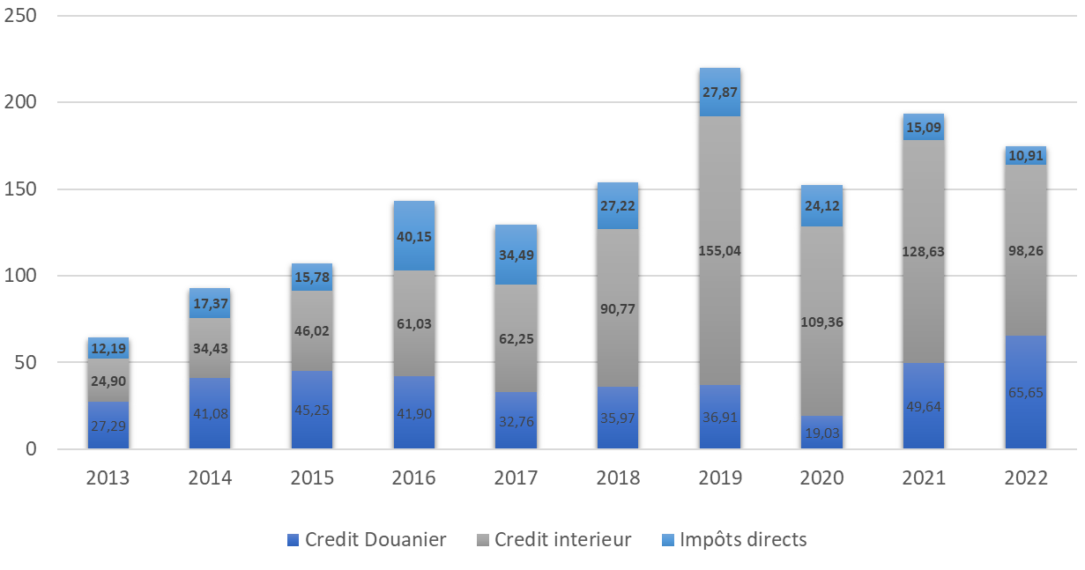
I. EXPERIENCE IN EVALUATING TAX EXPENDITURE (6/6)
RUBRIQUES 2021 data | Amount (in billions of FCFA) | Share (%) | % of tax revenue | % of total revenue | % of GDP
Indirect tax expenditure | 178,27 | 92,2 | 16,5 | 13,8 | 1,8
Direct tax expenditure | 15,09 | 7,8 | 1,4 | 1,2 | 0,2
Total tax expenditure | 193,36 | 100 | 17,9 | 14,9 | 2,0
RUBRIQUES 2022 data | Amount (in billions of FCFA) | Share (%) | % of tax revenue | % of total revenue | % of GDP
Indirect tax expenditure | 163,91 | 93,8 | 12,4 | 10,9 | 1,5
Direct tax expenditure | 10,91 | 6,2 | 0,8 | 0,7 | 0,1
Total tax expenditure | 174,82 | 100 | 13,2 | 11,7 | 1,6

Slide 10
II. INSTITUTIONAL GOVERNANCE OF TAX EXPENDITURE (1/4)
Organs | Technical services | Legislative and regulatory acts
Ministry of Economy and Finance | Direction Générale des Impôts Customs Department | General Tax Code
 |  | General Customs Code
 |  | Special agreements
 |  | Finance Act
 |  | Bylaws
Ministry of Foreign Affairs | Legal Affairs Department (MAE) | Seat agreements International conventions
Interministerial Investment Promotion Committee (CIPI) | Investment and Export Promotion Agency | Investment Code ZES law
Ministry of Energy | Department of Energy Planning, Rural Electrification and Regulation | Energy Code
Ministry of Water and Mines | Directorate General of Mines | Mining code
 | Directorate General of Hydrocarbons and Other Energy Resources | Oil code
Ministry of the Interior | Department of Internal Affairs and Religious Affairs | Framework agreement
Dedicated structure for each type of exemption
Functional relationship between structures
However, any proposal for exemption measures must be submitted to the Ministry of the Economy and Finance for technical advice before being submitted to the Council of Ministers and subsequently to the National Assembly.

Slide 11
II. INSTITUTIONAL GOVERNANCE OF TAX EXPENDITURE (2/4)
Exemptions managed by a joint structure (IMPOTS- DOUANE)
Existence of an exemption management software (GESEXO)
Processing of digitized exemptions at Customs level
Procedure for granting exemptions in three phases (MP1-MP2-MP3) but still manual (based on a regulatory act)
    MP1 (checking the physical presence of parts, verifying the conformity and validity of parts in the files, assessing the consistency between the parts making up the file, computer processing, etc.).
    MP2: liquidation of duties and taxes
    tax and customs authorities issue MP3s, which represent payment of the corresponding duties. MP3s are recorded as non-recurring expenses.

Slide 12
II. INSTITUTIONAL GOVERNANCE OF TAX EXPENDITURE
    Existence of a Commission for monitoring tax exemptions and evaluating tax expenditure (made up of managers from the technical departments of the Ministry of Economy and Finance):
  study draft texts on tax and customs exemptions ;
  propose the codification of various exemptions with a view to harmonizing tax and customs regimes;
  periodically monitor the destination of operations benefiting from tax exemptions, with a view to proposing appropriate solutions;
  propose solutions to improve the digitization of tax and customs exemption management;
  validate the annual report on tax expenditure;
  Ensure that the tax expenditure evaluation report is published in accordance with the budget timetable;
    Monthly monitoring of exemptions: monthly statistics on indirect taxation

Slide 13
II. INSTITUTIONAL GOVERNANCE OF TAX EXPENDITURE
    Some limitations
  Exemptions without prior formalities are not systematically recorded in the GESEXO software.
  At the customs cordon, some statistics are centralized under code 813 (but detailed by tariff heading).
  Under the Internal Revenue System, taxpayers benefiting from certain exemptions do not always file their tax returns.
  The MP1 and MP2 procedures only apply to indirect taxation;
  Order no. 212/MF/DC/DI of October 19, 1992, which sets out the rules and procedures for management using the MP procedure, dates back to 1992 and needs updating to take account of the dematerialization process currently underway.
  There is no set frequency for updating the decree codifying tax exemptions.

Slide 14
III. CHALLENGES IN MEASURING TAX EXPENDITURE
Pursue the implementation of the 2022-2025 tax expenditure rationalization strategy, in particular the measures contained in the Finance Bills;
evaluate tax expenditure linked to local taxes (local authorities) ;
strengthen institutional governance of tax expenditure by involving other structures responsible for managing exemptions in the work of the Commission de suivi des exonérations et de l'évaluation des dépenses fiscales ;
digitize the procedure (MP1-MP2-MP3);
Codification of tax expenditure linked to direct taxation.

Slide 15
ACTION PLAN TO IMPROVE INSTITUTIONAL GOVERNANCE OF TAX EXPENDITURES
Actions | Activities | Responsible structure | Associated structures | Priority | Implementation period
Improved information flow between administrative structures
Set up a permanent framework for exchanges between all administrations involved in the drafting of texts granting tax exemptions. | Review the composition of the Commission Chargée du Suivi des Exonérations et de l'évaluation des dépenses fiscales (CCSE), involving all the structures involved. Solicit the appointment of focal points for the structures involved Organize periodic exchange sessions | DGI | Structures identified for tax expenditure management | 1 | In the short term

Slide 16
ACTION PLAN TO IMPROVE INSTITUTIONAL GOVERNANCE OF TAX EXPENDITURES
Actions | Activities | Responsible structure | Associated structures | Priority | Implementation period
Improving the management of tax breaks
Digitizing the MPI-MP2-MP3 procedure | Digitizing the MPI-MP2-MP3 procedure at DGI level | DGI | DGD, ASIN | 1 | In the short term
Enhance GESEXO software | Audit GESEXO software Rewrite the GESEXO software; Put GESEXO software into production; Link the Tax Department to the management departments for consultation of GESEXO ; Equip software user departments with appropriate computer and electrical equipment. | DGI | DGD ASIN (Agence des Systèmes d'Information et du Numérique) Cooperation Department | 1 | In the short term
Reread order no. 212/MF/DC/DI of October 19, 1992 |  | DGI | DGD | 2 | Short term

Slide 17
ACTION PLAN TO IMPROVE INSTITUTIONAL GOVERNANCE OF TAX EXPENDITURES
Actions | Activities | Responsible structure | Associated structures | Priority | Implementation period
Improving the management of tax breaks
Capacity-building for executives in charge of processing tax exemptions | Acquire computer equipment | DGI | Technical and financial partners | 3 | Short term
Strengthen monitoring and control of tax expenditure
Continue to rationalize tax expenditure outside the general customs code, tax code and other derogatory regimes (investment code, mining code, etc.); | Carry out at least one socio-economic impact assessment of exemption measures each year, to determine whether or not they should be renewed in the Finance Bill. | DGI | DGD | 1 | Short term
Set up a tool for simulating and forecasting tax expenditure |  | DGI | DGD DGE; Technical and financial partners | 1

Slide 18
ACTION PLAN TO IMPROVE INSTITUTIONAL GOVERNANCE OF TAX EXPENDITURES
Actions | Activities | Responsible structure | Associated structures | Priority | Implementation period
Strengthen monitoring and control of tax expenditure
Gradual extension of the scope of evaluation to take into account State tax expenditure not yet evaluated |  | DGI | DGD CCSE | 1 | Short
Taking into account the valuation of tax expenditure on local taxes | Report on tax expenditure on local taxes. | DGI | CCSE | 2 | In the medium term
Development and publication of a brochure on all exemptions in force in the Republic of Benin. |  | DGI | DGD, APIEX, Direction des Mines, Direction des Hydrocarbures Trade and Industry Department Ministry of the Interior Ministry of Foreign Affairs | 2 | Medium-term

Slide 19

IV. OPPORTUNITIES

Slide 20
IV. OPPORTUNITIES
Benin's evaluation of tax expenditure can serve as a model for its peers.
Need for a brochure on the governance of tax expenditure in Benin
Institutional governance of tax expenditure helps limit abuse and cases of tax evasion and avoidance. It reinforces transparency,
Conducting socio-economic impact studies of measures makes it possible to :
  encourage the authorities to make decisions in terms of granting exemptions and targeting beneficiaries;
  promote the rationalization of tax expenditures ;
  provide the government with budgetary leeway to finance priority social spending.
The existence of an evaluation guide and a codification system makes it easier to evaluate tax expenditure.
Benin is available to provide technical assistance to countries that request it (currently underway with Mauritania).

Slide 21
CONCLUSION
The need for every country to evaluate tax expenditure on state taxes each year (first);
Need to conduct socio-economic impact studies (identify at least one measure each year, especially one of the most costly and/or whose expected objectives seem to have been achieved).
The results of this work contribute to better management of tax policy and provide governments with the means to implement their policies.

Slide 22

Thank You
Thank you

