Slide 1
AFRODAD’s PRESENTATION
Regional Workshop on Integrated National Financing Frameworks 2024
Public Finance for Sustainable Development in Africa by
YUNGONG, Theophilus Jong
Addis Ababa, Ethiopia 12-13 June 2024

Slide 2
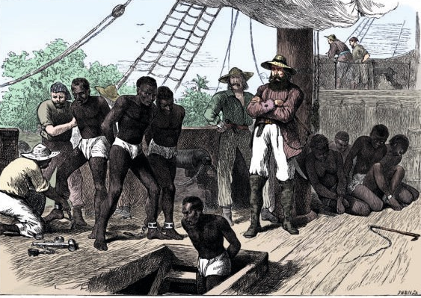
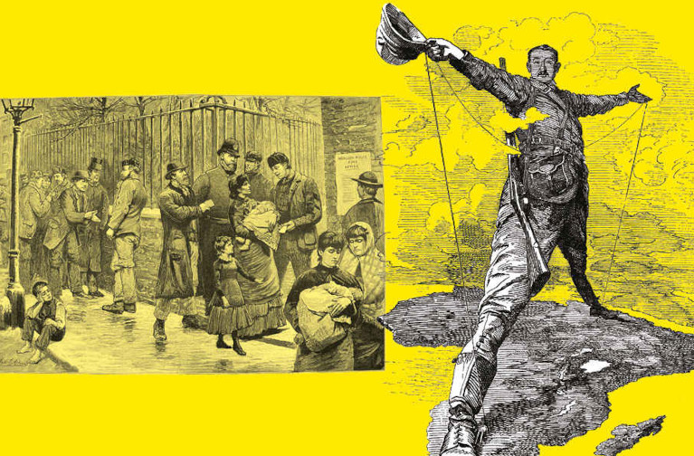
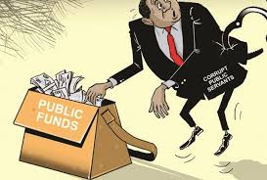
CHALLENGES
Faced with structural challenges: have roots, translate into other multiple challenges and barrier to Africa’s development
Historical legacies: often downplayed but experienced slavery, colonialism and massive dispossession
Systemic problems: faced with an unfair global financial architecture
The governance problem: – have not been able to organise self
Sources of the multiple structural problems and challenges: weak economic diversification, infrastructure and human resource deficits, extreme poverty, climate change etc
Debt and development financing lens: orchestrates interwoven challenges

Slide 3
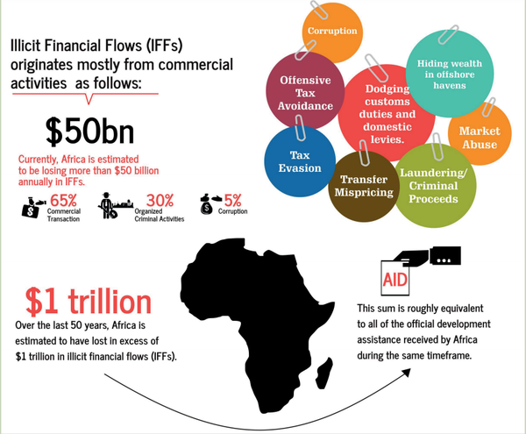
CHALLENGES
Economic injustice and exploitation
Unfair global financial architecture
Illicit financial flows and low tax base
Resource capture – mineral wealth
Climate injustice
Trade barriers – tariff barriers
Poverty & Inequalities
Debt, economic and financial haemorrhage
The bleeding of the African
Source: The Habari Network

Slide 4
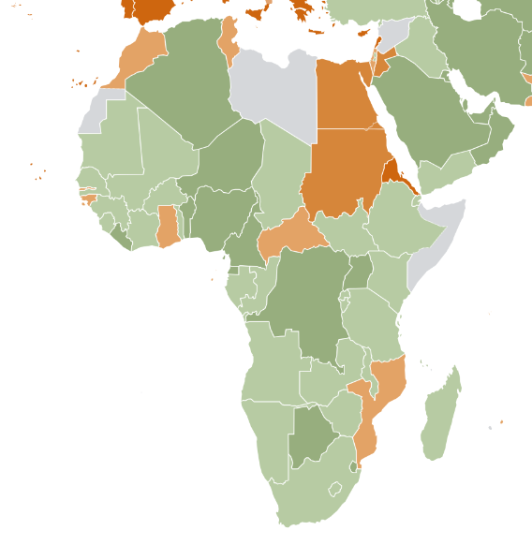
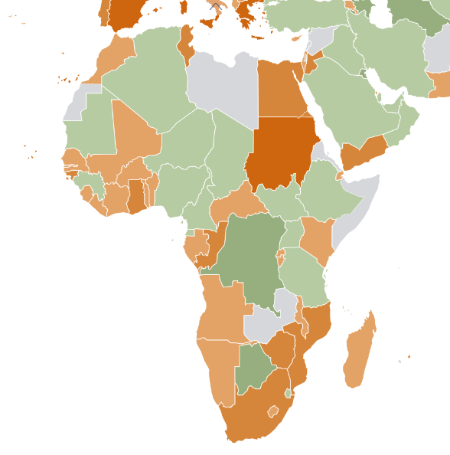
CHALLENGES
Heavy debt burdens
more expensive for developing countries to borrow money
costly loans is a structural impediment to permanently eradicating poverty
debt payments are a consistent source of financial outflows
unequal power relations: rules governing debt and borrowing dominated by the global north
huge development financing gap for SDGs and national development plans
close an annual financing gap of about US$402 billion between now and 2030 to fast-track its structural transformation
2014
2024
General government gross debt as percent of GDP
Source: IMF WEO Datamapper

Slide 5
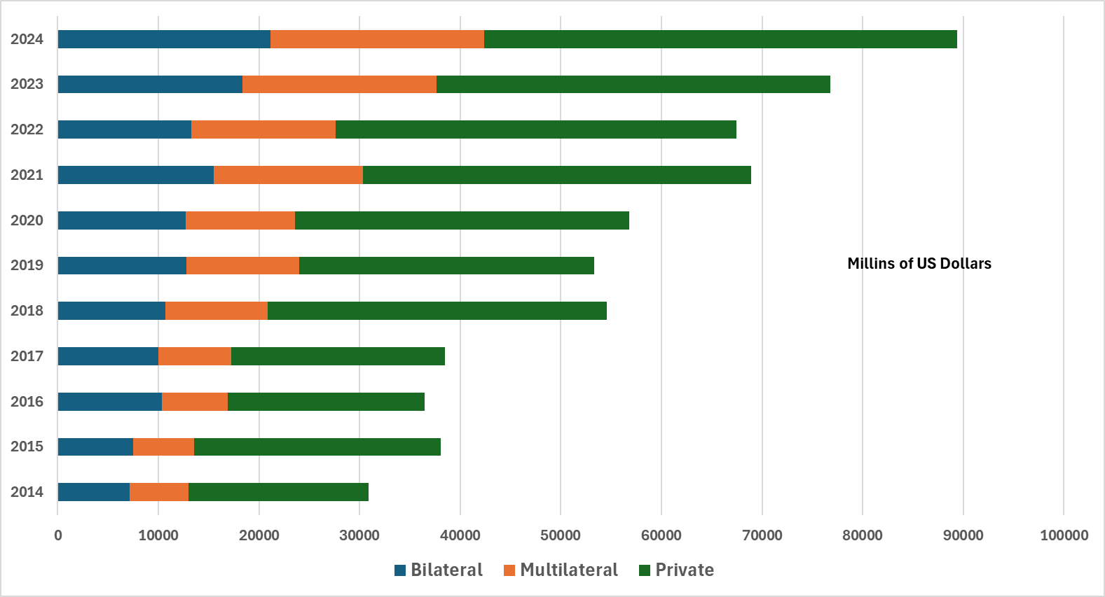
CHALLENGES
Heavy debt burdens
Revenue, % GDP consistently downward trends since 2011 with record amounts for debt service
About 53% of budget revenues in Africa go for debt payment – above 38 % for global south
This depicts widening financing gaps for development needs in African countries
SOURCE: AFRODAD, from International Debt Statistics, 2023
Source: adapted from AfDB &ADI reports

Slide 6
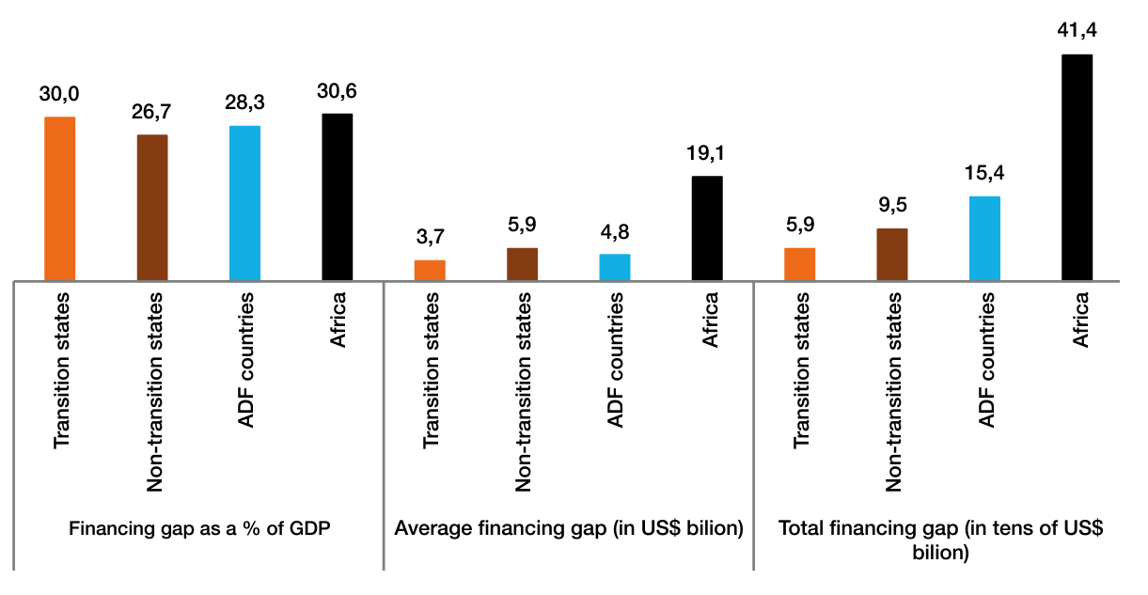
CHALLENGES
Heavy debt burdens
Development financing gaps are bigger for Africa compared to other regions and groups
Source: AfDB &ADI report,

Slide 7
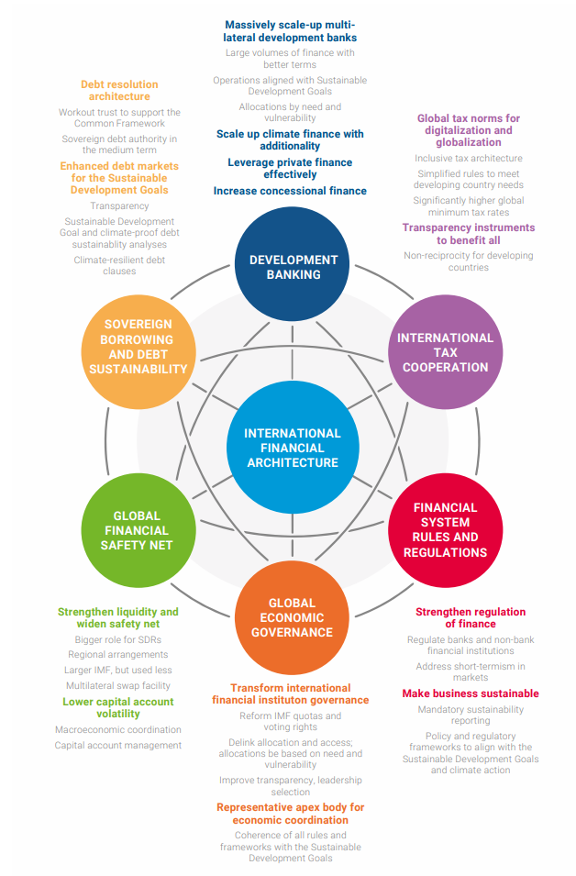
CHALLENGES
Global Financial Architecture
Essentially extractivist
Unfavourable terms of lending / high-interest rates
Illicit financial flows
Inherently unfair to African countries
Built on colonial legacies
Does not reflect current needs and challenges
Limited access to finance
Unfavourable trade terms
Weak voice and representation
Source of main structural problems and poverty and inequalities
Source: Diplo

Slide 8
CHALLENGES
Weak governance and political fragmentation
Orchestrate and exacerbate existing problems and challenges
Unsustainable debt burdens
Weak domestic resource mobilisation
Illicit financial flows
Inefficient tax policies
Weak industrial policies
Unfavourable global financial architecture
Increased external dependence and vulnerabilities
Poor infrastructure
Weak institutions & the rule of law
Lack of parliaments and oversight bodies
Inadequate regulatory framework and poor legal systems
Lack of transparency and accountability
Pervasive corruption
Limited citizen participation
Weak coordination with the global financial architecture
Weak structural transformation
Root cause of underdevelopment

Slide 9
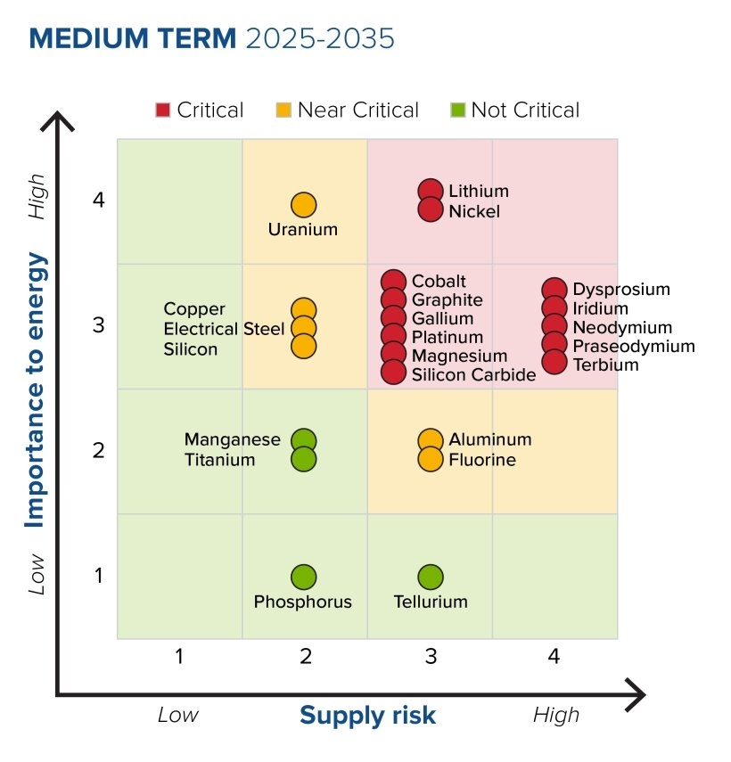
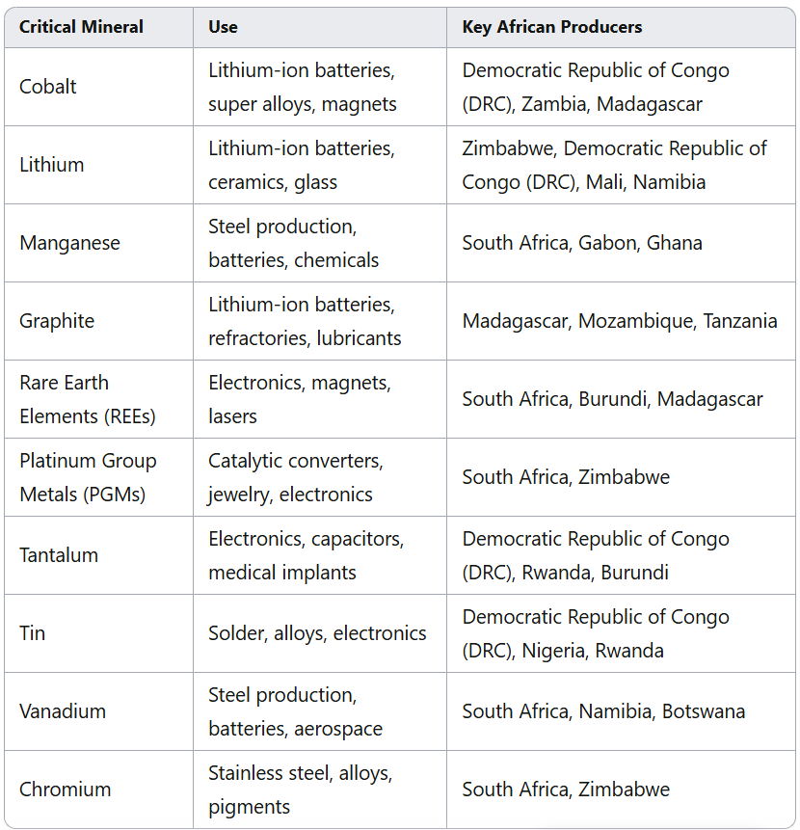
OPPORTUNITIES
Strengthening Domestic Resource Mobilization:
Tax Reforms: Implementing progressive tax systems, closing tax loopholes, and improving tax administration can generate more domestic revenue
Leveraging critical minerals, other natural resources and industrialisation: transparent and accountable management can create sustainable revenue streams
Diversification and deepening the tax bas
Spur economic growth and development
Avoiding experiences of fossil fuel age
Source: Energy.gov
Source: based on US Geological Survey

Slide 10
OPPORTUNITIES
Leadership in global and regional spaces
Shaping policy dialogue, narratives and outcomes – tax cooperation & FFD
G20 and Africa – increasing recognition
BRICS and Africa and changing multipolar world
Demographics – building on this dividend
Increased markets, labour force and manpower
Need investing in human capital
African Union institutions and their blueprints – political will required
Coordinated African approach
Promoting regional integration and trade
Leveraging development cooperation and partnerships
Development finance institutions
Success strongly reliant in reforming the global financial architecture

Slide 11
AFRODAD’s WORK & INFF
About AFRODAD
Pan-African Civil Society organisation
Development finance in Africa
Debt at the core of work
Development Finance
Sustainable public debt management
Domestic Resource mobilisation
International Public and Private Finance
Legal Analysis and Advocacy on Debt
Strategy
Convenings – capacity building and policy dialogue
Research and advocacy – national, regional and global policy spaces
Partnership and coordination with key stakeholder
Results thus far
Momentum on unsustainable debt preserved
Policy cooperation and policy dialogue
Increased awareness on risks and opportunities on debt issues

Slide 12

Thank You

