Slide 1


Macroeconomic Outlook, Challenges and Opportunities for Domestic Public Resource Mobilization
United Nations Economic Commission for Africa
Gamal Ibrahim, Chief, Macroeconomic Analysis, Institutions and Economic Governance, Macroeconomics, Finance, Governance & Planning Division. ECA
June 2026.

Slide 2
Africa's Economic Outlook
1
Resilient Growth
2
Key Drivers
Besides geo-political risks, growth remains constrained by high public debt, rising borrowing costs, and global economic uncertainty.
Growth is supported by public investment, infrastructure expansion, and improving trade dynamics.
Growth remains resilient, projected at ~4.0% in 2026, and averaging ~4.1% over 2025-2027.
3
Downward Revision
4
Easing Inflation
Due to the war in the Middle East, Africa's growth may be reduced by 2 percentage points in 2026 if the conflict exceeds 6 months.
Inflation is expected to decline from 11.3% in 2025 to about 8.2% by 2027, though some countries feel effects from the Middle East conflict.

Slide 3
Slow Structural Transformation and Its Consequences
Stagnant Manufacturing:
Service Sector Dominance
Structural transformation is sluggish, with manufacturing contributing only ~10-11% of GDP.
Traditional services continue to dominate Africa's sectoral growth, limiting diversification.
Economic Governance and Institutions: Weak public institutions, fragmented policy implementation, and governance gaps continue to constrain productive investment.
Low levels of Industrialization and Value Addition: Policies on critical minerals value chains, local processing and beneficiation still lag behind.
Energy Transition Challenges
Vulnerability Assessment: Complement GDP with more inclusive measures that capture employment, resilience & environmental sustainability.
Global energy transition creates new opportunities but also exposes Africa to financing, technology and infrastructure gaps that could limit participation in emerging green value chains.

Slide 4
Investment Constraints and Resource Mobilization Challenges
Africa has a relatively low tax-to-GDP ratio, averaging 16.1% in 2023. This is below Asia-Pacific (19.6%), Latin America (21.3%), and the OECD (33.9%).
Global official development assistance (ODA) is declining. Africa's share of total global ODA dropped from 35.5% in 2015 to 26.4% in 2024.
Recent global shocks, high borrowing costs, and currency depreciation have worsened debt vulnerabilities.
A large number of African countries are now in or at high risk of debt distress, with rising debt service obligations crowding out public spending on critical sectors like health and education.
The cost of capital in Africa (11.9% bond yield in 2023) is significantly higher than in other regions like the EU (5.7%) and Asia (5.4%), constraining investment.

Slide 5
ECA's Support for Domestic Public Resource Mobilization
Domestic Resource Mobilization (DRM)
Debt Management
INFFs: continental programe plus Zambia (DRM manual) and Burkina Faso (Diagnosis and evaluation of financing for development)
Trained 12 countries on tax expenditures.
Supported countries in improving debt governance frameworks using an ECA benchmarking approach.
Addressed illicit financial flows (IFFs) like profit shifting and trade misinvoicing in 14 countries, with ongoing training via IDEP.
Designing technical training materials to enhance peer learning on debt management.
Climate-Resilient Development
Macroeconomic Policy Analysis
Strengthened the capacity of Small Island Developing States (SIDS) to design and implement sustainable financing strategies.
Built capacity in macroeconomic modelling, forecasting, and policy simulation to aid policy formulation (e.g., in Botswana).
Led roadmap development for financial strategies in Cabo Verde and Comoros.

Slide 6
Impact Story: Strengthening Tax Expenditure Governance
12 countries utilized ECA's methodology to measure tax expenditure, including Angola, Burkina Faso, Cameroon, Chad, Cote d'Ivoire, Ghana, Kenya, Mauritius, Morocco, Namibia, Senegal, and South Africa.
Follow-up work in Benin and Zambia resulted in agreed national action plans.
Ethiopia produced a national tax expenditure report, influencing tax incentive policy reform and the publication of the Ethiopia Investment Directive 1064/2025.
In January 2026, ECA and the Ethiopian Ministry of Finance held a sub-national workshop with 51 participants from federal and regional bodies to review draft incentive regulations and strengthen governance.

Slide 7
Impact Story: Tackling Profit Shifting with Data-Driven Methods
ECA's methodology for risk assessment has enabled countries to better target transfer pricing audits and recover potential tax revenue losses.
Kenya: Targeted Audits
Uganda: Improved Allocation
Policy Impact
Identified 4.8% of multinational enterprises as high-risk, with just four firms accounting for over 50% of estimated potential tax revenue losses.
ECA's support informed Kenya's Draft Income Tax Regulations for 2025, strengthening the country's international tax framework.
Identified ~6% of multinational enterprises as high-risk, with four firms responsible for over 80% of estimated potential tax revenue losses.

Slide 8
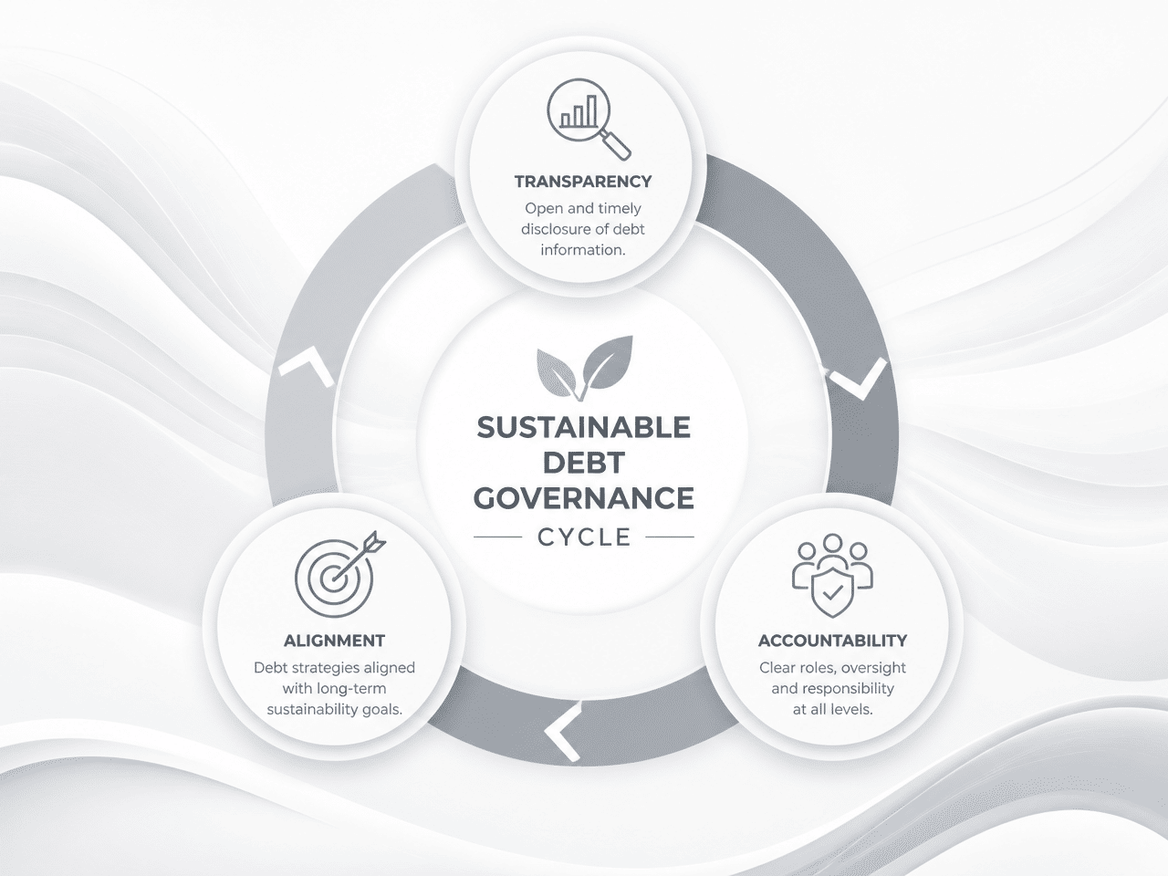
Strengthening Debt Governance and Management
Developed the Sustainable Debt Governance Cycle and Debt Sustainability Index via the Economic Governance' reportIII.
Assessed debt governance in six countries (Cameroon, Comoros, Egypt, Ghana, Rwanda, Zambia) to identify policy gaps.
Recommended reforms to strengthen debt management offices, strategies, and institutional coordination.
Supported country-specific roadmaps to improve transparency, accountability, and alignment with national priorities.
Provided practical policy recommendations for sustainable public debt management across Africa.

Slide 9
Capacity Building in Macroeconomic Analysis
Botswana: Forecasting and Policy Simulation
Developed a macroeconomic model for the Ministry of Finance.
Provided capacity building training for model customization, updating, and simulation.
Supported the Ministry in preparing for bilateral meetings with the IMF and World Bank with economic analysis and forecasts.
Pan-African: Machine Learning (ML) for Policymakers
Organized a workshop to demonstrate the effectiveness of ML in macroeconomic forecasting.
Raised awareness and fostered collaboration on economic modeling and ML among policymakers.

Slide 10
Strengthening Africa's Voice in Global Economic Governance
Financing for Development (FfD4)
In partnership with the African Union Commission, supported negotiators to inform Africa's Common Position and incorporate priorities into the Sevilla Commitment.
Operationalizing the Sevilla Commitment
Co-organized the Africa Regional Consultation to help member states translate global commitments into national and regional actions.
United Nations Tax Convention
Supported negotiators with studies and briefs to strengthen Africa's common positions on international tax cooperation.
Regional Coordination
Worked with the AUC, ATAF, TJNA, and member states for a coherent African position on tax, debt, and financial architecture reform.

Slide 11

Key Takeaways & Policy Recommendations
To navigate the complex economic landscape and unlock its potential, African countries must focus on strategic interventions to enhance domestic resource mobilization and governance.
Strengthen Global Voice
Improve Debt & Tax Governance
Boost Domestic Resource Mobilization
Drive Structural Transformation
This involves strengthening tax systems, improving debt management, building analytical capacity, and advocating for a more equitable global financial architecture.

Slide 12
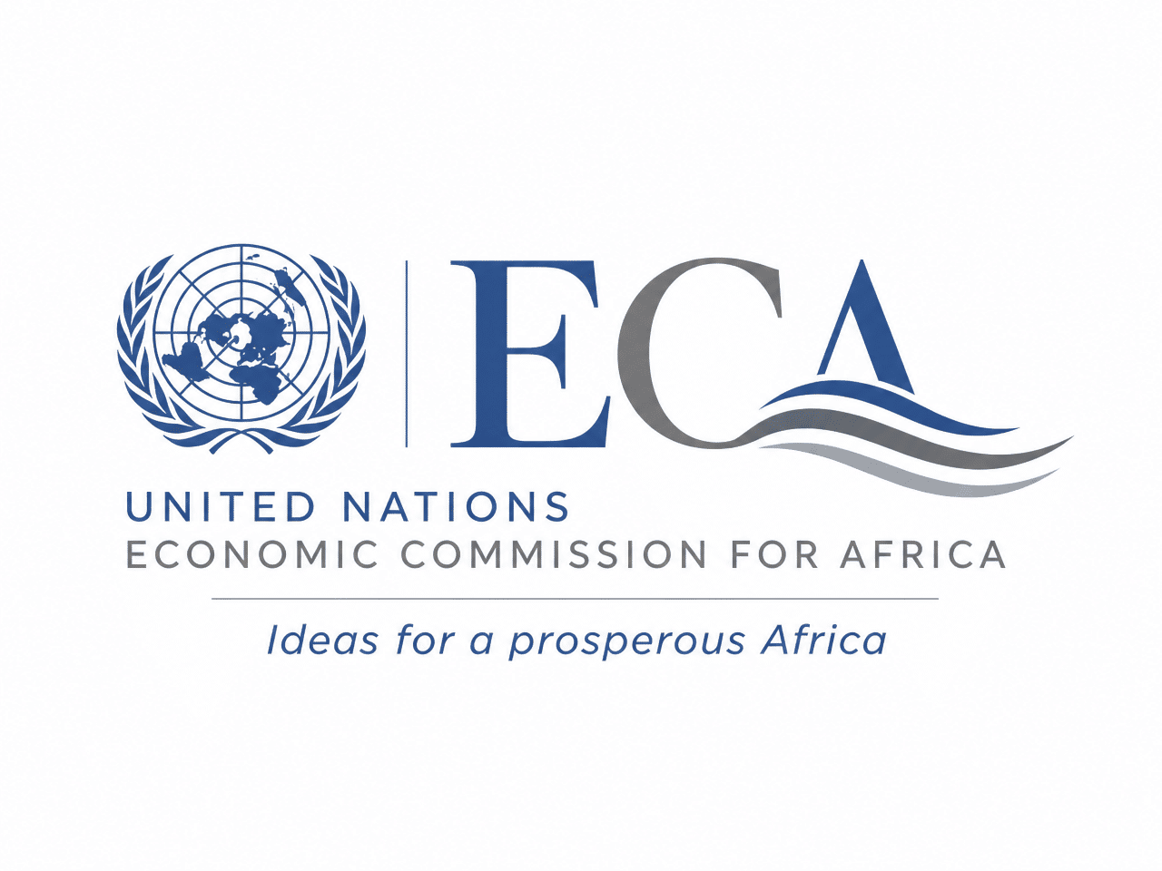
Thank You
United Nations Economic Commission for Africa

