Slide 1
Issues and challenges of financing for sustainable development in Africa: priorities for Africa for the FfD4 in 2025 (Agenda item 3) Presented by Zuzana Schwidrowski Director Macroeconomics, Finance and Governance Division 16 November 2024

Slide 2
A glimpse into the prevailing macroeconomic status
Recent global shocks including the Covid-19 pandemic, the Russia-Ukraine war and climate threats have worsened the already constrained and fragile Africa’s financing landscape
Progress gap between the current status and the target of Agenda 2030 is huge
Millions of people are deprived of the basic necessities of a quality life
Growth in Africa remains below the average recorded prior to the COVID-19 pandemic with low quality which is insufficient to meet the SDGs and Agenda 2063 targets
The average tax-to-GDP ratio in Africa is still below the pre-pandemic level of 15.8%
Fiscal deficits remains above their pre-pandemic levels and are projected to reach 5.0% of GDP in 2024
Public debt reached 67.3% of GDP in 2024. As of April 2024, 7 African countries were in external debt distress, and at a high risk of debt distress.

Slide 3
Size of the Africa’s SDG financing gap
An upcoming ECA study found that total SDG financing needs for all 54 African countries in 2030 range from 1.7 to 21 trillion USD
Based on projections of GDP, expenditure, and population, the analysis shows that Africa will require an additional 670 to 760 billion USD in 2030 to meet the lower-bound investment need of 1.7 trillion USD or 12% to 17% of the continent's projected GDP for 2030
Even under optimistic domestic growth scenarios, 35 countries will still fall short of meeting the SDG investment requirement by 2030
Meanwhile, development aid to Africa declined from 33.6% in 2021 to 25.6% of total aid in 2022
Moreover, there is low DRM potential: low tax to GDP ratio, a low tax base, high debt, low savings and investment, and a high prevalence of IFFs
At the same time, continued multifaceted global crisis in coming years implies a continued need for various fiscal support measures.
Notes:
An upcoming ECA study found that the total SDG financing needs for all 54 African countries in 2030 range from 1.7 to 21 trillion USD, depending on the level of ambition, such as high, medium and low achievement levels. This study focuses on the lower-bound estimate of 1.7 trillion USD for further gap analysis, as this level of investment can already drive significant progress toward the SDGs. Based on projections of GDP, expenditure, and population, the analysis shows that Africa will require an additional 670 to 760 billion USD in 2030 to meet this lower-bound investment need. In relative terms, this represents about 12% to 17% of the continent's projected GDP for 2030. Even under optimistic domestic growth scenarios, 35 countries will still fall short of meeting the SDG investment requirement by 2030.

Slide 4
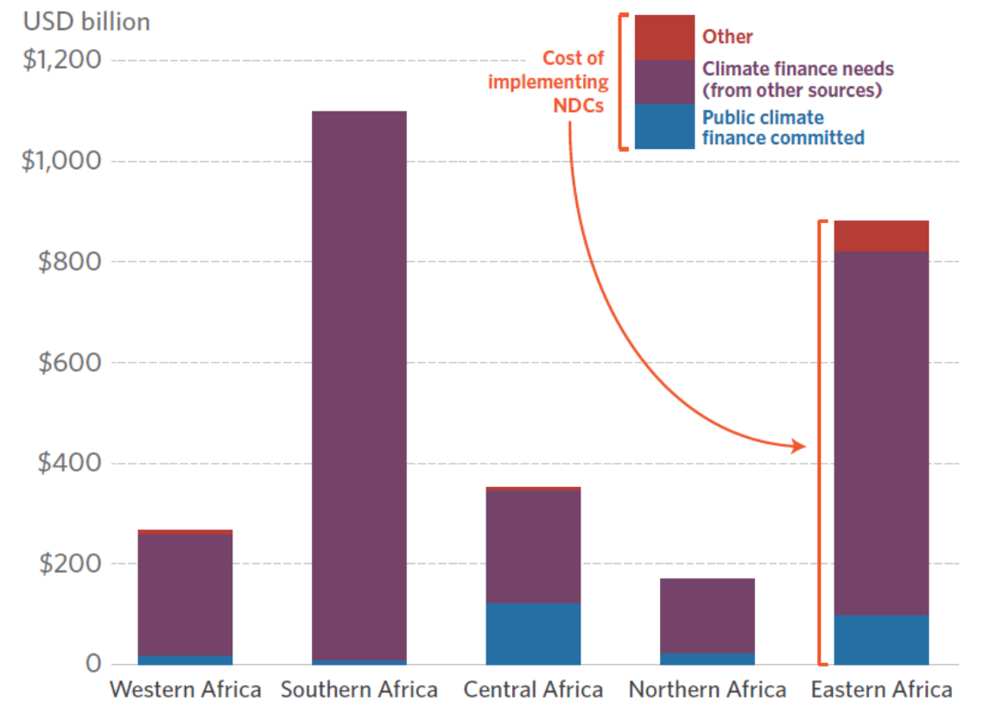
Concomitantly, Africa’s climate financing needs are growing and continue to be severely underfunded
About US$3 trillion USD is needed to implement NDCs in Africa
Financing gap of US$250 billion per year remains
10% of Africa’s 2022 GDP needs to be mobilized above and beyond current flows every year until 2030
Africa’s estimated costs to implement NDCs (2020 – 2030) vary by sub-regions
Source: Climate Policy Initiative, 2022.

Slide 5
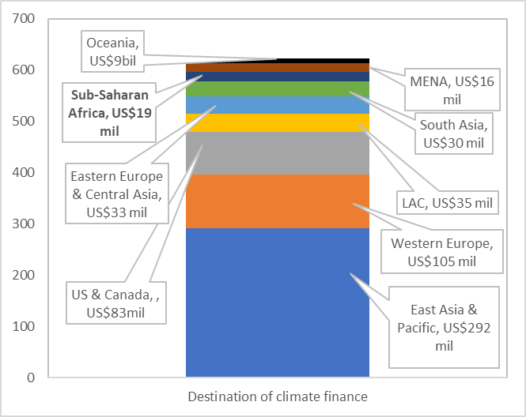
Geographic distribution of climate financing is greatly unequal
Regional breakdown of total climate finance, 2019-20 average
(US$ millions)
Global: green bond issuance,
3-year average
(percent)
Source: Climate Bonds

Slide 6
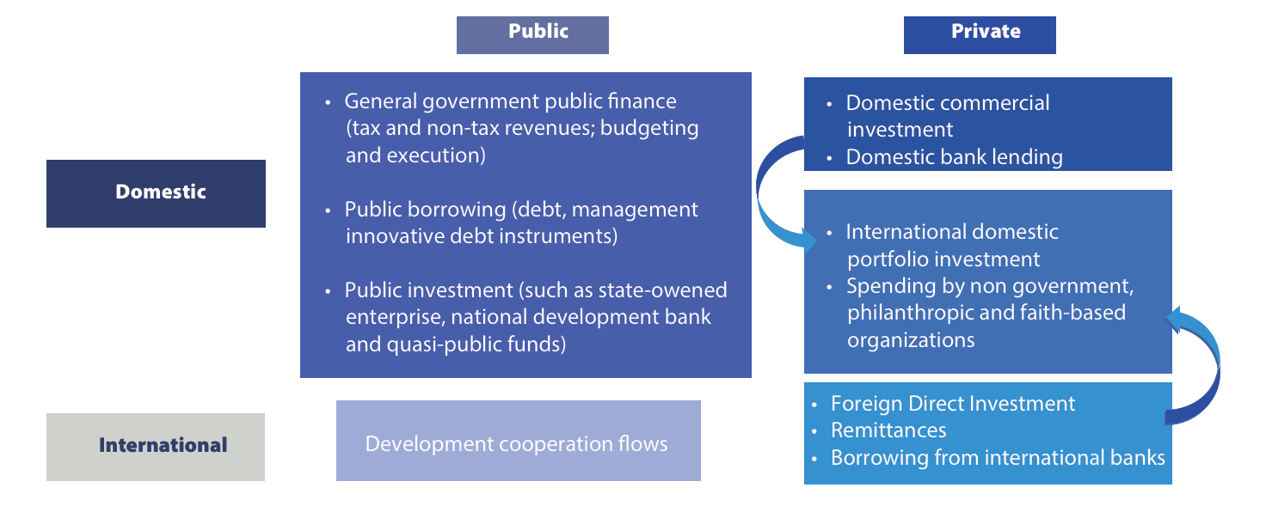
Potential sources of financing for the SDGs
Source: ECA, 2024
We need to tap into DRM efforts while ensuring a reform in the GFA

Slide 7
Enhanced DRM for sustainable financing for development in Africa
Broadening the tax base and improving the efficiency and effectiveness of the current system
Strengthening institutional capacity by improving the design of core domestic taxes, including carbon taxation for reducing emissions and promoting a green transition
African Governments need to revisit tax expenditures to examine the costs and benefits of the associated tax incentive provisions against the intended objectives
Digitalizing tax collection systems and taxing the digital economy
A strong political commitment and a whole-of-system approach to curb IFFs
An effective debt management framework to prevent deviation, leakages and inefficiencies in the use of debt
Deepening of African domestic financial market is warranted.

Slide 8
Scaling up development finance - Africa needs fair share of SDRs
In 2021, the IMF injected $650 billion - in SDRs - into the global economy. The 54 countries of the African continent received $33 billion. By contrast, the seven largest economies of the world, the G7, received $277 billion.

Slide 9
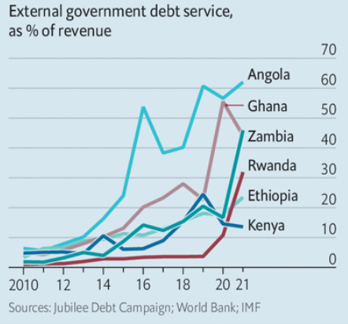
Debt restructuring mechanism beyond DSSI extension – Reform of G20 Common Framework
The DSSI lacked the required enforcement mechanisms that could ensure equitable treatment across creditor types in debt relief
A comprehensive debt restructuring including the private sector and multilateral creditors – with creditor parties accepting losses on equitable terms – could enhance countries’ credit profiles
Debt relief that goes beyond DSSI & the Common Framework and includes MICs is needed for sustainable recovery and equity.

Slide 10
Global financial architecture reforms for sustainable development in Africa
Begin negotiations under the UNTC Framework Convention with all States members of Africa for fair taxing rights
Call upon the Africa high-level working group for the global financial architecture reform to serve the interests of Africa
Enhance the Common Framework's effectiveness and promote equitable and timely debt restructuring
Scale up development finance for Africa to a level where sustainable development can be attained
Enhance the representation of Africa, by ensuring the improved governance of the international financial institutions
Revitalization of the Group of 20 Debt Service Suspension Initiative
Debt for climate swaps and other innovative tools.

Slide 11
What should different stakeholders do
African Government
At national level
At regional and global levels
International Community
At national level
At regional and global levels
Pan African Institutions
At regional and global levels

Slide 12
THANK YOU!

