Slide 1


Africa’s Youth Employment Challenge –
Good Practices in Youth Employment
Notes:
Suggested opener: frame this as a short synthesis of the draft report. The main message is that Africa's youth jobs challenge is large, persistent, and increasingly urgent - and the evidence points to demand-led, integrated, scalable interventions rather than stand-alone training programmes.
[Sources]
- Attached report, cover page and overall framing (page 1).

Slide 2
1. Youth Bulge and Labor Market Pressures

Slide 3
Population growth (total) by global regions 1990-2023

Slide 4
Africa’s youth bulge – labor market pressure & opportunity
Youth Bulge
Africa’s population, by age (mln)
~60% of population under age 25
~ Median age ≈ 19 years
Each age cohort (15 – 35) includes tens of millions,
But only 3 mln formal jobs created each year
→ Massive & growing pressure on labor market
By 2030, half of all new entrants into the global labor force will come from Africa.
Youth population set to double by 2063

Slide 5
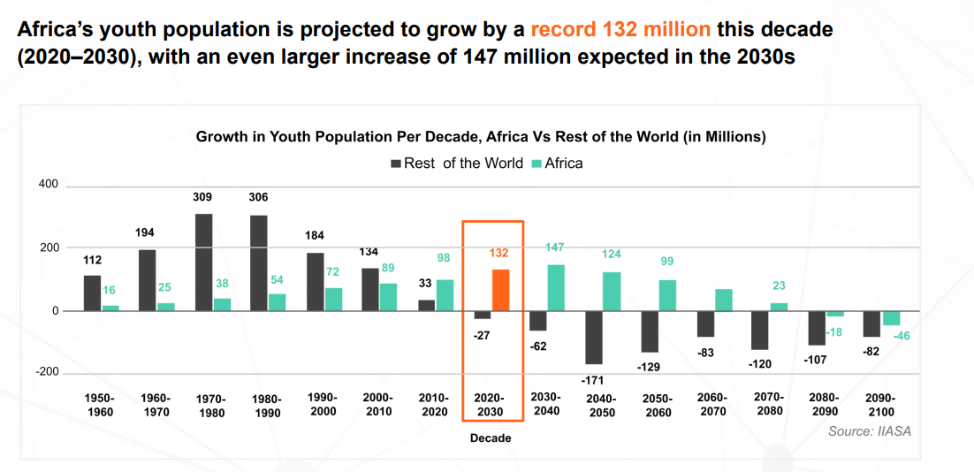
Source: UNPD.

Slide 6
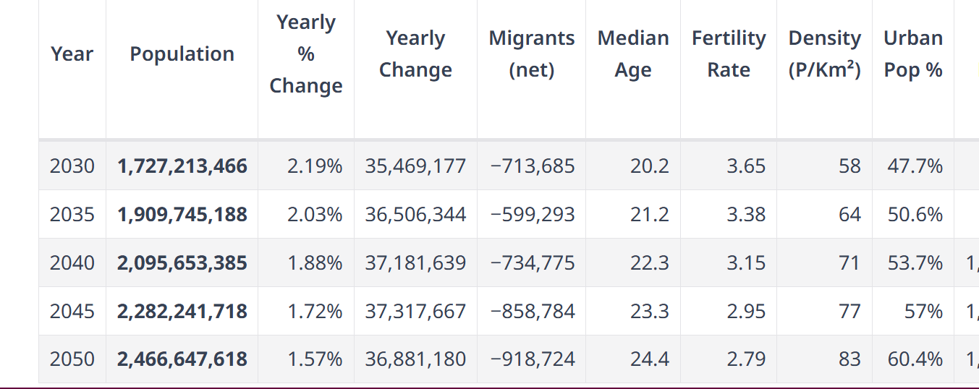
Africa’s fertility rate projected to remain above the replacement rate
Source: UNPD.

Slide 7
The labour-market challenge is broad and uneven
CURRENT CONTEXT
Total and youth employment (% of LF), 2024
Youth joblessness is consistently above overall unemployment in most countries.
Southern Africa is the epicentre: South Africa is about 60.9% and Eswatini 58.2%.
Very low official rates in some countries often reflect informal survival activity, not abundant decent work.
Policy cannot treat “employment” as equivalent to decent or productive work. The quality of labour-market insertion matters.
Source: Oxford Economics Africa / ECA draft report
3
Notes:
Talking point: the problem is not uniform across the continent, but the pattern is clear - young people struggle more than the general population to secure work, and “good” low rates often mask informality rather than decent jobs.
[Sources]
- Attached report, unemployment / underemployment / informality discussion and Figure 1 (page 4).
- Asset used: chart cropped from page 4.

Slide 8
Gender gaps and demographic pressure raise the stakes
URGENCY
Youth employment by gender (% of LF), 2024
Young women are consistently more likely to be NEET or unemployed.
Examples : Morocco female NEET ~51% vs male 15%; Nigeria 18% vs 9%.
Future pressure on the labour market
By 2035
the continent adds more workforce entrants per year than the rest of the world combined.
Urban population
is set to double by 2050.
Source: Oxford Economics Africa / ECA draft report
4
Notes:
Talking point: the jobs challenge is also an inclusion challenge. Young women face systematically higher exclusion, and demographic growth plus urbanisation mean the window for effective policy is narrowing.
[Sources]
- Attached report, gender dimensions and Figure 2 (pages 5-6).
- Attached report, demographic / urbanisation outlook (pages 6-7).
- Asset used: gender chart cropped from page 5.

Slide 9
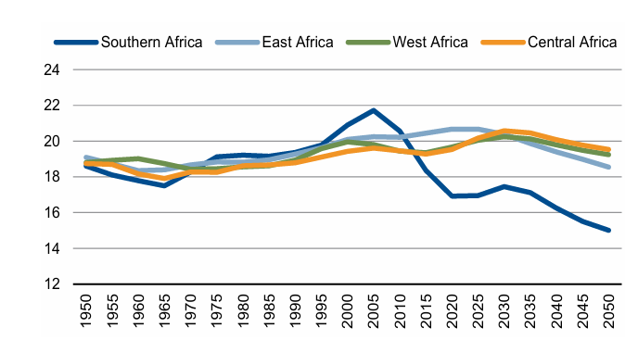
In some Africa’s regions, the window for demographic dividend is narrowing
Youth in total population in Africa’s regions, %
Source: UNPD.

Slide 10
2. Youth Employment Bottlenecks
– Some of the Main Causes

Slide 11
Labor Market Pressures – Risk of the Youth Employment Crisis
A growing labor market mismatch
Growth has not created enough decent jobs
Youth face unemployment or informality
Core issue is limited structural transformation
Informality often means low quality employment
Failed structural transformation →not enough quality jobs
Low productivity and earnings
Lack of social protection
High vulnerability to shocks

Slide 12
Root Cause: Weak Structural Transformation
Economies not shifting to high-productivity sectors
Growth driven by extractives & low-value services
Limited industrialization
Dual economy: small formal vs large informal
What Needs to Change
From informality → productive employment
Leverage technology for job creation
Invest in skills (digital & vocational)
Support transition to formal, higher-value jobs

Slide 13
What Needs to Change (cont.)
- Target sectors with high growth and high-job multipliers on the continent i.e. agriculture, technology, creative industries
- Promote industrialization - agribusiness, manufacturing, technology to support job creation with strong absorptive potential
- Strengthen the development of growth-oriented entrepreneurship ecosystems in Africa
- Align education to the labour market’s needs and strengthen vocational training in countries

Slide 14
3. What Can Be Done? What to Avoid?

Slide 15
Typology of Interventions

Slide 16
Why have so many youth initiatives underperformed?
Cross-cutting patterns in the evidence
Too much emphasis on labour supply alone
Weak coordination across ministries, agencies, and partners
Poor monitoring, evaluation, and accountability
Funding instability and limited institutional capacity
Political capture, duplication, and misalignment with market needs
Design lesson: stand-alone training schemes rarely solve jobs problem on their own.
Source: Oxford Economics Africa / ECA draft report
5
Notes:
Talking point: previous public interventions often suffered from the same weaknesses - fragmentation, weak execution, and an over-focus on training without enough attention to actual job creation. The country examples on the map make that message concrete.
[Sources]
- Attached report, evidence from previous reviews and discussion of challenges (pages 11-12).
- Asset used: constraints-and-challenges infographic cropped from page 12.

Slide 17
Youth employment initiatives in South Africa have underperformed due to:
structural economic issues leading to declining real GPD per capita
poor education quality, and
weak implementation of programs. Chronic low economic growth,
a severe skills mismatch,
limited entrepreneurship support, and lack of accountability in government initiatives
Source: Zikhali and Matsiliza, An evaluation of the Presidential Youth Employment Initiative in addressing youth unemployment
Country Experiences – South Africa

Slide 18
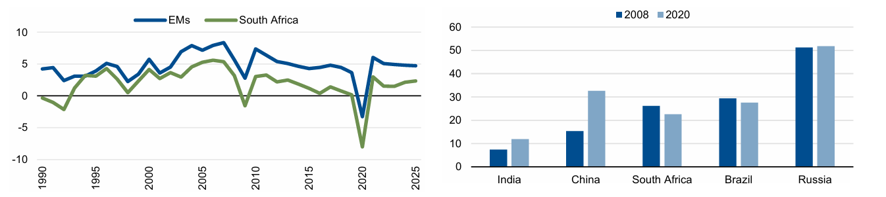
South Africa’s Low Growth Challenge – Decline in GDP per Capita
Real GDP growth in South Africa and other emerging markets (EMs), annual, %
GDP per capita (constant PPP) in BRICS relative to G7 countries, %, equal = 100

Slide 19
Youth employment initiatives in Ghana have underperformed due to:
significant skills mismatch between education outcomes & industry needs,
chronic funding constraints, and
political interference.
programs often suffer from poor implementation, lack of monitoring,
excessive focus on temporary public sector jobs rather than sustainable private sector opportunities.
Source: ACET, 2024
Country Experiences - Ghana

Slide 20
Pan-African youth employment initiatives underperformed due to:
Weak Job Creation (Demand-Side Failure – Missing Jobs)
Focus on Supply-Side Reforms
Skills Mismatches
Limited Access to Finance by Young Entrepreneurs
Implementation and Monitoring Gaps
Sources: Sumberg et al., 2020; Morsy and Mukasa, 2019.
Pan-African Experiences

Slide 21
3. What has Worked?

Slide 22
Supply-side employability
Demand-side job creation
Entrepreneurship support
Matching / school-to-work transition
Enabling environment
Good-practice interventions typically combine multiple levers
Five pillars
Good practice is usually a bundle, not a single instrument.
Examples pair training with internships, mentorship, finance, or employer links.
Source: Oxford Economics Africa / ECA draft report
6
Notes:
Talking point: this figure is a helpful pivot slide. It shows that the report is not arguing for one magic programme type. Instead, it organises interventions into complementary channels and emphasises that the strongest initiatives address multiple constraints at once.
[Sources]
- Attached report, typology of youth employment and entrepreneurship interventions (pages 9-10).
- Asset used: typology figure cropped from page 10.

Slide 23
Country Examples - Rwanda

Slide 24
Key successful elements of the YES initiative include:
Country Examples - South Africa
The Youth Employment Service (YES) has successfully created over 190,000+ jobs by partnering with private businesses to offer 12-month, paid work experiences
Key Success Factors:
Quality Work Experience (QWE): Besides training, the program provides 12-month, fixed-term, paid work contracts
Private-Sector Led & Funded: The initiative functions without state funding, utilizing corporate funding
Host Partnerships: If companies cannot hire directly, they can place youth in smaller, companies or partner organizations
Focus on High-Multiplier Areas: Jobs are created in areas with significant social impact, such as community health, education (reading champions), and environmental protection (rhino protection).
B-BBEE Incentives: Focus on structural transformation and inclusiveness which encourages large-scale corporate engagement.
Digital Integration: The program utilizes mobile technology which keeps youth connected and trained during the program.
Source: RSA Presidency

Slide 25
5. Practical Diagnostics

Slide 26
A practical diagnostic too for youth employment success
Three layers
Necessary foundations: Real demand, a credible transition path, multi-barrier support, and basic delivery capacity.
Performance enhancers: Employer integration, entrepreneurship enablement, matching, mentorship, inclusion, and learning.
Sustainability catalysts: Institutional anchoring, viable financing, ecosystem contribution, and replicability.
Source: Oxford Economics Africa / ECA draft report
7
Notes:
Talking point: if you need one framework for the audience to remember, use this slide. It turns the report into an assessment checklist: are we linked to real demand, do we solve multiple barriers, can the model last, and is there evidence it can scale?
[Sources]
- Attached report, job creation diagnostic text and Figure 6 (pages 17-19).
- Asset used: diagnostic figure cropped from page 18.

Slide 27
A practical diagnostic tool for youth employment success

Slide 28
Case studies show different strengths - and different failure risks
Different models can work - but each succeeds or fails for identifiable reasons that the diagnostic helps identify.
Harambee: strong matching and employer integration (job placement + training); weaker financing sustainability.
Ajira Digital: good implementation reach and inclusion (online freelance skills); weaker transition to stable income.
N-Power: strong state anchoring and scale (jobs + stipends + public service); weaker path from temporary placement to lasting jobs.
Source: Oxford Economics Africa / ECA draft report
8
Notes:
Talking point: the case studies are useful because they show the framework in practice. These three examples are easy to explain: one strong on matching, one strong on inclusion and reach, one strong on anchoring and scale - each with a different weakness that limits long-term impact.
[Sources]
- Attached report, analytical case studies and page 21 assessments for Harambee, Ajira Digital, and N-Power (pages 20-21).
- Assets used: case-study crops from page 21.

Slide 29
6. Policy Implications

Slide 30
Policy priorities
RECOMMENDATIONS
Put labour-market demand at the centre.
Deliver integrated packages, not stand-alone interventions.
Build implementation capacity and accountability before scaling.
Make inclusion an explicit design requirement.
Africa does not only need more youth programmes; it needs programmes that are demand-led, bundled, measurable, and built to last.
Source: Oxford Economics Africa / ECA draft report
9
Notes:
Talking point: end with the policy translation. The recommendations are straightforward and memorable: start from labour demand, bundle services, invest in delivery systems and accountability, and design for inclusion from the outset.
[Sources]
- Attached report, policy recommendations (pages 22-24).
- Assets used: diagnostic-factor strips cropped from pages 22, 23, and 24.

Slide 31
Three key messages
EXECUTIVE SUMMARY
1. Youth unemployment is a scale problem and also a job-quality and informality problem.
2. Programmes work best when they start from real labour demand and bundle multiple supports.
3. The priority is not more projects - it is better-designed, better-coordinated, more durable ones.
Why now
By 2035 more young Africans will enter the workforce each year than in the rest of the world combined.
Source: Oxford Economics Africa / ECA draft report
2
Notes:
Talking point: open with three messages. First, the challenge is about unemployment, underemployment and informality - not only headline joblessness. Second, the literature points to integrated, demand-led models. Third, the report's own diagnostic turns those lessons into a practical framework.
[Sources]
- Attached report, context and future pressures (pages 4-7).
- Attached report, best-practice evidence and diagnostic framing (pages 13-18).
- Asset used: diagnostic figure cropped from page 18.

Slide 32
Thank you.

