Slide 1

Economic Governance Report-III
Assessment of Institutional Governance of Public Debt in Africa
COM2026-Side Event on “Leveraging Data and Technology to Strengthen Domestic Resource Mobilization and Debt Governance in Africa”, March, 31ST 2026
By: Gamal Ibrahim,
Chief, Macroeconomic Analysis, Institutions and Economic Governance Section, MFGD, UNECA

Slide 2
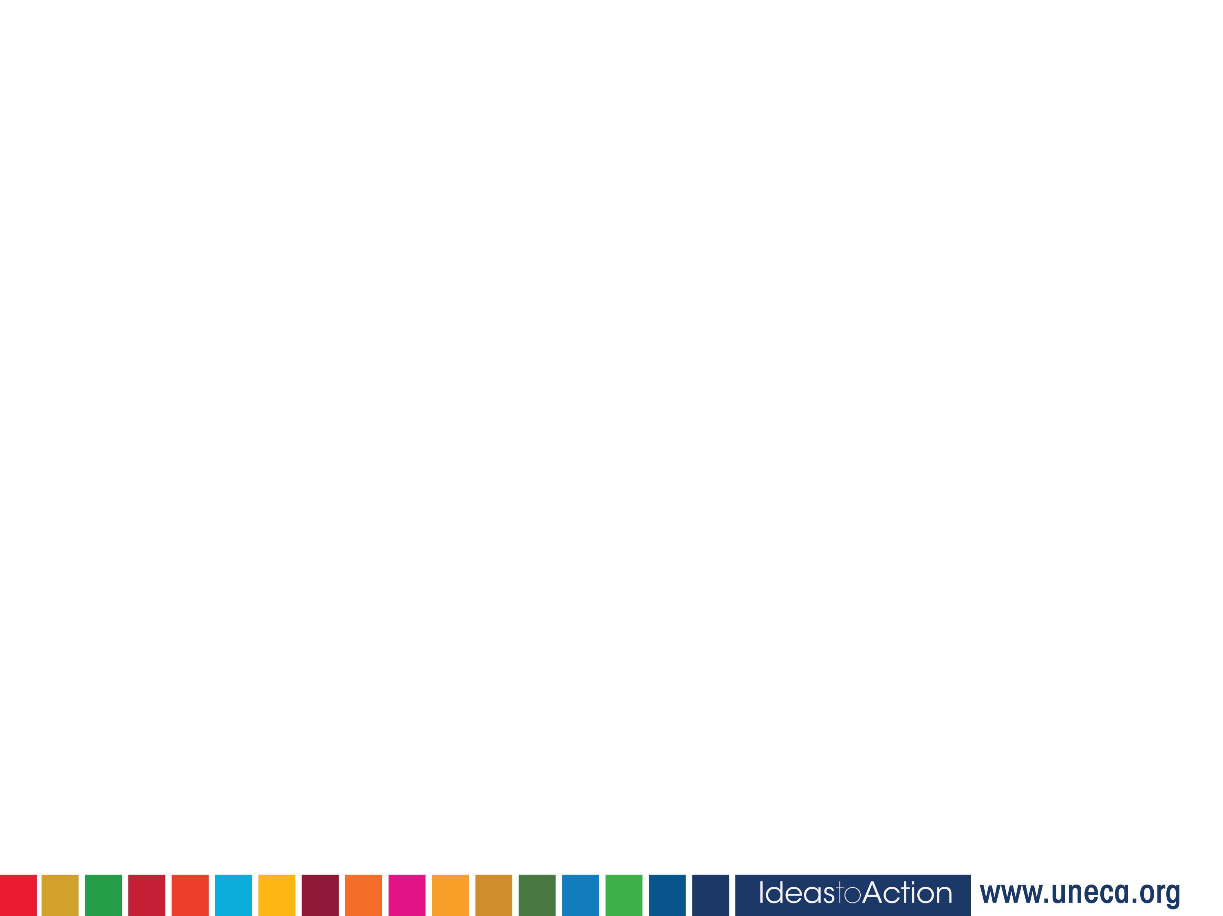
Rethinking Global Debt Sustainability
Framing statement: “Debt sustainability is not only about numbers, it is about governance. Without strong institutions to manage, monitor, and direct debt toward productive use, no amount of debt or restructuring can secure long-term sustainability.”
Global public debt is at record highs, with African countries increasingly vulnerable.
Global responses: DSSI, Common Framework, and Debt Roundtable have provided short-term relief but failed to address structural drivers of debt.
Current debt frameworks remain creditor-driven and focus narrowly on repayment capacity, neglecting whether debt fuels development.
Critically needed: A developmental approach that aligns borrowing with long-term national growth, productive investment, and domestic resource mobilization.

Slide 3
Debt Governance: The Foundation of Sustainable Borrowing
Debt supports development only when managed through robust governance frameworks that ensure transparency, accountability, and efficiency.
Weak institutions lead to inefficient debt use, corruption, and unsustainable borrowing.
Effective governance provides ex-ante prevention, guiding responsible borrowing, aligning debt with national priorities, and strengthening fiscal resilience.
Strong institutional capacity helps shift focus from debt resolution to debt prevention.

Slide 4
Objectives of the Report
Overall objective: To support African countries in strengthening debt governance frameworks that promote responsible borrowing and reduce debt vulnerabilities
Specific Objectives
Assess the robustness, transparency, and independence of institutional frameworks governing public debt
Identify gaps and weaknesses in existing systems and propose practical policy recommendations
Promote a developmentally aligned approach to debt governance that enhances inclusive and sustainable growth
Notes:
More than 44 African countries have undertaken reforms to improve public financial management systems, including the adoption of medium-term expenditure frameworks, performance-based budgeting, and integrated financial management information systems. These reforms were aimed at contributing to better planning, execution, and monitoring of public expenditures. Nevertheless, several challenges continue to inhibit public financial management efficiency mostly arising from weak institutional capacities, limited technical expertise, corruption and the need for greater transparency and accountability frameworks in public planning and expenditure monitoring. Moreover, fragmented budgeting processes which exclude tax expenditures granted for various reasons and weak links between planning and budgeting further hinder the effective allocation and use of public resources. Strengthening anti-corruption measures and promoting good governance remain essential to ensuring that public funds are used effectively and contribute to sustainable development.
https://papers.ssrn.com/sol3/papers.cfm?abstract_id=3043168
https://www.uneca.org/economic-governance-report-ii-%28egr-ii%29
https://hdl.handle.net/10855/46555

Slide 5
This report bridges the gap between global debt debates and national governance realities
It brings an African perspective, emphasizing how a developmental approach to governance shapes debt sustainability (growth vs market enhancing governance)
Value Addition of the report
Empirically, the developmental approach redefines debt sustainability as a function of institutional quality, policy coherence, and the alignment of public debt with a country’s broader development goals,

Slide 6
Methodology Overview
Quantitative: Using Customized tool( Sustainable Debt Governance Cycle FW)
Institutional Role Mapping(Qualitative Analysis)
Applied a customized analytical tool developed for this study: the Sustainable Debt Governance Cycle.
Developed a Debt Governance Index to rate each country’s adherence to the growth enhancing approach to sustainable debt governance across five stages:
A total of 29 indicators were used to construct the indices.
Technical details on the construction of the Debt Governance Index are presented in the appendix of the report
Mapped formal and informal roles of all key actors involved in debt management.
Assessed overlaps, gaps, and coordination across the debt management process — from origination and planning to approval, contracting, implementation, and oversight.
Helped identify institutional strengths and weaknesses within each country’s debt architecture
Notes:
More than 44 African countries have undertaken reforms to improve public financial management systems, including the adoption of medium-term expenditure frameworks, performance-based budgeting, and integrated financial management information systems. These reforms were aimed at contributing to better planning, execution, and monitoring of public expenditures. Nevertheless, several challenges continue to inhibit public financial management efficiency mostly arising from weak institutional capacities, limited technical expertise, corruption and the need for greater transparency and accountability frameworks in public planning and expenditure monitoring. Moreover, fragmented budgeting processes which exclude tax expenditures granted for various reasons and weak links between planning and budgeting further hinder the effective allocation and use of public resources. Strengthening anti-corruption measures and promoting good governance remain essential to ensuring that public funds are used effectively and contribute to sustainable development.
https://papers.ssrn.com/sol3/papers.cfm?abstract_id=3043168
https://www.uneca.org/economic-governance-report-ii-%28egr-ii%29
https://hdl.handle.net/10855/46555

Slide 7
Key Findings - from DSI Analysis
1. Across the six countries assessed, performance under the Debt Sustainability Index (DSI) reveals clear patterns of strength and challenge.
2. Most countries perform relatively well in defining strategic priorities, signalling good policy direction and alignment of debt management with national development goals.
3. Similarly, financing needs are generally well identified, suggesting progress in articulating development funding requirements.
4. However, countries tend to struggle in diversifying financing sources and securing favourable terms and conditions, pointing to limited access to varied funding instruments and weaker negotiation capacity.
5. Debt oversight and impact assessment also remain areas of concern, reflecting gaps in monitoring, transparency, and evaluation of debt outcomes.

Slide 8
Cont’d: Key Findings- Gaps in Debt Governance
A. Institutional Fragmentation & Weak Coordination: Debt functions spread across multiple agencies with limited integration or data sharing which led to duplicated efforts, operational risks, and inefficient project implementation.
B. Weak Legal & Regulatory Foundations: Lack of comprehensive debt laws; unclear mandates for off-budget liabilities, SOEs, and local government debt.
C. Oversight, Transparency & Accountability Deficits: Parliaments and audit institutions often lack capacity and independence; political interference, and poor monitoring of SOEs borrowing.
D. Technical Capacity Constraints: DMOs face staffing gaps, weak analytical skills, and limited tools for risk modelling, sustainability analysis, and project assessment
E. Political Economy Constraints: Political interference prioritizing short-term or electoral projects over fiscally sound investments
F. Operational & Project Management Inefficiencies: Inefficient use of borrowed funds and high undisbursed balances.

Slide 9
Key Policy Recommendations
Strengthening Institutional Coordination and Oversight through National Debt Governance Councils(NDGC)
Enact/Update Comprehensive Debt Governance Framework Laws
Building Inhouse Technical Capacity for DMOs and Modernizing Data Systems
Introducing Fiscal Neutrality Clauses ( Esp. During electoral periods) and Depoliticize SOE Oversight
Create Integrated Debt Dashboards for Transparency( incl. central, subnational, and SOE debt data)
Institutionalize Parliamentary Debt Review Panels (PDRPs)
Align National Debt Strategies with Global Governance Standards

Slide 10
Cont’d: National debt governance is only “ half the battle”: GFA needs to be reformed
Global financial architecture reform is imperative on two fronts
Urgent crisis responses including:
Automatic Debt Service Standstills during restructuring → immediate liquidity relief & reduced social/economic costs
2. Structural reforms to complement domestic efforts, including:
Borrowers’ Club → collective bargaining power
Re-channel SDRs via AfDB → cheaper, longer-term financing
IMF quota review → reflect Africa’s economic weight
Sovereign African Credit Rating Agency → address bias
Independent African-led IMF governance review
Notes:
More than 44 African countries have undertaken reforms to improve public financial management systems, including the adoption of medium-term expenditure frameworks, performance-based budgeting, and integrated financial management information systems. These reforms were aimed at contributing to better planning, execution, and monitoring of public expenditures. Nevertheless, several challenges continue to inhibit public financial management efficiency mostly arising from weak institutional capacities, limited technical expertise, corruption and the need for greater transparency and accountability frameworks in public planning and expenditure monitoring. Moreover, fragmented budgeting processes which exclude tax expenditures granted for various reasons and weak links between planning and budgeting further hinder the effective allocation and use of public resources. Strengthening anti-corruption measures and promoting good governance remain essential to ensuring that public funds are used effectively and contribute to sustainable development.
https://papers.ssrn.com/sol3/papers.cfm?abstract_id=3043168
https://www.uneca.org/economic-governance-report-ii-%28egr-ii%29
https://hdl.handle.net/10855/46555

Slide 11


