Slide 1
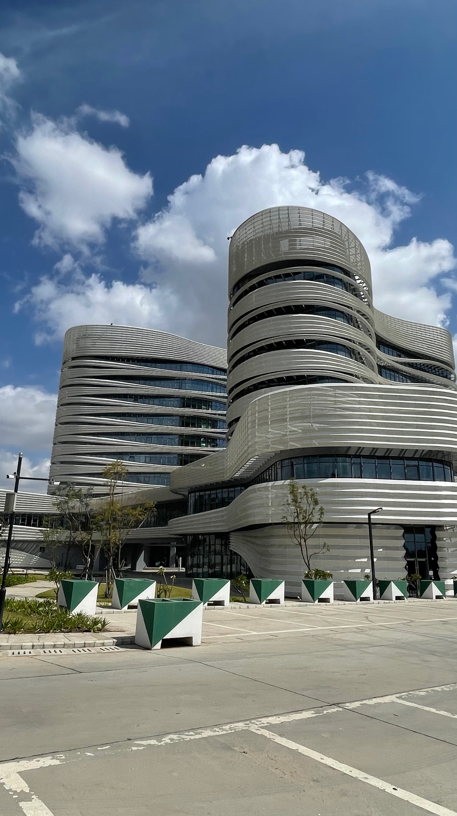

African Pooled Procurement Mechanism (APPM)
Senior Officials & Ministerial Meeting,
14th to 16th May 2024,
Mombasa, Kenya
Safeguarding Africa’s health
14th May 2024

Slide 2
Strategic agenda and the African Union’s vision for a pooled procurement mechanism
AU decisions and policies related to an African PPM
RECALLS the pivotal role that Africa CDC working with African Export-Import Bank (Afreximbank), UNECA and the Covid-19 Special Envoy played through the African Medical Supplies Platform (AMSP) in facilitating access to essential medical supplies during the COVID-19 Pandemic and acknowledges the valuable lessons learnt for a continental pool procured mechanism (Committee of Heads of State and Government for Africa CDC, 13th February 2024).
ADOPTS the AMSP as the continental pooled procurement mechanism under the leadership of Africa CDC with support from Afreximbank and UNECA in improving affordability, availability, and equitable access to essential medical supplies across the continent (Committee of Heads of State and Government for Africa CDC, 13th February 2024).
DIRECTS Africa CDC to upgrade PAVM to Platform for Harmonized African Health Manufacturing (PHAHM) to respond to the call of the New Public Health Order for expansion of local manufacturing of all medical countermeasures (vaccines, therapeutics, diagnostics, and others) towards building a self-sufficient healthcare manufacturing sector within Africa (Committee of Heads of State and Government for Africa CDC, 13th February 2024).
Alignment with AU financial rules and regulations and international best practices that guarantee Fairness, integrity, and transparency; Effective competition; Efficiency and economy; Value for money; Objectives of the AU; Segregation of duties; and Transparency, accountability, and ethics. Africa Union, Procurement Manual, Version 2.0, July 2016
The Committee of the Heads of State and Government meeting on Africa CDC on 13th February 2024 recommended the adoption of AMSP as the continental pooled procurement mechanism under the leadership of Africa CDC with support from Afreximbank and UNECA and report back to the African Union Assembly of Heads of State and Government.
37th Ordinary Session of the Assembly of the Union, (18th February 2024), the AU endorsed that a pooled procurement mechanism (PPM) be established and urged Africa CDC to immediately put in place the modalities for full implementation.

Slide 3
Aims of the African pooled procurement mechanism
The continental pooled procurement will play a dual role of improving access to quality and affordable health product technologies as well as promoting the localisation of manufacturing.
The AfPPM has a unique value proposition: locally manufactured health product technologies that meet global standards, in combination with strong collective bargaining power, will help African countries to achieve supply security and reduced costs.

Slide 4
Aims of the African pooled procurement mechanism
The AfPPM is tailored to the continent’s needs and will deliver on strategic objectives:
Ensure member states have access to quality, affordable health products in a principled (equitable, ethical) and sustainable approach via effective collective bargaining and strategic procurement modalities.
Build local and regional markets for health products.
Deliver emergency response health products through leveraging African suppliers.
Collaborate with partners to ensure sustainable [global] markets of health products and to prevent the negative consequences of competitive buying – Healthy Markets.

Slide 5
APPM at scale up phase will enable cost efficiencies
Illustrative
Total volume of vaccines utilised in African continent
Indicative production costs of African vs global vaccines manufacturers
Global vaccine supply
African vaccine supply
African
Global
100%
High
Market shaping (financial) incentives including PPM, Gavi AVMA, and other market shaping instruments to support economies of scale
% of volume in continent
Unit production costs
1%
0%
Low
2021
2040
2020
2040
The initial focus of the AU PPM is to support health security and local manufacturing which may lead to higher costs in the short term. Ideally as the PPM continues to evolve costs will approach the global costs

Slide 6
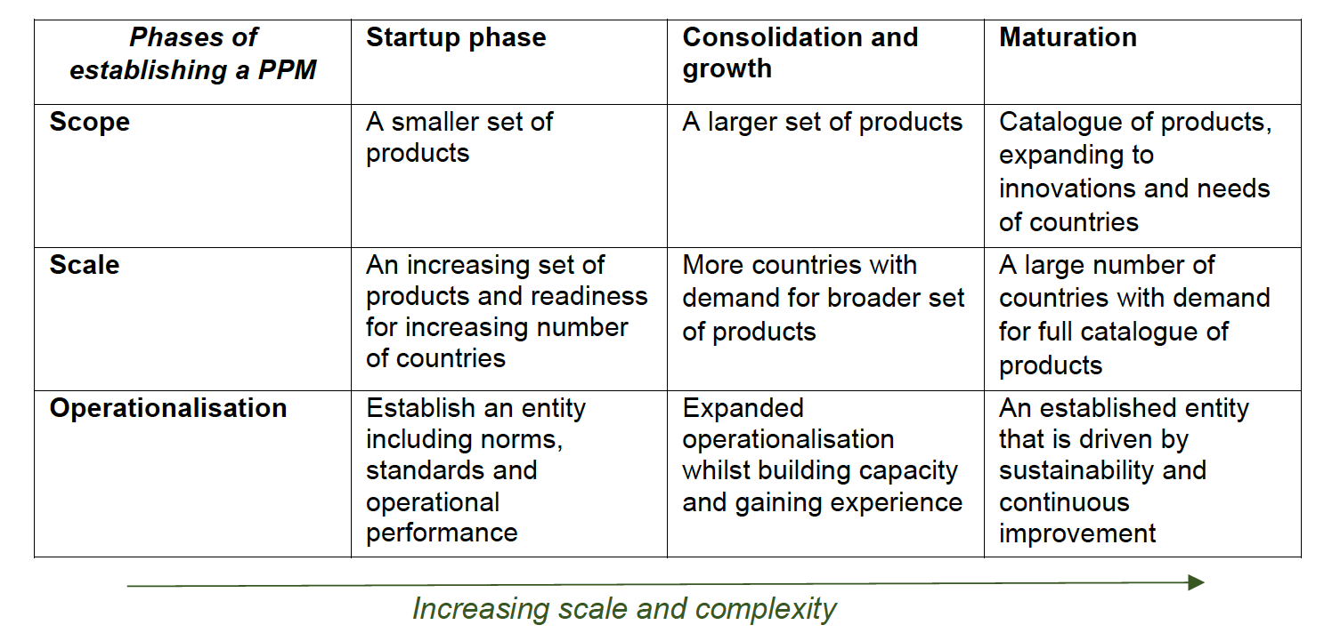
Establishment of APPM through a phased approach with increasing scale and complexity

Slide 7
Partnership Engagements
Partner | Areas of collaboration
UNICEF | Expertise, strategic implementation partnership
UNECA | Expertise, Pilot CPPM
WHO | Local production, WHO PQ , Quality Assurance
Afrixem Bank | Strategic partnership – design and implementation
AfDB | Financing
AfCFTA | Trade facilitation – implementation of harmonized standards
Gavi | AVMA and linkage to AfPPM
CHAI & PATH | Selected vaccine antigen roadmaps (route to market)

Slide 8

Thank you!

Slide 9
Status on the development of design options for APPM design components
Product
Scope
Financing
Quality
Governance
Client/MS interface
Core functions
Political will
Product Scope
Product Scope scenarios for Mature phase and Start-up phase drafted.
Africa CDC to finalize draft product scope options
Then conduct financial analysis
Governance
Draft options developed for:
Role and composition of Board
Role of Secretariat
Financing
Mapping of financial flows of an APPM; Seed funding
Capital Funding; and Trust account approach to manage other’s funds.
To be updated with banking options and FOREX issues
Engage with Afriexim Bank to further define options
Client/MS Interface
Options mapped for digital or analog interface (+ considerations for design) with MS across set of functions.
To be updated based on feedback from UNICEF
Consultations with EAC, OECS, SADC, ECOWAS this week
Quality
Options for QMS system as well as reference standards for tech specs, mfg, inspection (regulatory), registration, PMS, etc.
WHO PQ, Regional standards, Nat’l stds – harmonization.
Consultations with WHO, SADC, etc. this week
Core functions
Core functions mapped as well as implementation modality for Mature and Start up phase.

Slide 10

Regional Economic Communities and APPM - a collaborative network supporting national procurement systems to access health products
APPM: African pooled procurement mechanism
CEN-SAD: Community of Sahel-Saharan States
  Principles
  Nationally driven
  Shared objectives
  Tailored operating models
  Differentiated
  Synergies & collaboration
COMESA: Common Market for East and Southern Africa
EAC: East African Community
ECCAS: Economic Community of Central African States
ECOWAS: Economic Community of West African States
IGAD: Intergovernmental Authority on Development
SADC: Southern African Development Community
UMA: Arab Maghreb Union
Text in grey: no PPM needs confirmation
Plus SIDS: Small Island Developing States

Slide 11



There will be several stages to establish the end state APPM
Preliminary
Start-up: Launching the PPM (2025-2026)
Consolidate: Further growth of PPM
Maturation: Reaching scale and steady-state PPM
Product Scope
Likely a smaller set of health products, including vaccines and warehouse products
A larger set of health products, including vaccine as additional production is established
A broad set of vaccines and other health products accommodating scaled up production
Potential demand
A smaller set of countries with demand for start-up phase products
More countries with demand for broader set of products
A broader set of, or up to all AU countries with demand for health products
Potential supply
Demand is met by international and African suppliers
More of demand is met by African suppliers
Majority of demand for health products is met from Africa suppliers
Operationalisation
Cooperate with partners on operationalisation while the capabilities are concurrently developed within Africa
Continue partial operationalisation with partners while capabilitiess are verified and scaled
APPM leads the end-to-end procurement with some capabilities continued to be out-sourced

Slide 12



Landscape Analysis – Product Scope of Regional PPMs
Narrow range of products
(’00s of items)
Wide range
of products
(’0,000s of items)
Preliminary
Description of product scope
PPM has a scientific/ advisory group on products
(’000s of items)
PPM stockpiles products
i
AVAT/AMSP
Established in 2020. Covid-19 products only: Vaccines, PPE and IPC, Diagnostics, Medicines, Medical Equipment (’00s of items)
ii
EAC
Established in 2008. Focused on essential medicines and health technologies (’00s to ‘000s of items)
Initiated in 2022/3. Vaccines and other health products in communicable and non-communicable diseases. Product scope will be based on factors such as patient needs, Treatment Guidelines and Protocols, budget constraints, and regulatory guidelines (Unclear, but appears to be ‘000s of items)
iii
ECOWAS
ECOWAS is in start-up phase
Established in 1978. Medicines and health products; Sera & Vaccines, Chemical, Insecticides, Radiopharmaceuticals, Renal Dialysis Solutions and supplies, Hospital supplies, linens and uniforms, Oral and Dental medical supplies, Laboratories Sundries, Orthopaedic & Spine, Rehabilitation Sundries, Cardiovascular Sundries, ENT Supplies, OP Supplies, Veterinary medicines and vaccines. (‘0,000 of items)
iv
GCC
v
EU HERA
Established in 2020. Medical Countermeasures for (1) pathogens with high pandemic potential, (2) chemical, biological, radiological and nuclear threats, and (3) threats resulting from antimicrobial resistance. Committed by the HERA board. (’00s to ‘000s of items)
vi
GDF
Established in 2001. Focused on TB-related products, primarily medicines. Based on the mandate by host organisation ‘Stop TB’. (’00s of items)
vii
OECS
Established in 1986. Pharmaceuticals and non-pharmaceutical items, medical supplies, contraceptives and radiological supplies. 840 Product-Item list based on consolidated demand and to lower cost and increase quality. Demand driven and cost-effective strategy. (’00s of items)
Established in 1979. Vaccines, as well as (1) medicine types that have recently been added to the WHO Essential Medicines List (e.g., monoclonal antibodies); (2) new innovations for chronic diseases (e.g., insulin analogues for the treatment of diabetes); (3) essential medicines that are in short supply or are at risk of short supply; and (4) medicines with a concentrated supplier base to increase market competition (e.g., biosimilars). Product pool based on scientific research findings from NUC. (’00s to ‘000s of items)
viii
PAHO RRF & SF
ix
SADC
Established in 2005 Offering multiple types of pharmaceuticals. Rationale behind the product mix is based on a feasibility study 2010 market analysis. From here, 50 tracer medicines were identified including to treat Malaria, TB, HIV and medicines for child and maternal health problems. No vaccines. (’00s of items)
Established in 2019. Pilot project for 10 countries (Comoros, Djibouti, Eritrea, Ethiopia, Kenya, Madagascar, Mauritius, Rwanda, Seychelles and Sudan) includes 10 products. Aim is to advance key reproductive, maternal, new-born and child health pharmaceuticals products. 9 product groups including antibacterial, anti-cancer, anti-hepatitis, non-communicable deceases and vaccines. (‘000s of items)
x
UNECA
UNECA is in start-up phase

Slide 13
Landscape Summary – Product Scope of Global PPMs
Narrow range of products
(’00s of items)
Wide range
of products
(’0,000s of items)
Preliminary
(’000s of items)
Description of product scope
xi
UNICEF
Established PPM role in 1980’s. Vaccines, medicines, health technologies, nutrition supplies needed at the primary health care (PHC) level and based on UNICEF programmes. Emergency health kits and WASH supplies. (‘0,000s of items)
xii
wambo.org
The Global Fund
Global fund was established in 2002, including its PPM. Wambo.org interface established in 2016. Health products to prevent, diagnose and treat HIV/AIDS, Malaria and TB. As well as opportunistic infections. (‘000s of items)
Focused on health emergencies, including epidemic and pandemic prevention, preparedness and response. Including diseases and other hazards; and health emergencies as a part of humanitarian response. Emergency health and trauma kits. Surveillance and diagnostic supplies; essential medicines; WASH products (’00s to ‘000s of items)
xiii
WHO*
*WHO is not a PPM but their WHE OSL function has a similar mandate to Africa CDC so included as a reference.
Summary
31% have a narrow range of products (‘00s of items); 54% have a medium range of products (‘000s of items); 15% have a wide range of products (‘0,000s).
The majority PPMs have a medium range of products in their scope.
15% (HERA and PAHO) refer to using the PPM to drive R&D and new products and have technical advisory groups advising on such.
31% of PPMs also stockpile health products (HERA, PAHO, UNICEF and WHO*).
The scope of products of PPMs that are a part of a health institution reflect the focus of the institution’s mission.
Considerations for APPM
A narrow product offering enables for extreme strategic focus, a smaller set-up and cost, and potentially therefore, higher performance. Too narrow of a product offering could provide less value-add for member states.
A wide product offering can create greater market influence and impact, but it is more complicated and expensive to set up and success could rely on encroaching on national procurement systems and/or other African PPMs.
Given the similar mandates and technical focus between Africa CDC and PAHO, HERA and WHO, their product scopes could be interesting benchmarks for the APPM.
It is common for PPMs to focus on a scope of products or segment of demand or capability.

Slide 14
Five guiding principles to apply when considering product segments to be in scope for the APPM
  Key question(s): What should the scope of products for the APPM?
Guiding principles
Probing questions
Strategic importance
  Critical to the mission and aims of Africa CDC; technical expertise within Africa CDC
  Priority for Africa, including as articulated in Africa 2063
  Products that increase access and address current and past inequities
  Product that aim to improve health security
  Products that help APPM build its capacity and credibility with manufactures and AU Member states
Value-add
  Challenging for AU member states to access: Short supply or at risk of short supply; high pricing; or concentrated supplier base
  Opportunity: Recently added to the WHO/AU Lists; New innovations
  Avoid products that are procured by an existing African PPM
  The demand is sufficient size to successfully access the market.
  An understanding of the demand influences and reasonable likeliness of materialization
  Africa CDC is positioned to support to demand ‘generation’ (i.e., product choice) and uptake of products
  Do 1-2 major funding sources segment demand realization? (e.g.,. PEPFAR, GF, Gavi)
Sufficient demand
Supplier base
  There are existing, emerging or potential manufacturers of the product in Africa
  Demand side market shaping efforts are needed
Opportunistic
  Is there an immediate opportunity that strongly corresponds to at least one of the guiding principles?

Slide 15
Product Scope of the APPM for the mature phase
What are options for the scope of products of the APPM?
Segment
Summary of range of options
Additional ideas
Focus on vaccines for epidemic risks
Existing vaccines
Existing and pipeline vaccines
High expectation on the APPM as demand-side of African Vx market incl. for health security and to mitigate inequities. APPM not likely to be viable w/o broad range of vaccines
  Vaccines
  MCMs for a Africa epi-risks
Focus on products Africa CDC stockpiles
… and products in scarce supply & demand-side incentives for local production
… agenda for Dx, Kits (AWD, IPC, SCK) ETU, Chol. Ward., etc.
Bold agenda on MCMs with chronic shortage (ringer's lactate); an agenda to address the fragmentation of diagnostics. AWD, Sample Collection, IPC kits; Ebola treatment units, Cholera Wards
  High-burden disease (ATM)
Not included in scope
Focus on ATM products produced in Africa. Plus Malaria, TB, HIV Vx
Become a PR for Global Fund, a/o implementer with PEPFAR
Become a procurement agency for Global Fund for Africa produced products
Could collaborate with REC for them to procure
  NTDs
  and
  AMR
Not included in scope
Select set of NTDs
Full scope of NTD products & Scarce & reserve Antib. and new Dx (AMR)
Potential lift-and-shift of WHO managed NTD donation programmes to Africa CDC. Potential PPM for WHO & GARDP mechanism SECURE. 6 new products for NTD in DNDi pipeline to hep bring to market
  Essential Meds
Not included in scope
By exception. Focus on product with access challenges or specific risks
Full scope of Essential meds
Main focus of the RECs. RUTF is a product with half of needs met by African mfrs, but funding has dropped and risk of mfrs folding
  Biomed
Not included in scope
In response to specific requests and if resources permit
Build the specific technical expertise needed
Building the expertise could meet a MS need. Could also collaborate with a REC for them to establish the expertise
  NCDs, incl. aging
Not included in scope
Focus on products in scarce supply or high price
… and emerging products for NCDs
Product like glucometers and insulin are high price. Work with RECs to procure or establish reference prices. Similarly, cancer meds

Slide 16



APPM’s capability development: A build-cooperate-transfer model
Build
Co-operate
Transfer
Baseline of Africa CDC capability
Create staff profiles and establish the team
Update relevant governance & internal control framework
Adaption of good practices from other PPMs & UN: e.g., QMS, Operating procedures, specifications, cost-models, etc., UNGM
Participate in strategic modalities (UNICEF procurement ref. groups, procurement strategies, ICG, UNICEF Market Notes / WHO MI4A, etc.)
Understand requirements of donors
  Job shadowing with partners (bi-directional)
  Implement with partners based on product specific modality
  Secondments from partners while Africa CDC takes on a capability
  Collaboration on functions with partners or collaborative mechanisms (e.g., inspection pool)
  Expand team based on projected procurement / product scope
    Transition capabilities per consolidation and mature phase
    Onboarding and continuous improvement
    Ongoing ‘outsourcing’ to partners or other service-providers (non-transfer) based on product or function
Base line capability verification
Capability verification

Slide 17
Ilustration
Description of product :
PCV vaccine (3 dose, given at specific intervals within 1st year of life); PCV13 (80% of countries)
Open to all AU countries
45 countries in AU have introduced (75% Gavi eligible / 25% never-Gavi / 1 Former-Gavi); PCV13 (80% of countries) & PCV 10 (20% of countries)
9 AU countries have not introduced (5 Gavi eligible, 4 NG (of which 2 eligible for Gavi MICs support)
Gavi funding (Gavi-eligible countries, some support for eligible MICs for introduction), pricing established through PCV AMC
Majority of funding is Gavi; plus, national (including Gavi co-financing)
Majority of procurement through UNICEF, plus self-procurement
Demand, financing, procurement channels:
PCV vaccine – national and Gavi funding
Sources;
WHO MI4A Global Market Study: BCG (2019): https://cdn.who.int/media/docs/default-source/immunization/mi4a/who_bcg_vaccine_global_market_update_may2019.pdf?sfvrsn=eaf1cfed_6&download=true
WHO list of pre-qualified vaccines: https://extranet.who.int/prequal/vaccines/prequalified-vaccines
Note: no data for Sharawi Arab Democratic Republic
Supplier base:
6 manufacturers
3 manufacturers with WHO PQ vaccines
Pipeline African manufacturing
Potential partners:
UNICEF: procurement processes, financial mechanisms, demand consolidation and monitoring mechanism → supporting scape up of APPM capacities
WHO: standards, specifications, quality evaluation

Slide 18





Start-up phase illustration: PCV vaccine
Non-Gavi and Gavi funding
Support to implementation
Lead implementation of a function
Year x
Year y
Year n
Function
1.1 Procurement strategy
Non-Gavi
Gavi
Non-Gavi
Gavi
Gavi and Non-Gavi
1.2 Specifications
1.3 Supplier sourcing
1.4 Supplier evaluation and selection
1.5 Negotiations
1.7 Demand consolidation
Gavi and Non-Gavi
Gavi and Non-Gavi
1.8a Order processing
Non-Gavi
Gavi and Non-Gavi
1.8b Payment
Non-Gavi
Non-Gavi
Gavi
1.9 Monitoring

Slide 19
Core Functions
Summary, Interdependencies and Critical Success Factors
Summary
Implementation of the majority of the core functions in the start-up phase will be done in co-operation with partners
Product specific implementation plans based on the MS, financing, African manufacturing; and developed with partners that have existing capabilities and roles.
The APPM’s capabilities will be established over time, with a clear line of sight towards the mature stage (E2E APPM)
Interdependencies
Finance and financing as part of objective setting, contracting and processes
Quality assurance for establishing standards and specification, supplier evaluation / selection, monitoring and complaints management
Client interface with member states t0 ensure communication and timely information flow throughout the process
Governance to frame the full procurement process, objective setting, key decision points and internal controls
Critical Success Factors
Agreement with members states on the use, parameters and objectives of the APPM
Collaboration and co-operation with a partners and RECs, as relevant
Understanding of what it would take for Africa CDC to be a procurement agency for multilateral funding mechanisms

Slide 20
Mapping of PPM Transactions & Engagement with MS
Based on landscape analysis of UNICEF, OECS, Global Fund, etc.
MS Client Engagement / T&Cs
Access to Product Catalogue
Procurement Planning
Inquiry
Confirmation of Supply Requirement
Funding receipt and Funding management
1. Memorandum of Understanding, or other type of agreement, to formalize collaboration, roles & responsibilities between PPM and MS Client, including the GT&Cs
2. MS Client access to product catalogue and key product information (e.g., pricing, indicative lead time, product specifications, etc.)
3. MS Client access to procurement planning support, including forecasting and budgeting
4. Inquiry by MS Client, including a description of the requirement
5. Issuance of Cost Estimate / PF Invoice (“the offer”)
6. Confirmation by MS Client of the supply requirement, based on PPM terms and product specs
7. Confirmation of consignee
8. Receipt of funding from MS Client for order placement, or prefinancing/credit line through PPM related supply financing mechanism.
9. Monitoring & Visibility of received funding, balances, owed amounts, etc.
Ordering and order management
Expediting and Delivery
Receipt confirmation
Inspection
Supplier payment
Complaints Management & Customer Service
10. Ordering and order management
11. Monitoring of order status
12. Monitoring of international transport, by the supplier or an APPM contracted transport/shipping organization
13. In-country logistics/services
14. Delivery confirmation by MS Client
15. At delivery, inspection outcome submitted by MS Client
16. Supplier invoicing
17. Invoice Certification
18. Supplier payment
19. Complaint filing by MS Client: QA, troubleshooting, delivery delays, etc.
20. Complaint management and closure
21. General customer service.
Related Support Functions
Programmatic & Technical Advice
Legal
Financial management
Supply Financing
Administration
Shipping/logistics
QA

Slide 21
Minimum set of capabilities needed from start-up phase
Dimension
Vaccines
Therapeutics
Diagnostics
Other medical products
Notes
  Market intelligence & strategy
Includes demand intelligence & forecasting
Initially “other medical products” are managed by therapeutics or Dx team
  Technical
Cross-cutting function with mix of pharmacists, biomedical engineers, virologists, etc..
  Supplier management & purchasing
Initially “other medical products” are managed by therapeutics or Dx team
Cross-cutting function comprised of inspectors, QMS system lead, bid openings / supplier registration
  Quality
  Transportation
Cross-cutting function comprised of logistic experts, organized by (supplier/country) geography
  MS/Client interface
Teams organized by MS groups. Could also be a focal point for REC
Issuing quotations, planning needs, statements of account
Product specific team with set of capabilities
Cross cutting team for all products
All capabilities are shared with the Africa CDC Warehouse (WH)

Slide 22



Establishing the African pooled procurement mechanism
Financing mechanisms and financial instruments encompassed within the APPM will be essential to execute the functions, ensure sustainability, and achieve impact
Catalytic seed funding that enables the creation and set-up of the African PPM
A capital fund that underpins cash cycles and long-term contracts
Revenue generation model (such as a fee-based system) for the platform to be able to cover cost, but on a non-profit (self-sustainability/cost-recovery) basis
Consultation with key funders and member states to co-design the key elements of the APPM and relevant market or product class targets will be essential to obtain political buy-in and commitment. Further, linking this to the broader ecosystem of buyers and funders to ensure the market can be effectively managed.
Source: AfrCDC Onboarding / Briefing.

Slide 23







To sustain the financial budget several sources of funding can be considered
Key questions
How could the PPM be financed?
Note: We exclude any consideration of “Innovative Financing” in order to ground options which are actionable and not based upon a long-tailed / lower probability initiative. Any “innovative financing” should be developed to complement / supplement the base operating structure of the APPM.
Source of funding
Mechanisms
Description
Considerations
Example
Member states
Direct contributions (could be donors)
Direct contributions to the resourcing of the APPM and its functions
Various
Monetizes some of the current political capital.
Potential for securing multi-year funding upfront.
Conditionalities and expectations of the donors.
Donor monitoring and leverage via the funding.
Service fees
A service fee, generally a fixed percentage added to each transaction, is paid by the member state
PAHO Revolving Fund applies a 4.25%; service charge on each order; (1.25% is used to cover operating costs; balance to Capital Fund)
Supports long-term sustainability, “revenue” generation
Common model for many of the development sector PPMs
Choosing the “right” % fee and defending non-profit a challenge
Optics by partners and clients of “revenue” generation and running a business
Contingent on having good visibility and steady throughput.
Membership fees
A membership fee to participate in the mechanism or by all AU MS
PAHO Revolving Fund covers some expenses through PAHO’s general budget paid by member states
Supports ownership of MS in the mechanism
Fees irrespective of throughput makes it a “public good”
Ability to plan against a consistent budget
Inability to scale-up resources quickly in response to an emerging need.
Potential chasing of governments to pay those fees, limited fiscal space
Service fees
A service fee is paid by the manufacturer
The GCC covers organisational expenses through country membership and supplier fees 0.5%
If suppliers engage, then could be source of significant funding.
Manufacturers
Optics related to “pay-to-play”
Suppliers may fundamentally not be interested – especially when they have a product that is in high-demand (e.g., some of the vaccines).
Membership fees
A membership fee to participate in the mechanism is paid by the supplier
Some Vaccine Purchasing Groups in the United States cover organisational expenses through membership fees, paid by suppliers
If suppliers engage, then could be source of significant funding.
Optics related to “pay-to-play”
Suppliers may fundamentally not be interested – especially when they have a product that is in high-demand (e.g., some of the vaccines).
Clarity needed on whether AfCDC can accept funds from private sector.
Source: PAVM/McKinsey Analysis OECD, World Bank, USAID, Expert input, IFAD, Investopedia, press / website search
And, as supplemented April 2024

Slide 24
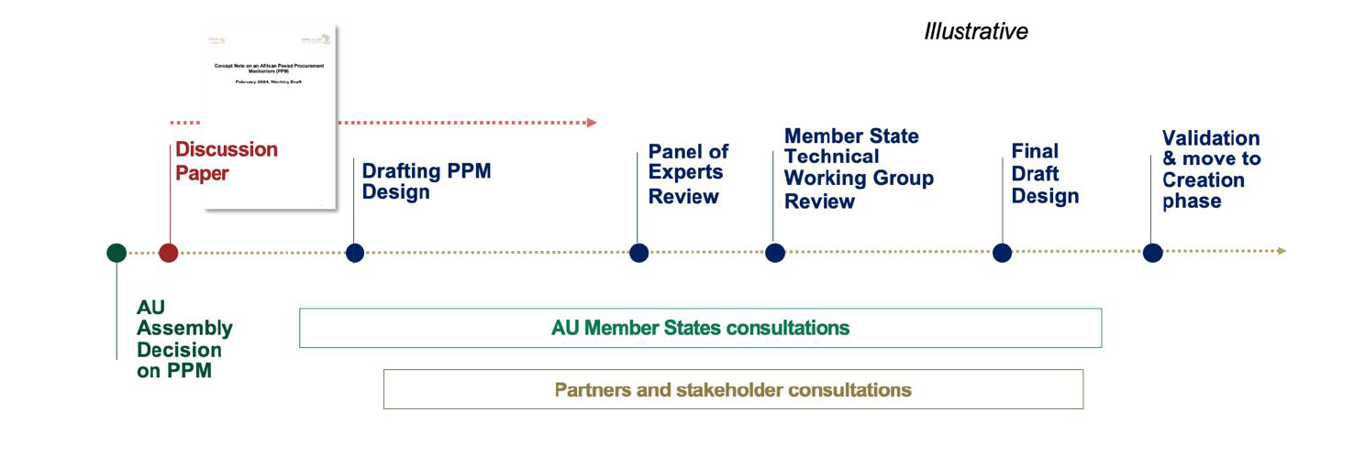
Design process in 2024

Slide 25
High-level roadmap of APPM design phase
2024
Technical
Political
Operational
May
June
July
October
  4Q
  Package of APPM draft design option in place
  Africa CDC internalize and update design
  Draft Financing Scenarios and Start-up Costing
  Engagement and advocacy Plan
  Panel of Experts (Partners)
  MS Technical Working Group
  REC Ministerial Meeting
  Interim report card on progress of APPM
  Finalize Design
  Prepare for AU Meeting (Nov)
  Draft Report Card
  (Nov)
  Member State consultations >>
  Demand creation >>

Slide 26
Engagement plan to solicit input and garner momentum
Event//date | Entities | Modality
Ministerial meeting UN ECA | UNECA, Africa CDC 10 MS | 3 day forum (Mombasa)
WHA 77 26 May – 1 June | Member States Global Health Partners | Side events:
WHA 77 | WHO Director General | F2F
WHA 77 26 May – 1 June | .. … | Side meeting
APPM Expert Panel meeting, 29 June | UNICEF WHO, Global Fund, [insert] | Virtual meetings and 1-day side meeting
APPM Technical Working Group | Select AU Member States | 1-day meeting
AU-REC meeting |  | Side meeting
REC engagement, July - October | REC PPM engagement | Side meetings
  Development of key questions and advocacy packages
  Use feedback to update and finalize APPM design
  Develop an APPM “report card” that reflects objectives, risk, etc. of MS
  Identify ‘coalition of the wiling’ for AU update/decision in Feb 2025
  Mobilize resources for Start-up phase

Slide 27

THANK YOU
Africa Centres for Disease Control and Prevention (Africa CDC),
P.O. Box 3243, Addis Ababa, Ethiopia, Ring Road, 16/17,
Tel: +251 (0) 11 551 77 00, Fax:+251 (0) 11 551 78 44

