Slide 1
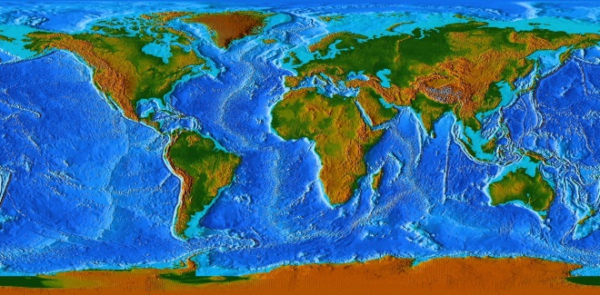
UN-GGIM Africa Addis Ababa, Ethiopia
30 October 2024
Guillaume Le Sourd | lesourd@un.org Secretariat of the Committee of Experts on Global Geospatial Information Management
Statistics Division | Department of Economic and Social Affairs
United Nations
Positioning geospatial information to address global challenges

Slide 2
“In a world increasingly reliant on higher accuracy measurements and location-based services, collaboration, coordination and coherence in global geospatial information management is more important than ever before. The United Nations is the right place to foster the needed cooperation. However, the availability and accessibility of quality, timely and reliable geospatial information remains a challenge, as does the capacity of countries to produce the information they need.
Your important work on developing consensus-based norms and frameworks, together with your practical guidance, will allow Member States to strengthen and enhance their national geospatial capacities to measure progress, and to make progress towards a better world for all.”
Li Junhua,
Under-Secretary-General for Economic and Social Affairs, United Nations
Opening Remarks, Thirteenth Session of the United Nations Committee of Experts on Global Geospatial Information Management, 2 August 2023

Slide 3
The Committee of Experts transmitted to ECOSOC its report, pursuant to resolution E/RES/2016/27 entitled ‘Enhancing global geospatial information management’ (E/2022/68) in June 2022. The comprehensive report described the process of ‘transition’ marking the Committee’s work, starting with an initial five-year period (2011 – 2016) on establishment; the report then detailed its second five-year period (2017-2021) on institutionalization; and then considers the Committee’s future in the coming five-year period – on implementation of the Committee’s frameworks, anchored by the UN-IGIF.

Slide 4
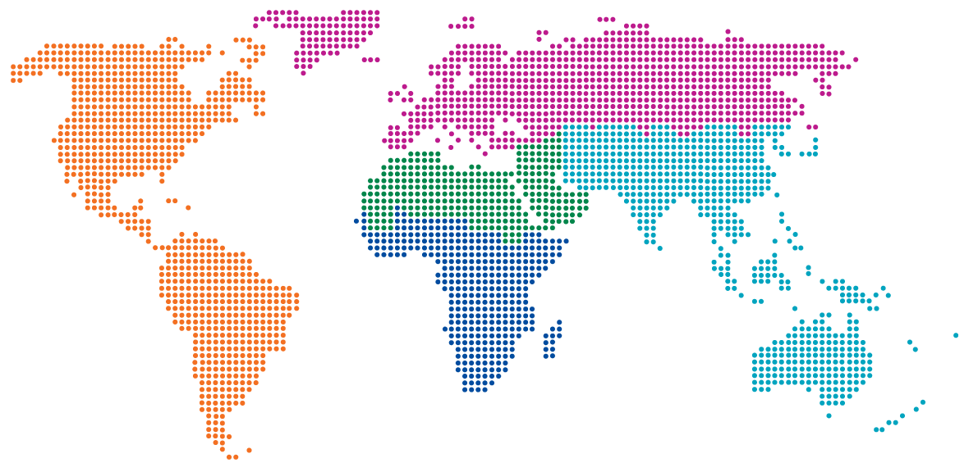
Co-Chair
Belgium
Co-Chair
Côte d’Ivoire
Co-Chair
USA
Rapporteur
Fiji
The Committee of Experts, a subsidiary expert body of the Economic and Social Council of the United Nations, is the peak intergovernmental body to liaise and coordinate among Member States, and between Member States, international organizations and stakeholders, to foster better coordination and coherence in geospatial information management
BUREAU
Arab States Saudi Arabia
Americas Chile
Africa
South Africa
Europe
UK & Netherlands
Asia Pacific
Indonesia
REGIONAL COMMITTEES
Geospatial Societies
Academic Network
Private Sector Network
United Nations Geospatial Network
UN-GGIM

Slide 5
Implementation of Resolution E/RES/2022/24 and the 2024 UN Programme Budget for the establishment of a Secretariat for the Committee
E/RES/2022/24
7. Also decides to strengthen the work of the Committee of Experts, and requests the Secretary-General, in the context of his next budget proposal, to identify options to do so, within existing resources, including the establishment of a secretariat for the Committee, dedicated to the Committee’s normative and implementation work on global geospatial information management;
Decision 13/101 (Thirteenth session)
(b) Noted the ongoing budgetary process associated with the adoption of resolution 2022/24 by the Council and the inclusion of performance measures and results focused on accelerated implementation of the United Nations Integrated Geospatial Information Framework within the strategic objectives and elements of the Department of Economic and Social Affairs of the Secretariat, and in this regard underscored the importance of continued advocacy and awareness-raising within and among Member States and their permanent missions in the next steps and final negotiations for adequate and sustainable resources within the Secretariat, and requested an update on the outcomes of the process;

Slide 6
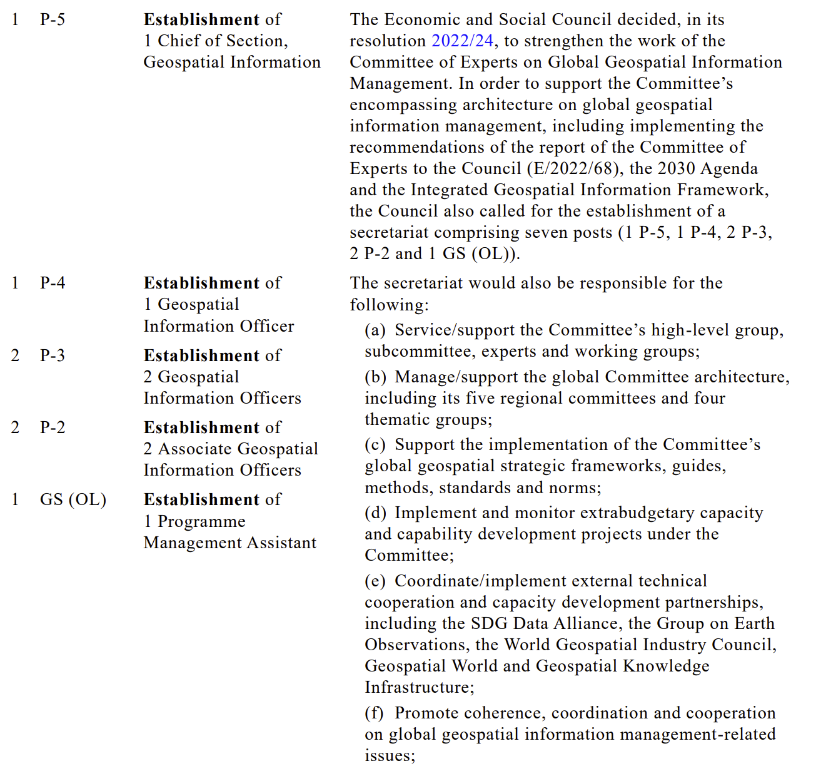
Extract from the Programme Budget Implication statement delivered to ECOSOC
In relation to E/RES/2022/24
Chief
Geospatial Information Management, P5
7 posts
Geospatial Information Officer
P4
Geospatial Information Officer
P3
Geospatial Information Officer
P3
Geospatial Information Officer
P2
Geospatial Information Officer
P2
Programme Management Assistant
P2

Slide 7
Current staffing situation
Inter-Regional Advisor
Global Geospatial Information Section
Senior Statistician (Geospatial)
CH Teo
Statistician (Geospatial) C Blake
Statistician (Geospatial) M Iliffe
Programme Management Assistant V Frani
7 posts
Geospatial Information Officer G Le Sourd
Programme Management Assistant B Tashybekova
Geospatial Information Officer A Mussayeva

Slide 8
Fourteenth Session of the Committee of Experts on
Global Geospatial Information Management
14/101 Enhancing global geospatial information management arrangements
(b) Appreciated the establishment of a new and enlarged secretariat for the Committee of Experts dedicated to the Committee’s normative and implementation work on global geospatial information management, and in that regard requested the Secretariat to focus, in particular, on
(i) supporting the Bureau to develop a strategic framework for the period 2025–2030,
(ii) strengthening effective global coordination and governance arrangements for the United Nations global geospatial centres, and
(iii) supporting a global programme of national capacity development aligned with the Committee’s operations focused on the Sustainable Development Goals and the United Nations Integrated Geospatial Information Framework;

Slide 9
United Nations Global Geodetic Centre of Excellence (Bonn, Germany) | United Nations Global Geospatial Knowledge and Innovation Centre (Deqing, China) | United Nations Global Geospatial Ecosystem Centre of Excellence (Riyadh, Kingdom of Saudi Arabia)
Recognizing the importance of the global geodesy supply chain, assist Member States and geodetic organizations to coordinate and collaborate to implement A/RES/69/266 and to sustain, enhance, access and utilize an accurate, accessible and sustainable Global Geodetic Reference Frame (GGRF) to support science, society and global development | Develop and promote the required knowledge, innovation, and leadership to strengthen the adoption of geospatial information to support the implementation of national development priorities and the SDGs, leveraging the United Nations Integrated Geospatial Information Framework, and where Member States will have the ability to integrate and deliver national geospatial information policy, systems, services and capabilities into national government development policies, strategies, and arrangements | Support Member States and stakeholders in enhancing global geospatial information management with the aim to progress towards a future geospatial ecosystem where the global geospatial information community and stakeholders actively engage and contribute sustainable real-world solutions to humanity’s many challenges, leveraging high-quality, timely and reliable location-based information and impactful geospatial analytics including advancements in geospatial technologies and artificial intelligence systems towards new geospatial approaches and capabilities

Slide 10
United Nations Global Geodetic Centre of Excellence (UN-GGCE)
UN Campus, Bonn, Germany
(established by an agreement between the United Nations and the Federated Republic of Germany on 7th October 2022)
The Overarching Goal of the UN-GGCE is to assist Member States and geodetic organizations to coordinate and collaborate to sustain, enhance, access and utilize an accurate, accessible and sustainable Global Geodetic Reference Frame (GGRF) to support science, society and global development.
https://ggim.un.org/UNGGCE/

Slide 11
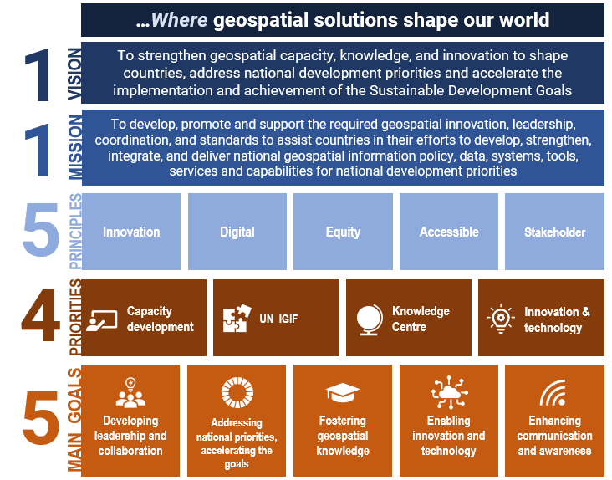
United Nations Global Geospatial Knowledge and Innovation Centre (UN-GGKIC), Deqing, China
(established by an agreement between the United Nations and the Government of the People’s Republic of China on 20 May 2022)
The Overarching Goal of the UN-GGKIC is to work towards the ambitions of implementation of the United Nations Integrated Geospatial Information Framework set by Member States, to develop capacity, promote and support the required innovation, leadership, coordination and standards to develop, strengthen, integrate and deliver national geospatial information policy, data, systems, tools, services and capabilities into their national government development policies, strategies and arrangements.

Slide 12
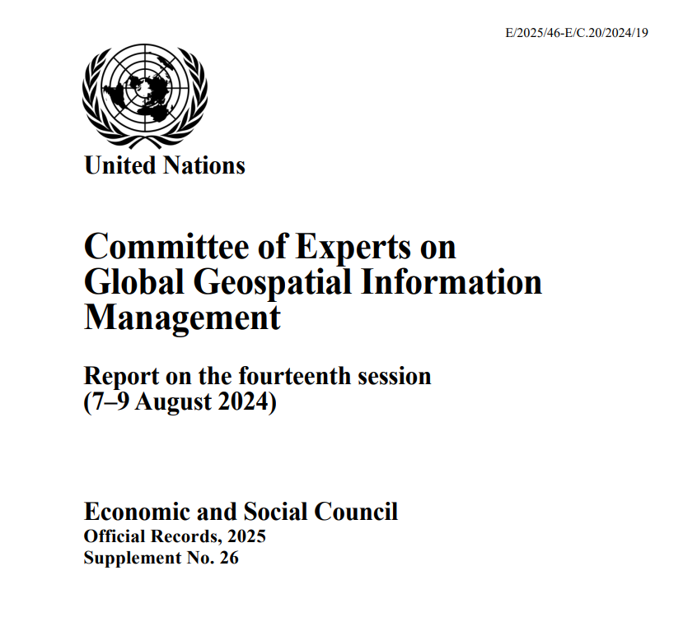
Decision 14/105
United Nations Integrated Geospatial Information Framework
The Committee of Experts on Global Geospatial Information Management:
(f) Welcomed offers from some Member States to support the adoption and operationalization of the Framework across Member States, noting that the Framework was a broad work item within the programme of work of the Committee of Experts and that strategic and effective implementing partnerships and collaboration arrangements would be beneficial, affirmed the benefits of partnership and collaboration, and welcomed and appreciated the tangible contributions of the SDG Data Alliance and its donors for their active support and involvement with a number of Member States to implement the Framework and to share their implementation experiences, and urged the United Nations Global Geospatial Knowledge and Innovation Centre to intensify its support to Member States to ensure the sustained adoption of geospatial information management capabilities and the operationalization of the Framework in accordance with national circumstances;

Slide 14
The United Nations Integrated Geospatial Information Framework (UN-IGIF)
Support Effective Administration of Land (UN-FELA), Coasts, Seas and Oceans (UN-IGIF-Hydro)
Manage Impacts of Climate Change and Improve Resilience
Advance National Development Priorities
Improve Health Care Delivery and Response
Modernize National Geospatial Capacities
Advance the 2030 Agenda for Sustainable Development
Advance Integrated Geospatial Information in Broader Digital Information Ecosystem
Facilitate Disaster Risk Reduction and Management (SFGIS4D)
Support SDGs Global Indicator Framework and the Integration of Statistical and Geospatial Information (GSGF)
Basis for Integrating the Terrestrial, Maritime and Cadastral Domains (UN-FELA/UN-IGIF-Hydro)
The United Nations Integrated Geospatial Information Framework (UN-IGIF) provides an overarching paradigm to further strengthen nationally integrated geospatial information management, not only for Member States that were in the early stages of adopting spatial data infrastructures but also for those that had already successfully implemented spatial data infrastructure capabilities
(Eleventh session, Committee of Experts on Global Geospatial Information Management, August 2021)
Notes:
The positive impacts of UN-IGIF are innumerable; with more effective land administration, improved health care delivery and response, improved management of climate change, more productive agriculture, better management of the maritime spaces and resources, the blue economy, and disaster risk reduction and management. We are hearing a lot about relating people, events and activities to place of location, relating environment and climatic events to people to place. It is very evident, from the many presentations we have heard so far, that UN-IGIF is about PEOPLE.
Enhancing national geospatial information management is about improving the wellbeing of PEOPLE.

Slide 15
9 Strategic Pathways
Knowledge ▪ Decisions ▪ Development
Governance and Institutions
Policy and Legal
Governance
Financial
Anchored by 9 Strategic Pathways, the IGIF is a mechanism for articulating and demonstrating national leadership in geospatial information, and the capacity to take positive steps. The Strategic Pathways ‘implement’ the IGIF through actions.
Technology
Data
Standards
Innovation
Users ▪ Citizens ▪ Access
Technology ▪ Applications ▪ Value
Capacity and Education
Communication
and
Engagement
People
Partnerships
Society ▪ Economy ▪ Environment
Notes:
The roadmap for implementing the IGIF occurs primarily through the 9 Strategic Pathways.
The strategic pathways are deliberately presented as separate pieces of a jigsaw puzzle in recognition that there are many aspects and dimensions to each individual pathway which can be addressed singularly. However, it is when the pieces are all joined together and united as one that the Framework is connected, integrated and able to be fully implemented as an integrated national geospatial information program.
Additionally, the Strategic Pathways are organized laterally in response to three principal areas of equally shared influence: these being aspects related to overarching national Governance; the underlying data and enabling Technology; and the importance of People in the geospatial information life cycle.

Slide 16
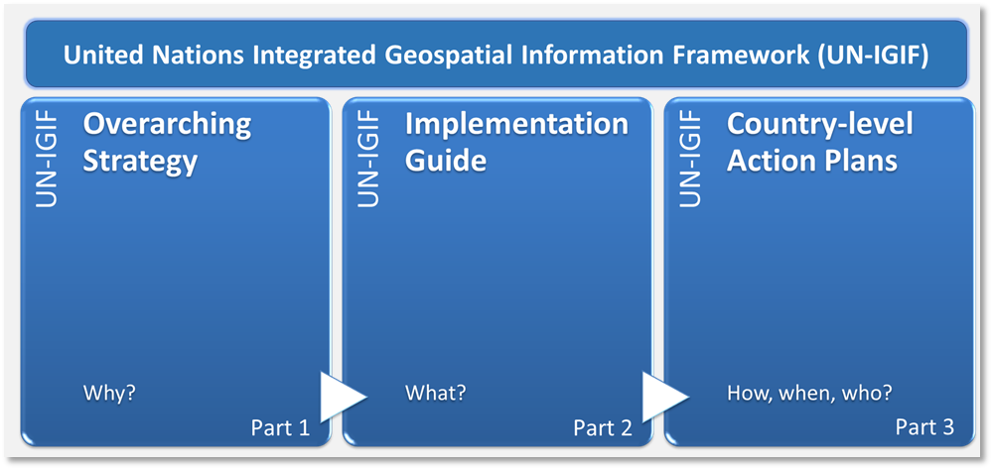
United Nations Integrated Geospatial Information Framework (UN-IGIF)
Globally developed, consulted and adopted
It is overarching, it is strategic, presents a forward-looking and aspirational framework, importantly, built on national needs and circumstances. The UN-IGIF Overarching Strategy comprises a vision and a mission, sets out the strategic drivers for and benefits from integrated geospatial information, with seven underpinning principles, eight goals and nine strategic pathways for a feasible and desired future.
The UN-IGIF comprises an overarching Strategy – from local to global, Implementation guidance, and Action plans at the country level.
http://ggim.un.org/IGIF/
Notes:
With a focus on the ability for geospatial information to be integrated with any other meaningful data to solve societal and environmental problems, the UN-IGIF as a multi-dimensional framework, is also a catalyst for economic growth and opportunity, stimulates improved understanding and decision making for national development priorities and the SDGs.
Importantly, the UN-IGIF, presented in three connected parts, is a strategy, an implementation guide and an action plan. UN-GGIM at its annual sessions had noted the global significance of the UN-IGIF, which served as a key umbrella for the many activities under the purview of the Committee of Experts, and more importantly, which could be applied to any country to guide transformational change.

Slide 17
Part 1: Overarching Strategy
https://ggim.un.org/UN-IGIF/part1.cshtml
Three interconnected parts
Part 2: Implementation Guide
https://ggim.un.org/UN-IGIF/part2.cshtml
https://ggim.un.org/UN-IGIF/documents/Solving_the_Puzzle_FINAL_17Mar2023.pdf
Part 3: Country-level Action Plan
https://ggim.un.org/UN-IGIF/part3.cshtml
https://ggim.un.org/UN-IGIF/

Slide 18
Adopted by UN-GGIM in August 2018, the Overarching Strategic Framework sets the context of ‘why’ geospatial information management is a critical element of national social and economic development, and ‘why’ it needs to be strengthened.
This is the strategic policy guide to reference when developing and strengthening national and sub-national geospatial information management systems and capabilities. It presents a forward-looking and aspirational geospatial framework built on national needs and circumstances.
As a ‘strategic’ introduction to the UN-IGIF, the intended audience includes national leaders, political leaders, organizational managers, the business community and academia, and defined benefits that take account of national priorities.
Adopted by UN-GGIM in September 2020, the Implementation Guide explains ‘what’ specific guidance and options can be taken by countries in implementing the UN-IGIF.
Expanding on each of the nine Strategic Pathways, the Guide captures strategic to operational needs with references, good practices, guiding principles, actions, deliverables, outcomes and resources for countries to establish ‘nationally’ integrated geospatial information frameworks in such a way that transformational change is enabled, visible and sustainable.
Recognizing that every country is at different levels of maturity in their geospatial development journey, the guidance is comprehensive, but general enough to be applicable to all countries, and sufficiently flexible so that each country can develop their own Action Plans to meet their national priorities and circumstances.
Includes elements such as the economic impact and value of geospatial information systems, investment needs and priorities, identification of short, medium and long-term activities, and potential funding sources.
Countries prepare and implement the UN-IGIF with their own country-level Action Plans (CAPs) that align with the country’s priorities and circumstances. A CAP references the specific guidance, options and actions provided in the Implementation Guide and addresses each of the Strategic Pathways, while taking into account the strategic and operational needs of a country when implementing the UN-IGIF.
Three interconnected parts
Notes:
The overarching Strategic framework presents a forward-looking Framework setting the context of ‘why’ geospatial information management is a critical element of national social and economic development. is designed to stimulate action towards bridging the geospatial digital divide, to find sustainable solutions for social, economic and environmental development, and to influence inclusive and transformative societal change for all citizens according to national priorities and circumstances. It communicates this via vision and mission statements, seven (7) underpinning principles, eight (8) goals and nine (9) strategic pathways, all of which are aligned to strategic national to global drivers. T
Implementation guide. provide guidance for governments to establish ‘nationally’ integrated geospatial information frameworks in countries in such a way that transformational change is enabled, the Implementation Guide, describes ‘what’ actions can be undertaken to strengthen geospatial information management. The Guide is a reference resource that provides information for governments to design, plan, establish, implement and maintain nationally integrated geospatial information frameworks in their country in such a way that transformational change is enabled, visible and sustainable.
The roadmap for implementing the Framework occurs primarily through the nine strategic pathways.
Countries prepare and implement the UN-IGIF with their own country-level Action Plans (CAPs) that align with the country’s priorities and circumstances. A CAP references the specific guidance, options and actions provided in the Implementation Guide and addresses each of the Strategic Pathways, while taking into account the strategic and operational needs of a country when implementing the UN-IGIF.

Slide 19
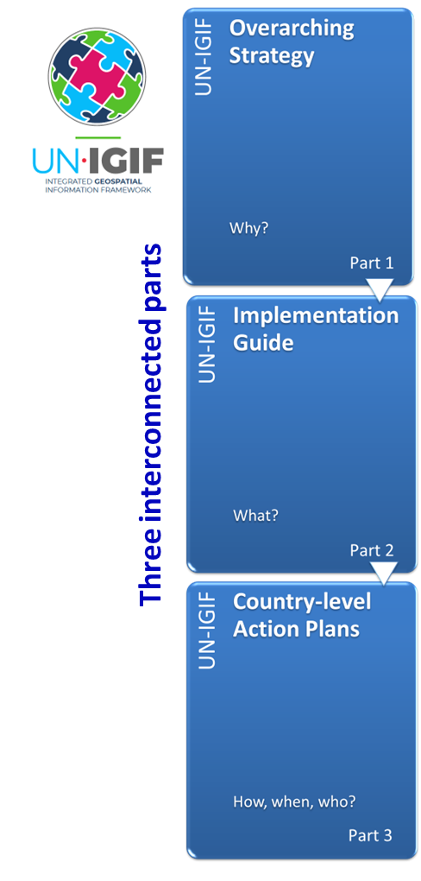
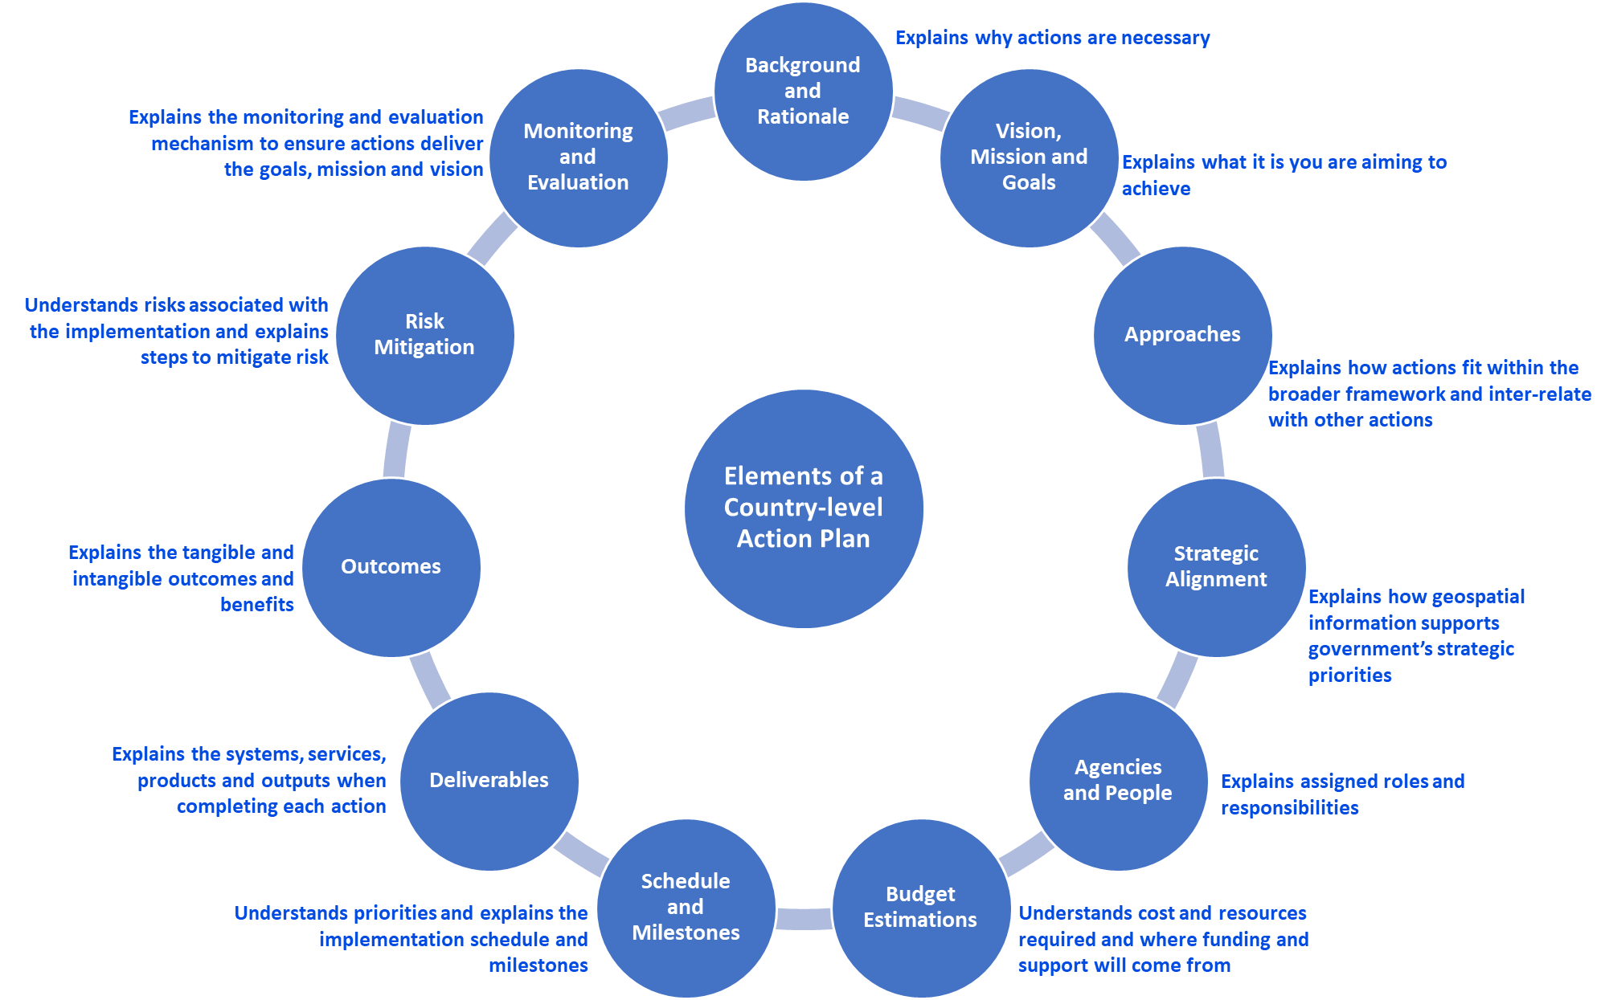
Elements of a Country-level Action Plan
https://ggim.un.org/UN-IGIF/

Slide 22
Fourteenth Session of the Committee of Experts on
Global Geospatial Information Management
14/101 Enhancing global geospatial information management arrangements
(h) Recognized the increasingly complex and challenging operating environment for national geospatial, mapping and cadastral agencies, with rapid technological changes and advancements (including artificial intelligence), noted that there were only six years remaining to implement the 2030 Agenda for Sustainable Development, in that context stressed the importance of holistically considering environment, climate, resilience and sustainability and requested the Bureau, with the support of the Secretariat, to consider those issues as a matter of priority as part of the development of the strategic framework of the Committee of Experts for the period 2025–2030, taking also into account, within all activities and operations, aspects of diversity, equality and inclusion

Slide 23
Thank you

