Slide 1
Addis Ababa, Ethiopia
30th of October 2024
Session 5: Strengthening Capacity and Resources for Disaster-Related Statistics
Habtamu Alamayo Farada
European Union Cooperation Expert, Ministry of Finance, Ethiopia
halemayehu@mofed.gov.et

Slide 2
Outline
Overview of Disaster Impact
Rationale for investing in Disaster Statistics
Challenges in Disaster Related Statistics
Recommendations for unlocking the Producers and Users of Disaster Related Statistics

Slide 3
Overview of Disaster impact
Disasters greatly disrupt development
Development i.e. GDP Growth % annual rate
Original Development Path
Disaster Event
post
disaster trend
Time
Disasters undermine development gains. They destroy basic social infrastructure (schools, hospitals, lifelines), but also impact the livelihoods and social tissue of the communities.

Slide 4
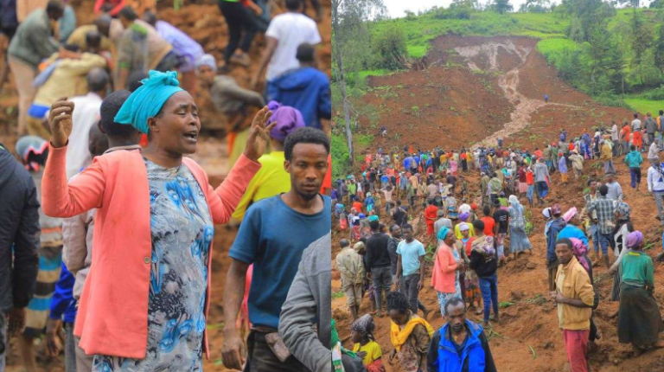
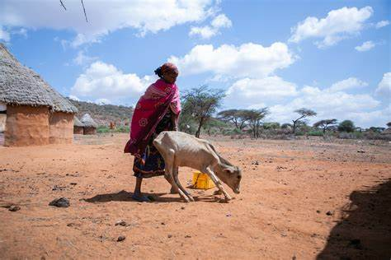
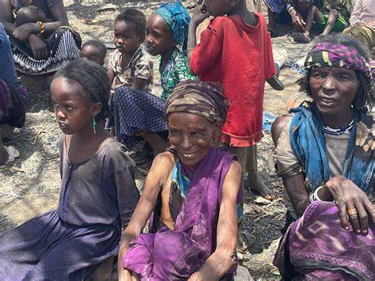
More than 200 people have reportedly died and more than 14,000 affected by landslide incidents on 21 and 22 July 2024 in Gofa Zone, South Ethiopia Region; Over the past three years, 3.3 million livestock have perished, approximately worth 3.3 billion birr due to climate-related humanitarian crises happened for three (2021-2023) Years In Borena, Oromia Region.

Slide 5
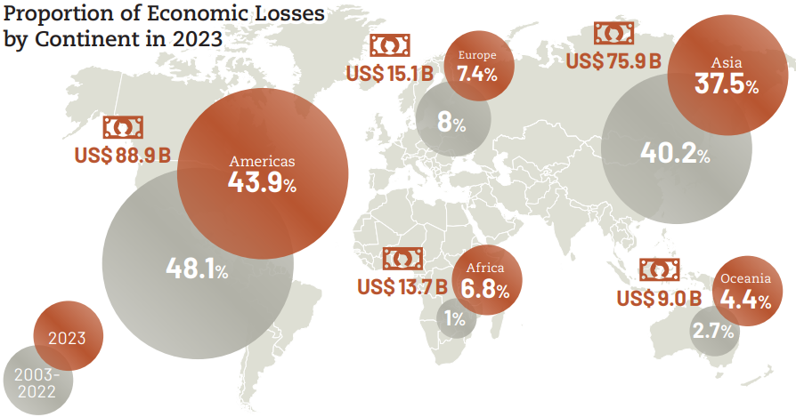
Cont…
Source: CRED (2024). 2023 Disasters in Numbers

Slide 6
Rationale for investing in Disaster Statistics
Economic benefits of data investments
Average of $ 32 USD return per $1 USD invested
Social benefits
Enhance the effectiveness of measures to reduce risk ( e.g. enable anticipatory action, inclusion)
Environmental benefits
Ecosystems preserved for resilient societies
Institutional benefits
Evidence-based decision making. Accountability
“ Data is the fuel that powers progress across all Sustainable Development Goals”

Slide 7
Challenges in Disaster Related Statistics
lack of political prioritization (commitment)
Insufficient funding,
Fragmented efforts,
Lack of Mainstreaming and Capacity gap
Lack of strong and common data collection, sharing and Analysis system (Application)
Unclear threshold, disaggregation and standardization,
Lack of clarity in roles and responsibilities
Weak communication

Slide 8
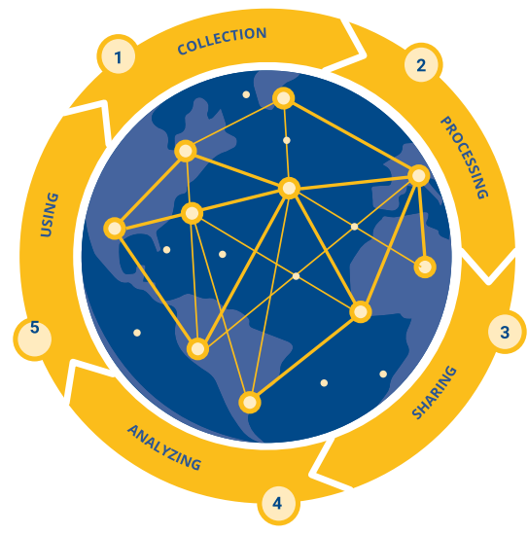
Recommendations for unlocking the Producers and Users of Disaster Related Statistics
Infrastructure: Innovative approaches to data production and use
Engage new technologies (Server, gadgets) to gain access to new sources of data and to automate where possible data entry, sharing and analysis.
Raise awareness of and support capacity to use disaster related data for planning
Improving disaggregated data for inclusive risk management
Data governance
Data quality
Data quantity
Source:
Global partnership for sustainable development data

Slide 9
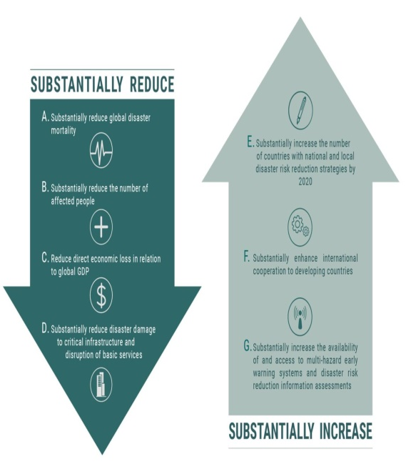
Cont…
Legal frameworks: Assess the national & Regional commitments and international agendas with operational vehicles and strengthen and/or establish
Sendai Framework for Disaster Risk Reduction (Target E- National DRR Strategy)
2030 Agenda for Sustainable Development (National SDG Targets)
Paris Agreement (NDC)
Agenda 2063: The Africa We Want
Improving INFF- national sustainable development plans and strategies per AAA (Finance for Development), and
Developing Disaster Related statistics Frameworks, strategies, and sharing mechanisms
Finance: For disaster data Financing
Financial information management system (budget tagging) for Disaster related data

Slide 10
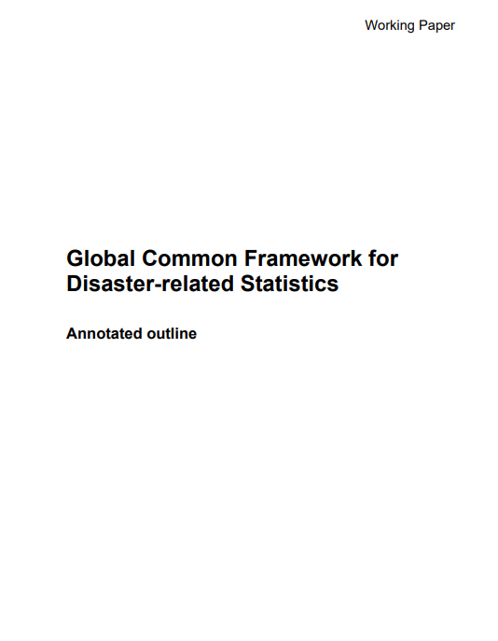
Cont…
Standardization: Agree on data standards, and standardized terms, standard operating procedures, and responsibilities for communicating disaster information
Mainstreaming:
Integrating local level data collection to national (national statistical systems) and Global disaster databases and systems.
Fully alignment of Disaster (type, magnitude, location, etc) with development plan and budgeting
desinventar.net

Slide 11
Cont…
Partnership: Effective global collaboration for Disaster impact modeling, capacity building, and monitoring
(Government (vertical & horizontal), private sectors, CSO’s, youths, UN system, academia, Media, multilateral development banks, and other development partners).
Effective communication
Pre and Post disaster
Advocacy and Networking
Awareness creation
Transparency

