Slide 1
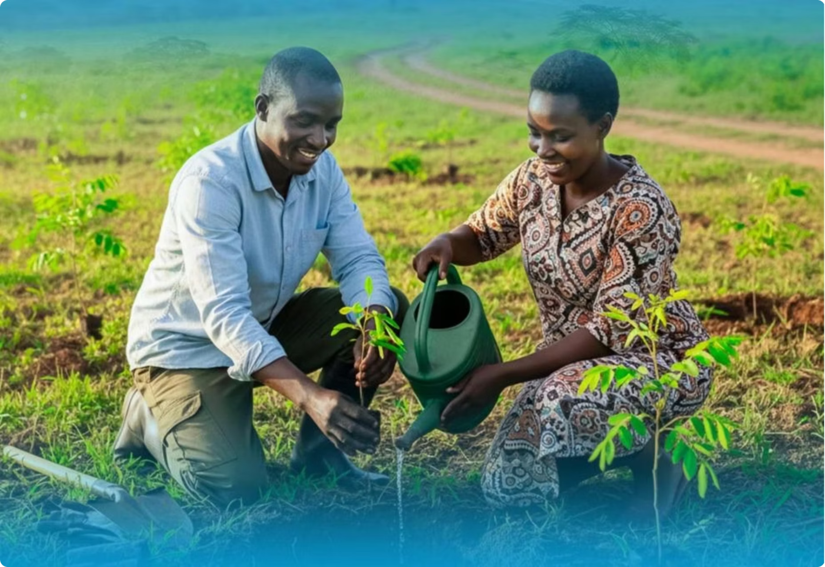



The first comprehensive national household-based survey on gender and environment in Tanzania Mainland and the second in Africa after Senegal.
KEY FINDINGS
Presented by
Philbert Mrema
Coordinator of Gender Statistics
National Bureau of Statistics, Tanzania
Tanzania Gender and Environment Survey 2025

Slide 2
Survey at a Glance
TGES 2025 delivers a unique statistical foundation, covering six agro-ecological zones across Mainland Tanzania.
4,715
6,844
Households Covered
Adults Interviewed
Nationally representative sample across all agro-ecological zones
One Men and One women aged 18 years and above
99.2%
6
Response Rate
Agro-Ecological Zones
Exceptionally high participation ensuring robust, reliable data
Full geographic coverage of Mainland Tanzania
Notes:
• TGES 2025 represents a major statistical achievement—the most comprehensive survey foundation we've built to date
• Highlight the scale: 4,715 households gives us a nationally representative sample across all six agro-ecological zones of Mainland Tanzania
• 6,844 adults interviewed—both men and women 18 and older—ensuring we capture diverse perspectives across the country
• The 99.2% response rate is exceptional and critical to emphasize—this level of participation means our data is exceptionally robust and reliable, not subject to significant non-response bias
• Complete geographic coverage across all six agro-ecological zones means we can make meaningful comparisons and understand regional variations
• This foundation sets us up to draw confident conclusions about agricultural practices, livelihoods, and conditions across Tanzania

Slide 3
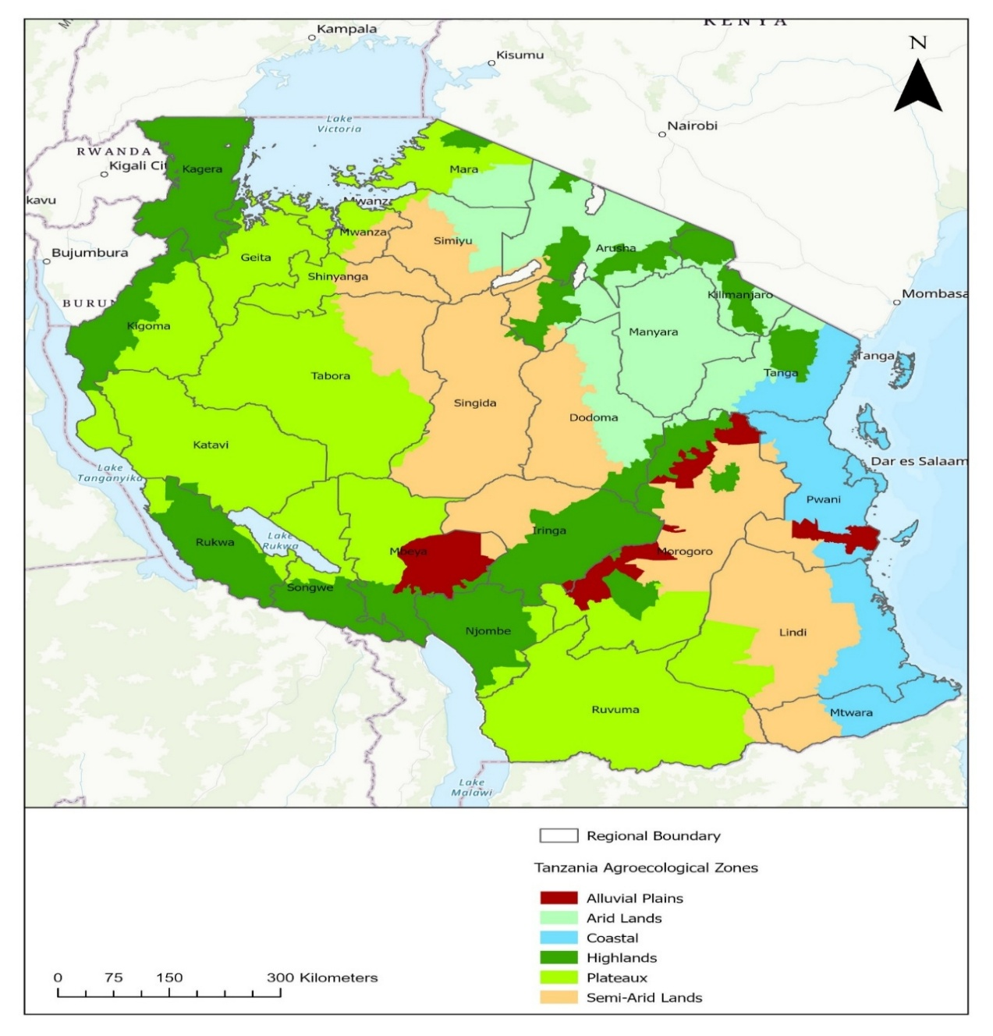

Agro-ecological Zones
Notes:
• TGES 2025 represents a major statistical achievement—the most comprehensive survey foundation we've built to date
• Highlight the scale: 4,715 households gives us a nationally representative sample across all six agro-ecological zones of Mainland Tanzania
• 6,844 adults interviewed—both men and women 18 and older—ensuring we capture diverse perspectives across the country
• The 99.2% response rate is exceptional and critical to emphasize—this level of participation means our data is exceptionally robust and reliable, not subject to significant non-response bias
• Complete geographic coverage across all six agro-ecological zones means we can make meaningful comparisons and understand regional variations
• This foundation sets us up to draw confident conclusions about agricultural practices, livelihoods, and conditions across Tanzania

Slide 4
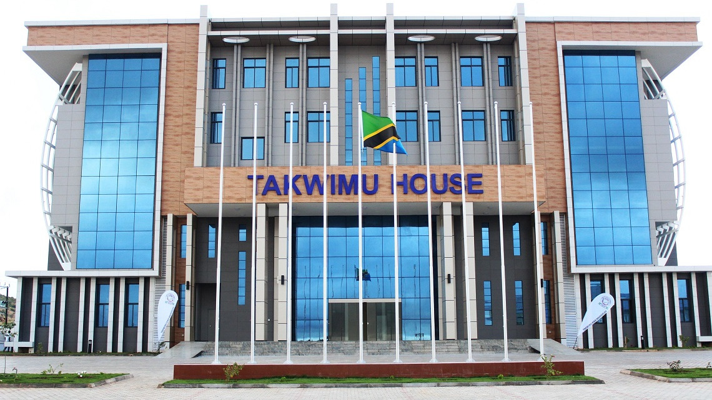
Lead Institution
National Bureau of Statistics (NBS), in partnership with the:-
  Vice President's Office, (Environment),
  Ministry of responsible for gender(Ministry of Community Development, Gender, Women and Special Groups (MoCDGWSG),
  other MDAs, non-state actors, research and academic institutions and
  UN Women, provided Technical Support
Fully financed by the Government of Tanzania through the Tanzania Statistical Master Plan II fund (National Strategy for the Development of Statistics - NSDS).
4

Slide 5

Survey Background & Objectives
Why This Survey?
2030 Agenda
Sendai Framework
UN Global Set
Sustainable Development Goals
Disaster Risk Reduction
A common Global framework for
climate change statistics.
Paris Agreement
FDES
Tanzania Development
Vision 2050
The Basic Set of Environment Statistics
Climate Action & Resilience
Four Core Objectives
Produce baseline gender-environment indicators
Benchmark sex-disaggregated environmental statistics
Estimate exposure to disasters and climate change impacts
Assess how livelihoods interact with the environment

Slide 6
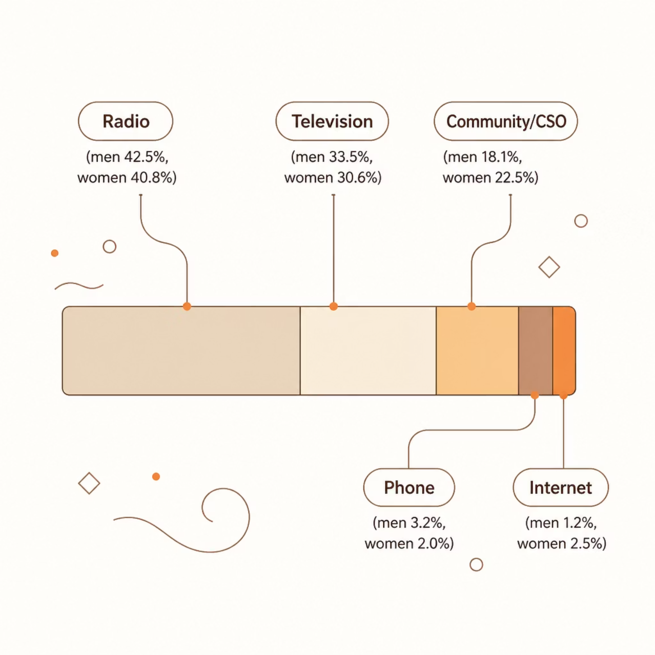
Key Findings
Disaster Preparedness & Early Warning: Who Gets the Message?
National Gender Gap
15.1% of men vs. 11.7% of women received early warning information in the past 12 months.
Urban access is higher (17.3% men, 14.1% women) than rural (14.3% men, 10.5% women).
Zone Extremes
Coastal zone leads: 21.8% men, 16.6% women.
Arid Lands lag: only 9.1% men and 6.3% women
informed.
Usefulness
Despite access gaps, usefulness is broadly similar: 75.5% men and 73.1% women found information valuable.
Highlands men: 85.3% vs. women: 70.8% — the widest gender gap.

Slide 7
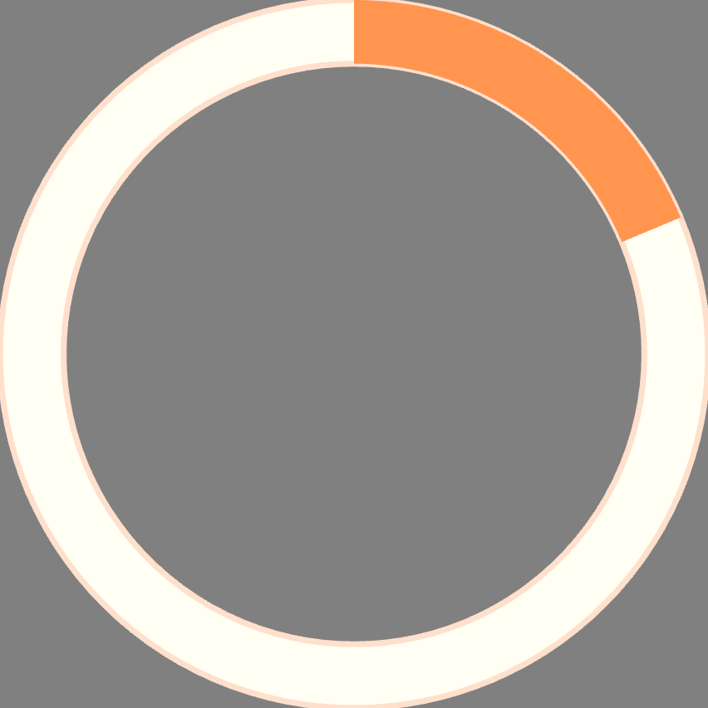
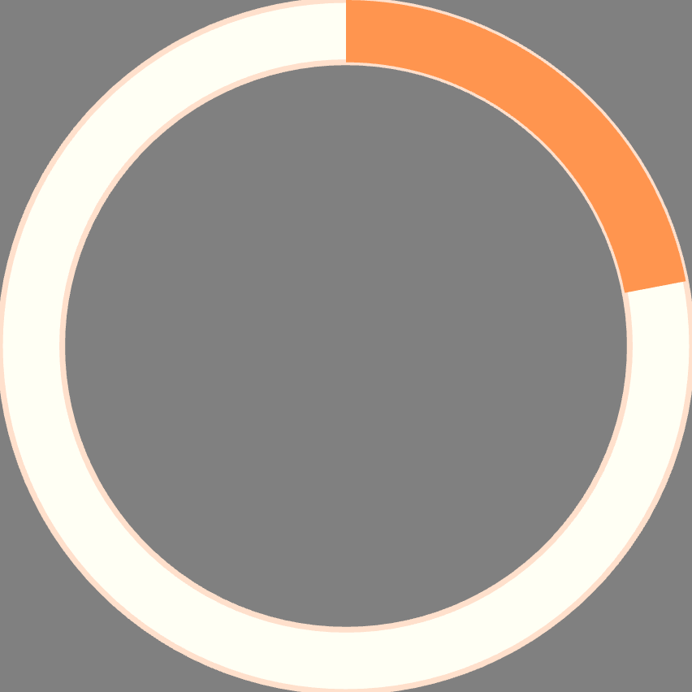
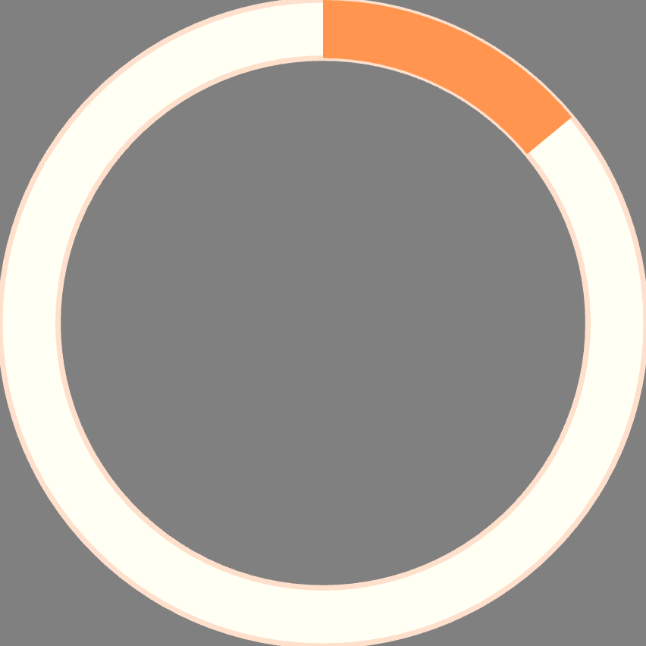
Key Findings
Early Warning: Awareness Without Action
Early warning information can improve household resilience — but uptake of preparedness measures remains modest, limiting its protective impact.
18.7%
22%
14–16%
Women Preserved Water
Preserved Dry Food
Harvested or Stored Crops
After receiving early warning information, vs. 16.1% of men
About 22% of households preserved dry food in preparation for climate hazards (22.3% for Women vs 22.1% for men
Only 14–16% harvested or stored crops in preparation for climate hazards (14.5% for Men vs 14.0% for Women)

Slide 8
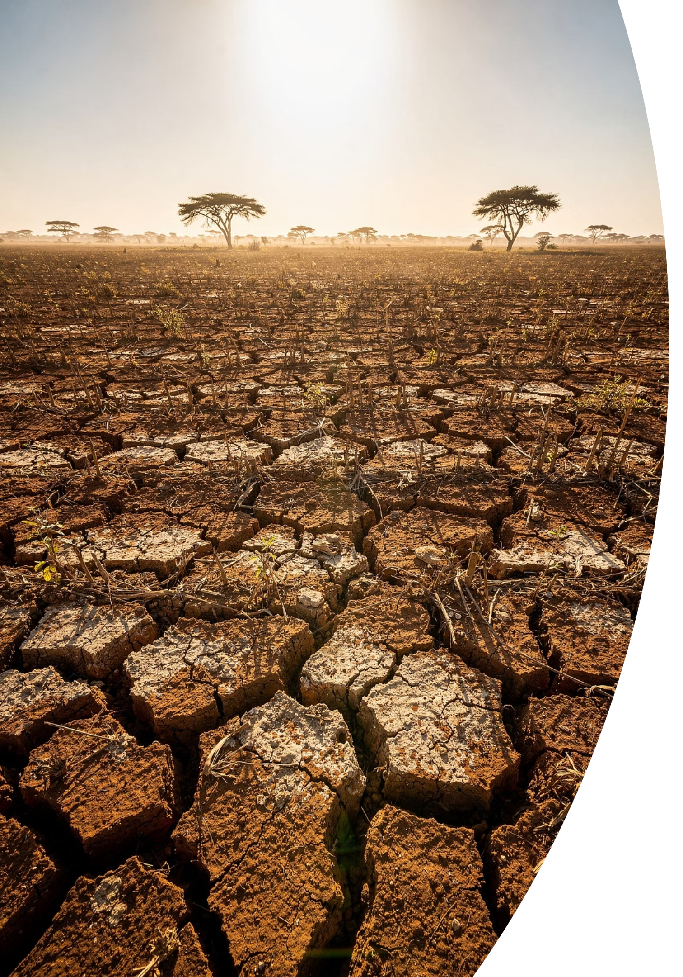
Key Findings
Disaster Experience & Impacts
Drought — Most Prevalent
Livelihood Damage
Drought was the most common disaster: 27.2% of men and 28.0% of women nationally. In Arid Lands, this rose to 48.0% of men and 50.3% of women. Rural women were most affected (35.0%).
Crop damage affected 40.2% of men and 38.4% of women nationally. In Semi-Arid Lands, crop damage reached 60.4% of men and 56.5% of women. Income decreases were reported by 48.6% of men and 43.6% of women.
Dwelling Destruction
Deepen Unpaid Care Burdens
In Semi-Arid Lands, dwelling destruction was more prevalent among women-headed households (81%) than men-headed households (60%). Coastal and Alluvial Plain zones also showed high destruction rates.
Disasters increased unpaid care work disproportionately for women: 12.4% of women reported increased water collection time vs. 9.3% of men;
10.3% of women reported increased domestic work vs. 5.7% of men.

Slide 9
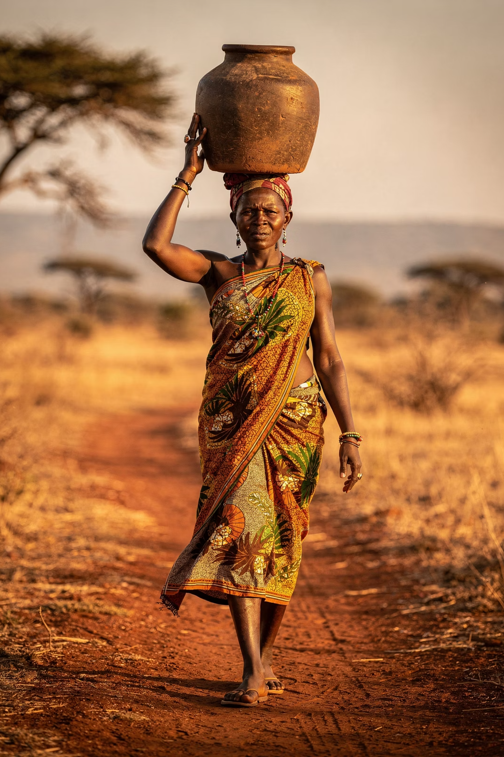
Key Findings
Water & Sanitation
Access to safe water and sanitation remains deeply uneven — rural communities and women-headed households face the greatest challenges.
69.2%
59.5%
Improved Drinking Water
Improved Sanitation
96.1% urban vs. only 58.1% rural households
Significant gaps remain, especially in rural areas
92.1% urban vs. only 46.0% rural households
Women-headed households are less than half (20.2%) as likely to access improved drinking water, increasing the time women spend collecting water.
Men – headed house holds 49. 0% access improved drinking water
Women-headed households are (17.1%) as likely to access improved Sanitation, vs Men – headed house holds 42.4% access improved Sanitation

Slide 10
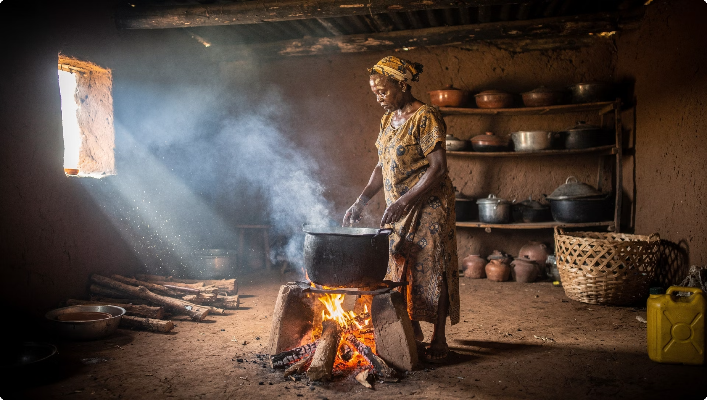
Key Findings
Energy Access & Clean Cooking
Majority rely on biomass fuels for cooking; firewood (60.9%) and charcoal (21.0%).
Firewood use: 81.0% rural vs. 13.6% urban.
Clean energy for cooking reaches only 16.6% nationally; Only 5% women headed households vs. 11.7% male headed households.
  Women and children face the greatest health risks from indoor air pollution.
Biomass Dependency
Clean Energy Gap
Over 80% of rural households use wood or charcoal
LPG and solar adoption remains low outside urban centers

Slide 11
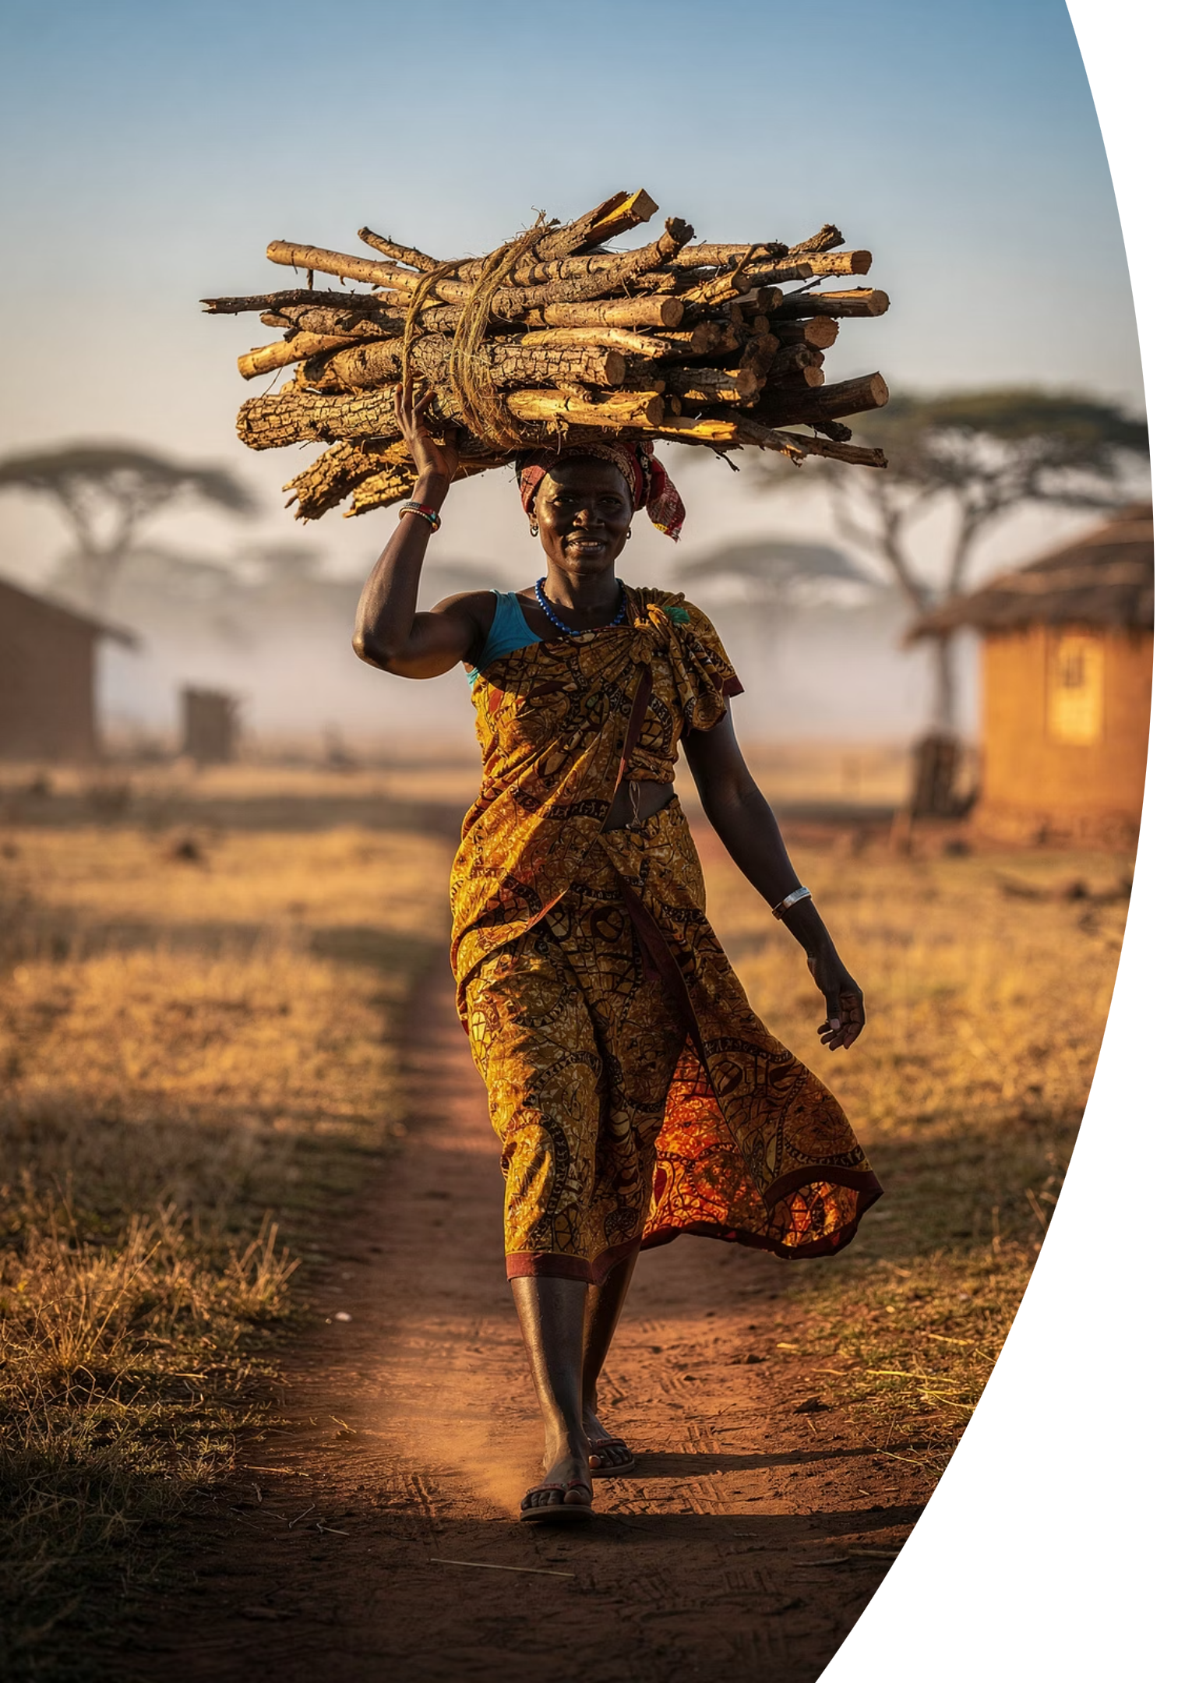
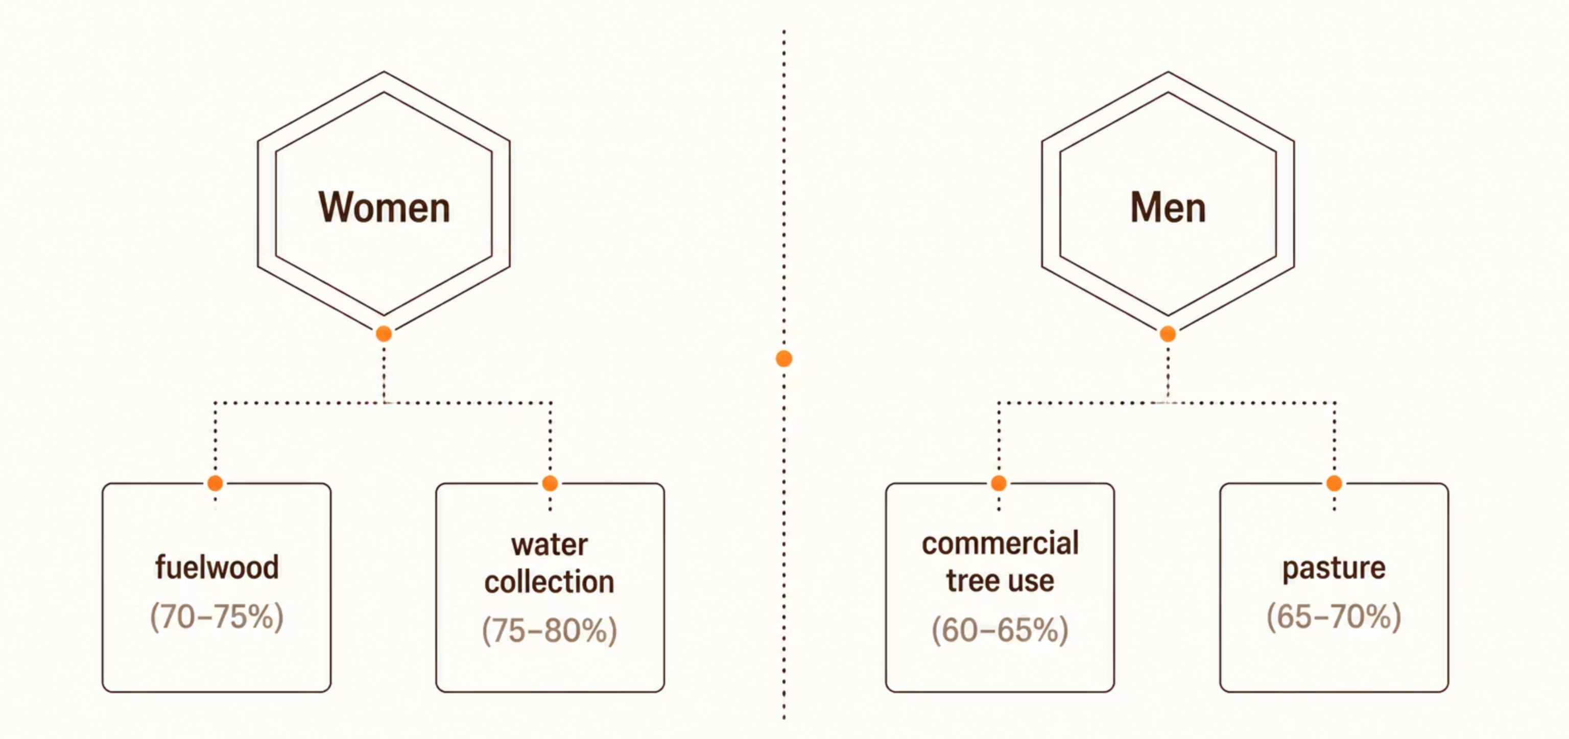
Key Findings
Natural Resources Underpin Rural Livelihoods
About 70% of adults are engaged in agriculture, and
70–75% of rural households depend directly on natural resources
for their livelihoods; making sustainable environmental
management essential.

Slide 12
Key Findings
Women Underrepresented in Environmental Governance
Despite their deep dependence on natural resources, women remain largely excluded from the decisions that shape environmental management.
Decision-Making Power
Committee Participation
Less than 2% of women participate in environmental and water management committees across agro-ecological zones; indicating systemic exclusion from environmental governance.
Men are considerably more likely to make independent decisions regarding financial resources and natural resource use — leaving women with little agency over the resources they depend on most.

Slide 13
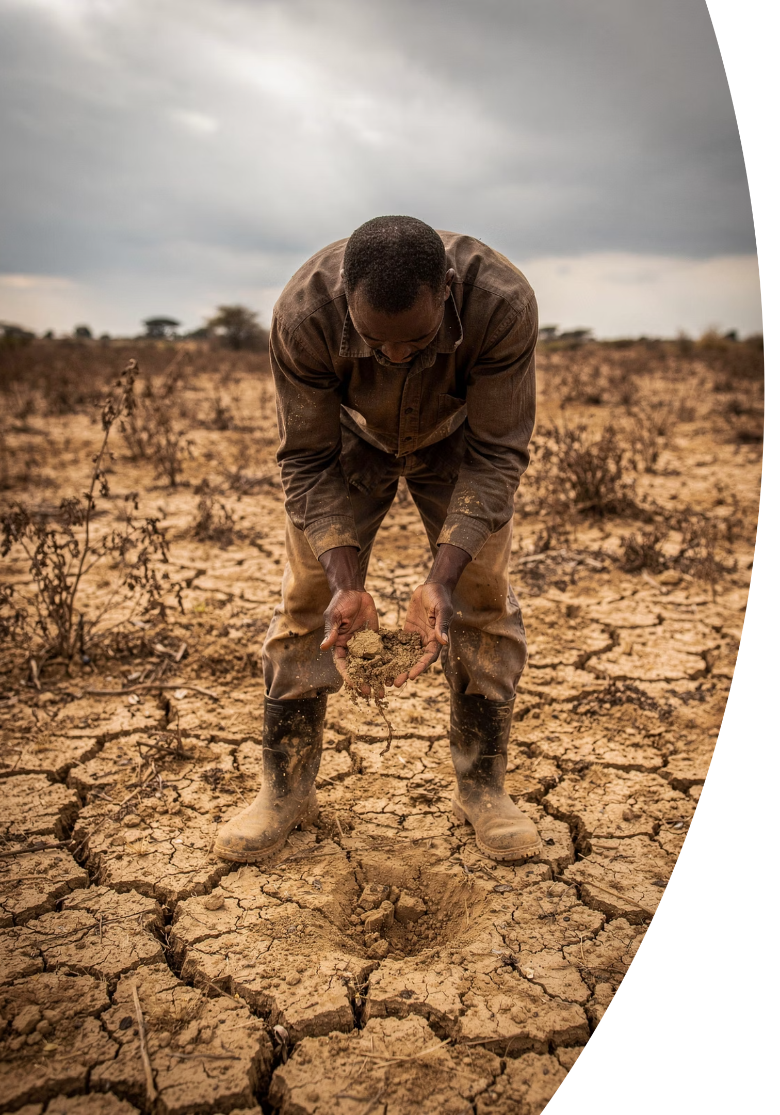
Key Findings
Environmental Degradation Threatens Livelihoods
Environmental degradation is undermining agricultural productivity and household wellbeing across Tanzania.
Declining Soil Fertility
Reduced Agricultural Yields
46.9% of households reported declining soil fertility threatening crop production
50.2% of men and 46.0% of women experienced reduced yields due to climate change
Fisheries in Decline
More than 80% of fishers reported declining fish catches over time

Slide 14
Key Findings
Conservation Practices Remain Critically Low
Low adoption of conservation measures limits household resilience to climate change and environmental degradation.
Arid Lands
Coastal Zone
Sustainable Farming
100% of women-headed households reported having no conservation measures in place
100% of both women- and men-headed households reported no household-level conservation practices
Fewer than 30% of farmers adopt practices such as crop rotation, mixed cropping, or intercropping

Slide 15
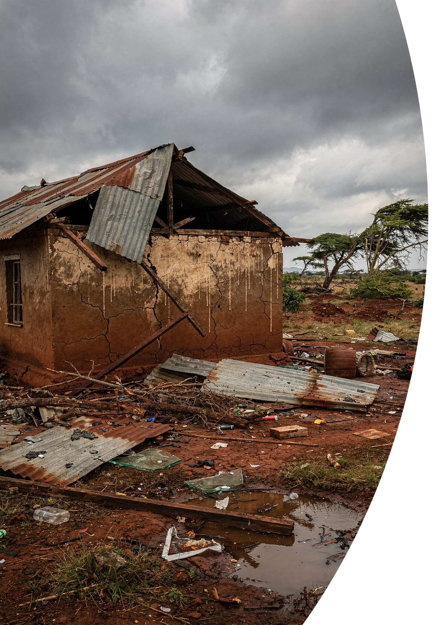
Key Findings
Climate Impacts on Health & Housing
Climate change has significant impacts on health, housing, and household wellbeing across Tanzania.
Physical Health
12.7% of women and 11.2% of men reported physical health impacts from climate-related events
Mental Health
23.0% of women and 28.8% of men experienced mental health effects
Housing Damage
Around 61% of households reported damage or destruction of their dwellings

Slide 16
Three High-Level Takeaways
1
Impacts Are Real and Gendered
2
Investment Builds Resilience
3
Evidence Enables Action
Climate change is already affecting households across Mainland Tanzania — but women and women-headed households face greater vulnerability due to unequal access to resources, services, and decision-making.
Investing in clean energy, resilient water systems, sustainable agriculture, climate-resilient housing, and women's empowerment will strengthen household resilience and accelerate progress toward the SDGs.
TGES 2025 provides an unprecedented statistical foundation for integrating gender into environmental, climate change, and development policies — ensuring interventions are targeted, equitable, and evidence-based.

Slide 17
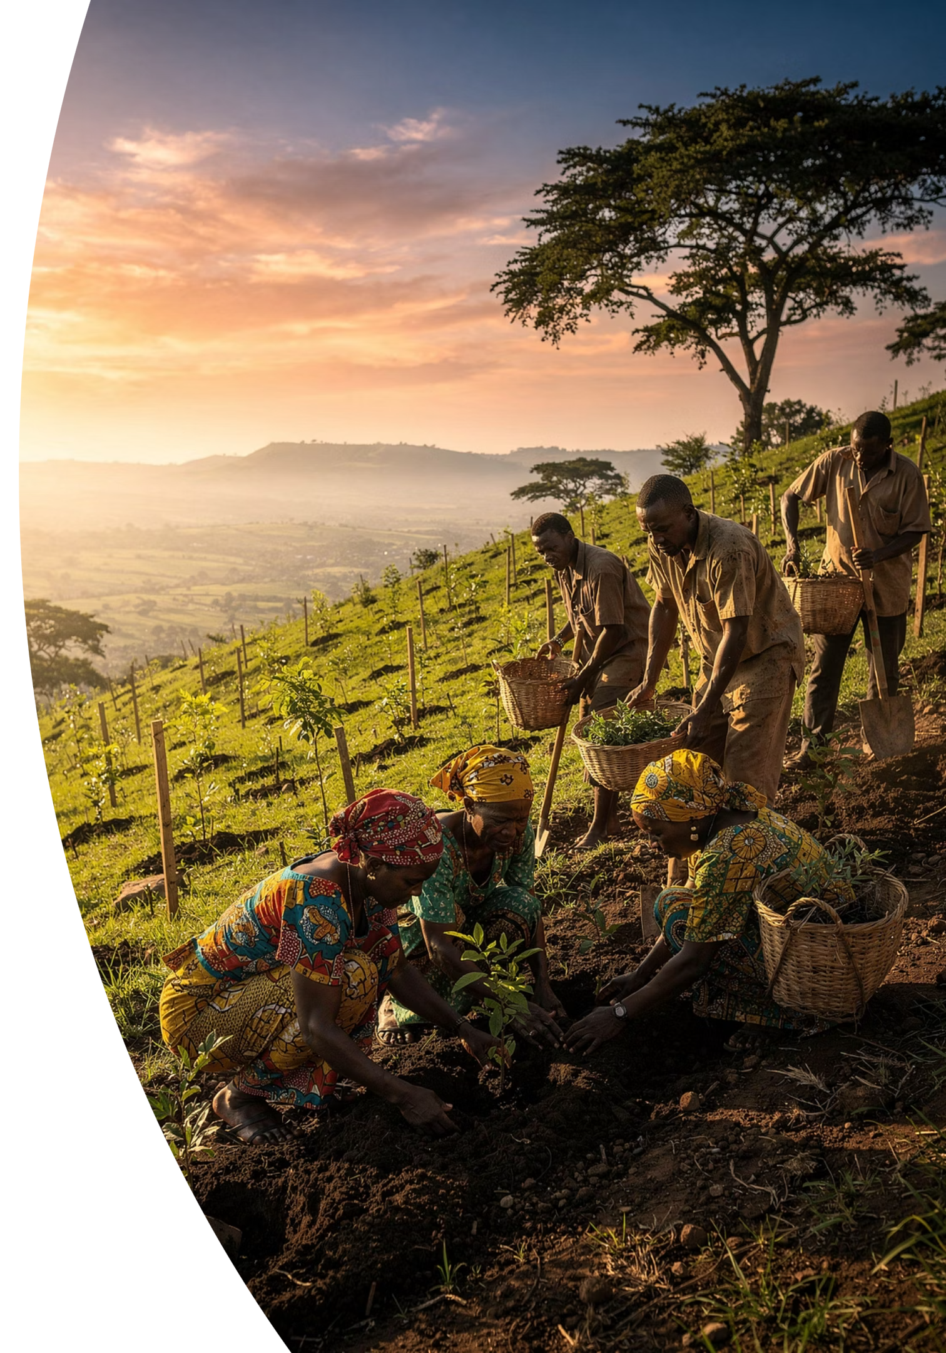
Thank you for your kind attention!
https://www.nbs.go.tz/uploads/statistics/documents/en-1778219009-Tanzania%20Gender%20and%20Environment%20Survey%202025.pdf
https://www.nbs.go.tz/uploads/statistics/documents/en-1778230114-Trifold%20Tanzania%20Gender%20and%20Environment%20Survey%202025.pdf

