Slide 1
Legal identity for all: a rights-based approach
William Muhwava

Slide 2
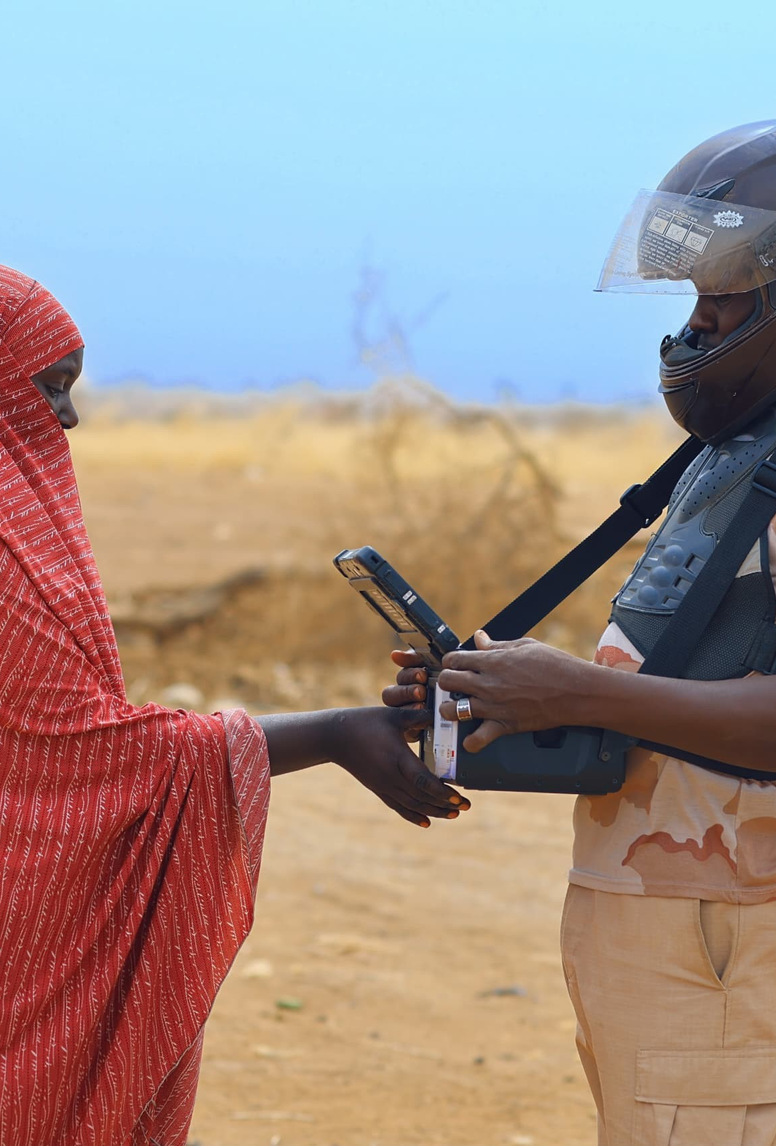
Background
Globally, 1.5 billion people did not have legal identity documents in 2019 (at the inception of UN LIA). Declined to about 850 million as of 2023.
The situation is worse in Africa where about 542 million people do not have identity cards. Of this number, around 95 million children under five have never had their births recorded, and 120 million children do not have a birth certificate.
Legal identity for all starting from birth is a game changer to close the global identity gap & fulfil the promise to leave no one behind and realize the 2030 Agenda for Sustainable Development.

Slide 3
Defining legal Identity
Legal identity is the basic characteristics of an individual’s identity—e.g. name, sex, place & date of birth conferred through registration and the issuance of a certificate by an authorized civil registration authority following a birth.
In the absence of birth registration, legal identity may be conferred by a legally-recognized identification authority
This system should be linked to the civil registration system to ensure a holistic approach to legal identity from birth to death.
Legal identity is retired by the issuance of a death certificate by the civil registration authority upon registration of death.
In the case of refugees, Member States are primarily responsible for issuing proof of legal identity.
Proof of legal identity issued to refugees may also be administered by an internationally recognized & mandated authority, for example, UNHCR
Proof of legal identity is a credential—e.g. birth certificate, identity card or digital identity credential—recognized as proof of legal identity under national law.
Notes:
To adjust size and position of photo, click on ‘Crop’ on the toolbar. Or right click on photo and choose ‘Crop’.

Slide 4
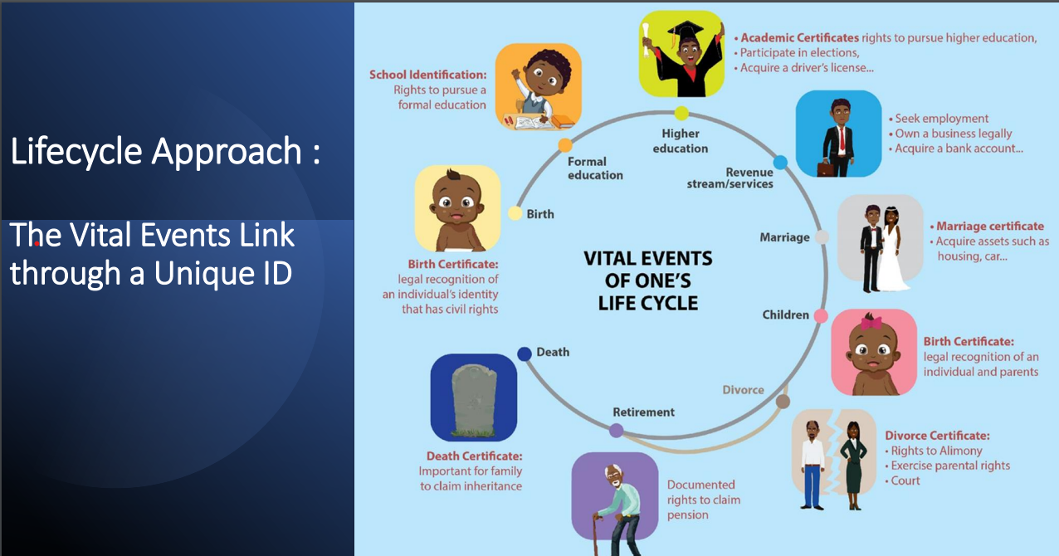

Slide 5
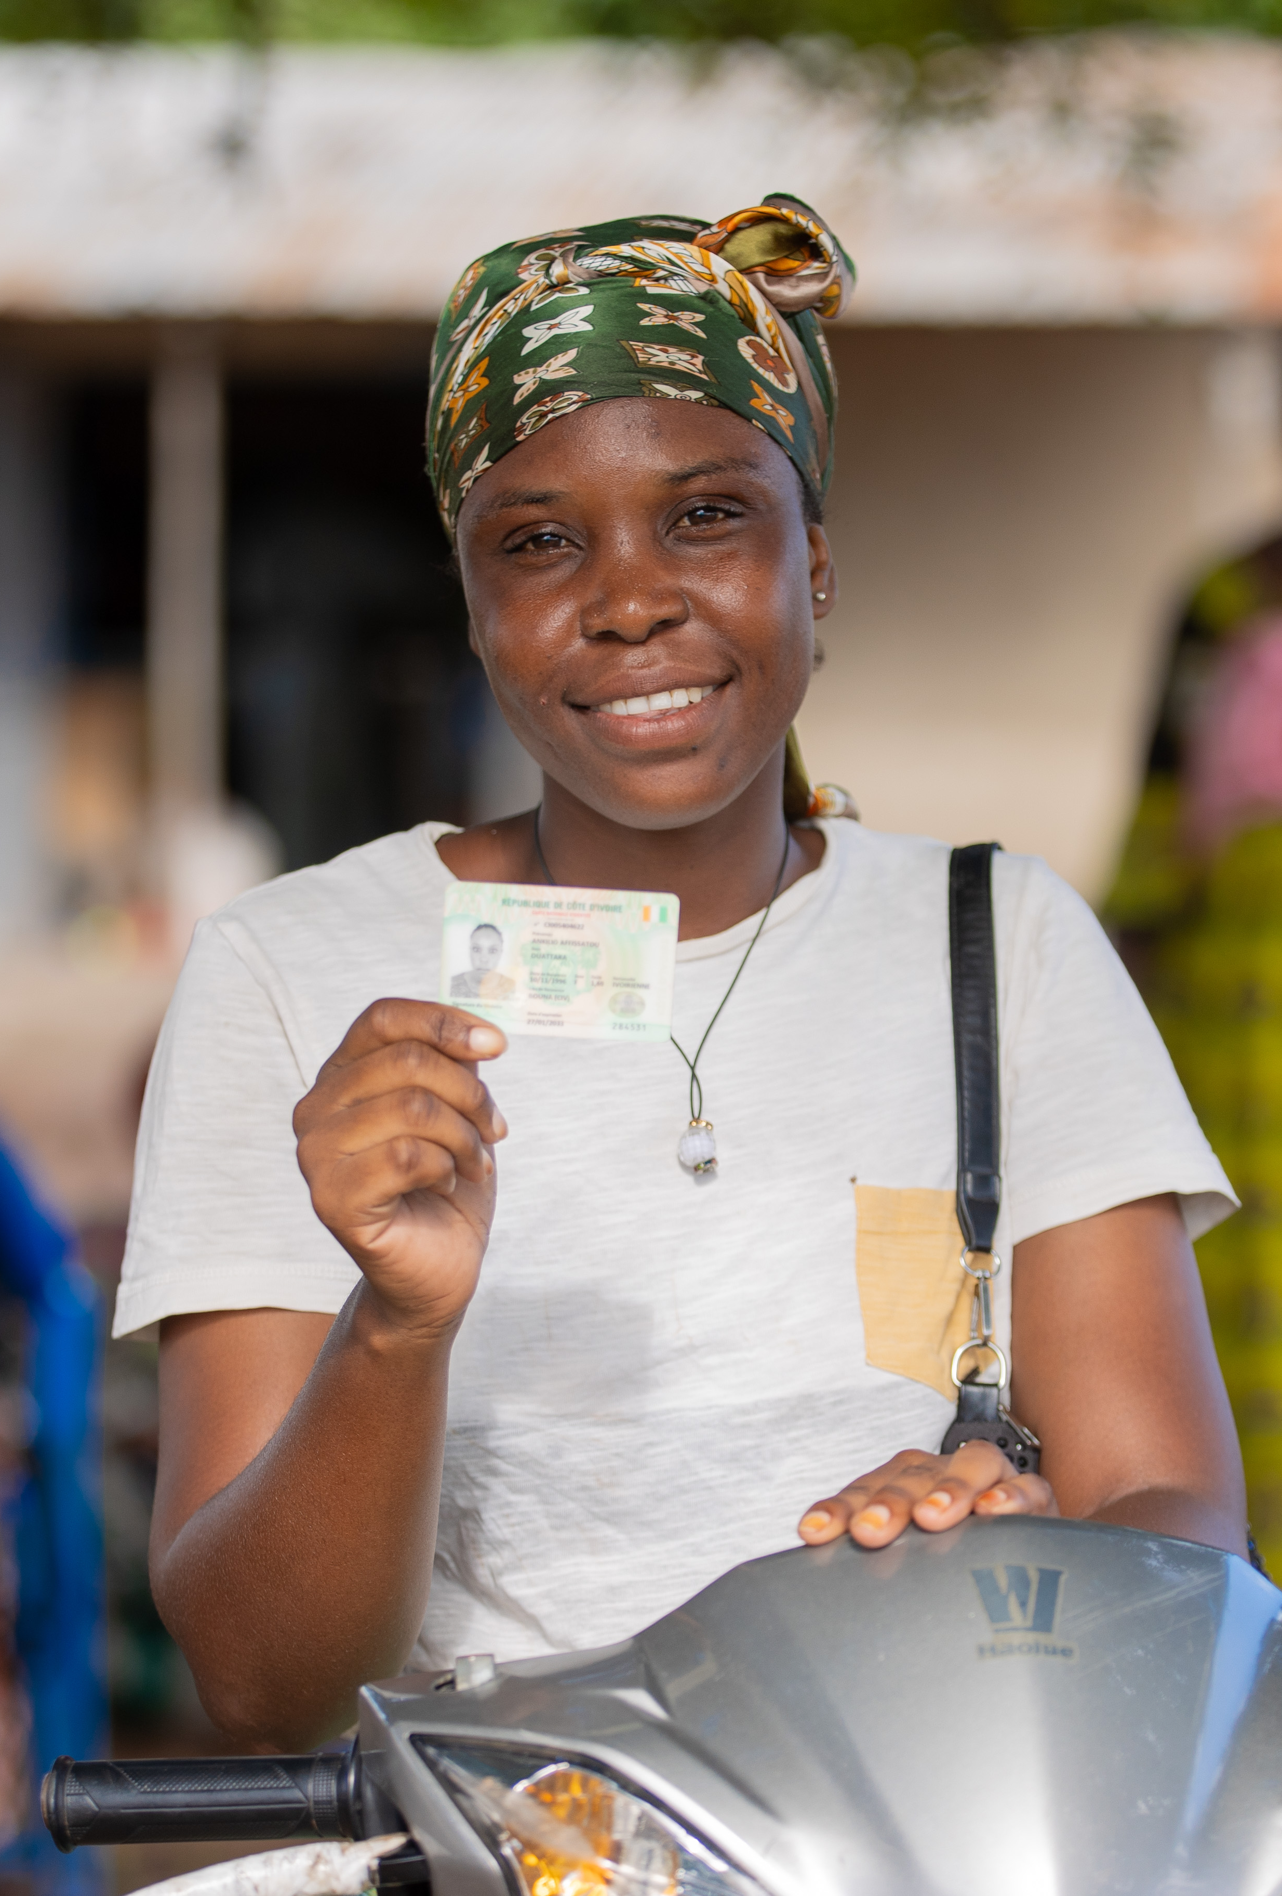
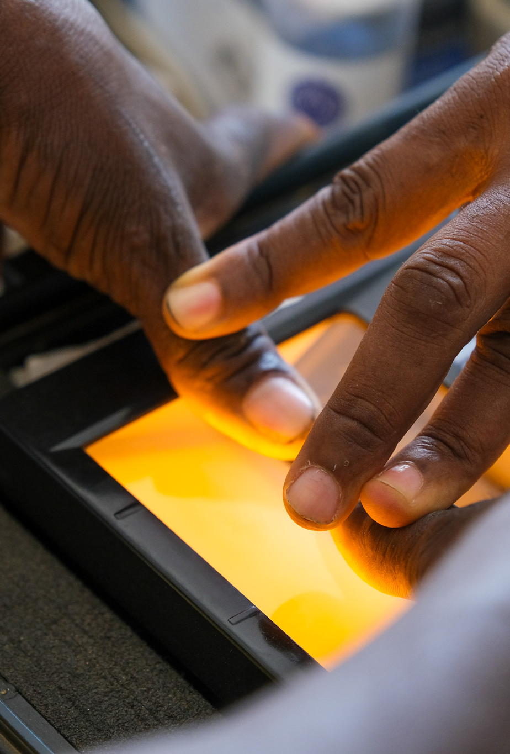

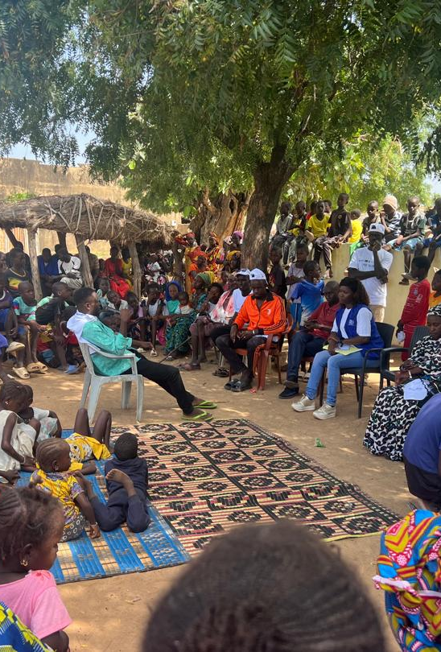
UN LIA: Principles
Everyone has the right to be recognized as a person before the law, as enshrined in Article 6 of the Universal Declaration on Human Rights and a number of international human rights instruments
To address this, the 2030 Agenda for Sustainable Development established SDG Target 16.9 – legal identity for all, including birth registration
Civil registration establishes the existence of a person under the law and is fundamental to granting legal identity
It is recognized as the ultimate source for production of comprehensive, regular and reliable vital statistics
In an effort to increase civil registration coverage worldwide the 2030 Agenda for Sustainable Development established SDG Indicator 17.19.2 – proportion of countries that have achieved 100% birth registration and 80% death registration
Notes:
To adjust size and position of photo, click on ‘Crop’ on the toolbar. Or right click on photo and choose ‘Crop’.

Slide 6
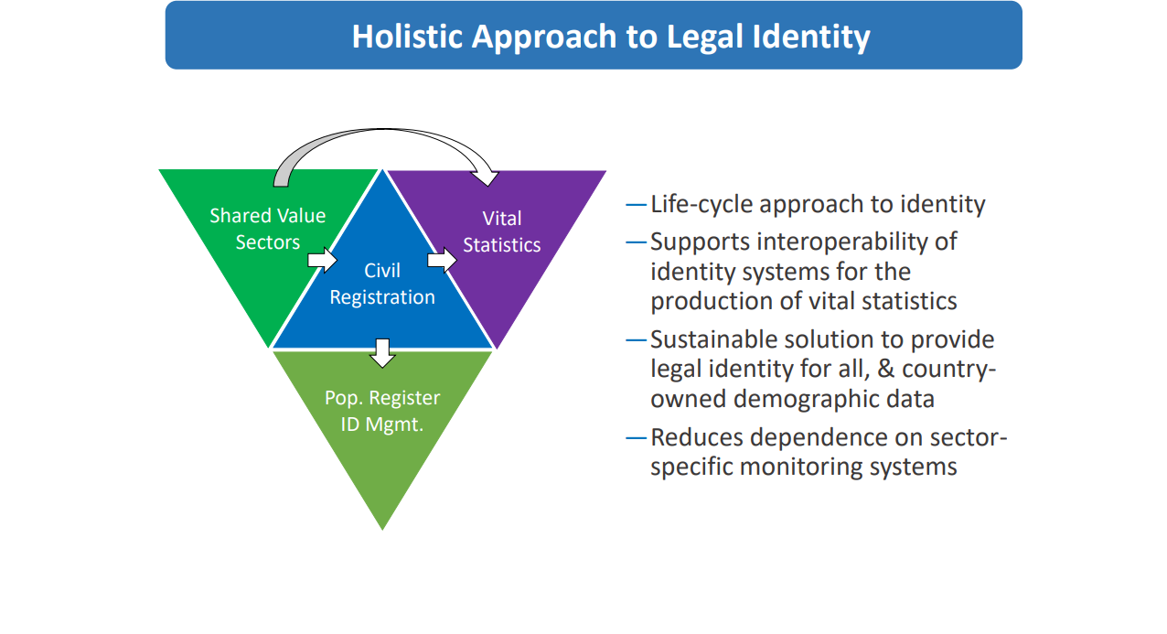

Slide 7
Linking CRVS and ID Management
Accurate population data: The linkage of civil registration and vital statistics to legal identity systems ensures the accuracy, completeness and timeliness of population data and of records of such vital events as births, deaths and marriages, while legal identity systems establish official recognition of individuals.
Effective service delivery: Linking civil registration and vital statistics and legal identity systems and harnessing the role of the health sector facilitate more efficient and targeted service delivery across various sectors such as education, social welfare and electoral processes.
Protection of rights: Legal identity is a fundamental human right and is crucial to gain access to other rights and services. Linking civil registration and vital statistics and legal identity systems ensures that individuals have official recognition and documentation of their identities, which will enable them to exercise their rights, gain access to social services, participate in economic activities and assert legal claims.
Reduced fraud and impersonation: Integrated systems that have strong verification mechanisms help to reduce identity fraud, impersonation and other forms of identity-related crime. By linking civil registration and vital statistics data with legal identity records, authorities can authenticate identities more effectively, thereby safeguarding against fraudulent activity in financial transactions, public services and voting processes, among other areas.
Cross-border recognition: The linkage of civil registration and vital statistics to legal identity systems facilitates cross-border recognition and documentation of identity. This is particularly beneficial for migrants, refugees and individuals moving between countries, as it enables them to gain access to services, establish legal status and participate more fully in their host societies.
Data for development: Linked systems provide valuable data for evidence-based policymaking, development planning and monitoring progress towards national and international development goals.

Slide 8

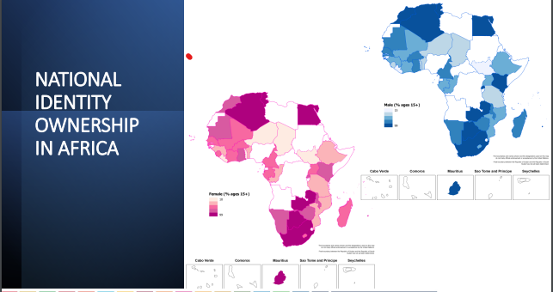
PROMOTING REGONAL STABILITY THROUGH COOPERATIVE BORDER GOVERNANCE AND INTEGRATED BORDER SECURITY

Slide 9
Conclusion
Advocate for the political will and commitments to provide and fund legal identity as public good and service
Advocate for adequate funding through the public fiscus for implementation of civil registration and national identities
Member States to put in place institutional capacity amongst relevant line ministries and departments to better, plan, budget, advocate and scale up delivery of legal documents
Member States to provide adequate infrastructure, supply and logistics chain to support service delivery
Communities have access to information and knowledge about the availability and benefits of civil registration and identity management services
Notes:
To adjust size and position of photo, click on ‘Crop’ on the toolbar. Or right click on photo and choose ‘Crop’.

