Slide 1



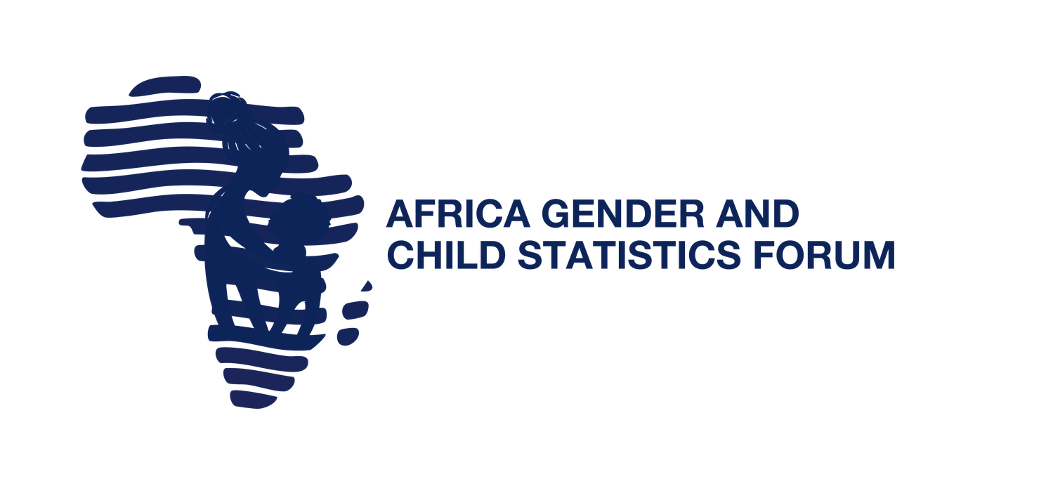
1ST AFRICA GENDER AND CHILD STATISTICS FORUM | AGCSF 2026
Statistics that Matter:
Advancing Rights, Justice, and Opportunities for All
6–10 July 2026 • Hilton Hotel, Yaoundé, Cameroon
Statistics outlook for CRVS and child rights in Africa
Pamela Kakande Nabukhonzo•
ACS, UNECA

Slide 2
Statistics that Matter Begin with Legal Identity
Civil Registration and Vital Statistics systems:
are foundational statistical systems for rights, justice, inclusion and opportunity.
record the vital events of life—births, deaths, marriages, divorces and causes of death—and transform them into evidence for governance, planning and accountability.
urpose
Focs
  A child who is not registered is often invisible in data, policy, service delivery and protection systems.
  Birth registration is recognized as a child right and is central to SDG Target 16.9 on legal identity for all, including birth registration in Africa Agenda 2063.

Slide 3
CRVS is More Than Registration
Statistics that Matter
It is a rights infrastructure for every child
“
CRVS supports child rights by enabling:
Birth registration ensures children are immediately recognized under the law, providing a foundation for protection from harm and exploitation, as well as access to essential services like vaccines, healthcare, and education.
🪪
Legal identity
from birth
🏫
Access to education,
health care & social protection
🛡
Protection from child marriage,
child labour, trafficking & statelessness
👨‍👩‍👧
Proof of age &
family relationships
📊
Evidence-based planning
for children’s services
⚖
Accountability for
government commitments
— Catherine Russell
UNICEF Executive Director
Source: UNICEF UK press release, 2024
Birth registration provides proof of a child’s existence and legal identity — birth certificates may be required for nationality, education, health care, justice and protection services.
Africa Gender and Child Statistics Forum | CRVS & Child Rights
Rights • Justice • Opportunities

Slide 4
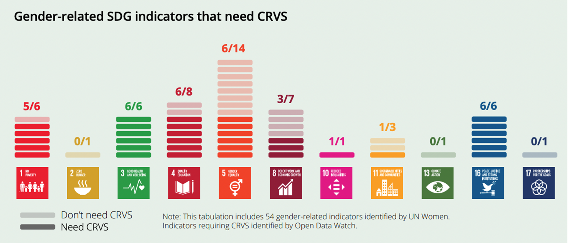
Gender Equality: Monitoring the SDGs
Of the 54 explicitly gender-related indicators, 34 benefit from CRVS data
urpose
Focs

Slide 5
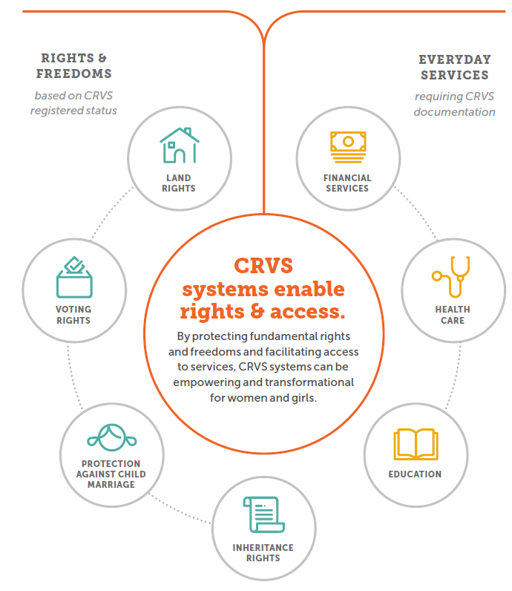
CRVS opens doors for women and girls
urpose
Focs
Exclusion of Women and girls from population data makes them ‘invisible,’ and the lack of legal identity exacerbates their vulnerability to poverty, abuse, and exploitation.

Slide 6
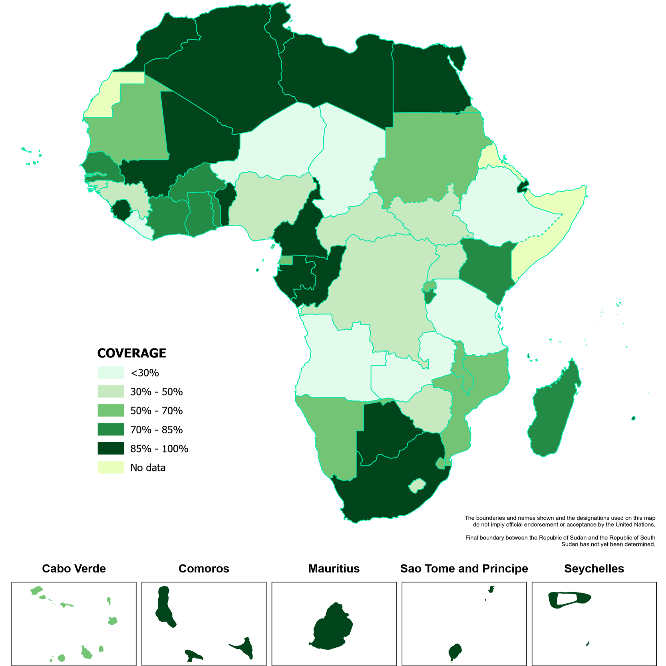
Africa’s CRVS and Child Rights Outlook
  Africa has made visible progress through the Africa Programme on Accelerated Improvement of Civil Registration and Vital Statistics (APAI-CRVS), whose vision is “Everyone Visible in Africa.”
  Many children remain outside official systems. - a major challenge for child rights monitoring, especially as Africa is expected to account for a growing share of global births by 2050.
urpose
Focs
Notes:
, In sub-Saharan Africa, only just over half of children under five are registered, and the region accounts for a large share of the world’s unregistered children.

Slide 7
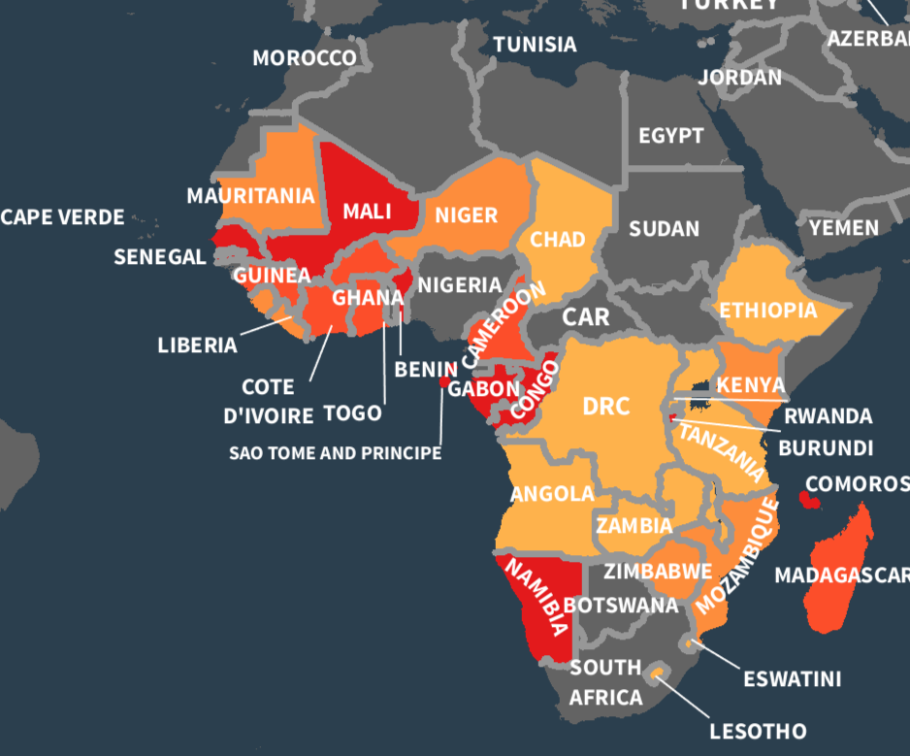
Birth registration in Africa
Gender issue: there was gender bias in birth Registration in more than half of the countries (54%)
Source: Demographic and Health Surveys
Notes:
In terms of gender equality, the situation is biased taking the example of birth registration across countries in Africa, we compared BR rates among girls and boys below age 5

Slide 8
Data Situation ECAStats: The ECA statistical data portal
Data completeness
How complete is the region since 2015? Count of all available country-year values and divide by the total expected country-year slots 54.8%
Geographic coverage
Only 31 out of 54 countries have data points since 2015 (57%)
Africa average birth registration coverage, About 67.8%
Data recency
Median years since each country's latest value ( lower is better) is 2 Years
Notes:
, Selected CRVS and Child Rights Statistics

Slide 9
The Statistical Value Chain for CRVS
From Registration to Rights-Based Statistics CRVS generates statistics through a continuous value chain:
Core CRVS Statistical Indicators for Monitoring CRVS Performance
Indicator | Why it matters
Birth registration completeness | Measures progress toward legal identity for every child
Birth certification rate | Shows whether registration results in usable proof of identity
Timely birth registration rate | Indicates accessibility and efficiency of registration services
Death registration completeness | Supports mortality measurement and public health planning
Cause-of-death certification coverage | Enables health policy and mortality surveillance
Marriage registration rate | Important for protecting rights, inheritance and women’s legal status
CRVS data transmission timeliness | Measures system responsiveness
Vital statistics report production | Measures statistical use and accountability
Occurrence of event -Birth, death, marriage, divorce or fetal death.
Notification Health facility, community health worker, local authority or family reports the event.
Registration Civil registration authority records the event.
Certification- Birth certificate, death certificate or other legal document issued.
Vital statistics production - Data compiled, quality checked, tabulated and disseminated.
Use for policy and rights monitoring
Well-functioning CRVS systems reduce reliance on periodic surveys and provide more timely statistics for national development planning.
Notes:
,

Slide 10
Child Rights Indicators Linked to CRVS - Statistics that Matter for Children
Child rights area | Suggested indicator | CRVS relevance
Legal identity | Proportion of children under 5 whose births are registered | SDG 16.9.1 indicator, Africa agenda 2063
Access to services | Percentage of children with birth certificates enrolled in school | Shows whether identity enables education access
Child protection | Proportion of children with proof of age | Helps prevent child marriage, labour and trafficking
Health | Neonatal, infant and under-five mortality rates | Requires reliable birth and death statistics
Gender equality | Birth registration coverage by sex | Identifies whether girls and boys are equally registered
Equity | Birth registration coverage by residence, wealth, disability and region | Identifies left-behind populations
Justice | Percentage of children in contact with justice system with verified age | Supports age-appropriate justice procedures
Social protection | Percentage of children receiving benefits with verified identity | Improves targeting and prevents exclusion
Disaggregation The Heart of Rights-Based Statistics - Who is Being Left Behind? CRVS and child rights indicators should be disaggregated by: Sex Age Geographic location Urban/rural residence Wealth quintile Disability status Migration or displacement status Ethnicity or minority status, where legally and ethically appropriate Mother’s education Place of delivery Registration source: health facility, civil registrar, mobile unit, community system
Notes:
Disaggregated data are essential for identifying inequalities in birth registration and access to services
note that major disparities exist across and within African regions.

Slide 11
“Registration turns family status into legal evidence — and legal evidence helps make equality enforceable.”
Case Study: Gender-Responsive CRVS in Africa
South Africa — marriage registration as a tool for women’s rights, legal protection and equality
Recognition
Registration
Customary marriages recognised in formal law
Customary marriages registered within 3 months; no fee
WHY IT MATTERS
Legal recognition of customary marriages
South Africa’s Recognition of Customary Marriages Act provides a strong example of gender-responsive CRVS. The Act recognises customary marriages, regulates their registration, and provides for equal status and capacity of spouses, including property and dissolution matters.
Equal status
Statistics
Spouses have equal legal status and capacity
Dedicated marriage and divorce statistical releases
Lessons for gender-responsive CRVS systems
• Register marriage and divorce across all legally recognised unions
• Link certificates to property, inheritance, pensions and social protection
• Publish sex-disaggregated marriage and divorce statistics
Gender lens: registration creates documentary proof of marital status, supporting women’s rights in inheritance, property, pensions, divorce, and social protection.
⚠
Watch point: legal reform must be matched by awareness, access, digitization and routine statistical reporting, especially for rural and marginalized populations.
Sources: South African Government — Recognition of Customary Marriages Act 120 of 1998; UNFPA/UNECA presentation on marriage and divorce registration in Africa; ESCAP/CRVS gender paper.
Notes:
Gender-Responsive CRVS Systems Advance Equality
CRVS systems matter for gender equality because they:
Ensure that girls and boys are equally registered at birth.
Provide proof of age to prevent child marriage.
Support monitoring of adolescent fertility.
Record marriage and divorce, which affects women’s legal and property rights.
Enable women and children to access social protection.
Produce sex-disaggregated mortality, fertility and population statistics.
Weak marriage and divorce registration remains a challenge in some African CRVS systems, limiting the ability to monitor family formation, women’s rights and legal protections. [au.int]

Slide 12
Outlook to 2030 - Where Africa Needs to Go
By 2030, Africa’s CRVS outlook should aim for:
Universal birth registration
Every child is registered at birth.
Every registered child is issued a birth certificate.
Complete and timely death registration
Reliable death and cause-of-death statistics for health planning.
Interoperable systems
CRVS linked with health, education, national ID and social protection systems.
Digital and decentralized services
Services closer to communities, especially remote and marginalized populations.
Rights-based statistical use
CRVS data used to monitor child rights, gender equality and inclusion.
SDG Target 16.9 calls for legal identity for all by 2030, SDG 17.19 recognizes the importance of strong statistical capacity, including birth and death registration systems.
Notes:
,UN legal Identity agenda

Slide 13
Bottlenecks Affecting CRVS and Child Rights Statistics
Weak or outdated legal frameworks
Limited financing
Fragmented systems
Low public awareness
Distance to registration points
Digital readiness gaps
Limited cause-of-death data
Inadequate linkage with child services
Opportunities for Acceleration exist at the global, continental and national level
Notes:
,
Key challenges

Slide 14
Recommendations - Accelerating CRVS for Child Rights in Africa
Governments and partners should:
Strengthen CRVS laws and align them with international standards.
Ensure free and timely birth registration and certification.
Integrate birth registration into maternal, newborn and child health services.
Expand registration services to rural, remote and displaced populations.
Improve death registration and cause-of-death reporting.
Invest in interoperable digital CRVS systems.
Strengthen collaboration among civil registration authorities, national statistical offices, ministries of health, gender, justice, education and social protection.
Produce and disseminate annual vital statistics reports.
Use CRVS data to monitor SDGs, Agenda 2063 and Africa’s child rights commitments.
Notes:
,
CRVS and Child Rights Statistical Dashboard

Slide 15
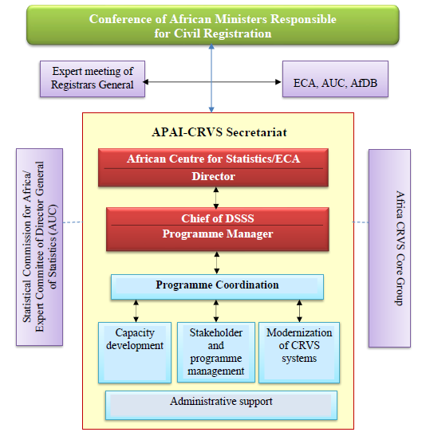
Efforts exist to improve CRVS in Africa
The African Programme for Accelerated Improvement of Civil Registration and Vital Statistics, launched in 2009.
Home | APAI-CRVS
Notes:
APAI-CRVS promotes a coordinated regional agenda for strengthening CRVS systems across Africa, supported by ECA, AUC, AfDB, UNICEF, WHO, UNHCR, UNFPA and other partners.

Slide 16

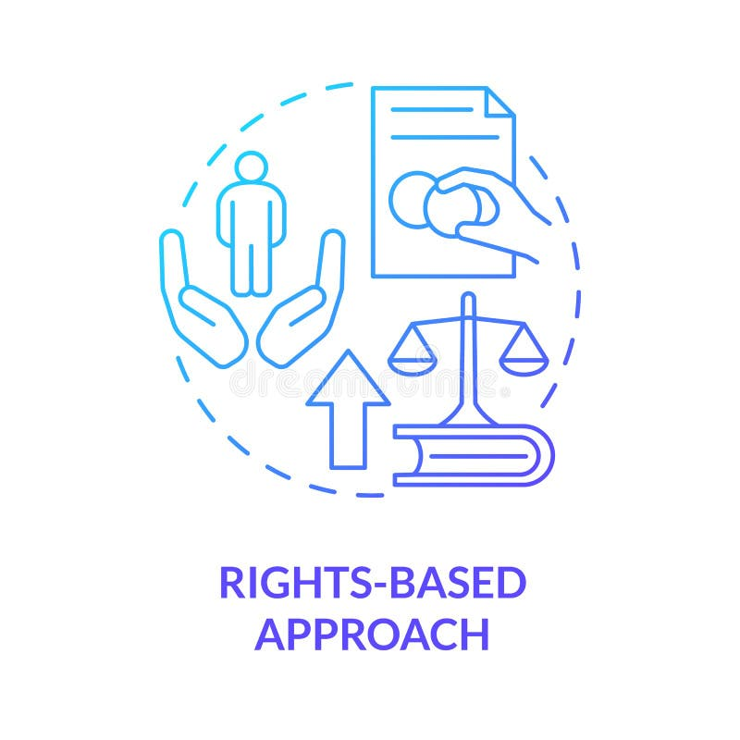


Statistics that Matter Must Make Every Child Visible
“When every child is counted, every child can be protected. When every child is visible in statistics, every child can be visible in policy, justice and opportunity.”
CRVS is the foundation for legal identity, child protection, inclusive planning and accountable governance.
Africa’s statistical outlook must therefore place CRVS at the centre of child rights, gender equality and development transformation.
13

Slide 17
Key Message for the Forum
Africa cannot fully advance child rights, gender equality or inclusive development without complete, timely and trusted CRVS systems. Statistics that matter are statistics that identify who is being born, who is dying, who is excluded and who needs protection.
13

Slide 18
THANK YOU | MERCI | OBRIGADO
Statistics that Matter: Advancing Rights, Justice, and Opportunities for All
CONTACT
NAME
EMAIL
ORGANISATION
Pamela Kakande Nabukhonzo
pamela.nabukhonzo@un.org
UNECA
AGCSF 2026 • Hilton Hotel, Yaoundé, Cameroon • 6–10 July 2026
12

