Slide 1



AFRICAN UNION COMMISSION · WOMEN, GENDER AND YOUTH DIRECTORATE
AFRICAN UNION
GENDER OBSERVATORY
Operationalising Africa's Continental Gender Data Ecosystem
OPERATIONALISATION PHASE - LIVE
Presented at the First Africa Gender and Child Statistics Forum (AGCSF 2026)
6–10 July 2026 · Yaoundé, Cameroon
AFRICAN UNION GENDER OBSERVATORY
01

Slide 2


THE CHALLENGE
Africa Already Produces Gender Data
Yet it remains fragmented, reported differently, and too slow to influence policy.
National Surveys
Health Systems
Education Records
Justice & Protection
AUGO
DISCONNECTED
One continental
evidence ecosystem
Agriculture Data
REC Platforms
AFRICAN UNION GENDER OBSERVATORY
02

Slide 3





DEFINITION
What Is AUGO?
AUGO is the African Union's continental ecosystem for collecting, harmonising and reporting gender statistics from all 55 Member States.
AUGO does not replace national statistical systems. It connects and strengthens them.
Collects
Harmonises
Reports
Enables Action
Standardised gender indicators from NSOs across the continent
One common definition and methodology, validated by STATAFRIC
Continental dashboards for MS, RECs, and partners
Turns evidence into policy across the continent
AFRICAN UNION GENDER OBSERVATORY
03

Slide 4
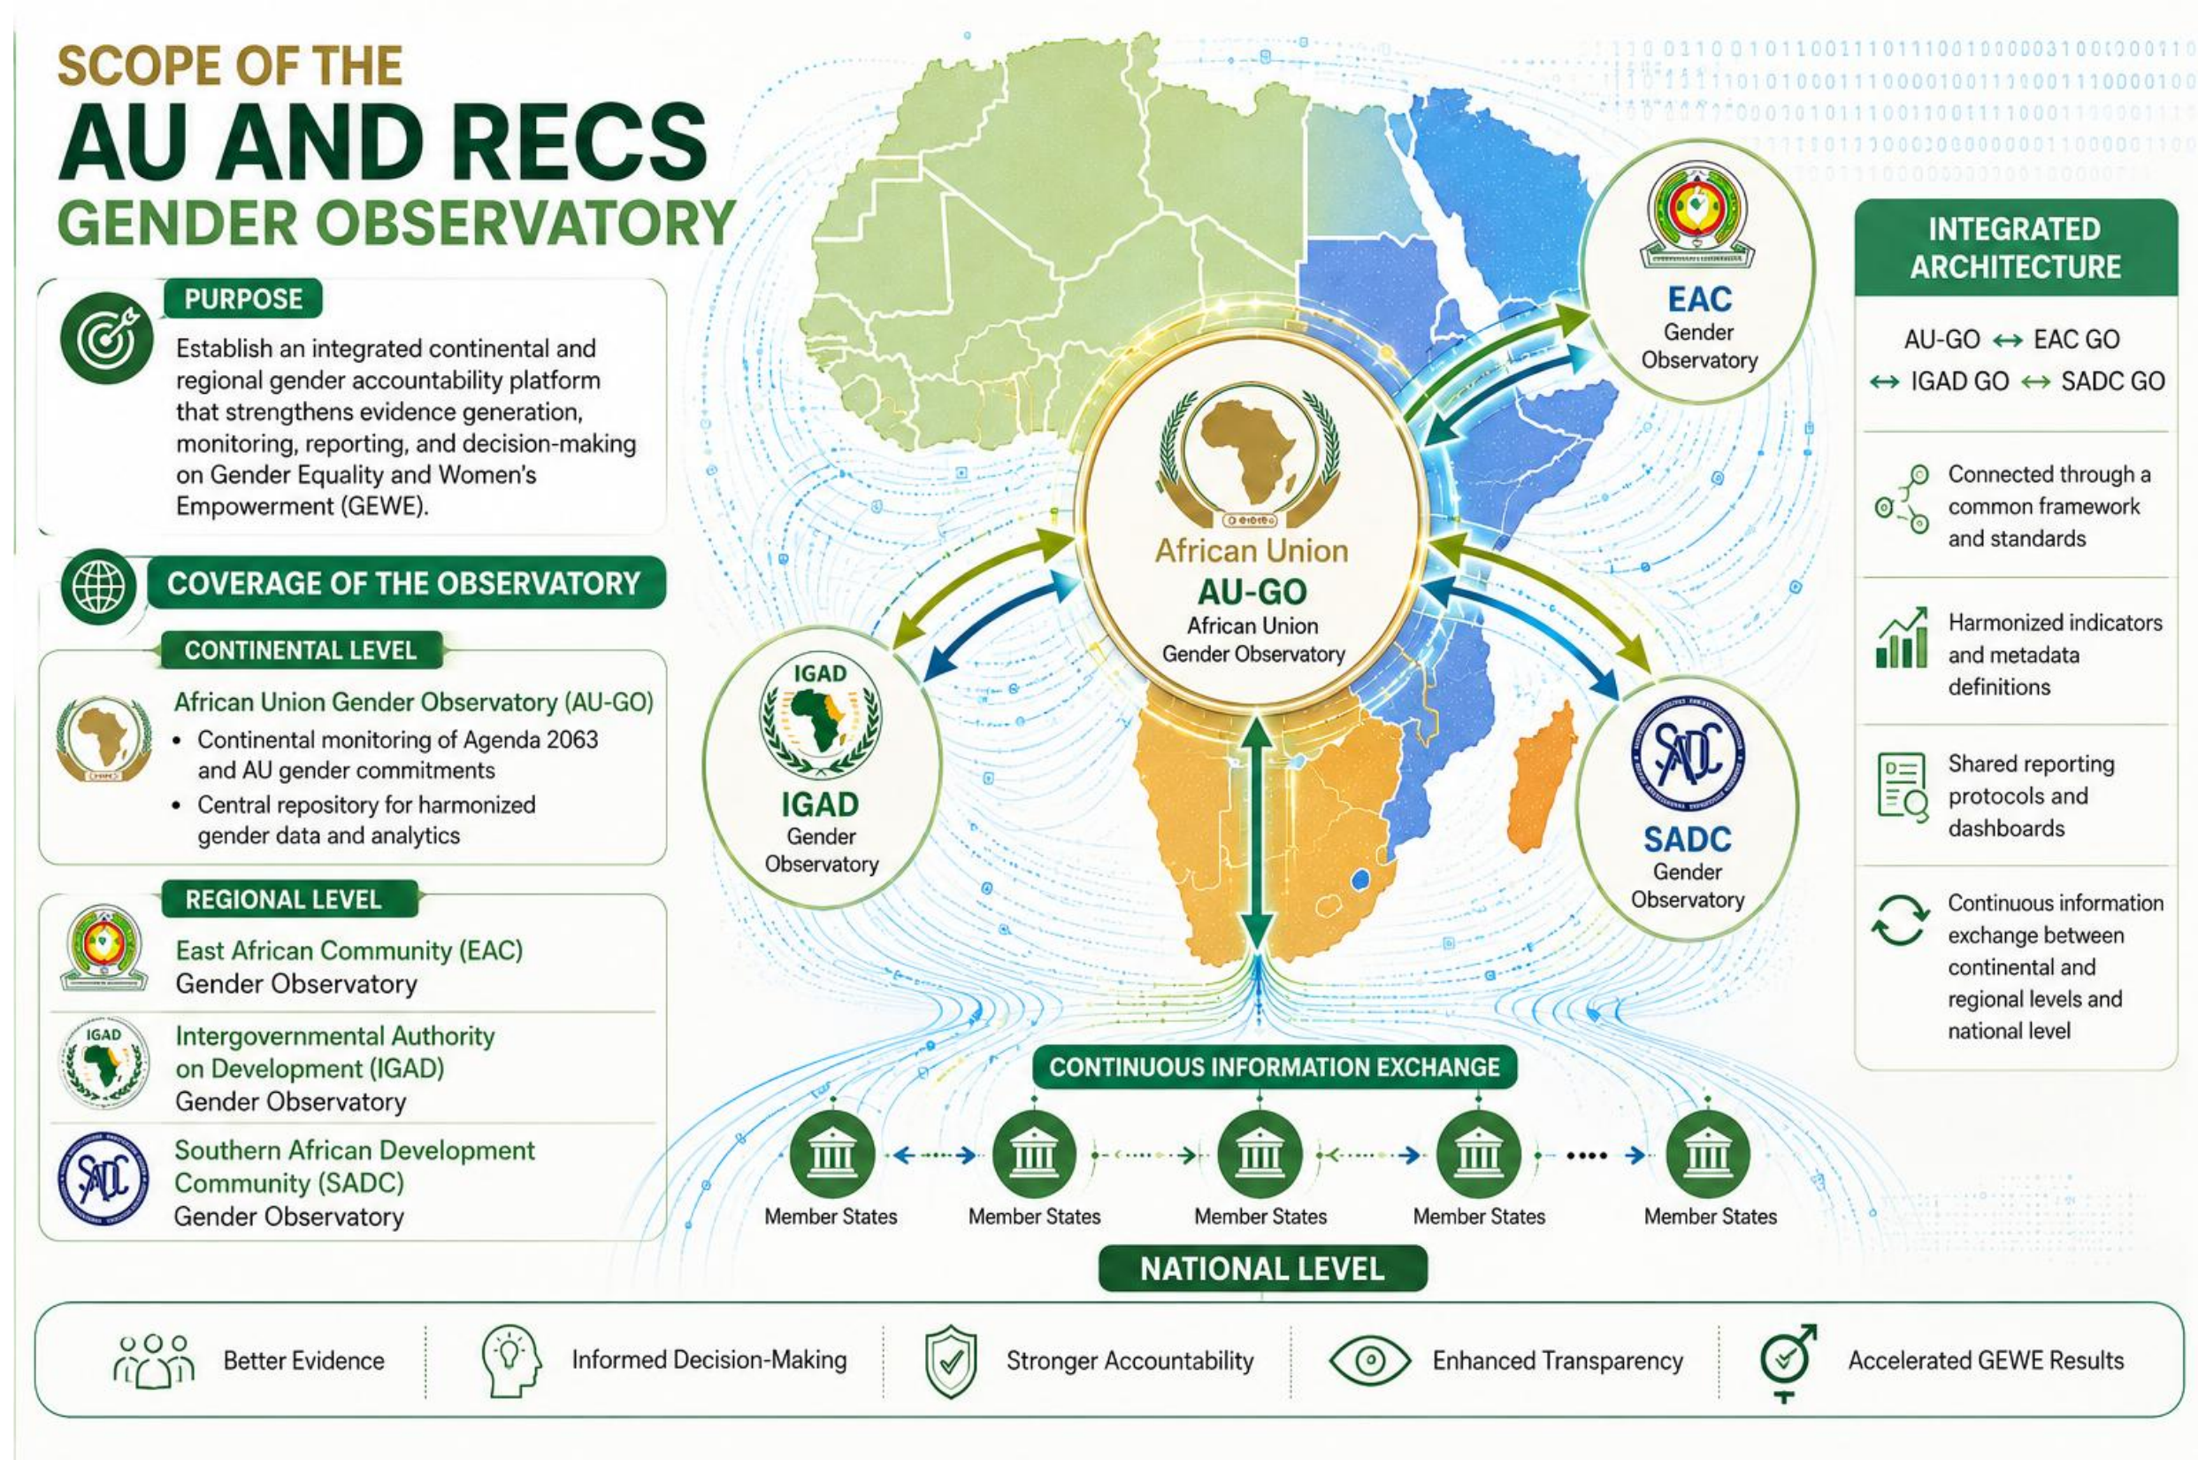

Slide 5


MANDATE & LEADERSHIP
Why WGYD — and What Stands Behind AUGO
WGYD
STATAFRIC
TOGETHER
AUGO
• Policy leadership
• Statistical methodologies
• Continental accountability
• Standards
• Gender frameworks
• Harmonisation
• Member State coordination
• Data quality
WGYD provides policy leadership while STATAFRIC provides statistical standards — AUGO brings both together in one continental accountability ecosystem.
Normative
Frameworks
Statistical
Standards
AUGO
Evidence
Policy
AFRICAN UNION GENDER OBSERVATORY
04

Slide 6





STRATEGIC FOUNDATION
Anchored in Africa's Normative Architecture
2003
2004
2013
2020–30
2026
Maputo Protocol
SDGEA
Agenda 2063
AWD-FEI
AUGO Operational
The missing technical layer: STATAFRIC's Guidelines for Gender Statistics in Africa provide the methodology AUGO uses to make these commitments measurable — the subject of technical review ahead of AGCSF 2026.
AFRICAN UNION GENDER OBSERVATORY
05

Slide 7
THE VALUE PROPOSITION
Report Once. Use Many Times.
Member States
already report to:
SDGEA
Maputo Protocol
ONE SUBMISSION
Agenda 2063
Many reporting obligations - satisfied once, reused everywhere.
CEDAW
AUGO
Beijing Platform
REC Reporting System
Every Member State already collects this data. AUGO removes the burden of reporting it six different ways.
AFRICAN UNION GENDER OBSERVATORY
06

Slide 8




IMPACT & OWNERSHIP
Who Benefits From AUGO?
AU Policy Organs | Member States
National Gender Missionaries |
National Statistical Offices
RECs
Policy
Reporting Efficiency
Regional Analysis
Researchers & Academia
Development Partners
Media
Open Data
Investment Decisions
Transparency
AFRICAN UNION GENDER OBSERVATORY
07

Slide 9



ARCHITECTURE
How AUGO Works
A governance mechanism, supported by technology — not the other way round.
Member
States
National
Systems
AUGO
Analytics
Policy
Impact
One glance tells the story: data moves from Member States through AUGO into the policy decisions that affect them — governed by standards, not software.
AFRICAN UNION GENDER OBSERVATORY
07

Slide 10


ARCHITECTURE
How AUGO Works
GOVERNANCE
DATA PIPELINE
AU ASSEMBLY & EXECUTIVE COUNCIL
AU COMMISSION (WGYD) & STATAFRIC
Collect
Validate
Integrate
Disseminate
RECS
NSOs & Ministries
STATAFRIC harmonisation
AUGO Data Hub
Dashboards & analytics
MEMBER STATE NSOS
DECIDE
Commissioners · RECs · Development Partners act on evidence
Governed at every stage: standardised metadata, validation and audit trails.
AFRICAN UNION GENDER OBSERVATORY
07

Slide 11
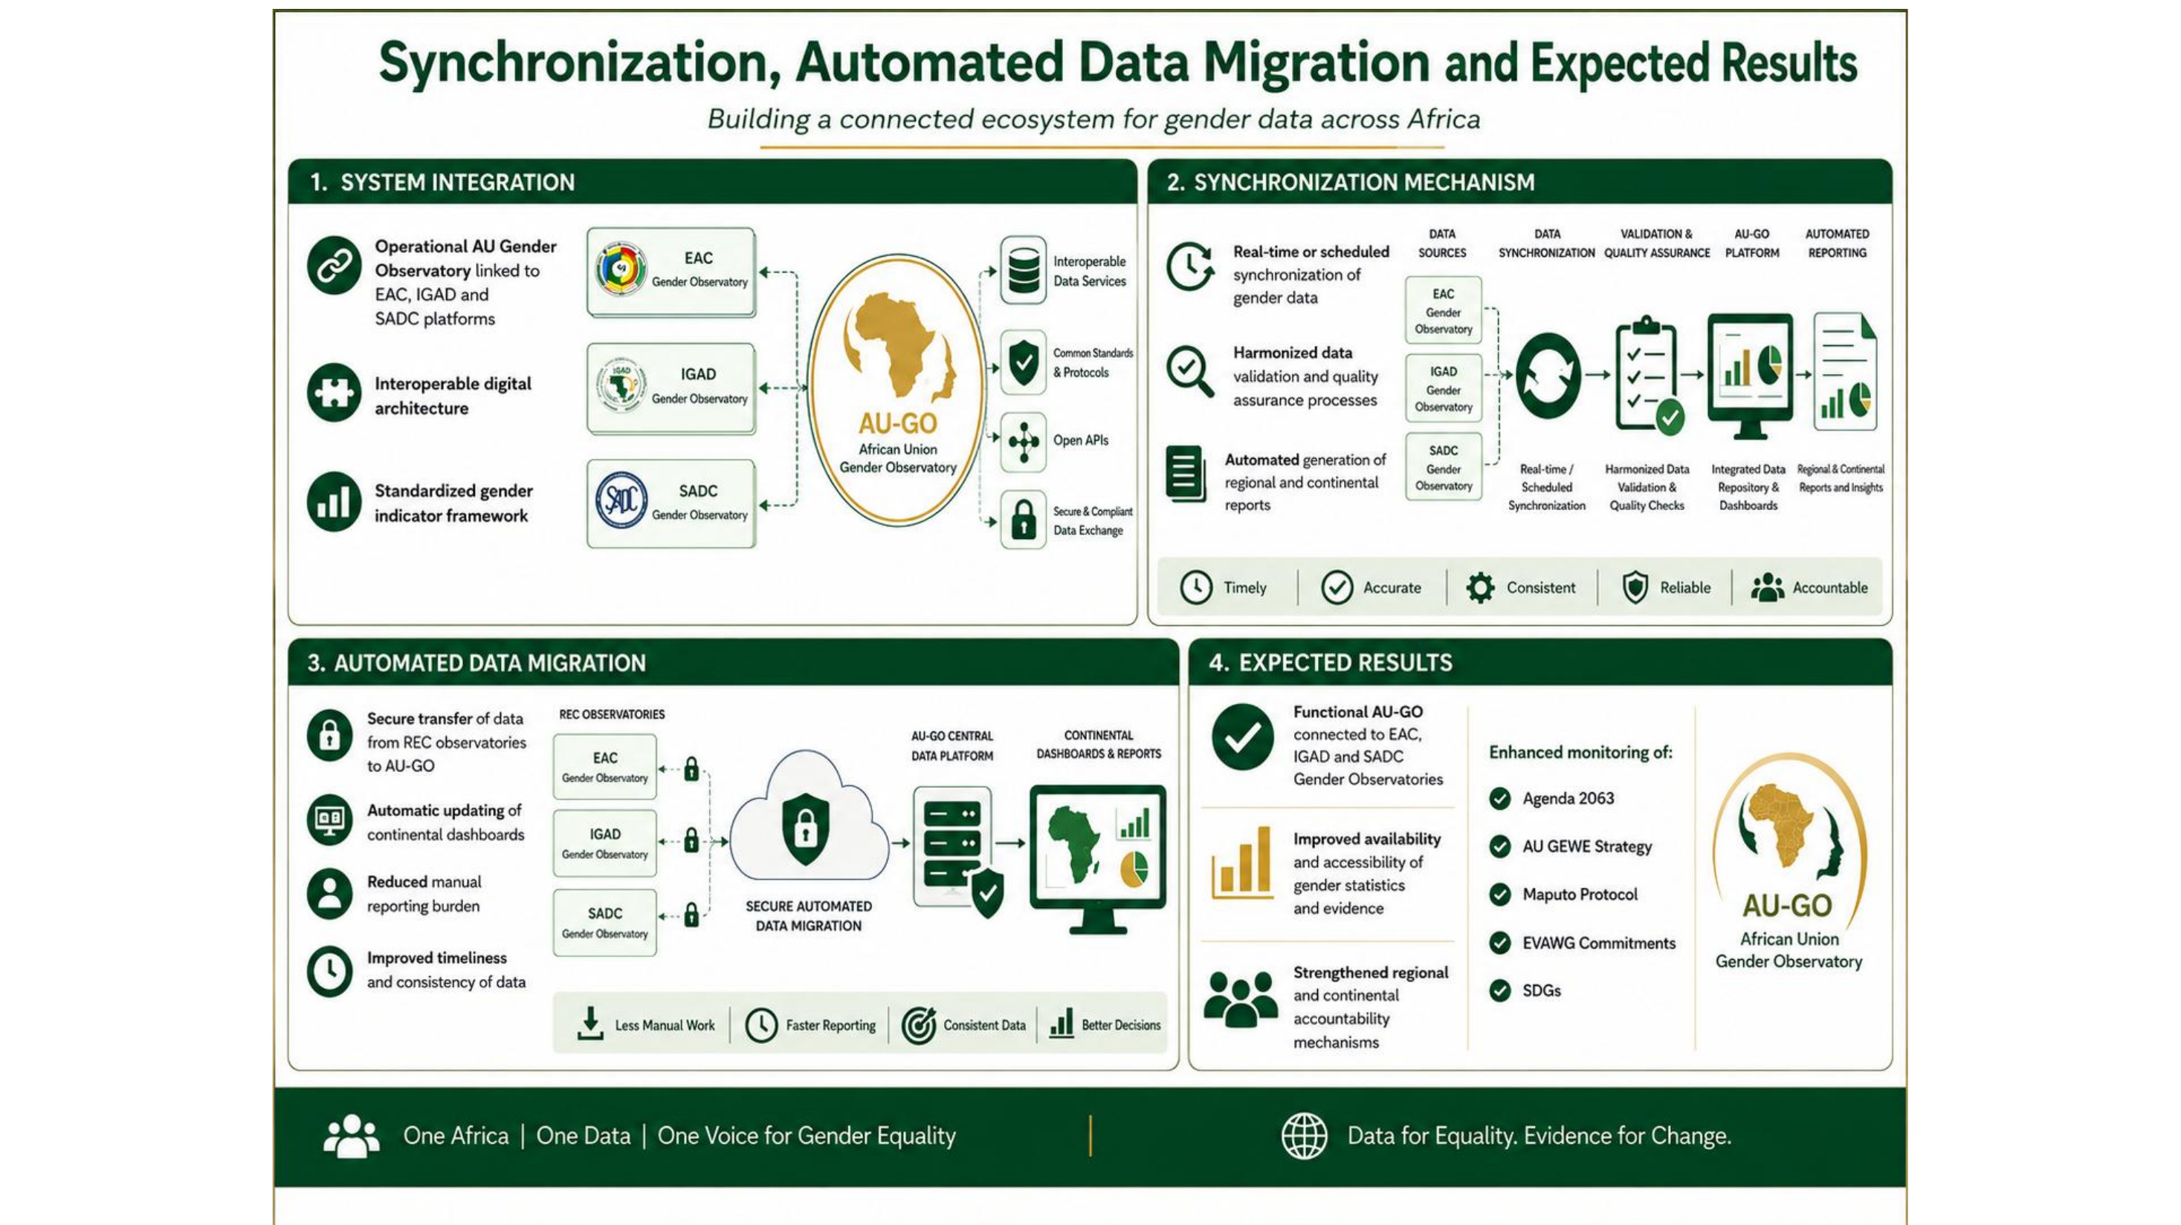

Slide 12





MEASUREMENT FRAMEWORK
Harmonised Continental Indicator Framework
Developed through AU frameworks, the Gender Statistics Guidelines, continental commitments and national priorities
Economy
Health
Education
Leadership
GBV
Digital
Youth
Climate
This register is the same technical basis feeding the Africa Gender Index (AGI) 2027.
AFRICAN UNION GENDER OBSERVATORY
10

Slide 13
AUGO IN ACTION
Continental Scorecard Dashboard
AUGO CONTINENTAL DASHBOARD · augo.au.int
Overview
Financial Inclusion
Skills & Outcomes
Health
Country View
62%
41
+8.4
128
Financial Inclusion
Index (avg.)
Countries Reporting
Live Data
pts YoY Index
Improvement
Indicators Tracked
Continent-wide
INDEX BY REGION (COMPOSITE)
REPORTING STATUS (55 MEMBER STATES)
AFRICAN UNION GENDER OBSERVATORY
11

Slide 14

DELIVERY STATUS
Where We Are
Design &
Consultation
Institutional
Set-Up
Operationalisation
Scale &
Institutionalise
Continental
Sustainability
WE ARE HERE
COMPLETED
IN PROGRESS
Platform deployed
Security assessment completed
Operationalisation initiated
Indicator harmonisation ongoing
Technical documentation prepared
Hybrid architecture agreed
Governance framework under development
REC engagement beginning
This is a phased, multi-year process. We name what is complete and what is under way - because credibility with this room depends on precision.
Next milestone: WYFEI 2030 Member State submissions due 14 August 2026, ahead of the AU 2nd Egumeni Dialogue in October.
AFRICAN UNION GENDER OBSERVATORY
13

Slide 15




CALL TO ACTION
What We Invite
Shape the continental indicator framework
Strengthen harmonisation across Member States
Align reporting with existing statistical systems
Collaborate in the phased operationalisation of AUGO
Build a sustainable continental gender data ecosystem
Together, we establish Africa's first harmonised gender data ecosystem - report once, use many times.
AFRICAN UNION GENDER OBSERVATORY
14

Slide 16
Africa already has policies. Africa already has commitments.
Africa already has data.
AUGO IS THE MISSING
INSTITUTIONAL LAYER.
African Union Gender Observatory (AUGO)
Women, Gender and Youth Directorate · African Union Commission
augo.au.int · wgyd@africa-union.org

