Slide 1
An enabling environment for gender data use
African Forum on Gender and Child statistics 2026
Un environnement favorable à l’utilisation des données sur le genre

Slide 2
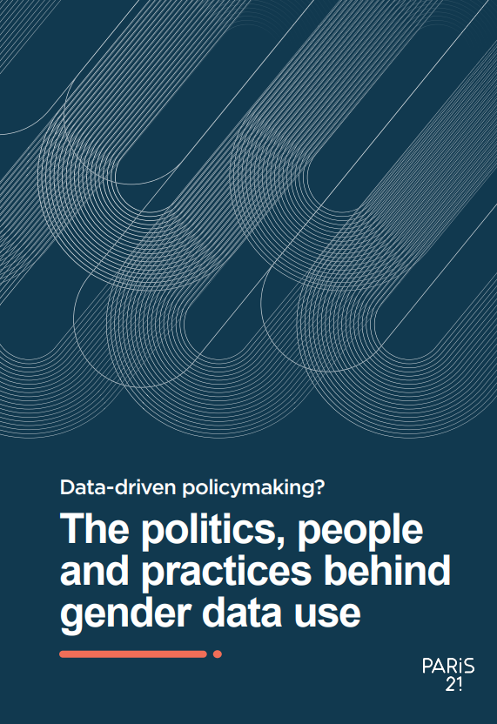
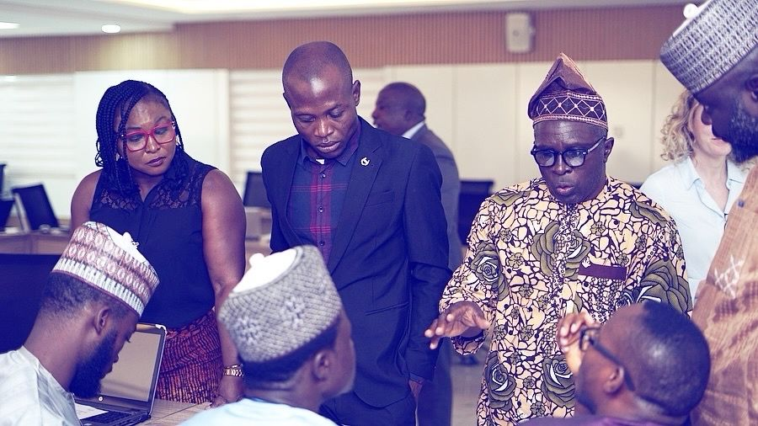
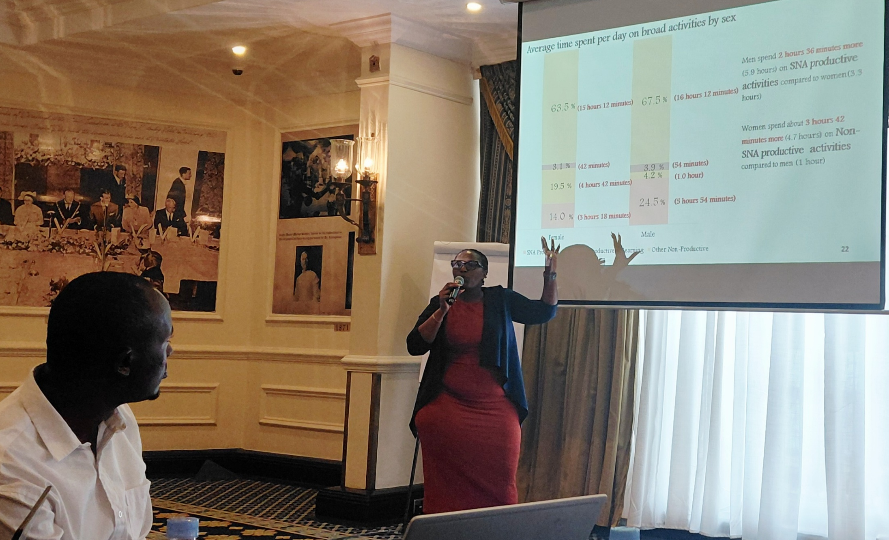
PARIS21 research and training on gender data use

Slide 3
What is specific about gender data?
Most components of an enabling environment for use are not specific to gender, but there are some exceptions:
Awareness
Social norms
Depriorisation
Notes:
[We posed this question to both of the panelists so you might want to refer back to their answers here]
Awareness: our country research points heavily towards the need for greater gender sensitisation and awareness of why gender data are relevant to a certain issues. For example, much of the literature points towards better gender mainstreaming in social sectors – so policy areas such as health and education – but not in areas like transport or infrastructure. Let us think about data on WASH, for example – number of toilets in schools, or access to clean water more generally. Because both boys and girls use school toilets and because both men and women need clean water, this might not always be considered a gender issue and therefore an issue on which we need gender-disaggregation. However, we know that it is adolescent girls who miss out on education if there are inadequate toilet and hygene facilities to manage menstruation and we know that it is women who spend more time cooking and cleaning and so who are disproportionately affected by limited access to clean water. So awareness and an understanding of why gender is relevant to a certain issue is still a challenge in many contexts.
Social norms: gender issues are often deeply rooted in social norms – they link to beliefs, cultures and societal contructs. While official statistics are important for telling us what key issues are, their scale, and how they change over time, they are less good at revealing the underlying social norms that cause them
Deprioritsation: When resources are tight, we see that gender is often the first to become a ‘nice to have’. Even in the DHS, the GBV module was optional. Esepcially with push back against gender agendas in some parts of the world, we are seeing gender become a ‘nice to have’ rather than a core component of statistics, from both a data quality and a human rights persepctive
You may want to ask an at the end / at this stage whether participants feel this also applies to statistics on children

Slide 4
What are the factors that can support gender data use?
Aligning production and demand
Skills and capacity
The ‘missing middle’
Investing in people and relationships
Notes:
There are many factors that affect if and how gender data are used in policy making. It’s important to remember that not all of these pieces are the responsibility of the NSO. Though as the coordinators of the NSS, it is important that NSÓs consider all of them.
For one, the right data – that is data that responds to policymakers’ needs and that speak to today’s challenges -- must be produced. This speaks to factors such as sufficient levels of diagreggation, by gender but also by factors such as age, disability status and geography; it speaks to up-to-date data; it speaks to data that reflects the concerns of society.
Second, we have what we call the ‘missing middle’ and this is the magic between once data is produced, and once it is turned into a policy-relevant inisght. So how to disseminate that data, how to analyse it to understand policy implications,

Slide 5
What are the factors that can support gender data use?
Aligning production and demand
Skills and capacity
The ‘missing middle’
Investing in people and relationships
Notes:
But today, I’m going to focus on one aspect in particular: skills and capacity

Slide 6
Skills and capacity
NSO
Curiosity
Communication
User
Curiosity
Data analysis
Data literacy
Notes:
National Statistical Offices (NSOs): Capacities for Enabling Data Use
1. Data Production and Management
Statistical methods and survey design
Data quality assurance
Data integration and interoperability
Metadata management
Data governance, privacy, and security
2. Data Analysis and Innovation
Statistical analysis and modelling
Data science and advanced analytics
Geospatial analysis
Use of administrative and alternative data sources
3. Data Dissemination and Communication
Data visualization
Statistical communication
Data storytelling
User-friendly dissemination platforms and open data services
4. User Engagement and Partnerships
Understanding user needs
Stakeholder consultation
Collaboration across government, academia, civil society, and the private sector
Capacity-building support for users
5. Institutional and Strategic Capacity
Leadership and strategic planning
Resource mobilization
Project and change management
Fostering a user-oriented and data-use culture
************************************************************
Data Users: Capacities for Effective Data Use
1. Data and Statistical Literacy
Understanding indicators and statistical concepts
Interpreting charts, tables, and dashboards
Understanding data quality and limitations
Reading and using metadata
2. Data Analysis and Interpretation
Data cleaning and manipulation
Trend and comparative analysis
Critical assessment of evidence
Understanding uncertainty, bias, and representativeness
3. Evidence-Informed Decision-Making
Identifying relevant data sources
Framing policy and research questions
Using data to inform decisions, priorities, and resource allocation
Monitoring and evaluating outcomes
4. Data Communication and Advocacy
Presenting evidence to decision-makers
Translating analysis into actionable insights
Data storytelling and visualization
Communicating findings to diverse audiences
5. Data Governance and Responsible Use
Data ethics and privacy awareness
Responsible use of statistics and AI
Data protection and confidentiality compliance

Slide 7

Mentimeter time
Scan me:

Slide 8
Does your institution train ministerial policy units on data use?
Never
Once in a while
Every year
Multiple times a year
Notes:
Ask participants to do the mentimtre and discuss how it’s important to do this type of training, then discuss the challenges of one-ofetc.)f or irregular training (i.e. high turnover, it takes longer than a week to learn etc.)

Slide 9
Does your institution train parliamentary policy units on data use?
Never
Once in a while
Every year
Multiple times a year
Notes:
Ask participants to do the mentimtre and discuss how it’s important to do this type of training, then discuss the challenges of one-ofetc.)f or irregular training (i.e. high turnover, it takes longer than a week to learn etc.)

Slide 10
Does your institution's training include a gender focus?
Yes
Sometimes but not as a priority
No
I don’t know

Slide 11
What skills do you think are key for state data users? (rank)
Access to official data and statistics
Understanding, interpreting and analysing official data statistics
Data visualisation
Gender awareness

Slide 12
Does your institution train non-state actors such as civil society or media?
                Yes, both
                Yes, only civil society
                Yes, only media
                No
                I don’t know

Slide 13
What are the biggest obstacles to regular training for data users (in max 2 words)?

Slide 14

For more insights on gender data use

Slide 15
Break with assumptions
Statistics produced is statistics used
Information reaches everyone equally
Awareness where data is will change the user behaviour
In my work, user engagement is a burden
…
Questions:
Tell us about your user-training experience
What assumptions about data use do you have?

Slide 16
Thank you

