Slide 1
UN-GGIM: Africa | Activities Report
UN-GGIM: Africa 9
Cape Town, 16 August 2023
Maroale Chauke
Chair, Executive Board, UN-GGIM: Africa
Directeur, National Spatial Information Framework
Branch: Spatial Planning and Land Use Management
Department of Agriculture, Land Reform and Rural Development
Maroale.Chauke@dalrrd.gov.za

Slide 2
UN-GGIM: Africa | Where we Come From
…From cartography as a standalone activity
CODI II
UN-GGIM
Resolution urging Member States to adopt National Spatial Data Infrastructures
8/2015 - UN-GGIM-4 Resolution 5/112
Endorsed the establishment of UN-GGIM:Africa
IGIF
...To information for development
7underpinning principles,
8 goals
9 strategic pathways.
1961
2001
2013
2015
2017
2018
…To integrated frameworks
UNRCCA
CODIST
Action Plan: Gi4SD
Resolution 816 (XXXI) of ECOSOC to convene a UNRCCA
second session of the UNRCCA held in Tunis in 1966
Recommends that the oversight and supervisory functions of the of CODIST-Geo be transferred to an equivalent subcommittee of StatCom Africa with the name of UN-GGIM:Africa
Action Plan
Strategy for integration GIS & Stats
.

Slide 3
UN-GGIM: Africa | The Journey So far…
FIRST MEETING
Formal Endorsement by UNCE
SIXTH MEETING
Geospatial response to COVID-19
2010
2017
2022
2015
2020
PREPARATORY MEETING
Taking Cognizance of the initiative
THIRD MEETING
Action Plan | Gi4SD
EIGHTH MEETING
Review of Management

Slide 4
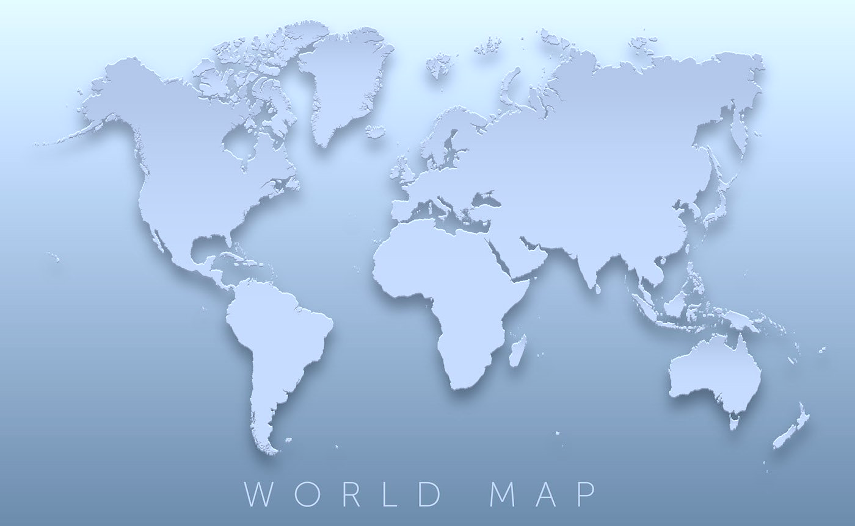
UN-GGIM: Africa | Governance & Institutions
Executive Board
Chair: South Africa
1st Vice-Chair: Cameroon
2nd Vice-Chair: Morocco
1st Rapporteur: Uganda
2nd Rapporteur: Burkina Faso
Secretariat: UNECA
Morocco
Cameroon
Burkina Faso
Uganda
South Africa

Slide 5
UN-GGIM: Africa | Governance & Frameworks
Executive Board (2022)
UN-GGIM Asia-Pacific
(2012)
UN-GGIM Africa
(2019)
UN-GGIM
Arab States
(2014)
UN-GGIM Americas
(2013)
UN-GGIM Europe
(2014)
Working Group (2018) | Chair | Members | No Voting Members
WG1: African Geodetic Reference Frame | 1. Kenya | Burkina Faso Morocco Botswana Cameroon | Madagascar Nigeria Senegal South Africa AFRIGIST RCMRD UNECA
WG2: Fundamental Geo spatial datasets and Standards | 1. South Africa | Cameroon South Sudan Burkina Faso Algeria | Côte d’Ivoire Madagascar Mali Niger Nigeria Senegal UNECA
WG3: Institutional arrangements and Legal frameworks | 1. Algeria | Nigeria South Africa Ethiopia Central Africa [TBD] | Burkina Faso Morocco UNECA
WG4: Capacity and capability development | 1. Nigeria | Kenya Eswatini Côte d’Ivoire Central Africa [TBD] | South Africa Burkina Faso AFRIGIST RCMRD AARSE UNECA
WG5: Integration of Geospatial and Statistical Information for Sectoral Applications | 1. South Sudan | Namibia Mali Cameroon North Africa [TBD] | Burkina Kenya Niger Senegal Togo UNECA
South-Africa
Cameroon
Morocco
Uganda
Burkina Faso
Ethiopia (ex-Officio)
Economic Commission for Africa (ECA)
Japan
ROK/Mongolia
China
SEN,
BTW, ALG, CAM, UGA, ECA
Saudi Arabia
Algeria
Jordan
Mexico
Chile
Mexico
Sweden
Netherlands/
EuroGeographics
WG 1
Geodetic Reference Frame for SD
WG 1 Geodetic infrastructure Standards
WG
Institutional, Legal, Policy
WG
NSDI
European Commission
+ Eurostat
WG 2
Data Sharing & Integration for Disaster Mgt
WG 2
Fundamental Datasets and Standards
WG
Fundamental Data & Geo Standards
WG
Integration
Stat & Geo
Euro
Geographics
WG 3
Place-Based Information for Economic Growth
WG 3
Institutional
& Legal
WG
Geodetic Reference
WG
Regional Coordination & Cooperation
WG A
Core Data
WG 4
Capacity Building
WG
Integration Stat&Geo
WG
GI in DDR
WG B
Data Integration
WG 5
Integration of Geospatial & Stats
Working Groups

Slide 6
UN-GGIM: Africa | Focus AReas
Frameworks with related policies & infrastructures
Integrated Geospatial Information Framework
National Spatial Data infrastructure
Policy
IGIF
NSDI
C-LAP
Data
FGDT
SALB
GeoNyms
Fundamental geospatial datasets
Core thematic data
Second administrative level boundary
Geographic Names
Common Services
Africa Geoportal
UN-GGIM Africa
Integration
GSGF
Mainstreaming GIS in NSOs
Integrating Geospatial
and Statistical Information
Geocoding schemes
Census mapping
Geoportals
Standards
Web data services (APIs)
Capacity Building
AFREF
Partnership
AUC | PSN
African Geodetic Reference Frame
eLearning
Spatial awareness
Spatial literacy
Facilitate and encourage linkages
international programs and initiatives
Networks | AARSE | ISPRS
Private Sector | Esri
6

Slide 7
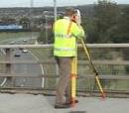
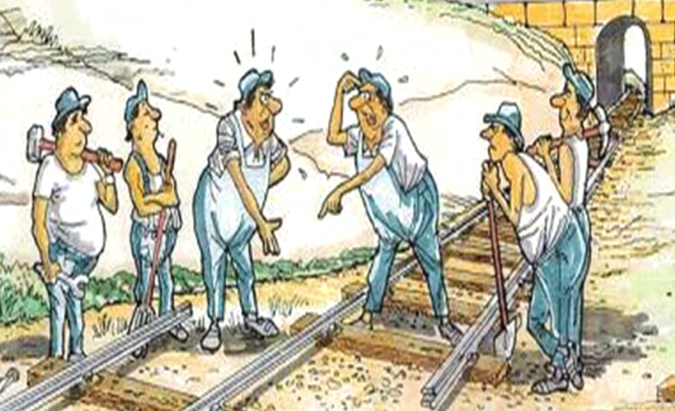
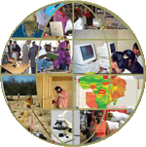
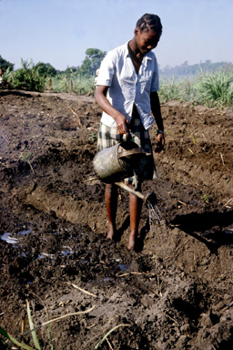
UN-GGIM: Africa | Activities Carried out
Dialogue
Operations
Knowledge
Partnership
Capacities
Developing Guidelines on Geocoding and using geospatial techniques in analyzing census data
UN-GGIM Secretariat
1. UN-GGIM 13th Session
2. Expanded Bureau
3. HLG – IGIF
4. IAC of CoE
5. WG | ISGI | Disasters
Organization of the 8th Session of the Regional Committee (24-28 Oct.2022)
#
Development of e-learning courses
• Business model options for sustainably financing national spatial data infrastructure agencies
GEO4Stats | Support to Burundi • Developing a geocoding scheme for geospatial analysis of census data • Creating census cartography geodatabase for over 1.4 million building footprints
• Agreement with Trimble.
• Advisory Services to AFRIGIST & RCMRD
• AUC • NewSpace Africa Conference • GMES.Africa Programme
#
#
#
Workshop on Value Proposition of Geospatial Data
Oct. 2022
Strategic Pathway to the Modernization of Geospatial Information
• 4 Manual on Census Cartography Office Training
National Trainings:
- Geocoding schemes
- Census Data Dissemination Strategy
#
.#

Slide 8
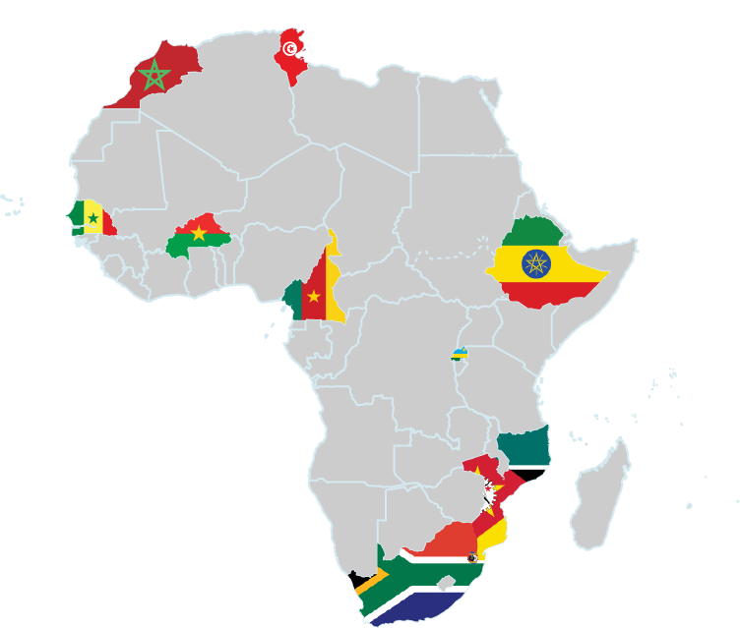
UN-GGIM: Africa | SDG DATA ALLIANCE COUNTRIES…
BURKINA FASO
MOZAMBIQUE
CAMEROON
RWANDA
ETHIOPIA
SENEGAL
ESWATINI
SOUTH AFRICA
MOROCCO
TUNISIA

Slide 9
UN-GGIM: Africa | The IGIF Journey …
Country | Model | Status of the CLAP
Burkina Faso | Development Account | Complete
Cameroon | UNGGIM Approach | Good progress, last stages but delayed due to extensive consultation
Ethiopia | Development Account | Completed in Dec 2022
Eswatini | UNGGIM Approach | Good progress, last stages but delayed due to other work pressures
Morocco | To be confirmed | Not started, awaiting authorisation
Mozambique | Development Account | Made good progress with CLAP. Consultation with Statistics Office underway
Rwanda | UNGGIM Approach | Process started, consultation workshop held but lost communication with the coordinating office.
South Africa | Hybrid (Outsourced but following the UN-GGIM Approach) | Process started but approach changed to prioritised the SA-GIM strategy
Senegal | Development Account | Lead by a consultant and progress not known
Tunisia | To be confirmed | Not started, two organisations involved in leading this work

Slide 10
UN-GGIM: Africa | NEXUS Issues & Challenges
Amplify | We need Spatially Enabled Societies
A government or society can be regarded as spatially enabled when location and spatial information are regarded as common goods made available to citizens and
Deliver | We need Spatially Enabled Services
A service is regarded as spatially enabled if the service delivery process incorporates seamless access to all the information that a user of the service might need to make spatial or location-specific decisions associated with using the service
Sustain| Is your service spatially enabled?
What did we set out to do, and how much of it have we done?
Benchmarking metrics Measuring the performance of one organisation against a standard
Delivering
Need for an appropriation framework with the private sector as a key catalyst in the development of the geospatial information infrastructures
How do we ensure that geospatial technology operates to its fullest potential?
Amplifying
The critical question that must now be asked is - how must this happen? It will happen on its own as individuals, organizations and national governments start to slowly embrace the GKI. Management: How can commit to the Framework?
What Collaboration and Partnerships to put in place
Sustaining
It is clear that international geospatial information initiatives, the development of NSDI and the development of institutional and individual capacity and understanding must be part of the solution.

Slide 11
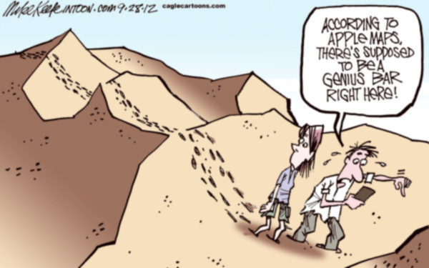
UN-GGIM: Africa | Perspective
Consolidate the consensus and critically resolve to maintain the current structure, functions and operations.
Define Strategies for the future of UN-GGIM: Africa | How to maintain and sustain the Committee.
Adapt to change through the modernization of national mapping agencies in response to new trends so that they remain relevant.
Organise the 9th Plenary Session of the Regional Committee | 14-18 August 2023 |
SDG Data Alliance Workshop | 17-18 August 2023

Slide 12
reference
The African Action Plan.
English: www.uneca.org/sites/default/files/PublicationFiles/un-ggim_-_geospatial_information_for_sustainable_development_in_africa-20171115.pdf
French : www.uneca.org/sites/default/files/PublicationFiles/geospatial_information_for_sustainable_development_in_africa_fre-20171115.pdf

