Slide 1
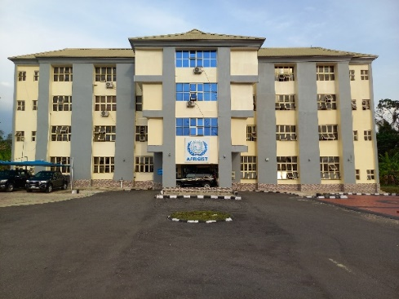
STATUS OF CAPACITY BUILDING ACTIVITIES IN AFRIGIST
Prof. Lazarus Mustapha OJIGI
Executive Director
AFRICAN REGIONAL INSTITUTE FOR GEOSPATIAL INFORMATION SCIENCE AND TECHNOLOGY (AFRIGIST)
Under the Auspices of United Nations Economic Commission for Africa) Off Road 1, PMB 5545, Obafemi Awolowo University (OAU) Campus, Ile-Ife, Nigeria
E-mail: ed@afrigist.org; Website: www.afrigist.org

Slide 2
Presentation Outline
AFRIGIST Vision, Mission, and Objectives
AFRIGIST Membership
Academic Programmes
Capacity Building
SDI Country Support Initiatives
Infrastructure Capacity Development Focus

Slide 3
AFRIGIST Vision, Mission and Objectives
The Institute:
The African Regional Institute for Geospatial Information Science and Technology (AFRIGIST), formerly known as Regional Centre for Training in Aerospace Surveys (RECTAS).
Established in 1972 under the auspices of the United Nations Economic Commission for Africa (UNECA) as an educational “one-stop” solution institution that trains highly skilled manpower, and conducts research in geospatial information science and technology, and its applications.
AFRIGIST is located within the campus of Obafemi Awolowo University, Ile-Ife, Nigeria.

Slide 4
AFRIGIST Vision, Mission and Objectives
VISION
To be a leading Institution of Excellence providing one-stop solution for quality geospatial science training, education and research to generate critical capacity for sustainable development in Africa.
MISSION
To contribute to rapid sustainable development of member states in particular, and Africa in general, through the development of critical capacity for timely delivery and responsible use of appropriate geospatial information

Slide 5
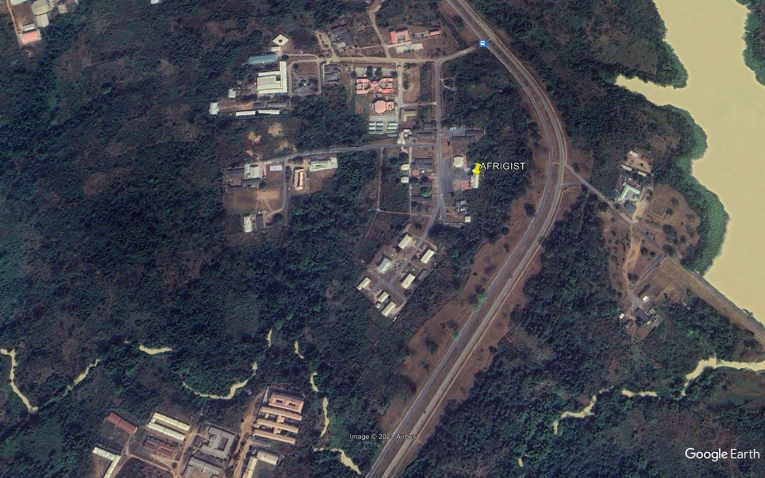
Figure 2: AFRIGIST Site Image and Boundary

Slide 6
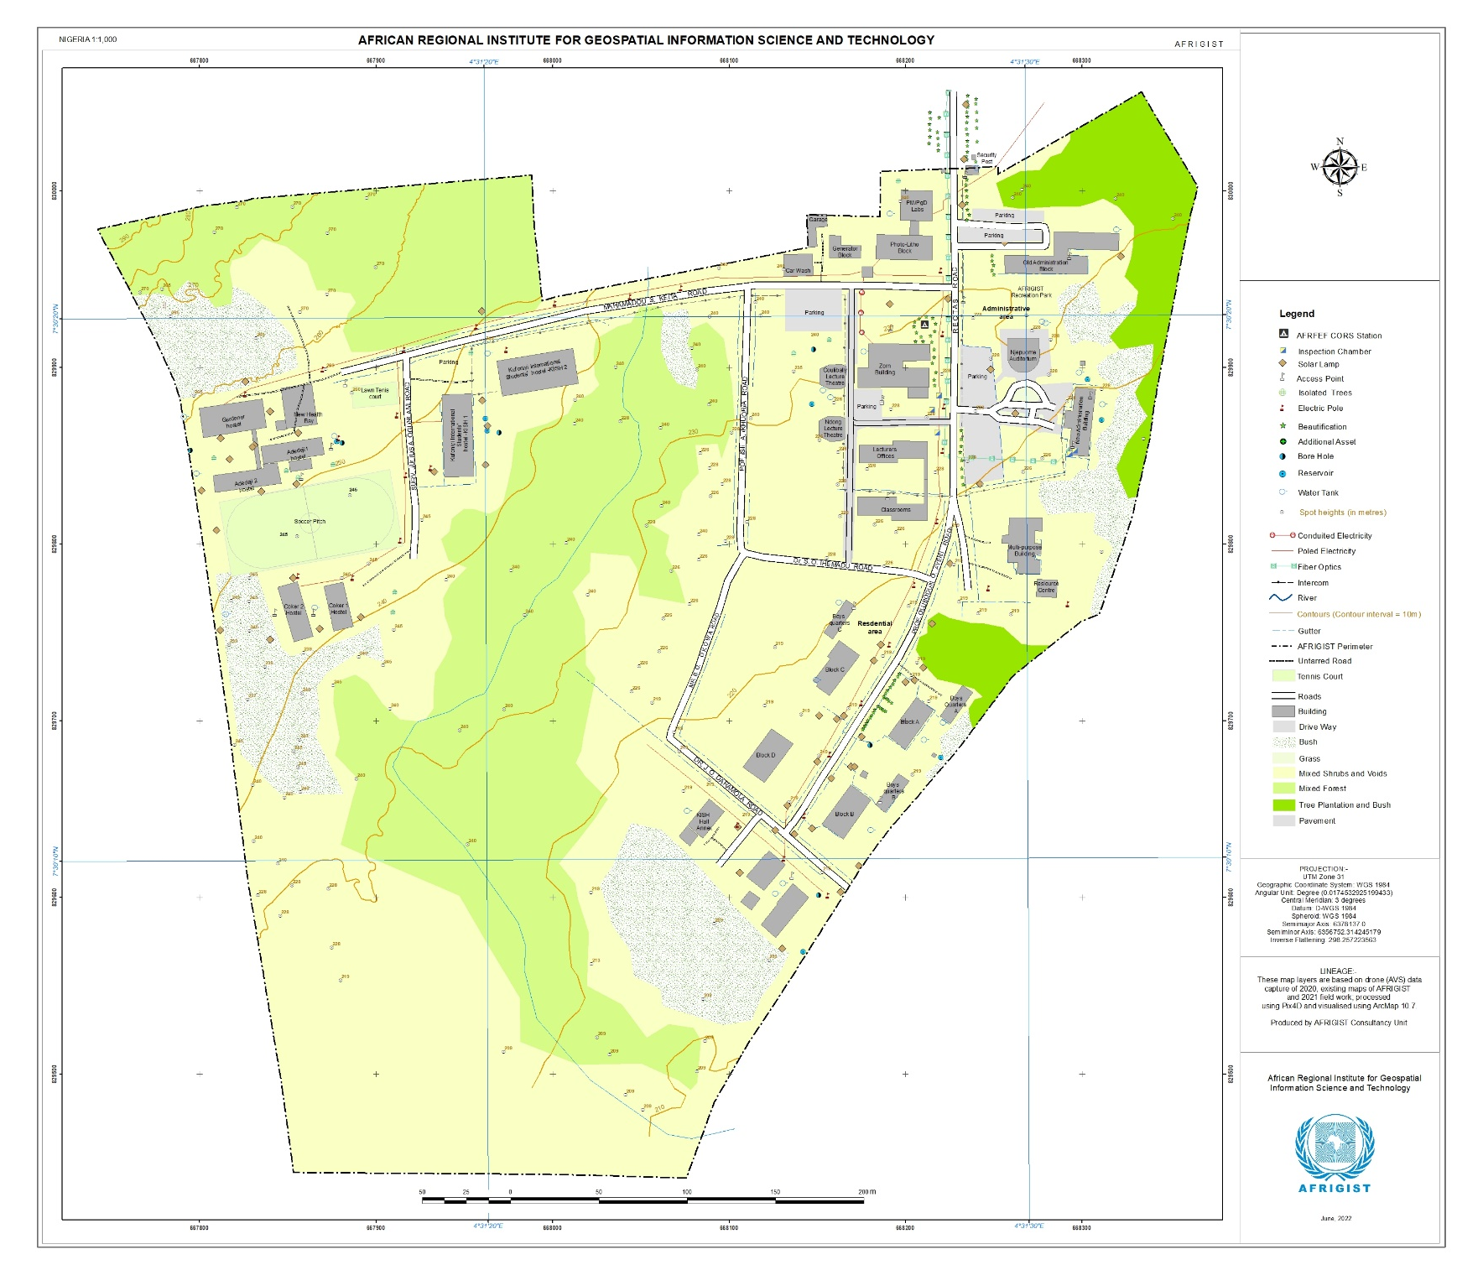
Figure 2: Physiographic Map of AFRIGIST
7°30'20" N
4°31'25" E

Slide 7
Objectives of the Institute
Provide theoretical and practical education, research, and training in the field of Geospatial Information Science and Technology including:
Photogrammetry and Remote Sensing;
Cartography and Geovisualisation;
Geographic Information Science;
Geodetic Science;
Hydrography and Marine Science, &
Applications in:
geodetic mapping,
land administration,
geophysical surveys,
environmental monitoring & climate change,
natural resources management,
infrastructure mapping,
security and safety
geohazard & disaster management,
transport, etc.

Slide 8
Objectives of the Institute
Conduct seminars and courses with a view to providing an opportunity for government officials, and researchers in the region to exchange information and experiences in the field of Geospatial Information Science and Technology (GIST).
Conduct research and carry out studies in GIST
Provide consultancy and advisory services in geospatial data and information production, management, and dissemination to member states, other African Countries and relevant stakeholders

Slide 9
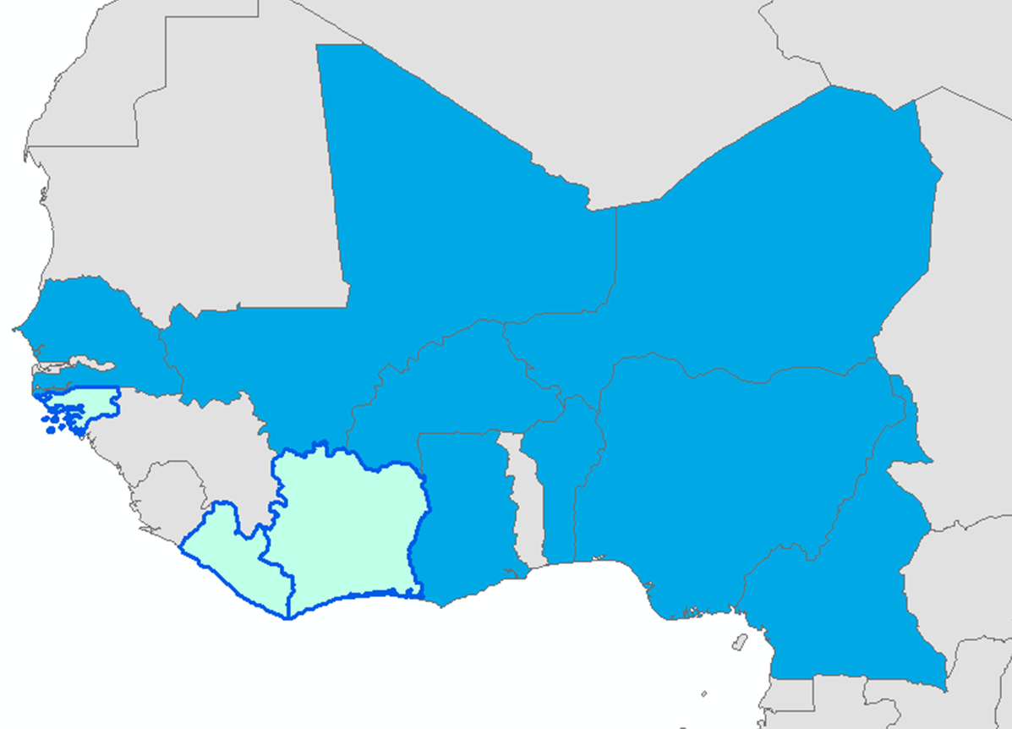
Membership
Member States at the moment are:
Benin⁽¹⁾, Burkina⁽²⁾, Cameroon⁽³⁾, Ghana⁽⁴⁾, Mali⁽⁵⁾, Niger⁽⁶⁾, Nigeria⁽⁷⁾
and Senegal⁽⁸⁾
Cote-d’Ivoire, Guinea-Bissau & Liberia are expected to join.
The membership is open to all African countries
❺
❻
❽
❷
❶
❹
❼
❸
Figure 3: AFRIGIST Member Countries

Slide 10
Major Strengths
CAMES Accreditation
Collaboration with Universities
Participation in Global Initiatives and Programmes
African wide Institute with support from Governments of Member States and UNECA
Bilingual Institute (English & French)
Availability of Expertise
Adequate Training Facilities
SDI Country Support Capabilities

Slide 11
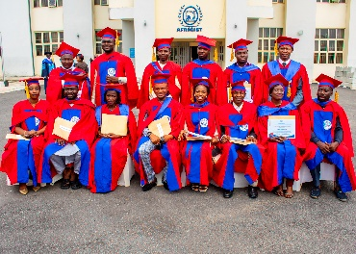
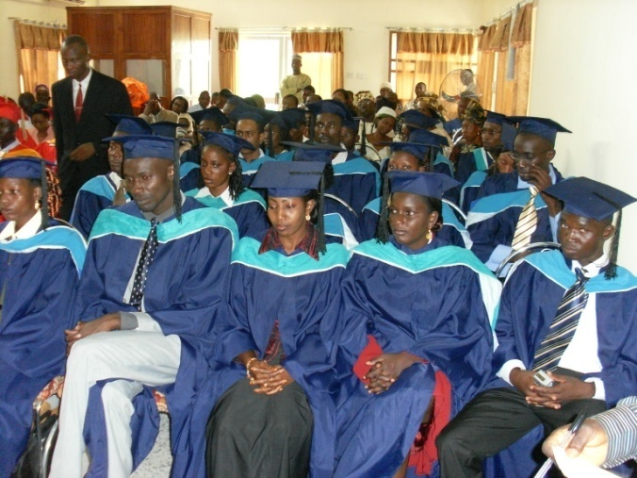
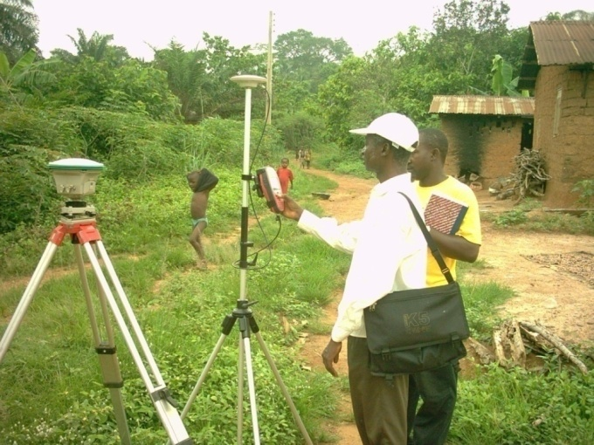
Academic Programmes
S/n. | Programme | Title | In Collaboration with: | Duration
1 | Technologist Diploma (TD) | Geospatial information Production and Management (French and English) | None | 18 months
2 | Postgraduate Diploma (PGD) | Geospatial information Production and Management [Specialisation: Remote Sensing, Photogrammetry, Geographic Information Science] (French and English) | None | 12 months
3 | Professional Masters (PM) | Geospatial information Production and Management, [Specialization: Remote Sensing, Photogrammetry, Geographic Information Systems] (French and English) | None | 12 months
4 | Professional Masters (PM) | Geospatial Information Science and Land Administration (French and English) | None | 12 months
5 | Master of Science(M.Sc.) | Geospatial information Production and Management (French and English) | None | 24 months
6 | Masters (MGIT) | Geo-information Technology (English) | Federal University of Technology Akure, Nigeria | 24 months

Slide 12
Academic Programmes (cont..)
S/no | Programme | Title | In Collaboration with: | Duration
7 | Master of Science (M.Sc.) | Geo-information Science (French) | University of Abomey Calavi, Benin Republic | 24 months
8 | Masters of Science (M Sc.) | Geospatial Information Production and Management (English) | Obafemi Awolowo University (OAU), Ile-Ife, Nigeria | 24 months
9 | Masters of Science (M Sc.) | Geospatial Information Science and Land Administration (English) | Obafemi Awolowo University (OAU), Ile-Ife, Nigeria | 24 months
10 | PhD | Geospatial Information Science and Technology, and Sustainable Development (French and English) | University of Abomey Calavi, Benin Republic | 3 – 4 years

Slide 13
Newly Proposed Academic Programmes
MSc/PhD in Geodetic Science
MSc/PhD in Hydrography & Marine Science

Slide 14
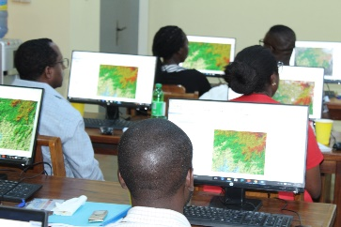
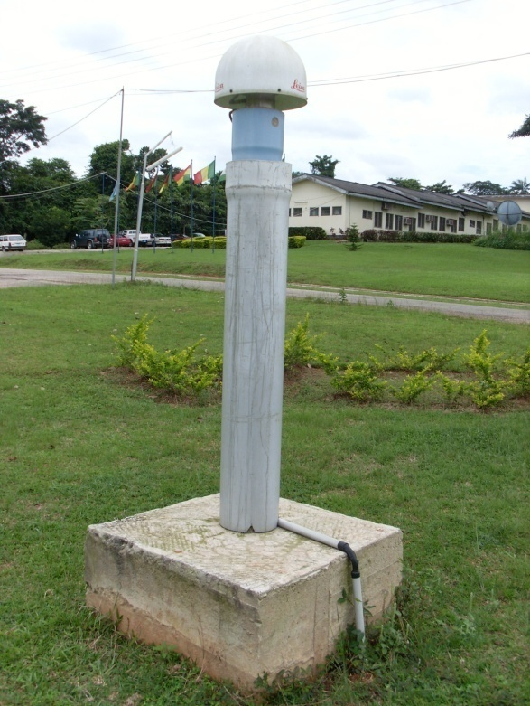
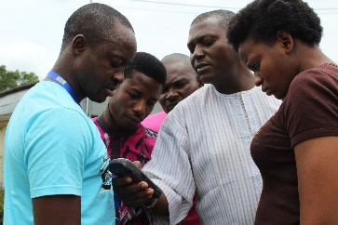
Capacity Building
Short-term Training Programmes | Duration
Global Navigation Satellite Systems and its applications | 2 - 6 weeks
Use of spatial positioning for Cadastral Management
Basic training in Digital Cartography Production
Fundamentals of GIS
GIS and Disaster Management (GDM)
Election Administration and Management
Geospatial Information in Border Management
Geo-Marketing
Geoinformation and Good Governance (GGG)
Digital Image Processing and Analysis
Security, Defence and Peace-keeping

Slide 15
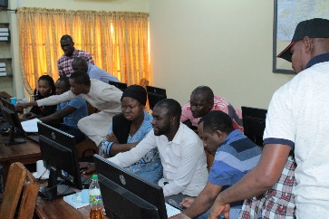
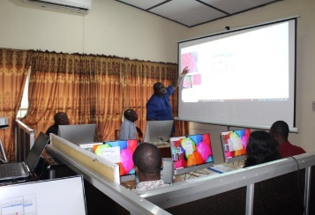
Capacity Building
Short-term Training Programmes | Duration
Remote Sensing and Digital Mapping | 2 - 6 weeks
Internet GIS, Distributed GI Systems and Web Mapping
Geospatial Information Technology, Health Care and Epidemiology
Geospatial Information Technology and Coastal Environment Management
Application of Geospatial Information Technology in Forest Resources Management
Geospatial Information Technology in Population Census
Geospatial Information Technology in Planning and Physical Development
Geospatial Information Technology in Geology, Mining and Environmental Analysis
Geo-Information and Communication Technology (Geo-ICT) in Land Administration
Geospatial Data Science, AI Neural Network (AINN) & Machine Learning (ML)

Slide 16
SDI Country Support Initiatives
Efforts have been made in recent years to advance the development of integrated SDI implementation in Nigeria.
In attempt to support the Mapping Agencies of AFRIGIST Member Countries (who are the SDI Focal Points) in Africa, the following strategies were recently initiated towards advancing the development of NGDI in Nigeria (See Figure 4)
SWOT Analysis of SDI in Nigeria
Review of SDI Datasets for Nigeria
Development of NGDI Country Action Plan for Nigeria

Slide 17
SDI Country Support Initiatives
RECENT NGDI DEVELOPMENT STRATEGIES IN NIGERIA BY AFRIGIST
SDI Country Support Initiative (Feb - July, 2023)
SWOT Analysis of NGDI in Nigeria
Review of SDI Datasets for
Nigeria
Development of NGDI Country Action Plan for Nigeria
Figure 4: Recent SDI Country Support Initiatives by AFRIGIST
Note:
The process would be used as a template for other AFRIGIST member countries (Benin Republic, Burkina Faso, Cameroon, Ghana, Mali, Niger & Senegal).

Slide 18
Infrastructure Capacity Development Focus
Establishment of Advanced Geospatial Data Centre for e-Learning and Spatial Intelligence
A Hub for Training Experts in Hydrography and Marine Science & Applications
GNSS CORS Network Installation, Management & Geodetic Applications
UAS and Hyperspectral Sensing Technologies

Slide 19
Contact:
Professor Lazarus Mustapha OJIGI
The Executive Director
African Regional Institute for Geospatial Information Science and Technology (AFRIGIST)
Off Road 1, Obafemi Awolowo University Campus,
P.M.B 5545, Ile-Ife, Nigeria
E-mail: ed@afrigist.org
lazarusojigi@afrigist.org
Mobile Contact: +234-8166930684
7°30'20" N
4°31'25" E

Slide 20
Thank You !
Merci !!

