Slide 1
*Economic Development Component Lead
Cities Support Programme, National Treasury
Spatial Economic Activity Data: South Africa
Karen Harrison*
15 August 2023

Slide 2
01
PROBLEM: SA lacks credible data on local economy
↓ ↓ ↓ ↓ THIS IS A BIG ISSUE ↓ ↓ ↓ ↓
How do we plan for more productive, inclusive and sustainable cities...?
How do local stakeholders advocate for change or hold leaders to account...?
How do we create jobs and promote investment without knowing where...?
↓ ↓ ↓ ↓
South Africa has a wealth of household surveys data: Quarterly Labour Force Survey, General Household Survey, Census, National Income Dynamics Study etc
BUT mostly national in scope with limited spatial coverage
Some spatial economic data is available from commercial intermediaries:
    Neatly packaged, easy to use BUT paywalls, transparency/black box, Garbage-in-Garbage-out?

Slide 3
Timeline: Where we have come from together –
Important milestones
02
Economies of Regions Learning Network (ERLN) – strong demand from metros for better spatial economic data
2014
Secure Data Centre for tax analysis set up in NT headquarters, Pretoria –
NT, SARS and the UNU-WIDER ‘SA-TIED’ programme
2014
2019
NT pilot study commissioned exploring feasibility of ‘spatialised’ tax data
Spatial Economic Activity Data Strategy (SEADS) – Economic Census not feasible, need for a longer-term capability within the State
2020
NT Metro Spatialised Economic Data Reports – demonstrated value of spatial tax mining
May 2021
July 2021
HSRC/NT formal partnership: build sustainable public capability

Slide 4
Internal spatial tax database released to metros – clear application,
but uneven uptake
Nov 2021
May 2022
Open access agreement – anonymised spatial tax panels freely available
Scoping of SARS 'Integrated Business Register’ (IBR) – geo-coding,
real-time feeds, new administrative sources
June 2022
Participatory planning workshop: Long-term vision – Metros, StatsSA, SARS, WIDER, NT, HSRC, private industry, academia
Nov 2022
Timeline: Important milestones
Feb 2023
HSRC/NT Tax Analysis Portal – www.spatialtaxdata.org.za
May 2023
HSRC/NT/FCDO partnership – consolidate tax panels, extend coverage beyond metros, start to explore new admin sources
June 2023
Official launch – Cities Economic Outlook 2023; expanded open access
tax databases; portal expansions (curated dashboards)

Slide 5















Who are the partners?
Primary partnership
National partners
Metro partners
Technical partners

Slide 6
03
BREAKTHROUGH: MINING ADMIN TAX DATA
Local data on all 213 municipalities – NOTE: formal sector only
Suburb (hex) level data for 8 metros (suburb level never seen before!)
Data is current (+- 12 month delay) AND sustainable – EVERY year we update
Indicators disaggregated by employment, industry/sector, wage levels,
gender, age, exports & firm size – NOTE: based on place of work
Spatial economic data: ‘value chain’ : Breaking down silos; innovation, experimentation and data sharing
INPUTS
PROCESSING
OUTPUTS
Raw SARS records
SARS Integrated Business Register: geo-coding, real time feeds, deep integration
Raw firm records: Companies & Intellectual Property Commission
Raw empl records: UIF, DoEL
Raw prop records: Deeds register
Legal cases, lobbying, MoAs
Secure Data Centre: NT/SARS/UNU-WIDER
Data spatialisation and assembly: HSRC
StatsSA’s National Statistics System
Spatial Tax Panel: open-access
Dissemination platforms e.g SCODA
Metro depts: Strategic planning, Economic dev etc
Partners: NT, WIDER SDL, StatsSA, HSRC
Partners: Metros, SALGA, SACN,
digital content providers
Partners: SARS, NT, StatsSA
Notes:
1)Comprehensive
2)Fine grained
3)Current and cost-effective
4)Flexible
NOTE: jobs from spatial tax data is from tax returns and hence covers formal sector only, but this is still 95% of SA’s Gross Domestic Product more than 80% of all jobs.

Slide 7
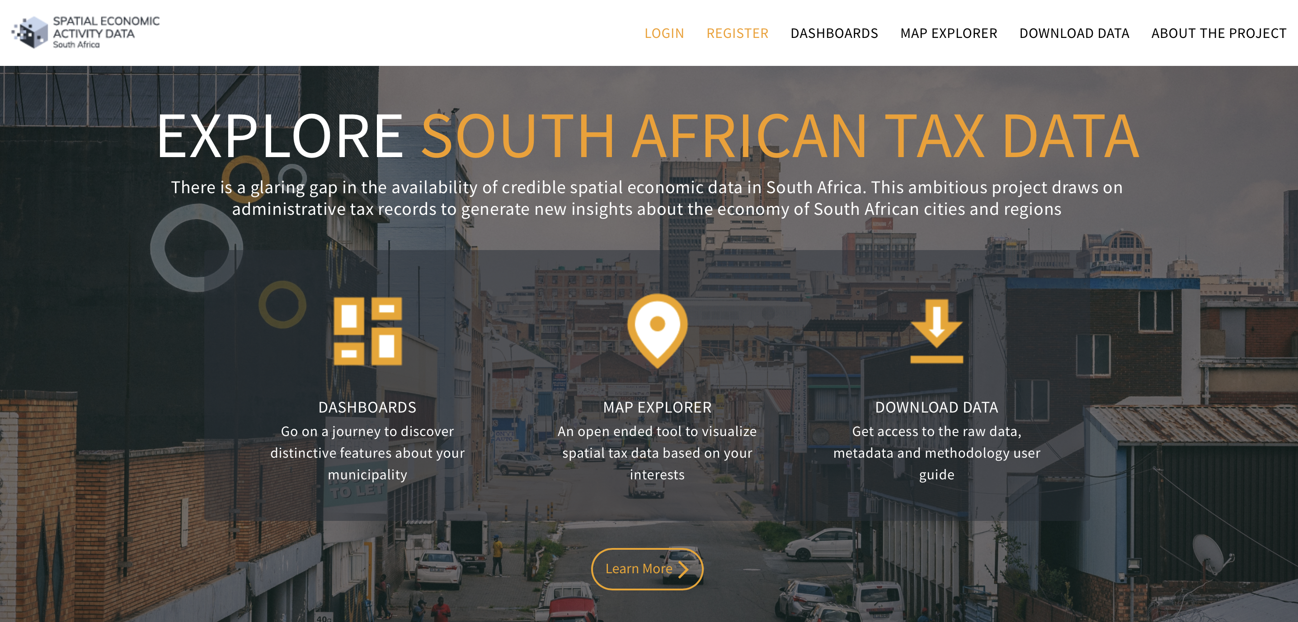



04
EXPLORE TAX DATA: www.spatialtaxdata.org.za
Thanks to our tech partners!

Slide 8
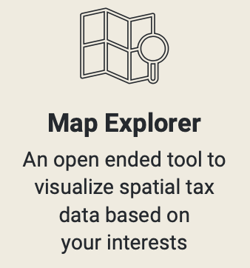
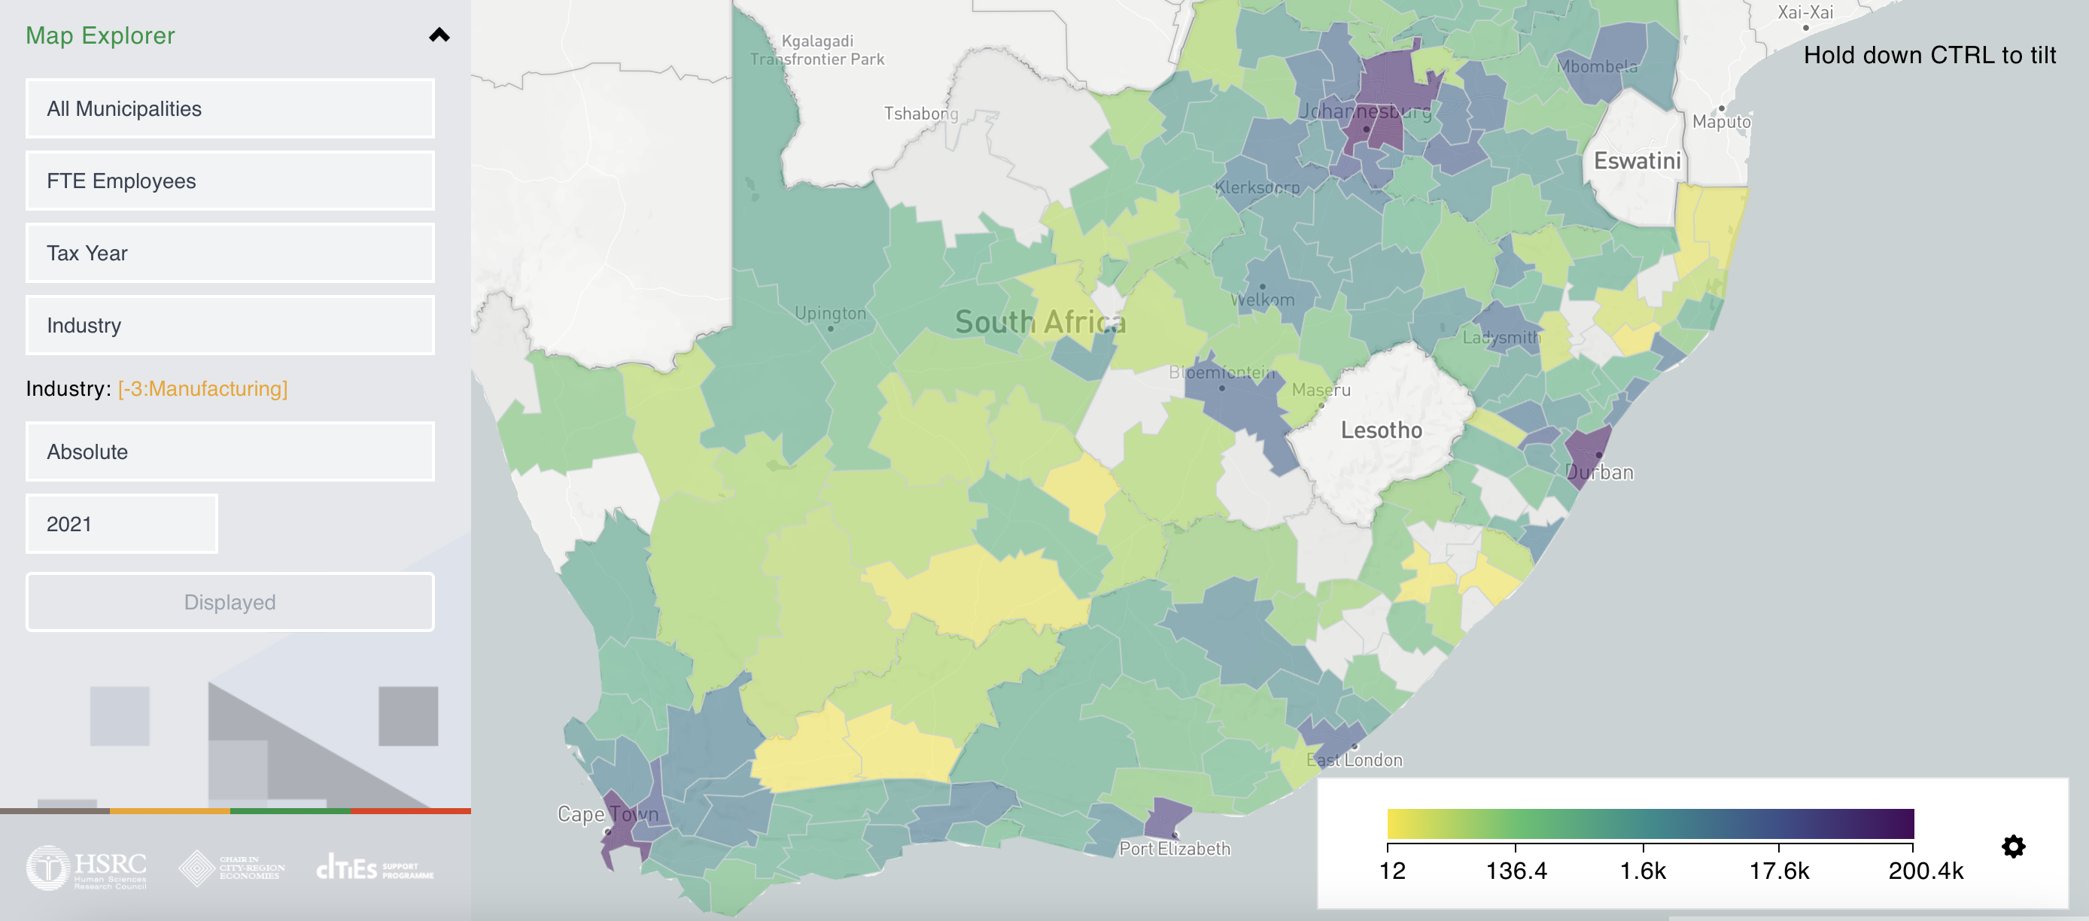

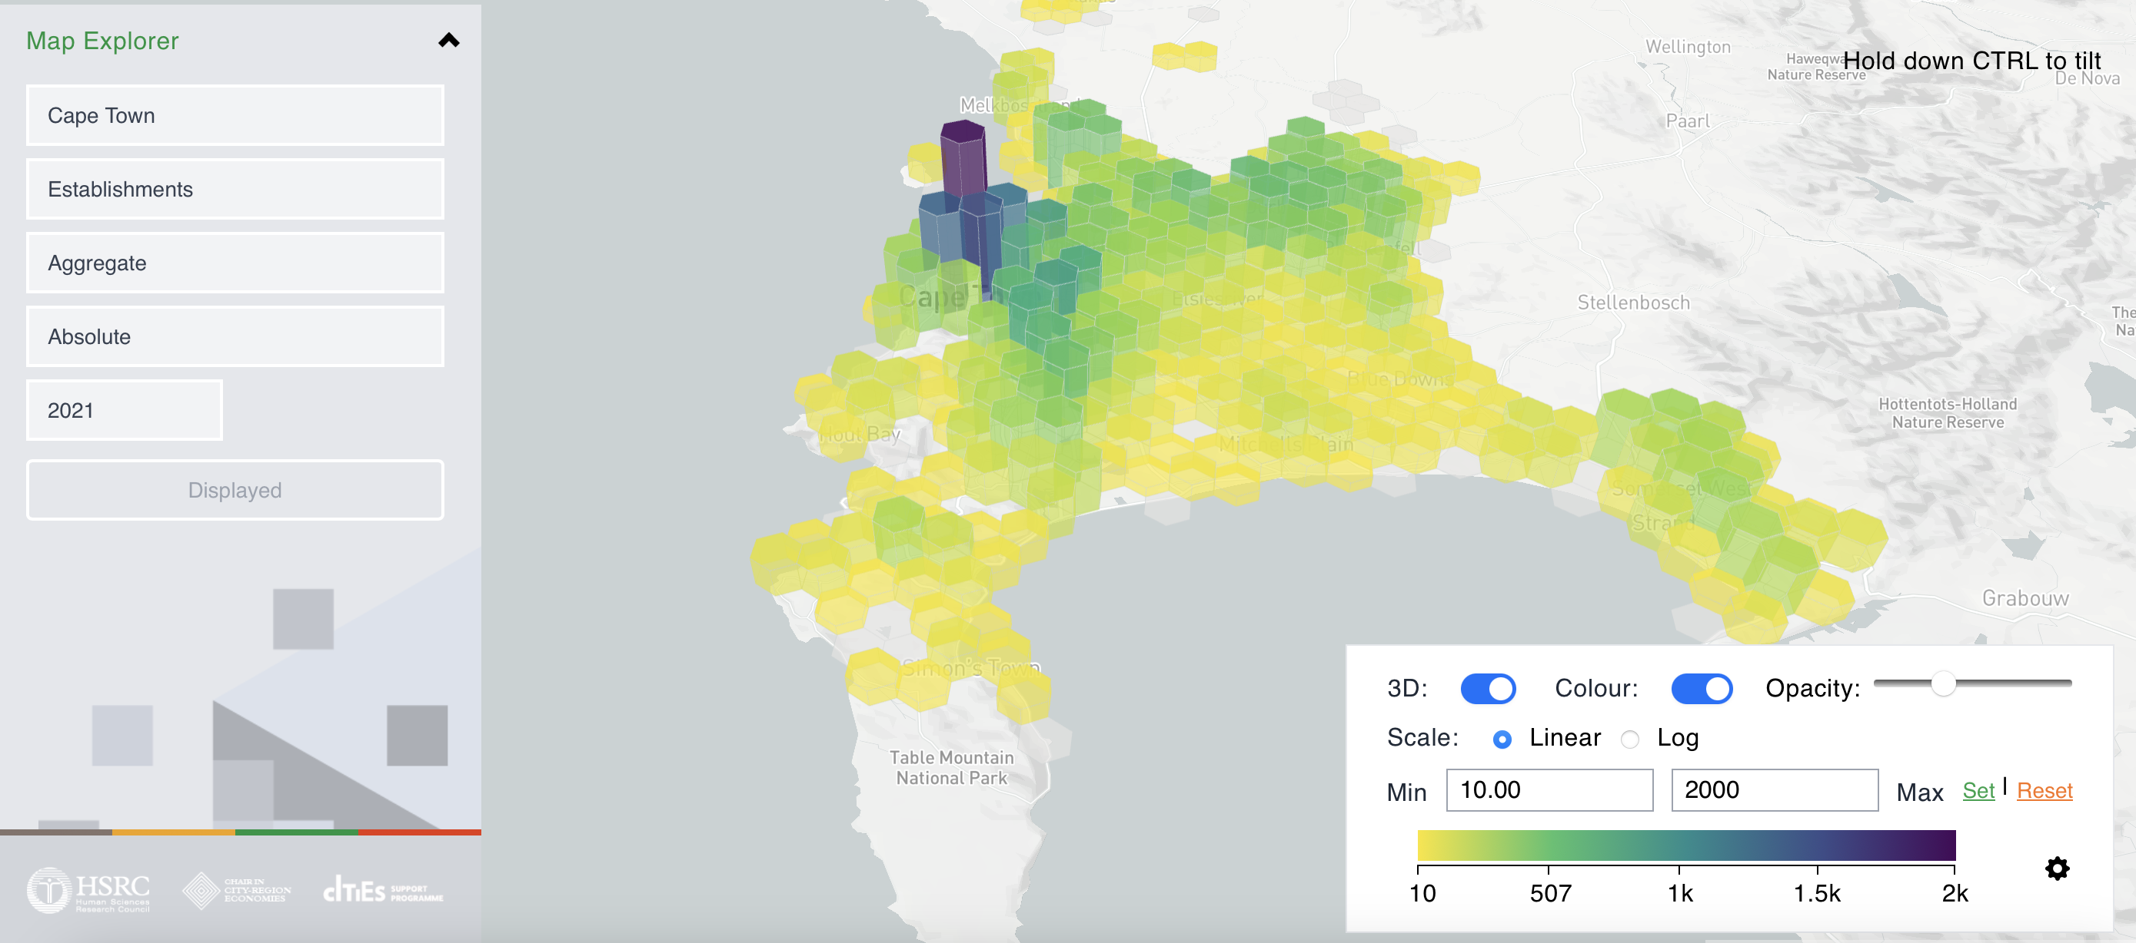
EXPLORE TAX DATA: www.spatialtaxdata.org.za
≈

Slide 9

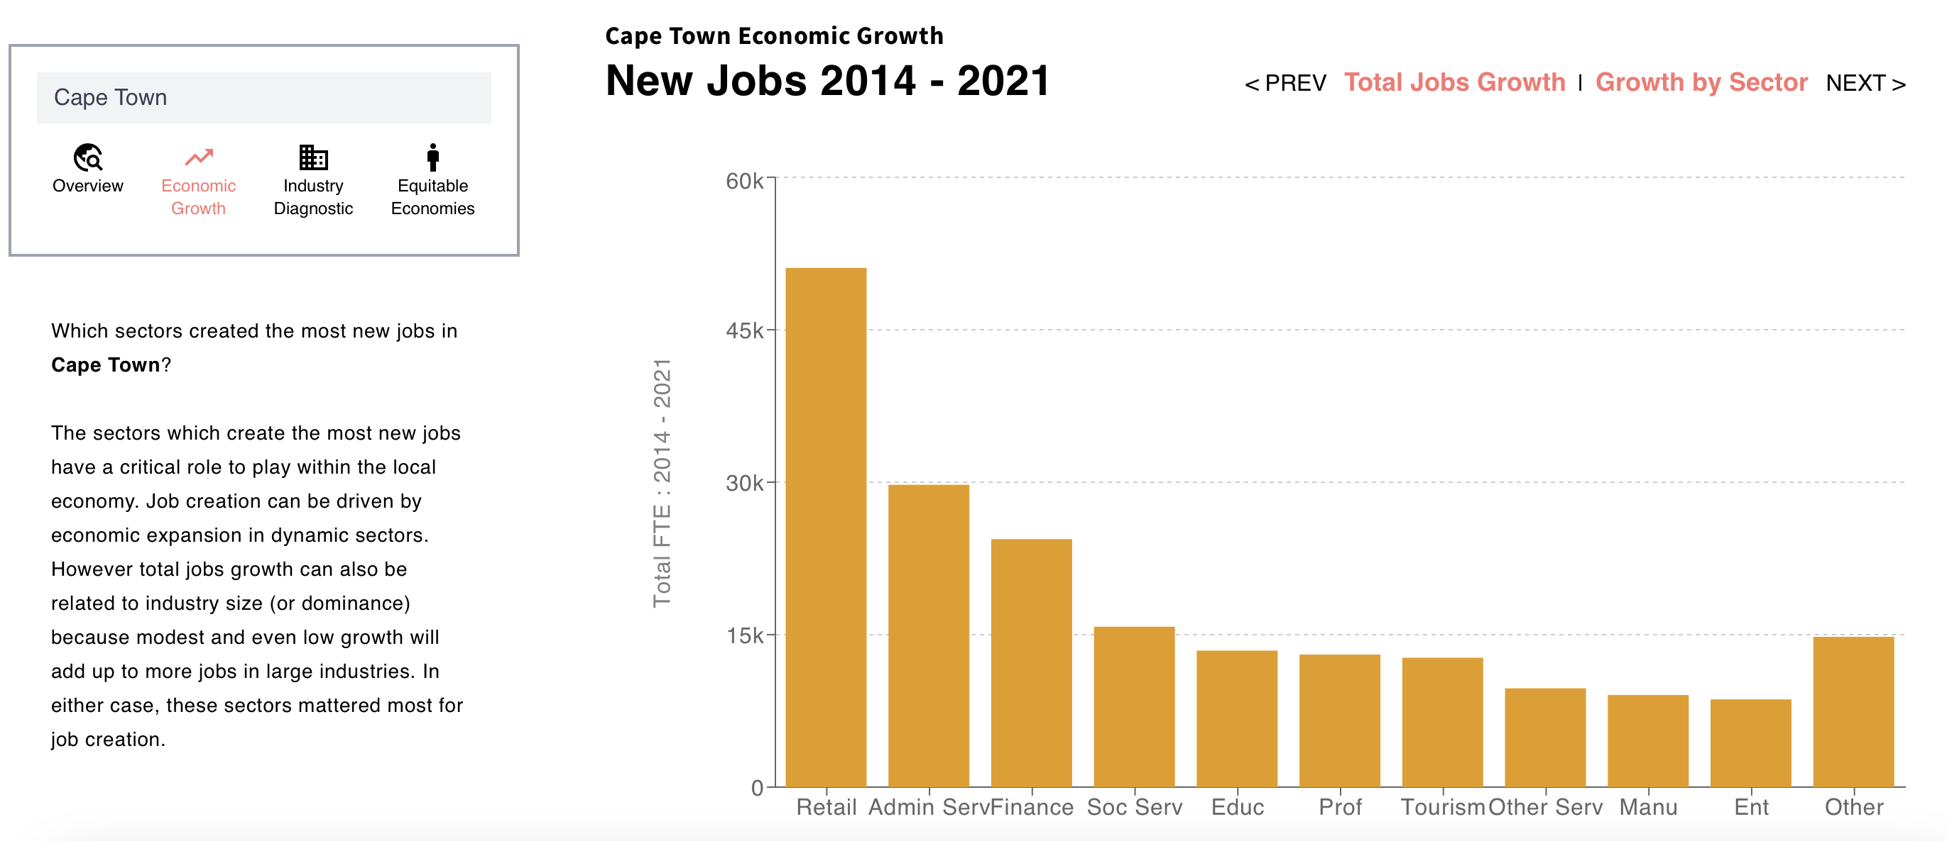
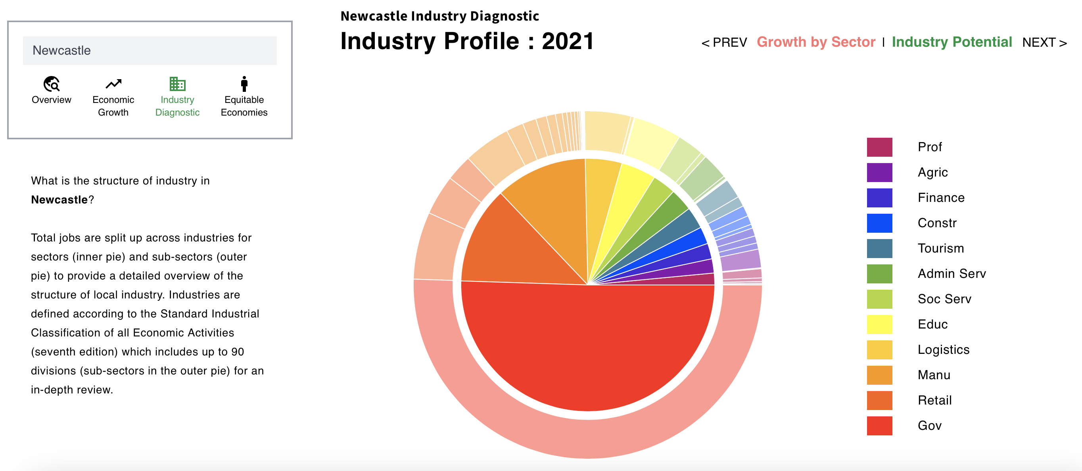
EXPLORE TAX DATA: www.spatialtaxdata.org.za
≈
Notes:
16 of such charts covering: overiview, economic growth, industry diagnostic, equitable economies

Slide 10

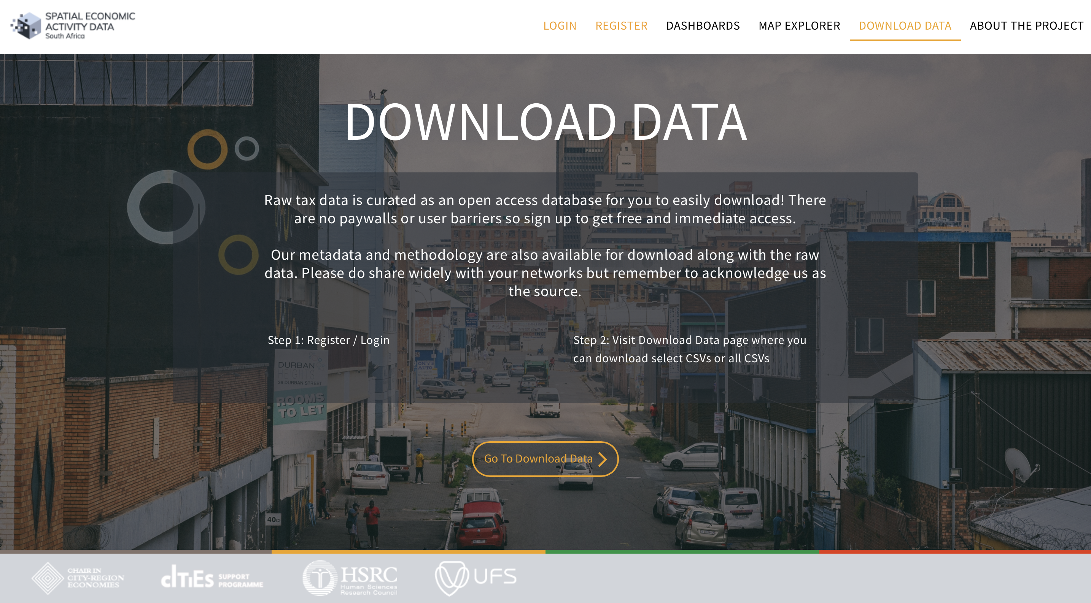
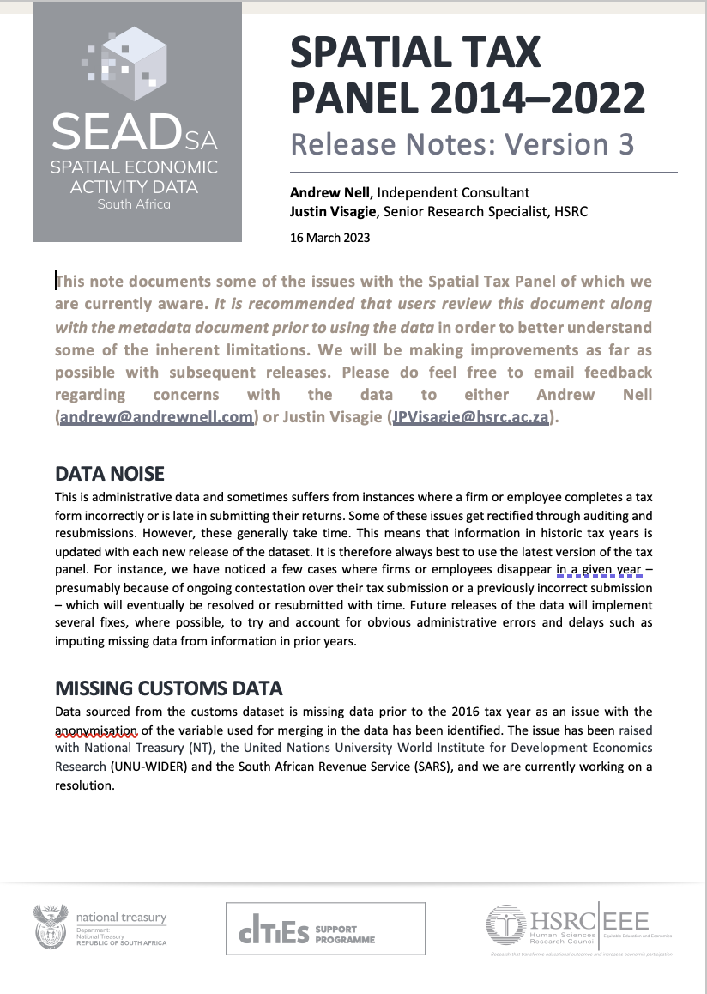
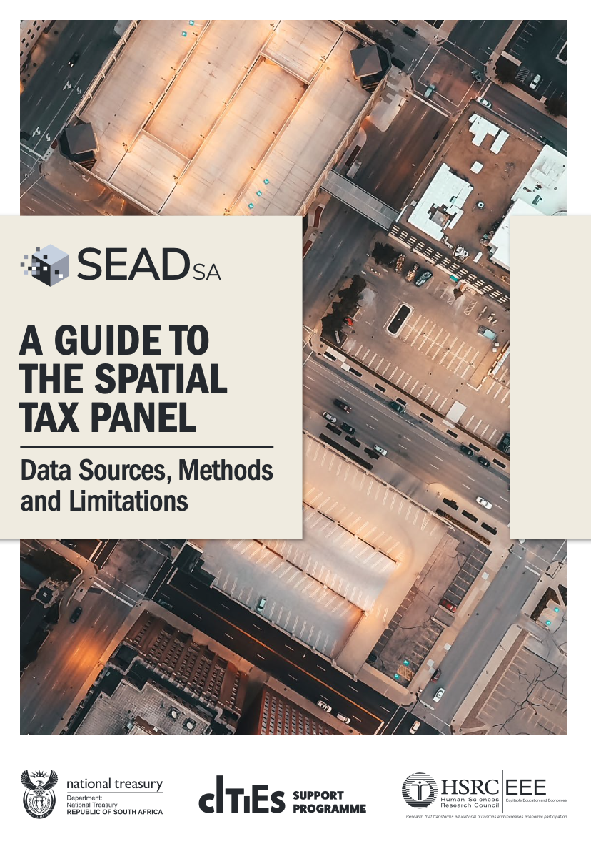
EXPLORE TAX DATA: www.spatialtaxdata.org.za
≈

Slide 11

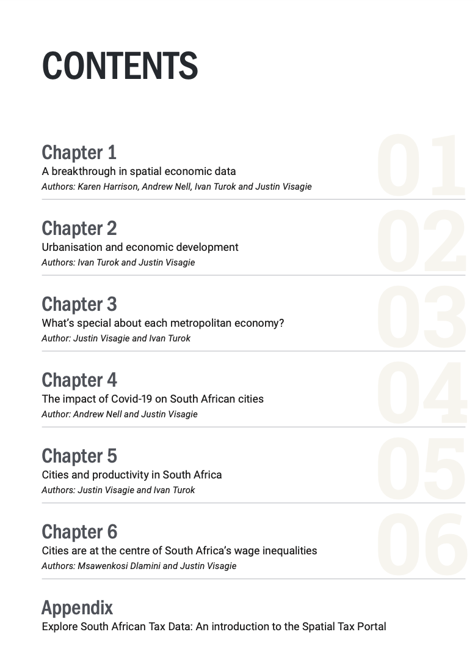
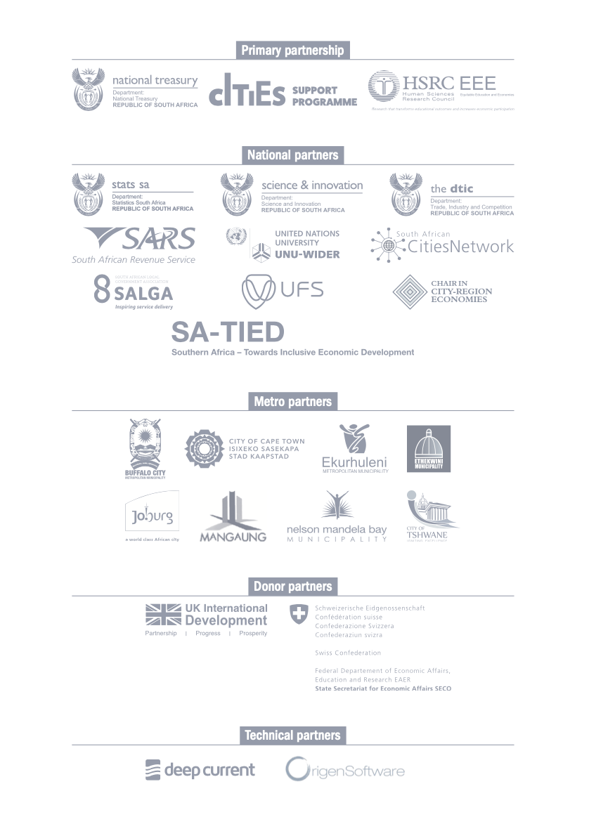
05
POLICY RELEVANT INSIGHTS
Available for download: https://spatialtaxdata.org.za/resources
Notes:
We’re pleased to present the Cities Economic Outlook. Distils key insights about the decisive influence of local features on economic development.

Slide 12












06
UK:FCDO partnership July 2023 – March 2026. Green circles are actively funded, so lots of scope for future partnerships!
Vision 2030: Theory of change
VIRTUOUS
CYCLE
Admin Spatial
Data Curation
Research-policy Community of Practice
Firm Interview and Survey Data Curation
Applied Research
VISION
A self-reinforcing cycle of better data, sharing, learning and action
Digital Dissemination and Diagnostics

Slide 13


07
Impact Tweet... Here’s some positive testimony!
The recent introduction of City Spatialised Economic Data has been an incredible game changer for eThekwini Municipality.
Senior official, eThekwini municipality
The spatial tax data is already informing policy such as our MSDF (metro spatial development framework) and IDP (Integrated Development Plan) planning.
Senior official, City of Cape Town
The NT/HSRC tax data is a major leap forward for economic planning and will fill a huge gap in the open source environment. This data is pure gold.
Economic Development Consultant, GIS specialist
National Treasury's decision to enter the partnership with the HSRC has been fully vindicated since its inception in July 2021
Senior official, National Treasury

Slide 14
THANK YOU
SIYABONGA
ENKOSI
KE A LEBOHA
NDZA NKHENSA
DANKIE!

