Slide 1
Timely Data for Sustainable Development
A program of

Slide 2
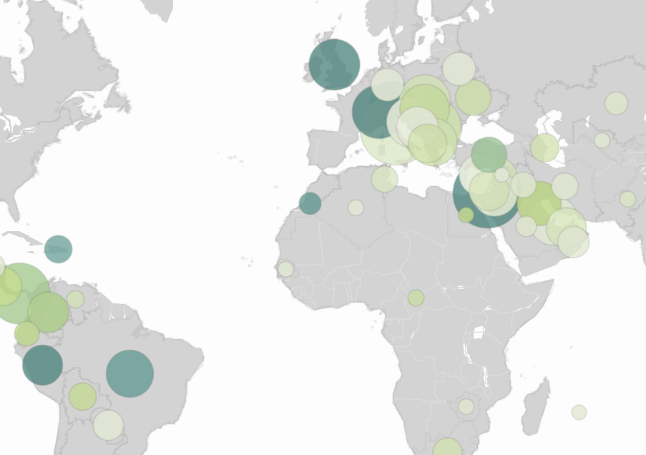
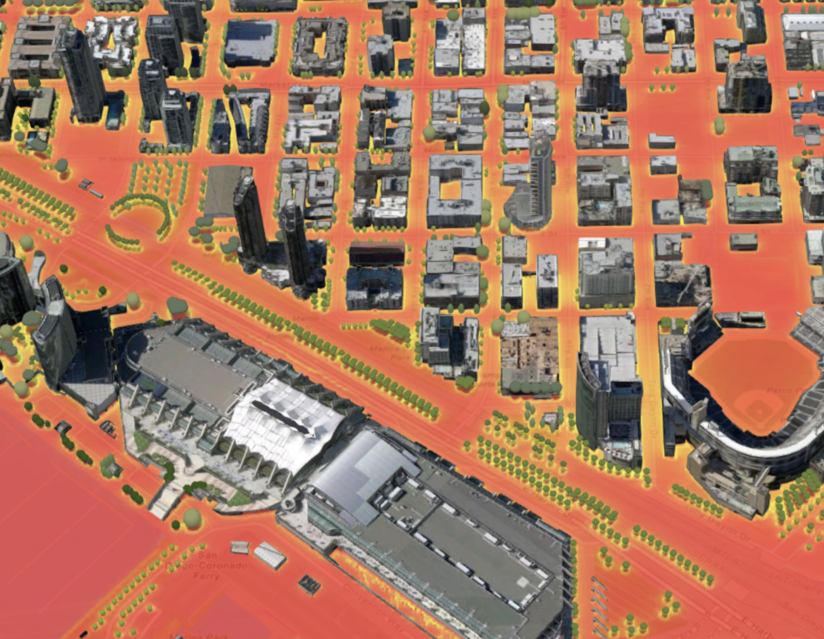
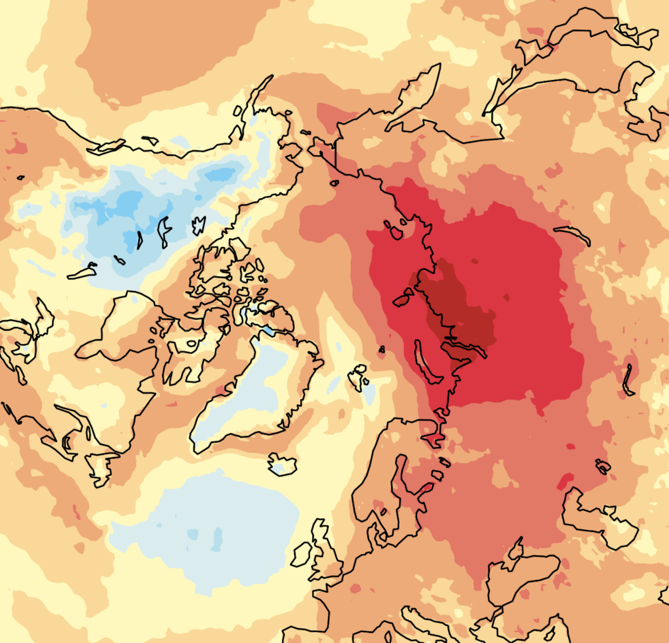
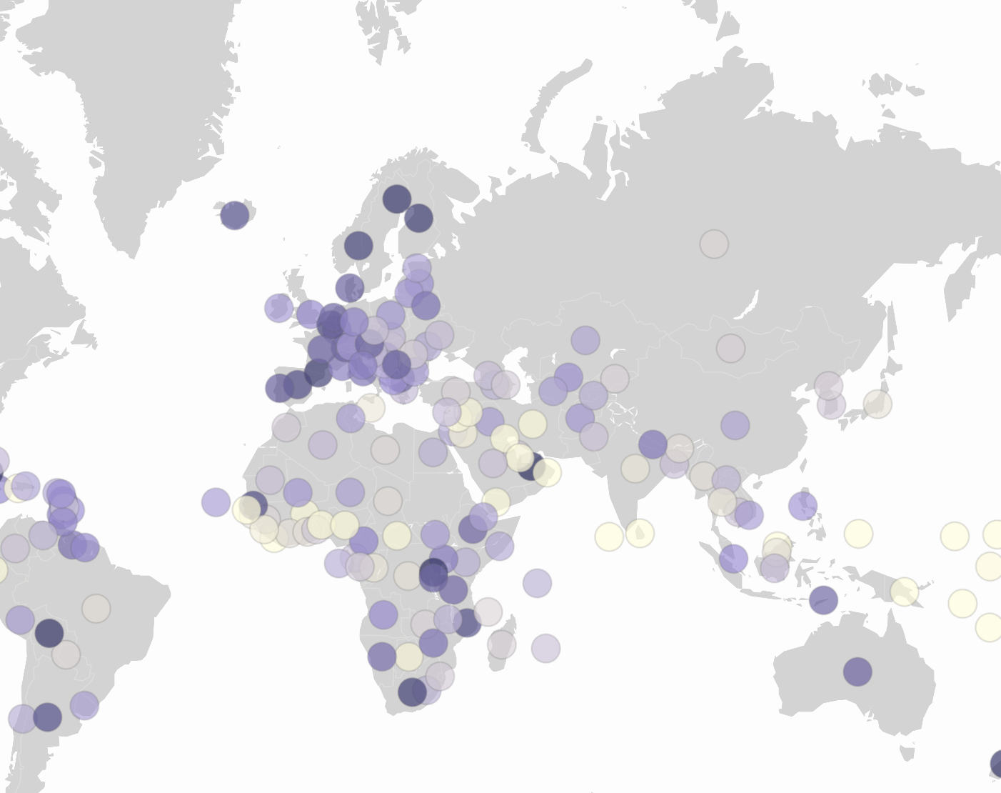
SDSN SDGs Today
SDGs Today is the geospatial program of the UN Sustainable Development Solutions Network (directed by Prof.Jeffrey Sachs) launched in July 2020 in partnership with Esri and the National Geographic Society
Our goal is to advance the production and use of timely geospatial data for the SDGs and to train the next generation of leaders in sustainable development in GIS
SDGs Today: Timely Data for Sustainable Development
@sdgstoday

Slide 3
Digital Data-Driven VNRs & VNRs
Template: SDGs Today and Esri developed an ArcGIS StoryMap template for data driven Voluntary National Reviews and Voluntary Local Reviews
Objective: Improve data accessibility and encourage the inclusion of timely and geospatial data and analysis
Expert Opinion: 40+ VNR and VLR focal points from 20+ countries were invited to review and provide feedback on the template
SDGs Today: Timely Data for Sustainable Development
@sdgstoday

Slide 4
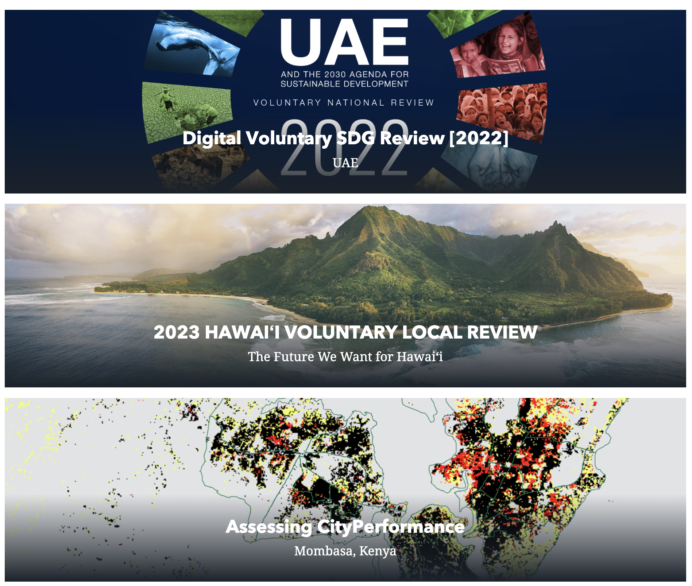
Digital Data-Driven VNRs & VNRs
On the sidelines of HLPF 2023, the UAE National Committee on the SDGs, Hawai’i Green Growth and the Local2032 Islands Network, and UN-Habitat presented their digital VNRs and VLRs using the template.
SDGs Today: Timely Data for Sustainable Development
@sdgstoday

Slide 5
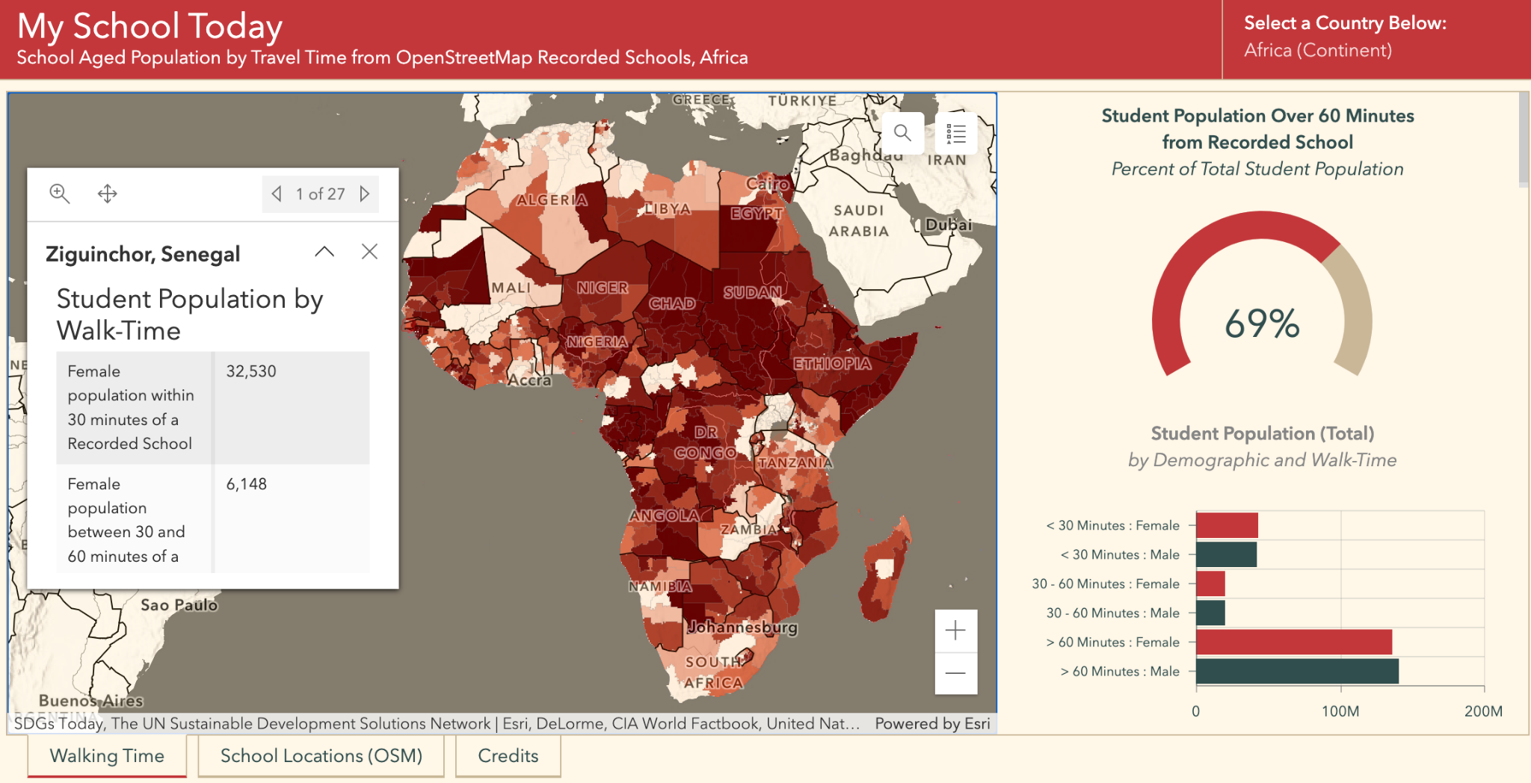
My School Today
A bottom-up approach to crowdsource school data, providing education & training to our participants.
Launched with the Ministry of Education of Ghana
Estimating sub-national population counts of students experiencing geographic barriers to education
Developed a suite of GIS educational lessons to engage local communities and youth groups
Linking data collection at a local level to decision making processes
Raising awareness about crowdsourced geospatial data and citizen science data among stakeholders
Amplifying local stories on barriers to education
sdgstoday.org/myschooltoday
We are grateful for the support of the Humanitarian OpenStreetMap Team (HOT), UNESCO IIEP, WorldPOP, Esri, and other organizations in this effort!
SDGs Today: Timely Data for Sustainable Development
@sdgstoday

Slide 6
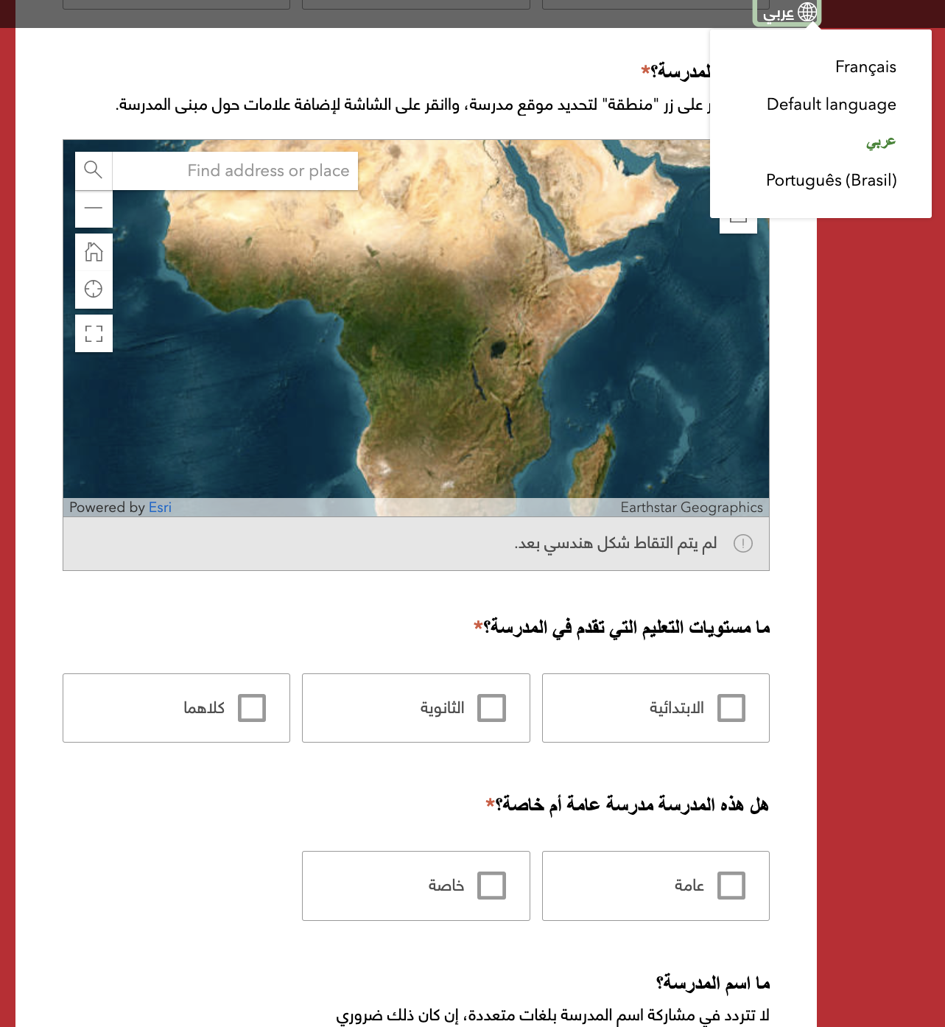
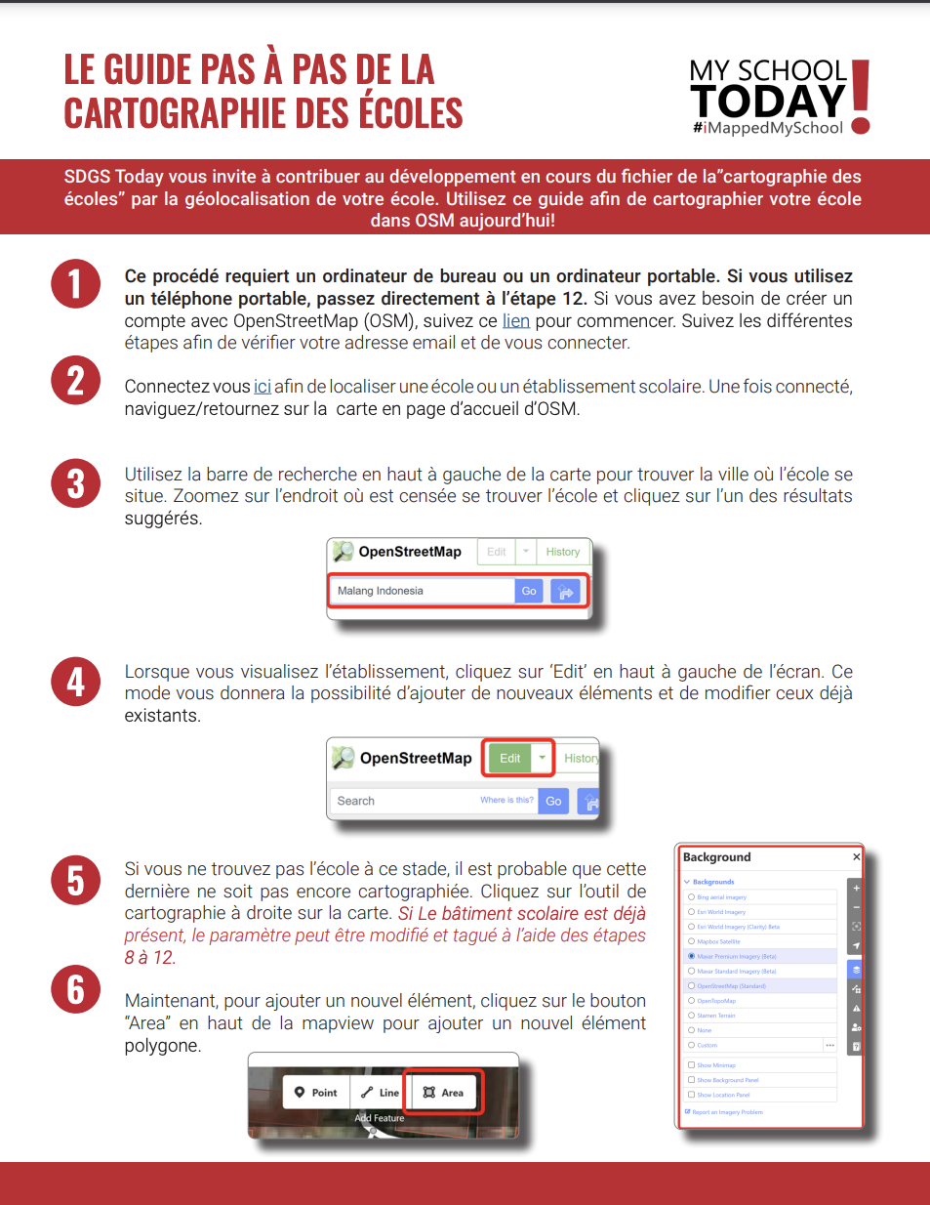
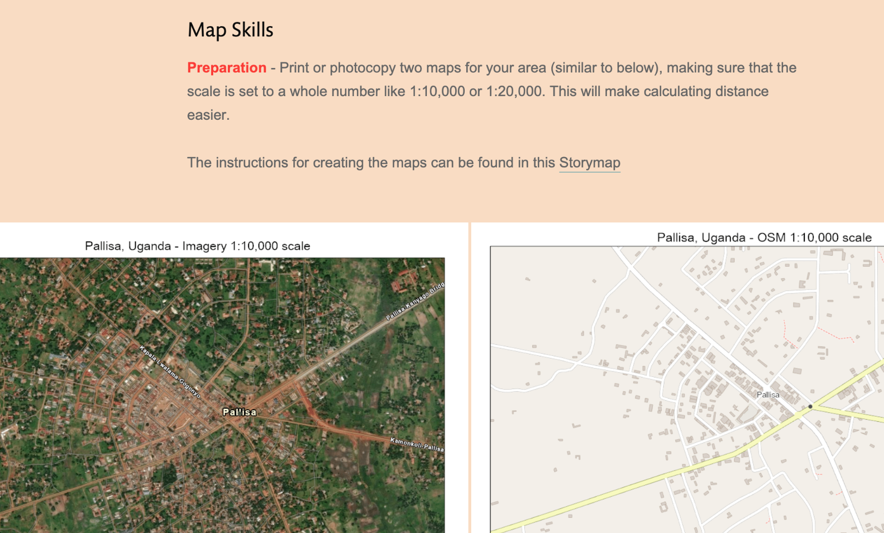
A Call to Action: Education and Training
SDGs Today: Timely Data for Sustainable Development
@sdgstoday

Slide 7
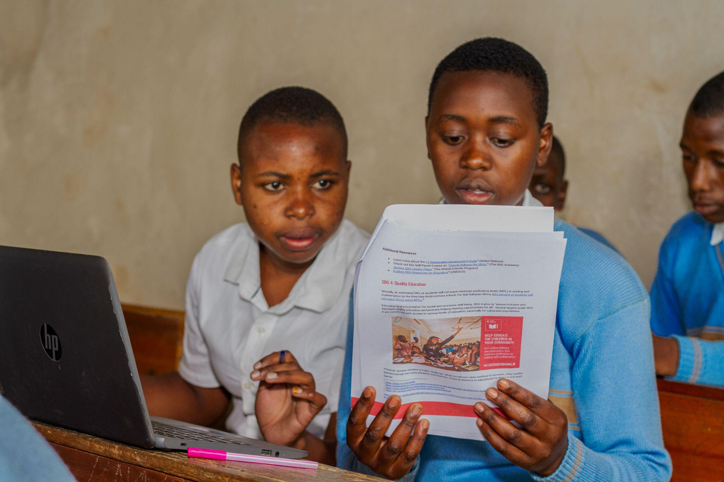
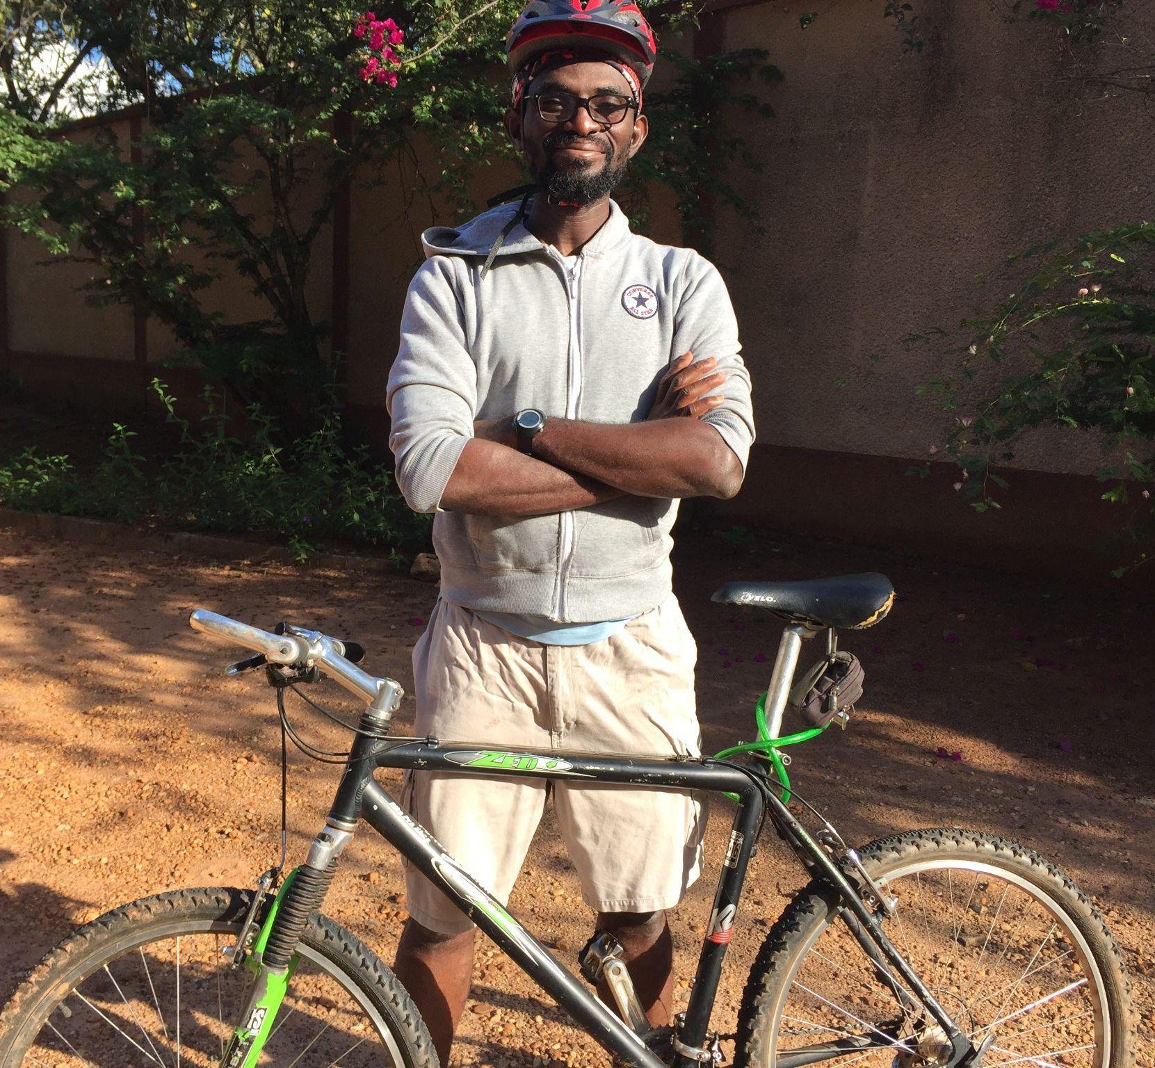
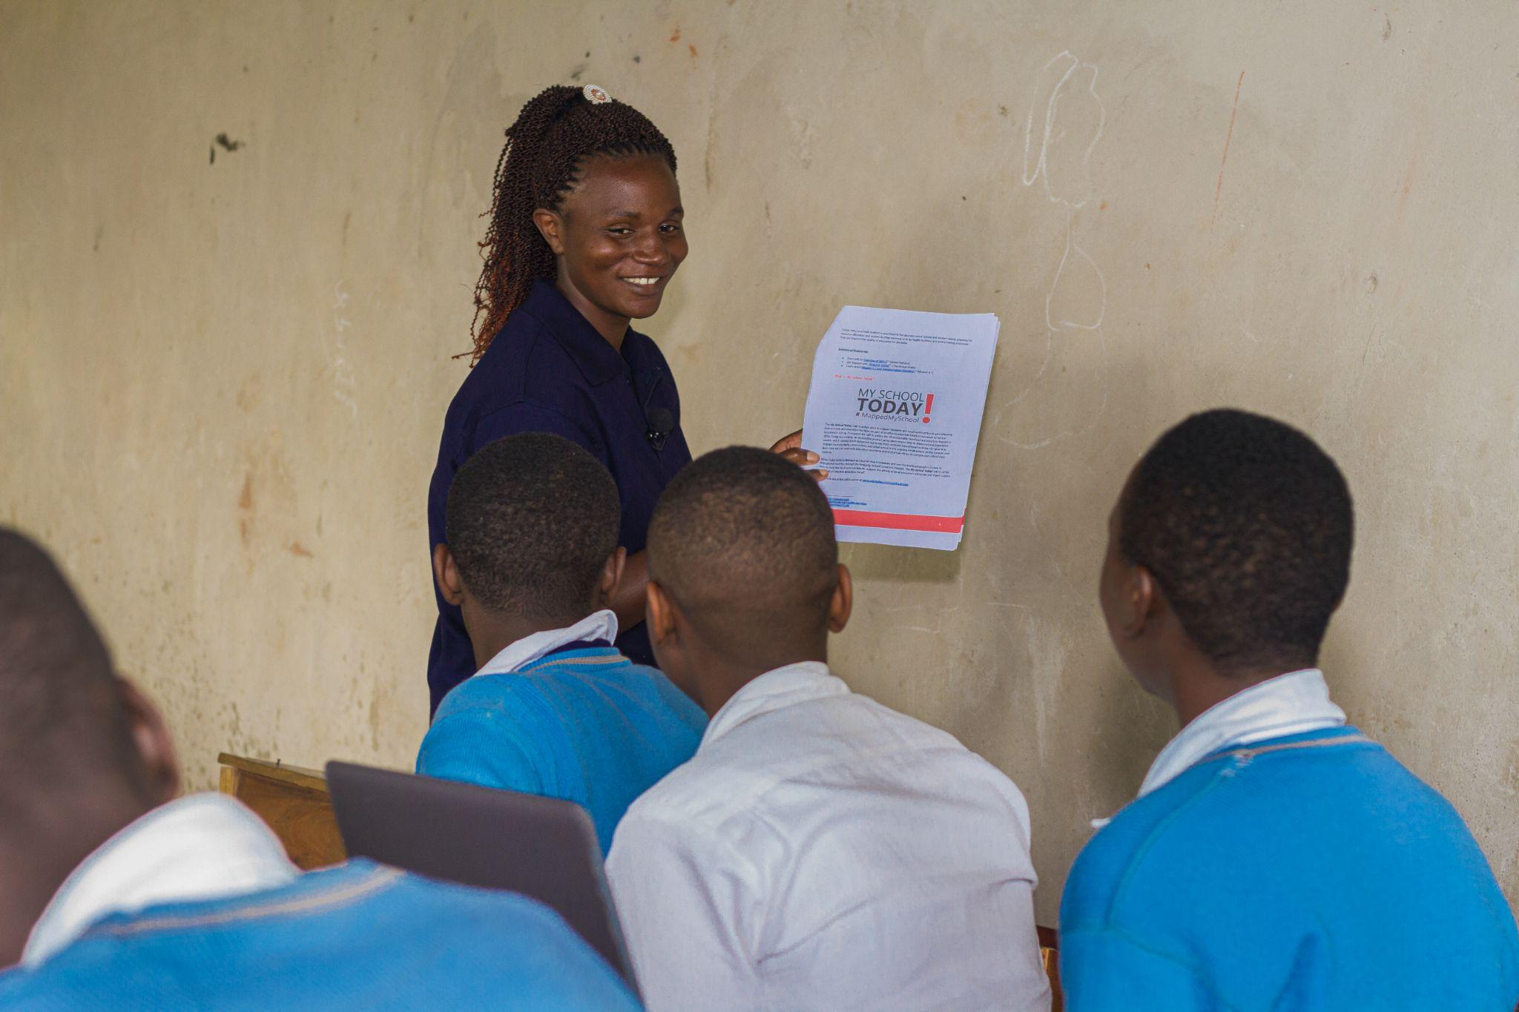
Participant Spotlight
“I decided to map while riding. In just one day, I mapped 4 schools in my area, for about 10 km. I am now thinking about some of my friends to join me in such an initiative.” -Ehouman Evans, Côte d’Ivoire
Participating students from Kisoro, Uganda (Organized by OSm Uganda as part of the Africa Digital Access Initiative)
SDGs Today: Timely Data for Sustainable Development
@sdgstoday

Slide 8
Join Us!
We would like to collaborate with YOU on My School Today and the Data-Driven VNR/VLR StoryMaps to empower citizens, decision makers, and other stakeholders with data collection, analysis and reporting mechanisms that spur action toward the SDGs!
SDGs Today: Timely Data for Sustainable Development
@sdgstoday

Slide 9
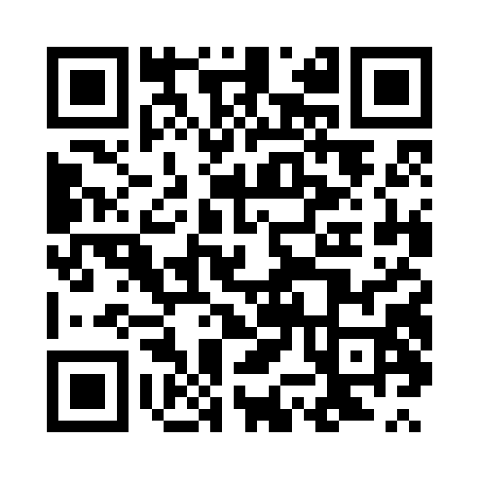
Connect with us
www.sdgstoday.org
sdgstoday@unsdsn.org
@sdgstoday
linkedin.com/showcase/sdgs-today

