Slide 1
IXth SESSION OF THE REGIONAL COMMITTEE OF UN-GGIM: AFRICA
REVAMPING THE WORKING GROUPS AND THEMATIC NETWORKS OF THE UN-GGIM: AFRICA
CAPE TOWN, SOUTH AFRICA: 14-18 AUGUST 2023

Slide 2
1 – BACKGROUND AND JUSTIFICATION
2 – OBJECTIVES AND EXPECTED RESULTS
3 – REVAMPING THE WORKING GROUPS (WG) & THEMATIC NETWORKS (TN)
4 – METHODOLOGY FOR THE REVIEW OF THE ACTIVITIES OF THE WG & TN
TRAVAUX DE GROUPES
5 – DELIVERABLES
6 – RECOMMENDATIONS
7 – QUESTIONNAIRE FOR THE ASSESSMENT OF THE WG & TN
8 – DRAFT PROPOSAL FOR NEW WG
9 – DRAFT OUTLINE OF TOR FOR THE NEW WG

Slide 3
1 – BACKGROUND AND JUSTIFICATION
UN-GGIM is a UN initiative that aims to improve the availability, accessibility, and quality of GI for decision-making across the globe.
UN-GGIM: Africa focuses on GIM for Africa
UN-GGIM: Africa Working Groups and Thematic Networks (Pillars)
The working groups are tasked with developing and implementing strategies and plans that support the objectives of UN-GGIM: Africa. providing guidance and technical support to member states on various aspects of GIM.
Unfortunately, most of the working groups could not fulfill their mandate to satisfaction. Hence the need to revitalize their operations in reviewing their composition and structure, strategy, outcomes, work plan, coordination and collaboration, and decision-making process, among others things, to achieve better results

Slide 4
2 – OBJECTIVES AND EXPECTED RESULTS
Overhaul the UN-GGIM: Africa WG and TN so that they can fully play their role as operational units and enable the Regional Committee to achieve its objectives for the development of GI and technology in Africa.
More specifically, it will involve:
Conducting an assessment and review performance of the WG and TN.
Recommending the best methodology to follow in establishing new WG and TN.
Developing Terms of Reference for each WG and TN that are aligned with the UN-GGIM: Africa strategic objectives.
Preparing the relevant inputs and facilitating various discussion forum on issues related to putting in place a viable implementation step that will need to be taken to achieve the strategic goals.

Slide 5
3 – REVAMPING THE WORKING GROUPS AND THEMATIC NETWORKS
Enhancing the collaboration between stakeholders, in order to help improve coordination and participation.
Developing/implementing capacity building programs that focus on developing and strengthening GIM skills and competencies.
Organizing regular workshops, webinars or discussion forums to promote the sharing of knowledge and the exchange of best practices.
Leveraging new technologies and innovations to streamline processes and for continuous improvement.
Improving communication and reporting, and evaluating and monitoring the implementation of the activities of the groups to ensure the objectives set are being achieved, and to make adjustments as necessary.

Slide 6
4 – METHODOLOGY FOR THE REVIEW OF THE ACTIVITIES OF THE WORKING GROUPS & THEMATIC NETWORKS
A process that will be conducted in six (6) phases:
Inception report as a roadmap.
Assessment of the WG and TN: current operations, consultation with stakeholders to gather their perspectives and needs, and identify their priorities and concerns.
Assess the status of the functioning of the WG & TN through using a questionnaire
Documentary review of existing best practices
Identify SWOT, as well as issues, and subsequently propose a methodology for implementing operational, high-performance WG & TN capable of meeting the strategic needs of UN-GGIM: Africa.
Develop TORs for the WG & TN, constituting their roadmap
Investigate and advise on the role of the private sector and academic networks in the activities carried out by the WG & TN,
Advise on reporting mechanisms to improve implementation of the work program.

Slide 7
5 – DELIVERABLES
Initial report contain the questionnaire and which describes the scope, objectives, methodology, timeline for carrying out the work and the main results expected.
Final report on the assessment of the WG and TN, including wins, challenges, and proposals on how to improve the functioning of the WG and TN.

Slide 8
6 – RECOMMENDATIONS
Recommendations will be made towards establishing highly functional UN-GGIM: Africa WG and TN by significantly improving the way they perform their activities.
Composition and structure, and leadership
Collaboration and coordination
Regular meetings
Communication and reporting
Capacity building
Aligning activities with the strategic objectives of UN-GGIM: Africa
Promoting cooperation with diverse stakeholders
Limiting the groups to an optimal number
Etc,
The recommendations will focus on specific and achievable action items whose implementation will be accompanied by concrete measures and for which progress and effectiveness could be monitored and measured.

Slide 9
7 – QUESTIONNAIRE FOR THE ASSESSMENT OF THE WORKING GROUPS AND THEMATIC NETWORKS
TARGETED STAKEHOLDERS
EXECUTIVE BOARD
UN-GGIM SECRETARIAT
CONVENERS OF THE WORKING GROUPS AND THEMATIC NETWORKS
MEMBERS OF THE WORKING GROUPS AND THEMATIC NETWORKS
MEMBER STATES
SURVEY RESPONDENT:
NAME OF ORGANIZATION:
NAME OF DIRECTORATE OR DEPARTMENT
MEMBER COUNTRY:
NAME OF RESPONDENT
AFFILIATION TO UN-GGIM: Africa (ex. Executive Board, Secretariat, WG Convener, WG Member)
TELEPHONE/WHATSAPP:
E-MAIL ADDRESS:

Slide 10
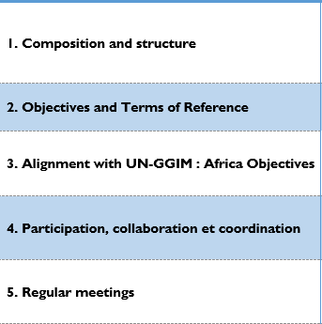
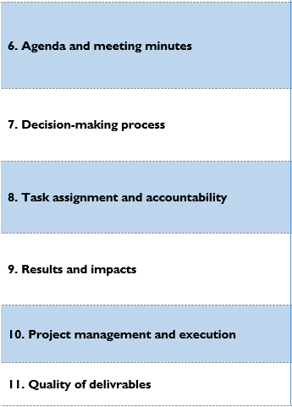
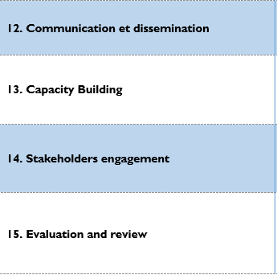
7 – QUESTIONNAIRE FOR THE ASSESSMENT OF THE WORKING GROUPS AND THEMATIC NETWORKS (CONT’D)

Slide 11
8 – DRAFT PROPOSAL FOR NEW WORKING GROUPS

Slide 12
9 – DRAFT OUTLINE OF THE TERMS OF REFERENCE OF THE WG
Mandate
Objectives
Composition
Roles and Responsibilities
Reporting
Duration
Meetings and Communication

Slide 13
Merci de votre attention !

