Slide 1
Policy, Governance, and Coordination Creating an enabling environment for geospatial engagement
Mollie Van Gordon, PhD
Senior Program Officer, Geospatial Insights
Bill & Melinda Gates Foundation

Slide 2
Geospatial Value Pipeline Assessments
Geospatial Value Pipeline
Conduct end-to-end assessments of the geospatial landscape in key focus countries
to understand the geospatial value pipeline and determine the gaps and needs within this pipeline.
Outcomes
Provide direct visibility into needs of local stakeholders while identifying the most impactful opportunities
Increased collaboration and partnerships among local implementing partners
Structured and coordinated geospatial interventions by donors
01
03
Desk Based Review
Validation Workshop
Development & Validation of Research Framework
02
Stakeholder Interviews & Analysis
04
mollie.vangordon@gatesfoundation.org

Slide 3
Generation, analysis and operationalization represent the main pillars of the geospatial value pipeline framework
Value Pipeline Framework
Generation
Analysis
Operationalization
1
2
3
Pipeline
Crosscutting
Sub-pillars
Governance & Policies
What governance structures and policies exist?
Data Form
What form of data is being collected?
Data Cleaning
What is the process of data cleaning?
Use Cases
What are the use cases for geospatial data?
Data Source
Where is data collected?
Analytics
What level of analytics & platforms are used?
Communication
How is information about geospatial data communicated?
Stakeholder Coordination
How are stakeholders coordinated?
Sub-pillars
Infrastructure
What infrastructure is required for data generation?
Infrastructure
What infrastructure is required for data analysis?
Advocacy
What advocacy efforts exists?
Capacity Building
How are capacities developed and sustained?
Data Collection
What is the data collection process?
Visualization
How is data visualized?
1
2
3
Evaluation Themes
Landscape
Challenges
Opportunities
Actors
Levels
Sectors
Funding
Sustainability
Successes
mollie.vangordon@gatesfoundation.org

Slide 4
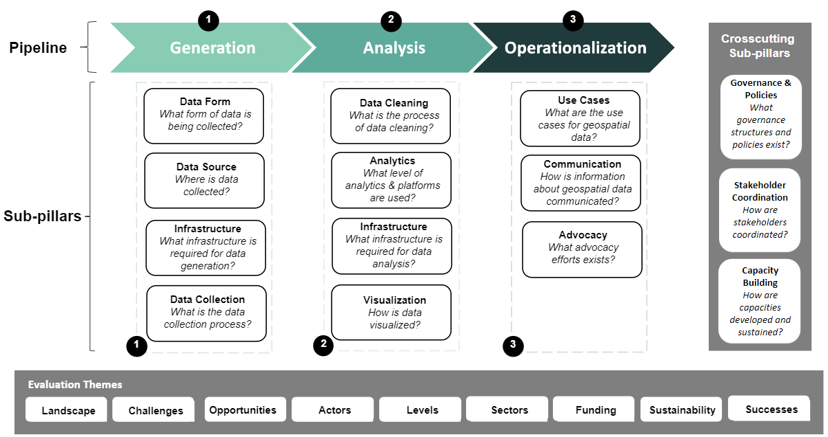
Policy, governance, and coordination are key inputs for effective enablement of the geospatial value pipeline with implications for donor engagement
Insights
Data Mandates
Data Validation
Policies & Processes
Data Storage
Data Access
Data Quality
Effective geospatial policy, governance, and coordination
Standards
Data Interoperability
Data Visibility
Data Sharing
Communication & Coordination
Data Use Cases

Slide 5
Case study: Government alignment at state-level
Case Study
Conducting microplanning for immunization services by the state PHC board.
Tracking polio outbreak and campaign.
Application of GIS to land administration through KADGIS, KAPSUDA, etc.
Mapping of farmlands across the state by KDBS.
The GIS development committee facilitates geospatial data generation and sharing, technology transfer, and capacity building within the state
Geospatial
use-cases
Demonstrated
value of
geospatial
State-level
government buy-in
Unified
geospatial
policy and
coordination
Kaduna State co-funds geospatial data initiatives and has a dedicated GIS development committee
Geospatial coordinated and centralized by the State Bureau of Statistics
Government alignment lays the groundwork for donor engagement

Slide 6
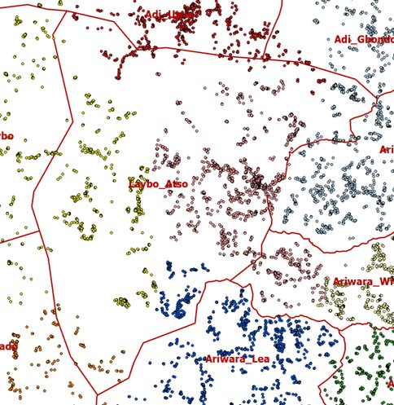
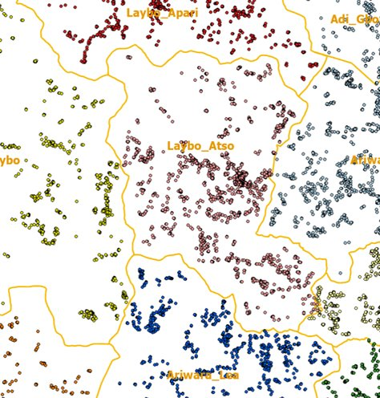
Case Study
Case study: Coordination and geospatial applications
Convening
GRID3 convenes over nine government ministries and agencies to provide oversight and strategic policy direction (Nigeria)
GRID3 national technical committee coordinates actors and has a listserv to facilitate geospatial data sharing (DRC)
Data storage and validation
GRID3 data portal developed and then transferred to government (Nigeria)
GRID3 uses a bottom-up approach by coordinating with sub-national staff (DRC).
Health program applications foster donor engagement
Polio: Modeling population in inaccessible areas; Settlement mapping to reduce missed populations (Nigeria, DRC)
Malaria: Establishing household locations for bed net distribution (DRC)
Immunization: Vaccinator tracking to improve campaign delivery (Nigeria)
Cross-programmatic benefits: Geospatial household data collected by Malaria program used to update health facility boundaries (DRC)
Household locations
Updated boundaries
Coordination and programmatic applications unlock government and donor support

Slide 7
Geospatial policy, governance, and coordination create an enabling environment for geospatial engagement
Enabling Environment
Geospatial Policy
1
Institutionalization and harmonization of mandates and cooperation with agencies that interact with geospatial
Directs government funding for sustainability
Unlocks aligned and coordinated catalytic donor engagement
Enabling Environment for Geospatial Engagement
Geospatial Governance
2
Data interoperability enables the layering of geospatial datasets
Data sharing and storage practices reduce risk of data loss
Validation standards and processes enable official dataset recognition
Coordination
3
Better data sharing, visibility, and access
Less duplication of data generation and capacity building efforts
Better use-case sharing and cross-learning
Increased cross-programmatic benefits
More efficient use of limited resources
Donor engagement based on programmatic applications (e.g. health)

Slide 8
Thank You
mollie.vangordon@gatesfoundation.org

