Slide 1
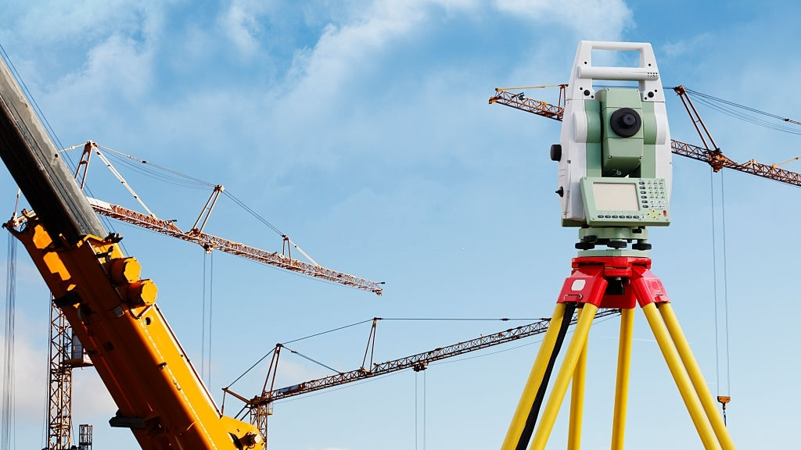
R.P.A.G.
Le Réseau des Professionnels Africains de la Géomatique
https://rpag.africa

Slide 2
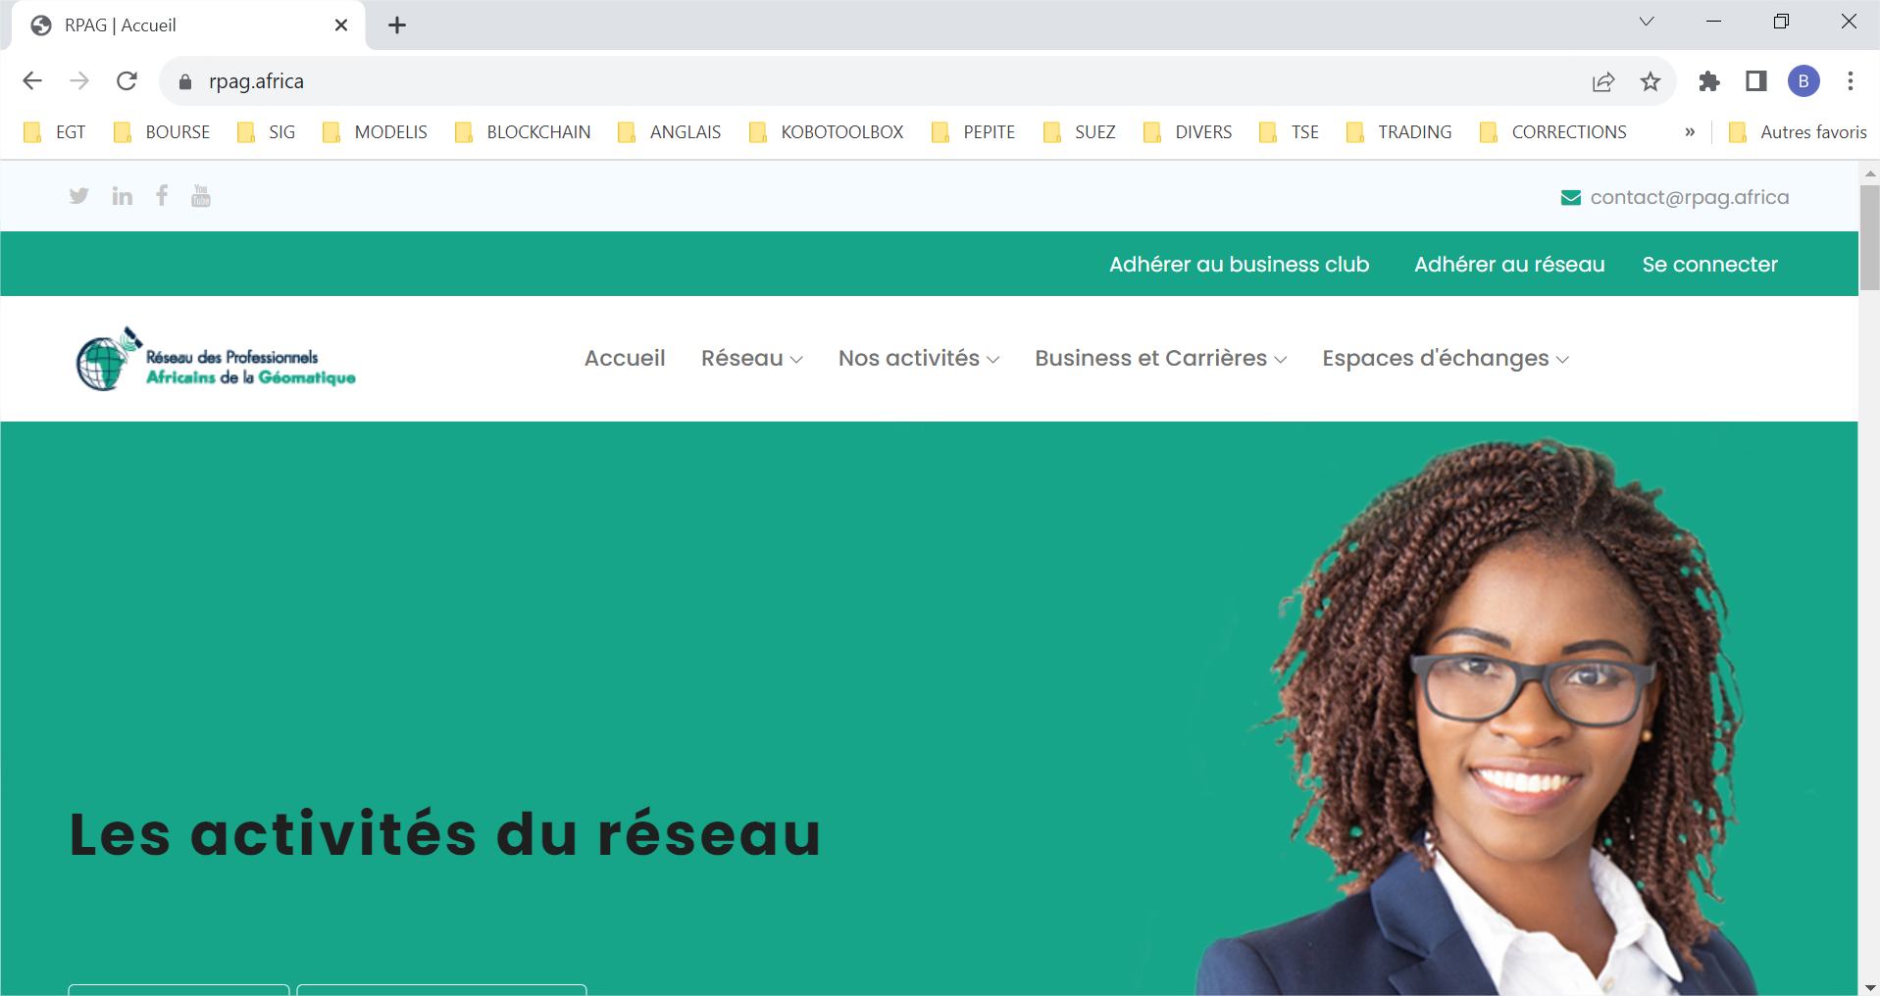
02
PRESENTATION OF RPAG NETWORK

Slide 3
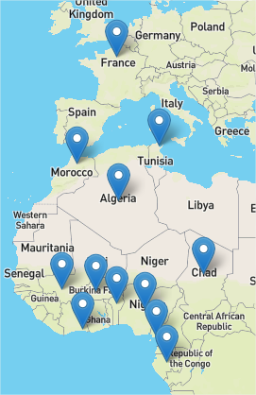
12 representatives country
03
THE NETWORK IN NUMBER
Created on 07th of September 2020 in Abidjan.
On the website
980 Individuals
22 company
28 Nationalities
Web site : https://rpag.africa

Slide 4
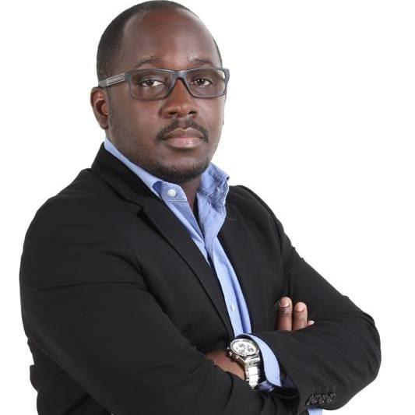
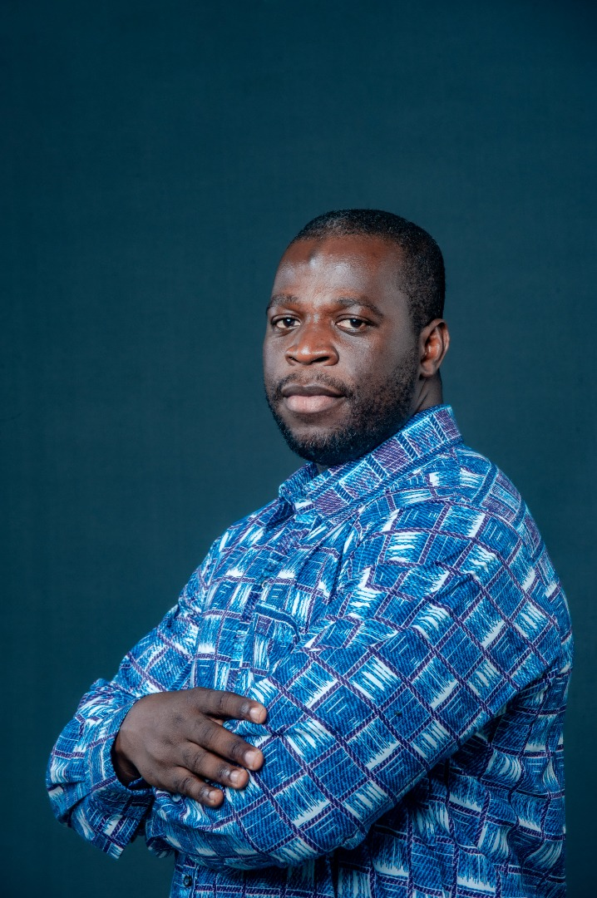
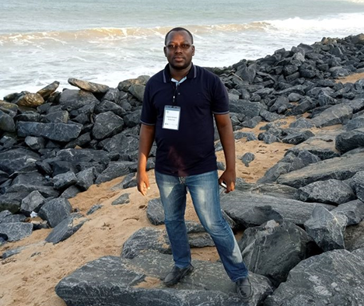
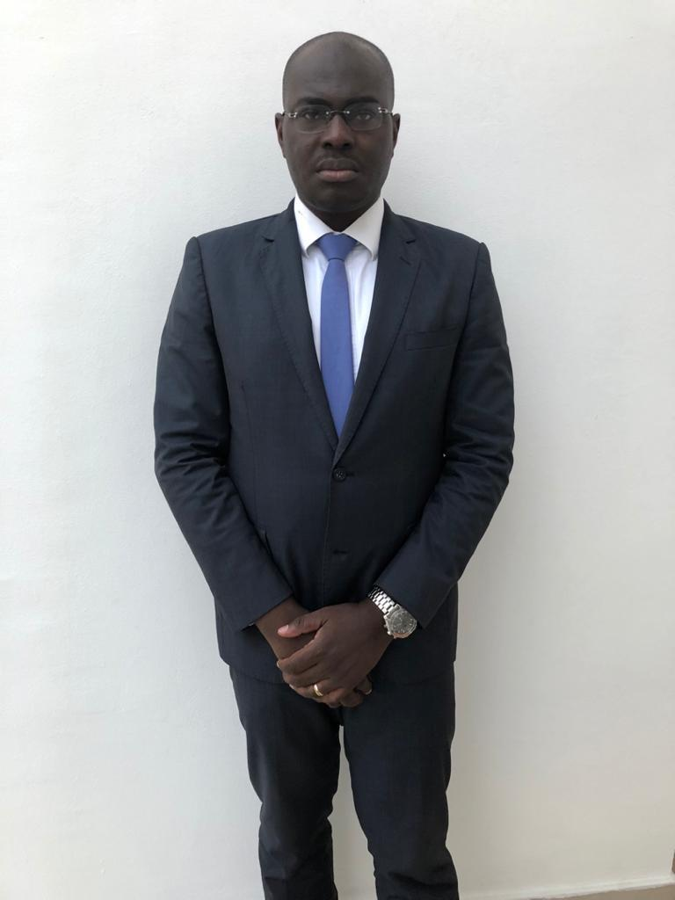
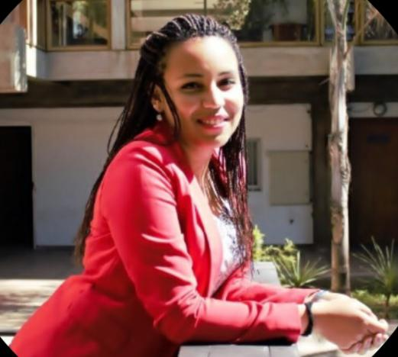
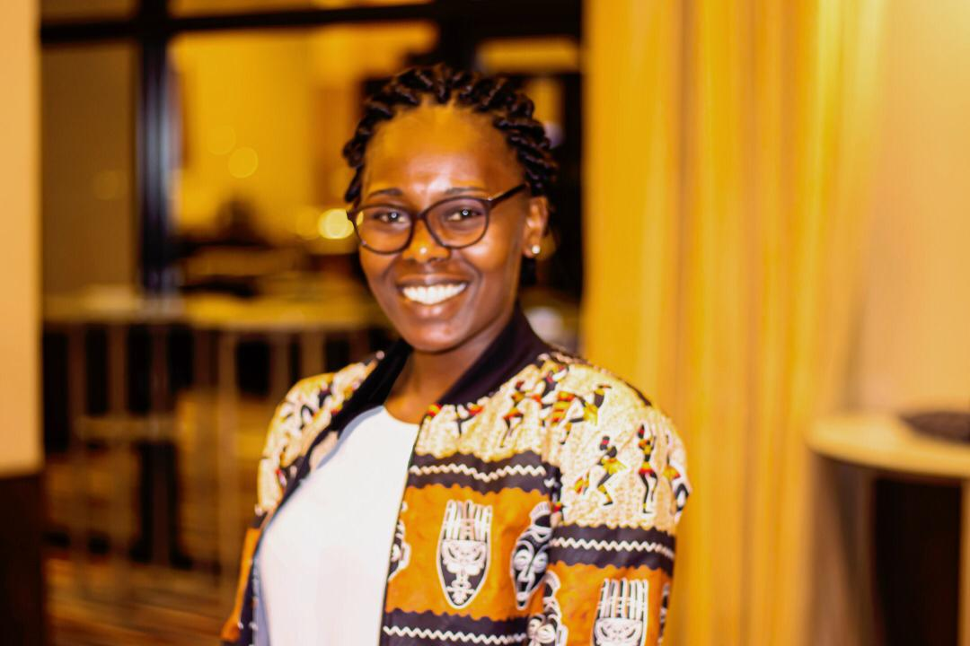
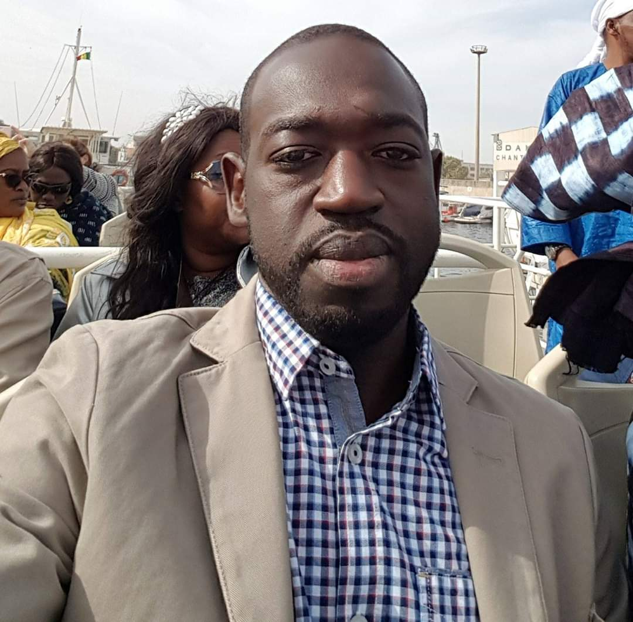
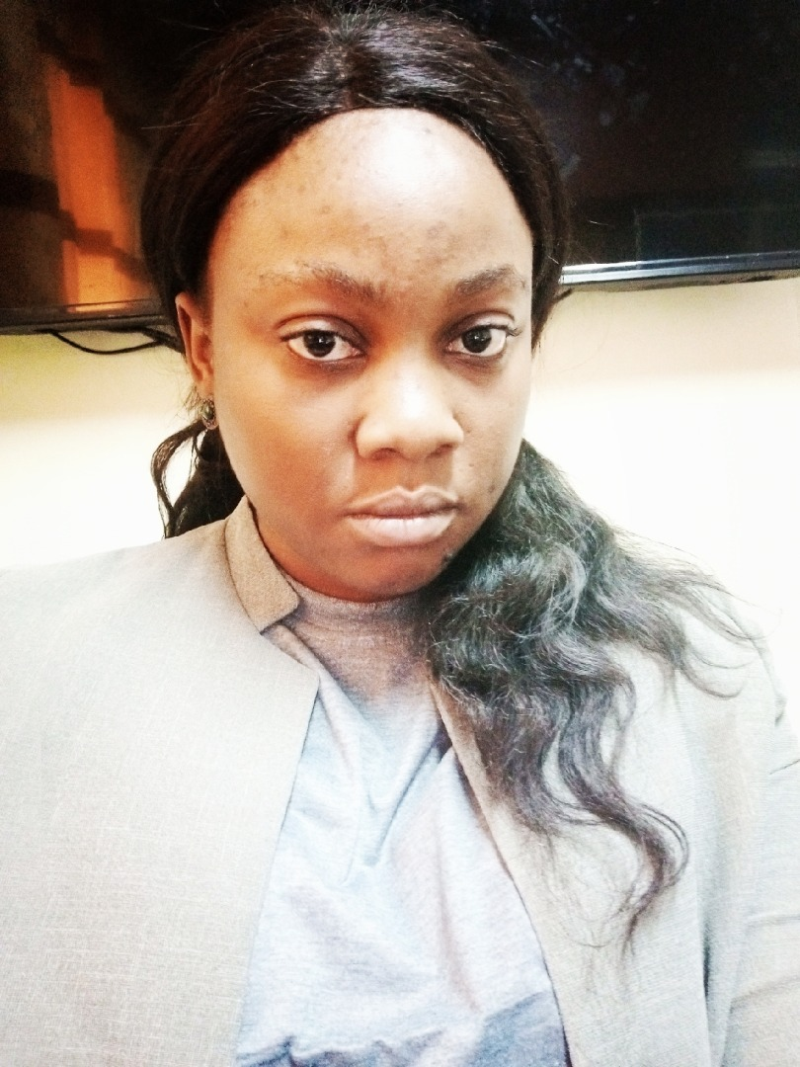
04
GOVERNANCE BODIES
The Executive Board
Fabrice IRIE Dr Labaly Augustin Joseph ITHRI AIT Marie Thierno Amandine
TOURE BAMOUNI AHOULOU HOU MAKUATE DIALLO NJEUGEUT
President Vice Secretary Treasurer Vice Communication Partnership Training
President General Treasurer Manager Manager Manager

Slide 5
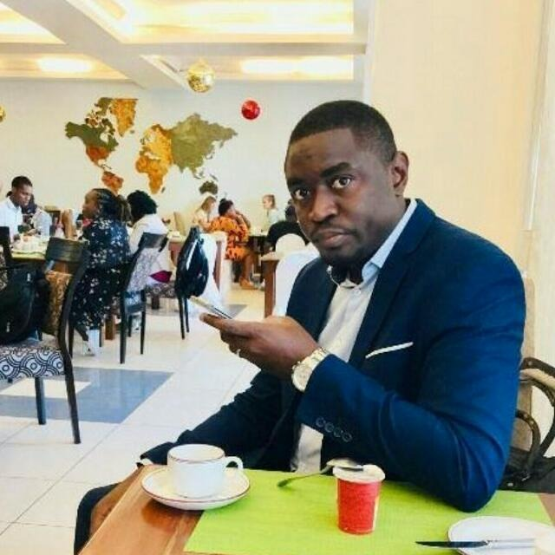
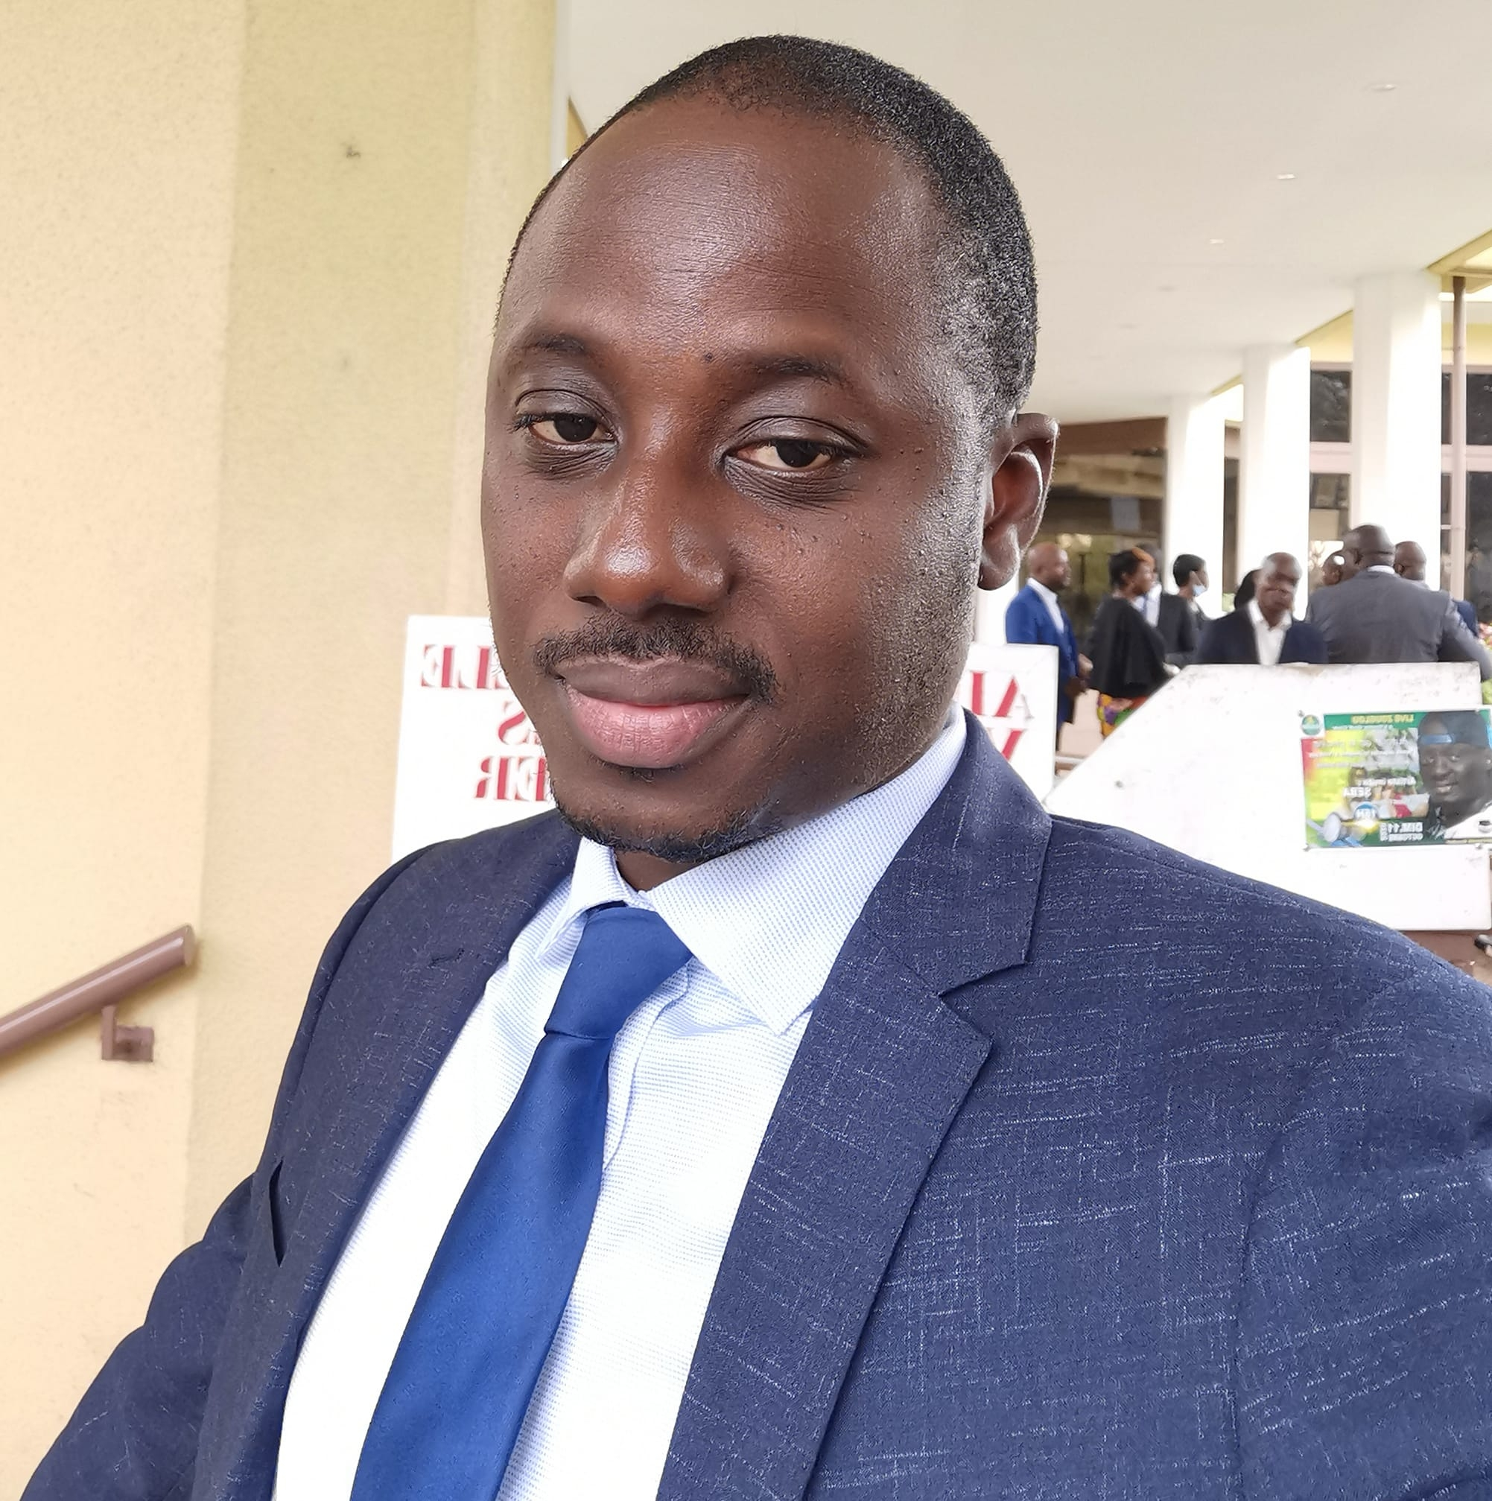
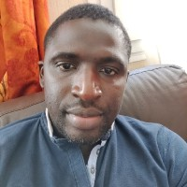
05
GOVERNANCE BODIES
The Supervisory Board

Slide 6
06
MISSION VISION VALUES
MISSION
The mission of the RPAG network is to make use of geomatics to provide solutions adapted to African States.
VISION
The vision of the RPAG network is to be the leading provider of geomatics skills and solutions to African states.
VALUES
Innovation, sharing, expertise, Africanness
.

Slide 7
07
STRATEGIC PLAN
THE DIFFERENT PHASES
P1
Creating the network
P2
Initialization
P3
Needs Mapping
P4
Build solutions
P5
Consolidation and Valorization of results

Slide 8
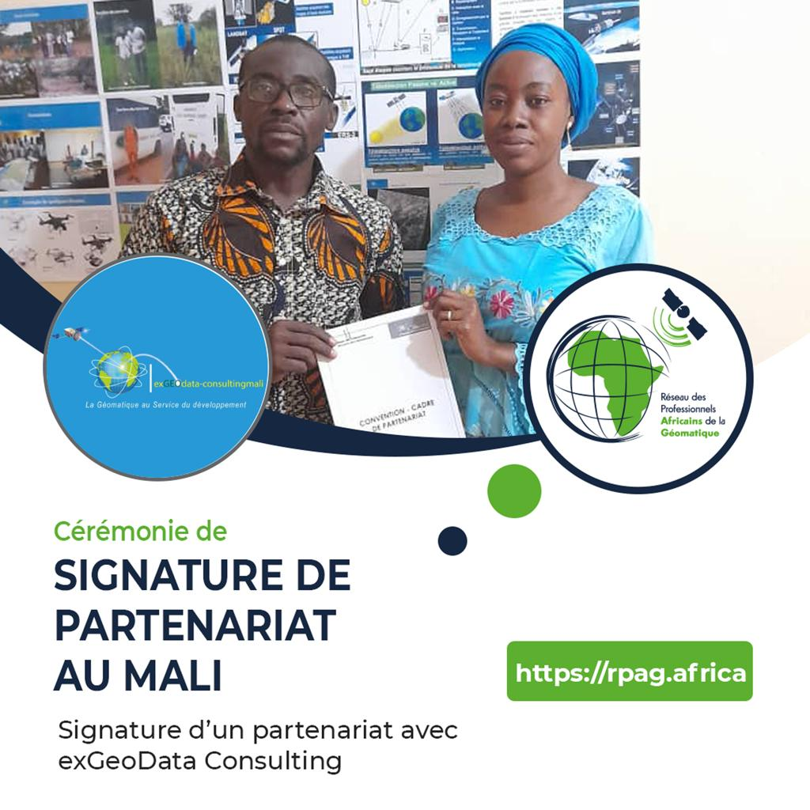
8
PARTNERSHIP
8 partnerships

Slide 9
9
GEOTALK
7 geotalks

Slide 10
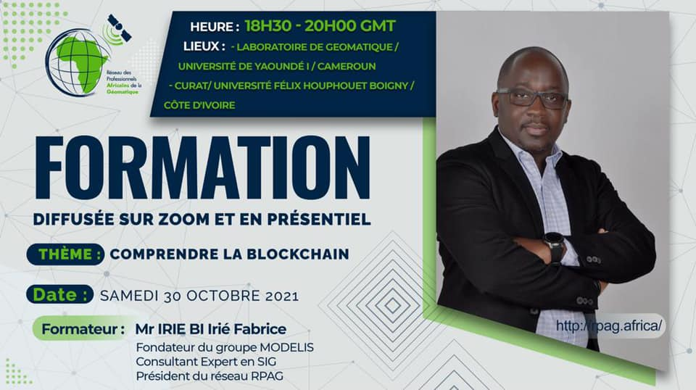
10
TRAINING
19 training courses, over 3,000 people enrolled

Slide 11
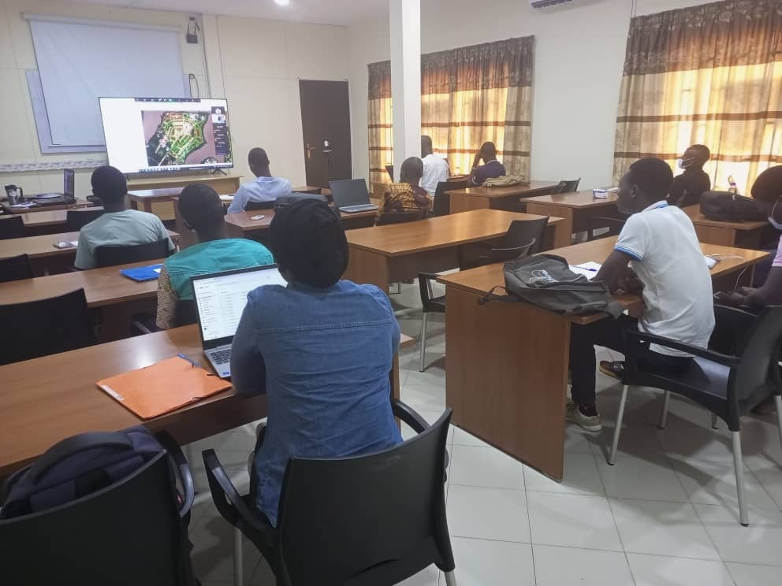
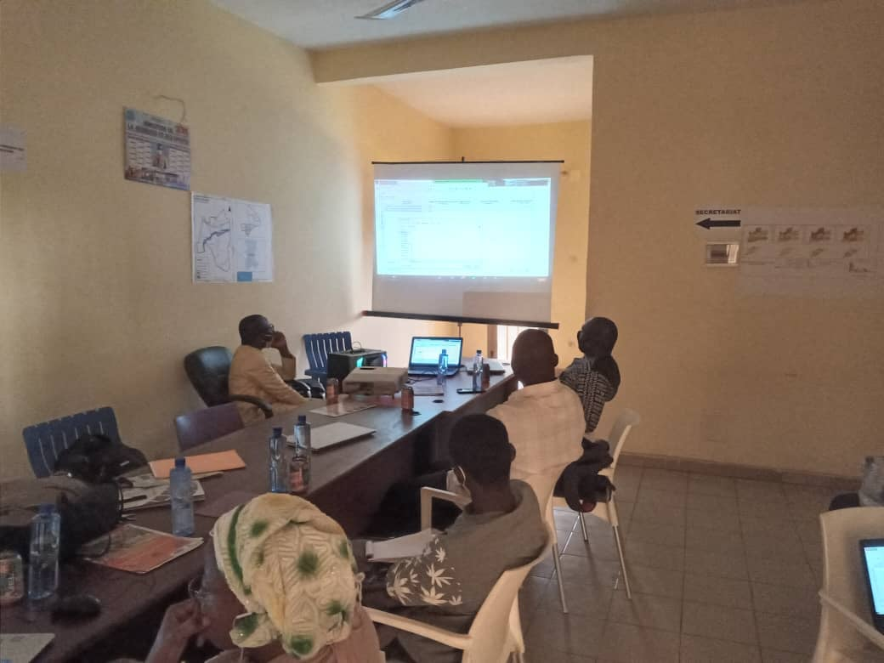
11
TRAINING
Partnership
+04 Centers that support RPAG in all its training activities
05 training sites
Cabinet S-Lab, Université d’Abomé Cavaly , BENIN
LABORATOIRE DE GEOMATIQUE Faculté des Sciences, Université de Yaoundé I / Cameroun, CAMEROUN
Responsable: Mr GAMGUEM
Ecole de Géomatique et du Territoire(EGT), ABIDJAN CÔTE D’IVOIRE
Université de Ouagadougou, département de Géographie, BURKINA FASO
Centre Universitaire de Recherche et d’Application en Télédétection (CURAT), Abidjan CÔTE D’IVOIRE
Responsable: Prof KOUAME KAN Jean
Cabinet exGEOdata-consultingmali, BAMAKO MALI
Responsable: Mr BAKARY
Centre Universitaire de Recherche et d’Application en Télédétection (CURAT), Abidjan CÔTE D’IVOIRE
Cabinet exGEOdata-consultingmali, BAMAKO MALI

Slide 12
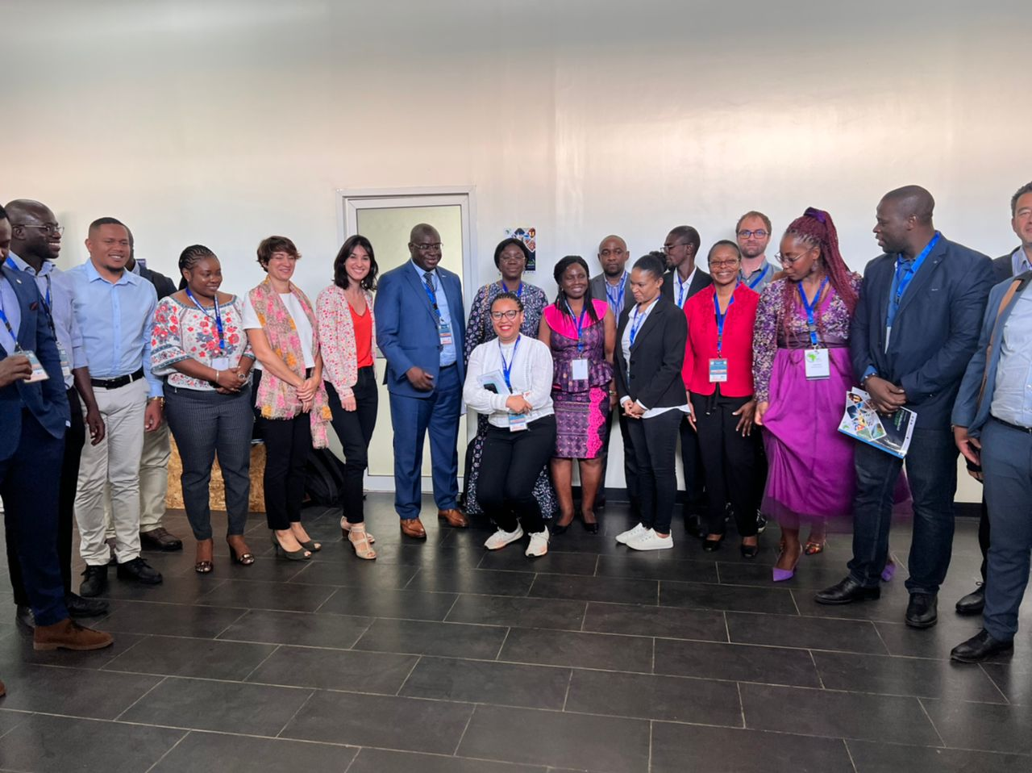
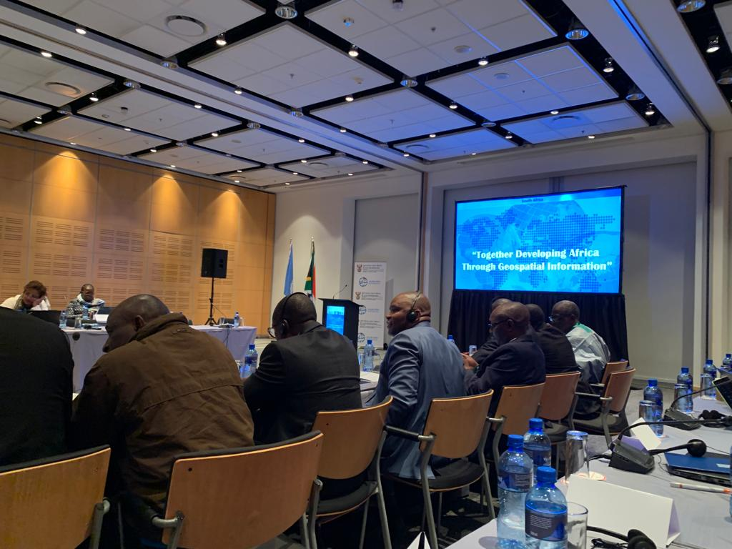
12
COLLABORATIONS
Rwanda, October 2022
CapeTown, August 2022
EOCAFE
19th of October 2023

Slide 13
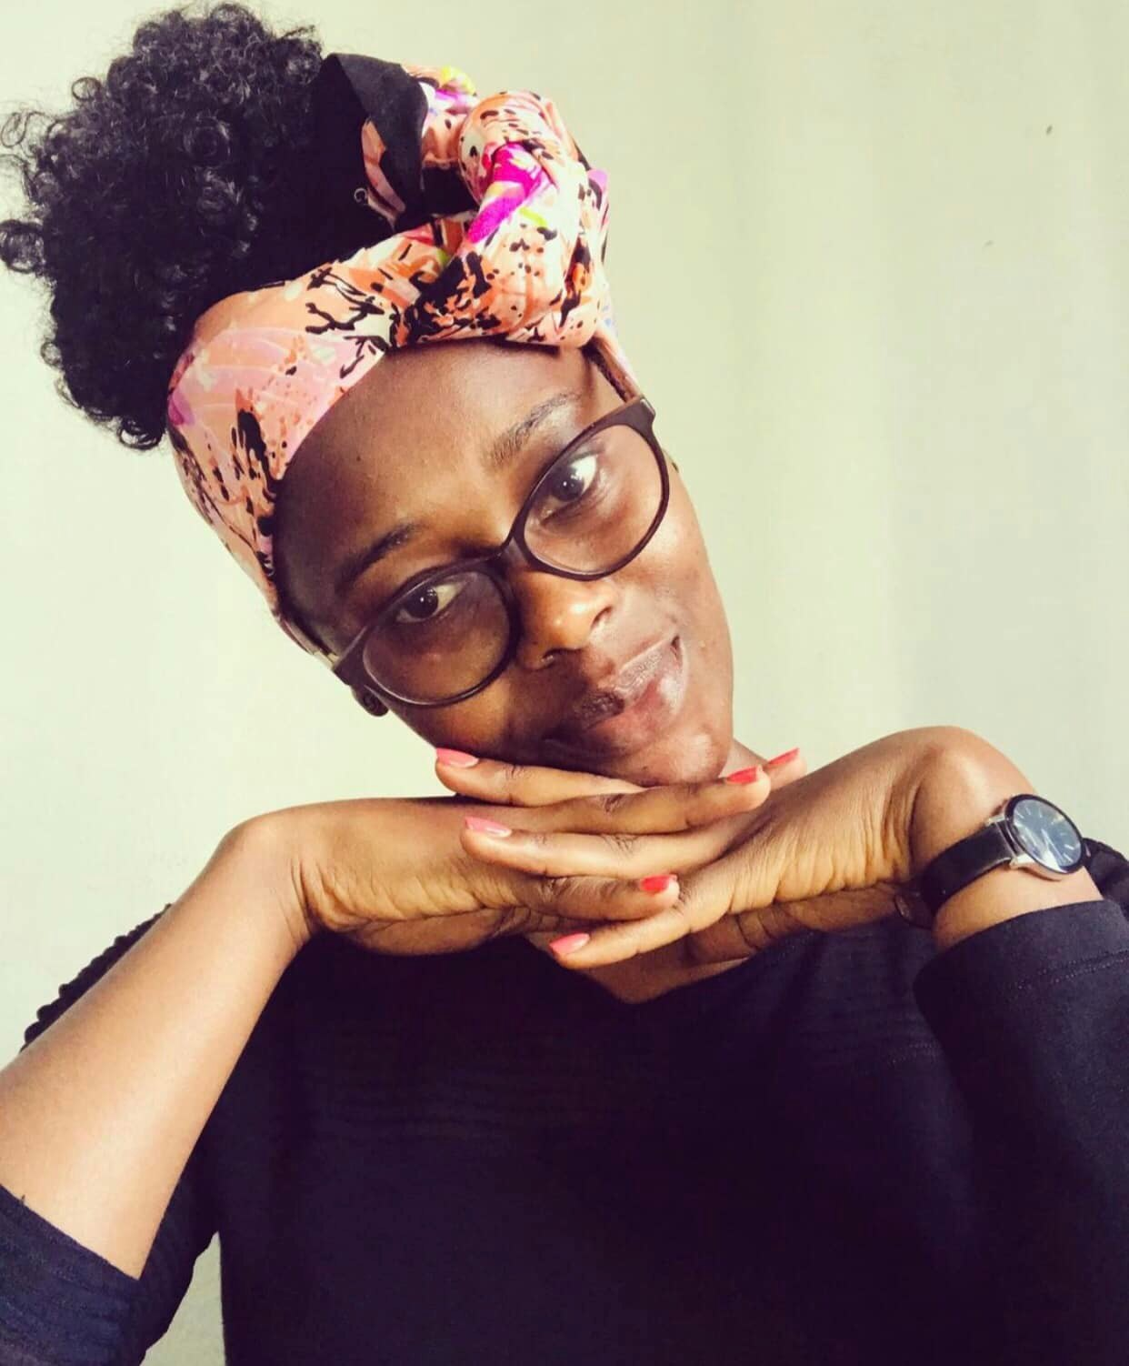
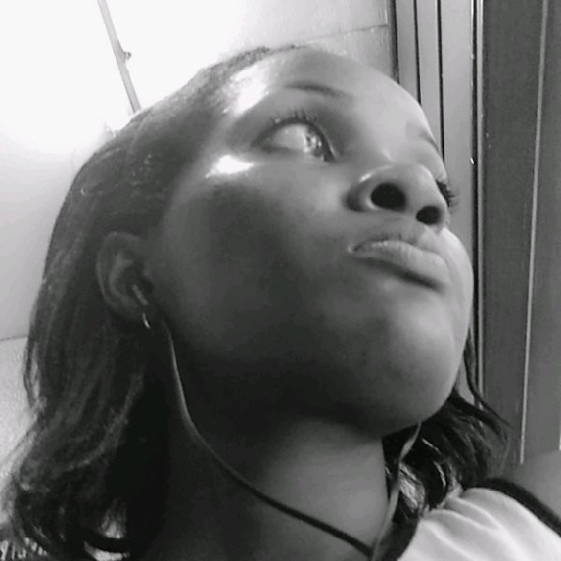
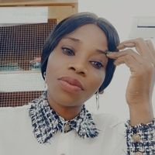
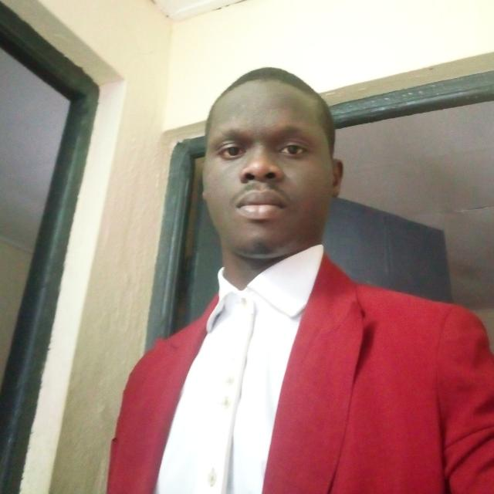
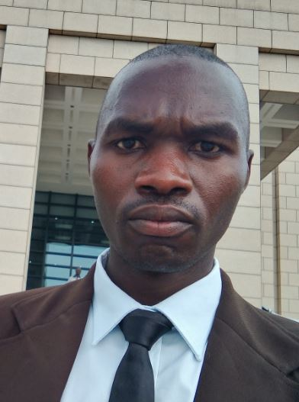
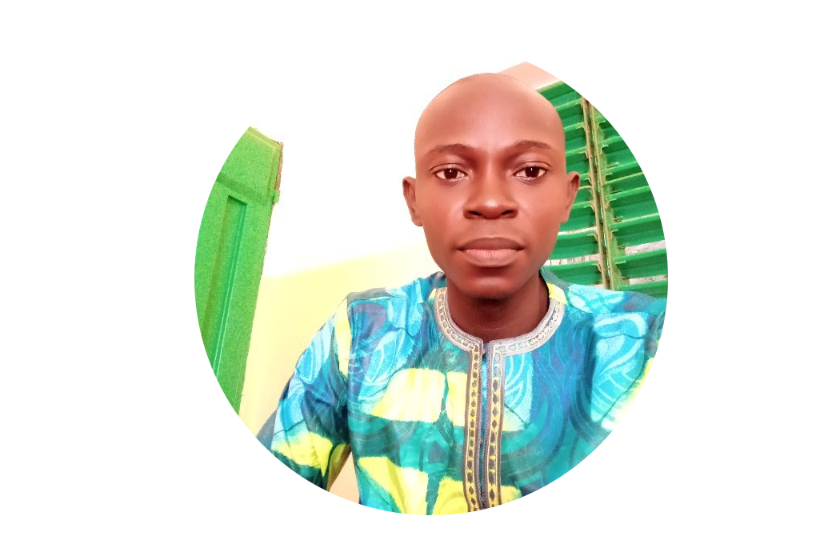
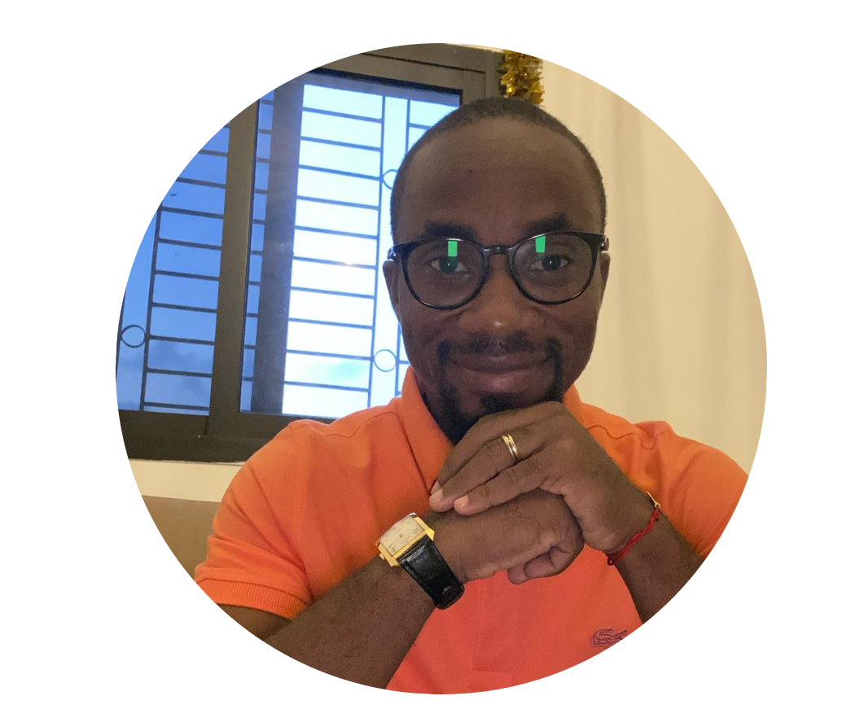
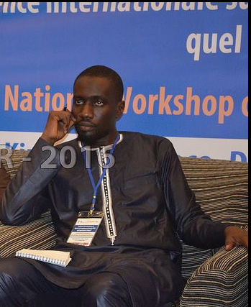
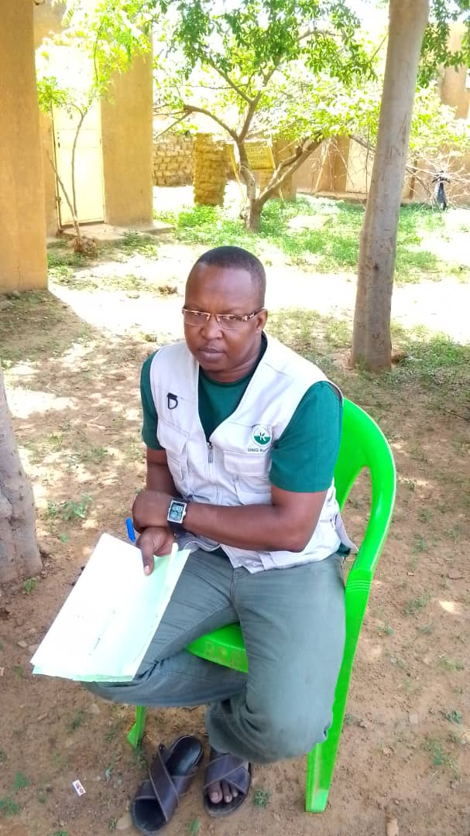
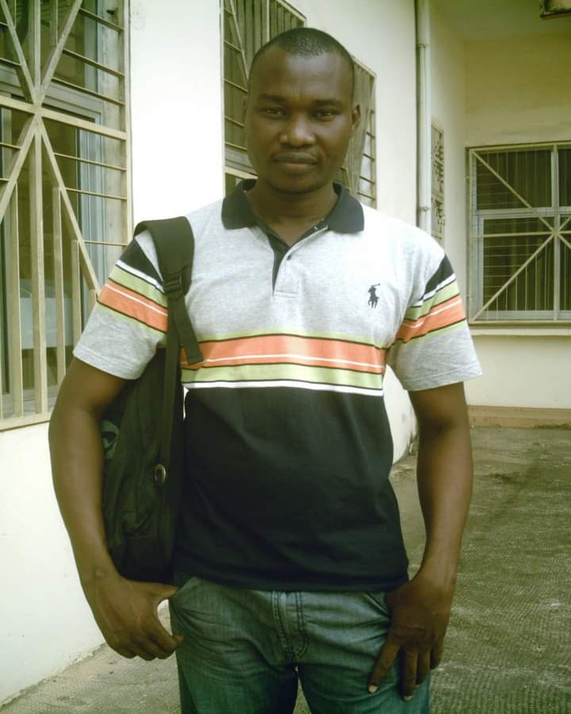
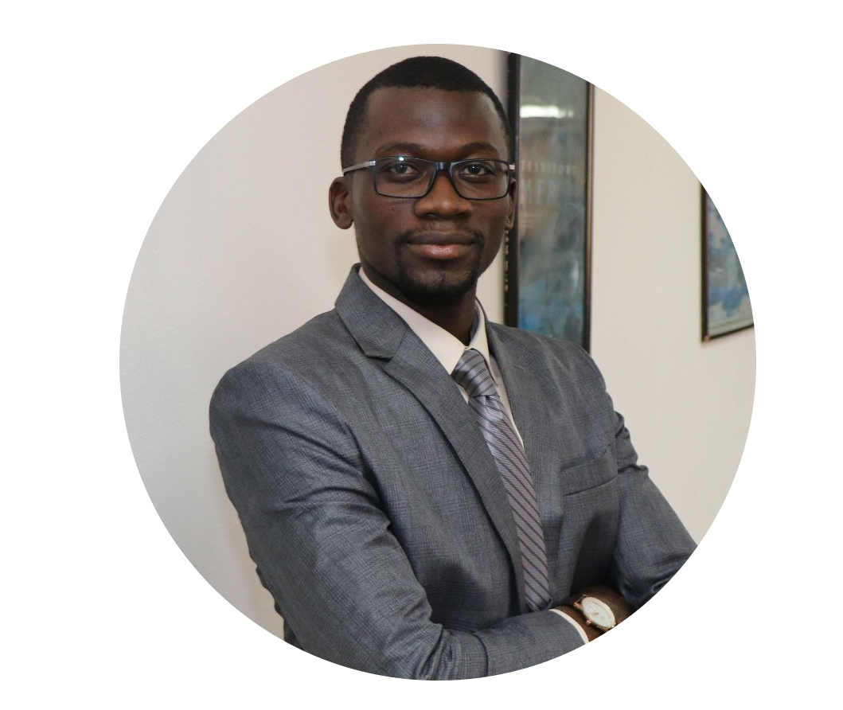
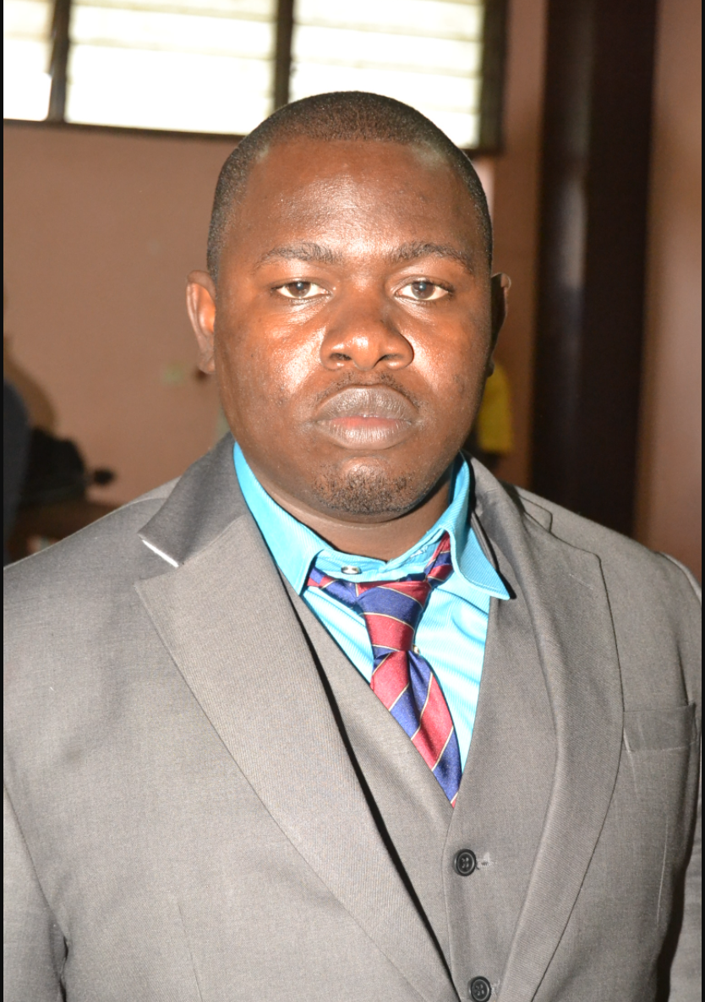
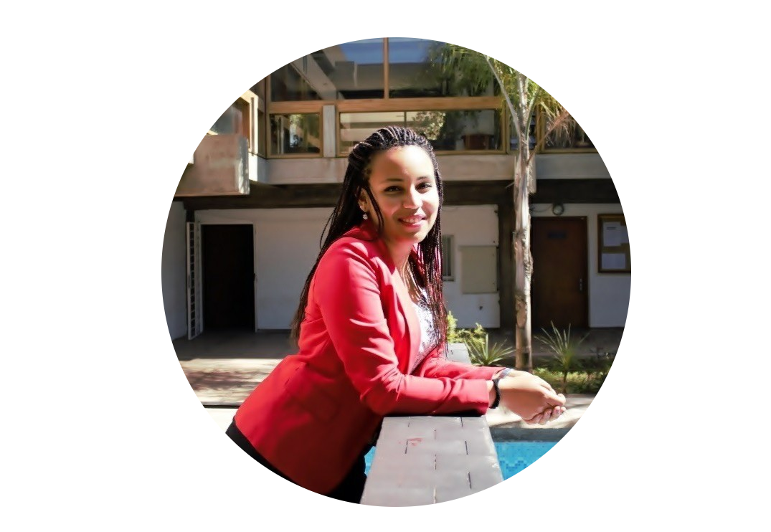
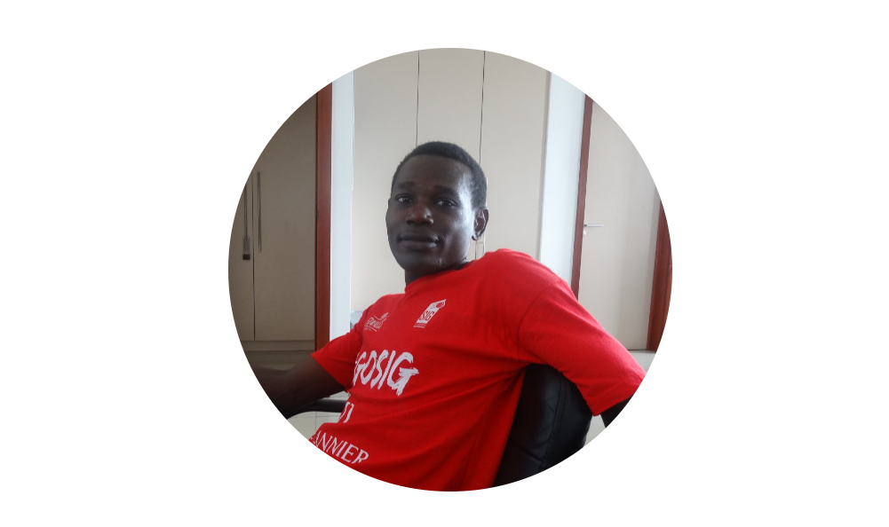
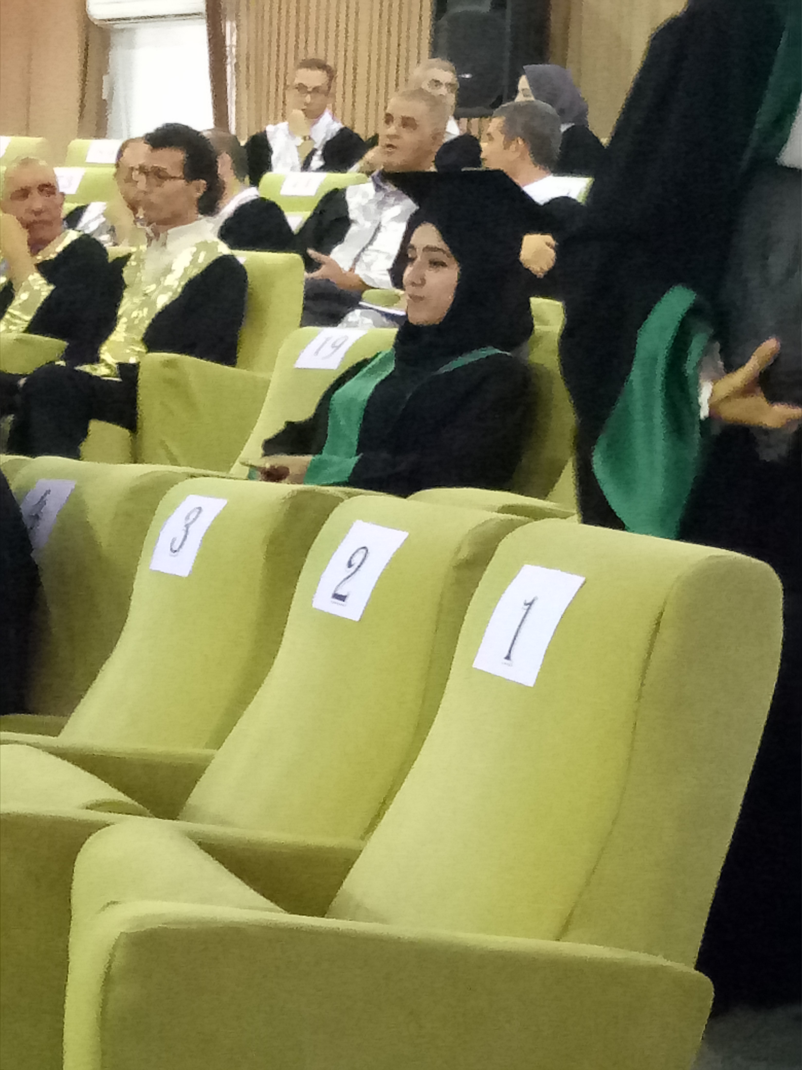
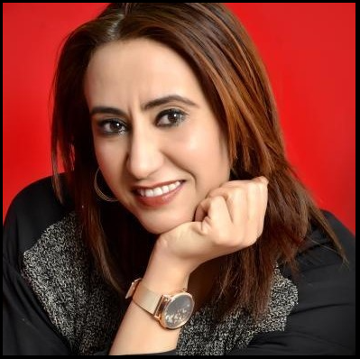
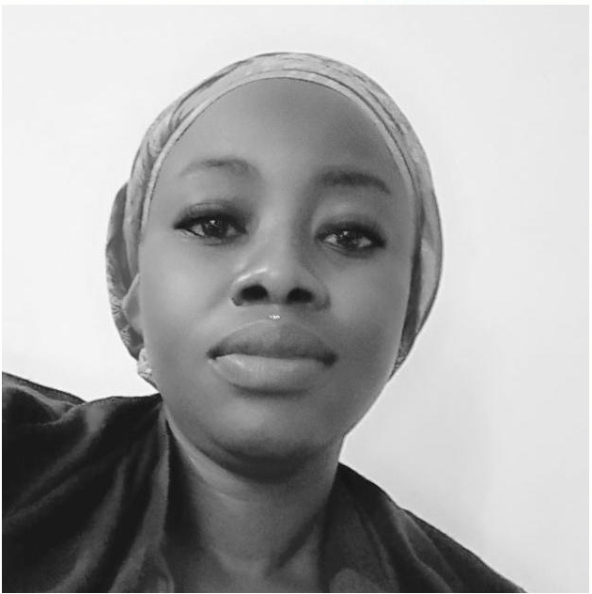
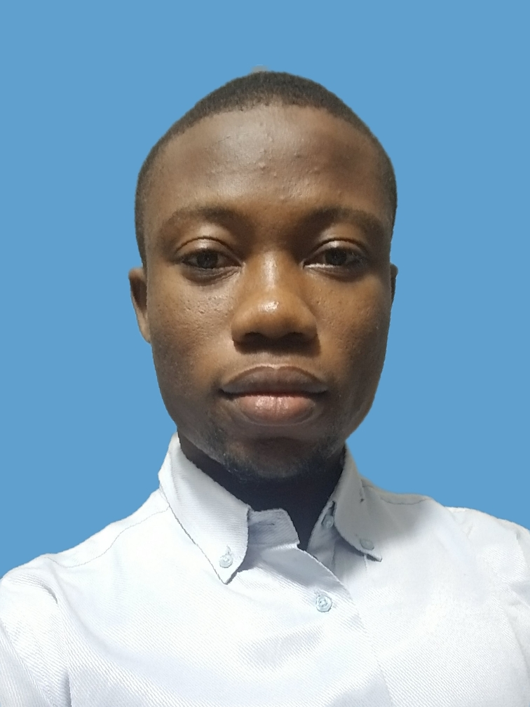
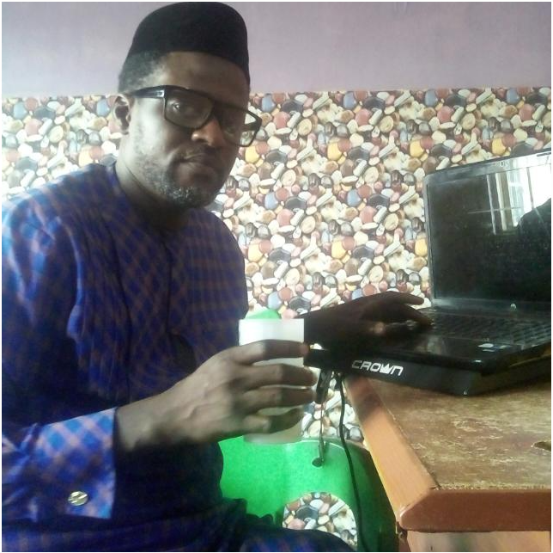
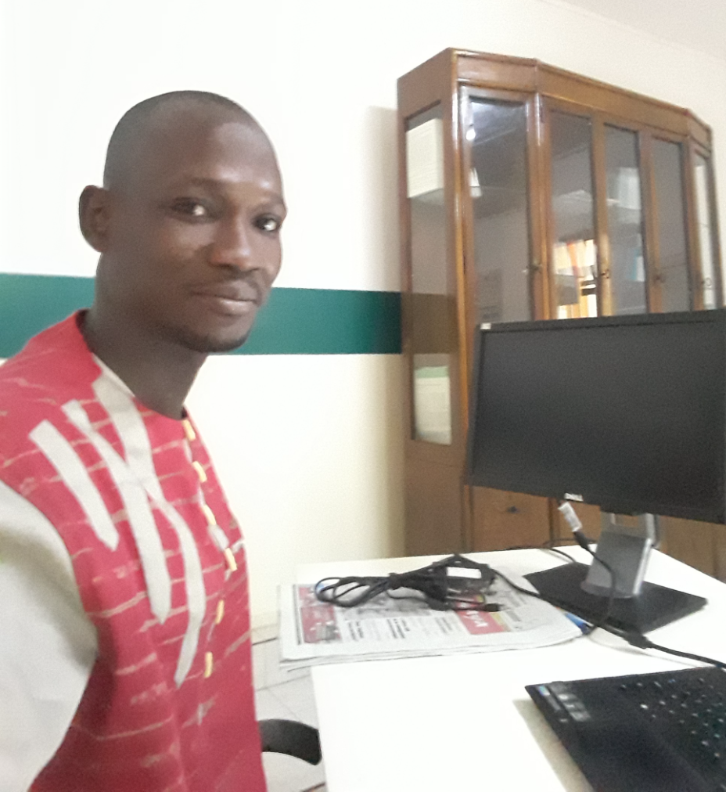
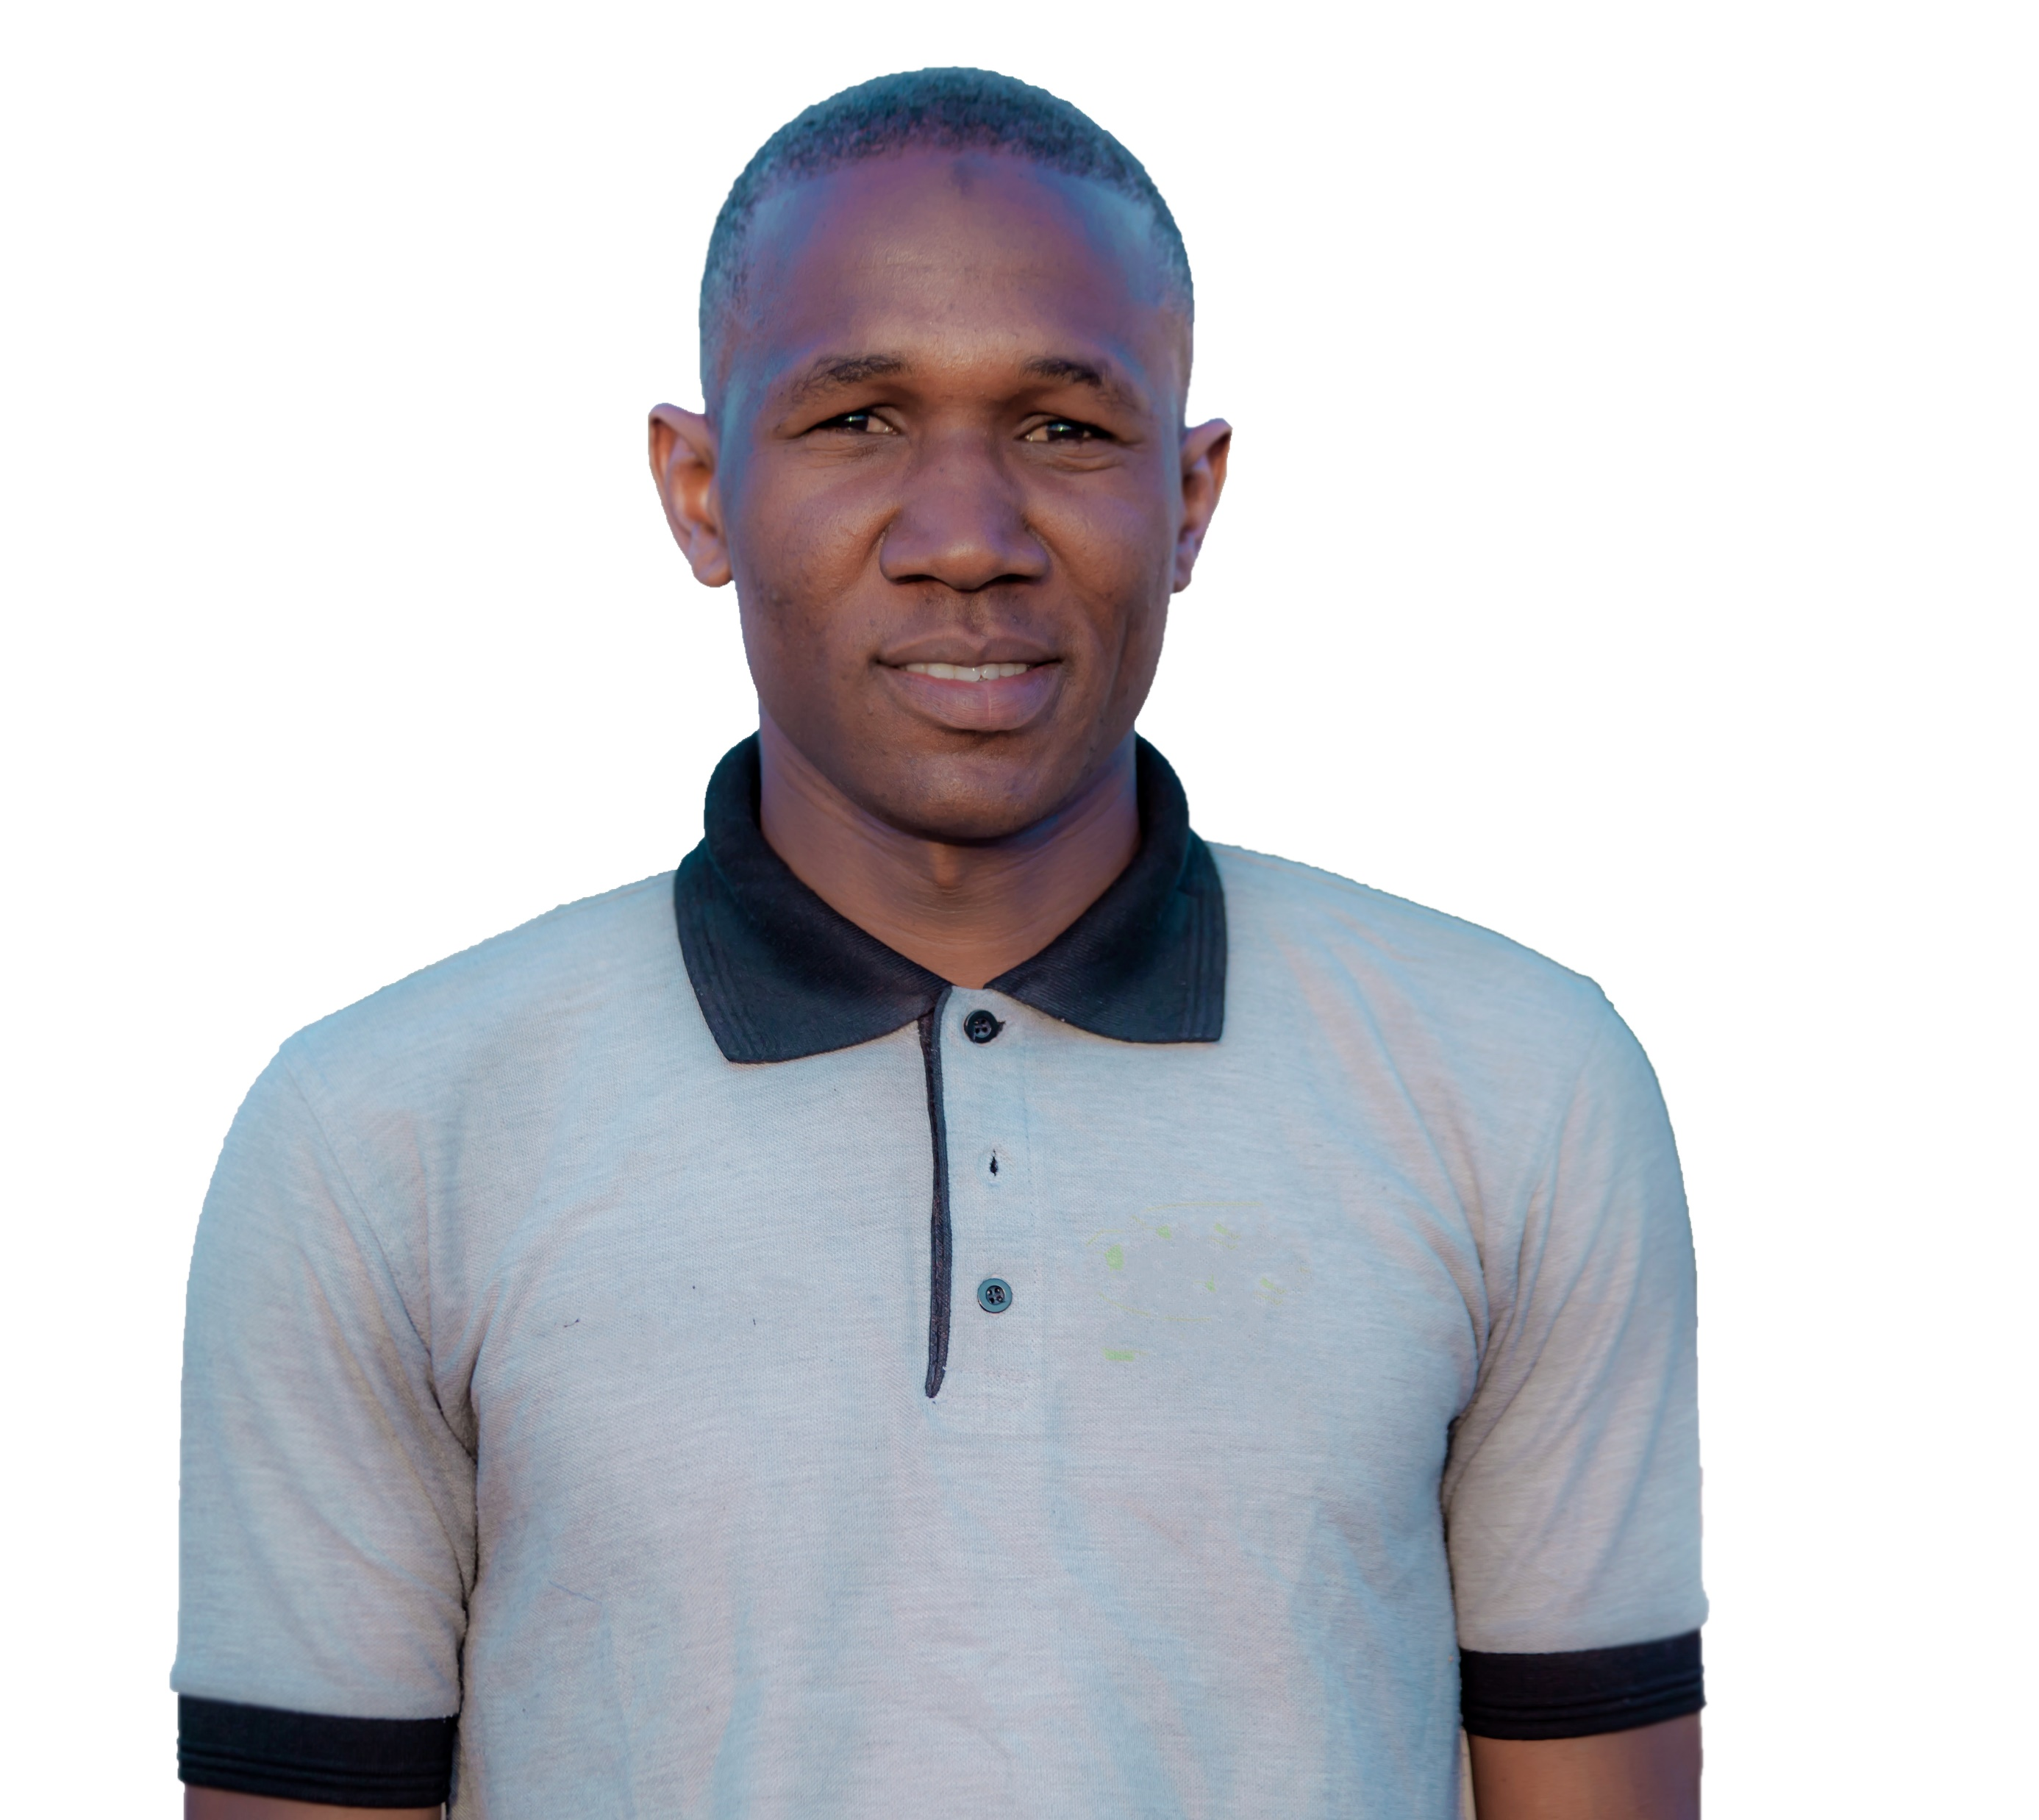
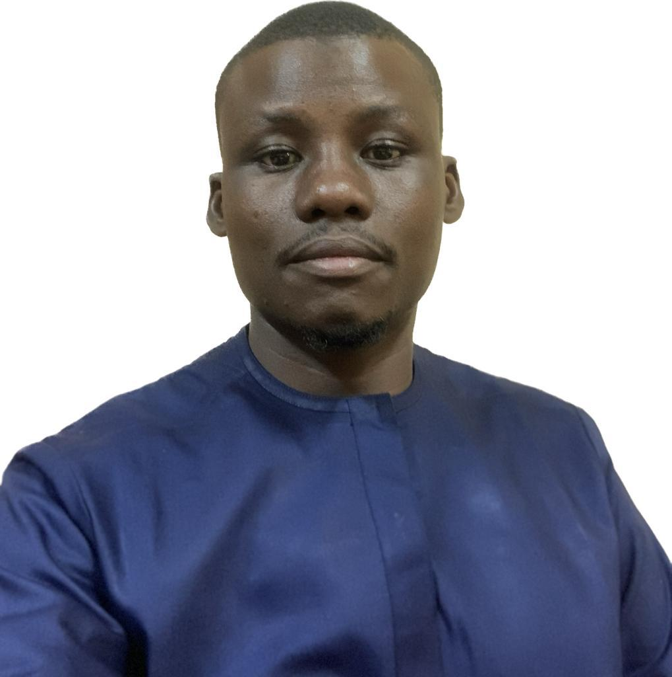
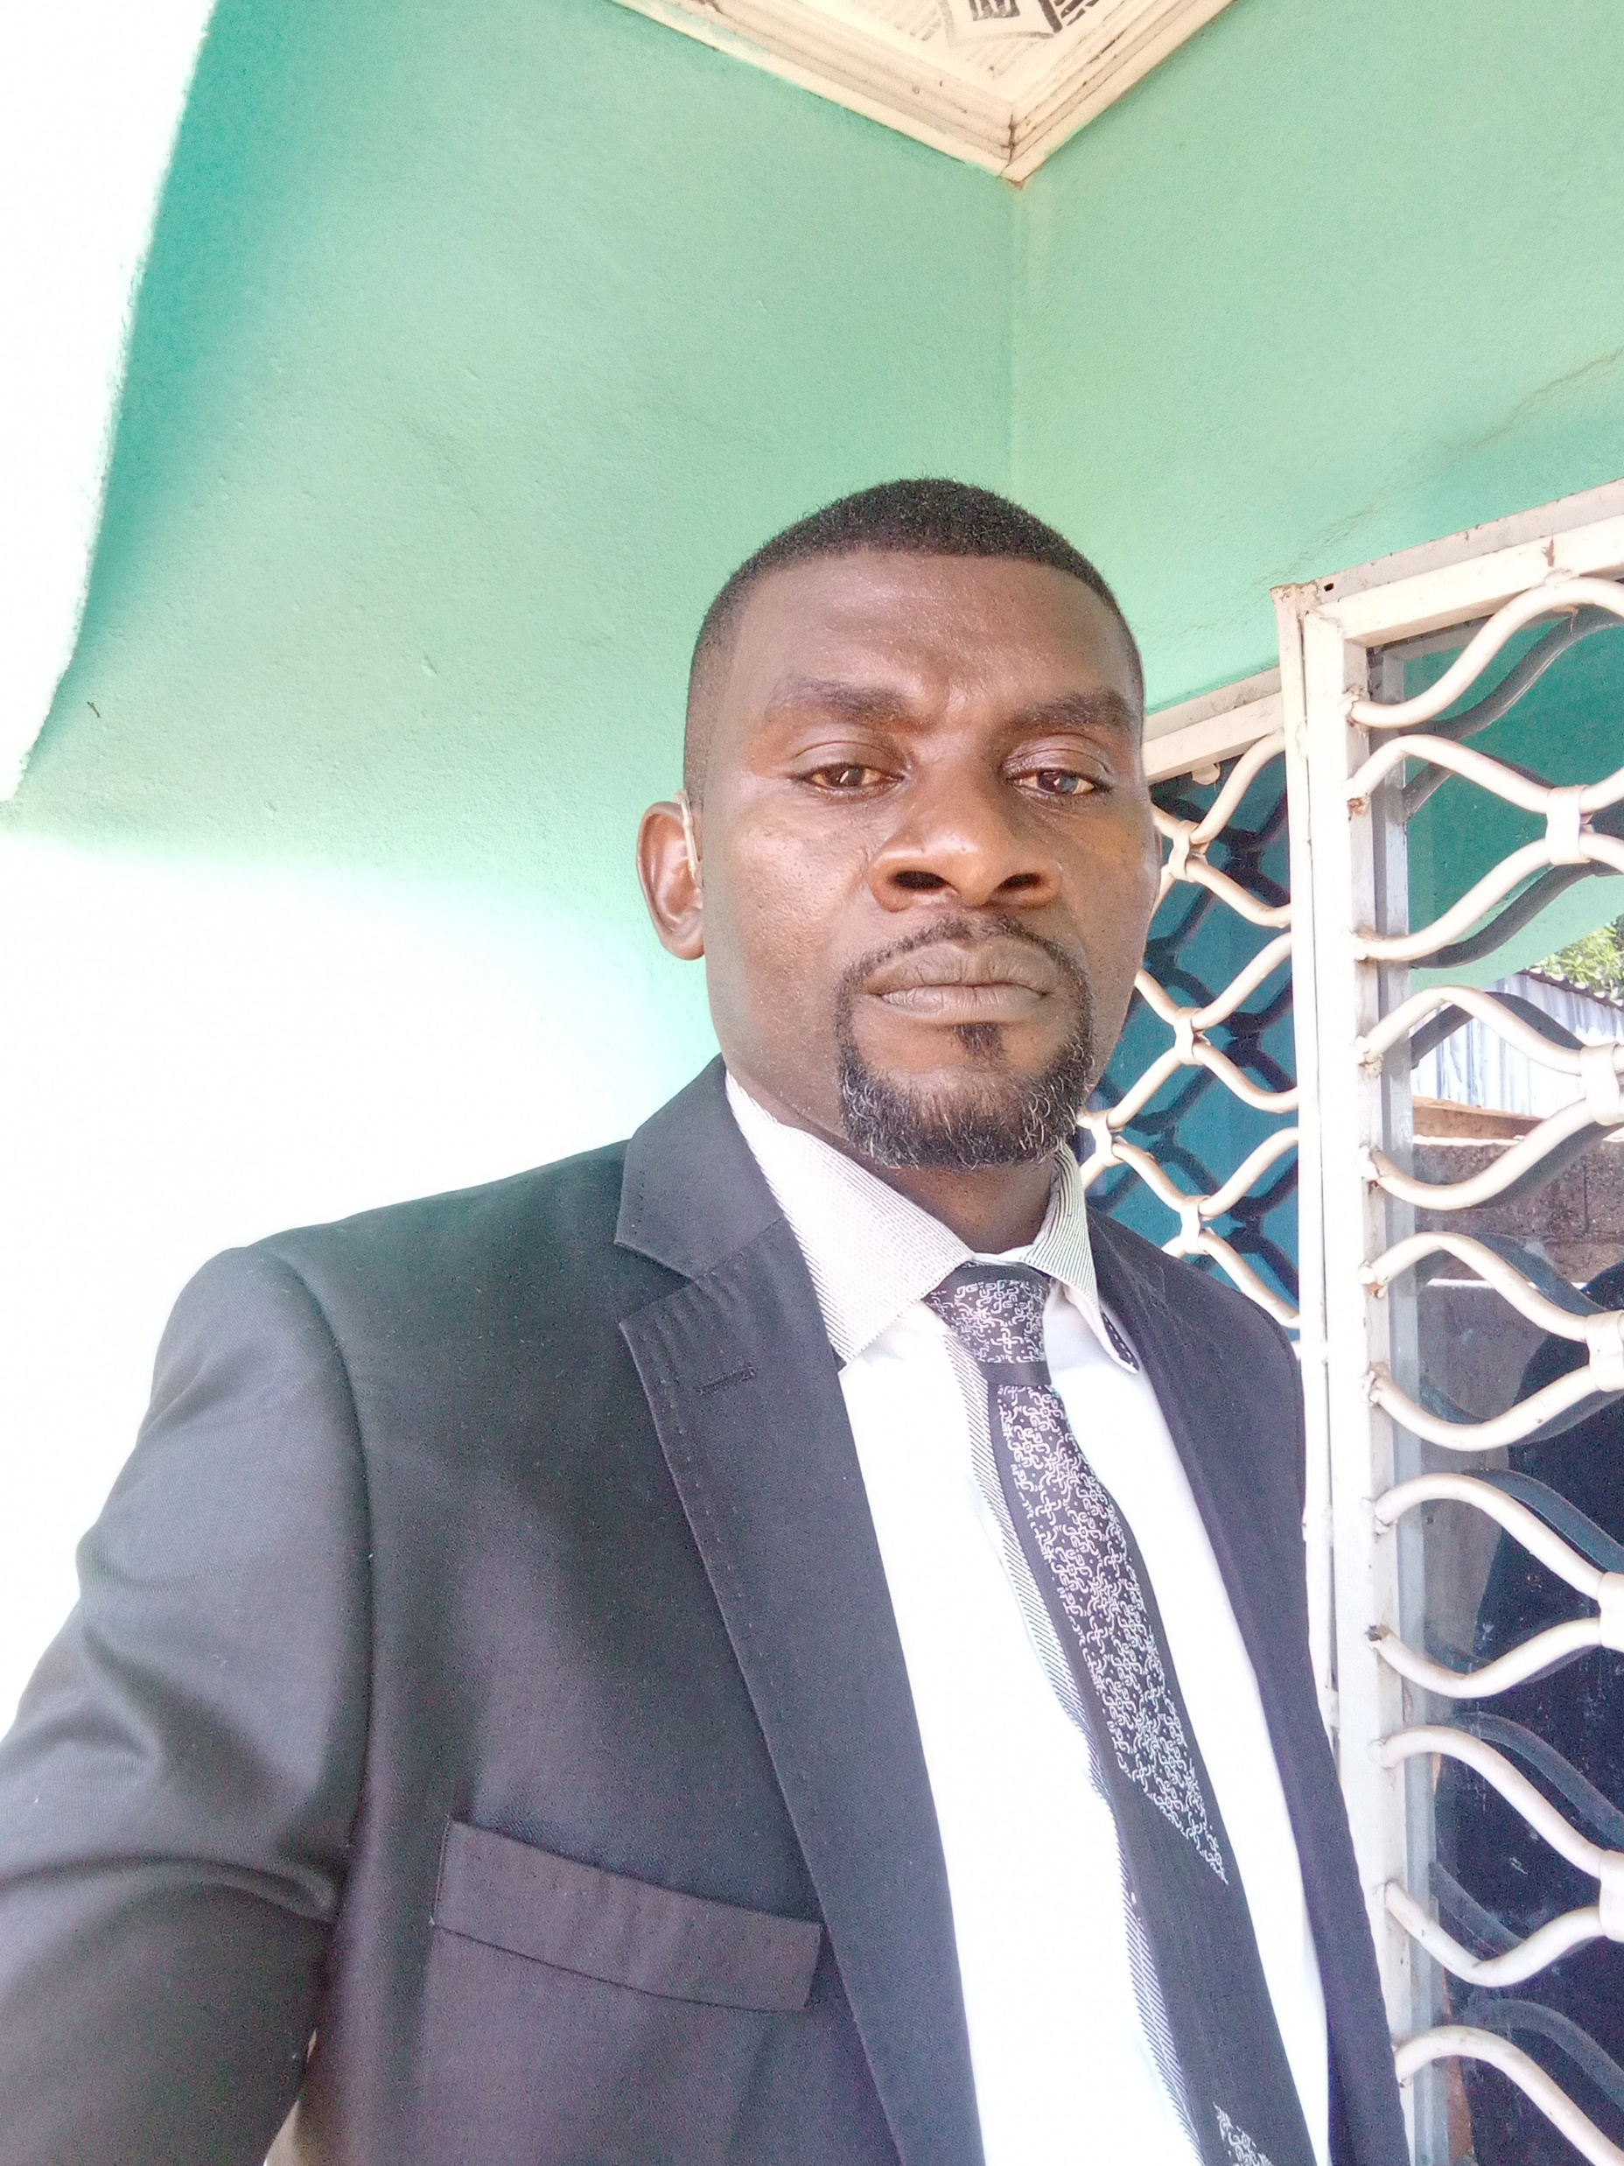
WORK TOGETHER…

Slide 14
Thank you !☺

