Slide 1



WORKSHOP ON THE INTEGRATION OF GEOSPATIAL AND STATISTICAL
information
REGIONAL COMMITTEE OF UNITED NATIONS GLOBAL GEOSPATIAL
Information Management for Africa
Ninth meeting
(Cape Town, South Africa)
14–18 August 2023
I
Integration of statistical and geospatial information in Africa
AYENIKA GODHEART-ECA

Slide 2


METHODOLOGY, TOOLS and
standards for geocoding population
and housing census daTA
Use of geocoding software and platforms

Slide 3
I. Introduction
- Brief overview of geocoding
- Importance of geocoding in today's data-driven world
II. Current Scenario of Geocoding in Africa
- Adoption and use of geocoding software and platforms
III. Benefits & Applications
- Discussion of the utility of geocoding in diverse areas such as urban planning, disaster management, etc.
- Showcasing the benefits of geocoding for effective decision-making, resources allocation, location intelligence, etc.
IV. Challenges in Implementing Geocoding in Africa
- Technical training and expertise
- Infrastructure limitations
- Data privacy and operational challenges
V. Key Players – Geocoding Software & Platforms Providers
- Overview of major geocoding software/platforms beneficial for Africa
- Discussing crucial features of these platforms
VI. Case Studies
- Sharing success stories of geocoding implementation in Africa or other similar regions
Lessons learned and potential for implementation in Africa
VII. Moving Forward
- Strategies to overcome challenges in implementing geocoding
- Opportunities for collaboration and next steps
VIII. Conclusion
- Recap and final thoughts on the future of geocoding in Africa
Table Of Content

Slide 4


GEOCODING
Geocoding is the process of converting addresses into geographic coordinates (like latitude and longitude), which you can use to place markers on a map or position the map. However, it's not just limited to transforming a description of a location - like a street address or a postal code - into spatial data on the Earth's surface. It also transposes the reverse, i.e., it turns geographic coordinates into a human-readable address, which is known as reverse geocoding.

Slide 5



IMPORTANCE OF GEOCODING IN TODAY'S DATA-DRIVEN WORLD
With the advancement of technology, geocoding is becoming increasingly accurate and essential for businesses and various sectors to function efficiently and make informed decisions based on geographic location. Geocoding is vital in today's data-driven world due to its role in transforming abstract data into actionable insights. By converting addresses and geographic coordinates into understandable visual data, essential information becomes instantly more accessible and insightful for processes ranging from decision-making to pattern detection.
20+
Add a main point
60K
Add a main point

Slide 6

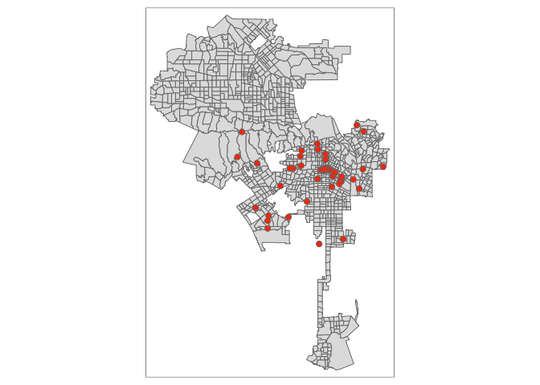
CURRENT SCENARIO OF GEOCODING IN AFRICA
1. Google's Geocoding API: This API from Google Maps is among the most used tools for geocoding due to its robustness, accuracy, and integration capabilities with other Google services.
2. Nominatim (OpenStreetMap): It's an open-source tool that uses data from the OpenStreetMap project and offers free geocoding services.
3. ArcGIS: Geocoding is part of the vast array of services offered by this platform from Esri, widely used by professionals in the field of GIS.
4. Bing Maps API: Microsoft's answer to Google's offering, this API provides geocoding as part of its mapping services.
5. Mapbox's Geocoding API: This tool offers both forward (address to coordinates) and reverse geocoding (coordinates to address) services.
6. OpenCage Geocoder: This tool offers a simplified and easy-to-integrate service that aggregates multiple sources of geocoding data.
7. Here Geocoding & Search API:This API from the HERE suite of location services offers geocoding alongside a location search functionality.
8. TomTom's Geocoding API:Falling within a broader category of an array of geospatial tools, this software provides developers with comprehensive documentation to work with, ensuring optimal implementation functionality, and success.
9. Geocodio: This service specializes in bulk geocoding and can break down an address into more actionable parts besides providing geolocation data.

Slide 7
Commercial Geocoding Software:
1. Esri ArcGIS Geocoding: A comprehensive geocoding solution offered by Esri, providing accurate address matching and geocoding capabilities. It offers both on-premise and cloud-based options.
2. Google Maps Geocoding API: A widely used commercial geocoding service provided by Google, offering accurate geocoding and reverse geocoding functionality, along with various mapping features.
3. MapQuest Geocoding API: A commercial geocoding service that provides geocoding and reverse geocoding capabilities, along with features like batch geocoding and address verification.
Commercial/Open-Source Geocoding Softwares
Open-Source Geocoding Software:
1. Nominatim: An open-source geocoding solution by OpenStreetMap, offering worldwide geocoding and reverse geocoding functionality. It allows users to set up their own geocoding server.
2. Pelias: An open-source geocoding engine that provides geocoding and reverse geocoding services. It supports multiple data sources and can be customized to suit specific needs.
3. Geocoder: A Python library that integrates with various geocoding providers, including commercial services and open-source options. It allows developers to easily access and use geocoding functionality in their applications.

Slide 8



BENEFITS & APPLICATIONS
1. Google's Geocoding API:
- Provides forward geocoding (address to coordinates) and reverse geocoding (coordinates to an address)
- Seamlessly integrates with Google Maps and harnesses the power of Google's extensive geographic database
- Robust handling of partial and ambiguous addresses
2. Nominatim (OpenStreetMap):
- Free and open-source geocoding tool
- Works with the extensive OpenStreetMap data
- Provides forward and reverse geocoding
- Open to contributions and updates from users around the world
3. ArcGIS:
- Comprehensive GIS platform that offers geocoding services
- Can handle complex geographical queries and multiple layers of mapping
- Packed with professional features for spatial analytics, data collection, and data sharing

Slide 9
BENEFITS & APPLICATIONS
4. Bing Maps API:
- Powerful geocoding offered as part of Microsoft's broader suite of mapping and location services
- Offers roadmap, aerial, and 3D views for rendered maps
- Integration with other Microsoft products and services
5. Mapbox's Geocoding API: - Offers both forward and reverse geocoding - Provides a feature called 'autocomplete' for place and address suggestions - Extended scope with batch geocoding and permanent geocoding features
6. OpenCage Geocoder:
- Aggregates data from multiple open-source geocoding dataset
- Simplified and easy-to-use API
- No rate limits for data caching allowing for more cost-effective operations

Slide 10
BENEFITS & APPLICATIONS
7. Here Geocoding & Search API:
- Apart from geocoding offers location search functionality
- Places API for rich information about a location
- Supports multi-language geocoding
8. TomTom's Geocoding API:
- Comprehensive developer-friendly documents
- Fuzzy search capabilities allowing for flexible data input
- Global coverage with inclusion of predicted future events such as street name changes
9. Geocodio:
- Specializes in bulk geocoding
- Provides parsing of addresses into more detailed, actionable parts
- Extended services including FIPS code, time zone, and congressional district appendix to geocodes

Slide 11



Geocoding, enabled through various software and platforms, offers numerous benefits across a variety of fields, enhancing efficiency, improving resource management, and supporting in decision-making processes. Urban planning, Disaster Management, Health care, Marketing and Revenue Optimization, Resource Allocation, Delivery and Logistics Services etc.

Slide 12


CHALLENGES IN IMPLEMENTING GEOCODING IN AFRICA
1. Lack of Standardized Addressing System: Many African countries lack a structured and standardized addressing system making it hard to implement geocoding effectively. Homes, streets, and locations are often not numbered consistently, and names can be in local languages making it difficult to chart broadly usable geocoded.
2. Quality and Detailing of Geographic Data: The quality and resolution of available geographic data can be a hindrance for geocoding. Lack of detailed and accurate maps, variations in spatial data coverage and its continuous update can lead to inaccuracies in the end results.

Slide 13






Case Studies
- Sharing success stories of geocoding implementation in Africa or other similar regions
- Lessons learned and potential for implementation in Africa
2020 Round of Population and Housing Censuses in Africa
Over 30 countries have conducted a census in this round using geocoding software(ESRI Modernization of NSO's Programme)
Demographic and Health Survey (DHS)
Over 38 countries in Africa have undertaken the DHS using geocoding software

Slide 14






Strategies to Overcome Geocoding Implementation Challenges
diagram
Opportunities for Collaboration and Next Steps
1. Collaborating with Tech Companies
2. Promoting Open Source Data Movements
3. Innovation and Localization
4. Integration with Existing Systems
Building Robust Addressing Systems
Who Cares
Improving Geographic Data Quality
Skilled Manpower and Technology Infrastructure

Slide 15

THANK YOU
FOR YOUR ATTENTION

