Slide 1
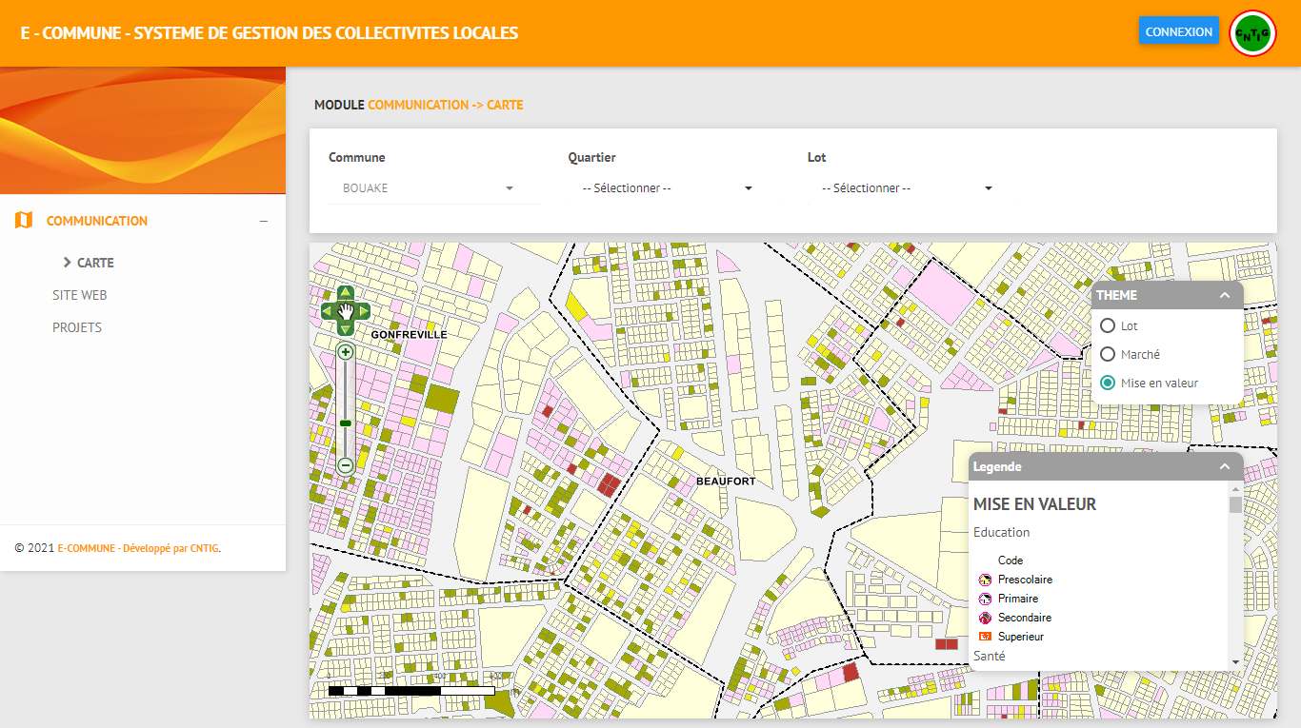
UN-GGIM
Eighth Session of the United Nations Global Geospatial Information Management for Africa (UN-GGIM: Africa).
Geospatial value to the economy and integration for tomorrow: Return of experience from Ivory Coast.
Dr. Edouard FONH-GBEI
CEO of CNTIG and General
Secretary of the National Committee for Remote Sensing and Geographical Information. Ivory Coast, Africa
14 - 18 August 2023, Cape Town, South Africa

Slide 2
PRESENTATION PLAN
THE ROLES OF NATIONAL GEOSPATIAL ORGANISATIONS
2. NEEDS FOR GEOSPATIAL DATA COLLECTION AND MANAGEMENT
3. CHALLENGES OF BUILDING AND MANAGING GEOSPATIAL ENVIRONEMENTS
4. A BUSINESS ORIENTED APPROACHES
5. E-COMMUNE: An Integrated system for cadaster, taxation and mobilization system for the municipalities
6. BUILDING A National Infrastructure for Geospatial and Statistical Data and Services( INDGS)
7. PERSPECTIVE 2030: SMART CITY, IA and IOT, 3D Modeling
8. EVIDENCE FROM DECISION MAKERS
9. PROMOTION OF GEOSPATIAL INFORMATION AND TOOLS
10 . EXCHANGES

Slide 3
1. THE ROLES OF NATIONAL GEOSPATIAL ORGANISATIONS
Geospatial information collection and management
implementation of a smart Spatial Data Infrastructures (SDI). SDI delivers services and data that help solving many specific issues such as road planning, environment, security matters etc,
Develop and strengthen their geospatial information infrastructures in support of census and statistical activities.
Updating regularly of socio-economic infrastructures databases ,
Developing innovative geospatial applications for better decision-making process for the benefit of public and private sectors.
Etc.

Slide 4
2. NEEDS FOR GEOSPATIAL DATA COLLECTION AND MANAGEMENT
Geospatial information is used by governments to plan and organize development. It’s also used to address issues of governance and poverty reduction. New geospatial technologies and the web, offer the opportunity to make the geospatial data available to everybody at a lower cost.
This goal is achieved through the implementation of a smart Spatial Data Infrastructures (SDI). SDI delivers services and data that help solving many specific issues such as road planning, environment, security matters and financial resources mobilization for local government.
In 2015, the Government of Cote d’Ivoire, asked CNTIG to coordinate the implementation of the National Geospatial Data Infrastructure (SDI) and demonstrate how this can be useful for the national economy
In Cote d’Ivoire, we began then , building our National Geospatial Data Infrastructure (SDI), by a "bottom-up“ approach. Thus, we addressed governance and business issues by developing specific applications based on the SDI
The actors see their interests more easily and agreed to the initiative.

Slide 5
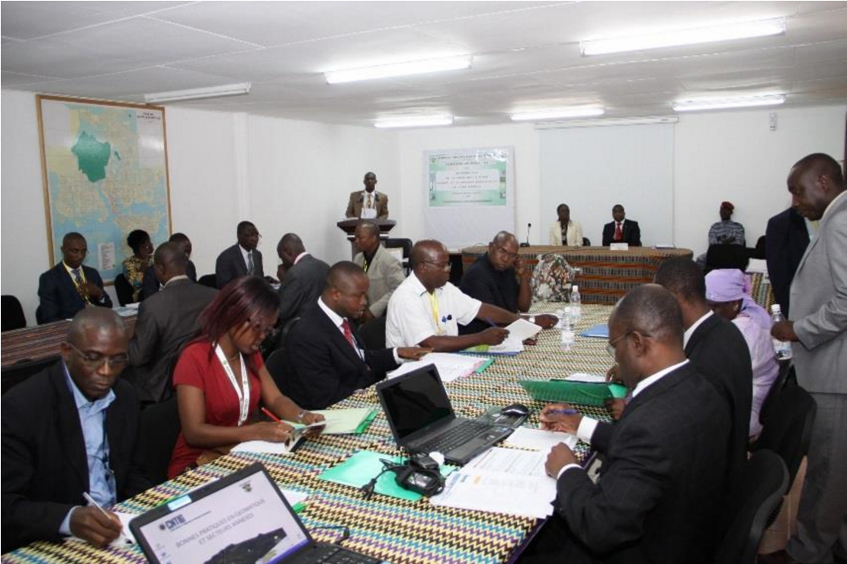
2. NEEDS FOR GEOSPATIAL DATA COLLECTION AND MANAGEMENT
In order to coordinate the implementation of the National Geospatial Data Infrastructure (NSDI) , we used following approach:
Initiated standards and norms for geospatial information
Created several working groups that aim to allow the geo-spatial communities members to collaborate and work together and attend practical seminars: standardization, Climate change, buried Networks, etc.
Mobilize various actors around win-win projects;
Engage the private sector and strong public actors with innovative solutions that address their needs,

Slide 6
3. CHALLENGES OF BUILDING AND MANAGING GEOSPATIAL ENVIRONEMENTS
Budget challenges:
Not all decisions makers understand the need of investing in such projects
Difficulties of continuous effort of supporting the project
Changing the Paradigm of thinking:
It is important to move from surveyor or cartographer mindset to business oriented thinking
Create a win- win relation with the decision makers
Create business cases:
solve a real problems for publics or private sectors
geospatial applications that help in the decision making process and help address issues of governance.

Slide 7
4. A BUSINESS ORIENTED APPROACHES
Thus in Ivory Coast, we have focus more on customs oriented development of geospatial and tools, and methods that cover following:
Modernizing the management of urban and rural land,
Creating and updating cadastral maps and geo-locating land and business owners
Increasing municipal tax revenue and helping local development
Updating regularly of socio-economic infrastructures databases ,
Developing innovative geospatial applications for better decision-making process for the benefit of public and private sectors.
Etc.

Slide 8
5. E-COMMUNE: An Integrated system for cadaster, taxation and mobilization system for the municipalities
In the Project e-commune, we have designed and developed methodologies and a solution, for taxpayers identification and geolocalization. It helps municipalities to mobilize their own resources and plan local development.
The methodological approach adopted is divided into 4 main stages, as shown in the following diagram:
1.
Update of the Commune plan
2. Identification of taxpayers
3.
Data processing and integration
4.
Deployment and Training

Slide 9
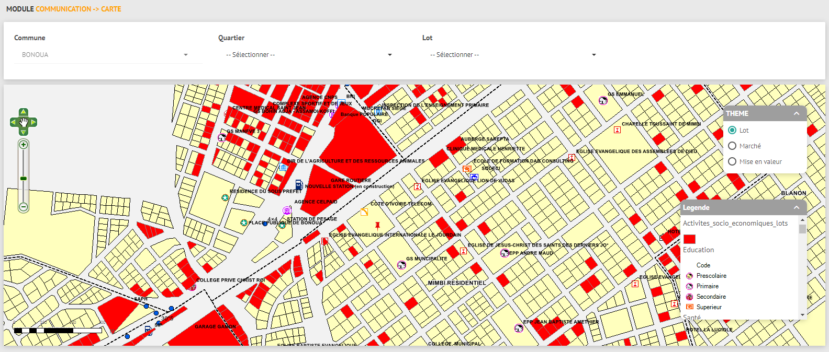
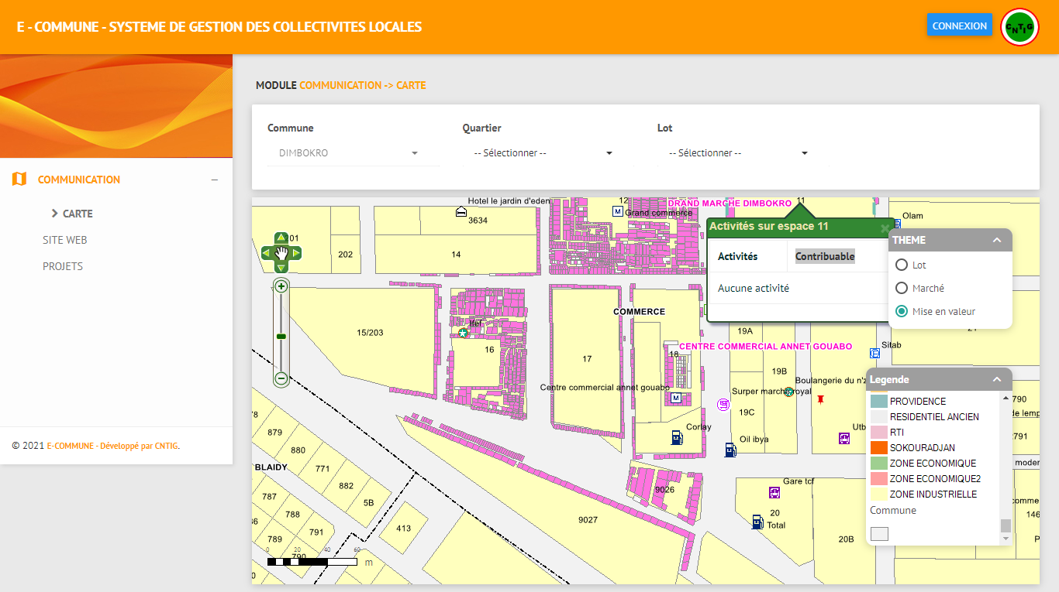
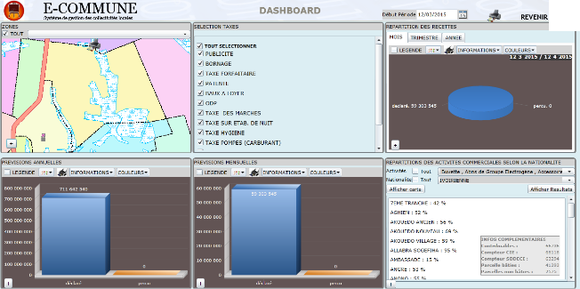
5. E-COMMUNE: An Integrated system for cadaster, taxation and mobilization system
KEY FEATURES OF E-COMMUNE
E-commune is a secured webmapping application, designed according to the needs of different users: elected officials, managers, technical workers and citizen. The solution includes several modules:
detailed map of the municipality
geolocation of taxpayers
project management and planning
dashboard and potential assessment

Slide 10
5. E-COMMUNE: An Integrated system for cadaster, taxation and mobilization system
MOBILE VERSION : ELECTRONIC TAX PAYMENT
a mobile version of the e-commune solution which allows the collection of taxes electronically has been developed ;
by using the e-commune mobile application on their smartphone, taxpayers will be able to pay taxes via existing electronic means (orange money, flooz money, MTN money, VISA, etc.).

Slide 11
5. E-COMMUNE: An Integrated system for cadaster, taxation and mobilization system
E-COMMUNE RESULTS
E-commune solution has a significant impact on the tax revenues of the the municipalities of Côte d'Ivoire. Today more than 60 municipalities have benefited from the solution. Its deployment in the municipalities has enabled mayors to multiply by 4 on average their own tax revenue.
Comparison between budgeted resources and potential

Slide 12
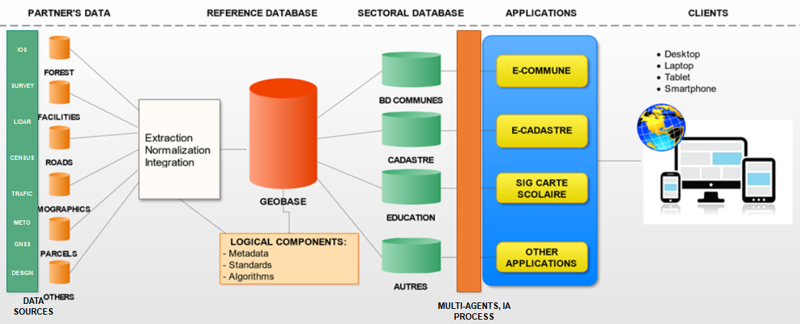
6. BUILDING A National Infrastructure for Geospatial and Statistical Data and Services( INDGS)
From the different sources, the data collected, processed and harmonized are put together in a geographical database. And to allow the various structures to have access to these data and related services, the CNTIG has set up the National Geospatial and Statistical Data Infrastructure (INDGS).
Architecture de l’INDGS

Slide 13
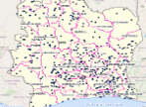
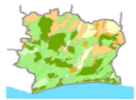
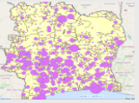
6. BUILDING A National Infrastructure for Geospatial and Statistical Data and Services( INDGS)
The INDGS provides solutions to the problems encountered by structures, public and private companies such as:
basic mapping of socio-economic infrastructure;
identification and geolocation of forest, mining, hydraulic resources, etc.;
knowledge of populations: size, standard of living, and socio-economic characteristics;
geomarketing analysis to create consumer profiles, locality typologies, etc.;
have up-to-date information to assess the needs of local populations...

Slide 14
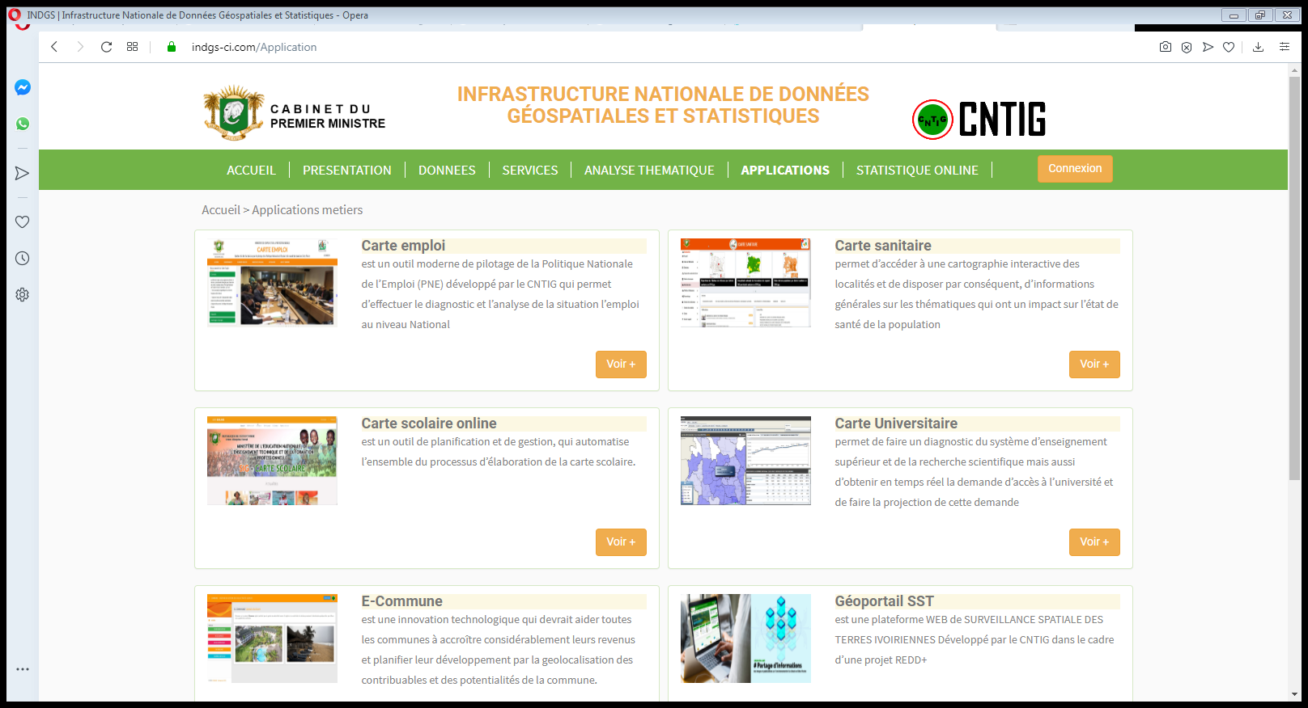
6. BUILDING A National Infrastructure for Geospatial and Statistical Data and Services( INDGS)
The main modules of the INDGS platform are:
DATA
THEMATIC ANALYSIS
Applications and web services
Online on demand Mapping
Emergency Card
Geolocation of companies
Dashboard
Thematic analysis
Opinion polls and elections
Households and cost of living…

Slide 15
6. BUILDING A National Infrastructure for Geospatial and Statistical Data and Services( INDGS)
DATA AVAILABLE
The data shared on the INDGS is diverse and covers all sectors of activity:
INFRASTRUCTURES: communication routes, networks, service stations, underground networks…;
LAND COVER: type of vegetation, hydrography, orography, pedology…;
SOCIAL AND SECURITY: Health, Electrification, Water Supply, Security…;
DEMOGRAPHY: population, population density…;
TRAINING: Education, higher education…;
LAND USE: Agriculture, Protected areas;
ECONOMIC: income, expense, employment,…
Etc.

Slide 16
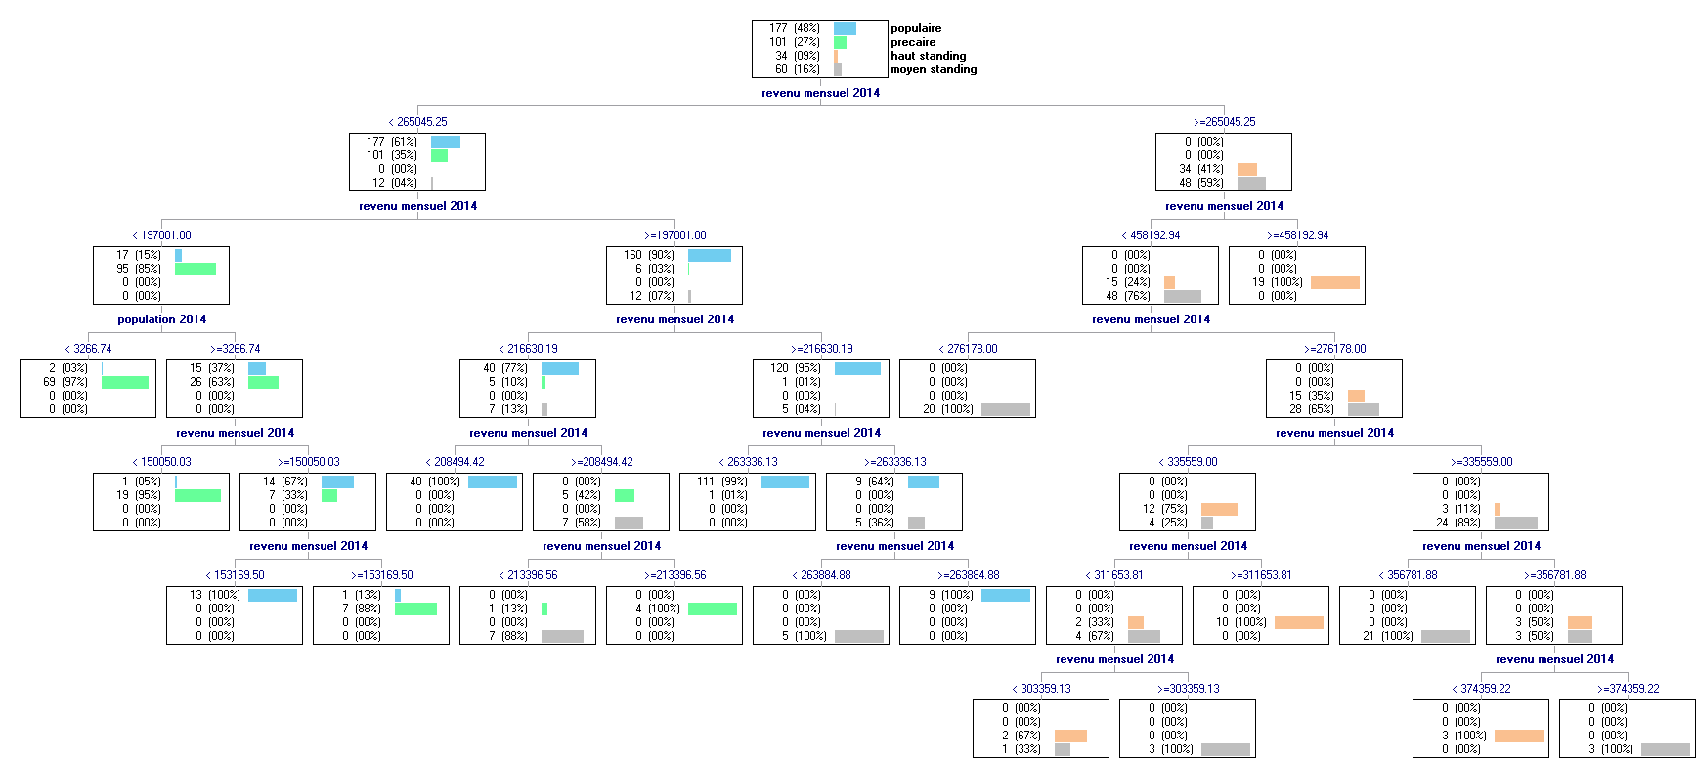
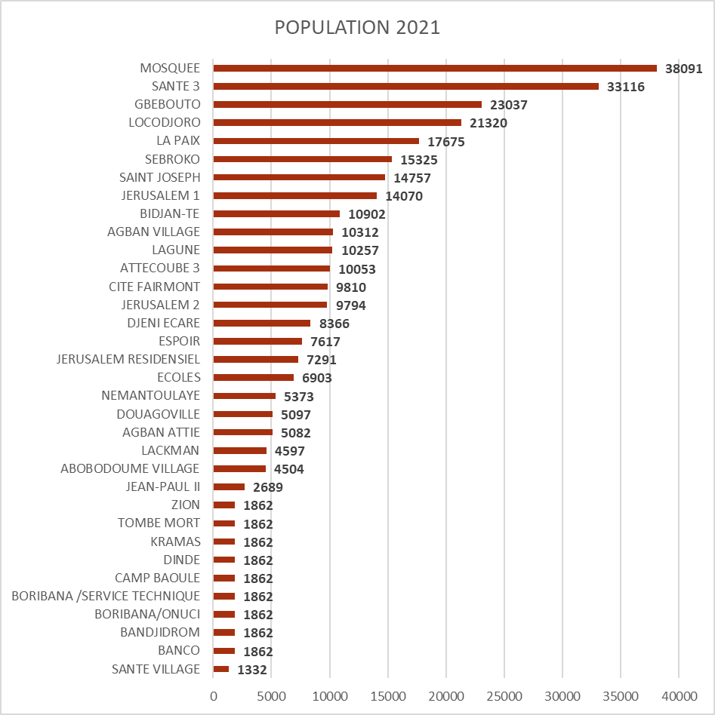
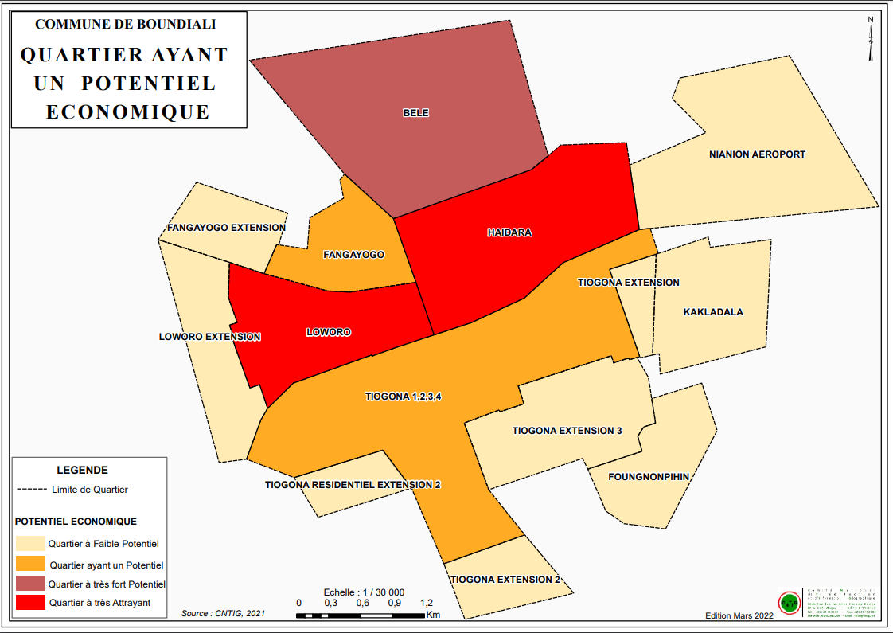
6. BUILDING A National Infrastructure for Geospatial and Statistical Data and Services( INDGS)
THEMATIC ANALYSIS
The INDGS platform, performs statistical analysis and modeling of data to generate additional geomarketing service:
Neighborhood segmentation
wealth and growth model
Population and Habitat Forecast
identification of potential areas

Slide 17
6. BUILDING A National Infrastructure for Geospatial and Statistical Data and Services( INDGS)
ECONOMIC MODEL :
Access to data on the INDGS platform is free of charge.
Users can access online data and use map services by adding their own data;
The data exchanged on the platform makes it possible to enrich it and provide the CNTIG with resources to create additional services;
access to these additional services is via a paid monthly subscription. The monthly subscription to CNTIG allows business sectors to benefit from market analyses, sector studies, economic forecasts,
Third parties applications can used the resources via a paid monthly subscription .

Slide 18
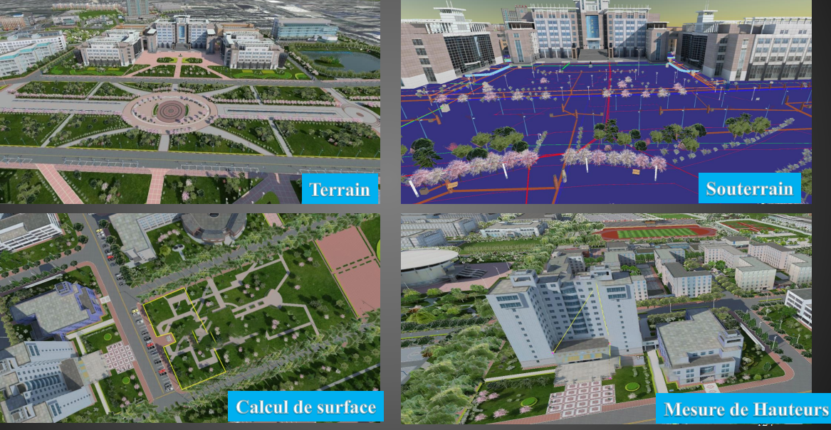
7. PERSPECTIVE 2030: SMART CITY, IA and IOT, 3D Modeling
EXAMPLE 1: INTEGRATED CAMPUS MANAGEMENT SYSTEM

Slide 19
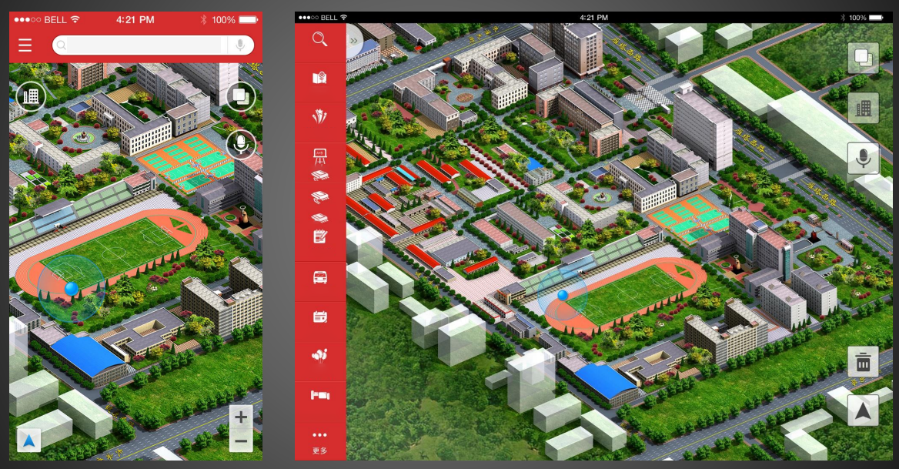
7. PERSPECTIVE 2030: SMART CITY, IA and IOT, 3D Modeling
EXAMPLE 2: MOBILE APPLICATION (ANDROID/IOS)

Slide 20
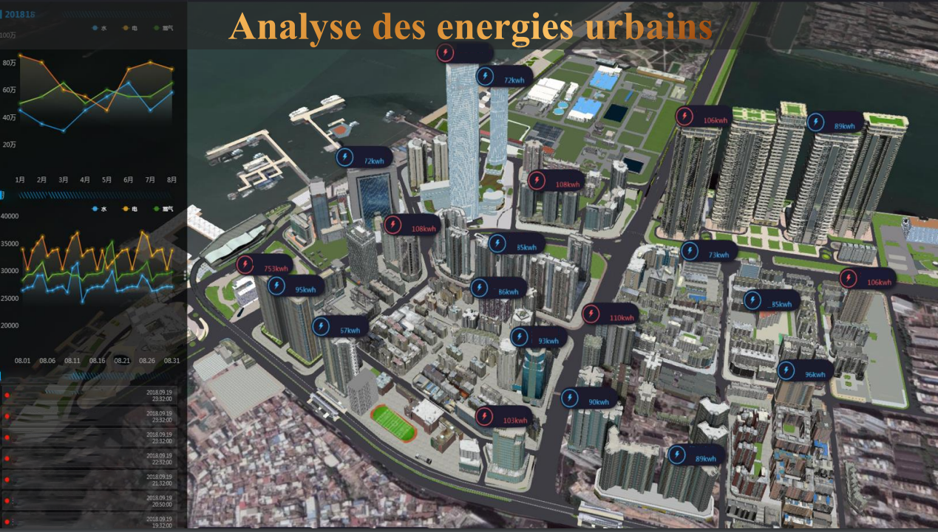
7. PERSPECTIVE 2030: SMART CITY, IA and IOT, 3D Modeling
EXAMPLE 4: SYSTÈME DE GESTION DE LA VILLE: CONSOMMATION D’ENERGIE

Slide 21
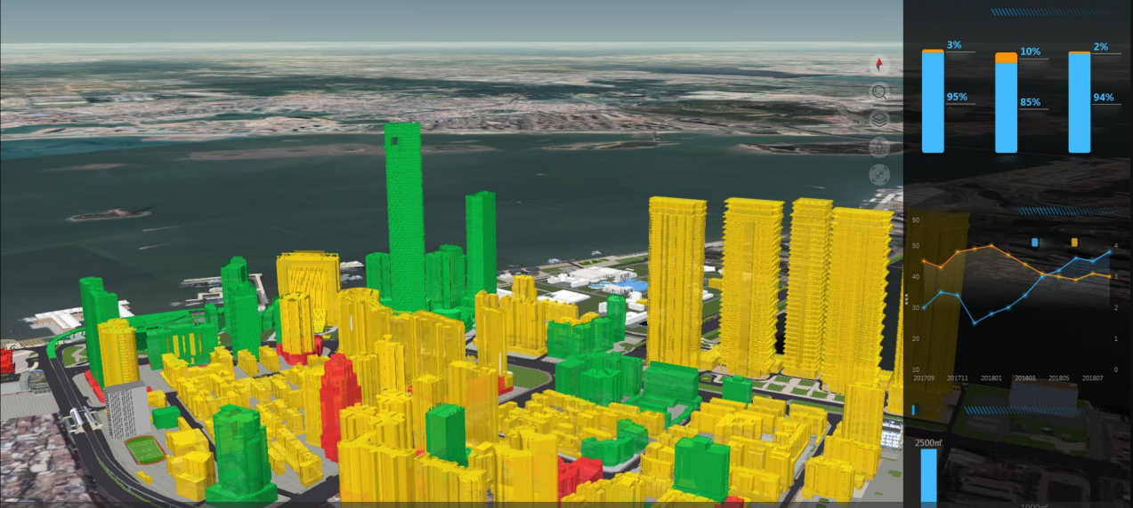
7. PERSPECTIVE 2030: SMART CITY, IA and IOT, 3D Modeling
EXAMPLE 5: LA DISTRIBUTION SPATIALE DES RESSOURCES DES BÂTIMENTS: JAUNES-RÉSIDENT, VERT-BUREAU, ROUGE-COMMERCIAL

Slide 22
8. EVIDENCE FROM DECISION MAKERS
M. DAHON PAULIN, PRESIDENT DE L’UNION DES VILLES ET COMMUNES DE CÔTE D’IVOIRE

Slide 23
8. EVIDENCE FROM DECISION MAKERS
M. KONE IDRISSA, MAIRE DE LA COMMUNE DE TOUMODI, CÔTE D’IVOIRE

Slide 24
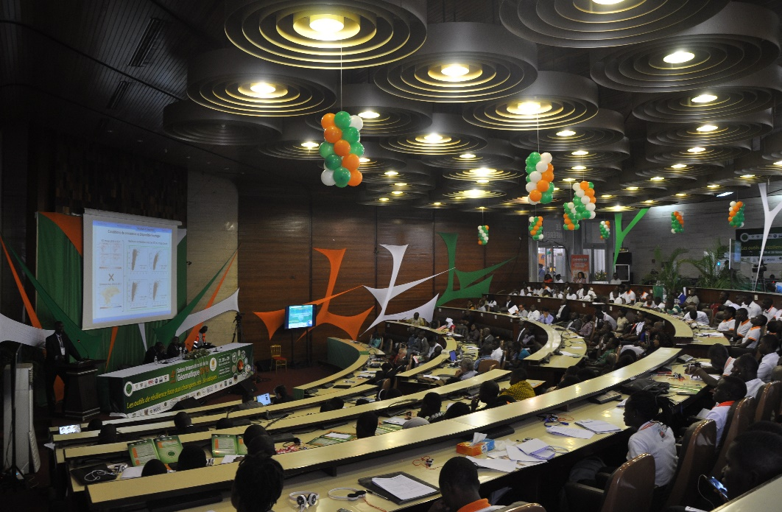
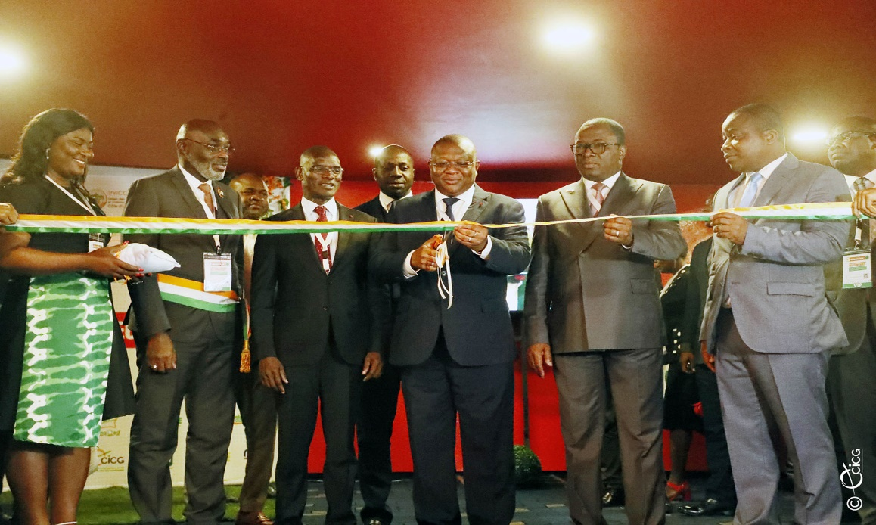
9. PROMOTION OF GEOSPATIAL INFORMATION AND TOOLS
Each year, the CNTIG promotes geo-information technologies to Ministries, local authorities, geomatics players and large public. To this end, we have initiated the International Geomatics Exhibition which brings together geomatics experts who come from all over the world to offer geoinformation solutions to users.
Geomatic 2018
Geomatic 2023

Slide 25
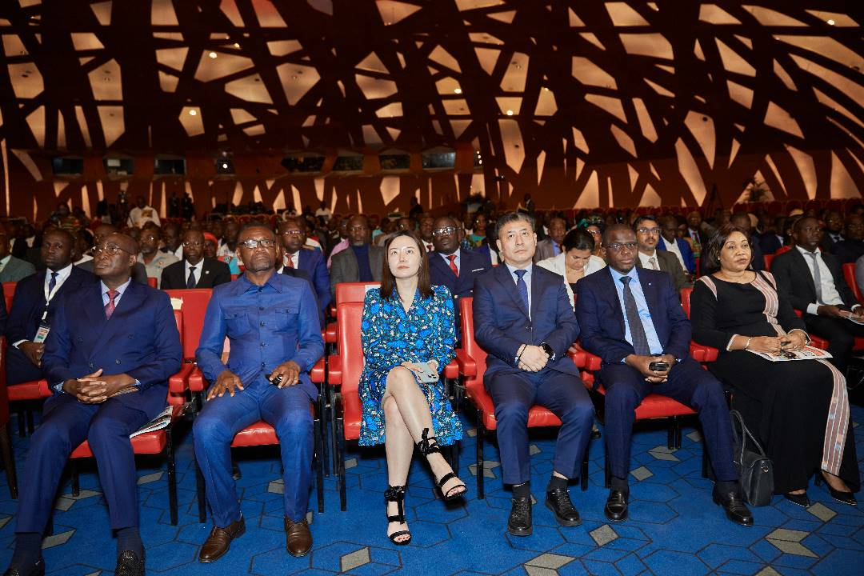
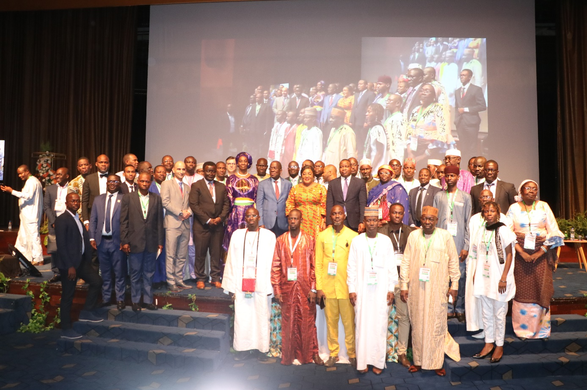
9. PROMOTION OF GEOSPATIAL INFORMATION AND TOOLS
Participants lors des Panels au Palais de Congrès - Sofitel Hôtel- 28 Avril 2023
Photo de Famille de Clôture du Salon International de la Géomatique 2023

Slide 26
Thank You All!
Eighth Session of the United Nations Global Geospatial Information Management for Africa (UN-GGIM: Africa).

