Slide 1
Geospatial Knowledge at the Heart of Tomorrow’s Global Digital Society
John Kedar
17th August 2023
Notes:
This is a 20 minute presentation

Slide 2
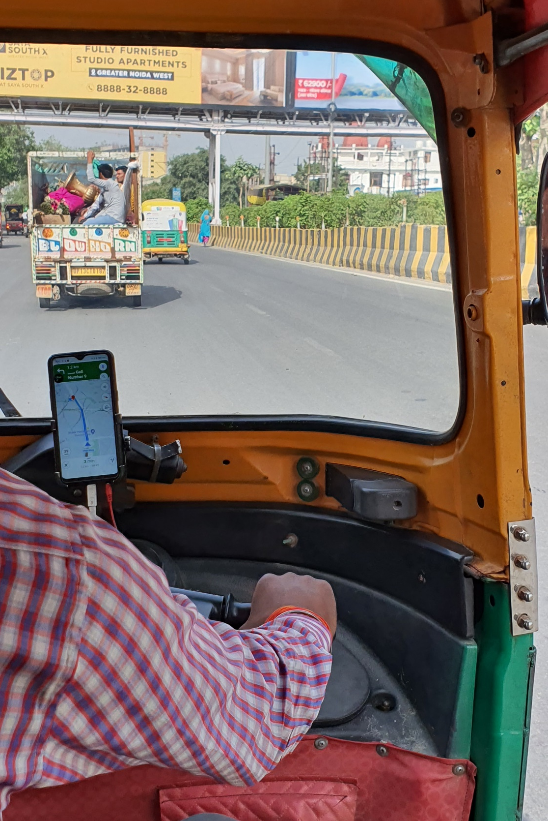
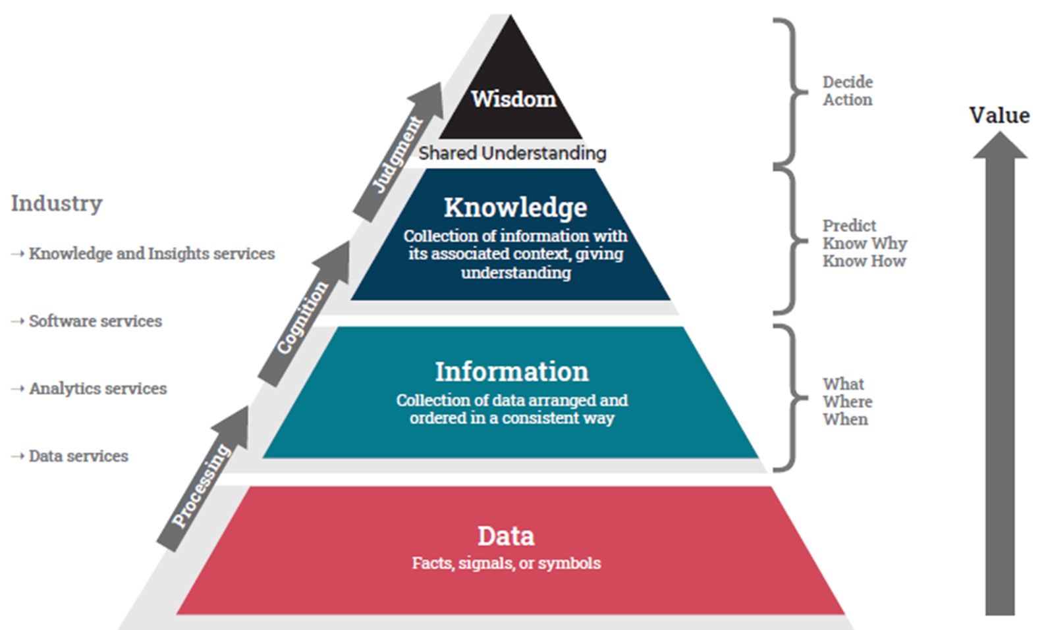
What does society want? Data or Knowledge?
Notes:
What links small-holding farmers in West Bengal, India, seeking greater yields, the National Oceanic and Atmospheric Administration weather forecasters in USA assessing terabytes of data daily and the driverless private-sector bus service in Edinburgh, UK? All seek answers that are derived using geospatial technologies, wider digital technologies and data. We call this geospatial knowledge.
Or thinking needs to move from inputs – spatial data infrastructures of old – to outcomes enabled by knowledge. In doing so, the geospatial ecosystem completely changes and, more importantly, we move up the value chain and are seen to solve problems, not just be a sink for government funding.
Lets look at the photo, taken last week in Delhi. This driver is enabled by knowledge; knowledge that finds customers, guides him to the customers, increases efficiency, decreasing journey time and impact on climate, takes payment, protects customers from fraud. It’s an application enabled by the digital ecosystem, provided by industry, using private sector geospatial data and government provided open GNSS, citizens protected by government policy.
Now, take this a stage further and imagine the autonomous tuk tuk, integrating the ride app with the autonomous vehicle which itself will likely need trusted foundation geospatial data that is as up to date as possible, which means an ability to search for the best source of government and private sector data. It will also need appropriate policies integrated across government, a 4th Industrial Revolution digital ecosystem that is geospatially enabled, a myriad of integrated applications perhaps licenced on a government digital testbed loaded with an appropriate digital twin. All of this will be a collaboration where risk and reward are shared across the value chain and it will be lead by industry.
As an aside, whilst having ridden tuk tuks many times in many places, drivers using ride apps, this ride bought an epiphany moment. We talf about a growing digital divide, growing geospatial divide. I would agree there is in government, but the private sector is enabling technology transfer – step changes in developing nations.

Slide 3
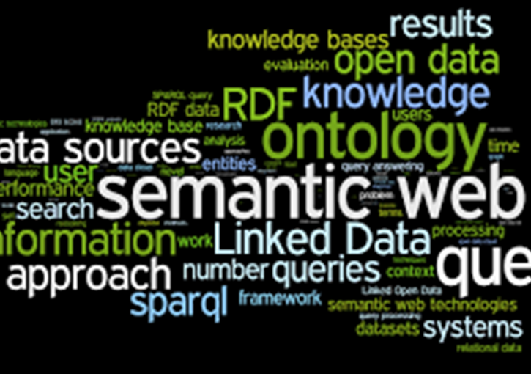
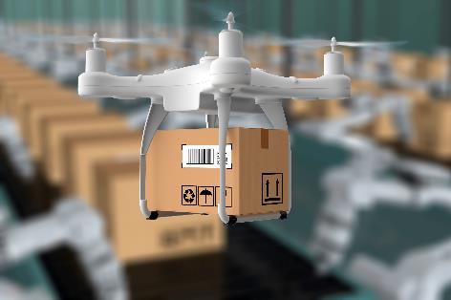
Digital and geospatial ecosystems merging
https://doi.org/10.5281/zenodo.3229400
Notes:
Over the last decades our geospatial ecosystem has been revolutionised. New use cases and customers
The greatest opportunities come from the web and the wider digital infrastructure
It’s a wake up call; Geospatial knowledge is happening across user sectors. Not comprehensively but increasingly so.
But there is much more to do,

Slide 4
Geospatial Knowledge Infrastructure (GKI) Project: Advancing role of geospatial knowledge in world economy, society and environment
3 phase project :
Consider GKI
Consider user sectors
National deep dives and GKI readiness 75 countries
Supports UN-IGIF
Moves thinking beyond current SDIs
Broadening government stakeholders
Growing value chain across user sectors
Helps geospatial agency innovation (SP5) Growing understanding of users
Notes:
So, we have to understand a much broader ecosystem, knowledge and machine to machine - how do we think more broadly
Project
Partners
Phases
Reach Out

Slide 5
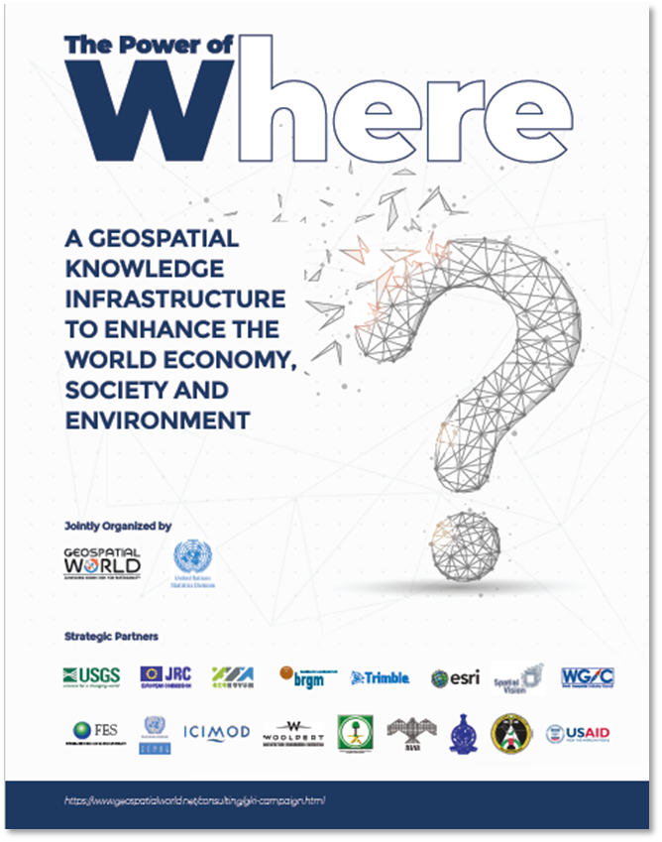
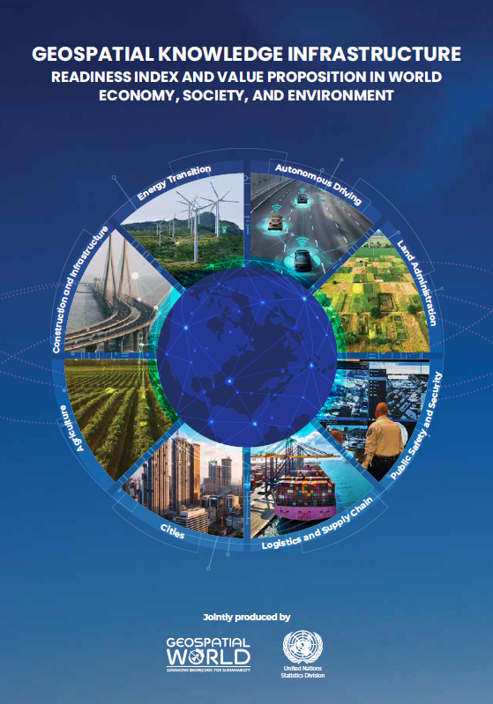
Main outputs and outcomes
Stakeholder Engagement
Final Report and 2024 Readiness Index
Disruption
Notes:
What is the project delivering
Well, top most – engagement
Outputs (including training)
Ultimately – as Greg Scott suggested at our latest partner meeting – disruption.

Slide 6
Tomorrow’s Geospatial Infrastructure
Vision
Geospatial knowledge at the heart of tomorrow’s global digital society.
Geospatial Knowledge Infrastructure
………. a blueprint to integrate digital economies, societies and citizens with geospatial approaches, data and technologies and, in so doing, deliver the location-based knowledge, services and automation expected in this 4IR digital age
Notes:
We are not hung up on names but on discussion
Vision and Definition
Values?

Slide 7
GKI Principles
Knowledge is the focus.
Unified geo-digital ecosystem.
Predictive.
Led by users.
Decentralized.
Collaborative solutions.
Agility.
Achievable actions now and then scale.
Notes:
Let me take you through principles:
Knowledge is the focus. Humans and machines seek knowledge to make decisions.
Geospatial technology and data should integrate with established and emerging wider digital infrastructures and data to be a unified geo-digital ecosystem.
Predictive. Be it in milliseconds or years, outcomes move from insight to intelligent foresight. Time and place are powerful contributions to prediction, integrated with many non-geospatial inputs.
Normally led by users knowledge needs, not data and applications available.
Decentralized. The web is naturally decentralized, with data and application value-chains becoming more complex across wider ranges of partnerships. Findable, Accessible, Interoperable and Reusable applications and data, for human and machine, are critical to this principle
Collaborative solutions. To effectively meet societies’ global sustainability challenges, including the digital divide.
Agility is inbuilt. Innovative, dynamic and agile solutions are far better able to respond to global challenges, technology change and people’s expectations in a rapidly developing world.
Take achievable actions now and then scale; success cannot be achieved overnight.

Slide 8
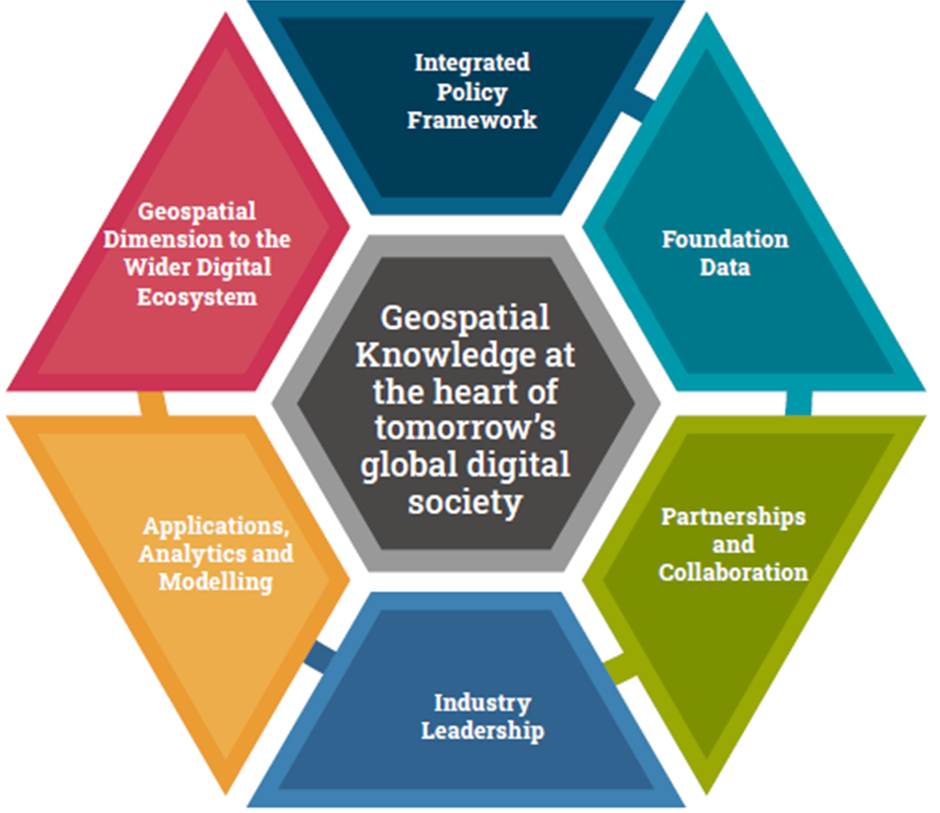
GKI Elements
Governments
Digital ecosystem & infrastructure
Industry
Notes:
Start with outside – noting that focus has largely been on government yet it is the two two that are making the strides forward.
Inside, elements – vision at very centre. In a sense this defines an ecosystem
Papers look at each element in more detail, including suggesting some guidelines for geospatial infrastructure development in future. We do not provide a technical architecture nor detail, rather a direction of travel towards knowledge.
Look at each.

Slide 9
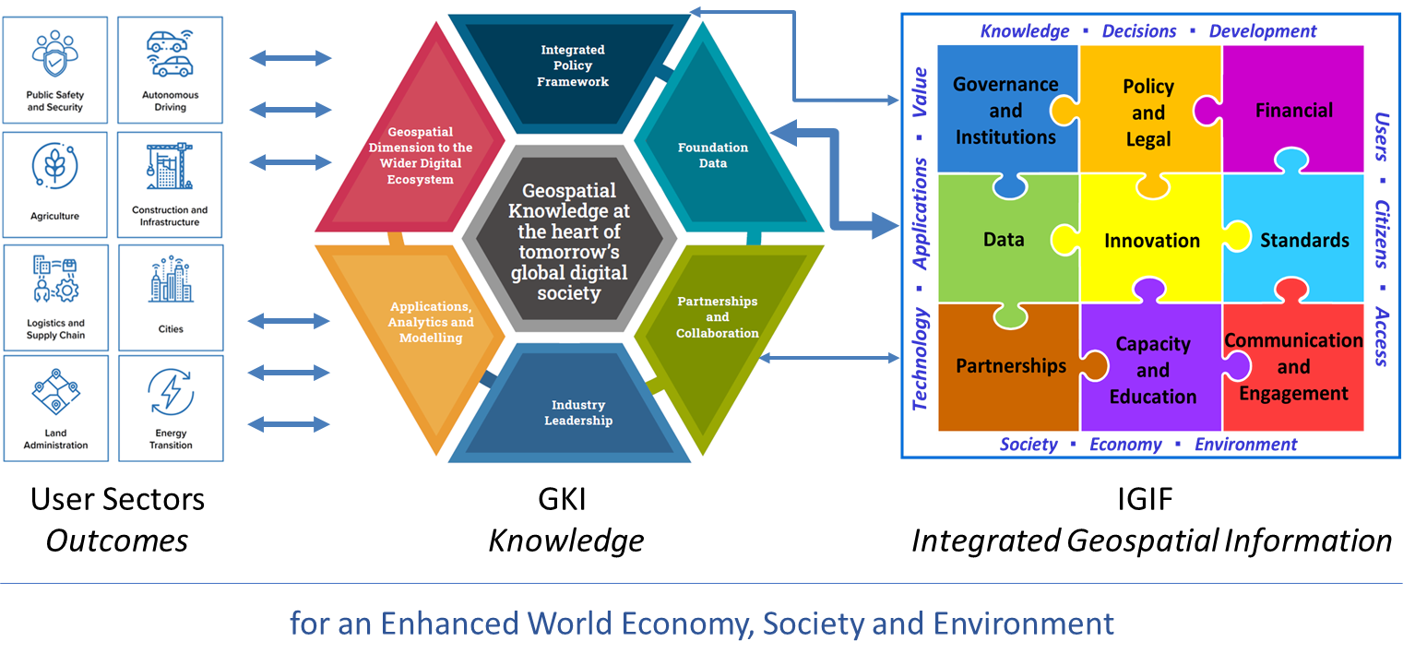
Relationship between GKI and UN IGIF
Notes:
The United Nations successfully launched the UN-IGIF to help countries develop integrated geospatial information infrastructures that meet national needs. This framework is in widespread use globally as governments develop action plans for their future geospatial information infrastructures. Because GKI focuses on user sector knowledge generation, which is anchored by geospatial information, GKI reaches beyond governments into industry, the wider digital ecosystem and the applications community. However, UN-IGIF country-level action plans provide much of the foundation data element of GKI along with associated geospatial information policies and partnerships. GKI needs nations to build sustainable foundation data capabilities and thus is reliant on the IGIF. Likewise, a nation seeking a more user-sector knowledge focussed UN-IGIF country-level action plan could consider relevant GKI guidelines as it uses the UN-IGIF.
Many GKI White Paper concepts and recommendations have also been incorporated into the United Nations’ July 2022 paper: “Future Geospatial Information Ecosystem: From SDI to SoS and on to the Geoverse — Making the Step Change Using the Integrated Geospatial Information Framework”. GKI is seen as part of this ecosystem whilst is also proposed as an engine to help power the ecosystem.
The European Union with its INSPIRE directive is developing its future thinking with its European Union Location Framework, that, where concepts overlap, has a substantially degree of alignment with GKI.

Slide 10
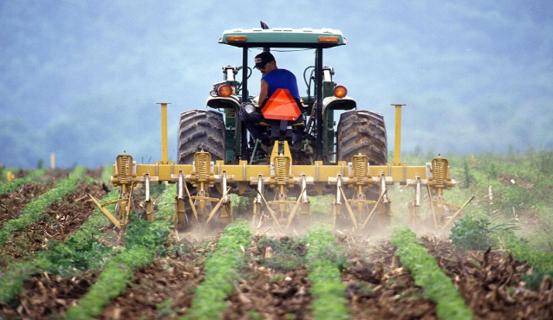
GKI Project Year 2 User Industry Focus
Energy Transition
Transport & Infrastructure
Autonomous Driving
Land Administration
Logistics and Supply Chain
Cities
Public Safety and Security
Agriculture
Notes:
Just to be clear, the engagement with industry – 8 sectors.
About understanding the sectors – these deliver economic and social value
how geospatial data and tech currently used and could be used
Wprkshops and roundtables

Slide 11
Agriculture

Slide 12
Sectoral Challenges
Productivity to meet increasing demand
Distribution
Climate change
Resilience to protracted crises, natural disasters and conflicts
Efficient farm management
Technology affordability
Slow uptake of innovation
Rural area network coverage
Lack of rural infrastructure including warehousing
National and international governance
Efficient administration (including land use permits, subsidies and insurance)
Role of geospatial knowledge - technology, applications and data

Slide 13
SDG 2: Zero Hunger
For example, Target 2.3:
By 2030, double the agricultural productivity and incomes of small-scale food producers, in particular women, indigenous peoples, family farmers, pastoralists and fishers, including through secure and equal access to land, other productive resources and inputs, knowledge, financial services, markets and opportunities for value addition and non-farm employment

Slide 14
SDG 2: Zero Hunger – Hand-in-hand
Hand-in-Hand - is an evidence-based, country-led and country-owned initiative of the Food and Agriculture Organization of the United Nations to accelerate agricultural transformation and sustainable rural development to eradicate poverty (SDG1) and end hunger and all forms of malnutrition (SDG2).
Geo-AI for agri-food system digital transformation. Hand-in-Hand’s Geospatial Platform unlocks over 2 million data layers for more targeted, evidence-based interventions
Cloud-based Infrastructure
Multi-disciplinary data federation and integration
Standards-driven
Visualization, dissemination, multi-criteria data analysis, image processing & knowledge discovery enabled by GeoAI

Slide 15
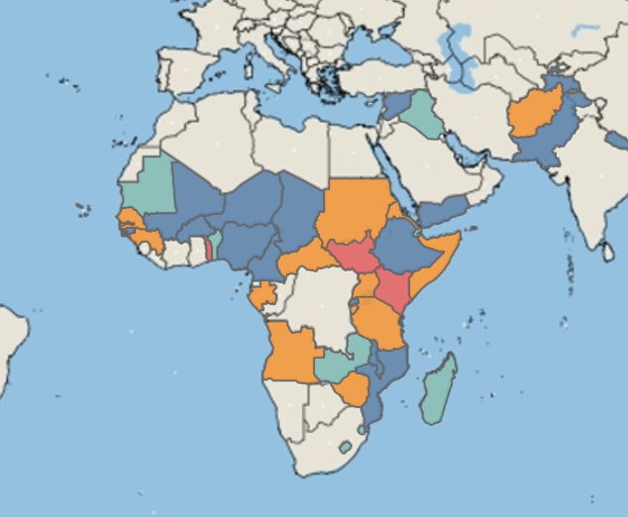
Hand-in-hand participation
Notes:
Identify the largest opportunities to raise the incomes and reduce the inequities and vulnerabilities of the rural poor, and to guide concerted action among partners and in keeping with national sustainable development priorities
Present an evidence-based view of economic opportunities and to improve targeting and tailoring of policy interventions, innovation, finance and investment, and institutional reform

Slide 16
SDG 2: Zero Hunger
Knowledge enables a holistic approach to improving the whole crop production system on a specific holding;
Earth Observation (EO) supports crop monitoring and yield prediction;
Governments open up high-resolution soil and hydro-meteorology data (from EO) to enable knowledge generation for small holders and industry;
This knowledge is made accessible through smartphones, with integration and analysis hidden from the user.

Slide 17
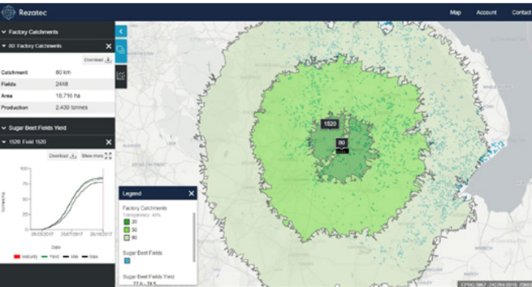
SDG 2: Zero Hunger
Rezatec’s Geospatial Artificial Intelligence (AI) solution for sugar beet processors combines remote sensing and data science to assist with procurement and inputs optimisations for processors and their contract farmers.

Slide 18
GKI Project Year 2 User Industry Focus
Energy Transition
Transport & Infrastructure
Autonomous Driving
Land Administration
Logistics and Supply Chain
Cities
Public Safety and Security
Agriculture
Notes:
Just to be clear, the engagement with industry – 8 sectors. Ruban will talk on two of these.

Slide 19
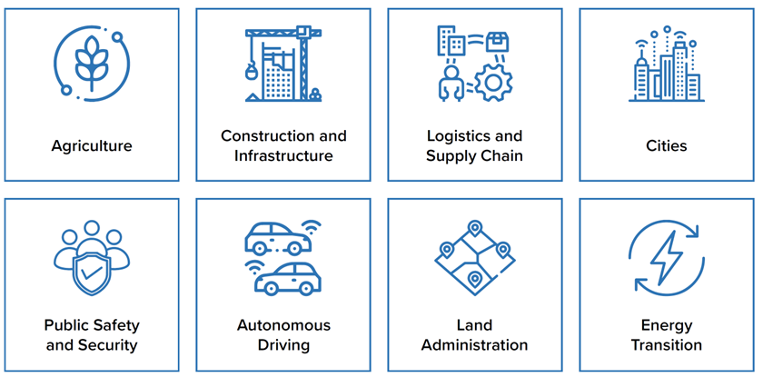
Phase 2 Report – October 2022
The value proposition of GKI for eight geospatial user industries.
Assessment of GKI readiness for 50 countries.

Slide 20
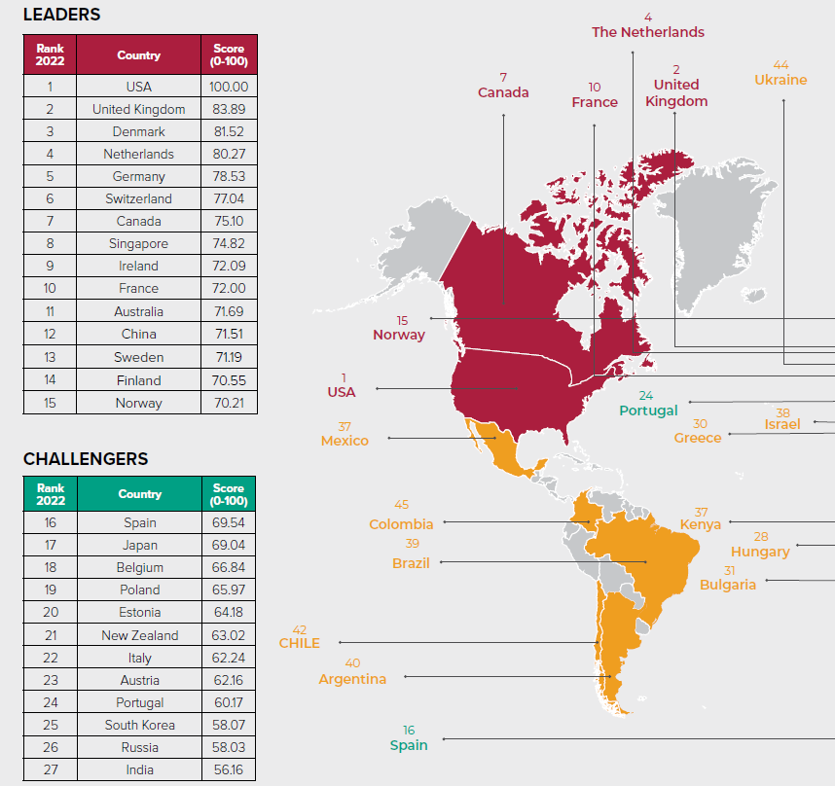
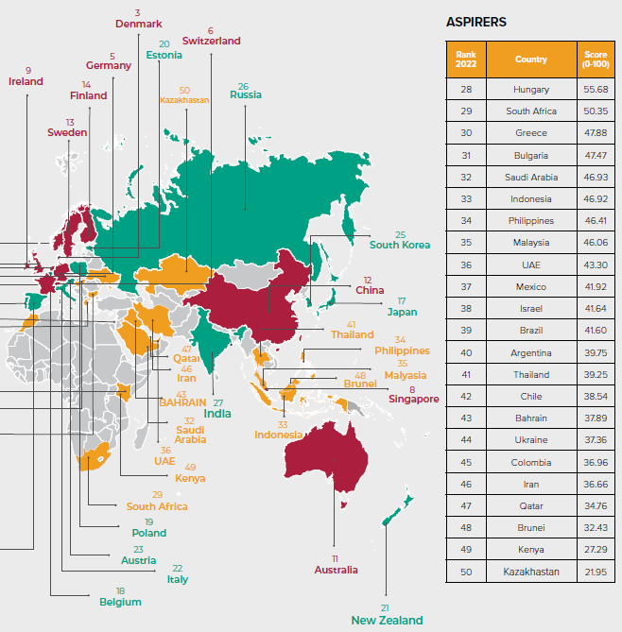
Why a GKI Readiness Index?
Notes:
To give nations and wider ecosystem a snapshot of their move towards a knowledge Infrastructure.
To help global and regional institutions understand the global and regional situation – including the digital divide
It is used. UK Strategy last week. Countries seeking greater insight, questioning their lower than expected scores in some areas, countries wanting to use the readiness methodology themselves

Slide 21
What does the readiness index consider?
Pillar | Sub-pillars
Pillar 1: Integrated Policy Framework | Core Geospatial Policies | Geospatial Mandate in Sectoral Policies
 | Enabling Policies | UNIGIF Adoption
Pillar 2: Foundation Data | Fundamental Data Themes | Open & Linked Data
 | Positioning Infrastructure | Earth Observation Infrastructure
Pillar 3: Partnerships & Collaborations | International Collaborations | National Geospatial Collaborations
Pillar 4: Industry Leadership | Industry Capacity | Innovation Promotion Programs
 | Industry Networks
Pillar 5: Applications, Analytics and Modeling | User Adoption | 4IR Adoption and Integration
Pillar 6: Geospatial Dimension to Digital Infrastructure | Spatial Data Access | Capacity Building
 | Standards | Digital Readiness
 | Institutional Capacity
Notes:
These things never perfect, you can only score what can be measured. Hence the benefit of organisations completing questionaires
All 6 elements
Research team of 4 started work on next GKI readiness index 4 months ago

Slide 22
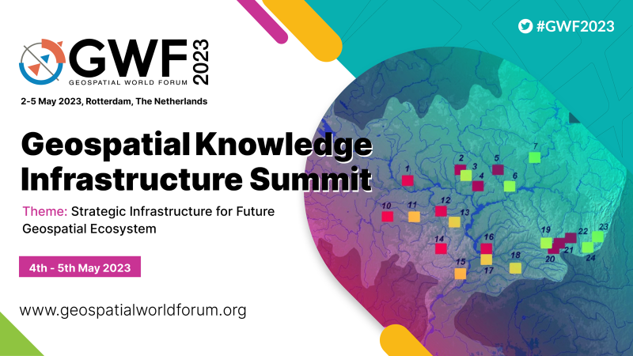
GKI Project Phase 3
Please complete the questionnaires that have been sent to countries
UN GGIM Future Geospatial Information Ecosystem
South Africa
Kenya
Morocco
+ Egypt
+ Nigeria
+ Ethiopia
+ Rwanda
+ Tanzania
+ Ghana
+ Mozambique
+ Namibia
+ Cameroon
+ Burkina Faso
Deep dive workshops: Netherlands, USA, Saudia Arabia, India, South Africa
Notes:
UN GGIM Future Geospatial Information Ecosystem
All material publicly available
GKI readiness index will grow further
Please answer questionnaires that GW has sent, more effective than internet research alone, gives better accuracy and helps build up the global picture

Slide 23
A Journey To find out more and contribute: GKI White Paper https://www.geospatialworld.net/gw-assets/pdf/GKI-White-Paper.pdf GKI Phase 2 Report and Readiness Index https://b24-snpob1.bitrix24.site/GKI-Phase-2-Report-Download-2022 GKI Phase 3 Final Proposition – draft for discussion https://geospatialworld.net/consulting/gw-assets/pdf/Draft-GKI-Proposition-Document.pdf
Geospatial Knowledge at the heart of tomorrow’s global digital society
Notes:
You can contribute by providing feedback on the short paper, third bullet, which is there to help guide the content of part of the final report. It builds on everything that has happened since the original white paper was published two years ago.
The project concludes in 6 months – the information produced is open and can be used by anyone.
Thank you

