Slide 1
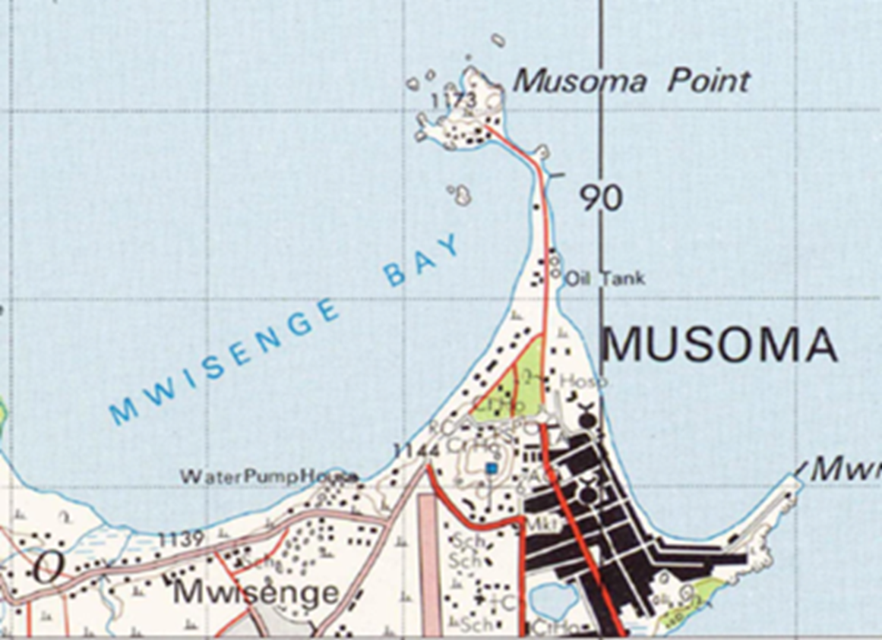
CORS Project by JICA Technical Cooperation
Tsuda
16 Aug. 2023
UNGGIM AFRICA
Cape Town, RSA
First JICA mapping project
in Africa in 1973
* Japan International Cooperation Agency

Slide 2




Self-Introduction
1st Visit in RSA: 1995
Visited RSA: 41 times
37 Countries in Africa
Love Rugby
4 Grandchildren

Slide 3
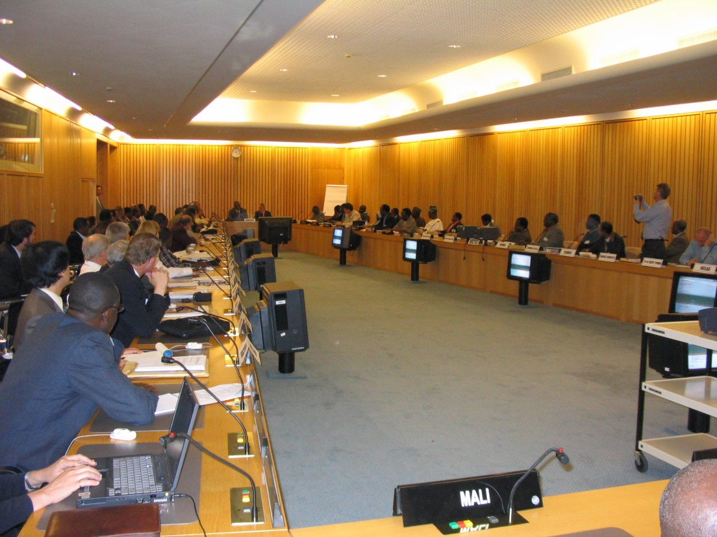
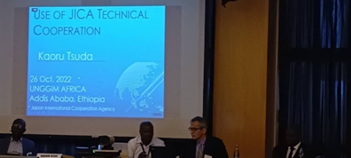
Participation of A total of 12 Geo-Info Conferences
2003
Year | My Participation
2001 | CODI 2
2003 | CODI 3
2007 | CODI 5
2009 | CODIST 1
2011 | CODIST 2
2014 | GGIM Tunisia
2015 | GGIM Kenya
2016 | GGIM Ethiopia
2017 | GGIM Ethiopia
2019 | GGIM Rwanda
2022 | GGIM Ethiopia
2023 | GGIM South Africa
2022

Slide 4

Technology
National Geospatial-information Organizations
Budget
Human Resource

Slide 5


use
“Japan’s Grant aid” wisely !
Only
JICA supports “implementation”

Slide 6
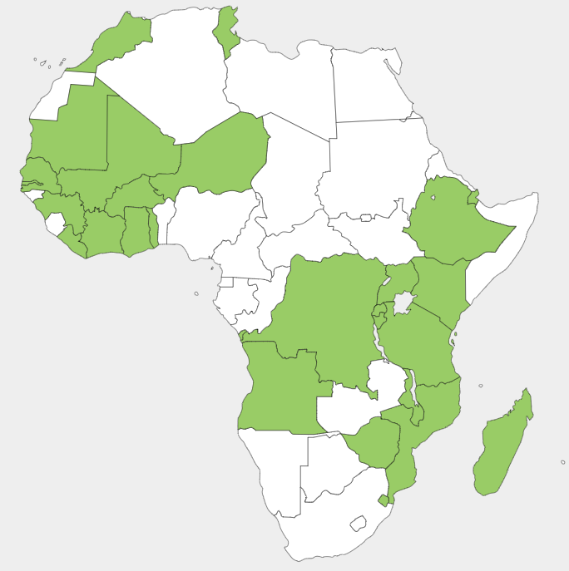
JICA Geo-Spatial Info Projects in 26 Countries
Technical Transfer
Equipment Supply
Training in Japan
Mapping/LiDAR
GIS
CORS
NSDI
Data Sharing
Data Update

Slide 7
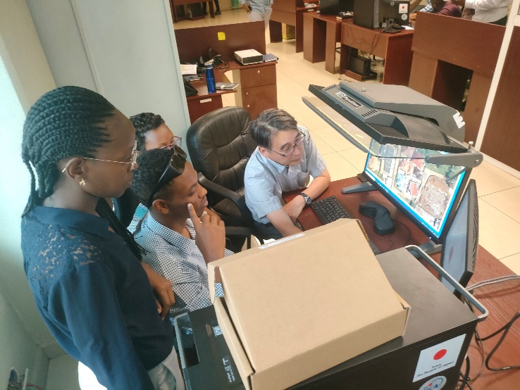
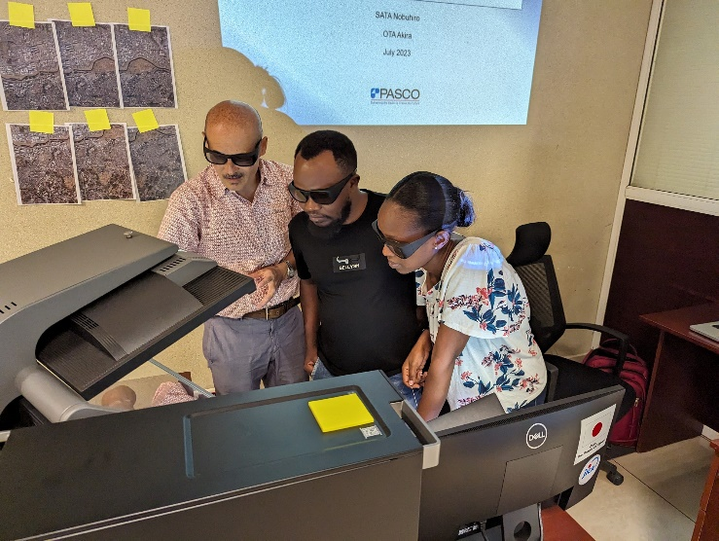
Recent JICA Projects in Africa
Year | Recipient Country | Project Contents
2023~ | Senegal | (New Project) Establishment of CORS
2023~ | Madagascar | (New Project) Sea Chart (Bathymetric chart)
2023~ | Djibouti | (New Project) Data Update and Sharing
2021～24 | Rwanda | 1/1000, 1/2500,1/10000 Map Production
2021-22 | Guinea | 1/5000 Topomap Update
Rwanda
Rwanda

Slide 8
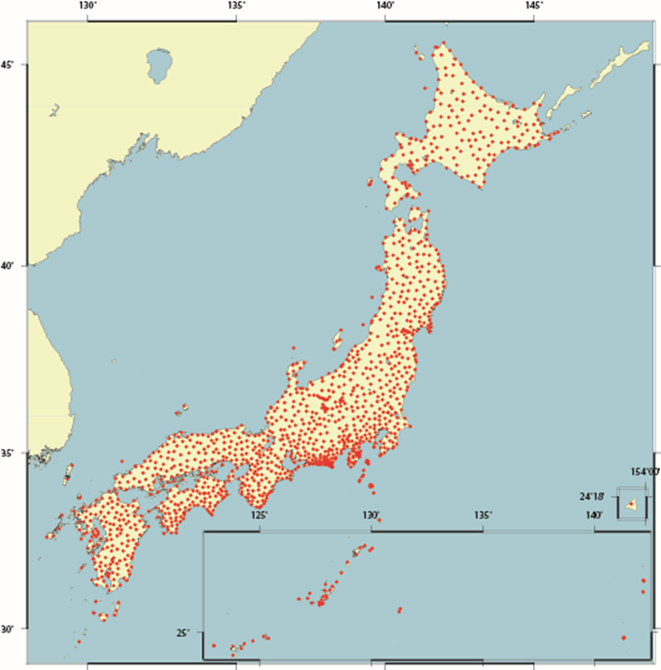
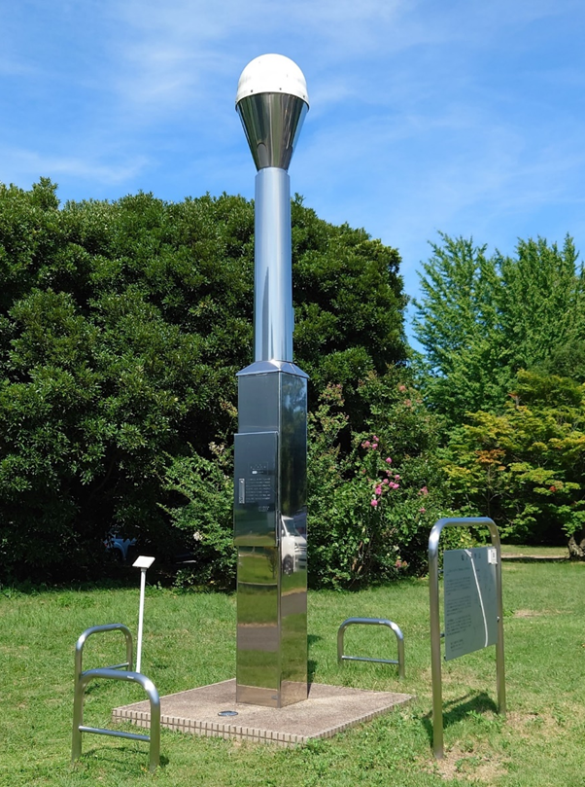
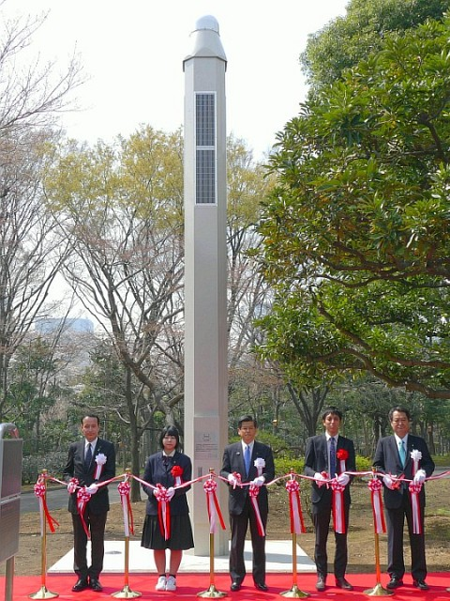
CORS
Continuously Operating Reference Stations
Japan | 378,000km2
Population | 125 million
Commencement of Operation: | 110 points in 1993
Existing CORS: | 1318 points in 2023
Distance between each CORS: | 20km

Slide 9
1318 CORS in Japan
Bangladesh
Thailand
Cambodia
Myanmar
Senegal
Experience
Knowledge
Technology
Information
Transfer
Gift from Japan

Slide 10

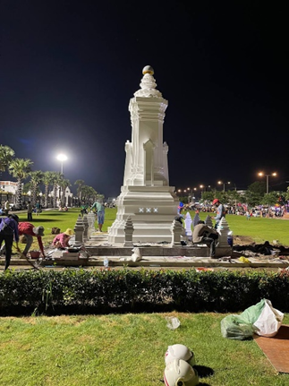
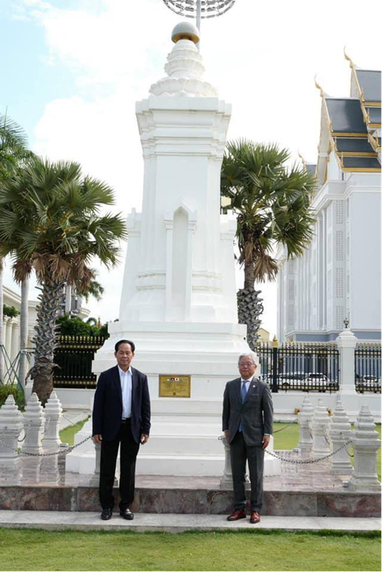
CORS

Slide 11
Cors Project in Cambodia
Technical Assistance Project
Outcome | Contents
1 | Establishment of 5 CORS and a Data Center
2 | Enhancement of O&M of CORS and Data Center
3 | Promotion of Utilization of CORS data
Grant Aid
Outcome | Contents
1 | Establishment of 94 CORS
2 | Upgrade of Data Center

Slide 12
JAPAN’s Grant aid for CORS
Phase 1 (5 CORS)
Phase 2 (94 CORS)
99 CORS covering the country

Slide 13
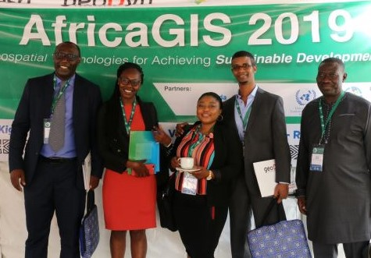
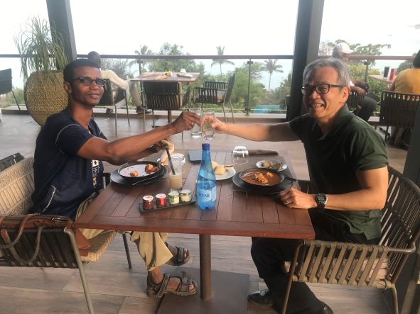
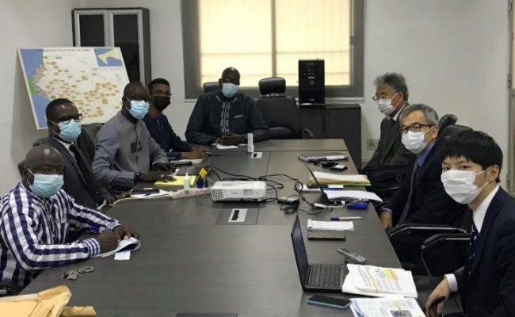
Case study: Project formulation in senegal
Year | Activity | Remarks
2019 | GGIM Africa | First contact
2021 | Visited Senegal | Proposal preparation
 | Requested to Japan | Declined
2022 | Visited Senegal | Proposal preparation
 | Requested to Japan
 | GGIM Africa | Discussion
2023 |  | Accepted
2023 Sept. | Mission will be dispatched | Specifications preparation
2024 Jan. | Project Implementation | 5 CORS Constructions Data Center Technical transfer for Integration of Geodetic Reference Frame and Operation & Maintenance

Slide 14
Long and winding road
Consultation with Tsuda
Proposal Preparation
Request to JPN
Evaluation by JPN
Acceptance
Rejection
Implementation

Slide 15
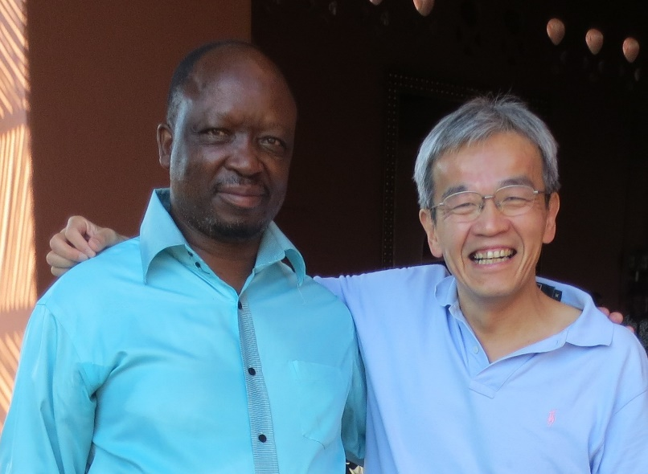
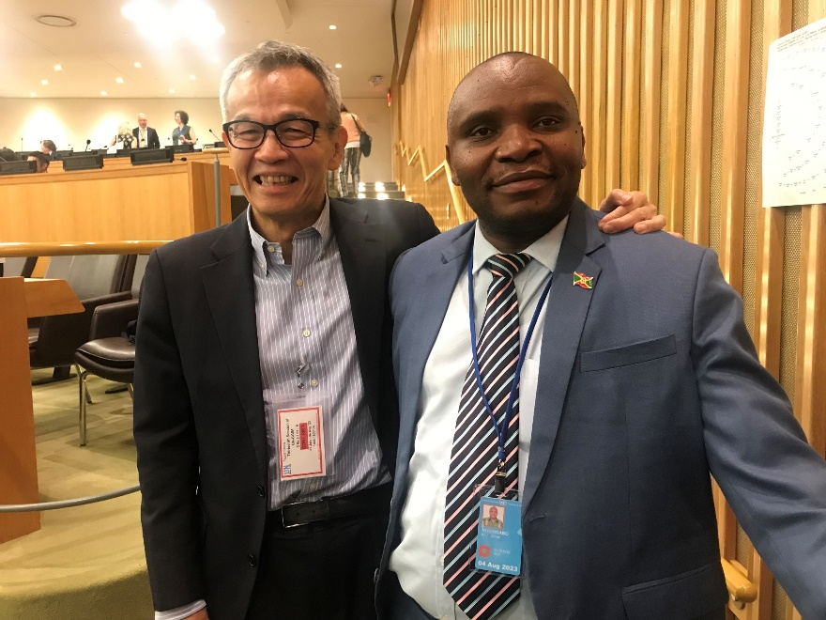
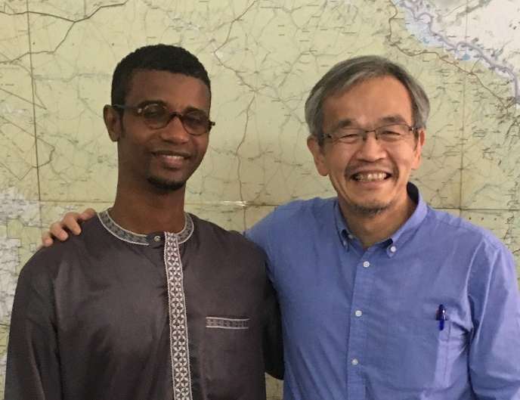

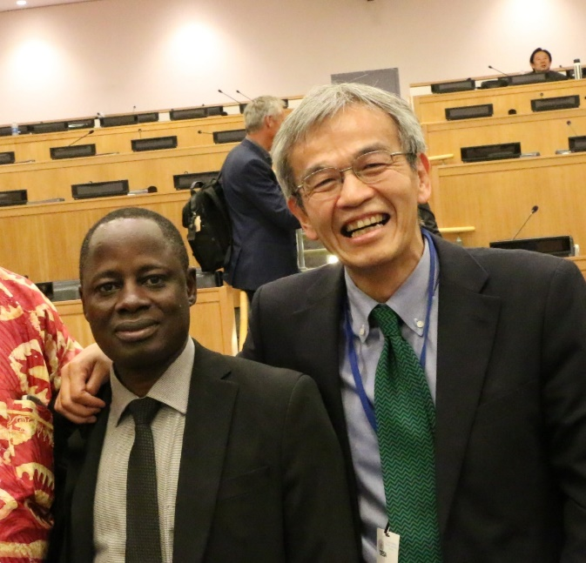
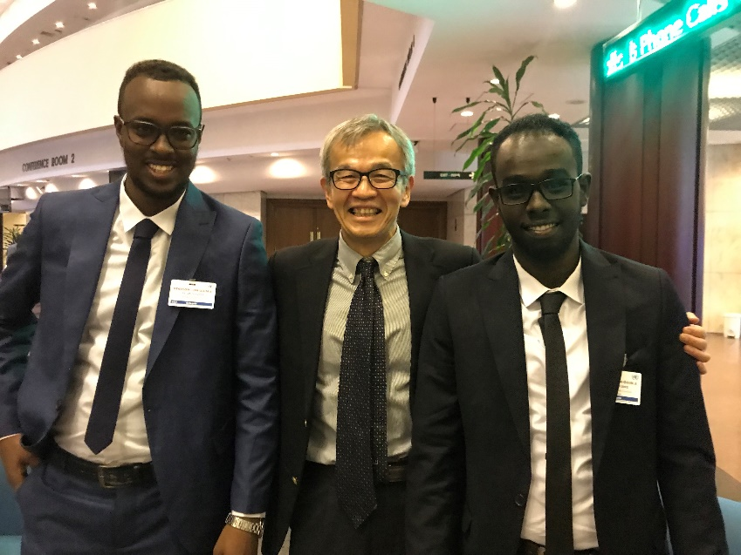
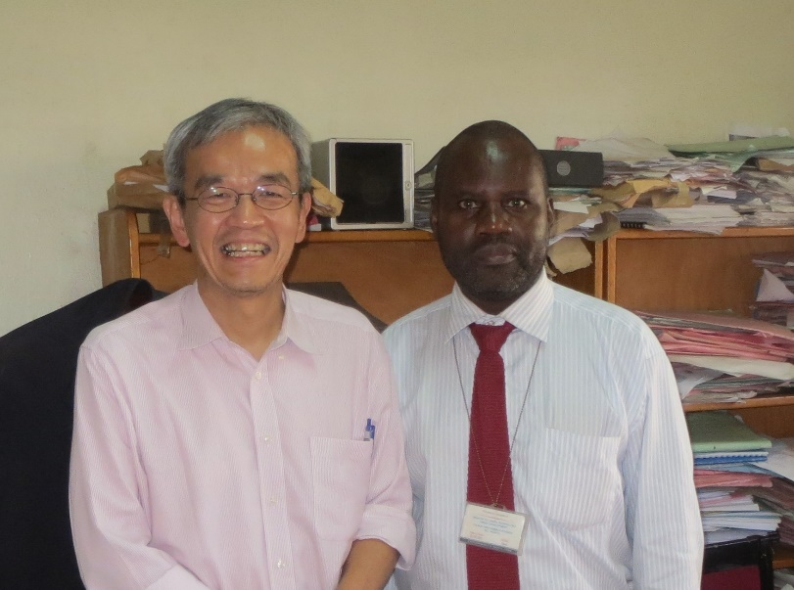
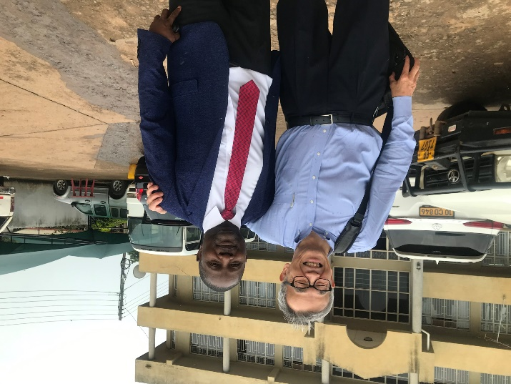
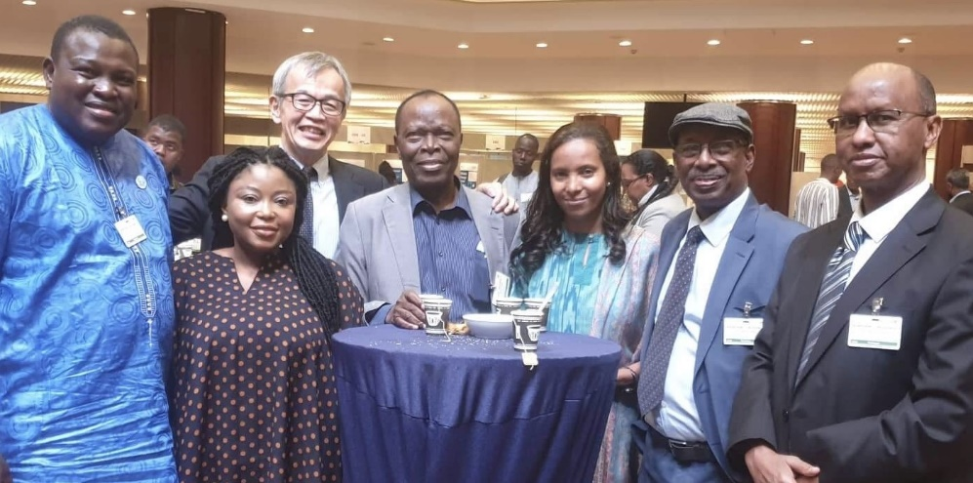
Contact me!
WhatsApp, Messenger
+81 90 9305 7188

