Slide 1

Sustainable Business Models
Presented by:
Andrew Coote
Chief Executive
ConsultingWhere
Notes:
Open data a decade later (than what?) – the impact on NMCAs from both an economic and social perspective.
1

Slide 2
Agenda
Context
Impacts – How to objectively assess them
NMCA Business Models – pivoting for a new world
Takeaways
Notes:
First, I will set some context - where we are now and where we are heading?

Slide 3

Fourth Industrial Revolution: Information Age
“The Information Age is a period beginning in the late 20th century characterized by the digital transformation from traditional industry to an economy based on data and communications becoming the driving force of social evolution.”
Source: Forbes
Notes:
First some context
Over the last decade or so, we have observed the emergence of a fourth industrial revolution dubbed the Information Age.
The information age is characterised by digital transformation from traditional industry models to a global economy where data and communications is becoming the driving force of social evolution.

Slide 4

Why: Policy and Decision Making
“You can’t manage what you don’t measure.”
- Peter Drucker
Source: https://www.thefamouspeople.com/profiles/peter-drucker-132.php
Notes:
Why is Socio-economic impact assessment necessary?
This is a quote from Peter Drucker an Austrian-born American management consultant, educator, and author, whose writings contributed to the philosophical and practical foundations of modern business.
As geospatial is fundamentally about measurement of our most important resource (Planet Earth) , so it follows that you cannot manage most projects without geospatial information.

Slide 5
Open Geospatial Data?
Principles
  FAIR : Few would disagree with these principles
Fee or Free?
  There is no such think as a free lunch (someone has to pay at some point)
Does free today, mean free forever?
  Budget pressures are increasing
  Politicians’ change responsibilities frequently
  Governments’ priorities change
  If funding is reduced how do you maintain data currency?
Once this free decision is made “Genie is out of the bottle” it can’t be put back in
Whatever the decision - you need to understand the economics.

Slide 6
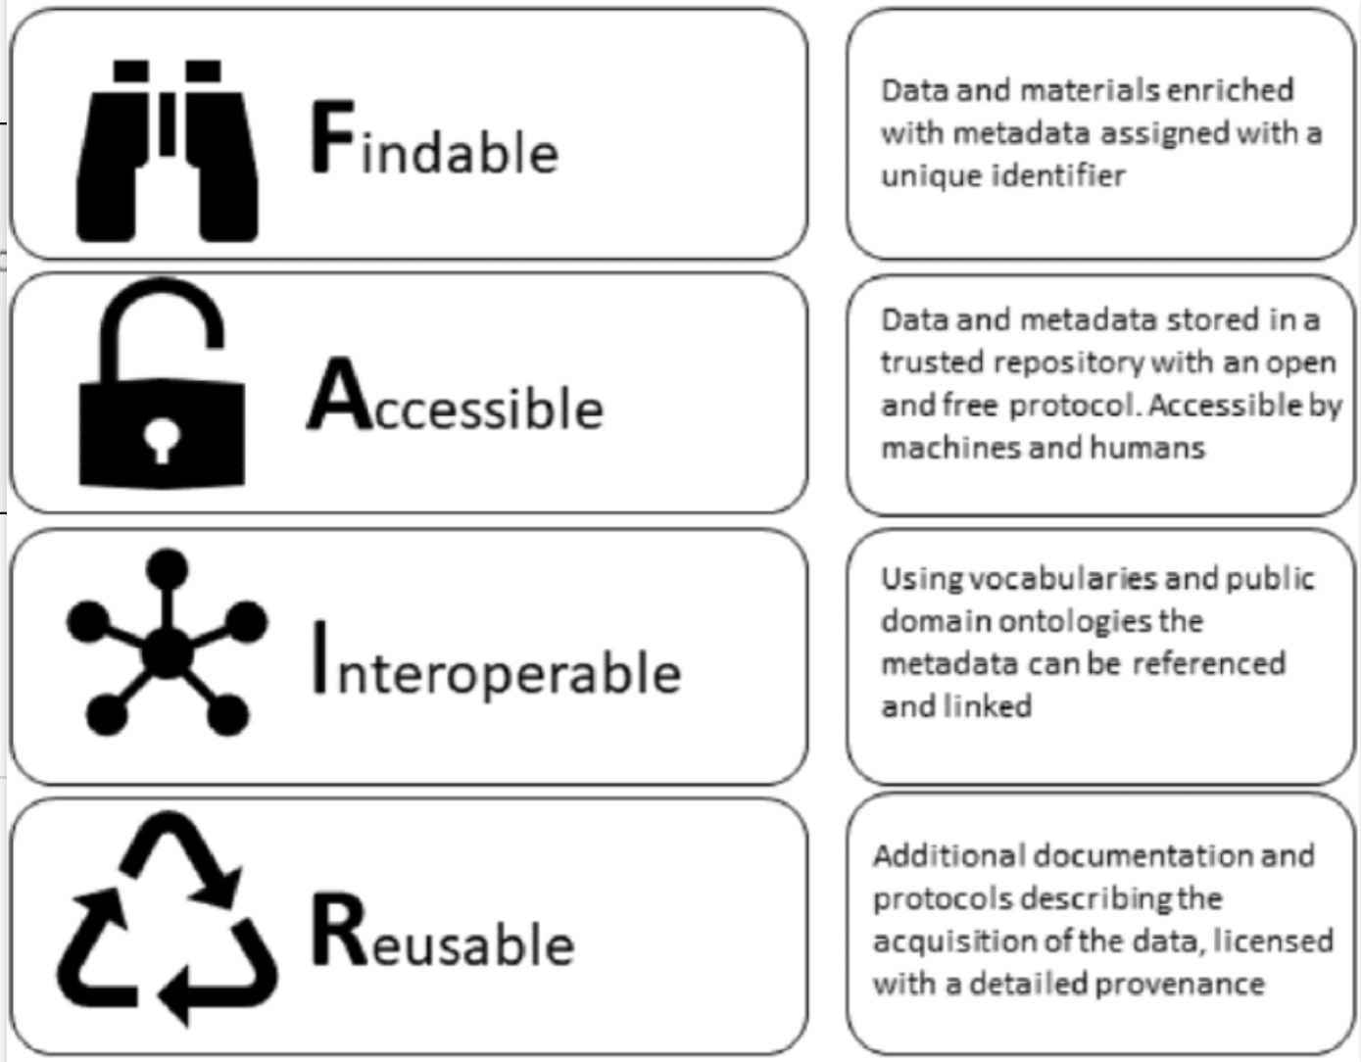
FAIR Principles

Slide 7
The impact of Open Geospatial Data?
Principles
  FAIR : Few would disagree with these principles
Fee or Free?
  INSPIRE does not say all data has to be free
  There is no such think as a free lunch (someone has to pay at some point)
Does free today, mean free forever?
  Budget pressures are increasing
  Politicians’ change responsibilities frequently
  Governments’ priorities change
  If funding is reduced how do you maintain data currency?
Once this free decision is made “Genie is out of the bottle” it can’t be put back in.
Whatever the decision - you need to understand the economics.

Slide 8
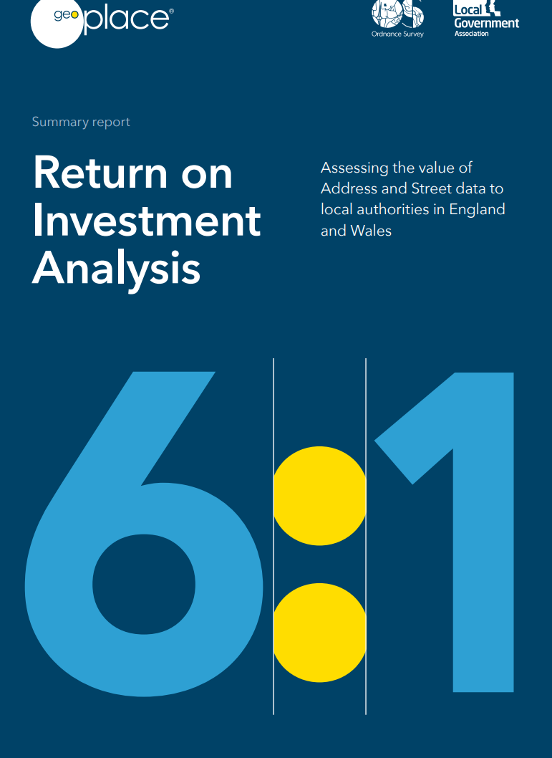
Socio-Economic Impact Studies (National)
England and Wales
  Return on Investment predicted at 6:1 for local authority use of National Address and Street data (Period 2022-6).
  This data is free at the point of delivery BUT the UK Geospatial Commission pays Ordnance Survey circa £100m per annum for it.

Slide 9
Future Business Models for NMCAs

Slide 10
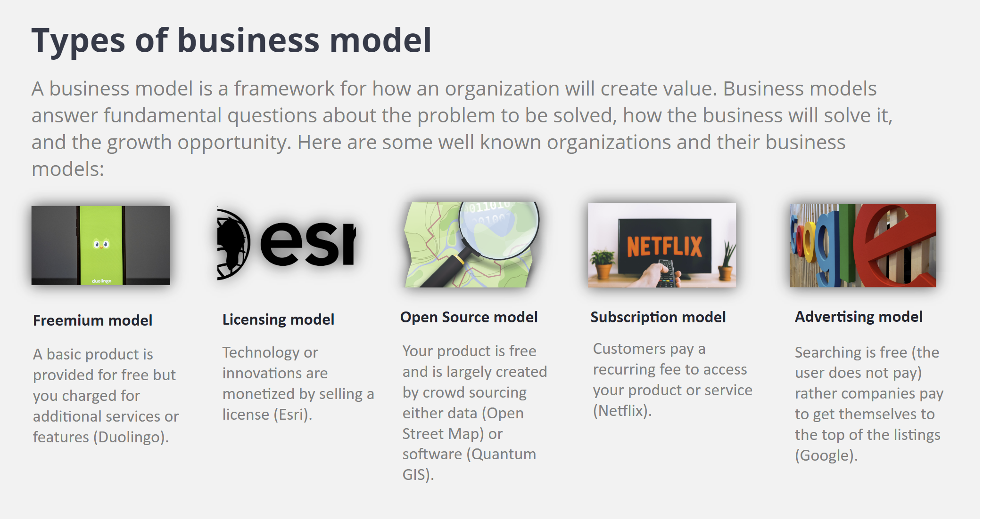
Notes:
Open Source – revenue is made from selling services to use the data.

Slide 11
NMCA Business Model Options
Centrally funded by Government
  One Ministry provides all (or vast majority) of the funding
Cost Sharing e.g. Norwegian GeoVekst model
Overseas Development Aid – usually needs to be tied to specific project
  International Financial Institutions: generally only available to low and middle income countries, usually project specific
  Charitable Foundations e.g. Gates, Ebay
  Non-governmental organisations e.g. FAO, UN-Habitat, UNDP
Value Added Services e.g. data matching, compliance testing
Public Private Partnerships
  land administration - well established business model in developed countries
  CORS network usage
  Aerial imagery – free to government, chargeable to private sector

Slide 12
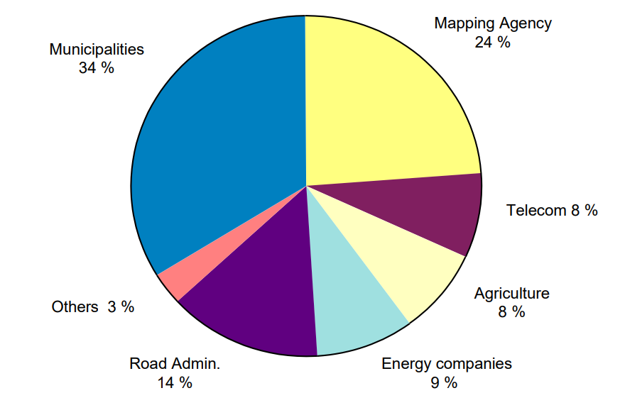
Cost Sharing – GeoVekst (Norway)
Strapline:
  Give a little, get a lot
Running successfully for over 15 years
Over 600 member organisations
- includes commercial organisations
All have input to decision making
Payment rates decided on basis of relative utility.
Coordinated by Kartverket (Norwegian National Mapping Agency
Source: https://www.kartverket.no/geodataarbeid/geovekst

Slide 13
The Impact of Open Data - key takeaways
Data underpins the 4th Industrial revolution – exponential rise in demand for authoritative geospatial data to support evidence–based decision making.
Open data doesn’t necessarily mean free - opportunities but also risks.
Align to the policy agenda – maximizing impact both social and economic. More quantification studies now available.
Requires re-thinking the NMCA Business Model

Slide 14
Extra Slides

Slide 15
?
Costs
  Capital (e.g. servers, vehicles)
  Recurrent (e.g. staff, internet access)
    Benefits
  Who gains: Government, business or citizens (consumers)
  Types of Benefits: Economic, Social, Environmental
Notes:
Step 4 is where we bring together the evidence from stakeholder engagement and previous studies.
These are the costs and benefits of investment.
They are collectively referred to as impacts, as change can have negative consequences.
Let’s look at some economic, social and environmental impacts

Slide 16
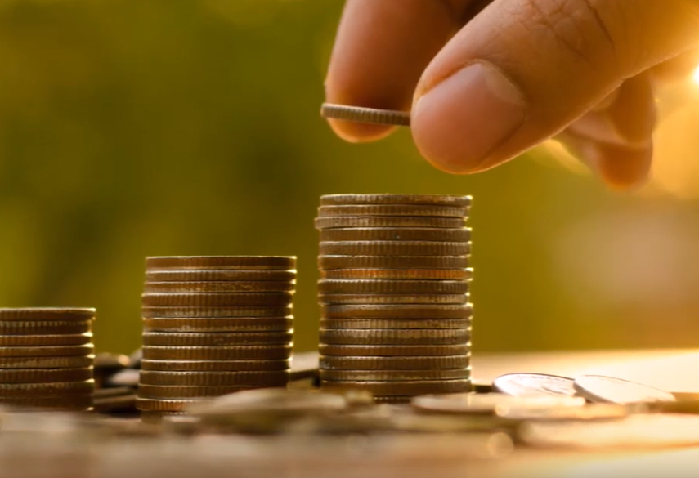
Economic Impacts
Additional jobs and economic growth from new products and services
Improved tax collection
Increased productivity – do things quicker or smarter

Slide 17
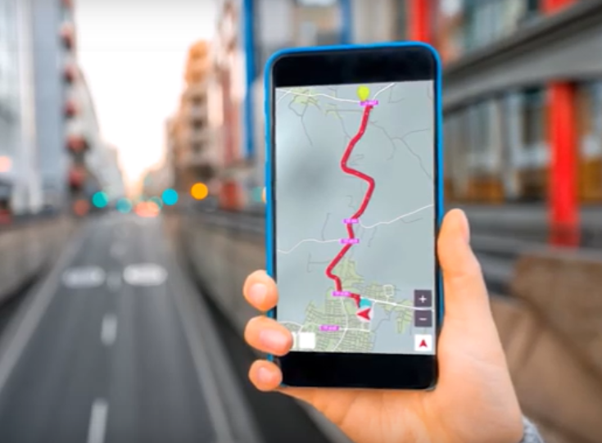
Social Impacts
Faster emergency response by Police, Fire and Ambulance services
To the door Collection and distribution services
More efficient citizen interaction with customer services
Enhanced Crime Pattern Analysis leading to better prosecution rates and reduced levels of offences

Slide 18
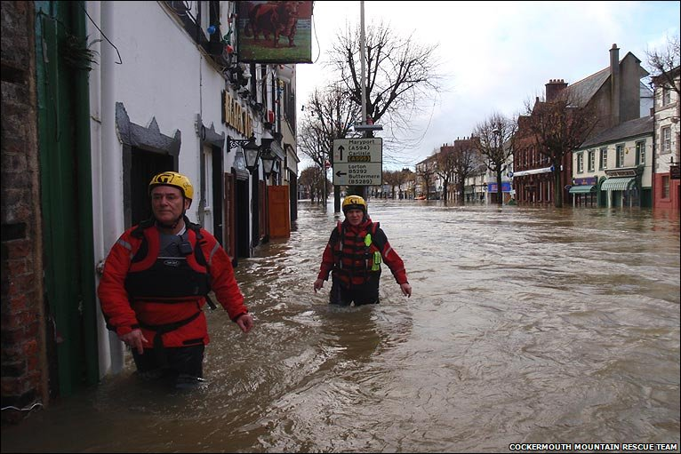
Environmental Impacts
Smarter and more sustainable Urban Development Planning
Better support for Climate Change Adaptation and Mitigation
    Drainage and irrigation maintenance
    Improved flood prediction
Reduced Air and Water Pollution

Slide 19
Qualitative Benefits
Not every benefit is easily quantifiable:
  Quality of Life
  Gender equality
  Reputation
  Legacy: how you leave the planet for subsequent generations
Many such benefits are referred to non-market benefits
  They can’t be bought and sold
They should be documented as fully as those that can be quantified.
Investment decisions are more often made for political than economic reasons

Slide 20
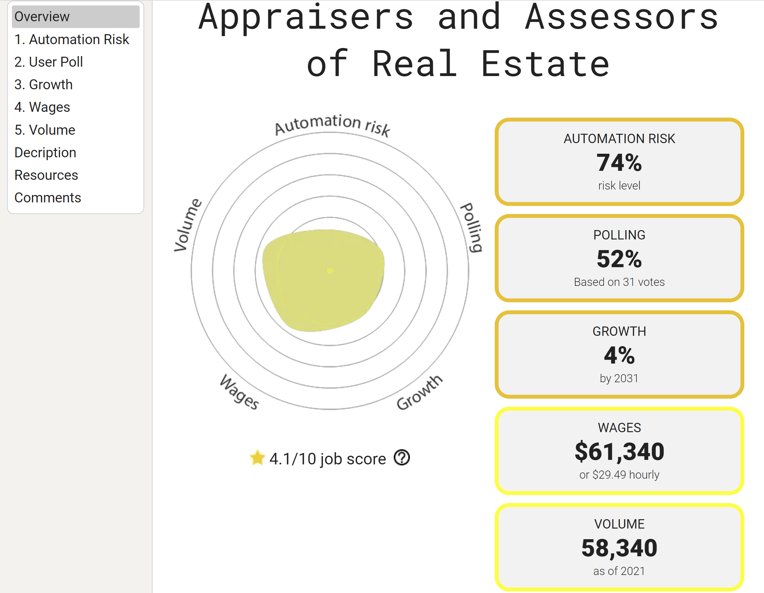
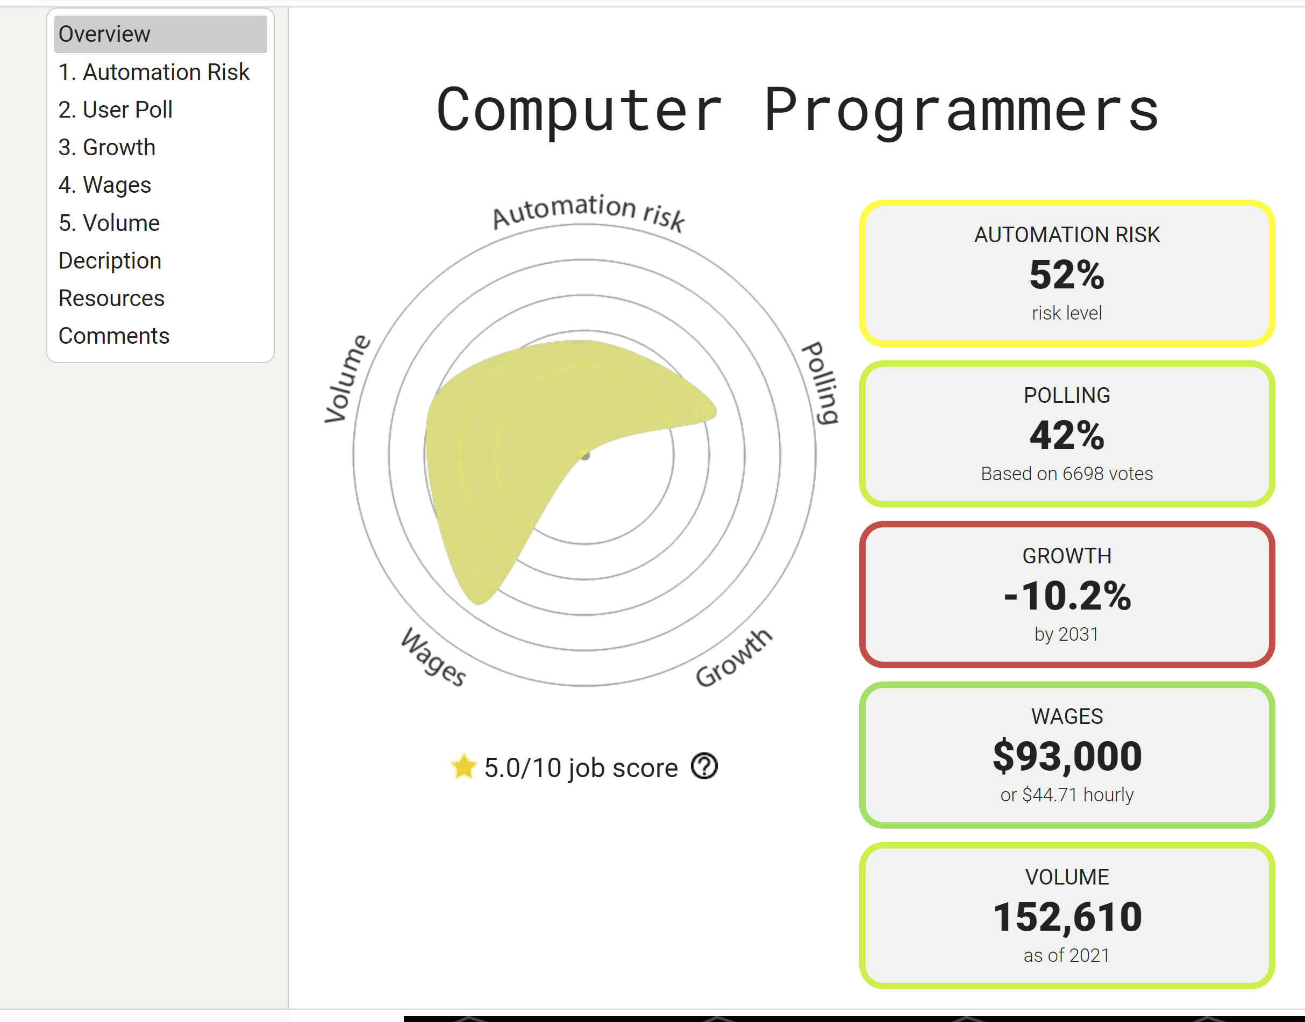
Will Robots Take My Job?

Slide 21
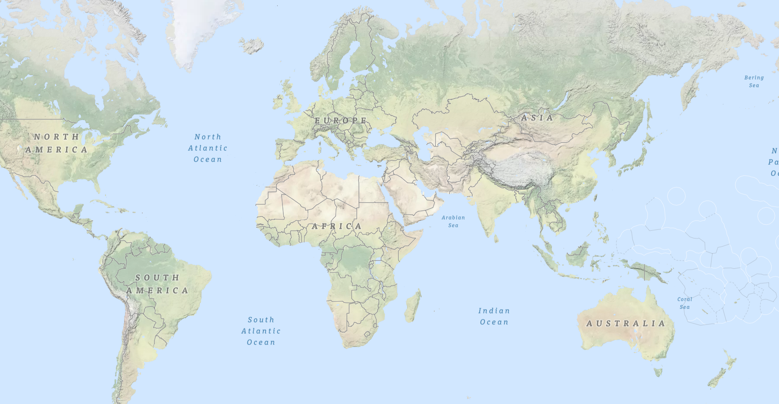






Implementations using WB IGIF Methodology
Moldova
Ukraine
Germany
Kyrgyzstan
Georgia
Mongolia
Nicaragua
Jersey
Egypt
Serbia
Philippines
Senegal
Vietnam
Cambodia
Liberia
Colombia
Guyana
Seychelles
Source: World Bank

Slide 22
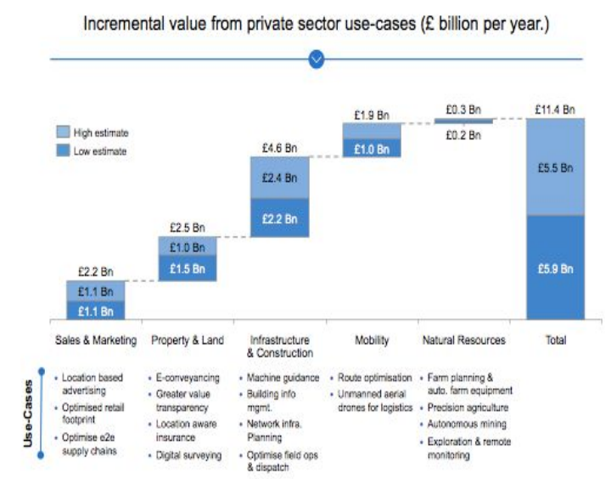
Private Sector Value Drivers
Source:https://assets.publishing.service.gov.uk/government/uploads/system/uploads/attachment_data/file/733864/Initial_Analysis_of_the_Potential_Geospatial_Economic_Opportunity.pdf
Notes:
The UK Government geospatial oversight body, the Geospatial Commission, has produced estimates of what they describe as the “unlocks” to the economy of geospatial.
For the private sector this identifies a series of use cases across five industries, including land and property, infrastructure, mobility and agriculture.

Slide 23
Messages for Decision Makers
Better Geospatial Infrastructure can:
Locate those in the world being left furthest behind
Provide the evidence-base for critical decision making
Identify inequalities and measures to address them
Save lives and reduce costs of damage by improving disaster risk management
Realised provable savings from collaboration
Provide compelling evidence of the value of investment
The ability to create new jobs
AND help to save the planet
Notes:
And we can add many other messages.
Two particular areas not covered directly today are:
the ability to create new ICT jobs
and perhaps most importantly, geospatial can (and is) helping to save the planet.

