Slide 1
Rachael Umazi, Principal Surveyor
RCMRD

Slide 2
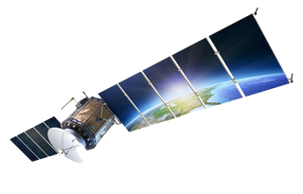
RCMRD
01
About Us
Establishment, Mission and Vision, Member States and Core Mandate.
Thematic Areas: Projects at RCMRD
02
GMES and Africa, BIOPAMA, AGRA, OFESA, DEA, NELGA.
03
Capacity Development
Professional courses, Technical courses, Conferences
04
Knowledge Management
Data access and Sharing, Apps portal.

Slide 3
About Us: Establishment
1975

Slide 4
About Us
To be a Premier Centre of Excellence in the provision of geo-information and allied technologies for sustainable development in the member States and other stakeholders.
To strengthen the member States and our stakeholders’ capacity through Generation, Application and Dissemination of Geo-information and Allied Technologies for sustainable development.

Slide 5
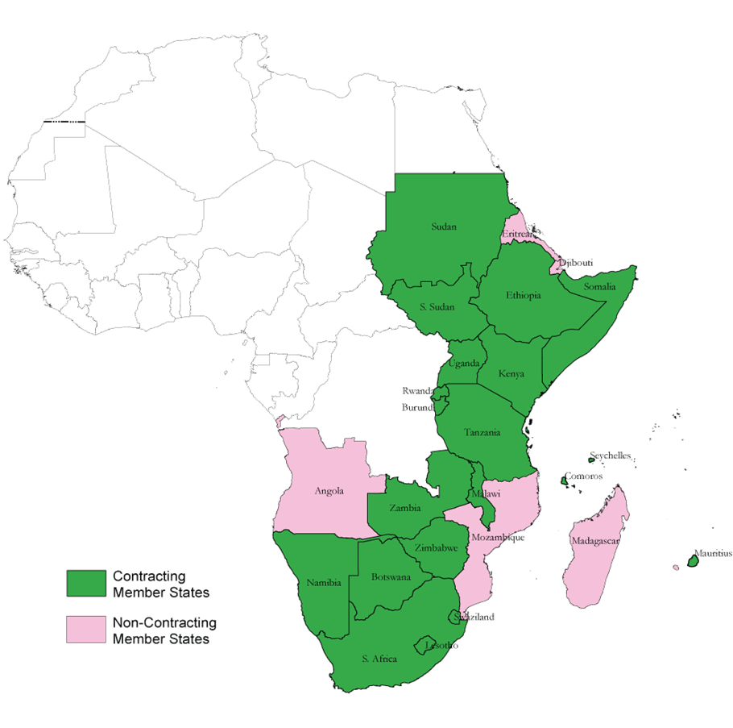
Member States.
BOTSWANA, BURUNDI, COMOROS, ESWATINI, ETHIOPIA, LESOTHO, KENYA, MALAWI, MAURITIUS,NAMIBIA RWANDA, SEYCHELLES, SOMALIA, SOUTH AFRICA, SOUTH SUDAN, SUDAN, TANZANIA, UGANDA, ZAMBIA, AND ZIMBAMBWE

Slide 6
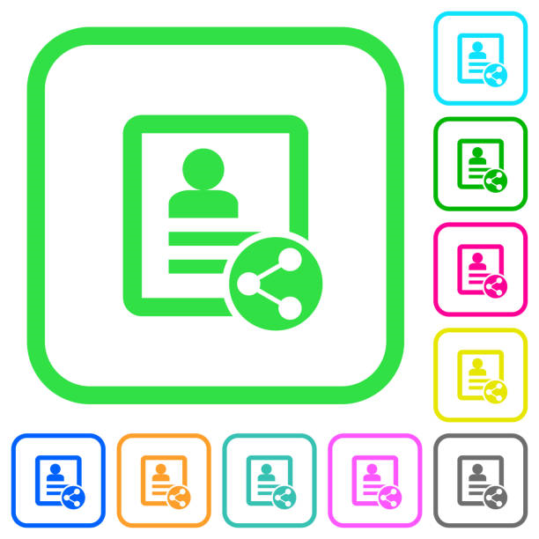
Core Mandate
Capacity Development
Advisory Services
A
Data and Information
Dissemination
Project Implementation
Servicing and Calibration of Mapping Equipment
Research and Development

Slide 7
THEMATIC AREAS
AGRICULTURE AND FOOD SECURITY
LAND ADMINISTRATION AND MANAGEMENT
WEATHER AND CLIMATE
WATER AND WATER RELATED DISASTERS
KNOWLEDGE MANAGEMENT

Slide 9
Capacity Development
Technical Diploma Courses
Diploma in Land Surveying
Diploma in Cartography and GIS
Diploma in Photogrammetry and Remote Sensing
Diploma/ Certificate in Information Technology
Professional & Short Courses
Introduction to Earth Observation (Remote Sensing- RS)/ Digital Image Processing
Open Source Tools Data and Applications
Introduction to Geographic Information System (GIS)
Introduction to Digital Cartography & GIS Mapping
Radar & Lidar Remote Sensing
Applied Remote Sensing & GIS
Mobile GIS
CAD Drawings (AutoCAD Civil 3D)
Digital Photogrammetric Mapping and Terrain Modeling
Global Navigation Satellite Systems (GNSS) Technologies for Precise Applications
Continuously Operating Reference Stations (CORS)
Global Positioning System and Mobile Mapping for General Applications
Land Information Management Systems
Level Use and Applications
Service, Repair & Adjustment of Opti-Mechanical Surveying Instruments
Total Station, Use and Applications
Tailor-made courses
Based on user-specific needs,
Project Implementation (Training components)
Conferences and workshops: RCMRD International Conference, AFREF and GNSS workshop)
Research and development: Support curriculum development, Student project supervision, and assessments
Youth Mentorship Programs: (KUZA, Boot camps, industrial attachment and internships
Technical Certificate Course
International Computer Driving License (ICDL)
Graphic Design
Web Design, Dreamweaver, MS flash, JavaScript
Programming
It Security and Cyber Crime
Data Analysis and Statistical Packages
Project Management
Accounting Packages; Quick Books, Sage, Pastel
Computer Repair and Maintenance
Digital Skills for Managers
Certificate In Information Technology
Certificate In Land Surveying

Slide 10
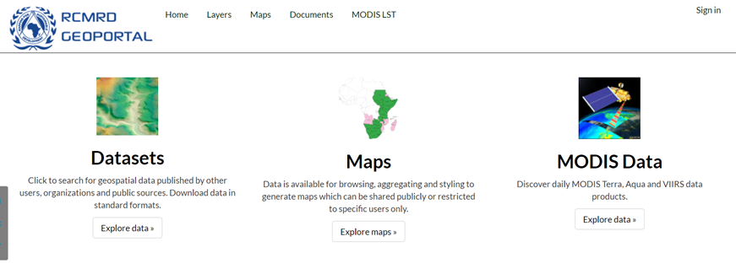
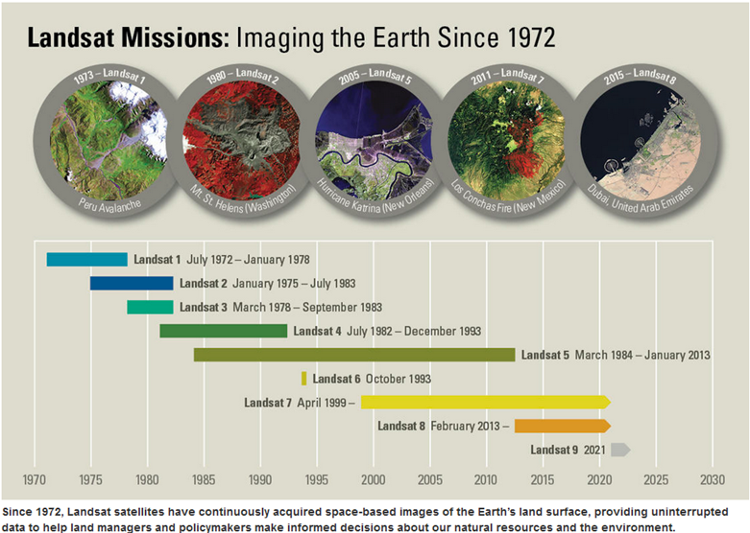
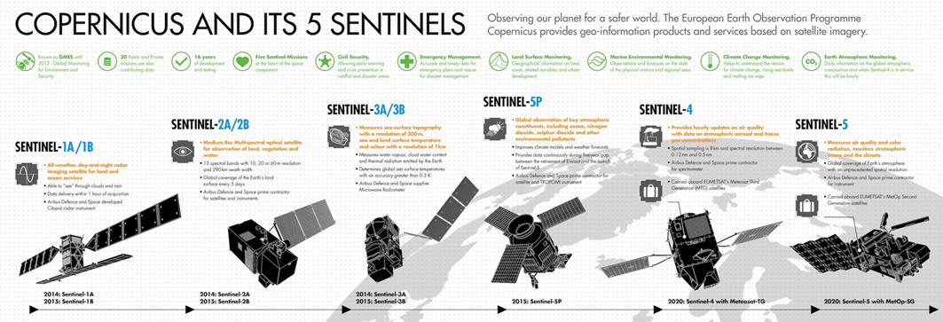
Data and Information Management

Slide 11
Thank You

