Slide 1
Border Governance: GIZ support to the African Union Border Programme
Ninth Meeting of the United Nations Global Geospatial Information Management for Africa (UN-GGIM: Africa)
Yannick Le Gléau | 16 August 2023

Slide 2
Quick introduction…
Yannick Le Gléau
Working for GIZ, the German International Cooperation
… But French by nationality
Worked for 13 years in different African Countries. All my working experiences were related to geospatial information management for international development projects
Urban Planning, Establishment of Land Information System, National topographic Mapping, Geologic cartography…
Lived in Mauritania (5 years), Mali (3 years), Tanzania (2 years), Congo-Brazzaville (6 months) and now Ethiopia (since 2021)
Pure product from the French Mapping Agency (IGN).
Training at the French National School of Geographic Sciences (ENSG)
Worked for 5 years with IGN-FI
Proud to have joined GIZ and the border community since 2 years and a half !
Contact
Yannick.legleau@giz.de
+33 6 62 53 69 48 (WhatsApp)

Slide 3
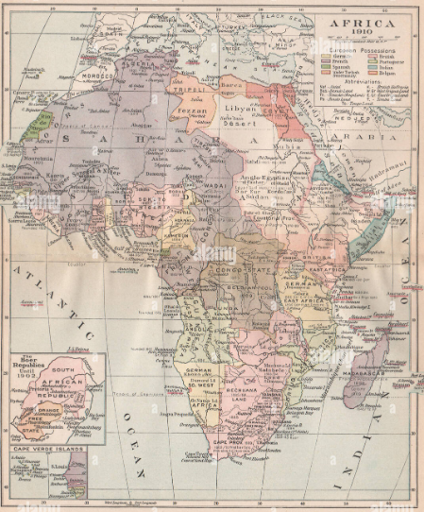
History of the African borders
Since always: African countries and empires have existed without the “Westphalian” borders principle
1440 –1884 : European trade posts along the African coast
1884/5: Berlin conference
1964 Cairo Declaration – intangibility of borders
2007 Declaration of AUBP by the Conference of African Ministers in charge of border issues in Addis Ababa
2008 Start of German Support
2027 Extended deadline

Slide 4
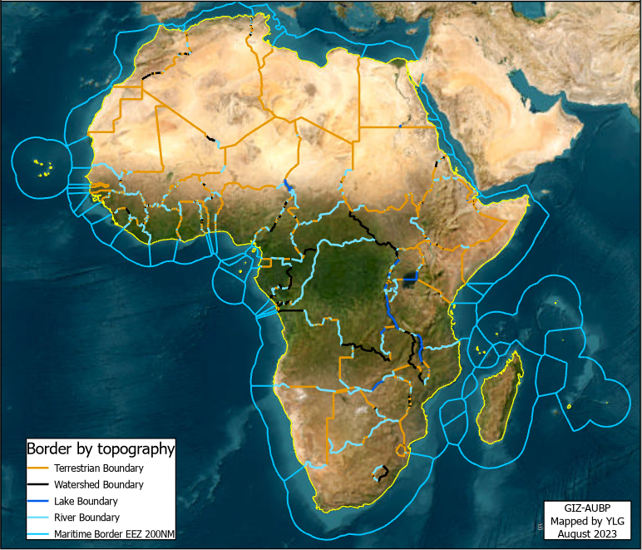
Description of African boundaries
Continental (non-maritime) borders are around 80 000 km long
55 000 km dry-land
22 000 km of river boundaries
3 000 km of lake boundaries
43% geometrical: straight / equidistant lines, arcs
33% rivers and lakes
13% watershed lines
11% other (Foucher, 1991)
Maritime boundaries : around 64,000 km

Slide 5
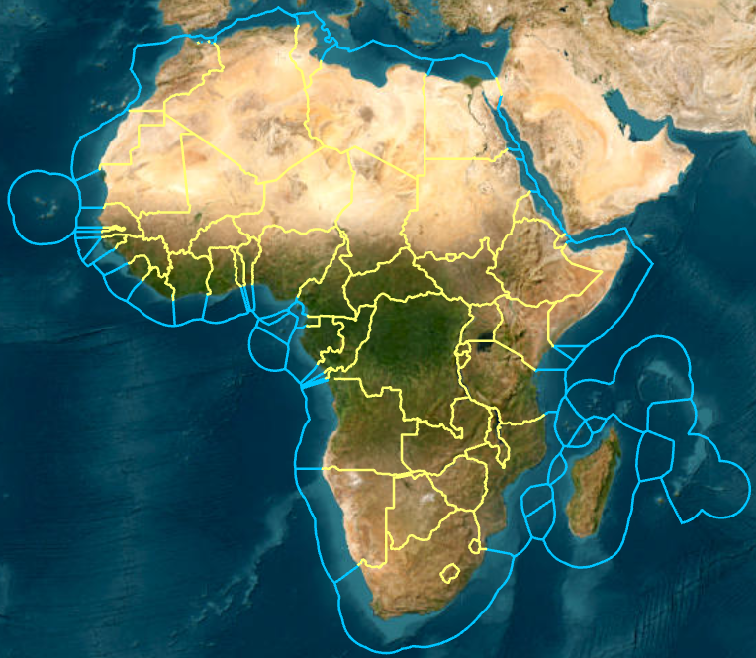
Why borders matter ?
In 2010, a study shown that only a third of the African borders are properly defined.
OECD led a study ‘Borders and Conflicts in North and West Africa’ which demonstrates the link between the probability of an armed conflict occurring and its distance from the border
Poorly defined borders are a potential source of conflict
African borders have a significant impact on peace and stability on the African continent.

Slide 6
Threats related to ill-defined borders
Land issues
Local communities separated
Tax collection
Tension between states
Regional proliferation
Natural ressources ownership
Access to social services
Migration
Free-trade

Slide 7
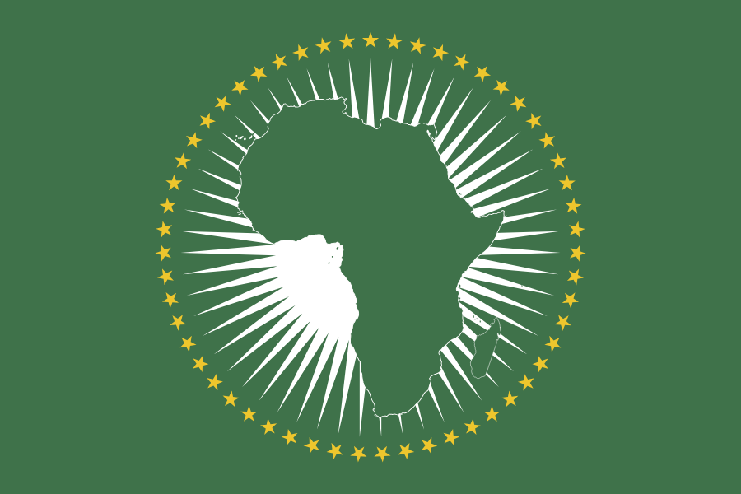
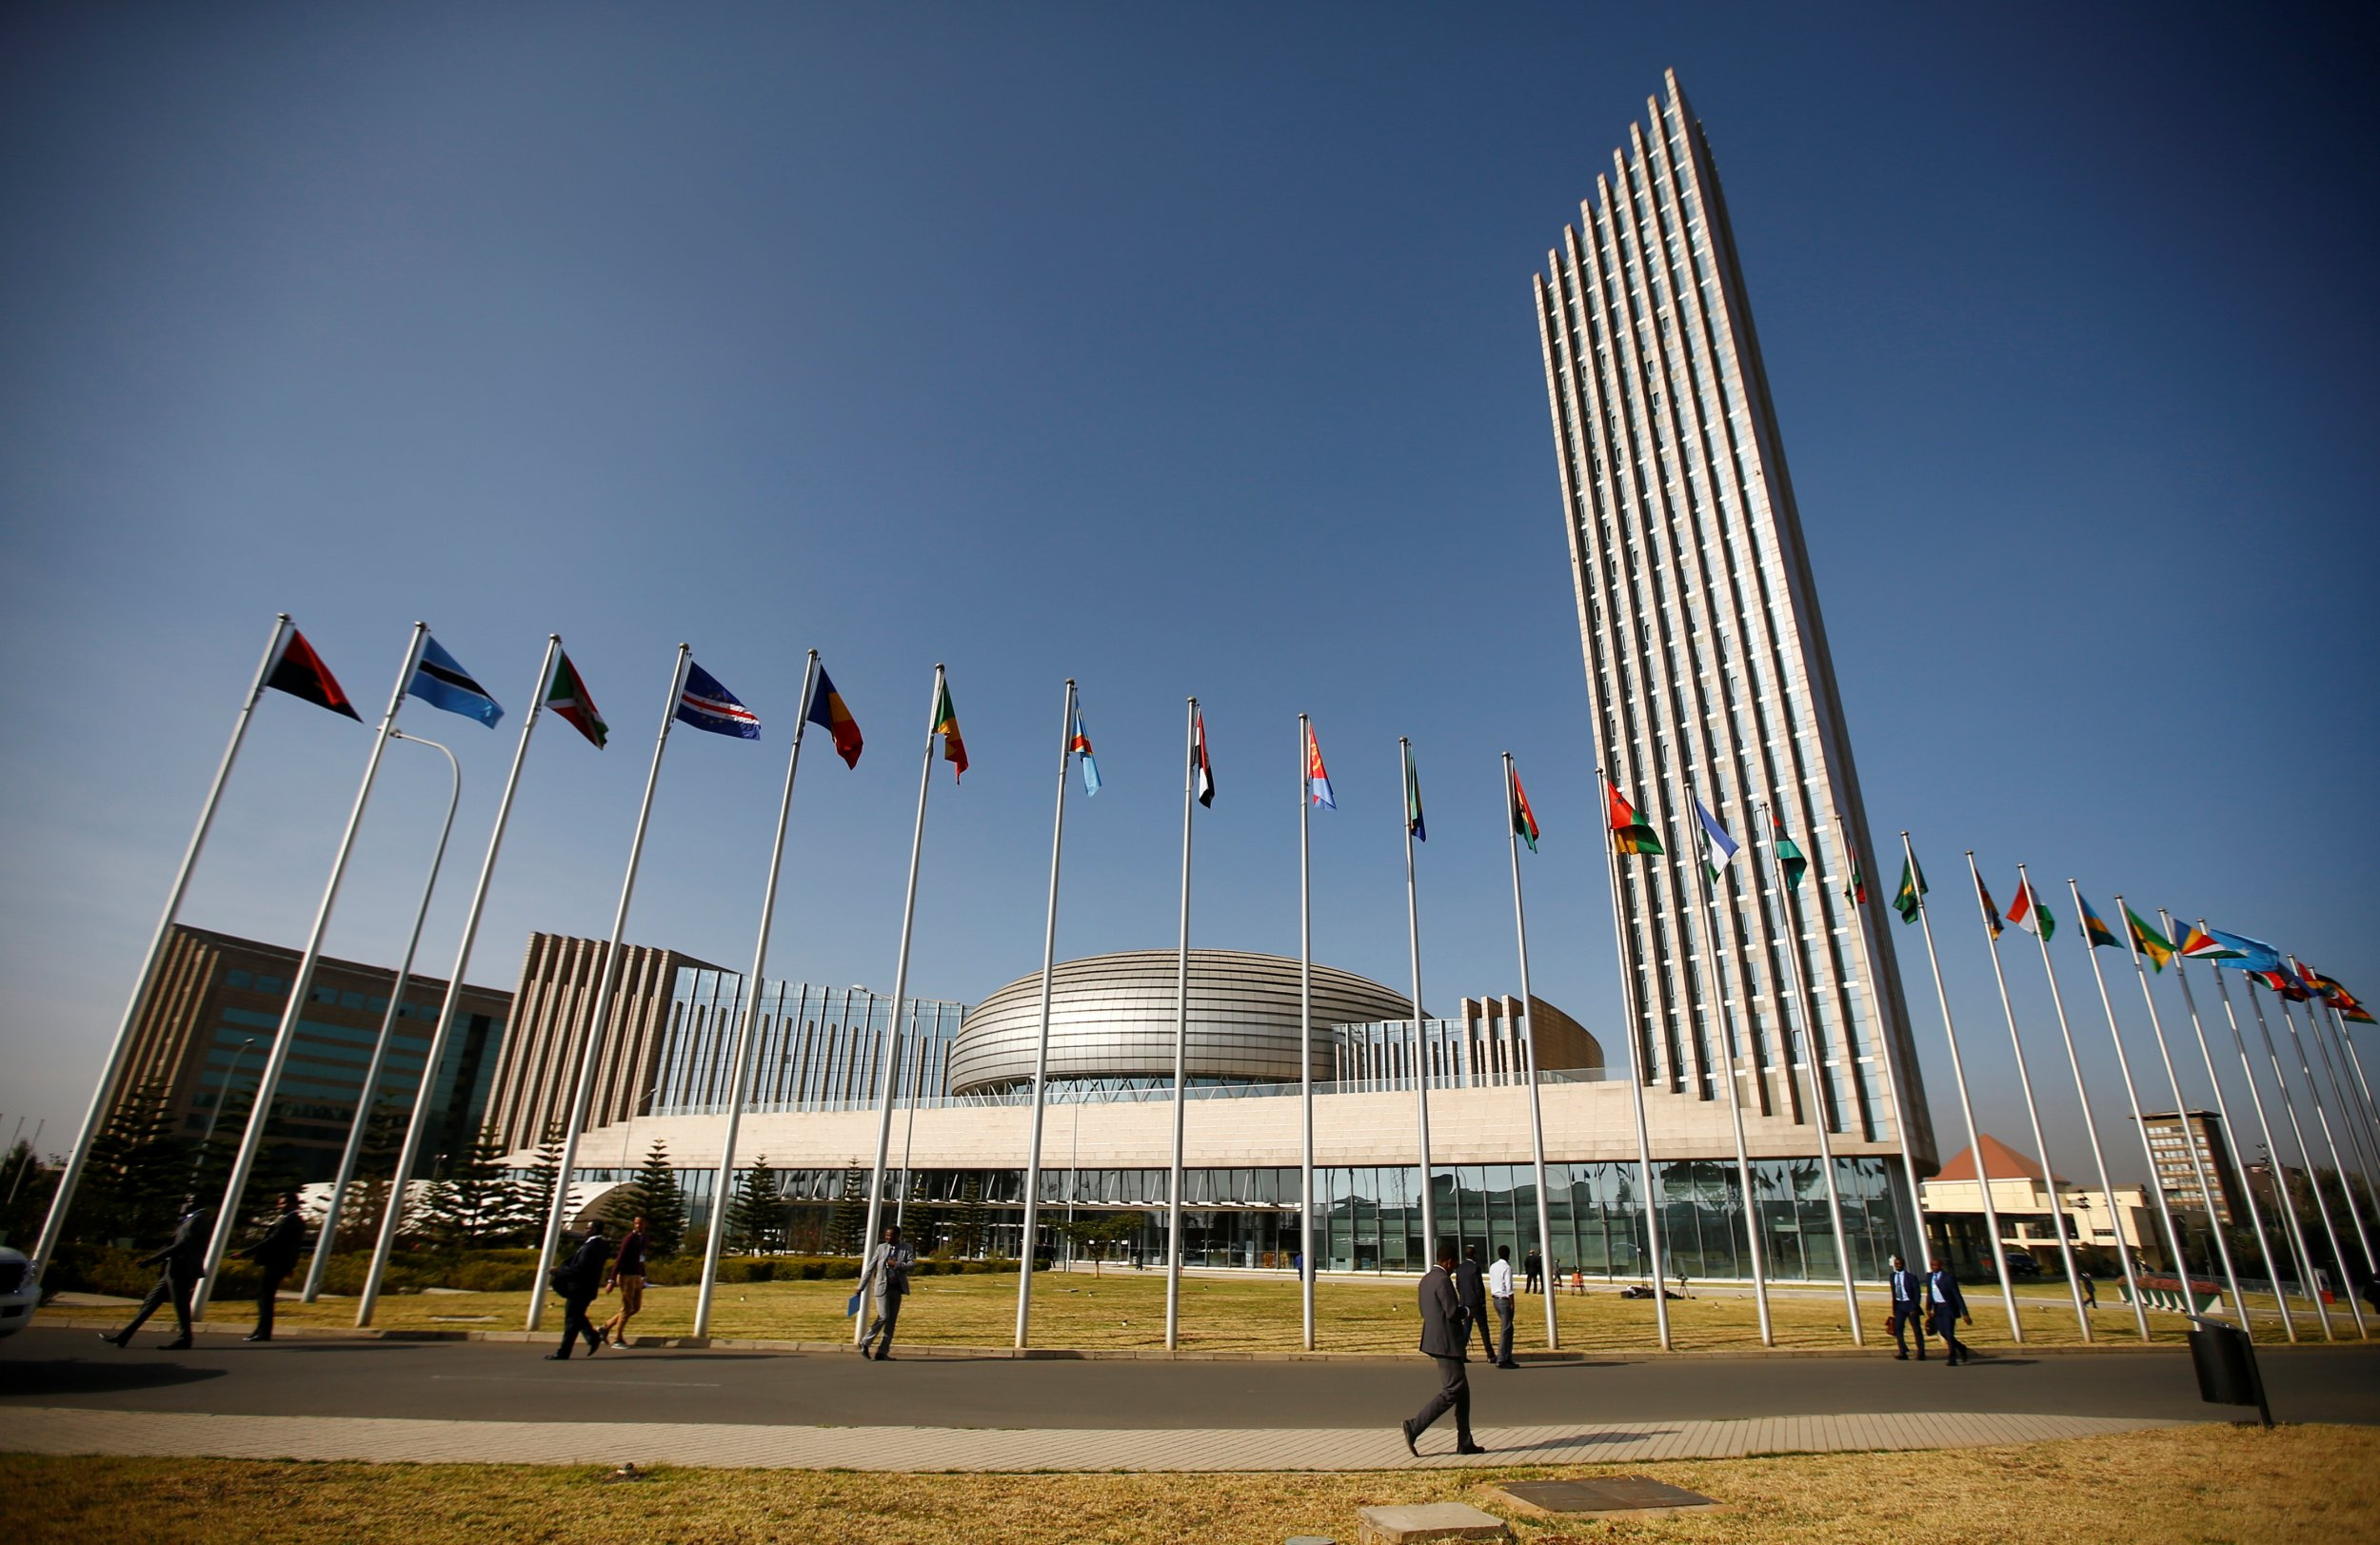
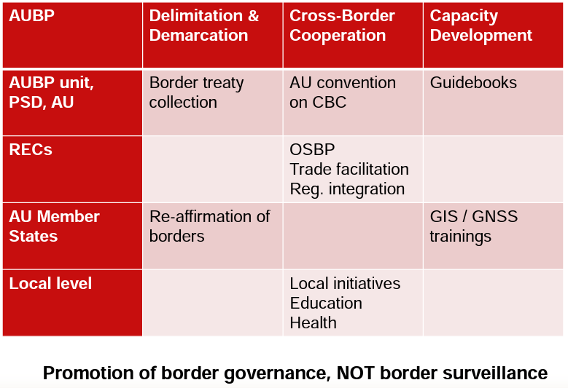
AUBP overview
The African Union considers ill-defined borders as potential sources of conflict, especially when natural resources are discovered in the border regions. Such borders are a threat to peace and security, and they hinder regional integration, economic growth and development.
In 2007, the AU launched the African Union Border Programme (AUBP) as a direct response to these risks. Clearly defined, internationally recognised and locally accepted state borders are therefore considered to be an important basis for conflict prevention.

Slide 8
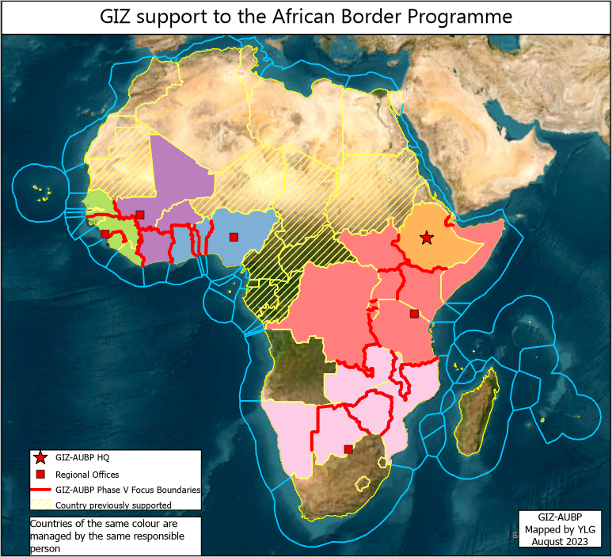
GIZ support to AUBP
GIZ support the African Union Border Programme since 2008
A coordination team in Addis Ababa works closely with the Commission of the African Union.
Colleagues in various countries support the implementation of the AUBP on the regional (RECs), national (MS) and local levels (Crossborder communities).
Motto :
From Barriers to Bridges

Slide 9
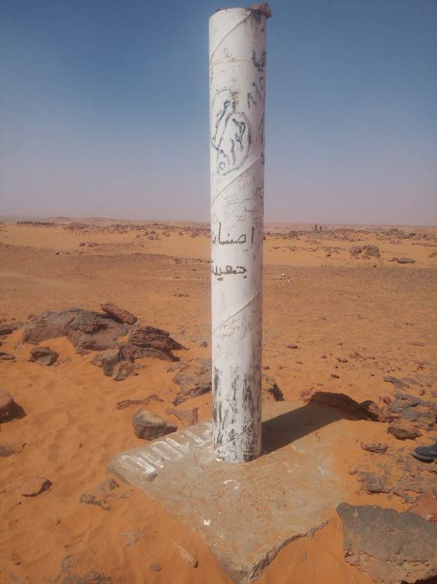
Focus on the delimitation-demarcation component
Delimitation and demarcation
Member States use improved technical and planning capabilities for the common definition of borders
Advice on the preparation and implementation of Delimitation and Demarcation (land, river and maritime boundaries) and Delineation (high seas, continental shelf)
Acquisition and processing of geodata and support for complex software, land, satellite and airborne survey processes

Slide 10
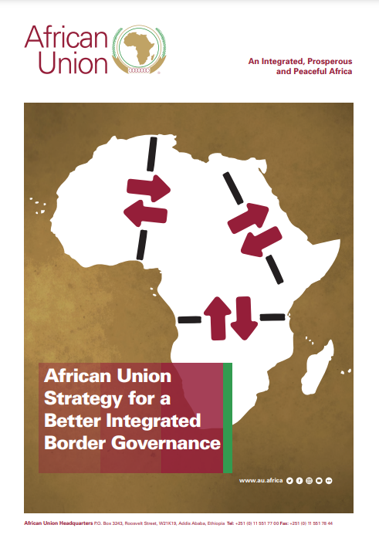
African Union Border Governance Strategy
Adopted in 2020 by the African Union Commission
Roadmap and guidance for better integrated border governance
Development of Capabilities for Border Governance
Conflict Prevention and Resolution, Border Security & Transnational Threats
Mobility, Migration & Trade Facilitation
Cooperative Border Management
Borderland Development and Community Engagement

Slide 11
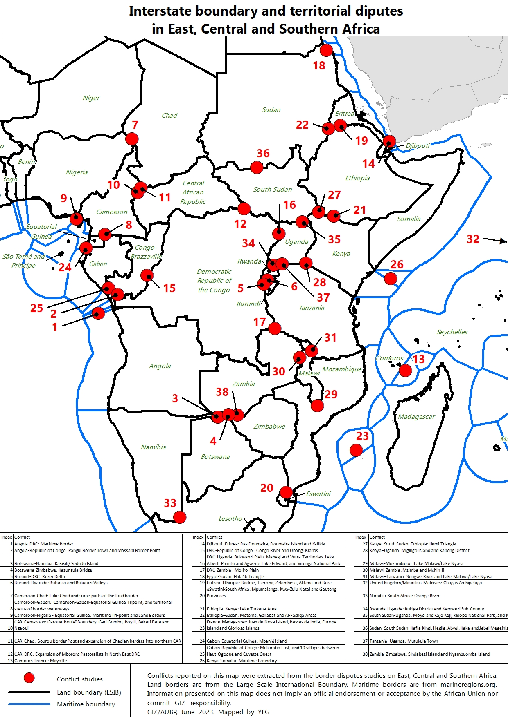
Conflict studies
AUBP, GIZ, the involved RECS and Member States commit to prepare regional studies on Interstate boudary and territorial disputes.
Study finalized and validated for East and Horn of Africa
Study finalized but not validated yet for Southern Africa
Study finalized but not validated yet for Central Africa
Study to be conducted for Western Africa
Without taking into consideration Western and Northern Africa, the studies reported 38 border conflicts.
Around 65 borders conflicts active or latent (depending on the definition we give to a border conflict).
This studies allows to have a deeper understanding of the different border disputes across Africa and provide guidances on priorities for AU and GIZ.

Slide 12
Usual demarcation process
Best case scenario
Joint decision by country A + country B to demarcate their border
(opt.) joint request for support to AUBP
Setting up of a joint boundary commission
Tracking of existing treaties and other legal documents
Analysis and evaluation of treaties, new supersedes old
Delimitation: agreeing on the boundary line
(opt.) delimitation treaty
Demarcation on the ground, surveying, (opt.) mapping
Demarcation treaty

Slide 13
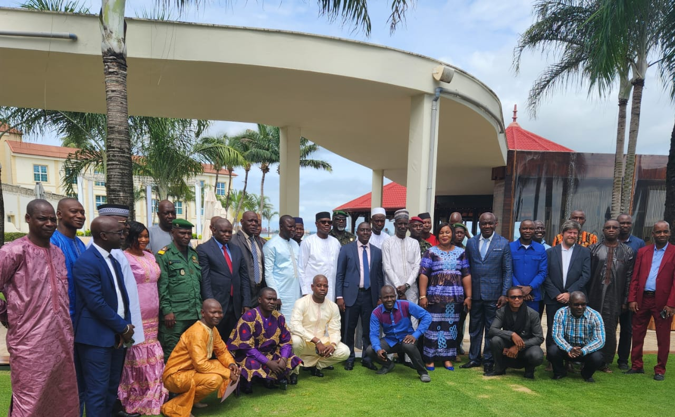
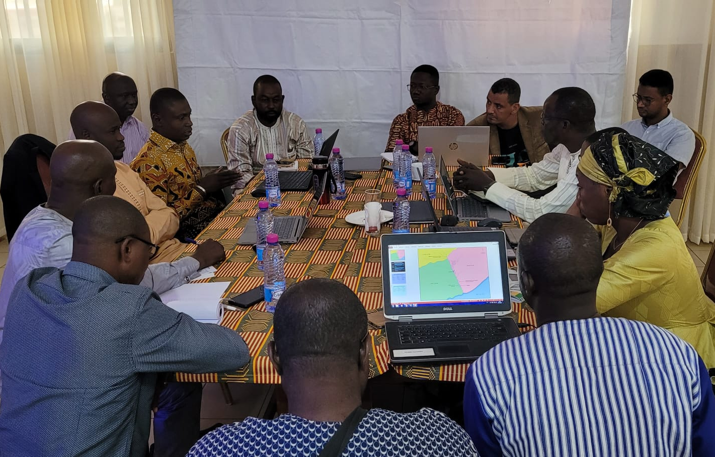
Confidence building
Support to bilateral meetings for the Joint Border Commisions

Slide 14
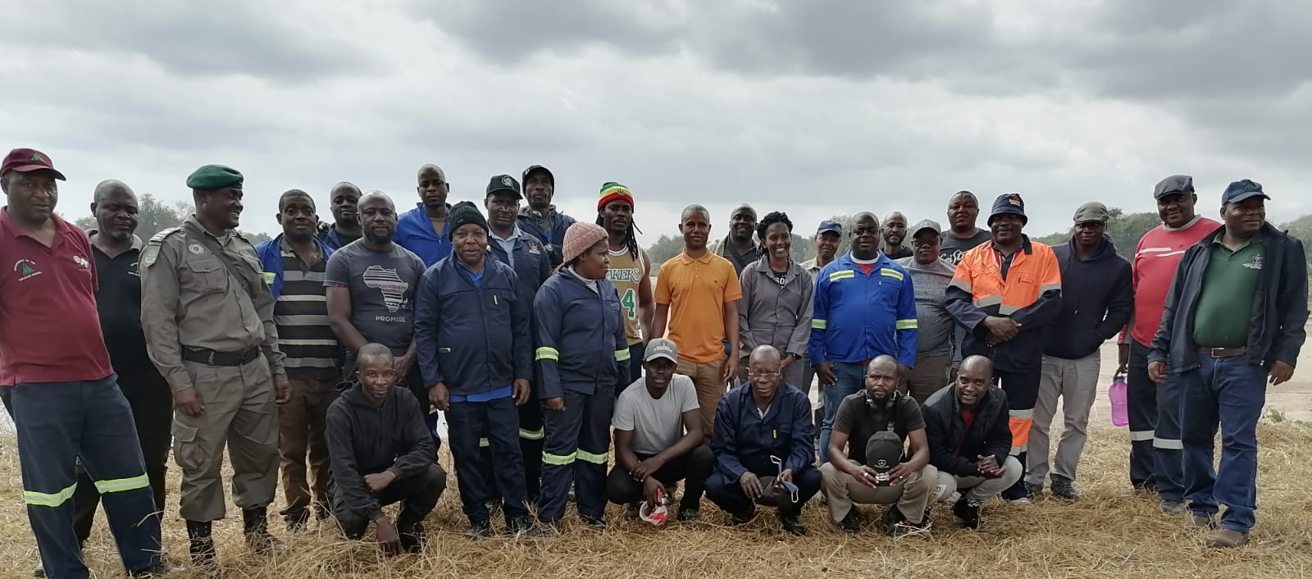
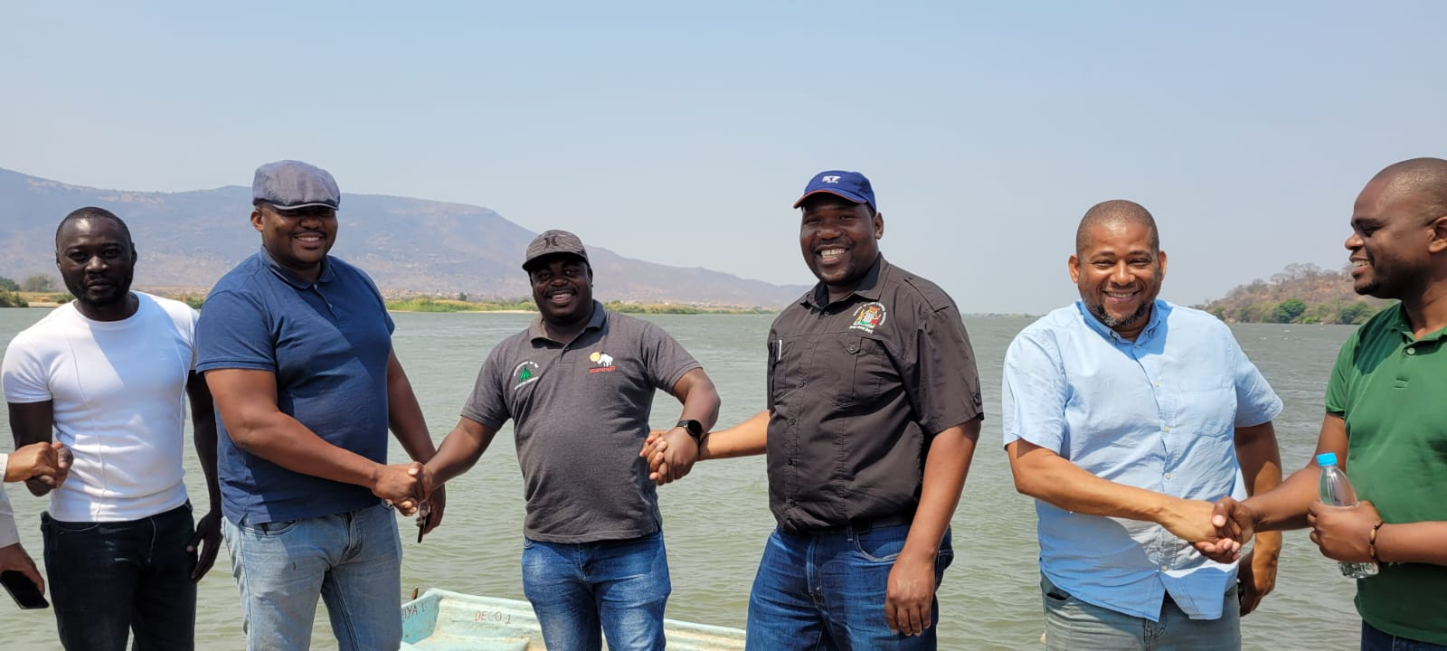
Support to recognition field work

Slide 15
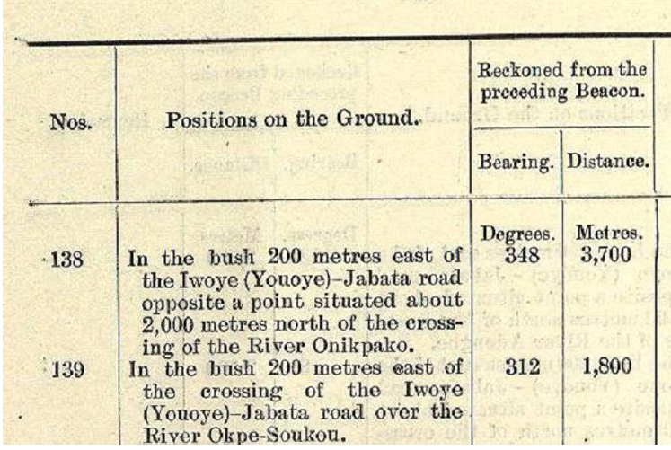
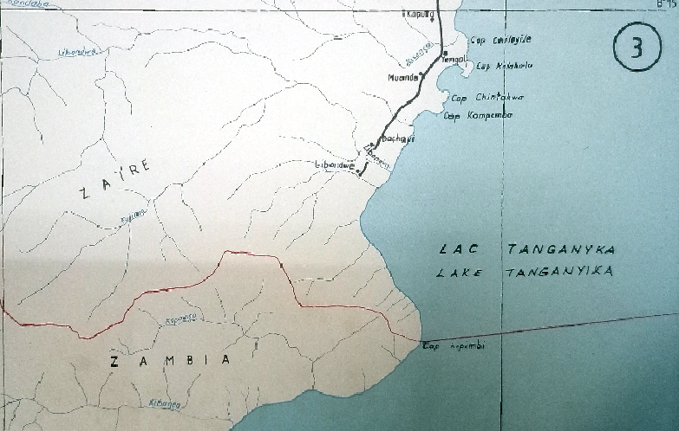
Collection of treaties
Support to the treaty collection
Support to analyse the treaties

Slide 16
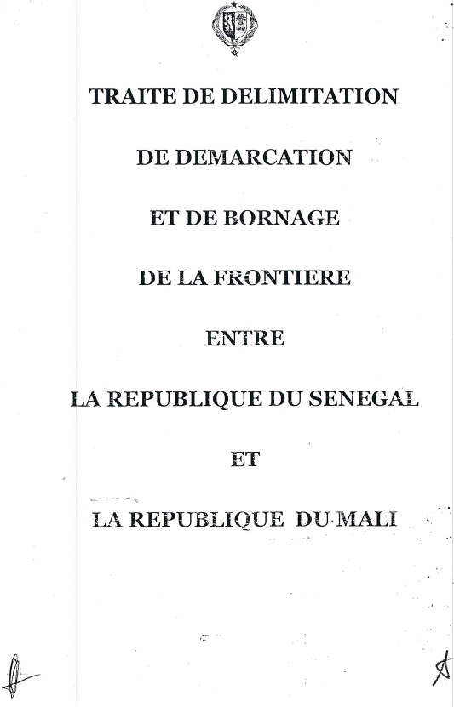
Support to new treaty drafting
Support to draft new treaties
Why do we think it’s important ?
Colonial border treaties are often outdated
They describe in vague terms where the border runs
The topography of many borders has changed during the 60 last years, many border beacons have been destroyed
Make ajustement on the border defined at the colonial time to take into consideration reality on the ground
Domestication of the borders, take full responsibilty of the agreed border

Slide 17
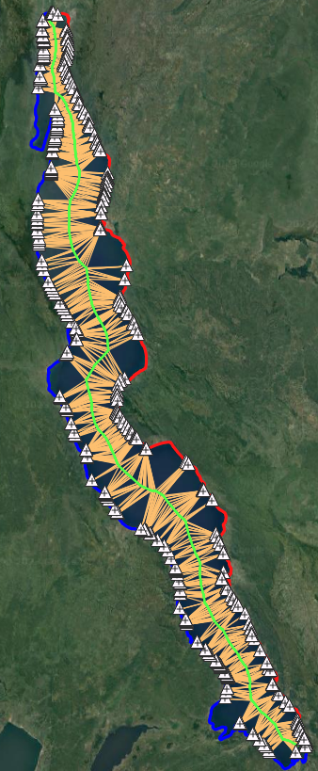
Median line calculation tool
Prepared for Lake Tanganyika median line calculation
Runs on QGIS : no licence required.
Based on Voronoï diagrams
Allow to calculate the median line thanks to the digitalization of the shoreline
Only problems
Take hours to compute results
Not based on geodetic lines. A few meters difference for large surfaces such as Lake Tanganyika, a few centimeters for rivers
Advantages
Don’t need training
FREE !
Relevant for land-lock countries
Garbage in = garbage out

Slide 18
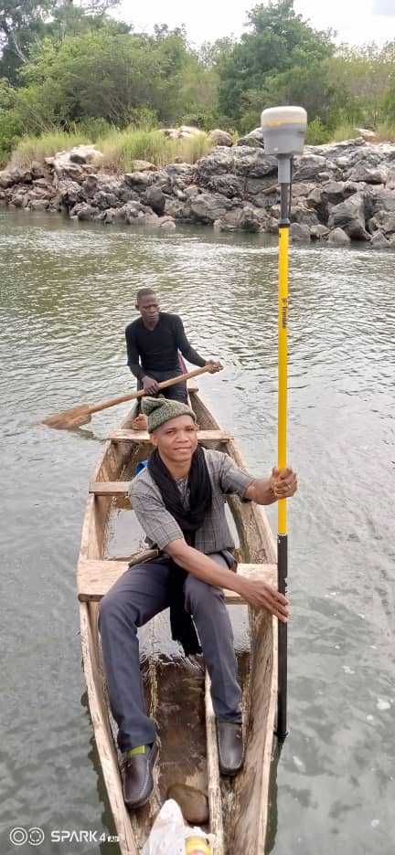
River boundaries : thalweg identification
Benin and Togo fully delimitated their shared border.
Land boudaries (demarcated)
River boundaries
Non-navigable watercourse (median line)
Navigable rivers (thalweg)
Thalweg identification method along River Mono
Identification of the deepest point of the river every 100 m along the rivers (220 km long)
GNSS/RTK technology used
Bathymetric data processed with an in-house geostatistical tools for data processing
Common decision to agree that border coordinates are perpetual

Slide 19
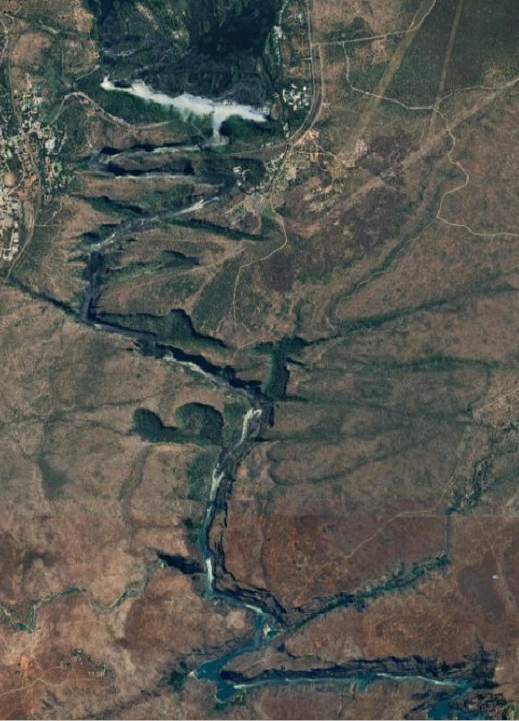
Satellite data acquisition
Possibility to purchase aerial imagery
From satellite
From airborne
From drone

Slide 20
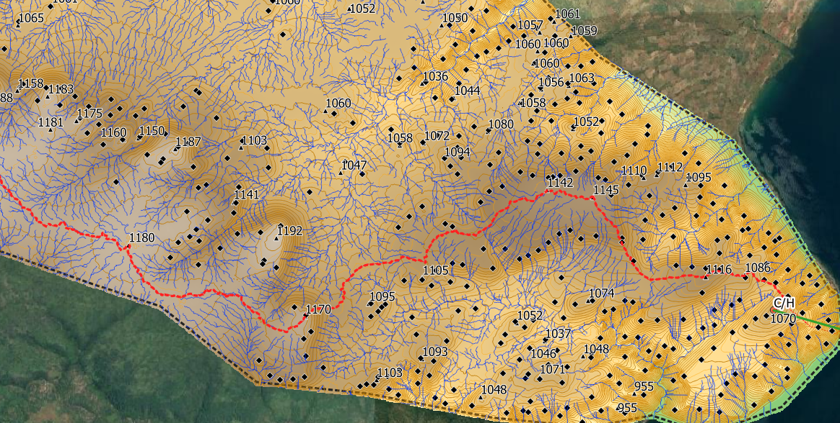
Watershed limit definition
DTM acquisition
Calculation of the ridge line

Slide 21
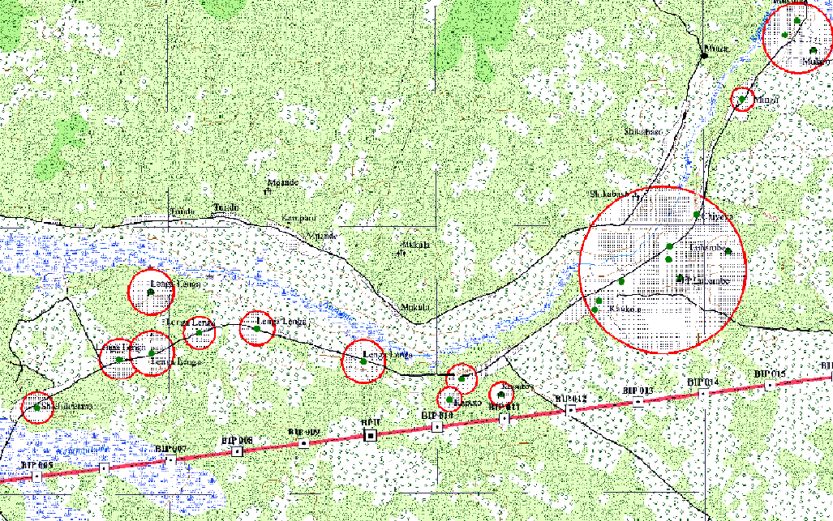
Support to map production
Map production in borderlands
Harmonization of toponyms, inventory of infrastructures
Base for bilateral fruitful discussion

Slide 22
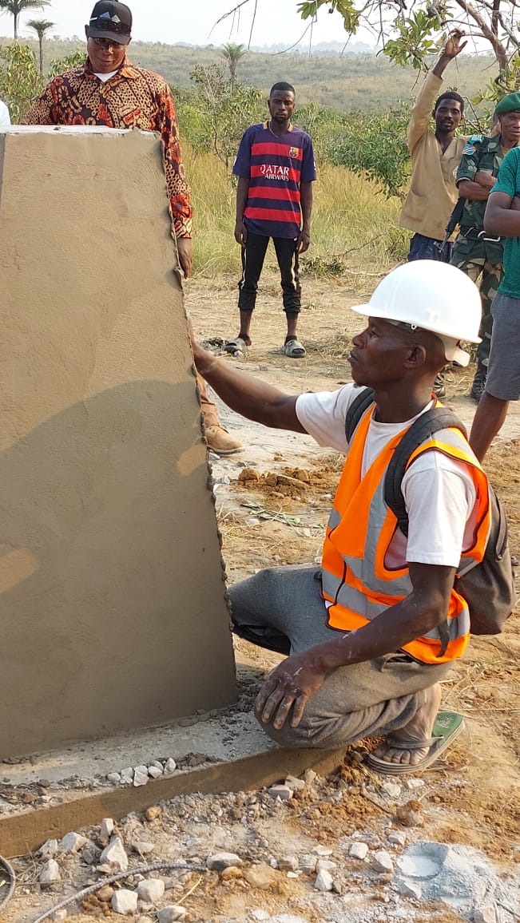
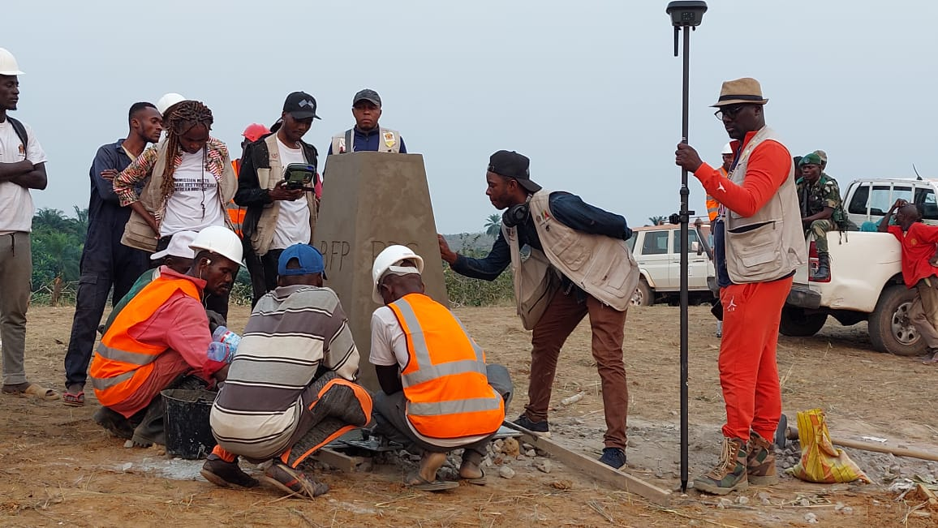
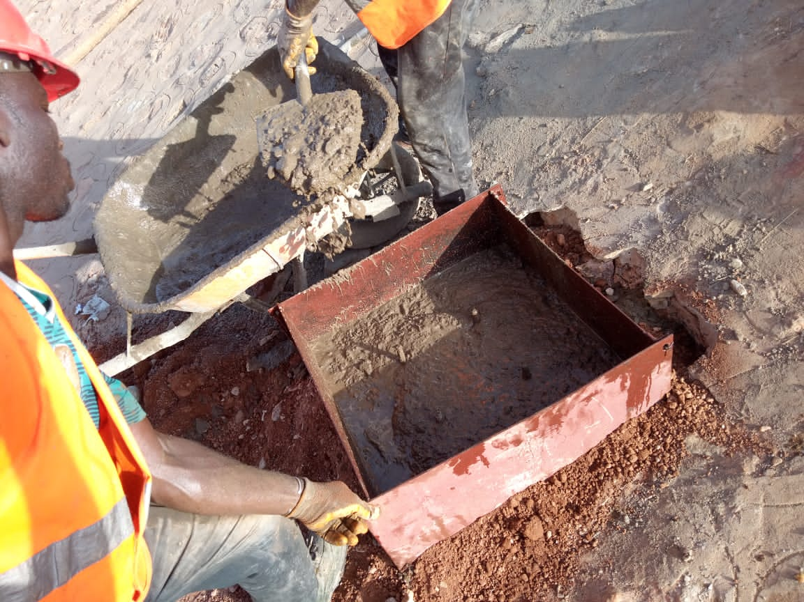
Support to the demarcation process

Slide 23
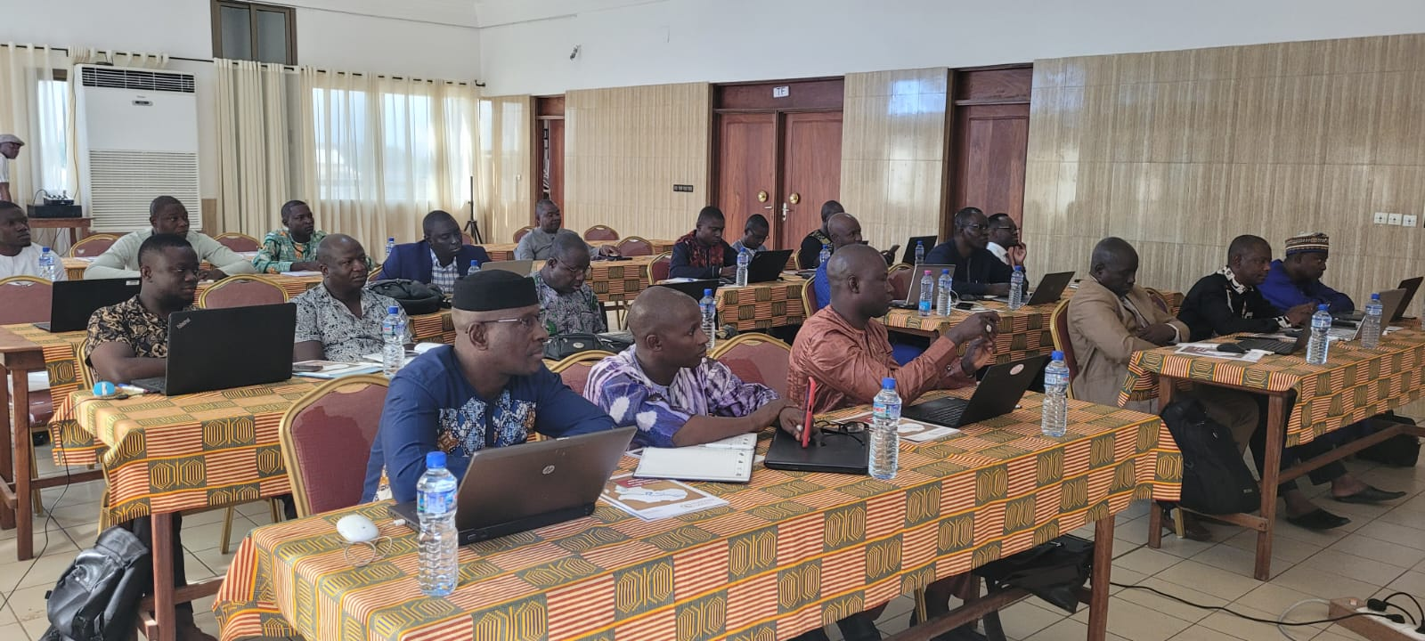
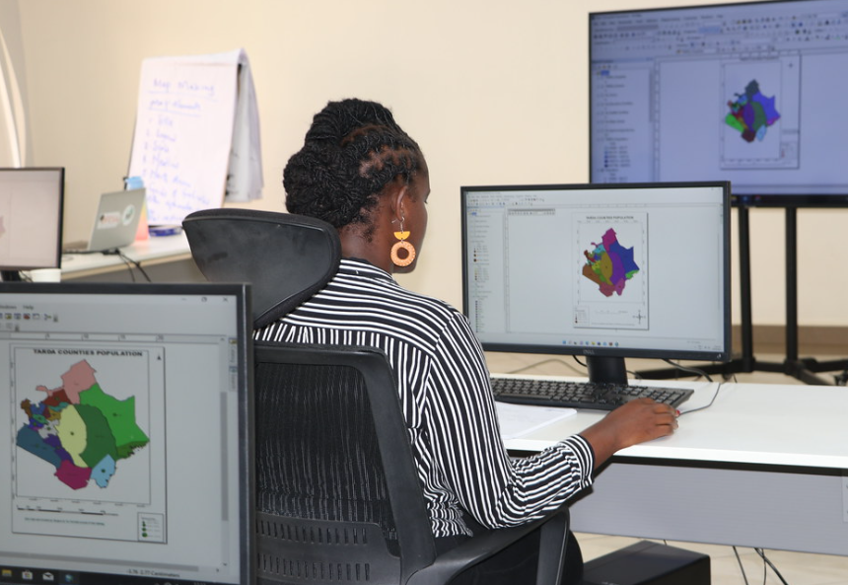
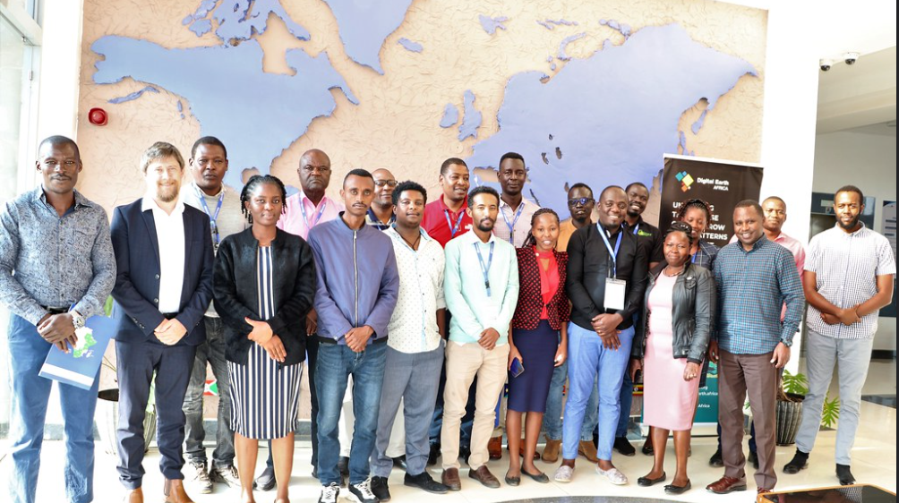
Capacity building

Slide 24
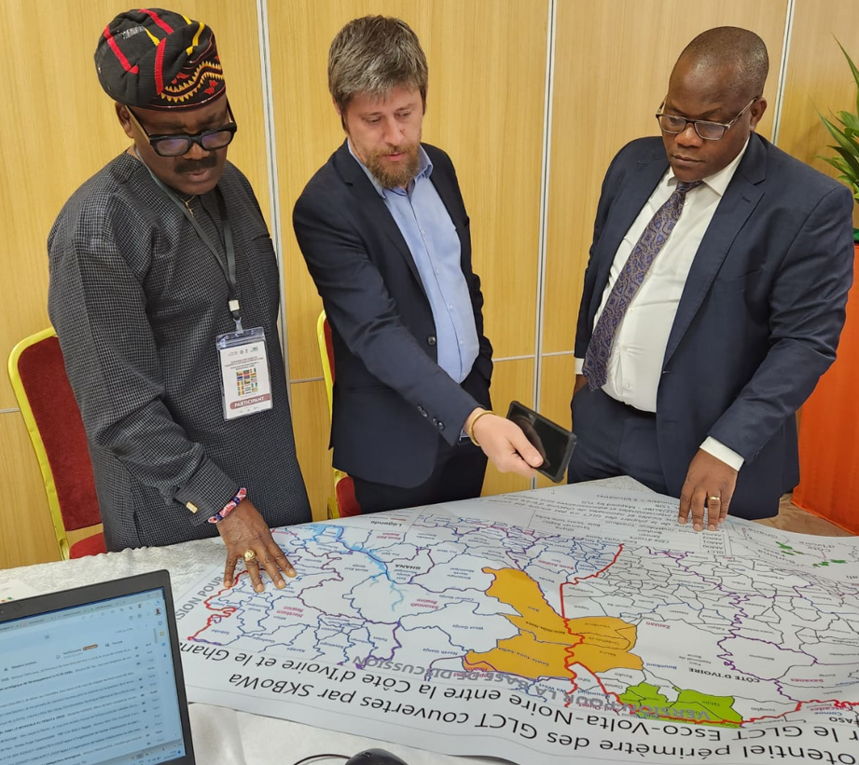
Regional planification workshops
Last one organized last June in Abidjan for Western African Countries (with UEMOA and ECOWAS)
15 MS attended
A regional planning workshop planned end of August in Tanzania (with EAC and IGAD)
10 MS invited

Slide 25
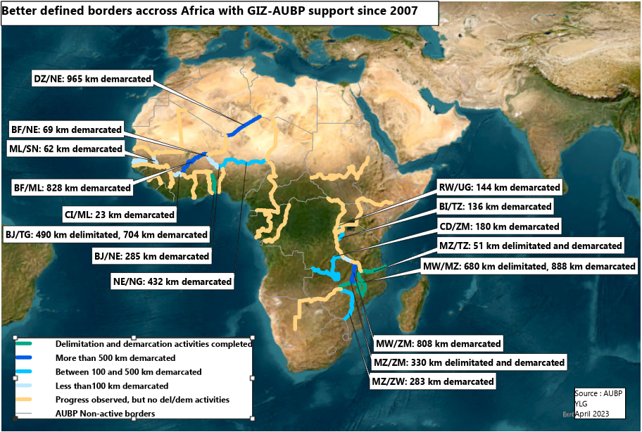
Achievements
More than 7 000 kilometers of borders across Africa are better defined thanks to AUBP and GIZ support
Adoption of the African Union Strategy for a Better Integrated Border Governance
Adoption of the African Union Convention on Cross-Border Cooperation (Niamey Convention)
African borders are no longer taboo

Slide 26
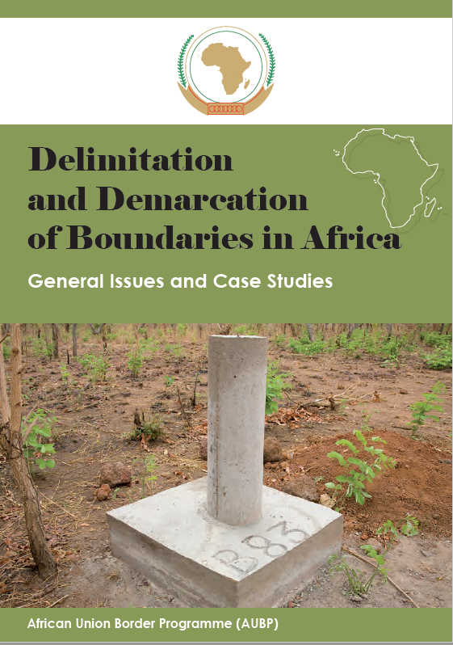
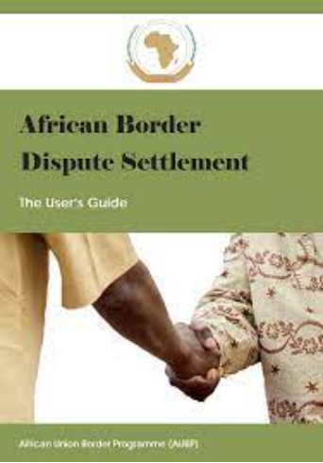
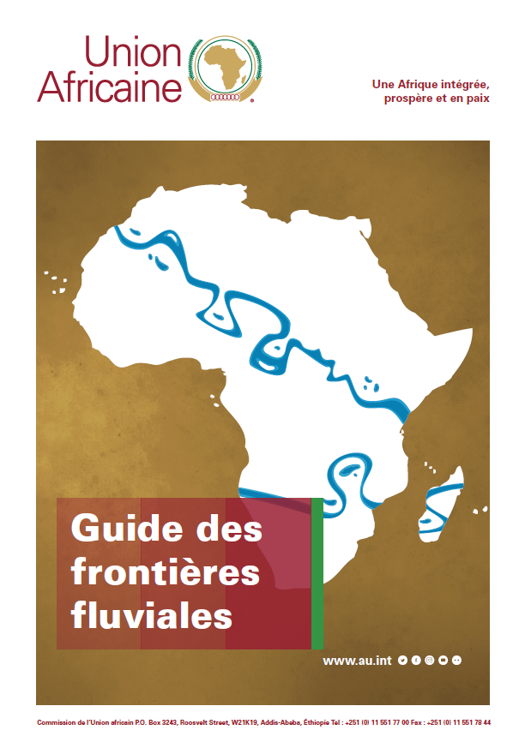
Achievements
8 practical guidebooks
River Boundaries, Establishment of a National Boundary Commission, Delimitation/demarcation good practices, African Border Dispute Settlement…

Slide 27
Perspectives
GIZ-AUBP remains available for any technical or financial support
GIZ-AUBP want to increase partnerships, networking and co-building creation
Promote shared trainings on specific technical topics to be defined
Call for the creation of a technical network of specialists in geospatial information management in the context of border governance
Surveyors, cartographers, geomatician
NBC, Mapping Agencies, international organizations, academic institutions, and non-governmental organizations (NGOs) with relevant expertise
Experience sharing on border delimitation and demarcation
Start with bi-monthly online conference
All experience-sharing will be welcomed
Develop and disseminate best practices, guidelines, and standards for border surveying and mapping

