Slide 1
Welcome to
A business model for sustainable geospatial information financing
Tuesday 15th August 2023

Slide 2
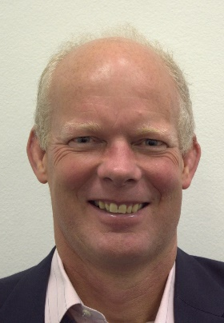
Moderator: John Kedar Director John Kedar Geospatial Initiatives Ltd john@johnkedar.uk +44 7493 917582

Slide 3
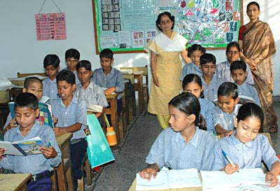
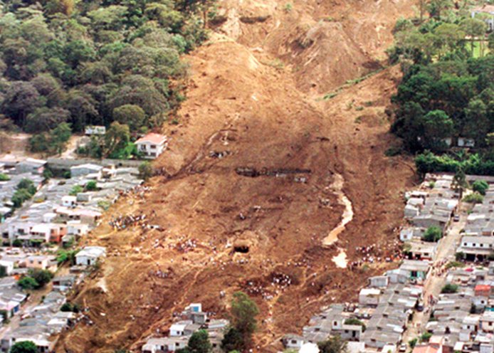
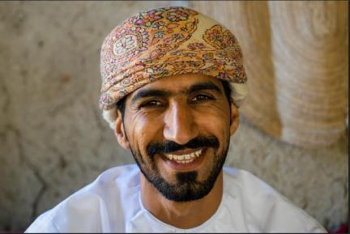
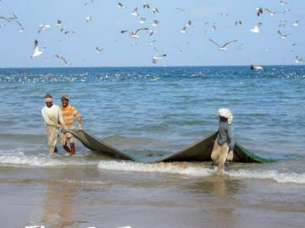
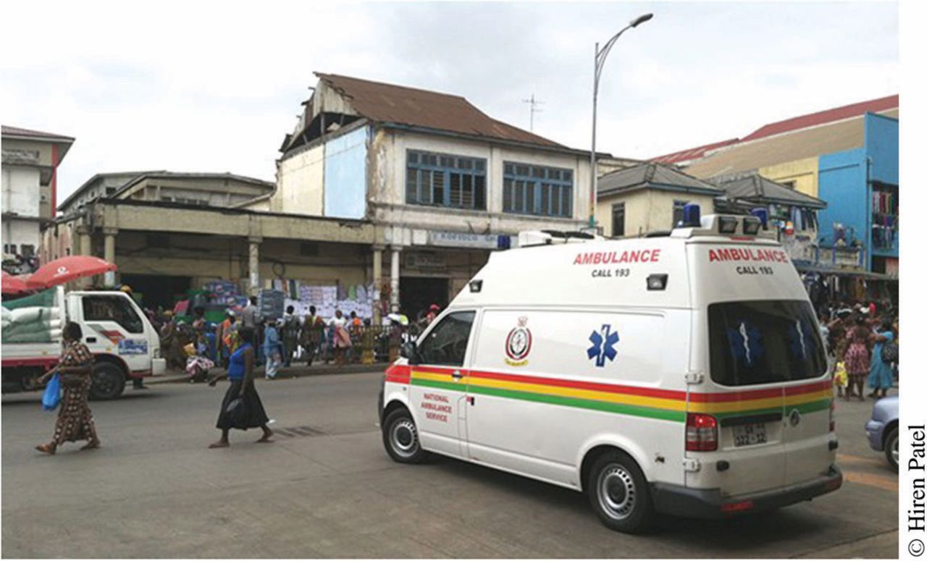
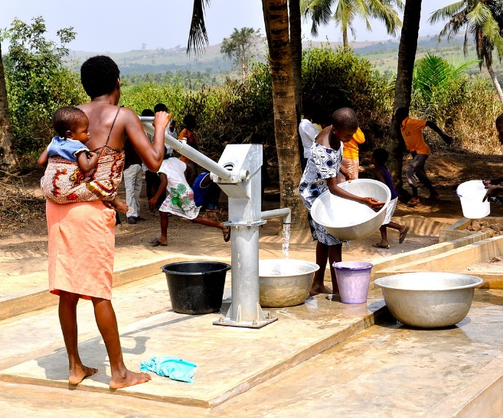
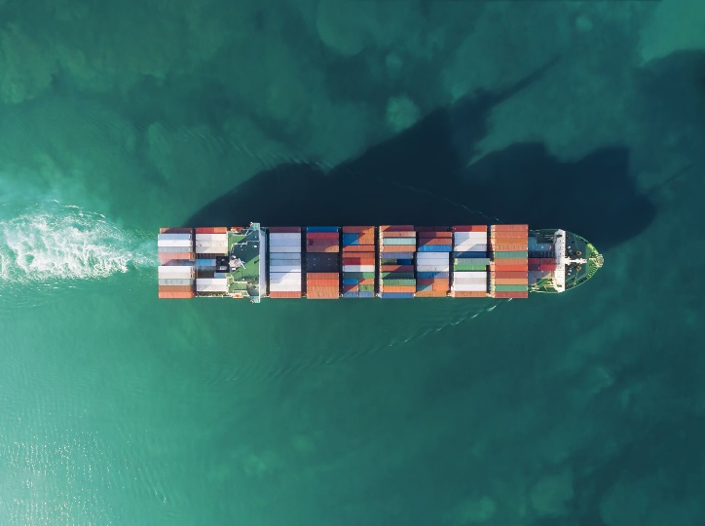
Government and revenue Jobs Knowledge Economy Disaster Response
Enabled citizen Smart urban planning Resource management Emergency Services
SDG delivery/measurement Water and health Trade Resource security
Notes:
This Photo by Unknown Author is licensed under CC BY-SA
This Photo by Unknown Author is licensed under CC BY-NC-ND

Slide 4
How often have we heard ……..
“We cannot get the money to create the geospatial information for users to generate the benefits that justify the investment”

Slide 5
How often have we heard ……..
Need a plan – IGIF based country-level action plan
Need strong governance
Need excellent stakeholder engagement and communication
Need a business case based on quantifiable national socio–economic impacts
Need business models to ensure sustainable delivery
“We cannot get the money to create the geospatial information for users to generate the benefits that justify the investment”

Slide 6
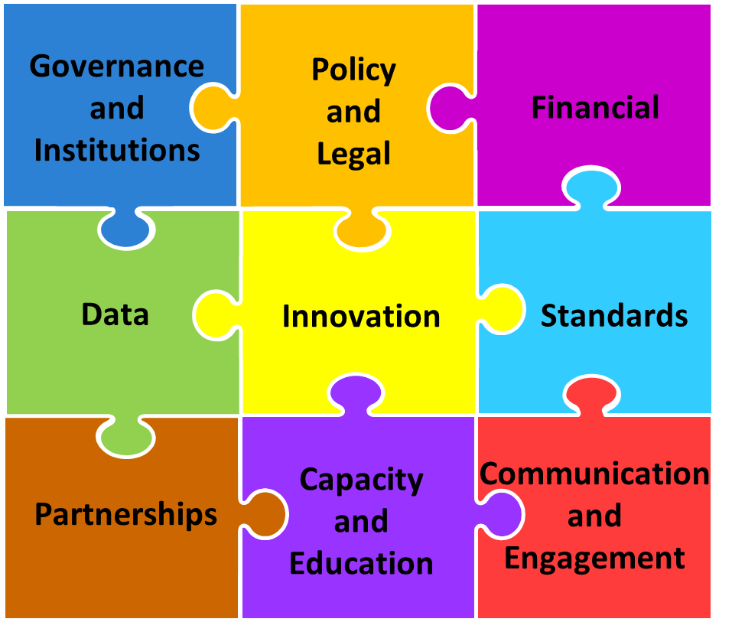
The UN Integrated GI Framework Pathways
Knowledge ▪ Decisions ▪ Development
Technology ▪ Applications ▪ Value
Users ▪ Citizens ▪ Access
Society ▪ Economy ▪ Environment

Slide 7
The UN Integrated GI Framework Pathway 3

Slide 8
Two-part training
A business model for sustainable geospatial information financing
Online Course
Webinar/discussion

Slide 9
Format
• Welcome, Introduction, e-learning key points – John Kedar
• Panellist opening remarks.
• Questions from audience and moderator)
• Wrap Up and thank you – John Kedar (3 Mins)

Slide 10
Your panel today
Ms. Mimi Chauke, Director, National Spatial Information Framework, Department of Agriculture, Land Reform, and Rural Development. Mimi is Responsible for implementing a South African Spatial Data Infrastructure and leading the development of the South African Integrated Geospatial Information Framework.
Mr. Mohamed Timoulali, Director General GTOPIC sarl, Rabat, Morocco
Dr Edouard Fonh Cbei. CEO and General Secretary of the National Committee of Remote sensing and Geographic Information(CNTIG), COTE D'IVOIRE.
Mr Andrew Coote, Chief Executive, ConsultingWhere, UK

