Slide 1
Operationalizing WSIS+20 and GDC
July 1, 2026
Dawit Bekele
Regional Vice President – Africa

Slide 2
GDC and WSIS+20 are done!
What’s next?
Make the outcomes known, usable, and locally relevant
The technical community started the discussion at the AIS last week

Slide 3
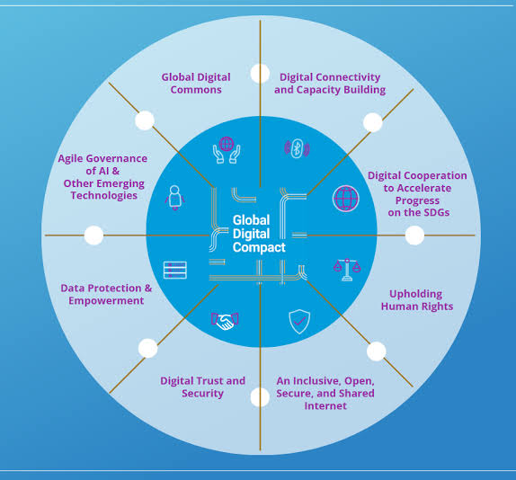
Global Digital Compact (GDC),
Objective: an inclusive, open, sustainable, fair, safe and secure digital future for all.
Headline outcomes
  Universal connectivity .
  An open, safe, and secure digital future
  Data governance and interoperability
  AI governance cooperation
  Inclusive multistakeholder digital governance

Slide 4
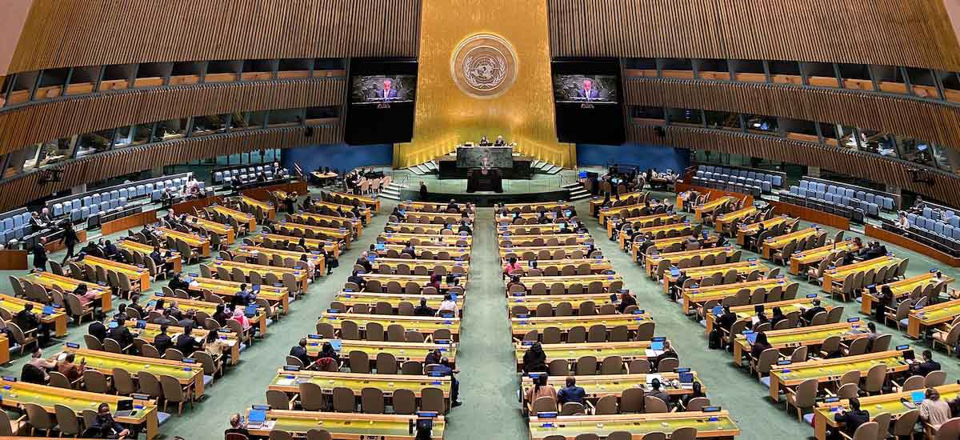
WSIS+20: what matters
Global support for
the WSIS Framework
was reaffirmed. In particular the
11 action areas (C1–C11), including:
  Infrastructure and access
  Capacity building
  Trust, security, and enabling environment
  ICT applications (health, education, etc.)
  Cultural diversity and local content
Persistent gaps in access,
affordability, and participation remain —especially in developing
regions.
WSIS remains the anchor framework, and the outcome aligns the Global Digital Compact with it.

Slide 5
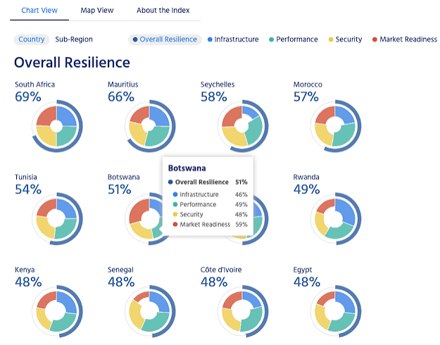
Implementation: what is changing: from dialogue to impact
Implementation roadmaps, indicators, and measurable progress are becoming central
What gets measured will shape priorities, resources, and attention
IGF and WSIS follow-up processes are expected to play a stronger role in tracking progress
ISOC is measuring important aspects of the Internet in Africa through Pulse Platform

Slide 6

Africa’s role: from participation to proof of impact
Ensure African stakeholders shape decisions, not just observe them.
Engage early so roadmaps and metrics reflect African realities.
Show what works: IXPs, community networks, and Internet governance initiatives are practical evidence of implementation in action.

Slide 7
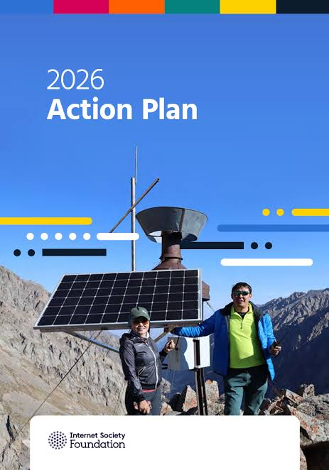
Closing: overall call to action
Keep engaged in the implementation phase.
Use community-driven processes to turn global agreements into local tools for action.
Partner with the Internet Society Foundation, which will continue funding national and regional IGFs and Schools of Internet Governance.

Slide 8
Dawit Bekele
Regional Vice President – Africa
internetsociety.org

