Slide 1
WSIS+20 PROGRESS REPORT
Uganda's Progress in
Implementing WSIS+20 Outcomes
A national review of digital transformation, infrastructure growth, cybersecurity and digital inclusion since the 2005 WSIS outcomes
Ministry of ICT and National Guidance | Republic of Uganda
Aligned with Cotonou Declaration (May 2025) & UNGA Resolution A/RES/80/173

Slide 2




Executive Summary
Two decades of digital transformation, accelerated by policy reform and infrastructure investment
5,204
47,771 km
76%
50.5M
Telecom towers
(from 260 in 2002)
Fiber optic cable
(from 222 km in 2002)
Government services
digitized via NBI
Mobile money
subscriptions (Q4 2024)
Driven by a comprehensive policy ecosystem
Uganda's progress is anchored in the National Digital Transformation Roadmap (FY23/24–FY27/28), the National Broadband Policy (2018), and the Digital Uganda Vision 2040, all integrated into the National Development Plans.
Since the WSIS+20 Africa Regional Review in Cotonou (May 14–16, 2025) and adoption of UNGA Resolution A/RES/80/173 (December 17, 2025), Uganda has continued advancing infrastructure expansion, cybersecurity strengthening, and digital inclusion.

Slide 3
Policy Framework & Governance
Action Line C1 — The legal and institutional foundation
National Digital Transformation Roadmap
Cybersecurity Index
Launched 17 August 2023, FY23/24–FY27/28, structured around five pillars:
62nd
Digital Infrastructure
Digital Services
Cybersecurity
Data Protection & Privacy
Digital Skilling and Innovation & Entrepreneurship
globally on the National Cybersecurity Index
5th in Africa • 1st in East Africa
UGPass — National Digital Identity
ITU Global Cybersecurity Index
Winner of the WSIS Digital Service Design Prize 2024. UGPass lets citizens, businesses and government entities securely authenticate and sign documents online, without requiring physical presence.
83.10%
up from 69.98% (2020) and 62.10% (2018)
Key Regulations Enacted
Access to Information Act (2005) • Computer Misuse Act (2011) • Electronic Transactions Act (2011) • Data Protection and Privacy Act (2019) • Regulation of Interception of Communications Regulations (2024)
World Bank funding of $200 million secured for rural connectivity and e-governance, aligned with the African Telecommunications Union Master Strategy.

Slide 4
ICT Infrastructure Growth
Action Line C2 — Base Year 2002 vs. FY 2024/25
Indicator | 2002 | FY24/25
Telecom towers | 260 | 5,204
Fiber optic cable | 222 km | 47,771 km
National Backbone (NBI) | — | 4,387 km
2G coverage | 72% pop. | 99% pop.
4G coverage | — | 45% pop.
Mobile subscriptions | 330,000 | 41.5 million
Licensed operators | 3 | 41 (2025)
Values scaled for chart comparability — see exact figures at right
76% of public services digitized through NBI • Over 5,000 government offices connected for real-time data sharing

Slide 5
Access & Digital Inclusion
Action Line C3 — Three decades of UCUSAF programming
UCUSAF I
UCUSAF II
UCUSAF III
2002–2008
2009–2016
2016–2023
Voice access
Basic internet
Broadband usage
90 GSM masts, 4,000+ payphones, 70% voice penetration
542 ICT school labs, 19 digital TV broadcasting sites
300+ ICT labs, public Wi-Fi, digital skilling for women, youth & PWDs
Digital Skilling Outcomes (UCUSAF 2020–2024)
45,772
total beneficiaries trained across all groups
1,395 ICT labs in 95% of govt-aided secondary schools
50,000+ citizens with basic ICT skills
67 public ICT Access Centers
4,500+ subsidized smartphones across 23 districts

Slide 6


Capacity Building
Action Line C4 — Skills, training and digital literacy
Digital Literacy Rate
1,231
Broadcasters & filmmakers trained in 2024
1,000
Women trained in Gulu on documentary production
2030 Target
70% national digital literacy, up from 48% in 2024 — a core pillar of NDP IV (2025/26–2029/30) and the Digital Transformation Roadmap.

Slide 7



Cybersecurity & Trust
Action Line C5 — Building a trusted digital economy
62nd
83.10%
50.5M
Global ranking, National Cybersecurity Index
(5th in Africa, 1st in East Africa)
ITU Global Cybersecurity Index score
(up from 69.98% in 2020)
Mobile money subscriptions, Q4 2024
(up from 45.6M in Q3 2024)
CERT-Uganda & Mobile Money Trust
CERT-Uganda | Established and accredited to FIRST, the global forum of incident response teams
Digital Financial Services Lab | ITU-backed facility supporting digital payments security
Mobile money transactions | Grew from over $1 trillion (2020) to $1.68 trillion (2024), surpassing $2 trillion by 2025
Fraud resolution | Increased from 46,594 cases (2023) to 63,719 cases (2024); 870,962 complaints resolved in 2024

Slide 8
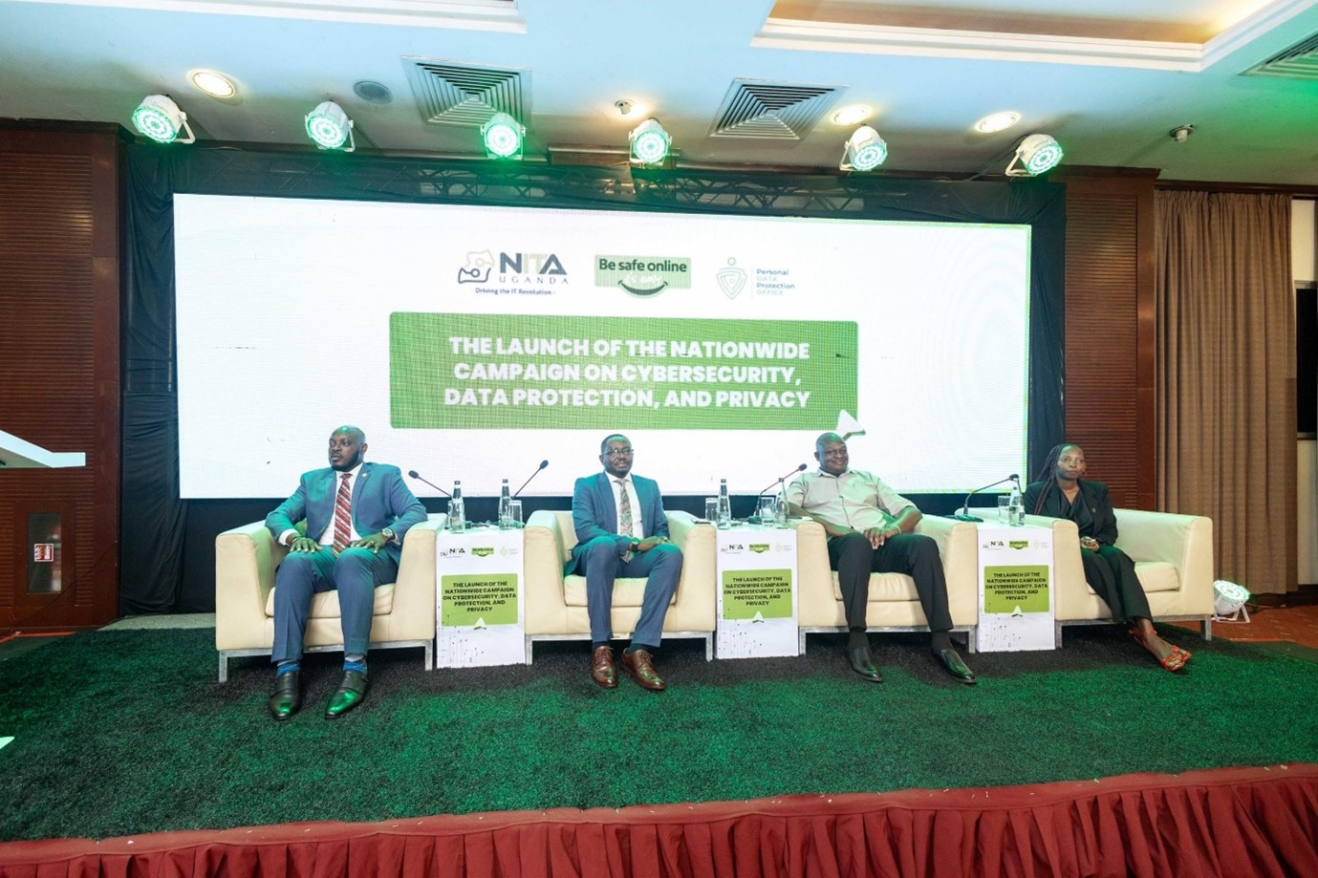
Enabling environment
Action line C6- Fostering supportive legal, regulatory, and policy frameworks.
There are campaigns like Beera Ku Guard, which was a nationwide campaign fostering cybersecurity, Data Protection, and Privacy that was championed by the Personal Data Protection Office, which encourages and enables citizens to stay alert against cyber-attacks and Data privacy breaches, but runs campaigns along with other stakeholders in the data governance landscape to create awareness around cybersecurity, data protection, and privacy. This campaign, launched in September 2025, demystifies laws, translates rights into relatable languages, and inspires every Ugandan to own their online safety. Beera Ku Guard empowers individuals and institutions to take practical steps in protecting personal data.”

Slide 9




ICT Applications Across Sectors
Action Line C7 — E-Government, e-Business, e-Learning & e-Health
E-Government
E-Business
76% of government services digitized by 2024
OBRS for business registration; eKYC via national ID
eGP rolled out to 36 government entities
USSD enables 2 million citizens without internet to access government systems
50.5 million mobile money users (2024), up from 9 million in 2009
2.5 billion transactions in 2024, up from 399 million in 2009
Jumia Uganda: 25% rise in rural e-commerce orders
E-Learning
E-Health
3D mini theatre delivered interactive STEM content to 50,000 students
Damalie series streamed to 1 million households via Showmax/Pearl Magic Prime
5,000+ teachers retrained through teacher retooling program
Telemedicine pilots cut diagnostic delays by 50% for rural patients
SMS disease surveillance alerts 10,000 health workers during outbreaks
National telemedicine platform planned for launch by end of 2025

Slide 10




C8
Cultural Diversity, Linguistic Diversity & Local Content
Achievements
UCC-driven local film growth: Memories of Love Returned (Best Int'l Documentary, AFRIFF 2024); The Last Shoemaker (AMAA, Uganda Film Festival 2023)
Women in Film Empowerment Program (Gulu): 37 women trained; works on Malakwang and Bulola traditions
474 licensed radio stations broadcasting in Luganda, Runyankole, Acholi & other local languages
Content Development Support Program (CDSP) funded Janani, The Last Stand (2024); 1,231 creatives trained across Arua, Gulu, Mbale, Mbarara
Challenges
80% of pay-TV channels carry foreign content; only 15% of online content is in Ugandan languages
Piracy erodes local creator revenue; rural areas lack production and distribution infrastructure
Future Priorities
Enforce 40% local content quotas for broadcasters/streamers by 2027
Expand CDSP funding for indigenous-language programming; develop orthographies for minority languages
Build a national digital archive for Ugandan films and music
Strengthen anti-piracy enforcement under copyright law
Source: ITU 20-Year Country Report on WSIS Outcomes — Uganda

Slide 11

C9
Media — Pluralistic, Independent & Diverse Coverage
Achievements
UCC enforces content standards under the Uganda Communications Act 2013 (content ratings, event permitting)
77 Ugandan films submitted to festivals; Damalie (Pearl Magic Prime/Showmax) won Best TV Drama at Mashariki African Film Festival, reaching 1M households
474 radio stations in 40+ languages, plus 116 local TV channels
1,231 filmmakers/broadcasters trained on licensing and content standards
Challenges
Piracy and weak digital copyright enforcement persist across platforms
Rural access lags urban areas; 35% of rural radio stations lack reliable electricity
Future Priorities
Refresh the 2006 Copyright Law for emerging technology issues (task force underway)
Deploy solar-powered community media hubs for off-grid stations
Grow the Uganda Film Festival to drive co-productions and international visibility
Source: ITU 20-Year Country Report on WSIS Outcomes — Uganda

Slide 12

C10
Ethical Dimensions of the Information Society
Achievements
Uganda participating in AI Policy Framework formulation, addressing governance principles for AI development and use
Data Protection and Privacy Act (2019) and Computer Misuse Act (2011) underpin trust and ethical safeguards in digital systems
UCC has begun examining how AI, IoT, big data and blockchain intersect with freedom of expression and privacy
Challenges
No standalone national C10 reporting track — ethical-AI and data-governance work is currently distributed across C1 and C5
Public awareness of digital rights and AI ethics remains limited outside government and civil-society circles
Future Priorities
Feed Pillar 3 cybersecurity and data-protection work (CSIRP) into an explicit national C10 submission
Build public-facing guidance on AI ethics, privacy and digital rights
Note: this Action Line is a gap in the current ITU country report — flagged here for MoICT&NG follow-up.

Slide 13

C11
International & Regional Cooperation
Achievements
Founding member of EACO (East African Communications Organisation) — Burundi, DRC, Kenya, Rwanda, South Sudan, Tanzania, Uganda
Implemented the One Network Area (ONA) framework, lowering cross-border communication costs
Harmonised mobile money interoperability standards with Kenya and Rwanda
Challenges
Only ~35% of planned EACO broadband initiatives are funded
Uganda's 47,771 km of fibre trails Kenya's 65,000 km — regional infrastructure disparity; cross-border tax inconsistencies undercut ONA's goals
Future Priorities
Push for an EACO Regional Broadband Network to harmonise tariffs and spectrum
Leverage ITU cybersecurity frameworks for cross-border digital transaction security
Deepen alignment with the African Union's Digital Transformation Strategy
Source: ITU 20-Year Country Report on WSIS Outcomes — Uganda

Slide 14

Challenges Remaining
Persistent gaps that temper the progress made
Unconnected population
Electricity access
Smartphone affordability
~7 million Ugandans still lack ICT access
Only 25% of territory has reliable power; 780+ network-ready sites non-operational
Only 40% of population owns a smartphone; a 40% levy on smartphones exacerbates exclusion
Data costs
Infrastructure inequity
Gender gap
1GB costs $1.34, vs. Rwanda's $0.76, Kenya's $0.84 and Tanzania's $0.75
30% passive infrastructure serves only 46% of the population
Women constitute only 25% of ICT professionals

Slide 15
Challenges Remaining
Persistent gaps that temper the progress made
Unconnected population
Electricity access
Smartphone affordability
~7 million Ugandans still lack ICT access
Only 25% of territory has reliable power; 780+ network-ready sites non-operational
Only 40% of population owns a smartphone; a 40% levy on smartphones exacerbates exclusion
Data costs
Infrastructure inequity
Gender gap
1GB costs $1.34, vs. Rwanda's $0.76, Kenya's $0.84 and Tanzania's $0.75
30% passive infrastructure serves only 46% of the population
Women constitute only 25% of ICT professionals

Slide 16




Progress Since Cotonou & New Global Priorities
Aligned with the Cotonou Declaration (May 2025) and UNGA Resolution A/RES/80/173
Cotonou Priorities
New Resolution Priorities
Digital cooperation & regional integration
Artificial Intelligence
Pursuing EACO's One Area Network; alternative fiber routes via Tanzania; interconnectivity with Kenya, Tanzania, Rwanda and South Sudan
Participating in AI Policy Framework formulation; AI workstations at the Test Bed for Emerging Technologies
Digital Public Infrastructure
Accelerating digital skills
UNDP support scaling interoperable e-payment gateways and digital ID (UGPass)
UCUSAF Strategy (2023–2028) targets 15,500 learners across 80 districts via UICT
Permanent IGF Mandate
Active in Uganda IGF multistakeholder processes; Uganda Internet Governance Week hosted in Kampala, July 20–24, 2026
Scaling infrastructure investment
NBI Phase V adds 5,845 km of fiber; National Data Centre at 70% utilization, targeting 83% by 2030
SDG Alignment
NDP IV (2025/26–2029/30) integrates digital transformation as a central strategy for SDG achievement

Slide 17



Future Priorities 2025–2030
Based on NDP IV and the National Digital Transformation Roadmap
Infrastructure Expansion
Digital Services
5,845 km of additional fiber for underserved regions
1,000 solar-powered towers by 2027
Alternative fiber routes via Tanzania for resilience
Satellite broadband licensing finalized
National payment switch for interoperability
National spatial data infrastructure
Digital addressing platform for e-commerce last-mile delivery
National Big Data Strategy implementation
Capacity Building
Cybersecurity
70% digital literacy by 2030
Women in Film Program expanded to 10 districts (1,000 participants/year)
Mobile training vans for 50 remote districts by end-2025
1,000 developers trained via Andela partnership by 2026
AI-driven fraud monitoring deployment
Blockchain verification for cybersecurity frameworks
Nationwide rollout of UGPass

Slide 18
Conclusion
Uganda has demonstrated strong commitment to WSIS+20 outcomes through substantial infrastructure development, policy reform, cybersecurity strengthening, and digital inclusion initiatives.
The country's 5,204 telecom towers, 47,771 km of fiber, 50.5 million mobile money users, and 76% digitized public services reflect significant progress toward WSIS goals.
Since the Cotonou Regional Review and UNGA Resolution A/RES/80/173, Uganda continues aligning with the Global Digital Compact while addressing remaining gaps in connectivity, affordability, electricity access, and gender disparity in ICT.
5,204
Telecom towers
47,771 km
Fiber optic cable
50.5M
Mobile money users
76%
NDP IV (2025/26–2029/30)
Provides the framework for achieving 70% digital literacy by 2030 and positioning Uganda as a regional ICT hub — consistent with Vision 2040 and WSIS+20's extended mandate through 2035.
Digitized public services
Ministry of ICT and National Guidance, Republic of Uganda

