Slide 1






Founding funders
Delivered with
The Government AI Campus

Slide 2



The National AI Capacity Development Workstream is being implemented as part of the MoU between the Economic Commission for Africa (ECA) and Google, focussing on:
OVERVIEW
AI Policy, Research and Capacity Development
In 2026, the partners engaged Apolitical, the world’s largest online network of public servants, with a mission to make governments smarter.
PRIVATE AND CONFIDENTIAL

Slide 3













A snapshot of the range of resources available on the AI Campus:
Training that drives outcomes
A global community
of peers
Insights and research
Workforce efficiency & productivity tools
Convenings that drive action
Train whole workforces, from leaders through to implementers, with AI-powered courses that draw on global insights and experts.
Engage with public servants around the world sharing opportunities, challenges and insights on AI in the public sector.
Understand global workforce benchmarks and trends, powered by Apolitical’s unique global data, and share with government stakeholders.
Access cutting-edge AI tools and frameworks that drive efficiency and effectiveness, from policy making to implementation.
Attend in-person and online events with government and AI influencers and decision-makers.
ONLINE & IN PERSON
ONLINE & IN PERSON
INTEGRATES WITH
YOUR SYSTEMS & DATA
ONLINE & IN PERSON
ONLINE & IN PERSON
More detail in the following slides…

Slide 4
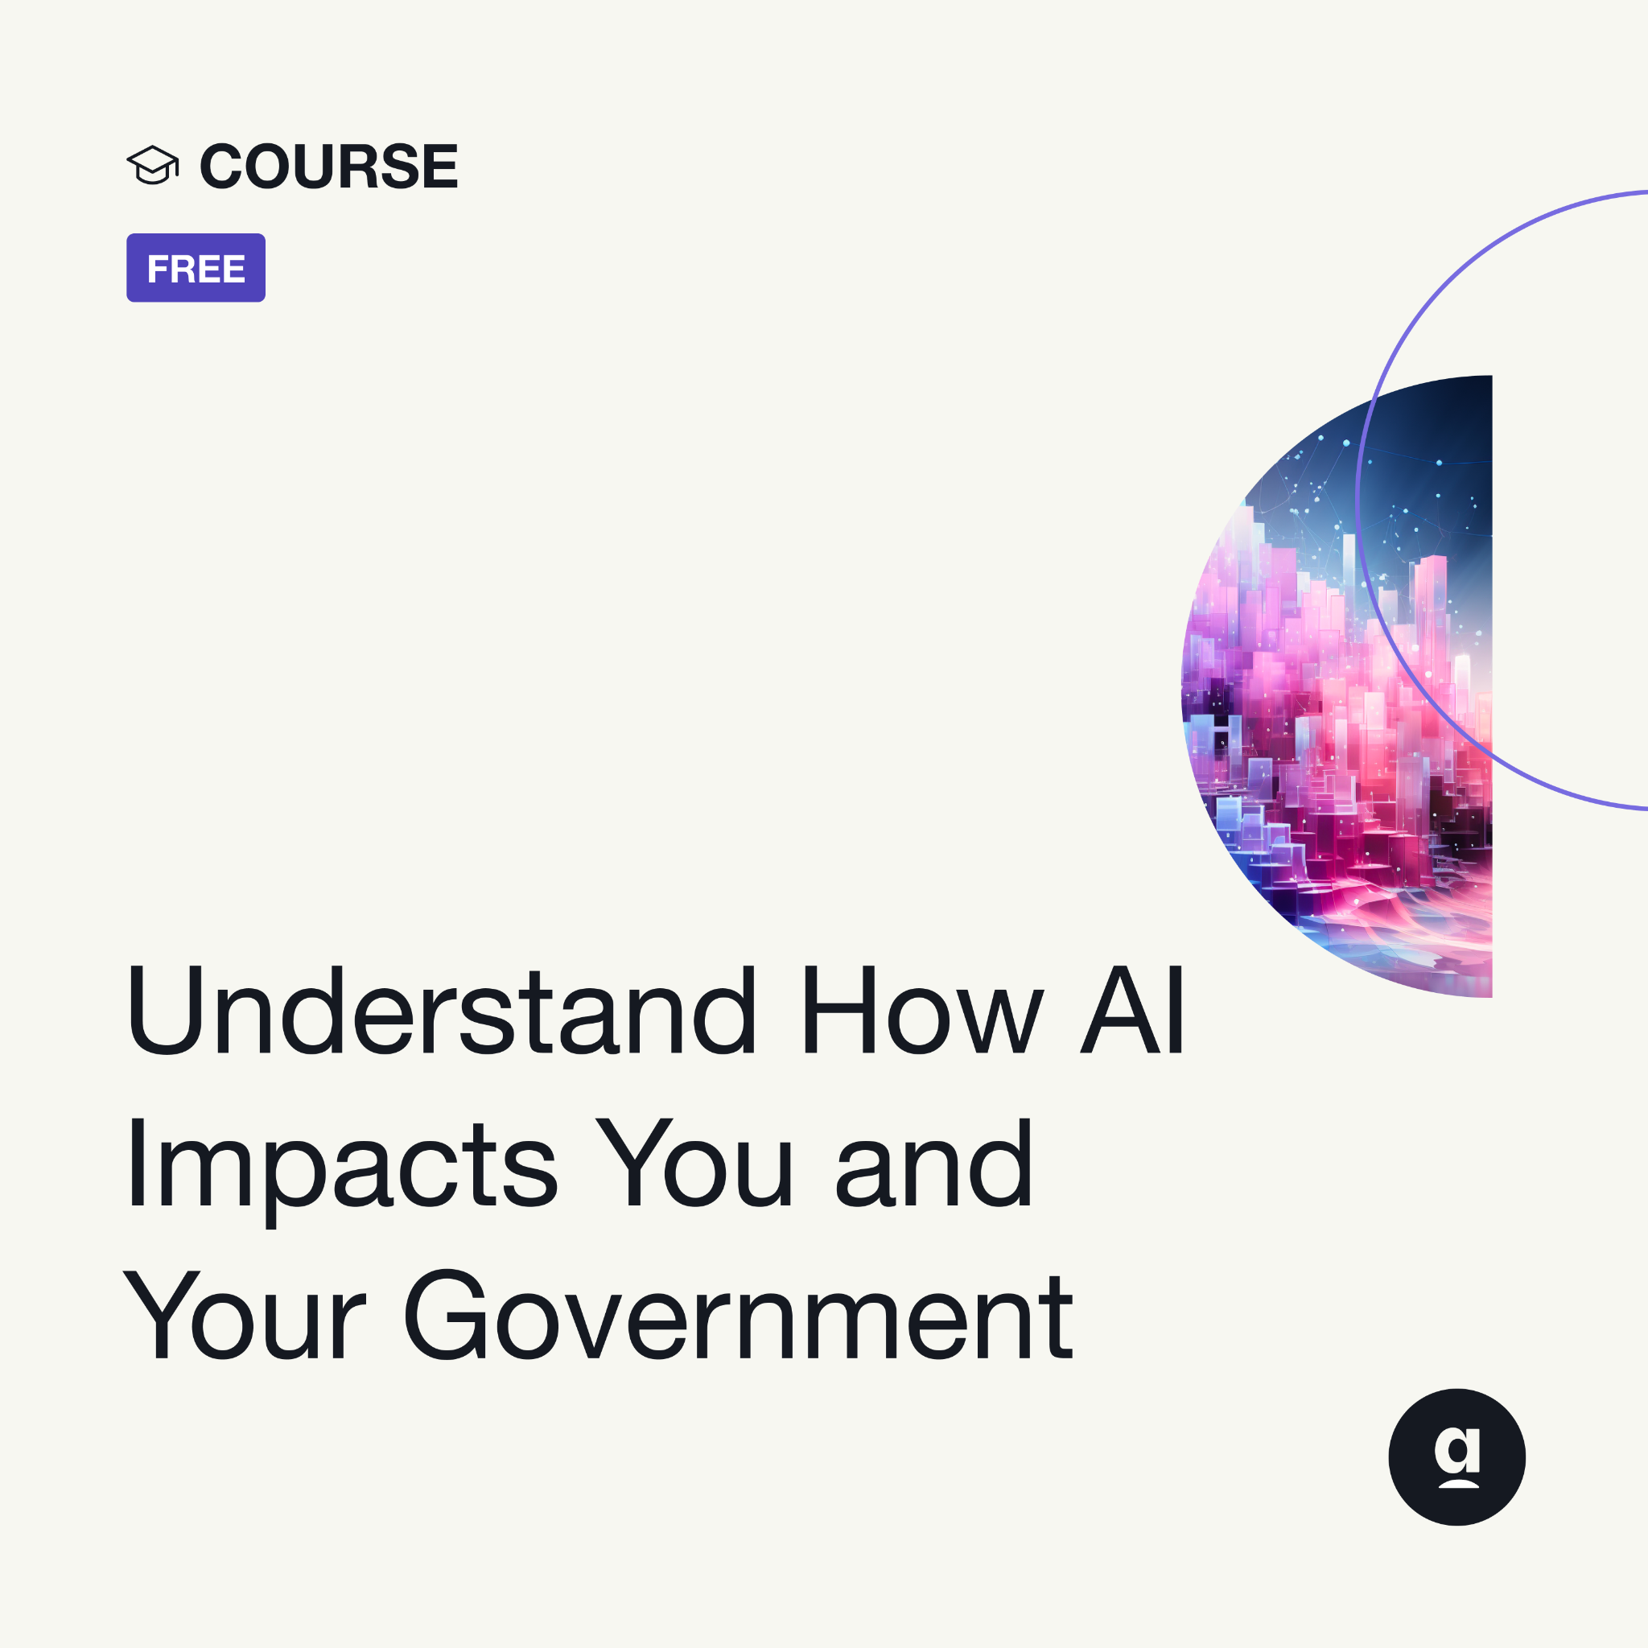

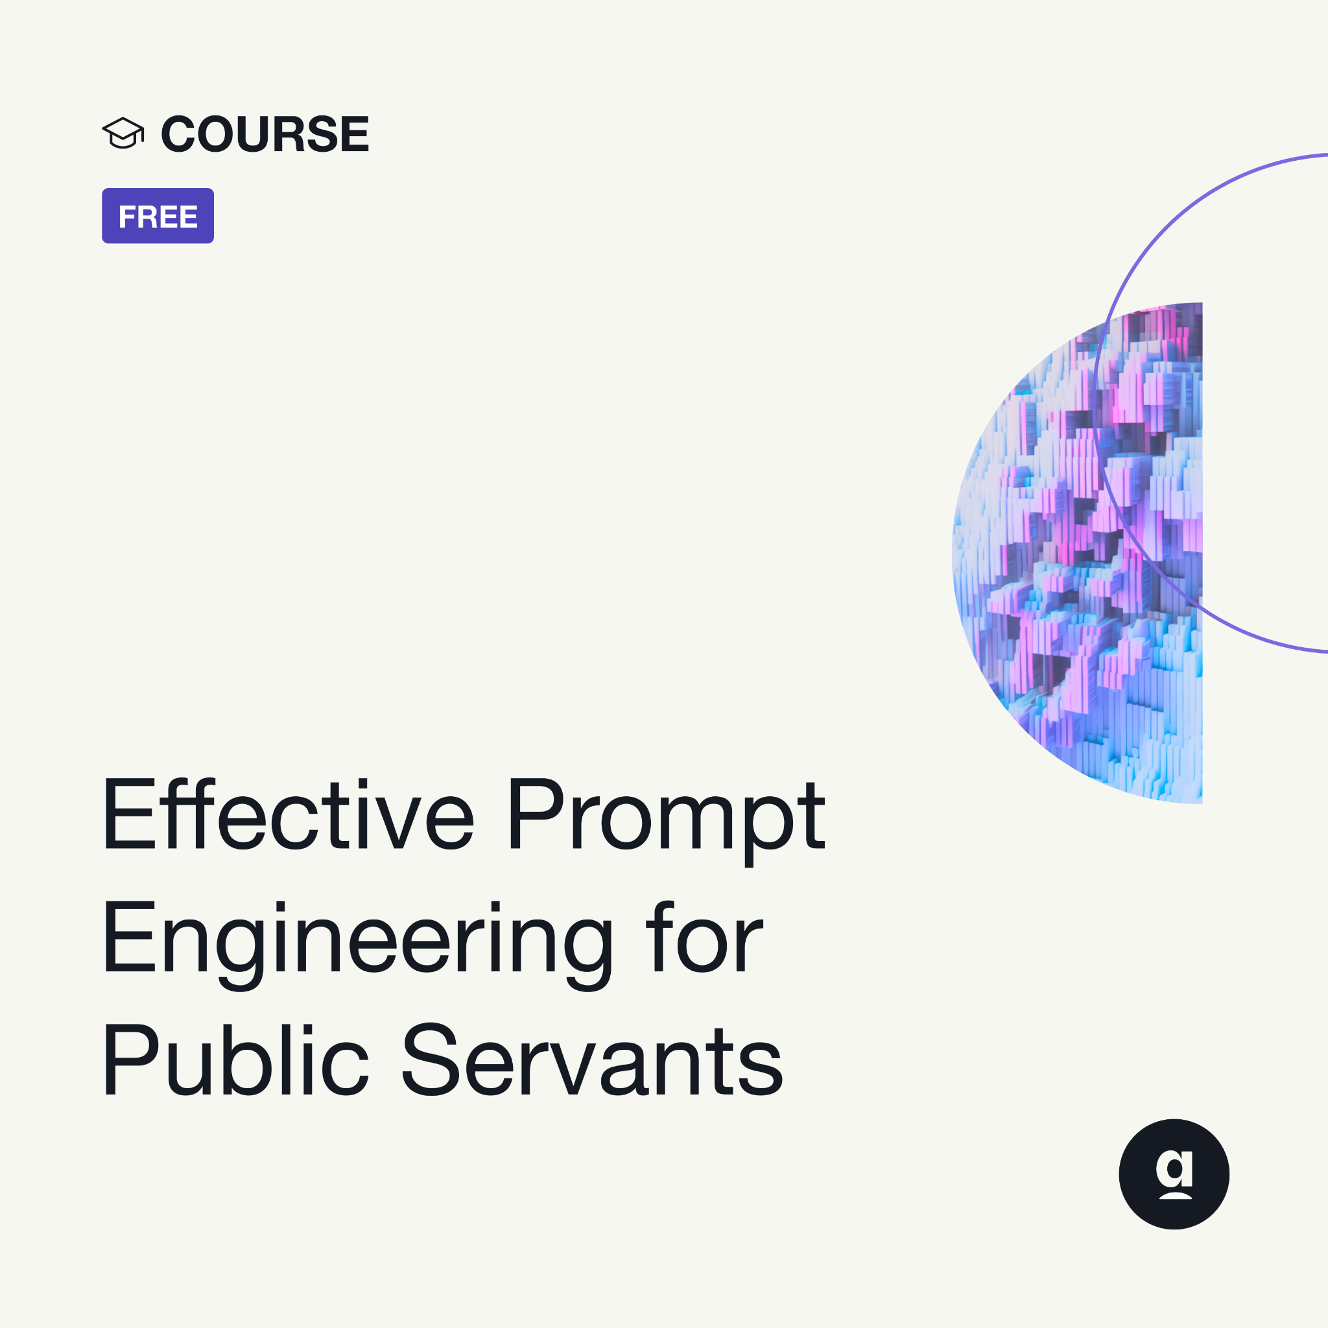
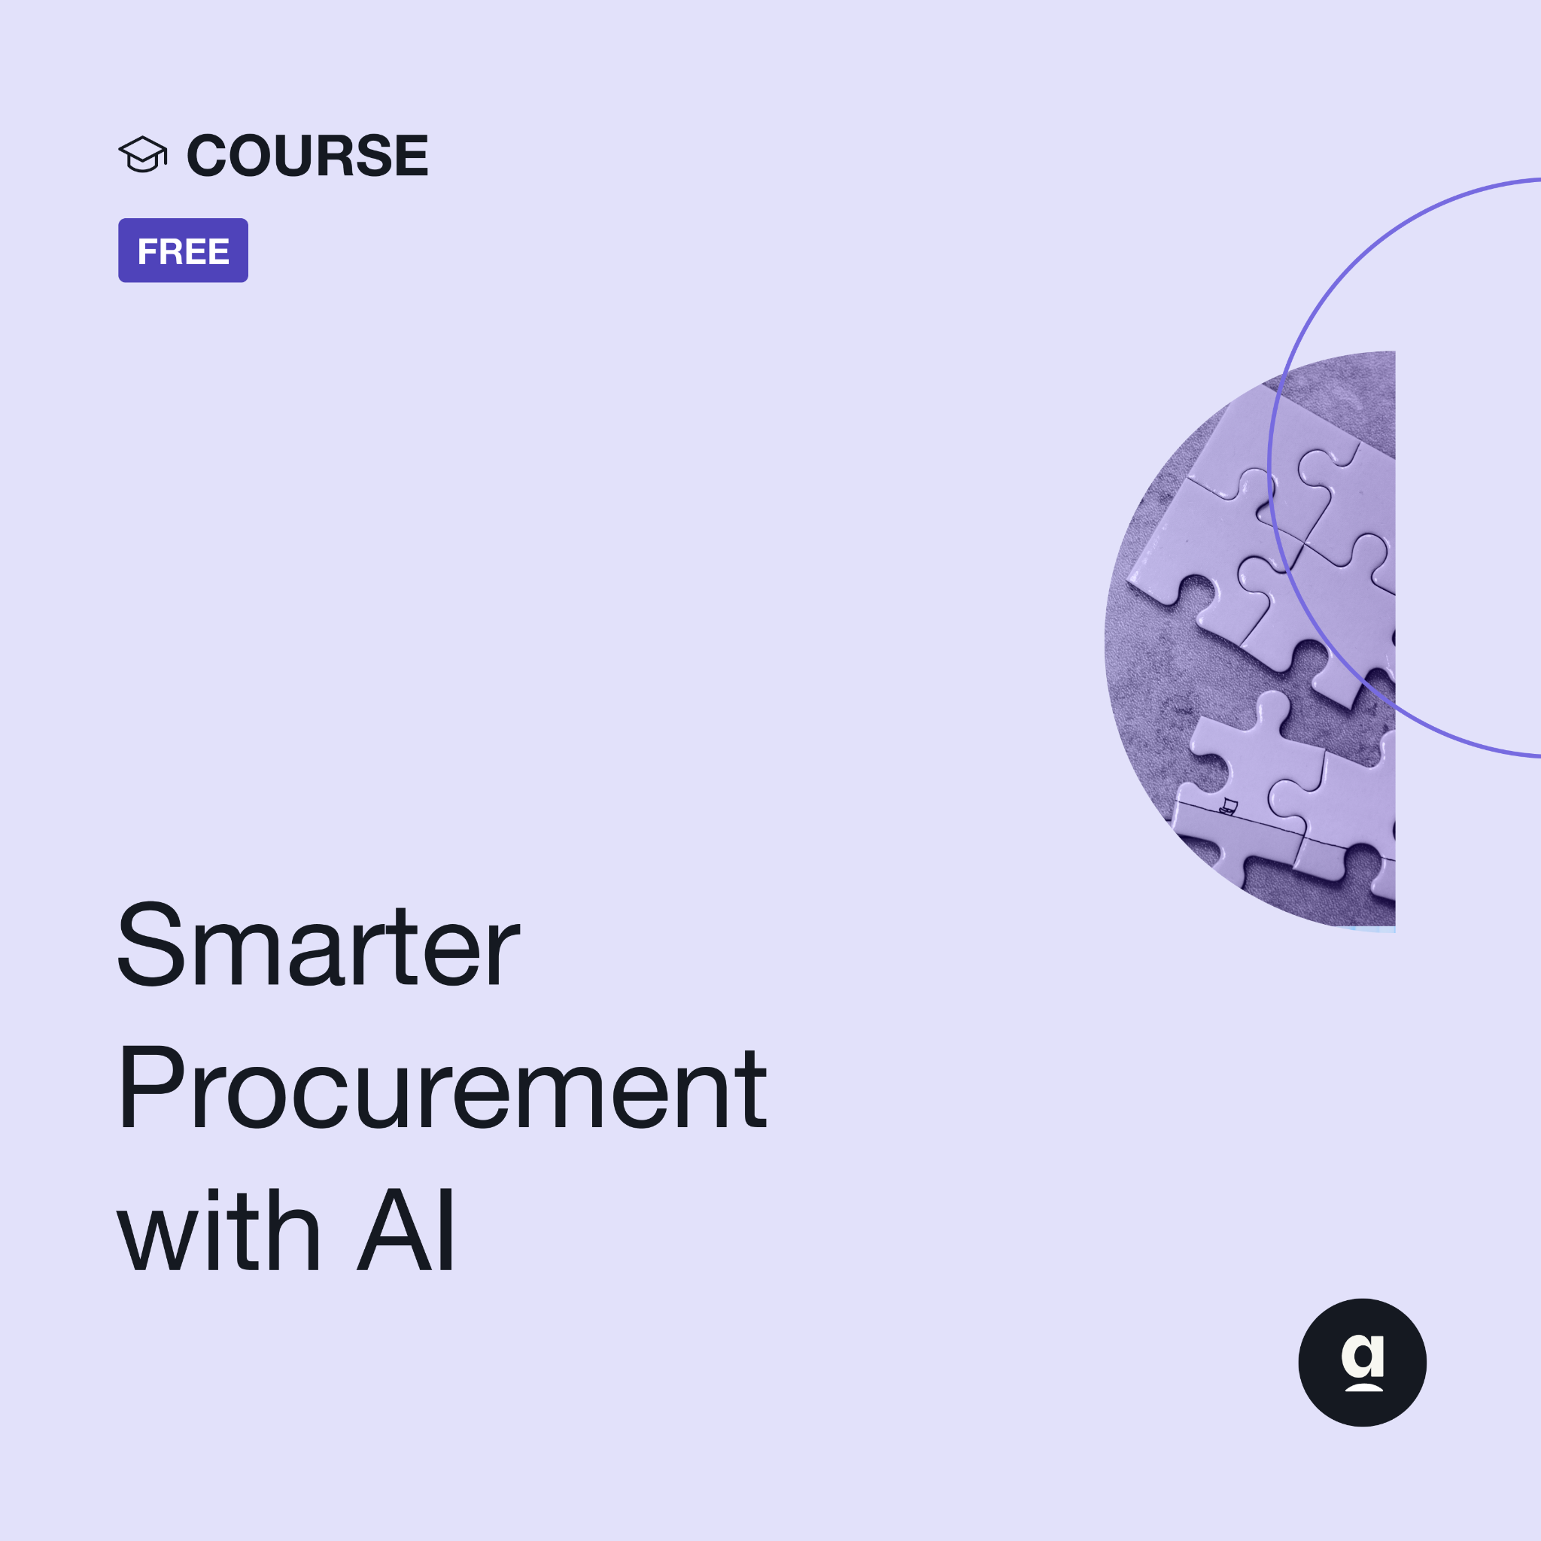

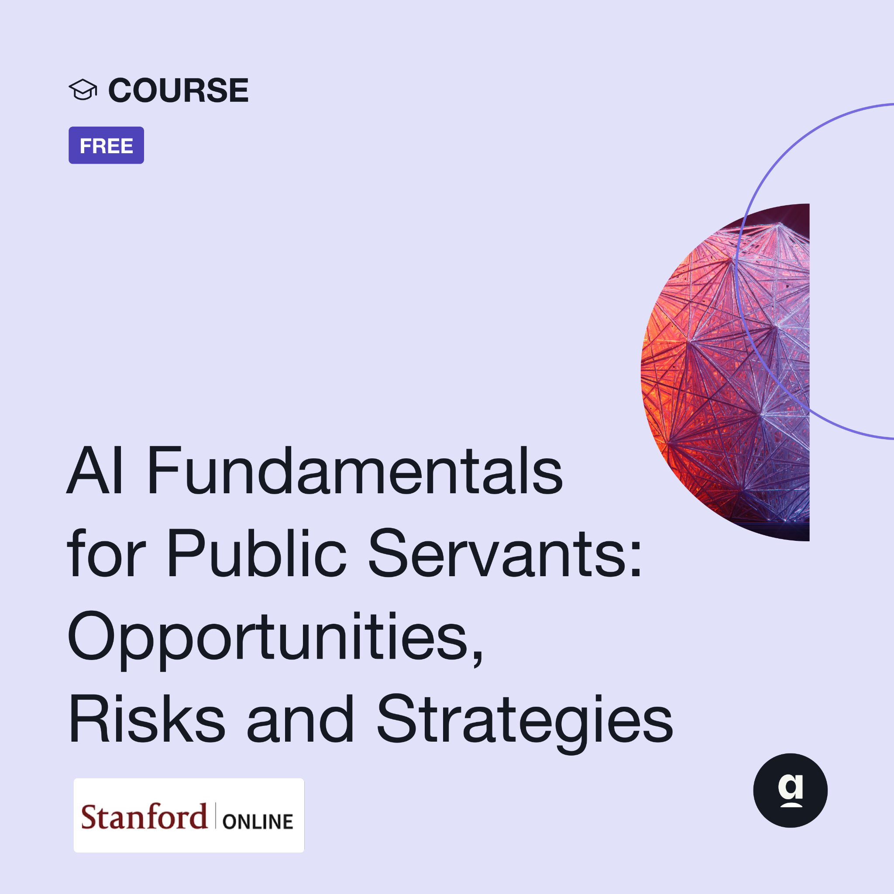
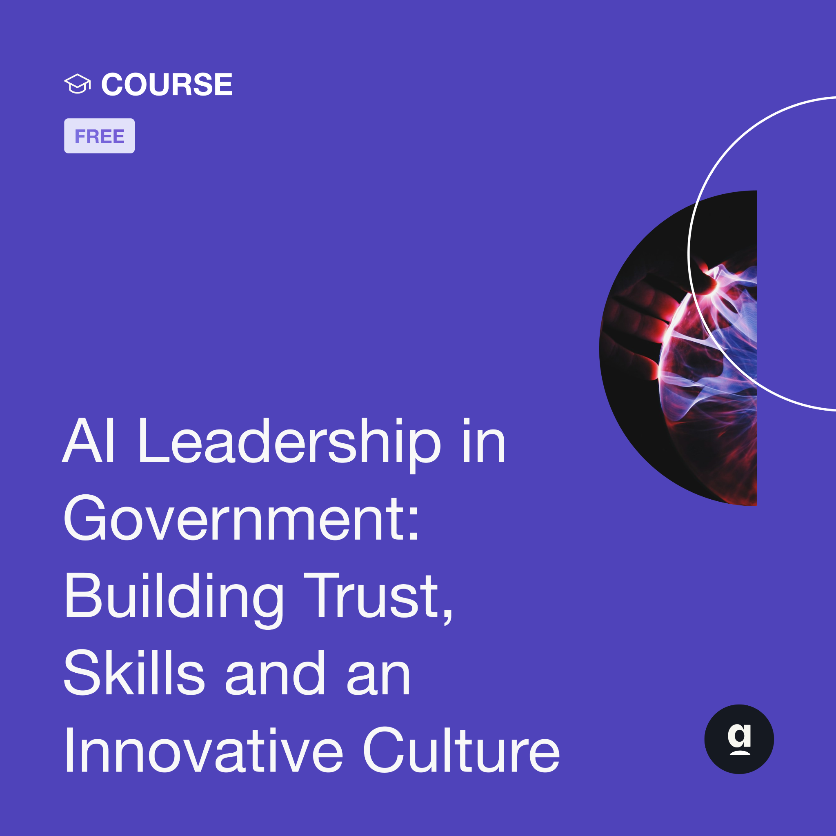
Expert-led courses for whole-workforce training
Available in Arabic, Bahasa Indonesia, English, French, German, Italian, Japanese, Korean, Polish, Portuguese and Spanish.
AWARENESS LEVEL
AWARENESS LEVEL
AWARENESS LEVEL
PRACTITIONER LEVEL
PRACTITIONER LEVEL
PRACTITIONER LEVEL
LEADERSHIP LEVEL

Slide 5
AI READINESS CHECK
What is the AI Readiness Check?
A simple, 6-minute self-assessment with individualized feedback.
Helps public servants identify the knowledge, skills, mindsets and principles that will equip them to be confident and effective users of AI.
The world’s largest global dataset for public sector AI capability.
9,000 public servants globally and numerous governments customising the assessment.
100,000 individual data points from 60 questions across 3 pathways into 23 thematic areas.
Notes:
You can just read this slide. For rough numbers of how the 5,700 respondents break down by their level in government:
≈ 750 ‘Leaders’
They answer questions about their institutional readiness, not their individual leadership skills (e.g. “My organisation has run AI experiments or has a procurement strategy in place”)
≈ 850 ‘Implementers’
They answer questions about their individual capabilities, but these questions are geared toward their ability to support the implementation of AI into operations and services (e.g. can you evaluate value for cost/ value; procurement approaches; embedding human oversight)
≈ 3,500 ‘Users’
These are ordinary public servants, and the questions are geared toward their individual AI confidence and skills/awareness (e.g. prompt engineering skills).
More on this in the next slide

Slide 6
AI TRAINING FOR YOUR CONTEXT
Join the global movement to build AI-ready governments
Partner with Apolitical to deliver scalable, government-focused AI training tailored to your context.
Fully funded
Unlimited learners
Available until the end of 2026
Tech-agnostic training philanthropically funded by Google.org.
The Campus can be delivered at scale in your organisation. We’d also be happy to support you in rolling out mandatory training.
Learners must be onboarded before the end of the calendar, but they do not have to complete their training by that same date.
PRIVATE AND CONFIDENTIAL

