Slide 1

WSIS+20 Country Report
Outcomes Implementation — WSIS, Global Digital Compact, AI & Digital Public Infrastructure

Slide 2
Executive Summary
Vision 2030 & NDP6
National Digital Strategy
Key Gains
Guiding frameworks for digital transformation
Whole-of-government roadmap 2024–2028
Fibre, submarine cable, e-Justice, e-Health, NamX, Universal Service Fund

Slide 3
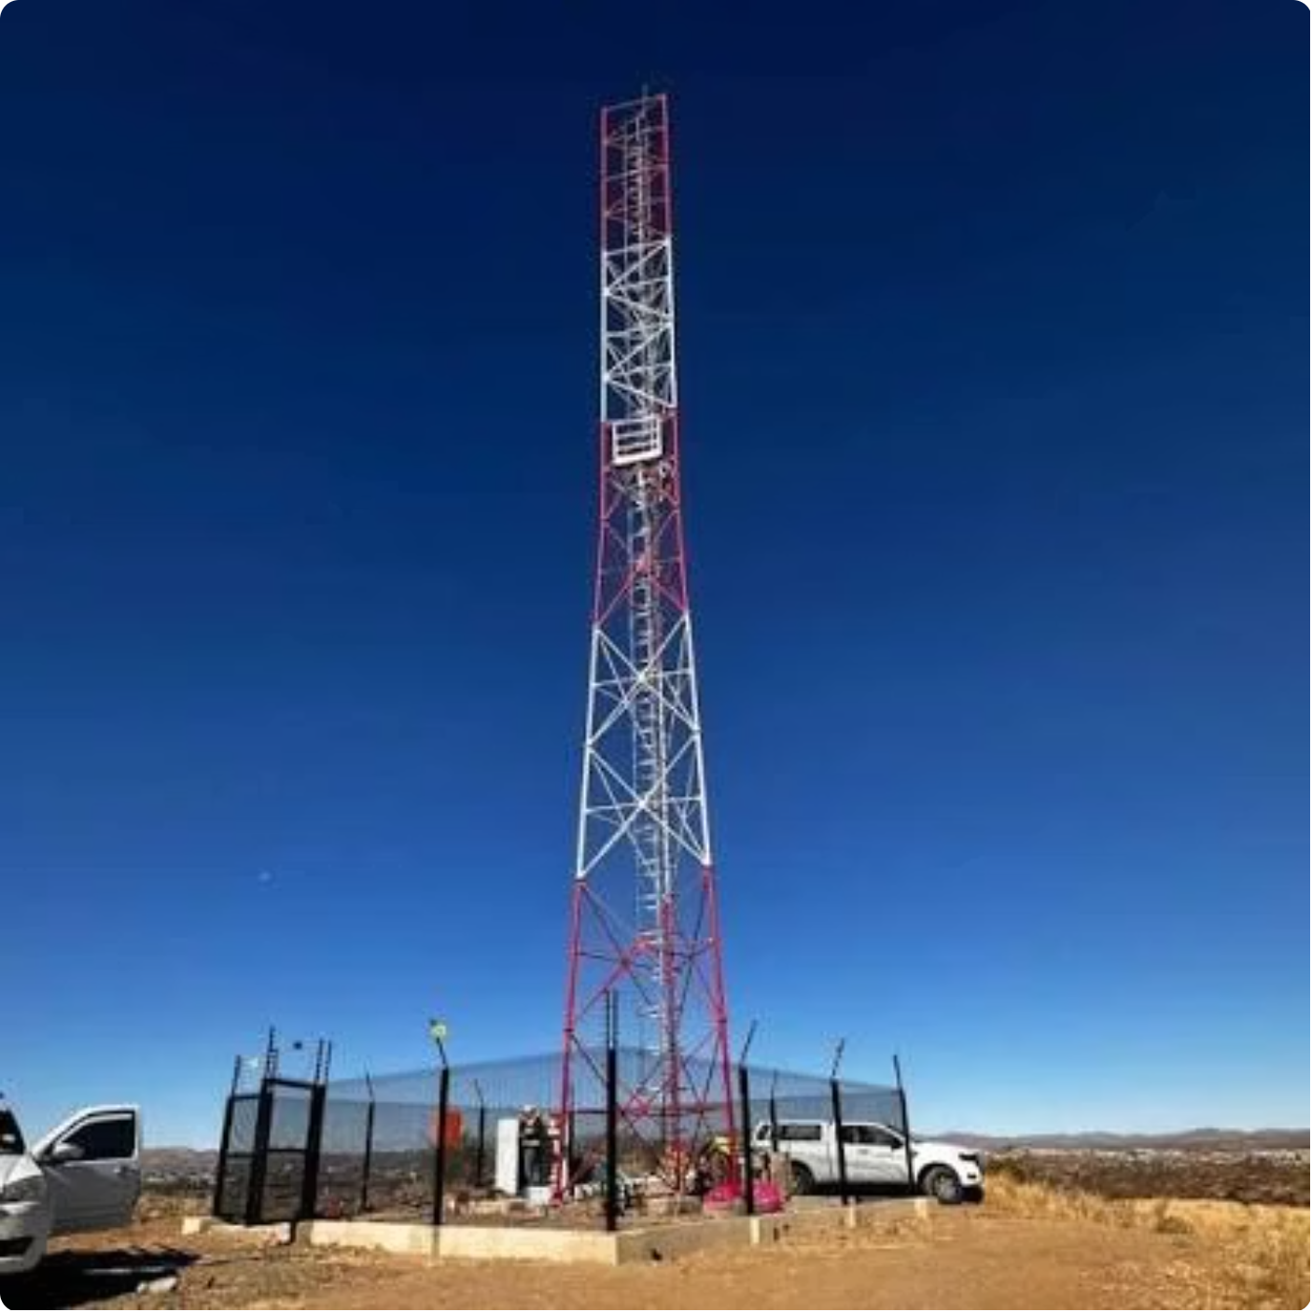
WSIS Action Lines C1 & C2
C1 — Governance
National Digital Strategy 2024–2028
Annual ICT Summit
e-Justice System
Smart City Strategy (Windhoek)
C2 — Infrastructure
Equiano Submarine Cable landed
Universal Service Fund operational
Fibre across major towns
National Data Centre approved

Slide 4
Access, Capacity & Security
C3 — Access to Information
C4 — Capacity Building
C5 — Cybersecurity
Access to Information Act enacted; CIVIC +264 established
Digital Literacy Programme; Huawei Seeds for the Future
National Cybersecurity Awareness Programme; legislation in development

Slide 5
Enabling Environment & ICT Applications
C6 — Enabling Environment
E-Government
Independent regulator; data protection & AI strategy under development
NamX interoperability platform; Digital Identity; e-Visa
E-Business & E-Learning
E-Health & E-Employment
BIPA One-Stop Registration; GIGA school connectivity; Yyeni AI & Lesha
National e-Health Strategy; NIESS job platform

Slide 6


Culture, Media & Ethics
C8 — Cultural Diversity
Namibia Film Commission & Film School
National Creative Fund (N$50 million)
C9 — Media
Windhoek Declaration; press freedom maintained
Community broadcasting support
C10 — Ethical Dimensions
Human rights-based digital governance
AI ethics frameworks in development

Slide 7



International & Regional Cooperation
ITU & WSIS
AU & SADC
Global DPI & AI
Active participation in global processes
ICT Ministerial engagement; bilateral cooperation with Angola, Zimbabwe, South Africa
Aligned with Global Digital Compact; South-South partnerships

Slide 8
Key Indicators of Progress
64.4%
87.1%
Internet Penetration
Mobile Connections
Population connected (2025)
Of population (2025)
88%
90%
LTE Coverage
2030 Target
National population coverage (2024)
Internet usage goal under NDP6

Slide 9

Challenges & Gaps
Principal Barriers
High cost of broadband deployment
Rural connectivity gaps - low population density
Skills shortages in AI & cybersecurity
Slow adoption of digital government services
Data interoperability challenges

Slide 10




Vision Beyond 2025
Accelerate NDS
Full implementation of 2024–2028 Strategy
Expand DPI
Digital identity, NamX, payments, cloud
AI Governance
National framework aligned with Global Digital Compact
Inclusive Society
No Namibian left behind in digital transformation

