Slide 1






Policy Gaps and Community Marginalization in Land and Mining Access in Post-
Independence Namibia
by
¹Aune Iyaloo Kamosho and ^{2,3} Oluibukun Gbenga Ajayi
¹ QKR Navachab Gold Mine, Mining Technical Services Department, Karibib, Erongo Region, Namibia
² Namibia University of Science and Technology, Faculty of Engineering and Built Environment, Department of Land and Spatial Sciences, Windhoek, Khomas Region, Namibia
³Department of Geography, Geoinformatics and Meteorology, University of Pretoria, South Africa

Slide 2
Table of Contents
Introduction
Historical Context of Inequality
Ownership Patterns in Mining
Legal & Policy Framework
Policy Gaps & Challenges
Proposed Reforms
Conclusion

Slide 3
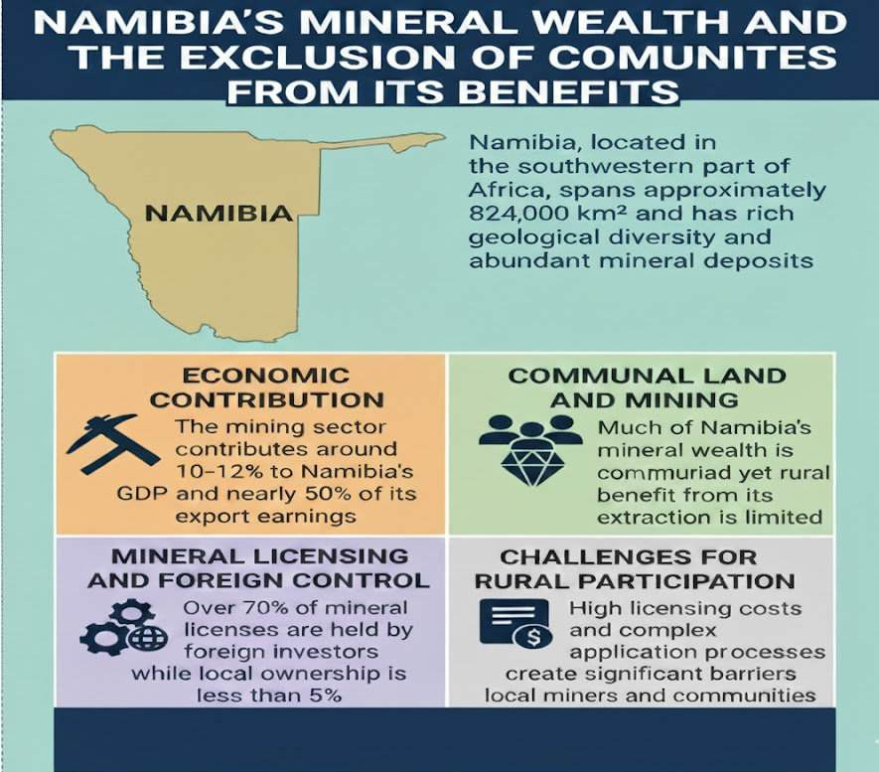
Introduction

Slide 4
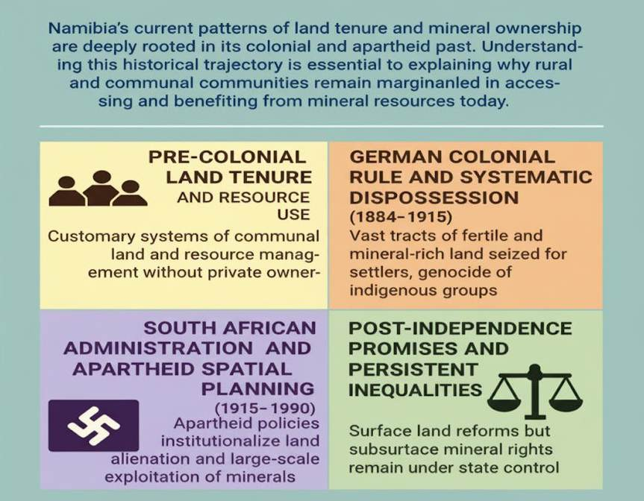
Historical Context of Inequality

Slide 5
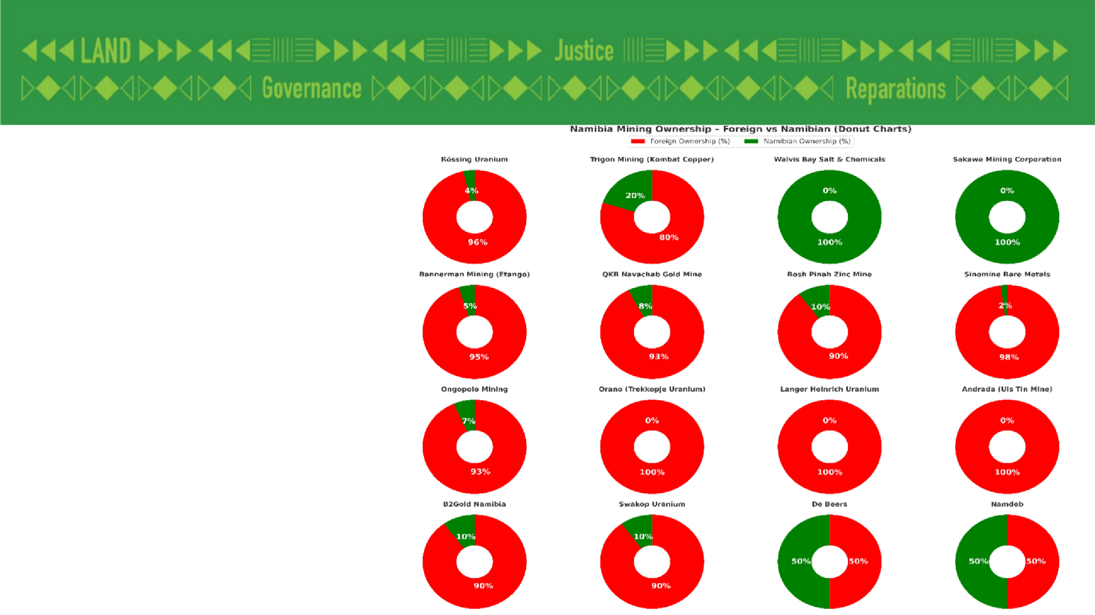
Ownership Patterns in Mining

Slide 6
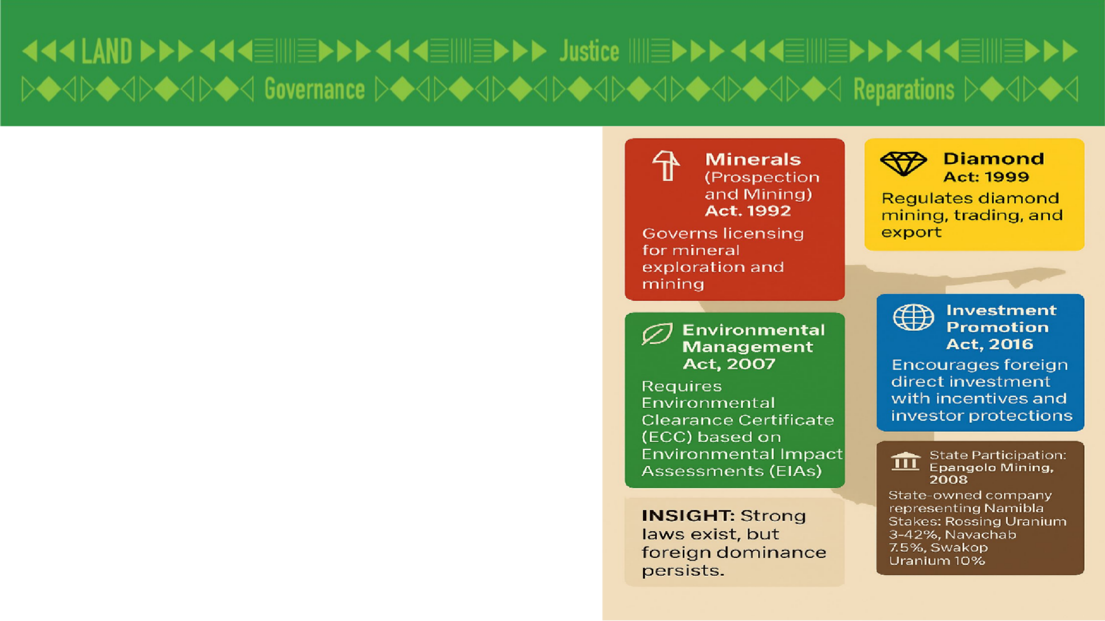
Legal & Policy Framework

Slide 7
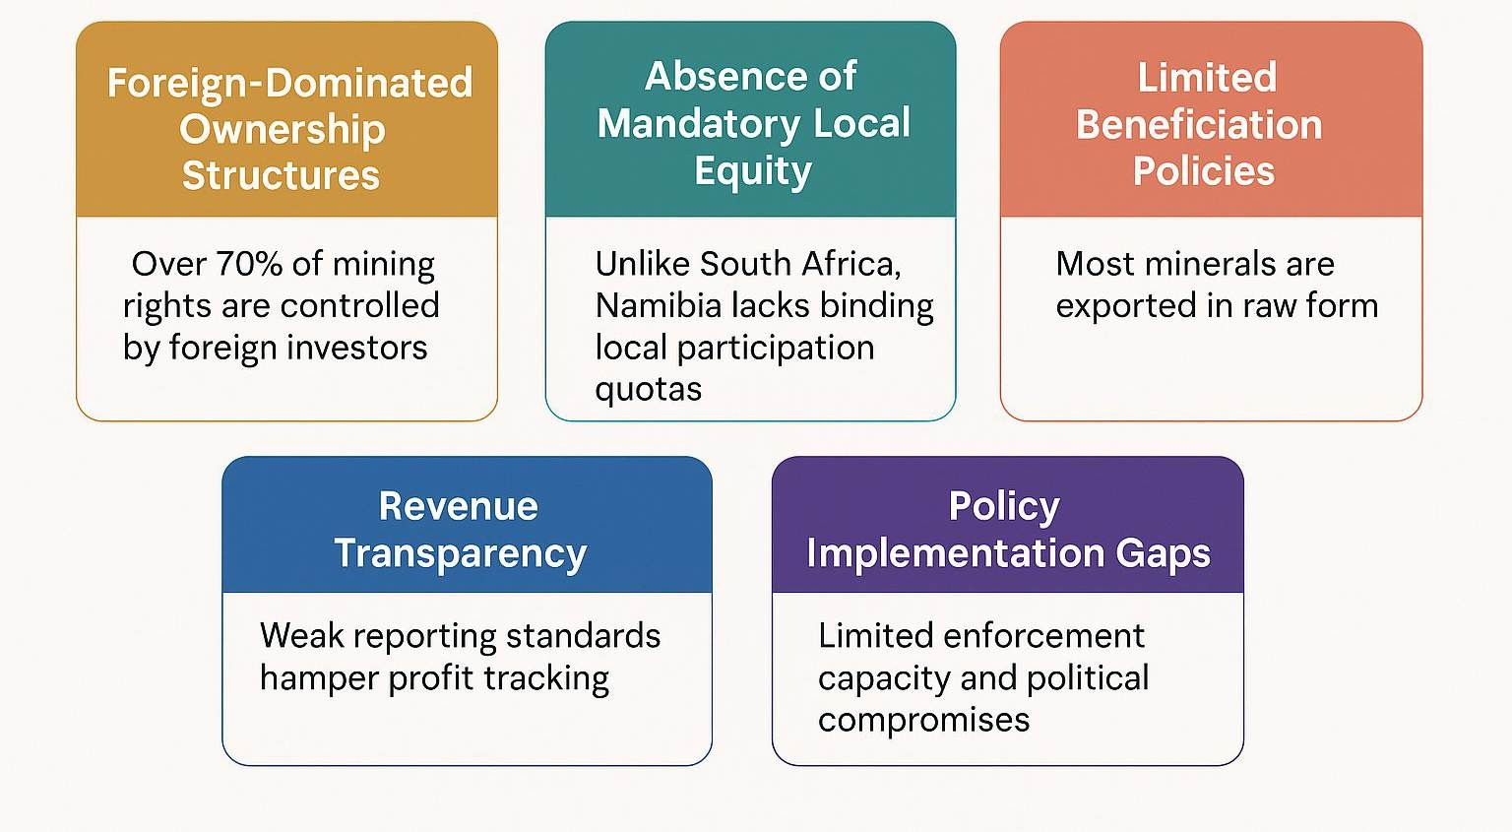
Policy Gaps & Challenges

Slide 8
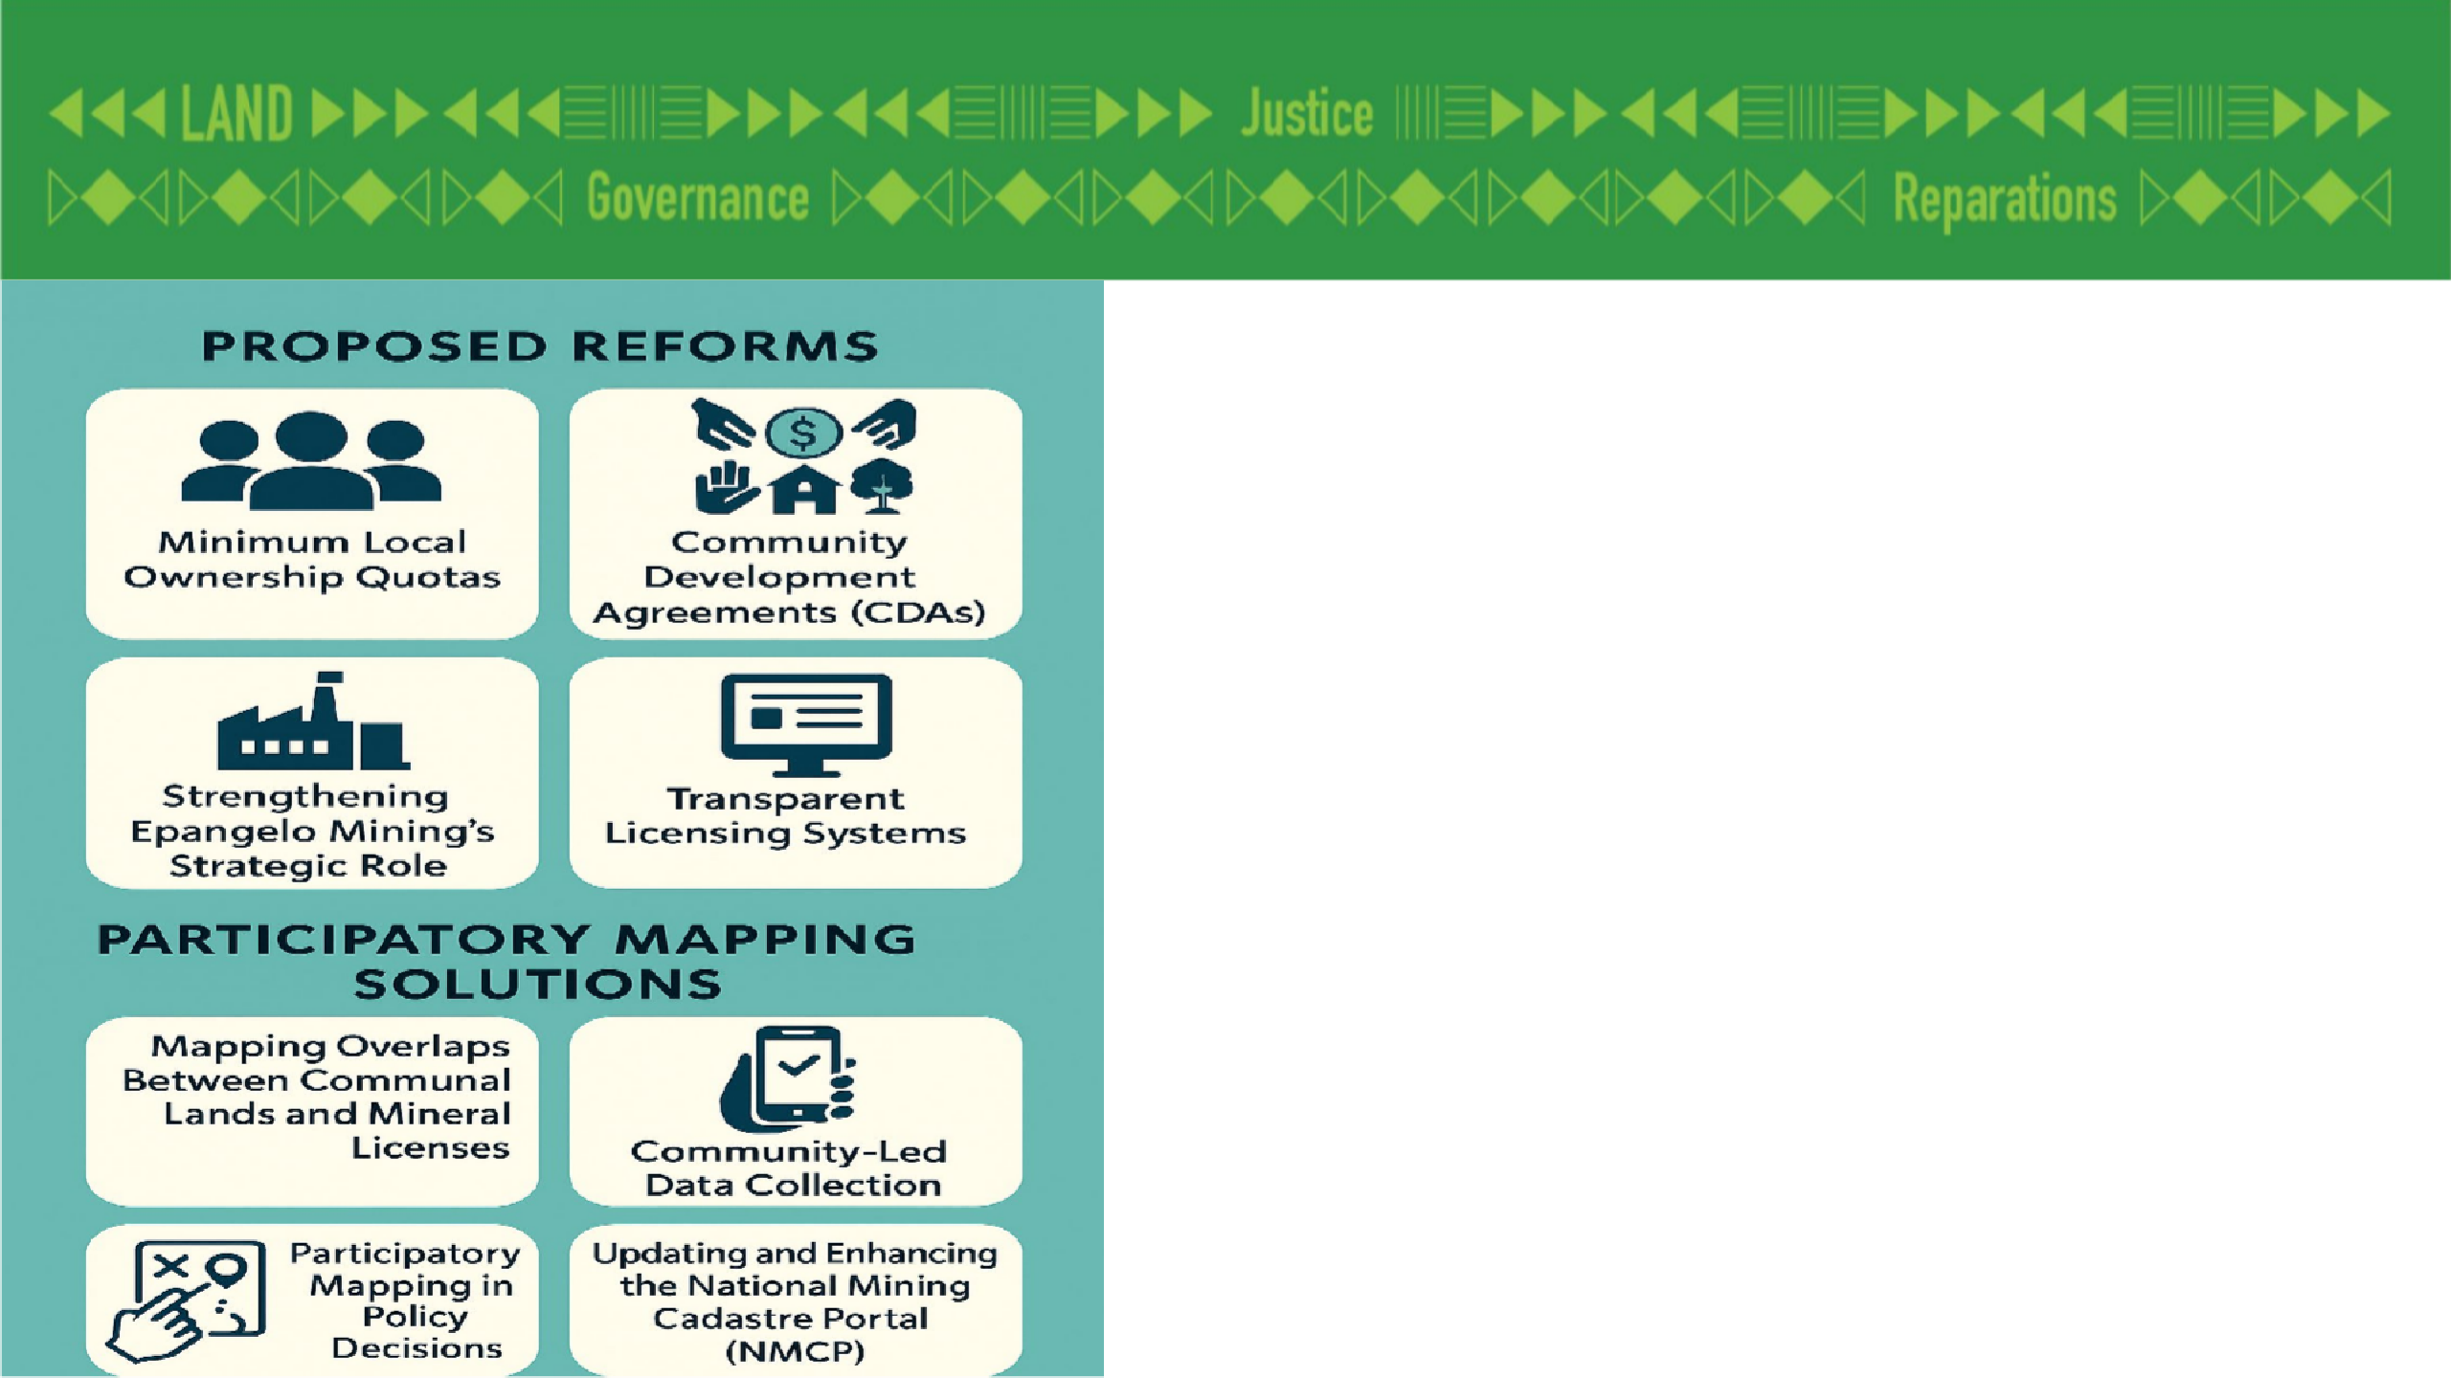
Proposed Reforms and Participatory Mapping Solutions

Slide 9
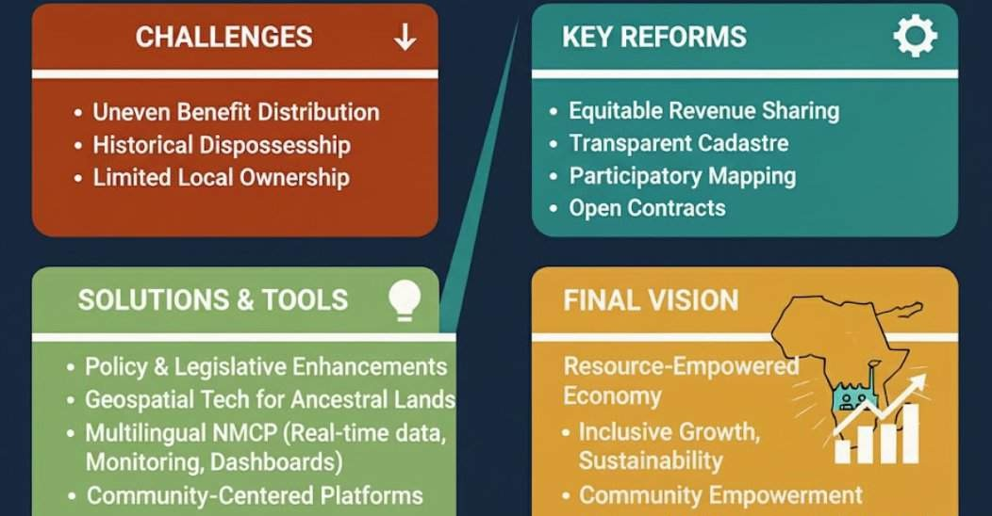
Conclusion

Slide 10


Thank you so much!
107aune@gmail.com

